Slide 1
Riley County
Water Resources
Comparing Curve Calculation Methods to Inform Local Resiliency Initiatives in Riley County, Kansas
Trista Brophy, Ella Griffith, Elizabeth Nguyen, Adelaide Schmidt
Virginia – Langley
Notes:
This is a presentation of the Riley County Water Resources DEVELOP Summer 2020 team's feasibility study. Our project title is Comparing Curve Number Calculation Methods to Inform Local Resiliency Initiatives in Riley County, Kansas.
The team member researchers were Trista Brophy, Ella Griffith, Elizabeth Nguyen, and Adelaide Schmidt.
Speaker – Elizabeth

Slide 2
Agenda/Table of Contents
Project Overview
Results & Conclusion
Data Summary
Methodology Tutorials
Notes:
In this presentation, we will be discussing a broad overview of the project, we will show our results and share some conclusions, we will discuss what data products and deliverables we have and how we will share them, and we will close with tutorials for our methods.
------------------------------Image Information Below ------------------------------
•Image Credit: Powerpoint Template Icon
•Image Source: PowerPoint (Office 2020) [Computer Software]. Redmond, WA: Microsoft
Speaker – Elizabeth

Slide 3
Scientific Problem
Runoff Curve Number (CN) is an estimate of water runoff over a specific landcover type
Conventional CN is a static method that does not account for seasonal variability
Create LULC maps to highlight both detailed urban and agricultural land use
Notes:
Runoff curve numbers (CN) are the most common way to account for the rainfall runoff potential for each unique hydrologic soil-land cover complex. The U.S. Department of Agriculture’s Hydrology National Engineering Handbook maintains several CN tables that have been in place since 1954, with little changes other than supplemental tables for special regions. While the CN is a trusted source that is widely adapted and used globally, it is a static method that does not account for variations in seasonal growth or die back, nor does it account for LULC changes that impact runoff conditions.
------------------------------Image Information Below ------------------------------
•Image Credit: Powerpoint Template Icon
•Image Source: PowerPoint (Office 2020) [Computer Software]. Redmond, WA: Microsoft
Speaker – Elizabeth

Slide 4
Objectives
Conduct and compare two methods of curve number calculation: conventional method and a dynamic method
Provide project partners with updated LULC maps
Provide project partners with a tutorial on how to calculate a dynamic, NDVI-based curve number
Notes:
This project aims to provide local officials with better insight into runoff potential. We will conduct and compare methods of CN calculation including the traditional method the uses a look-up table and incorporates Land Cover, Cover treatment and soil type. The other method is a phenology based approach that uses NDVI as a proxy for land cover and accounts for seasonal variability. The outcome will be multiple CN maps from 2006-2020, as well as updated LULC maps that we will create during the process of calculating traditional CN. Additionally, the final objective is to provide partners with a tutorial on how to replicate the procedure we followed so they can create runoff maps in the future.
Traditional method and a phenology-based Normalized Difference Vegetation Index (NDVI)-incorporated method.
------------------------------Image Information Below ------------------------------
•Image Credit: Powerpoint Template Icon
•Image Source: PowerPoint (Office 2020) [Computer Software]. Redmond, WA: Microsoft
Speaker – Elizabeth

Slide 5
2008
2011
2016
2019
2013
2006
Study Period
Years
Annual Rainy Season
March to September
Early Rain Season
March to May
Late Rainy Season
June to September
Seasons
Notes:
This study period covered the rainy season of years 2006, 2008, 2011, 2013, 2016, and 2019 to coordinate with available NLCD data. The CDL data collection for Kansas started in 2006. This study sampled NDVI annually from March through September to cover the beginning and the end of the rainy season. We also took two sub samples in each year: one for the Early Rainy Season from March through May and a second for the Late Rainy Season from June through September.
Speaker: Trista

Slide 6
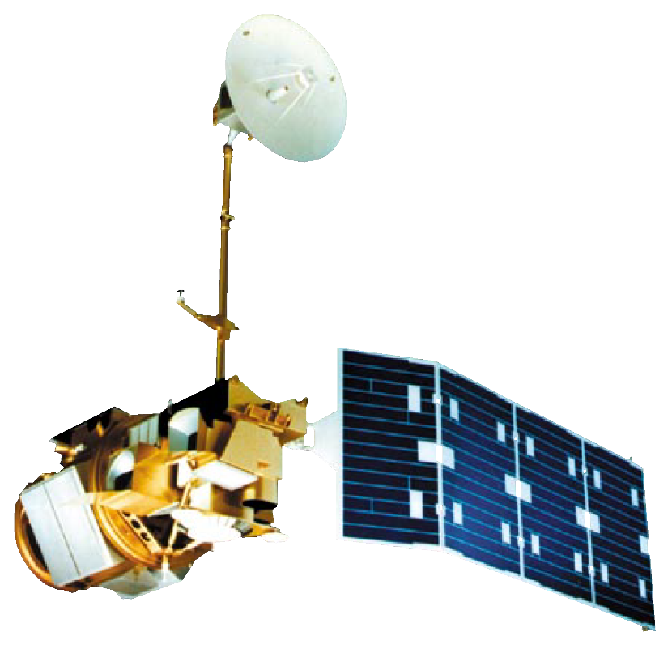
NASA Earth Observations
Landsat 5 TM
2006 - 2012
Landsat 7 ETM+
2013
Landsat 8 OLI
2014 - 2020
Image credits: NASA
Notes:
Landsat 5, 7, and 8 satellites were used to derive the NDVI, or normalized vegetation difference index, which is a measure of "greenness" or chlorophyll-a in plants on the ground. NDVI can tell us quite a lot about the types of landcover, their stage of growth, and their health. Landsat is an excellent tool for tracking urban land use and land cover changes because greenness changes as impervious surfaces replace vegetation during development.
Speaker: Trista
------------------------------Image Information Below ------------------------------
•Image Credit: NASA Images
•Image Source: https://www.nasa.gov/multimedia/imagegallery/index.html

Slide 7
Methodology
Dynamic Curve Number
Landsat in Google Earth Engine
NDVI in Google Earth Engine
Curve Number in ArcGIS Pro
Change and Risk Analysis
Synthetic land use/land cover maps
Conventional Curve Number
Slope map to determine farming practices
CN Lookup Table
Hydrological soil group map
Notes:
In order to produce our final analysis of the change in curve number (CN) over time and our highlighted areas of high runoff risk, we used two separate methods. In the first method we calculated CN by using a dynamic NDVI incorporated method. In order to create this CN layer we imported and processed Landsat 5, 7, and 8 data in GEE. In GEE, using this Landsat data, we were then able to calculate NDVI between the months of March and September, which is the rainy season in Riley County. After running NDVI in GEE, we then moved into an ArcPro environment, where we used raster calculator to apply the NDVI dynamic CN equation.
The second method we used to calculate CN was the traditional CN lookup table method. In order to use the look up table we created three input layers. The first layer was a synthetic LULC map created from NLCD and CDL. The second layer was a hydrological soil group layer from gSSURGO. The third layer was a slope map to determine if the farming practices were row crop or contour farming. We then reclassified all 3 of these layers to match the traditional CN lookup table to create out CN layer.
Speaker: Trista

Slide 8
Results: Land Use Land Cover Change
LULC in 2008
LULC in 2016
Water
Grass/pasture
Urban/developed
Various agricultural
0
40
0
40
Kilometers
Kilometers
Notes:
The team created detailed LULC maps for the years 2006, 2008, 2011, 2013, 2016, and 2019 based off of availability of NLCD and the start of the CDL for Kansas in 2006. The maps were synthesized by taking all agricultural land cover types from the CDL and all other landcover types from the NLCD. The selected maps show examples of the LULC maps created detailed to represent crop type, urban cover, forest cover, and other categories from the NLCD and CDL.
Speaker: Addy

Slide 9
Results: Land Use Land Cover Change
LULC trends from 2006 to 2019:
Grass/pasture decreased by 11%
Agriculture increased by 13%
Urban/developed increased by 6%
Notes:
The chart demonstrates the tracked changes in LULC in broad categories over the study period in acreage. There is an overall downward trend for the most prevalent category of grass and pastures with rises in agriculture, forest, and urban/developed areas. The percent changes show change in land cover from 2006 – 2019.
* The increase in water/wetlands is less of a change in the landscape but the result of technical classification from wetlands to water in the NLCD data
Speaker: Addy

Slide 10
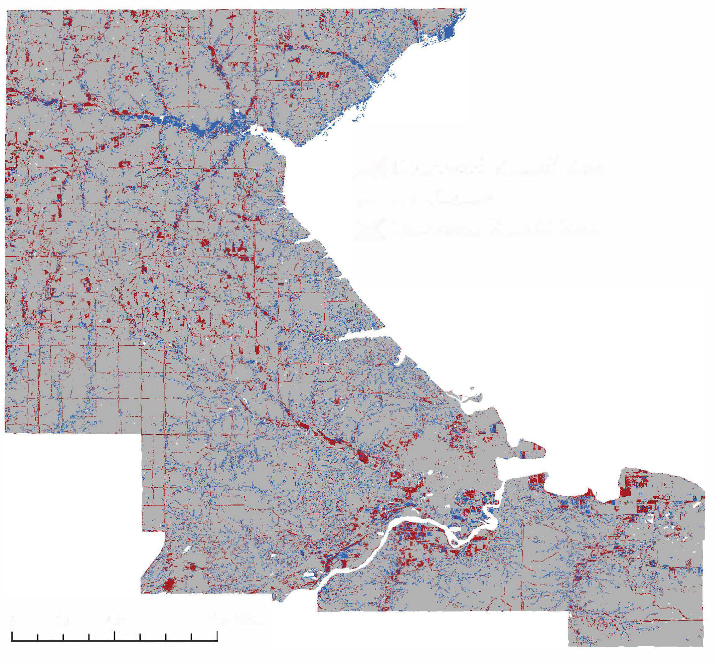
Results: Conventional CN Change
2006-2019
Change in average runoff between 2006 to 2019
10,600 acres showed increased runoff risk
9,500 acres showed decreased runoff risk
117,000 acres showed no change in curve number
Decreased Runoff Risk
No Runoff Change
Increased Runoff Risk
0
5.8
11.6 Miles
Notes:
We created curve number change maps yearly, as well as from 2006 to 2019, which is shown in the map. For this 14 year period the runoff risk decreased by 9,500 acres, and increased by 10,600 acres. This shows a distinct change in land use throughout the county.
Speaker: Addy

Slide 11
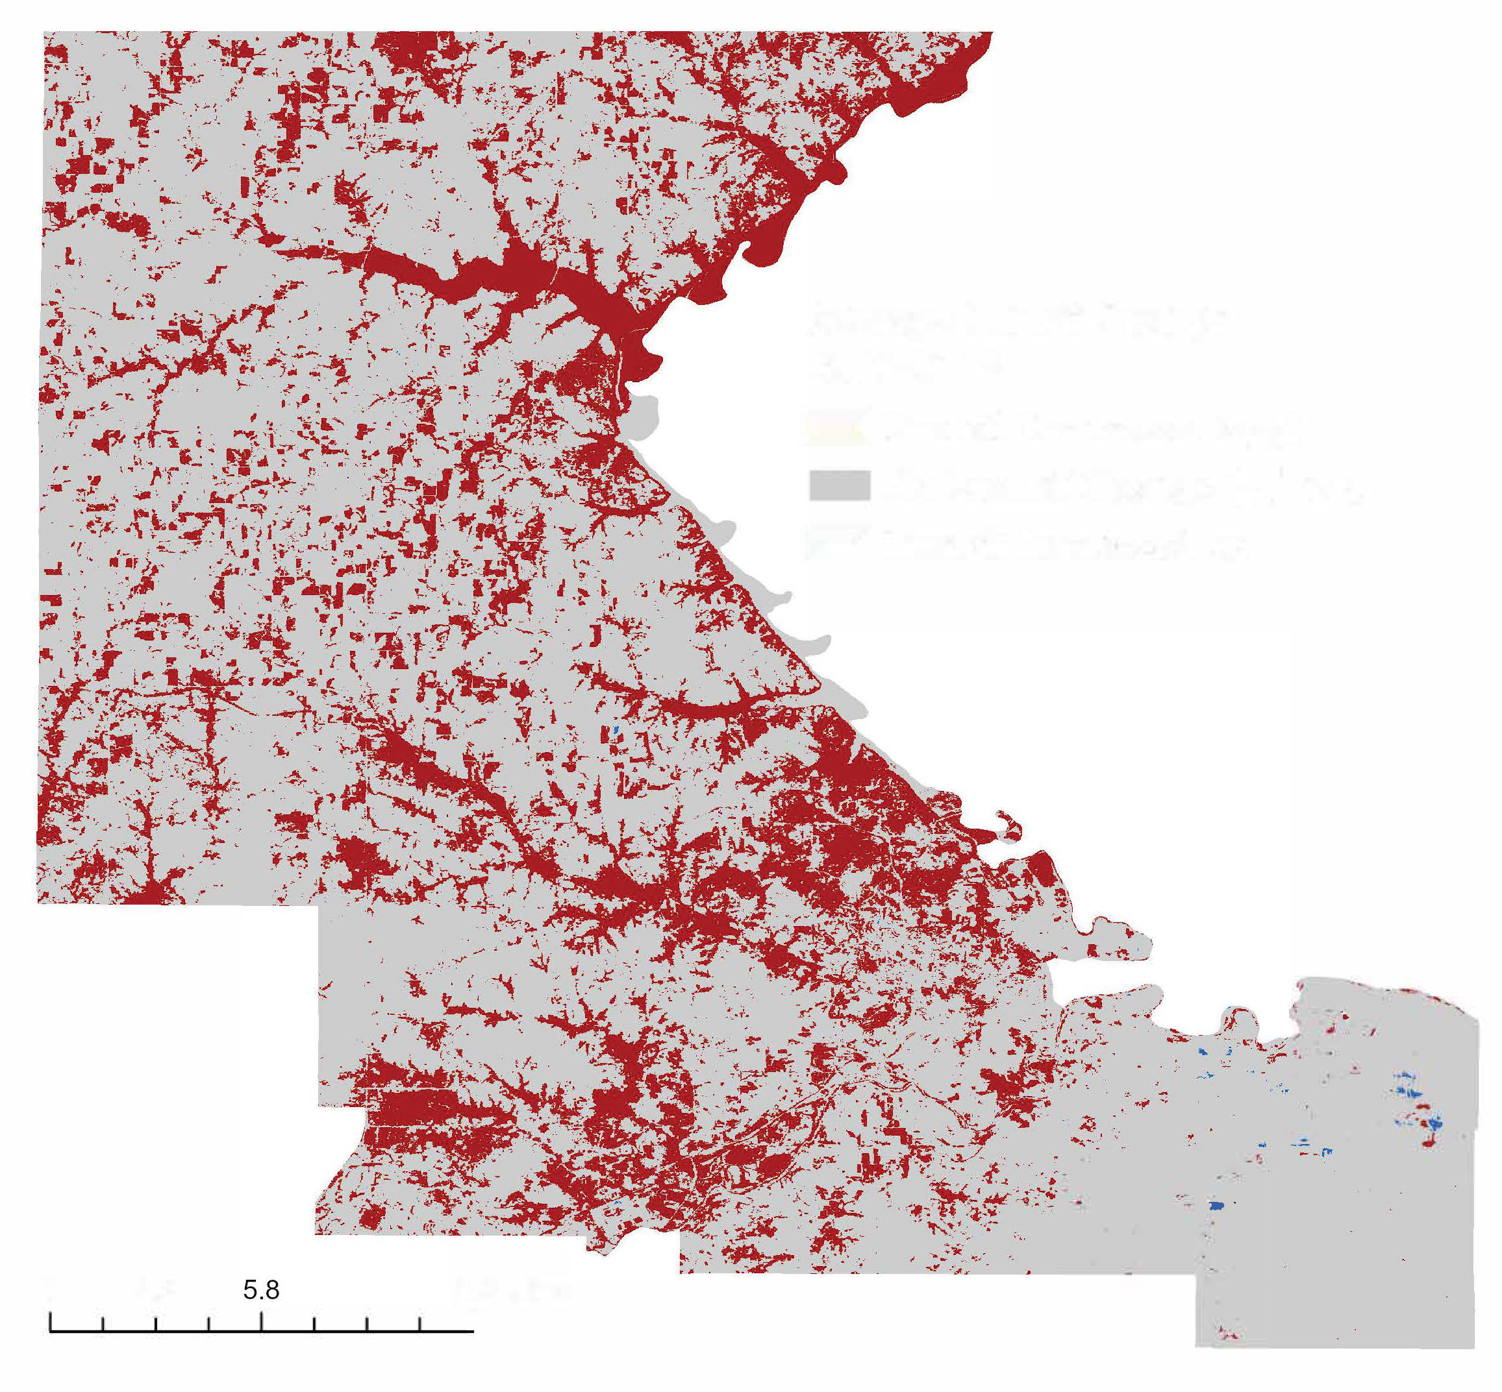
Results: Dynamic Average CN Change
2006-2019
Change in average runoff between 2006 to 2019
Overall increase in average runoff risk
Risk is displayed in increments
Runoff Decreased >( -5)
No Runoff Change (-5) to 5
Runoff Increased < 5
0
11.6 Miles
Notes:
The dynamic CN calculation method incorporates NDVI, which changes more frequently than the static elements incorporated into the traditional method. The map above highlights there is an overall increase in average runoff from 2006 to 2019. However, some areas, as highlighted in the blue areas, show a decrease in runoff. These areas will be of interest to the project partners.
Speaker: Ella

Slide 12
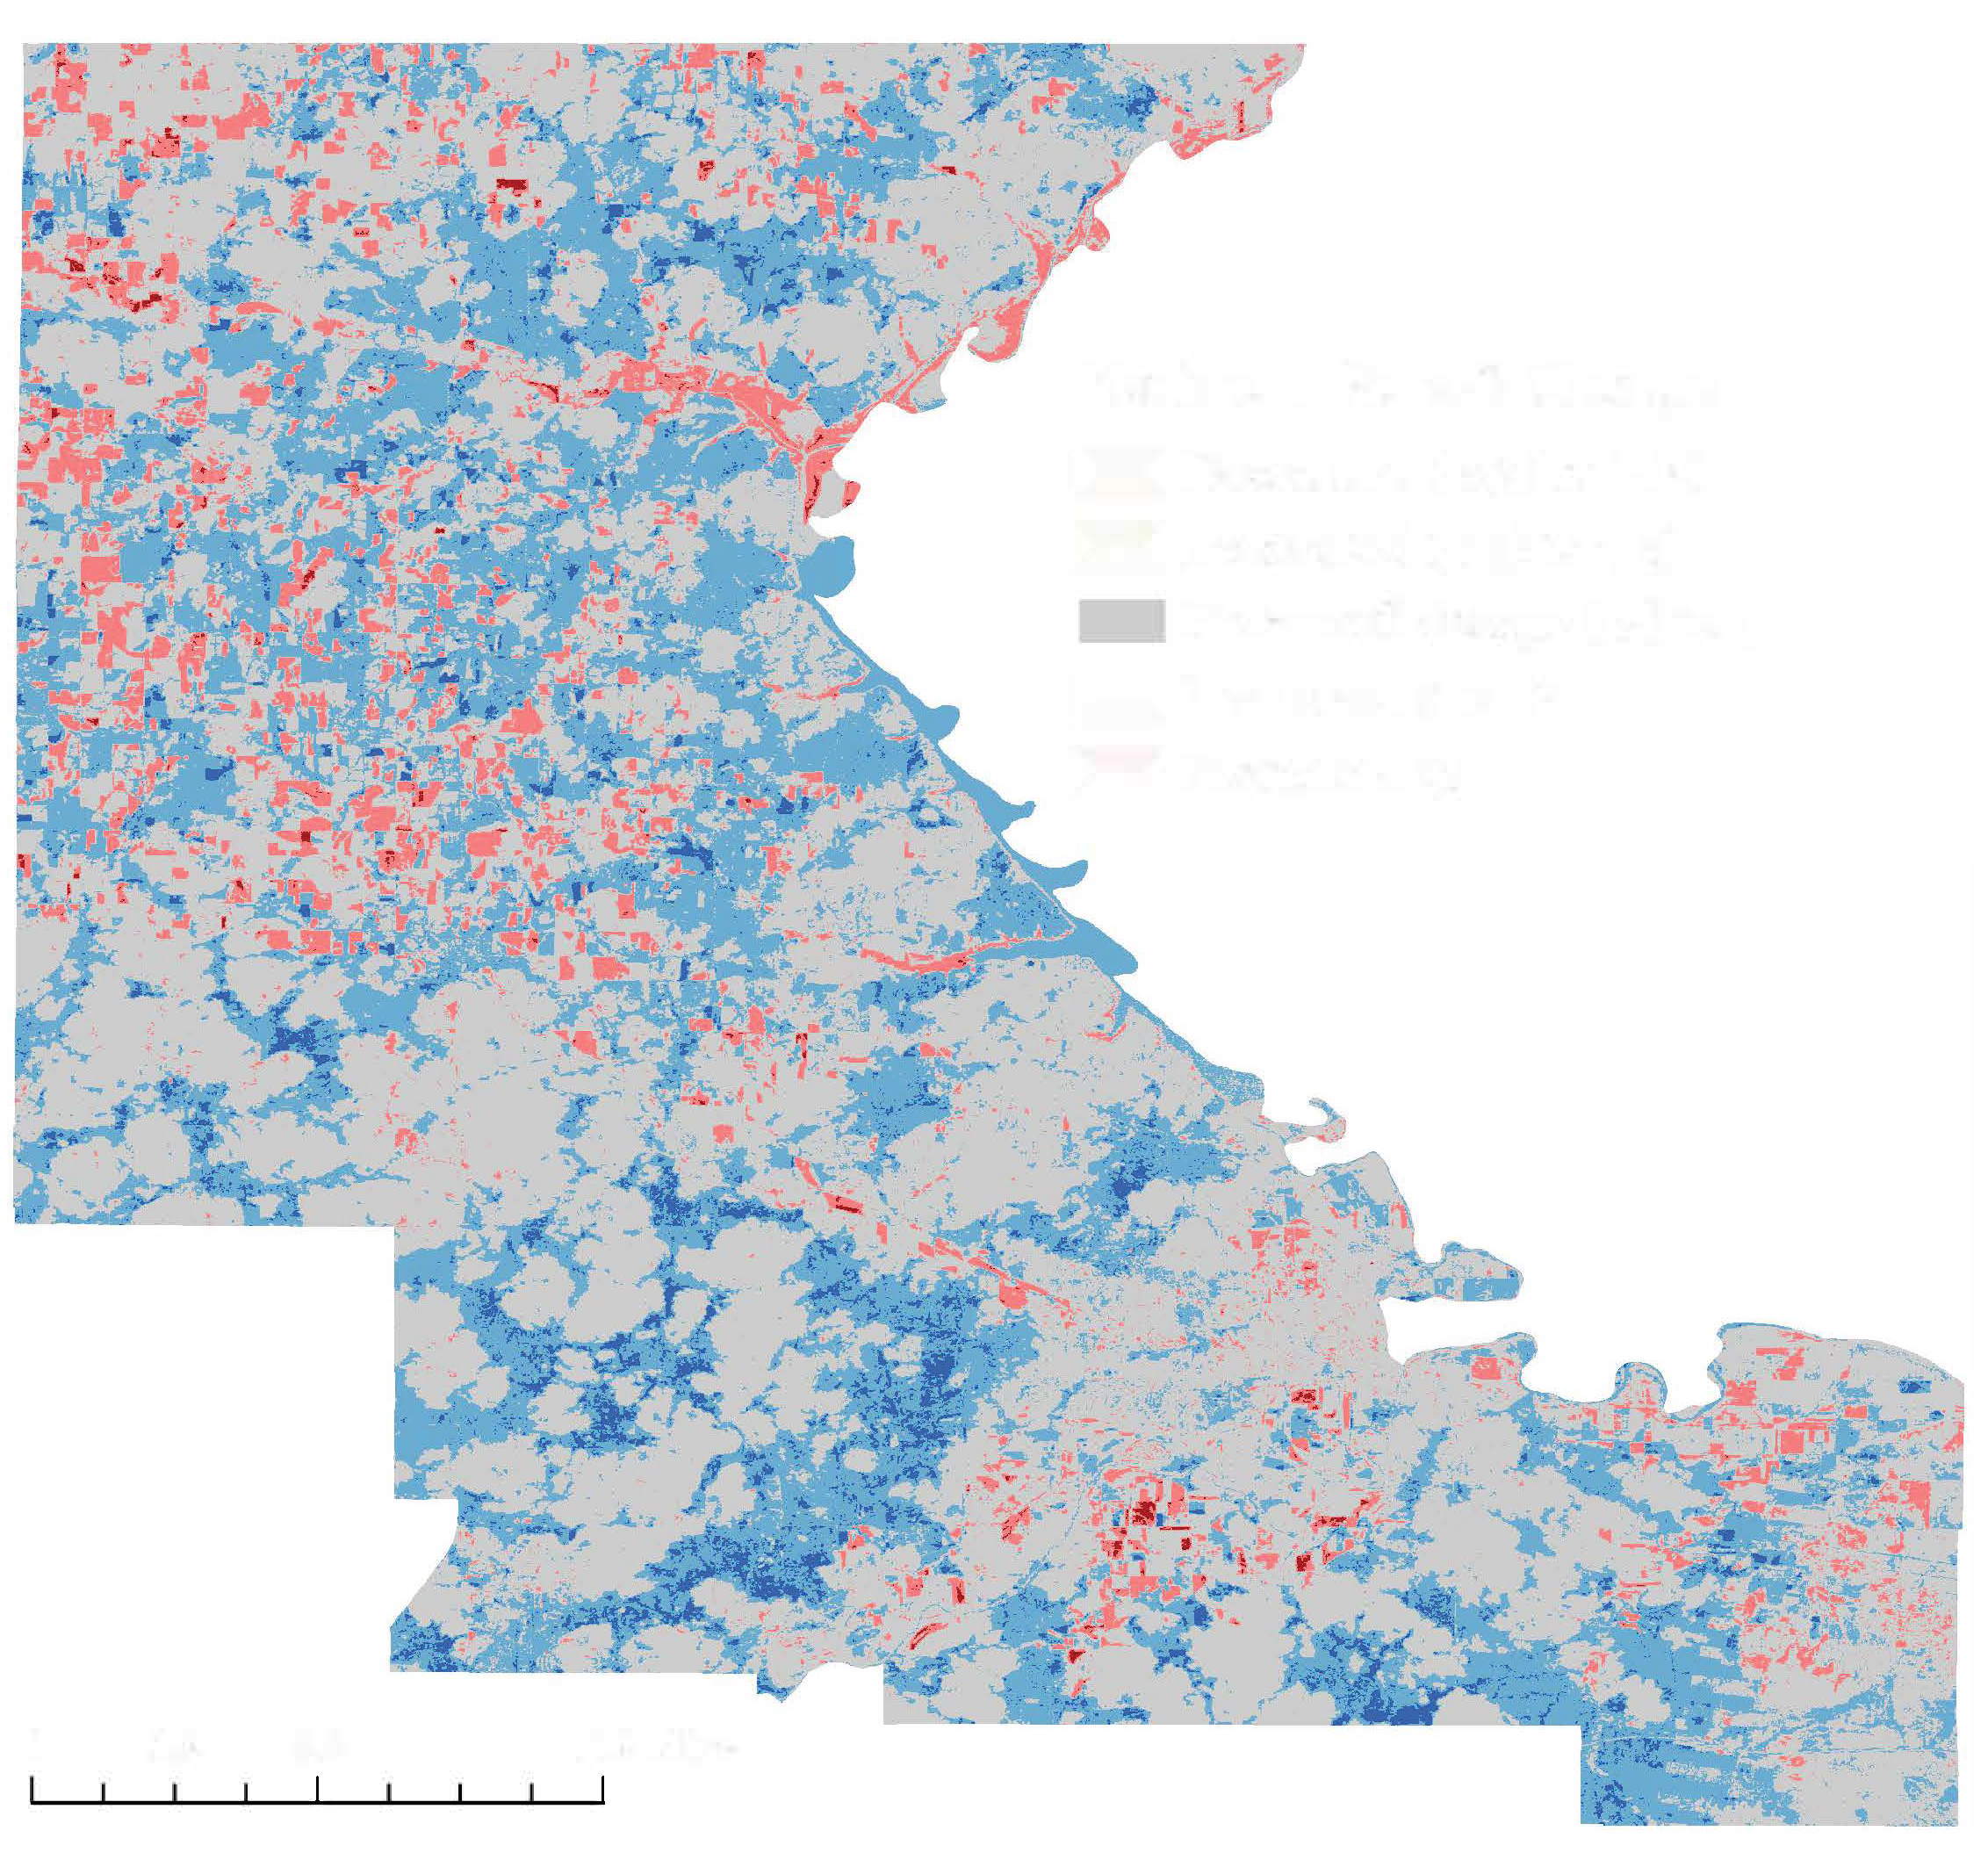
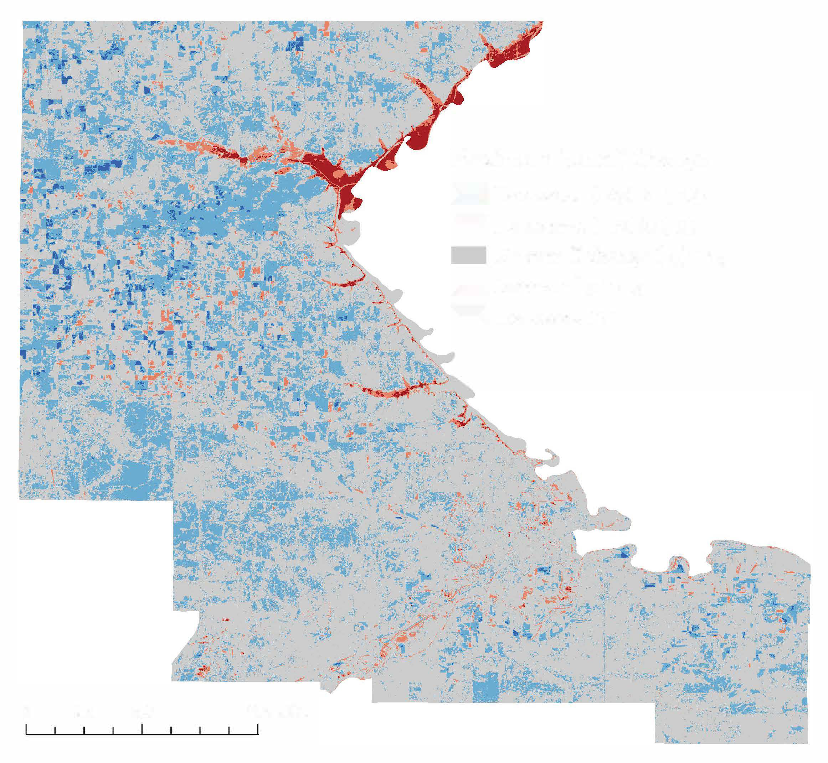
Results: Early vs. Late Rainy Season
Max CN Change from 2006-2019
Max Runoff Change
Max Runoff Change
Decreased (-25) to (-15)
Decreased (-15) to (-5)
Neutral (-5) to 5
Increased 5 to 15
Increased 15 to 20
Decreased (-25) to (-15)
Decreased (-15) to (-5)
Neutral (-5) to 5
Increased 5 to 15
Increased 15 to 20
0
5.8
11.6 Miles
0
5.8
11.6 Miles
Early rainy season
Late rainy season
Notes:
Changes in the early and late season maximum potential runoff are shown here. During the early rainy season, the trend indicates a greater increase in the risk of runoff compared to the late season over time. Within both the early and the late rainy season, however, maximum runoff potential is decreasing.
Overall, the maximum CN from 2006-2019 increased more during the early part of the rainy season.
Speaker: Ella

Slide 13
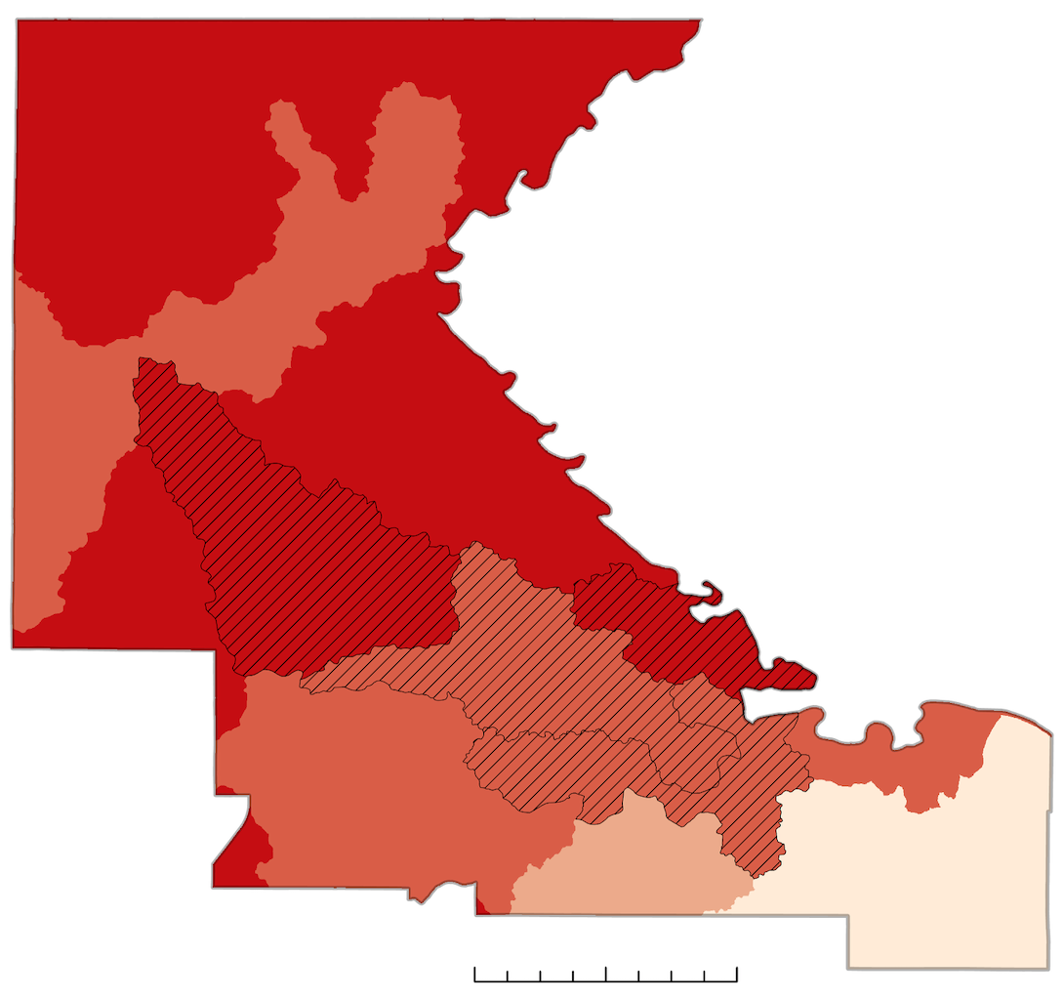
Results:
HUC-12 Watershed Level Zonal Statistics
2019 Mean Curve Number Per Watershed
≤ 88.70
≤ 89.85
≤ 90.82
≤ 92.05
Selected Study Area Watersheds
Headwaters - Wildcat Creek
Kitten Creek - Wildcat Creek
Cedar Creek - Big Blue River
Eureka Lake - Kansas River
5
10
Miles
Notes:
This image shows the mean curve number for each watershed in Riley County, with the 4 selected watersheds of interest highlighted with hashmarks. The Southeast portion of the county has the lowest average curve number. Relatively speaking, the curve number is fairly high across all counties, as curve number ranges from a low of 30 to a high of 100.
Speaker: Elizabeth

Slide 14
Results: HUC-12 Watershed Level Zonal Statistics
Notes:
These time plots demonstrate the fluctuations in runoff potential through curve numbers in the HUC 12 watersheds of interest surrounding Manhattan. They show the four different metrics of curve number including the conventional method in blue using static tables, and the dynamic calculation in the early, late and the entire rainy season. There are several key patterns across the watersheds, one technical finding that conventional method has less variability due to the nature of static tables. There is higher runoff risk in the early season throughout the watersheds. Overall average runoff curve numbers across all watersheds has increased from 2006 to 2019.
Speaker – Elizabeth

Slide 15
Conclusions
LULC for developed areas increased by 6%. Increases in impervious surface increase chances for runoff
Runoff risk increased in 2.67% of the county over 13 years
Dynamic CN shows more variability
Allows for seasonal analysis
Overall runoff increased across the county
Allows for more practical resiliency planning
Notes:
The team created detailed LULC maps using cropland data layer CDL and national land cover database NLCD to specify crop type and cover type for the county and interested watersheds. These maps were then used for change detection analysis in order to determine the differences in LULC change for various categories including impervious surface area, agricultural land, urban land, and forested land.
Across Riley County, grass/plains decreased by 11%, impervious surface area increased by 6% and agricultural land use increased by 13% over the study period.
A 2.67% increase in the average curve number from 2006-2019 correlates with an increase in runoff, and therefore flood risk. This mirrors the LULC change over the study period.
The team used two different methods to calculate curve number for the area; both the conventional method of static tables and the dynamic method with NDVI. The dynamic method allows for more precise temporal analysis and allowed us to track seasonal changes in relation to the flooding and growing season for the study area.
Speaker: Trista

Slide 16
Data Summary
Dynamic NDVI-based Curve Number Maps
Conventional Curve Number Maps & Tables
Land Use Land Cover Maps
Story Map
Tutorial of Methods
Notes:
We are excited to hand off these data products and maps in the coming weeks. Most of these products will be available this week in a shared google drive with others going through export control with NASA to be distributed shortly after.
Dynamic NDVI-based Curve Number Maps – maps for study years, seasonal maps, comparative maps. Landsat data compiled in GEE and processed in arcPRO
Conventional Curve Number Maps & Tables – maps for the study years, reference static tables, comparative maps
Land Use Land Cover Maps – compiled
Tutorial of Methods
Story Map
Speaker: Elizbeth

Slide 17
Future Work
Incorporate precipitation data to understand the role intensity and frequency of rainfall may play in exacerbating runoff
Include various farming techniques to determine changes in runoff for different tillage methods
Model the area with the Soil and Water Assessment Tool (SWAT) to better quantify the impacts of land use and land cover practices over watersheds
Notes:
For further study, the team would recommend analysis of precipitation data to not only track runoff but also study the roll of precipitation fallen on the county to assess flood risks and trends. Precipitation and runoff are related but further study could be done to isolate the variables causing increases in floods in Riley County. Farming practices are also an increasingly important aspect of flood risk as agricultural land cover continues to expand in Riley County. Tillage practices can vary the amount of infiltration versus runoff and further analysis of these practices in Riley County would allow stakeholders to make more informed decisions on best practices. Additional tools such as SWAT would be useful for modeling of watersheds to be updated closer to real time.
Speaker: Ella

Slide 18
Results Q & A
Notes:
For further study, the team would recommend analysis of precipitation data to not only track runoff but also study the roll of precipitation fallen on the county to assess flood risks and trends. Precipitation and runoff are related but further study could be done to isolate the variables causing increases in floods in Riley County. Farming practices are also an increasingly important aspect of flood risk as agricultural land cover continues to expand in Riley County. Tillage practices can vary the amount of infiltration versus runoff and further analysis of these practices in Riley County would allow stakeholders to make more informed decisions on best practices. Additional tools such as SWAT would be useful for modeling of watersheds to be updated closer to real time.
Speaker: Ella

Slide 19
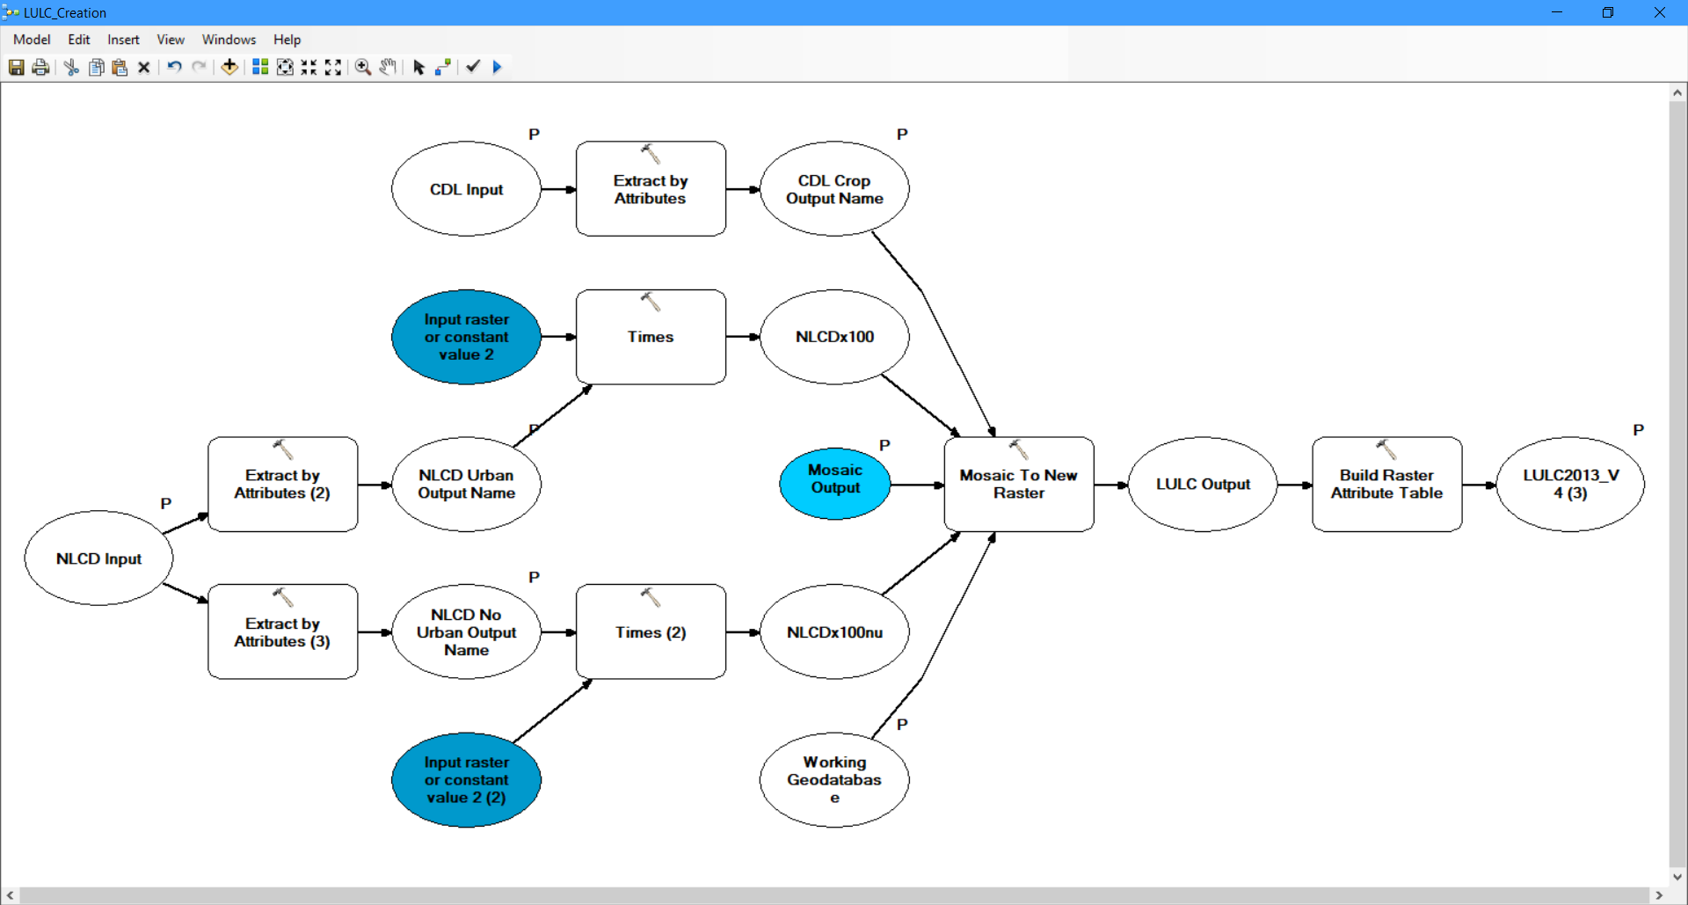
LULC Tutorial
Notes:
In order to create a new LULC layer from the existing CDL and NLCD layers, a toolbox for ArcGIS was created. The image shown is the inside of the toolbox. To start to uses extract by attribute in order to separate the crop only land use from CDL, urban only from NLCD, and the non-urban land use from NLCD. After the attributes are extracted to a new raster, both NLCD layers are multiplied by 100, so that none of the values overlap. After insuring the land use values won't overlap, the three new layers are mosaiced to a new raster. The order within the tool is urban NLCD, cropland CDL, and no urban NLCD. After the new raster is created, an attribute table is built to show the landuse values.
Speaker: Addy

Slide 20
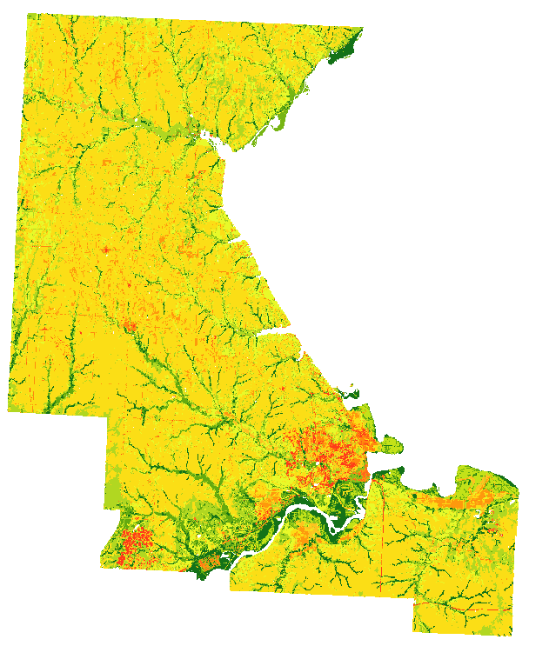
Conventional CN Tutorial
Synthetic land use/land cover maps
Hydrological soil group map
Combine Datasets
Apply CN Lookup Table
Slope map to determine farming practices
Notes:
In order to calculate conventional curve number, you need at least 3 input layers. You need the synthetic LULC rasters for the years you're working in, you need the hydrological soil group from gSSURGO, and a slope map reclassified into 2 different elevations to show farming practices. Once these layers are complied, you use the combine tool in ArcGIS in order to create a raster that overlaps all of the pixels. Using a combination of select by attribute and field calculator, apply the CN lookup table. Using the Look Up tool in ArcGIS you are able to export out just the CN values into a new raster.
Speaker: Addy

Slide 21
Dynamic CN Tutorial
Google Earth Engine
Import Study Area & Landsat
Set NDVI Script Dates
Export GeoTiffs
ArcGIS Pro
Import GeoTiffs
Raster Calculator
Notes:
The DEVELOP Riley County Water Resources team is not pursing a software release on the Google Earth Engine code we wrote to produce the NDVI output maps. As a result, we are unable to share any of the code we created from scratch. The Dynamic curve number methodology required two data processing tools: Google Earth Engine and ArcGIS Pro.
There is more than one way to correctly calculate NDVI through Google Earth Engine. The general flow we followed is outlined on the left box:
`Import Study Boundary
Import Landsat image collections
Create an NDVI Calculation Function that includes:
Filtered Boundary
Filtered Dates
NDVI function
Mapping the NDVI function over filtered image collection by mean or maximum NDVI
Apply the NDVI Calculation Function to the year of interest
Recalibrate NDVI imagery to prepare for export
Export the NDVI GeoTiff
The second step involves Importing and Processing NDVI GeoTiffs in ArcGIS Pro to Create Curve Number Maps.
The general flow we followed is outlined on the right box:
Import NDVI GeoTiffs into a new ArcGIS Pro project
Calculate the Dynamic curve number by using raster calculator on the GeoTiffs
Apply the following equation “NDVI GeoTiff Name” * (-0.11) + 100
Name and save the resulting CN output raster
Congratulations! You should now have a Dynamic NDVI-incorporated CN map! Adjust the symbology according to style preference.
Speaker: Ella

Slide 22
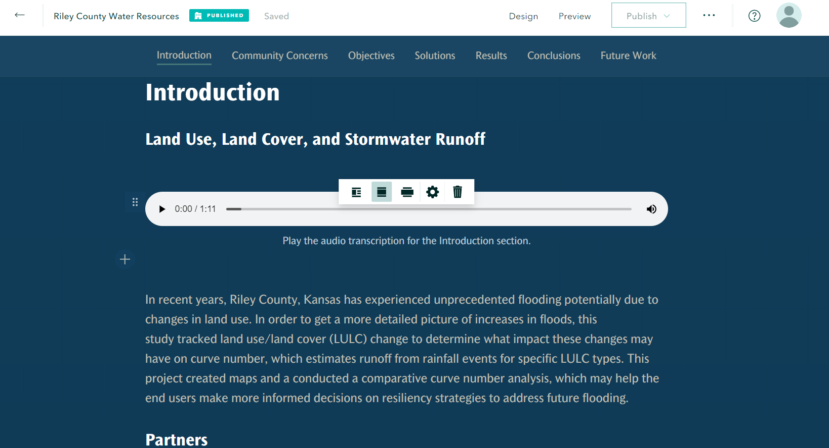
ArcGIS StoryMap
Notes:
We created an ArcGIS StoryMap to further communicate our project and project outcomes to our wide range of partner organizations.
::AGOL Story Map demo::
Speaker: Trista

Slide 23
Project Partners
Dr. Aida Farough, Kansas State University
Dr. Bill Heatherman, City of Manhattan
Samantha Estabrook, City of Manhattan
Angela Unrein, Kansas Department of Health & Environment
Steve Higgins, Riley County
Dr. Trisha Moore, Kansas State University
Scott Satterthwaite, Kansas Department of Health & Environment
Andrew Klein, Kansas Forest Service
NASA DEVELOP Lead/Fellow
Sydney Neugebauer, NASA Langley Research Center
NASA Science Advisor
Dr. Kenton Ross, NASA Langley Research Center
Notes:
The Riley County Water Resources Team would like to thank the following partners for their enthusiasm and guidance throughout the span of this project:
Dr. Aida Farough, Dr. Bill Heatherman, Samantha Estabrook, Angela Unrein, Steve Higgins, Dr. Trisha Moore, and Scott Satterthwaite
The authors would like to thank Sydney Neugebauer, Fellow of NASA DEVELOP, for her guidance and coordination of this project.
We would also like to acknowledge the contributions made by Dr. Kenton Ross of NASA Langley Research Center, who served as a scientific advisor for this research.
Speaker: Elizabeth
------------------------------Image Information Below ------------------------------
•Image Credit: Powerpoint Template Icon
•Image Source: PowerPoint (Office 2020) [Computer Software]. Redmond, WA: Microsoft

Slide 24
Tutorials Q & A
Notes:
Please ask us any questions or clarifications on the tutorials presented to you today .
Speaker: Elizabeth

