Slide 1
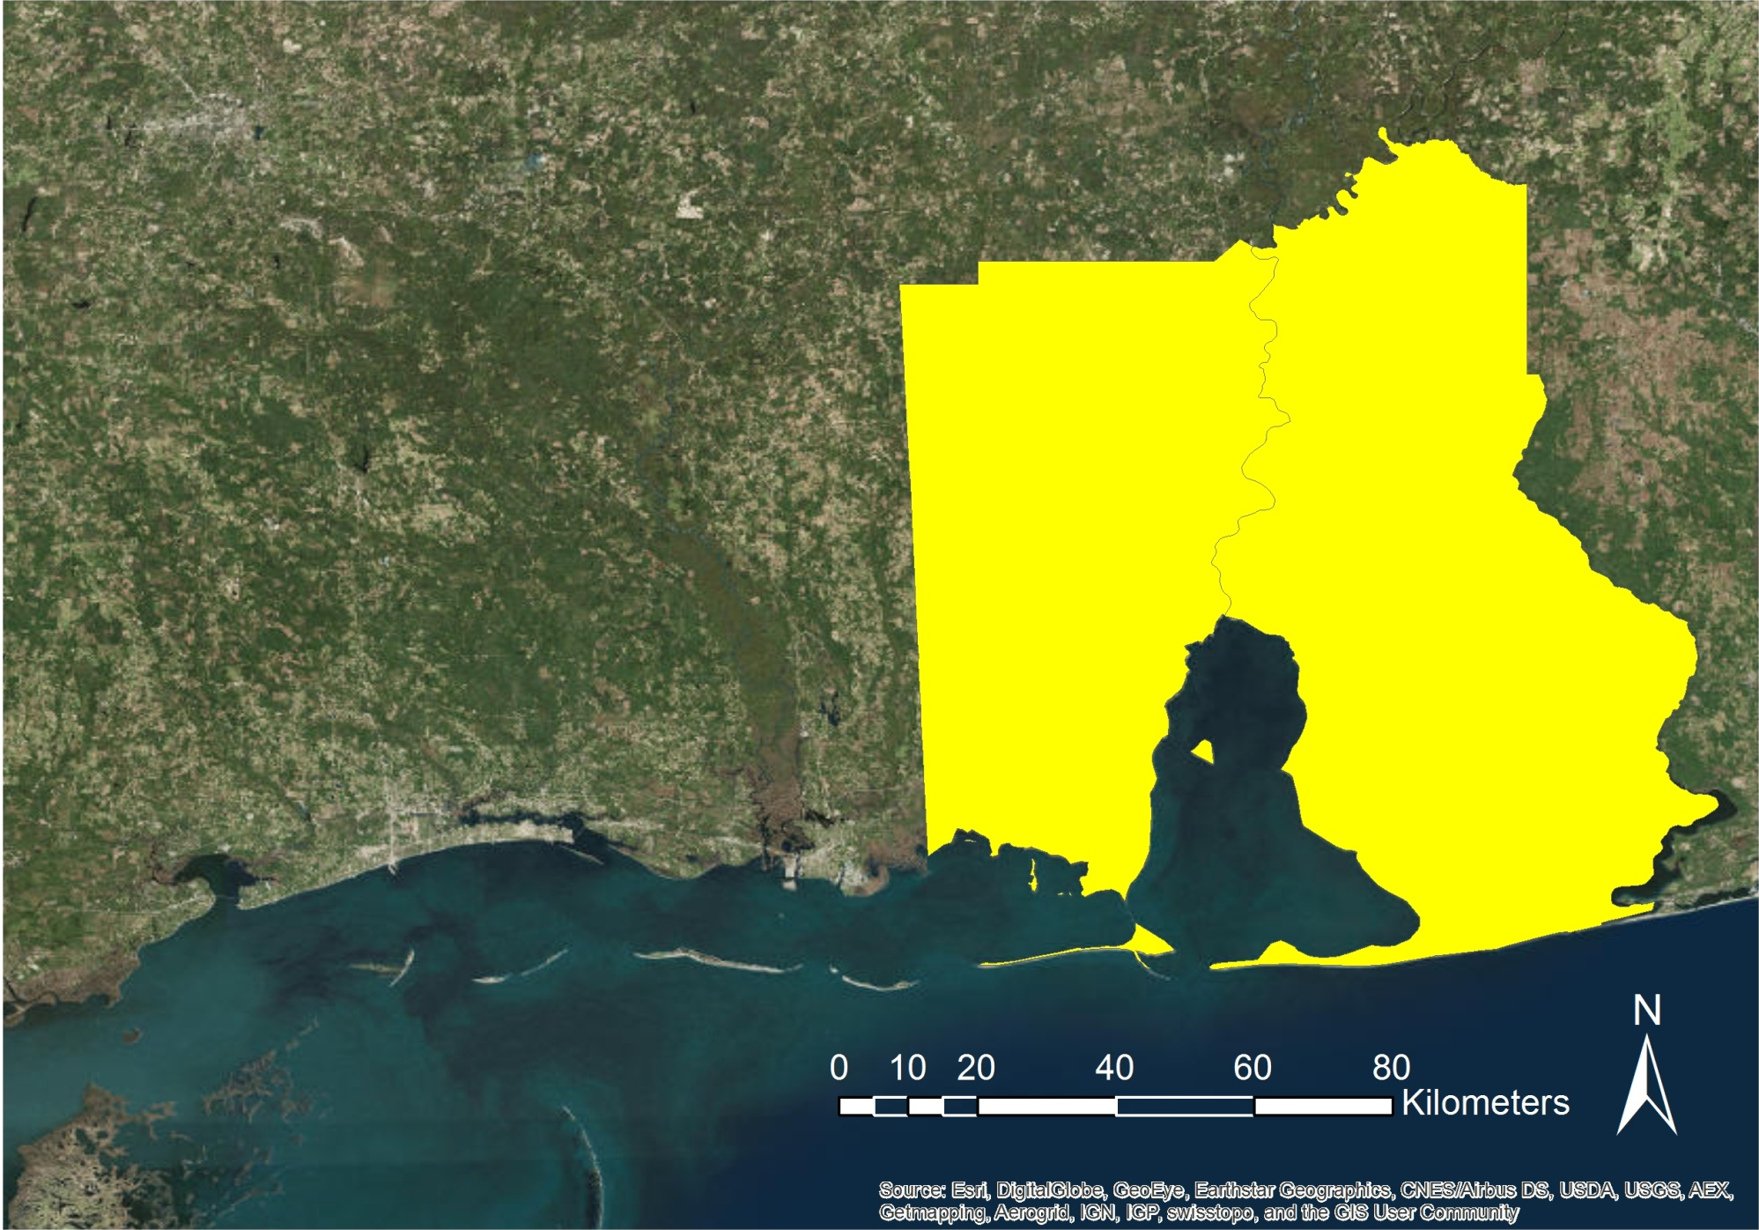
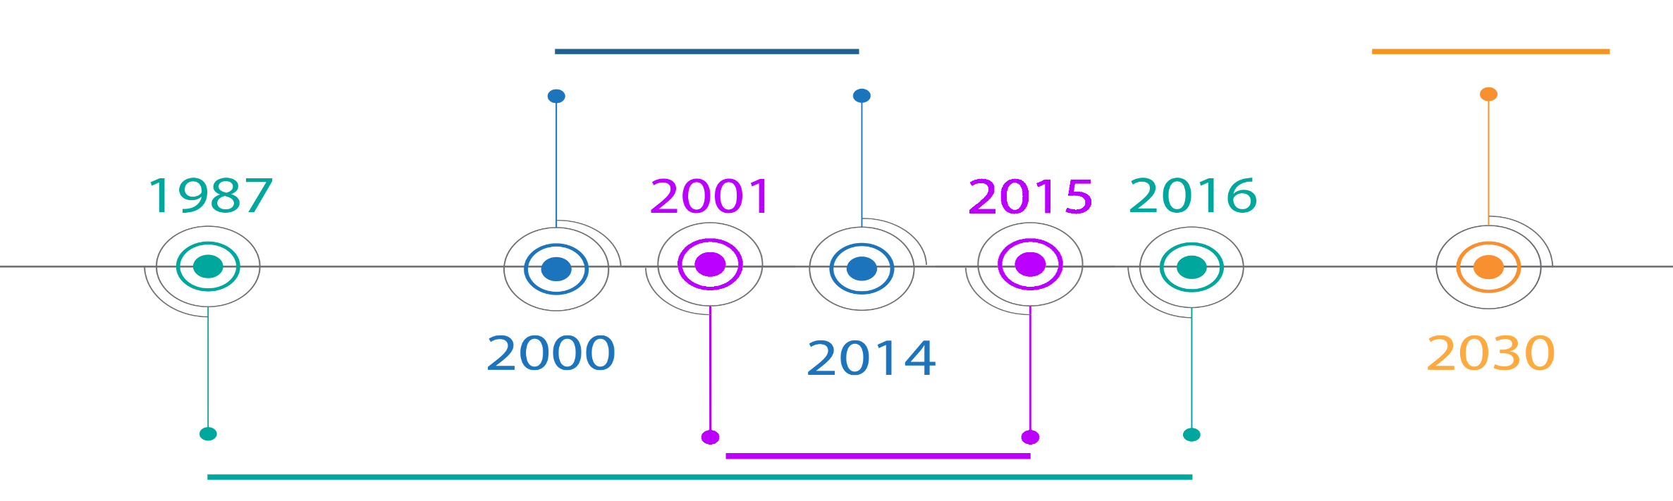

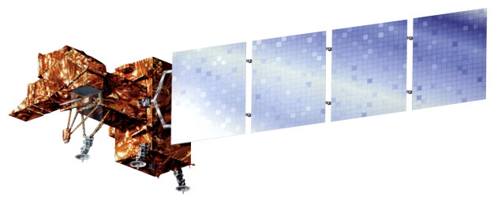


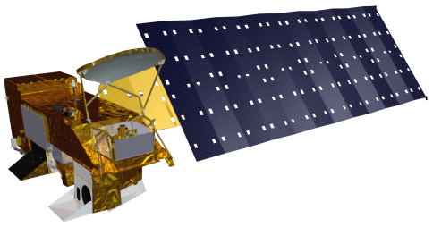

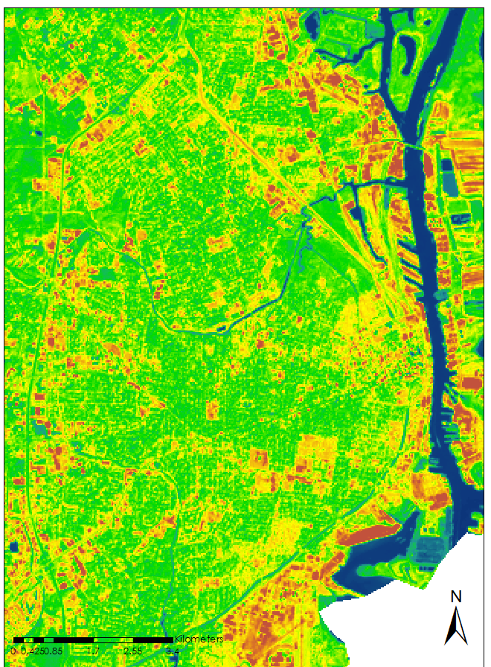

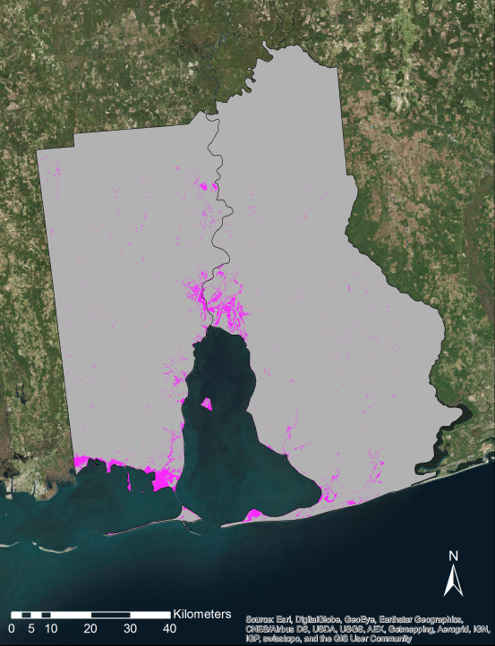




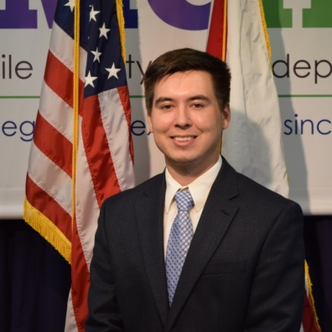
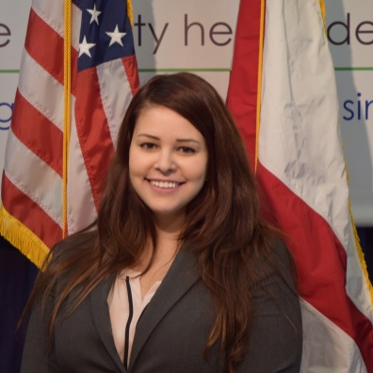
Monitoring Marsh Conditions in Coastal Alabama Using NASA Earth Observations to Support the Alabama Coastal Foundation’s Restoration and Conservation Initiatives
Abstract
Study Area & Period
The marshlands fringing Mobile and Baldwin counties collectively comprise one of the most dynamic ecosystems in the Northern Gulf of Mexico. Coastal Alabama wetlands are an important ecological region providing a number of important ecosystem support services, such as breeding and nursing habitats, creating buffer zones for storm surge, and water filtration. However, many marsh areas have deteriorated both in health and extent due to a combination of anthropogenic and natural stressors, including nutrient pollution, turbidity, and urbanization. This study used NASA Earth observations to investigate the present and future health of wetlands in coastal Alabama. The datasets were derived from the United States Department of Agriculture Forest Service ForWarn Normalized Difference Vegetation Index (NDVI), which uses imagery captured by Moderate Resolution Imaging Spectroradiometer (MODIS). Additionally, data from Landsat satellites 5, 7, and 8 were used to provide higher resolution imagery over larger temporal scales to aid in land use and land cover classifications. The NDVI was then used in conjunction with data from the Coastal Change Analysis Program to classify marsh type, health, and extent over several decades. The data were then used for modeling of future marsh health using TerrSet Geospatial Monitoring and Modeling System Land Change Modeler software. Collectively, these analyses provided a holistic assessment of current and future marsh health for select watersheds over wide temporal and spatial scales. The Alabama Coastal Foundation can use these results to more efficiently direct restoration efforts to the most critically impaired watersheds.
MARSH HEALTH
FORECAST
Objectives
URBANIZATION
Gauge marsh health trends from 2000 to 2014 using MODIS NDVI to determine the growth differences between coastal and inland marshes, the impacts of stressing events, and the general trend for each type of marsh over the 15 years
Assess marsh extent change from 1987 to 2016 using Landsat data
Observe impervious surface change and intensity from 2001 to 2015 using Landsat data and the Impervious Surface Analysis Tool (ISAT).
MARSH EXTENT
Earth Observations
Methodology & Results
Landsat 5 TM
Landsat 7 ETM+
Landsat 8 OLI
Aqua MODIS
Terra MODIS
(a)
Mobile Bay Ecological Forecasting II
Landsat Imagery
Impervious
Surfaces
Impervious Surface Assessment
NDISI 2015
Classify
Assess
__
High 2.89
__Low 0.00
Landsat Imagery
Segment
Segmented
Images
Classify
Marsh Extent Map
(b)
Marshes
ForWarn NDVI Imagery
Masks
NDVI
Marshes/
Wetlands
Statistics
Marsh
Health Trends
(c)
Conclusions
Analysis of imperviousness using ISAT and the NDISI suggested a 25% increase in impervious surface area from 2001-2011.
Marsh extent analysis revealed an overall decreasing trend in extent closely correlated to urbanization and extreme weather conditions.
Analysis suggested that wetlands in the study area have a general decreasing NDVI trend as an indicator of health.
Further analysis indicated that hurricanes and droughts have large impacts on coastal wetlands whereas cold winters have the greatest impact on inland wetlands.
(a) Normalized Difference Impervious Surface Index (NDISI) for 2015; (b) Marsh Extent for 2006; (c) Health trend lines for Little Lagoon as a percent max from 2000-2014.
Project Partners
Team Members
Alabama Coastal Foundation & Dauphin Island Sea Lab
Acknowledgements
Special thanks to: Bernard Eichold, M.D. Dr. PH (Mobile County Health Department), Just Cebrian, Ph. D. (Dauphin Island Sea Lab), Kenton Ross Ph. D. (NASA Langley Research Center), and the previous DEVELOP Mobile Eco Team Saranee Dutta, Jeanette Bosarge, and Courtney Kirkham.
Any opinions, findings, and conclusions or recommendations expressed in this material are those of the author(s) and do not necessarily reflect the views of the National Aeronautics and Space Administration. This material is based upon work supported by NASA through contract NNL11AA00B and cooperative agreement NNX14AB60A.
Darius Hixon
Project Lead
Austin Clark
Tyler Lynn
Manoela Rosa
Mobile County Health Department – Summer 2016

