Slide 1
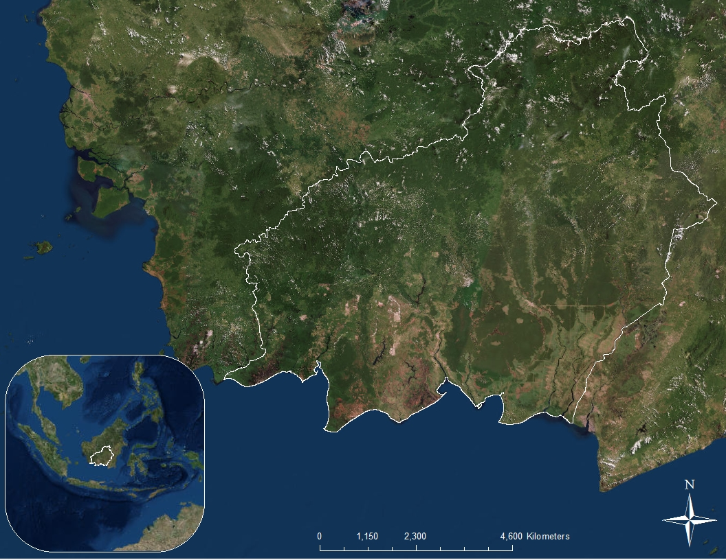
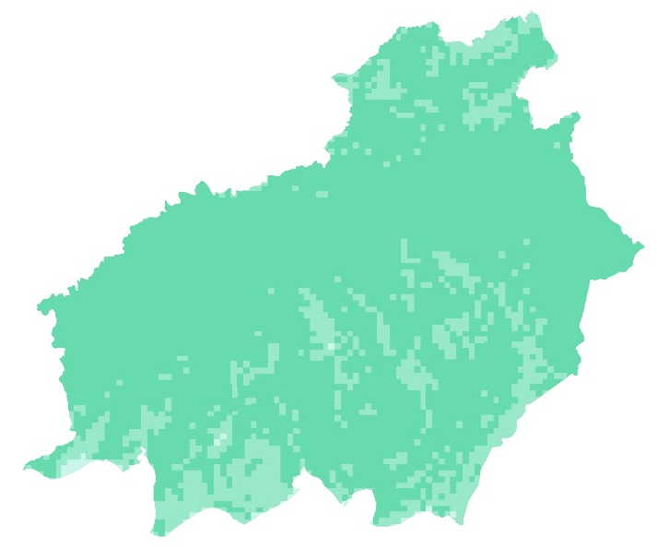
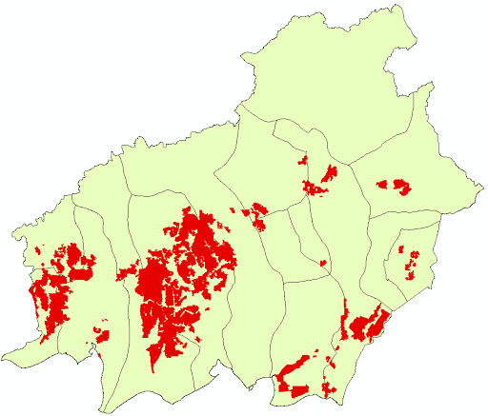
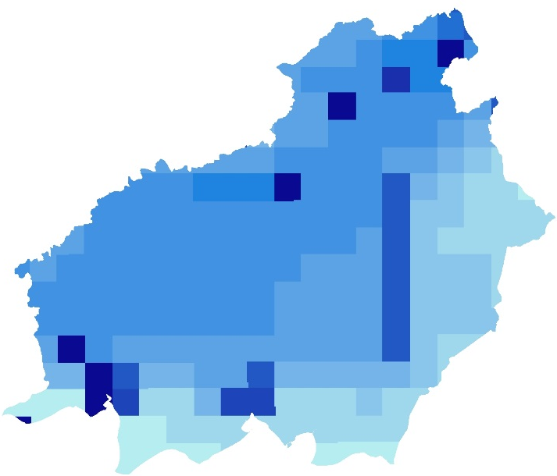
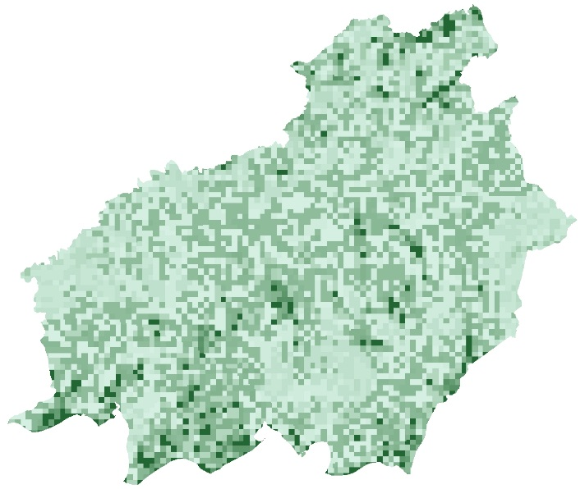
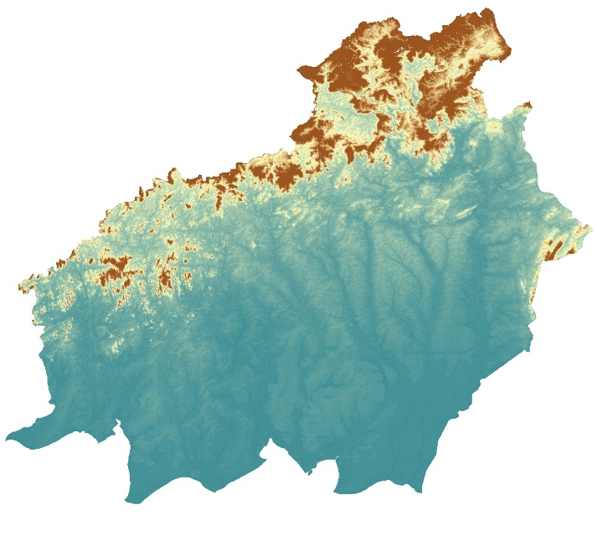
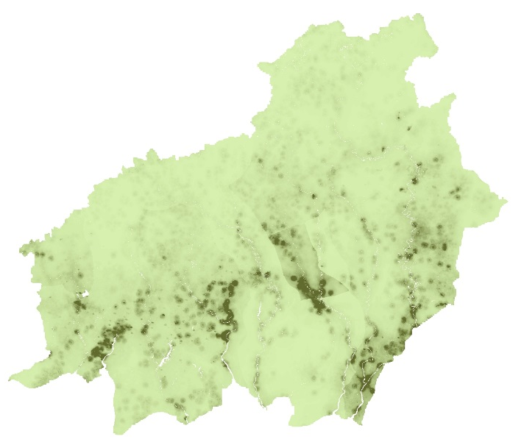
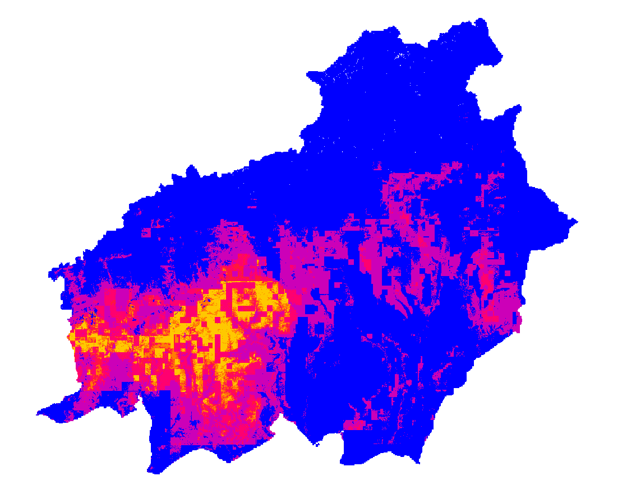
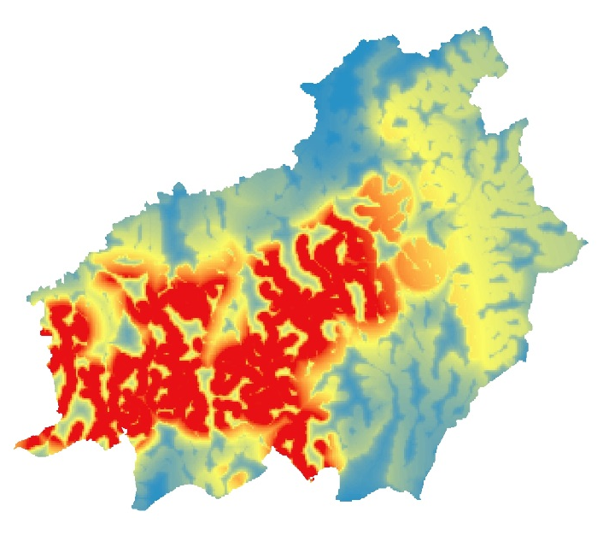
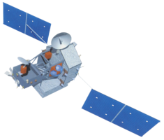
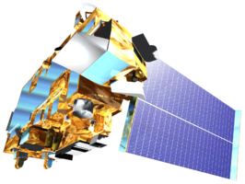
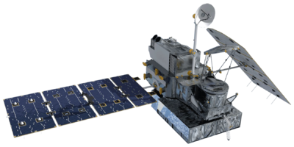
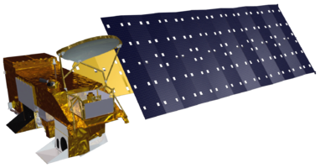
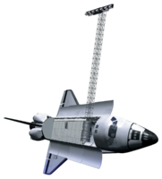
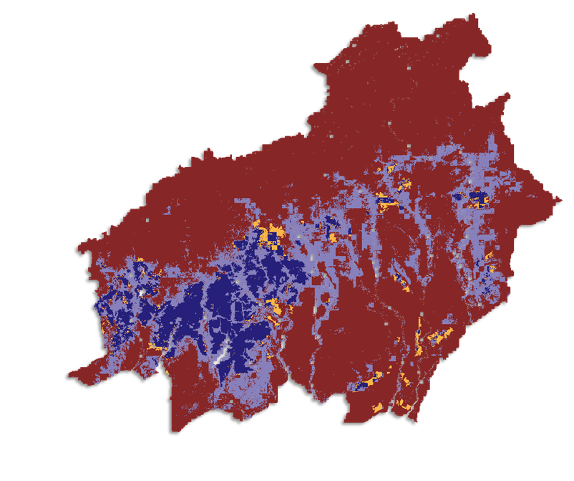
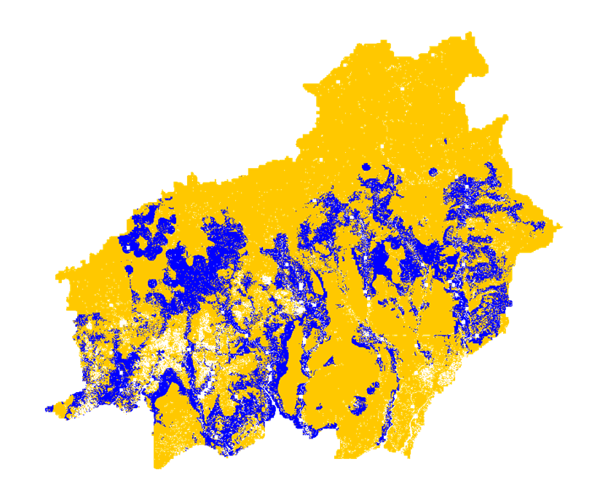
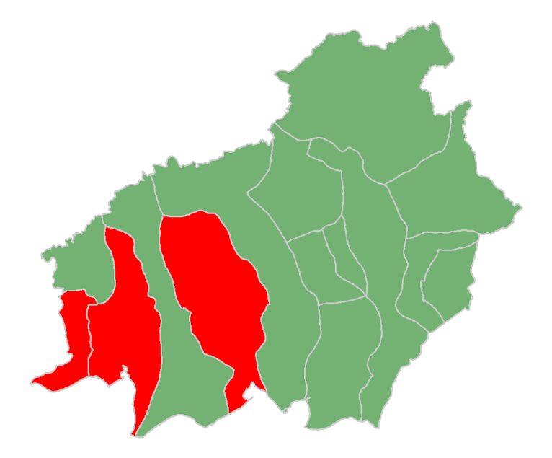
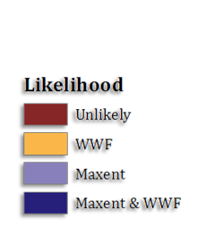
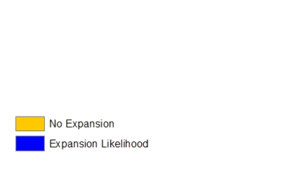
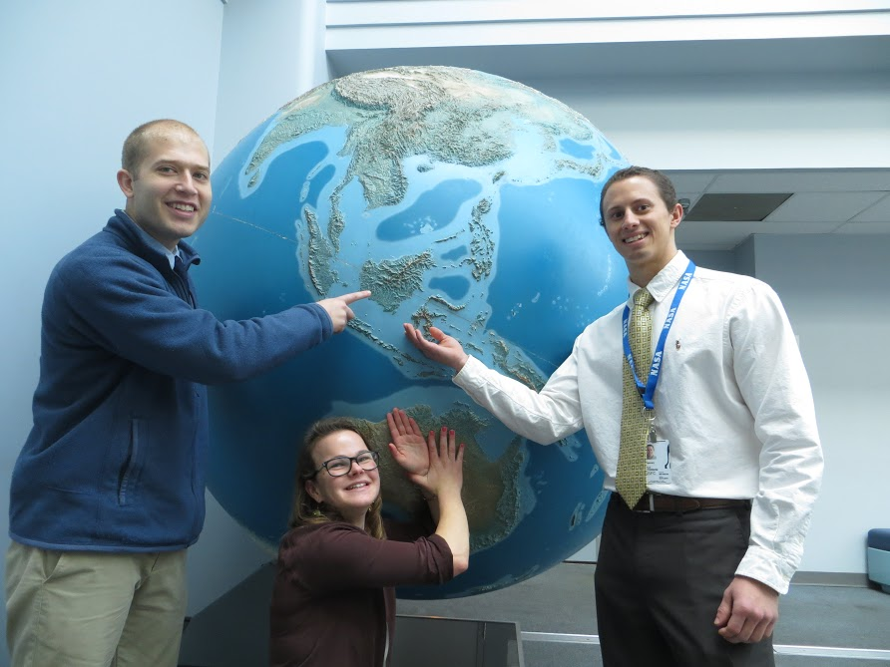
Indonesia Agriculture
Identifying current areas of palm oil production and modeling a risk map for future expansion in Central Kalimantan, Indonesia
Kyle T. Peterson (Project Lead), Abigail Childs, Michael Riedman
DEVELOP National Program at NASA Goddard Space Flight Center
Abstract
Objectives
Indonesia is the world’s leading producer of palm oil. To keep pace with the continued worldwide expansion of palm oil demand, the government of Indonesia formulated an agricultural policy with the express purpose of doubling palm oil production by 2020. Unfortunately, palm oil plantation expansion has come at the cost of natural rainforest and biodiversity loss in the province of Central Kalimantan. Although the government imposed a moratorium on deforestation in 2011 and extended it to present, there has been insufficient enforcement and deforestation continues to be a pressing issue in the region. The purpose of this project was to work with the World Wildlife Fund (WWF) to identify current palm oil plantations, including those on protected lands. A second component of the project was to delineate future palm oil plantation growth by creating a risk map of areas that are most vulnerable to palm expansion. The suitability analysis of palm oil plantations relied on Maxent to model palm oil plantation locations. This model used known plantation locations, continuous data from remote sensing systems including Tropical Rainfall Measuring Mission (TRMM), Global Precipitation Measurement (GPM), Aqua, and Terra along with ancillary data, to best predict other current and future locations of palm oil plantations. It is essential to map palm oil plantation locations and future palm oil plantation expansion to protect the biological and ecological diversity of rainforests and peatlands and to encourage palm oil expansion into regions that will not cause rainforest degradation.
Identify current palm oil plantations in Central Kalimantan, Indonesia, using MaxEnt
Generate a risk assessment map of future palm oil plantations based on identified plantations
Enhance World Wildlife Fund’s ability to combat deforestation using NASA Earth observations
Study Area
Methodology
NASA Earth Observations
Training Data
Central Kalimantan
MAXENT
Ancillary Data
Earth Observations
TRMM
Terra
GPM
Aqua
SRTM
Results
Conclusions
Most plantations occur and are likely to expand in southwestern Central Kalimantan.
The regencies most at risk of development are:
Sukamara
Kotawaringin Barat
Kotawaringin Timur
Conservation areas and peatlands were not substantial contributors to the likelihood model.
These results will allow decision makers to see what districts are at greatest likelihood of expansion into forested areas.
Palm Oil Locations
Likelihood of Expansion
The model to predict the location of palm oil plantations was primarily based on biophysical data including: NDVI, Elevation, Slope, Accessibility, Population Change, Palm Oil Concessions, Primary Forest, and Peatlands.
The model to predict the likelihood of future palm oil expansion was primarily based on management data including: Accessibility, Population Change, Provinces, Primary Forest, Peatlands, and Conservation Areas
Team Members
Variable | Percent Contribution | Permutation Importance
Palm Concessions | 35.8% | 15.5%
Elevation | 27.3% | 51.0%
Accessibility | 10.6% | 3.9%
Primary Forest | 9.4% | 4.5%
Population Change | 9.0% | 14.3%
Peatlands | 4.2% | 5.1%
NDVI | 3.0% | 4.0%
Slope | 0.7% | 1.5%
Variable | Percent Contribution | Permutation Importance
Accessibility | 37.2% | 28.5%
Population Change | 25.0% | 38.2%
Provinces | 18.0% | 20.6%
Primary Forest | 14.2% | 2.4%
Peatlands | 4.9% | 7.7%
Conservation Areas | 0.9% | 0.5%
Left to Right: Michael Riedman, Abigail Child, Kyle Peterson (Team Lead)
Project Partner
Acknowledgements
Dr. Naikoa Aguilar-Amuchastegui, WWF (Science Advisor)
Aakash Ahamed, USRA/GSFC (Science Advisor)
Sean McCartney, SSAI/GSFC (DEVELOP)
World Wildlife Fund
NASA Goddard Space Flight Center

