Slide 1
Great Lakes Climate II
Impact of Decreasing Lake Water Levels on Great Lakes Wetlands
Emily Adams (Project Lead)
Idamis Del Valle Martínez
Miriam Harris
Rodney Meyer
Stephen Zimmerman

Slide 2
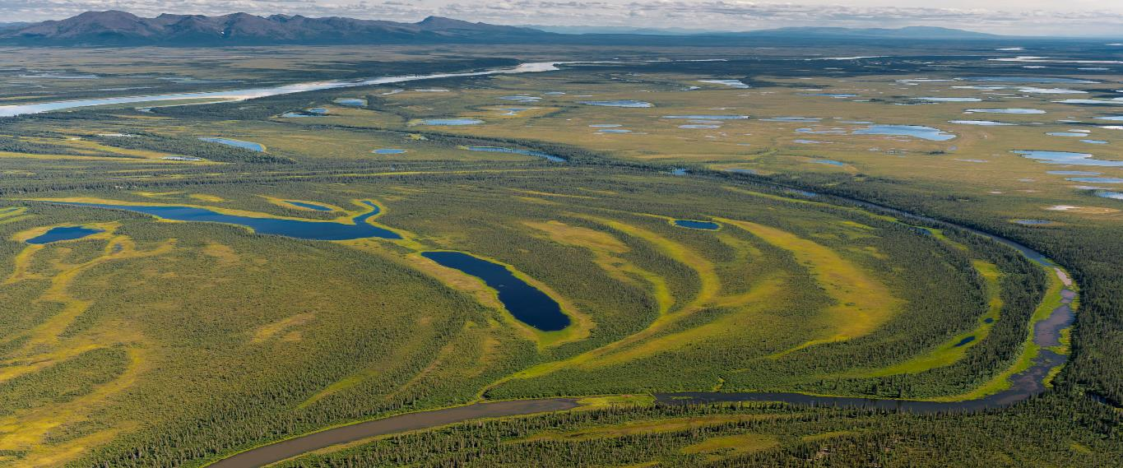
Wetlands
Link between terrestrial and aquatic ecosystems
Wetland extent decreased up to 90%
Ecological and economic benefits:
Filtration
Ground water recharge
Biological diversity
Tourism
Photo by Neal Herbert, Creative Commons by 2.0
Photo by Miriam Harris, Sandy Bottom State Park, Hampton, VA
Notes:
Wetland extent decreased up to 90% due to human activities

Slide 3
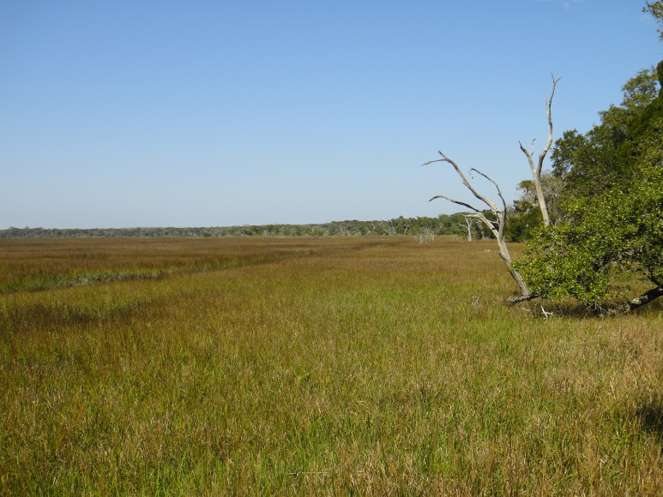
Wetlands
Link between terrestrial and aquatic ecosystems
Wetland extent decreased up to 90%
Ecological and economic benefits:
Filtration
Ground water recharge
Biological diversity
Tourism
Photo by Miriam Harris, Sandy Bottom State Park, Hampton, VA
Photo by Miriam Harris, Amelia Island, FL
Notes:
Wetland extent decreased up to 90% due to human activities

Slide 4
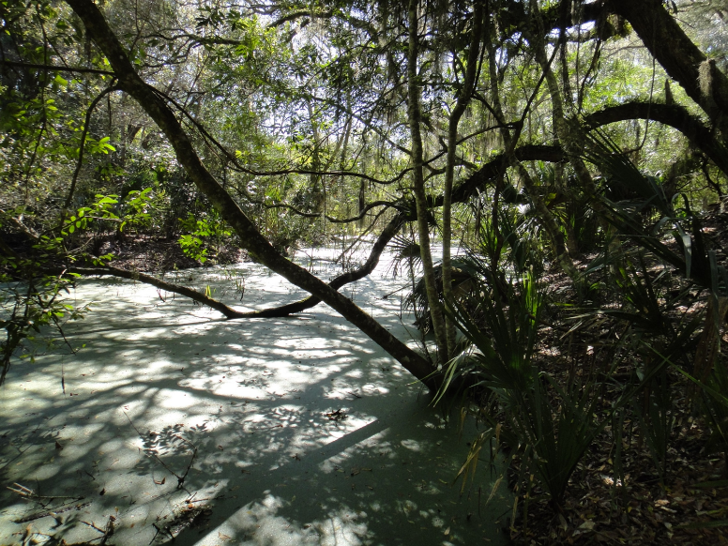
Wetlands
Link between terrestrial and aquatic ecosystems
Wetland extent decreased up to 90%
Ecological and economic benefits:
Filtration
Ground water recharge
Biological diversity
Tourism
Photo by Miriam Harris, Sandy Bottom State Park, Hampton, VA
Photo by Miriam Harris, Amelia Island, FL
Notes:
Wetland extent decreased up to 90% due to human activities

Slide 5
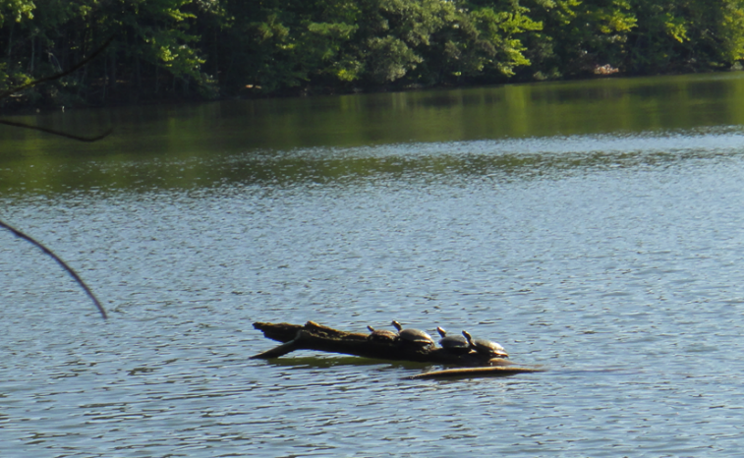
Wetlands
Link between terrestrial and aquatic ecosystems
Wetland extent decreased up to 90%
Ecological and economic benefits:
Filtration
Ground water recharge
Biological diversity
Tourism
Photo by Miriam Harris, Sandy Bottom State Park, Hampton, VA
Photo by Miriam Harris, Sandy Bottom State Park, Hampton, VA
Notes:
Wetland extent decreased up to 90% due to human activities

Slide 6
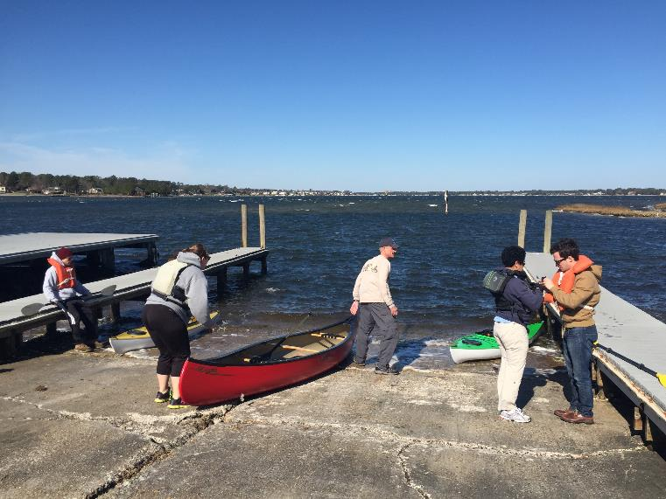
Wetlands
Link between terrestrial and aquatic ecosystems
Wetland extent decreased up to 90%
Ecological and economic benefits:
Filtration
Ground water recharge
Biological diversity
Tourism
Photo by Idamis del Valle Martinez, First Landing State Park, Virginia Beach, VA
Photo by Miriam Harris, Sandy Bottom State Park, Hampton, VA
Notes:
Wetland extent decreased up to 90% due to human activities

Slide 7
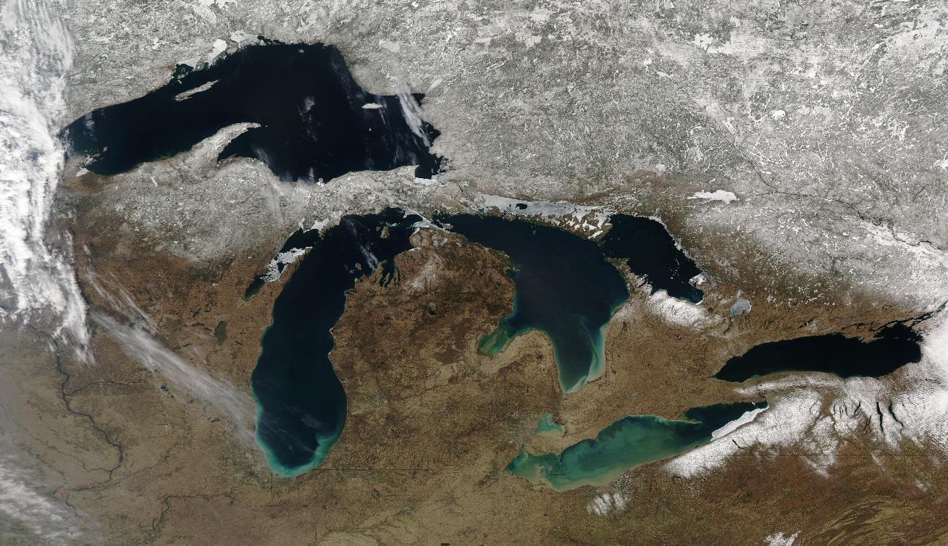
Great Lakes
Largest source of fresh water
Wetlands cover an area of 1700 km²
Lake Superior
Georgian Bay
Lake Huron
Lake Michigan
Lake Ontario
Lake Erie
Photo by Jeff Schmaltz, MODIS Rapid Response Team, NASA/GSFC

Slide 8
Water Levels in the Great Lakes
Fluctuations due to climate variability
Vegetation adapts to these changes
Water Levels in Parry Sound, Georgian Bay, Ontario, CA

Slide 9
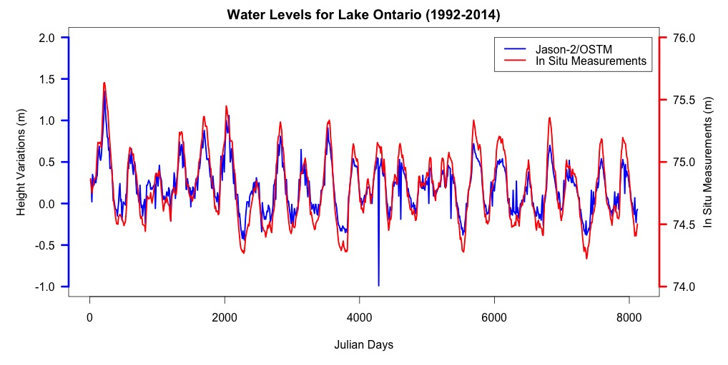
Water Levels in the Great Lakes
Fluctuations less variable in Lake Ontario
Water levels regulated
Water Levels in Lake Ontario (US/Canada)

Slide 10
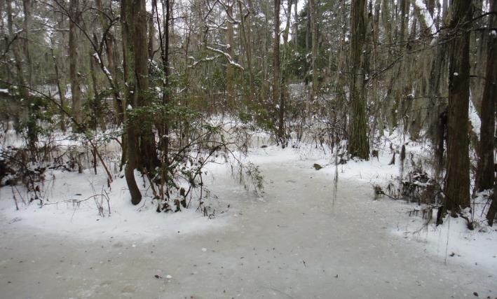
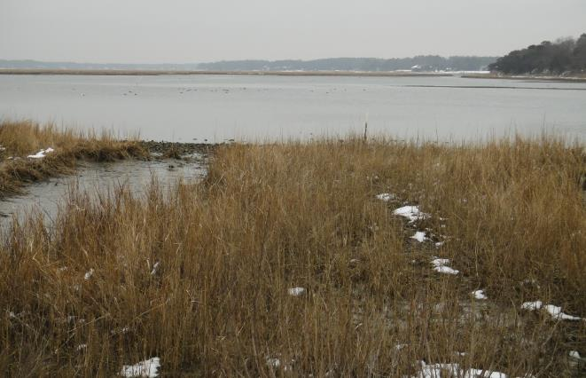
Community Concerns
Decreasing lake levels
Wetland degradation and loss
Climate change may impact wetland’s:
Hydrologic cycle
Biological diversity and tourism
Photo by Miriam Harris, Sandy Bottom State Park, Hampton, VA
Photo by Miriam Harris, First Landing State Park, Virginia Beach, VA
Photo by Miriam Harris, Pleasure House Point, Virginia Beach, VA

Slide 11
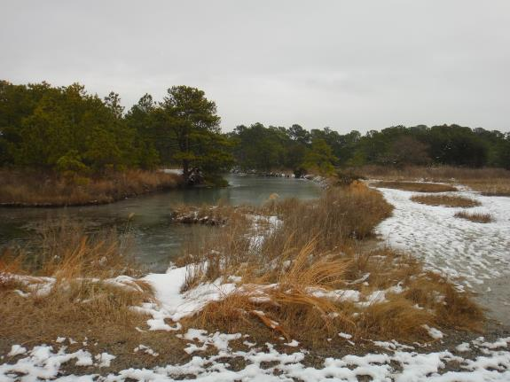
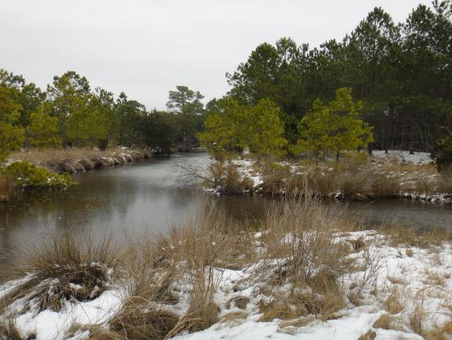
Project Partners
Photo by Miriam Harris, First Landing State Park, Virginia Beach, VA
David Ullrich
Executive Director
Great Lakes and St. Lawrence Cities Initiative
David Sweetnam
Executive Director
Georgian Bay Forever
Photo by Miriam Harris, First Landing State Park, Virginia Beach, VA
Mike Robertson
Imagery Project Manager
Ontario Ministry of Natural Resources

Slide 12
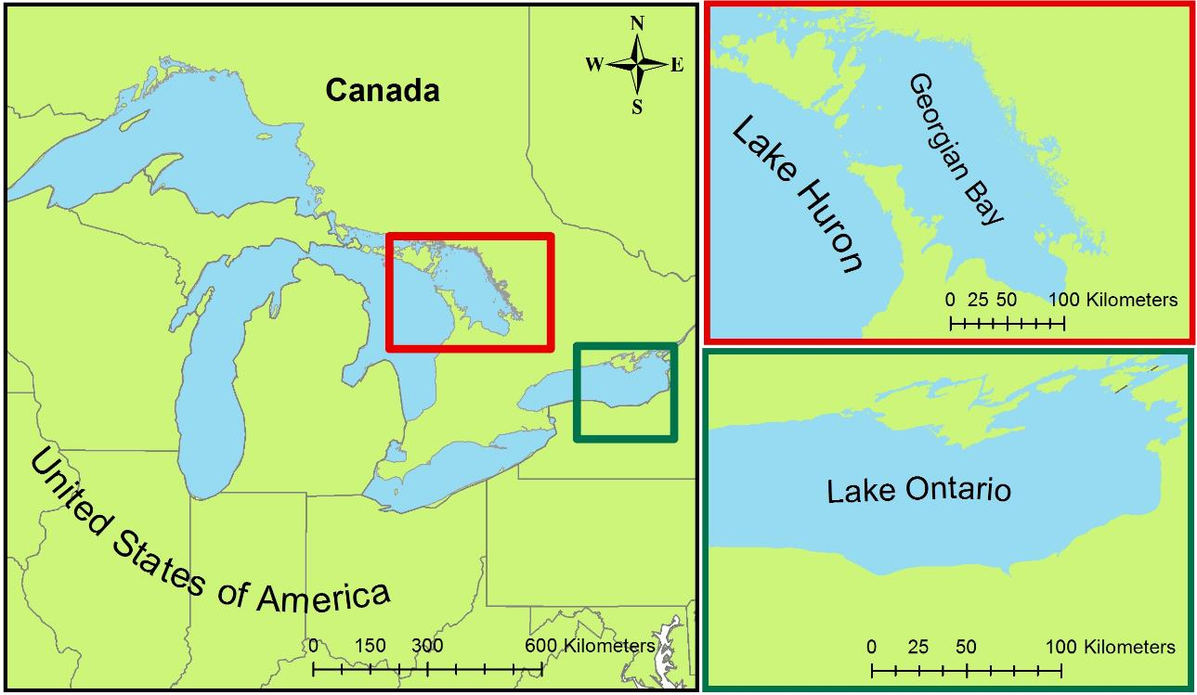
Study Area & Study Period
Georgian Bay (1987 -2013)
Southern Lake Ontario (2006 -2014)

Slide 13
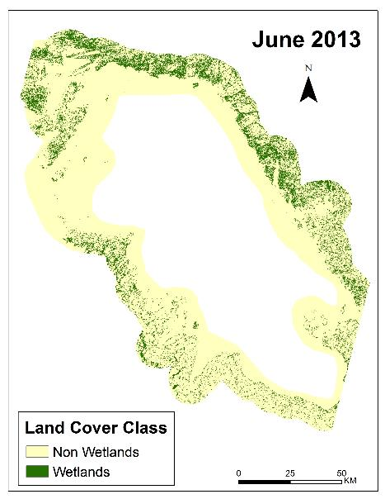
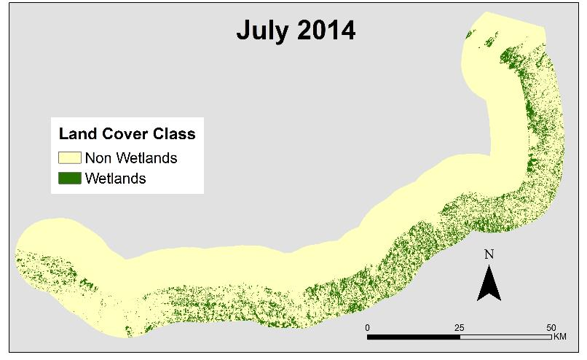
Objectives
Land cover classification maps
Wetlands extent change maps
Time series of wetland health and extent

Slide 14
Methodology
Data Acquisition
Data Processing
Data Analysis
Georgian Bay
Landsat 5 (July 1987)
Landsat 8 (June 2013)
ASTER DEM
Top of Atmosphere Corrected
Training Site Selection
Lake Ontario
Landsat 5 (August 2007)
Landsat 8(June 2014)
ASTER DEM
Mosaicked Landsat Scenes
Random Forest Land Cover Classification Script (R)
Water Levels
TOPEX/Jason-1
OSTM/Jason-2
In situ water level gauges
Study area defined by 10 km buffer around shoreline
Validation and Accuracy Assessment

Slide 15
Methodology
Data Acquisition
Data Processing
Data Analysis
Georgian Bay
Landsat 5 (July 1987)
Landsat 8 (June 2013)
ASTER DEM
Top of Atmosphere Corrected
Training Site Selection
Lake Ontario
Landsat 5 (August 2007)
Landsat 8(June 2014)
ASTER DEM
Mosaicked Landsat Scenes
Random Forest Land Cover Classification Script (R)
Water Levels
TOPEX/Jason-1
OSTM/Jason-2
In situ water level gauges
Study area defined by 10 km buffer around shoreline
Validation and Accuracy Assessment

Slide 16
Methodology
Data Acquisition
Data Processing
Data Analysis
Georgian Bay
Landsat 5 (July 1987)
Landsat 8 (June 2013)
ASTER DEM
Top of Atmosphere Corrected
Training Site Selection
Lake Ontario
Landsat 5 (August 2007)
Landsat 8(June 2014)
ASTER DEM
Mosaicked Landsat Scenes
Random Forest Land Cover Classification Script (R)
Water Levels
TOPEX/Jason-1
OSTM/Jason-2
In situ water level gauges
Study area defined by 10 km buffer around shoreline
Validation and Accuracy Assessment

Slide 17
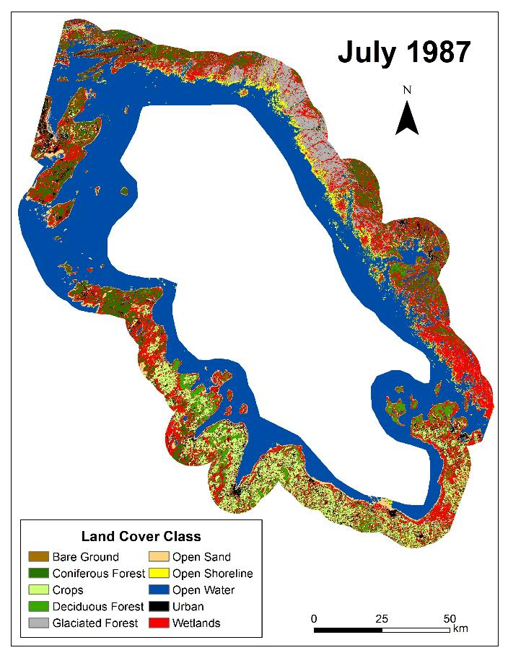
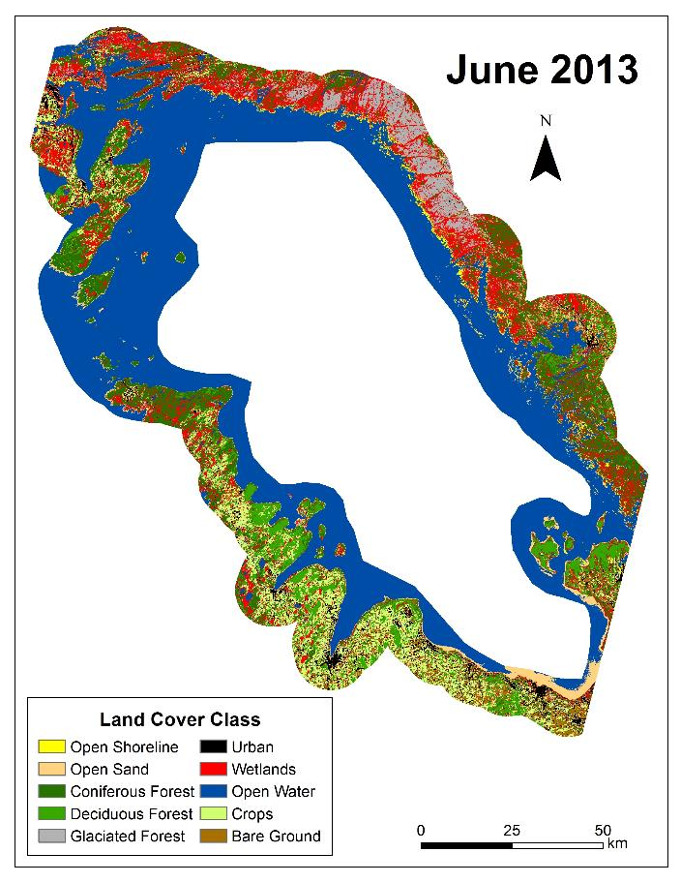
Results: Classified Maps Georgian Bay
TBD

Slide 18
Results: Wetland vs Non-Wetland Maps

Slide 19
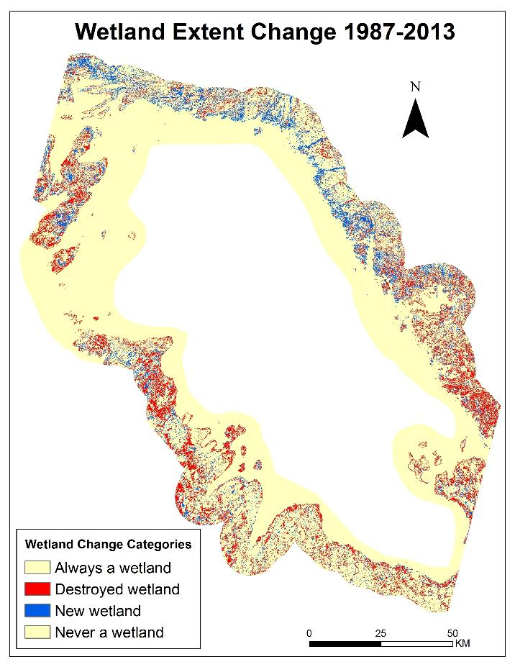
Results: Wetlands Extent Change Maps

Slide 20
Results: Accuracy Assessment
Georgian Bay

Slide 21
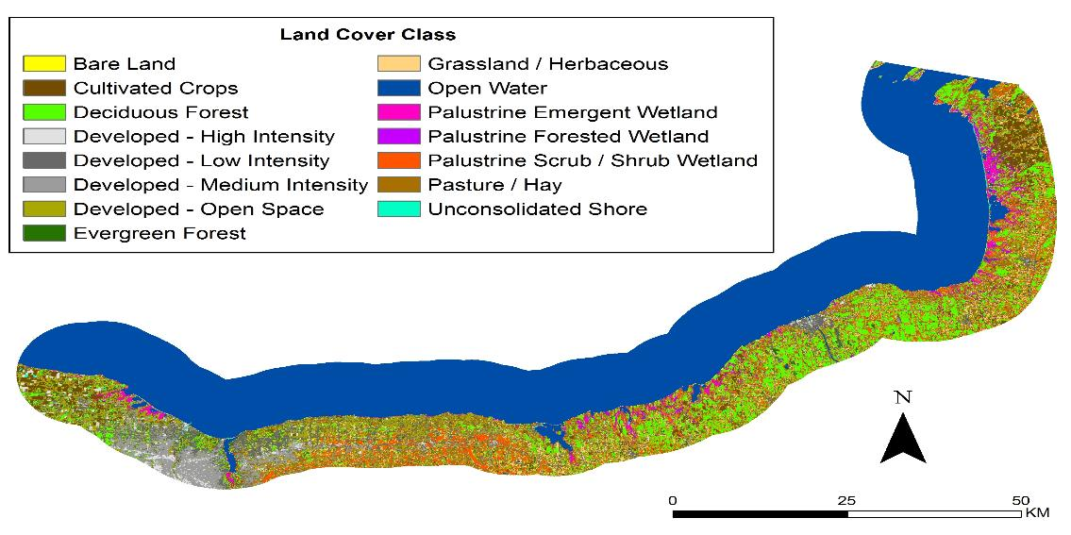
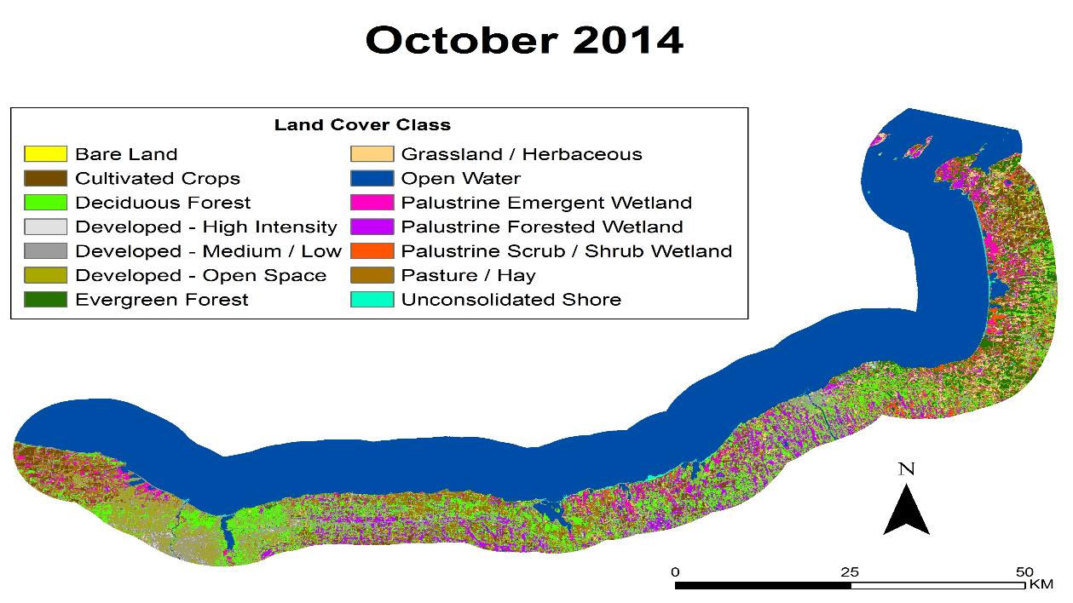
Results: Classified Maps Southern Lake Ontario
TBD
October 2007
August 2014

Slide 22
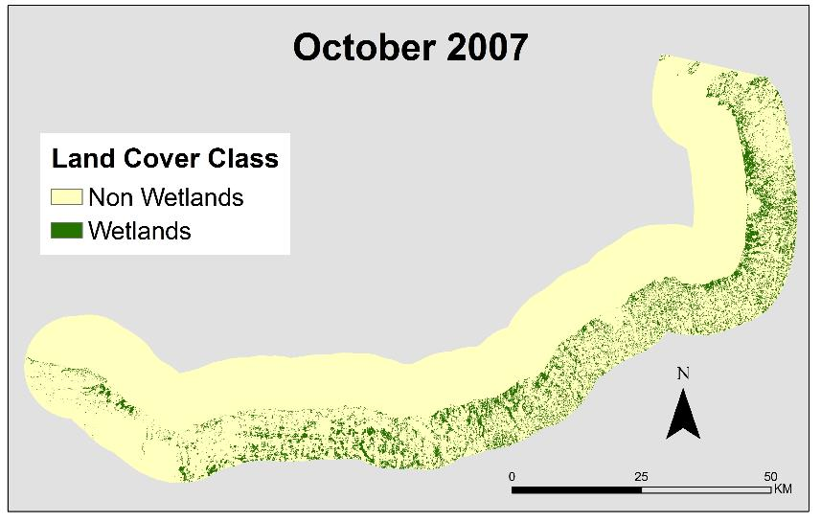
Results: Wetland vs Non-Wetland Maps

Slide 23
Results: Wetlands Extent Change Maps
Southern Lake Ontario

Slide 24
Results: Accuracy Assessment
Southern Lake Ontario

Slide 25
Conclusions
Thermal band + DEM + slope
reduced random forest error rate ~ 2%
Georgian Bay: 1987-2014
4% Wetland Loss
Southern Lake Ontario: 2007-2014
Negligible change in wetlands
Photo by Miriam Harris, First Landing State Park, Virginia Beach, VA

Slide 26
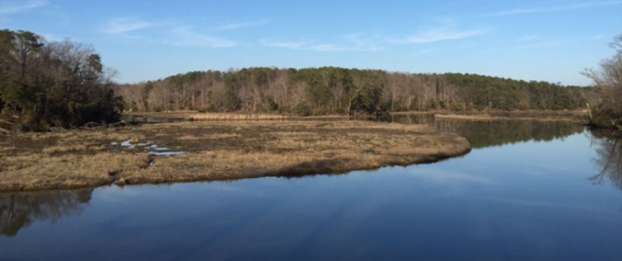
Conclusions
Cost effective methodology for creating classified land cover and wetland extent change maps
Accuracy assessment in progress
Photo by Idamis del Valle Martinez, Williamsburg, VA

Slide 27
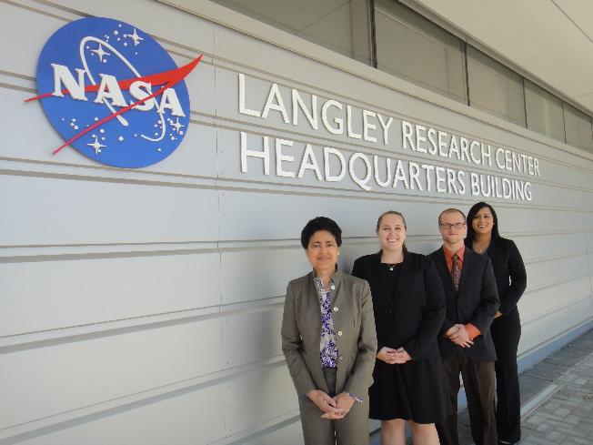
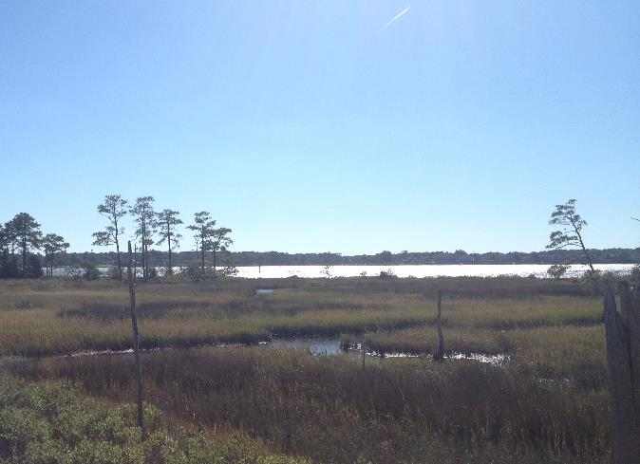
Benefits of Research
More cost effective methodology for land classification maps
Facilitate comparison of wetlands extent over time
Insights on impact of climate change to wetlands health
Photo by Miriam Harris, First Landing State Park, Virginia Beach, VA
Photo by Miriam Harris, First Landing State Park, Virginia Beach, VA

Slide 28
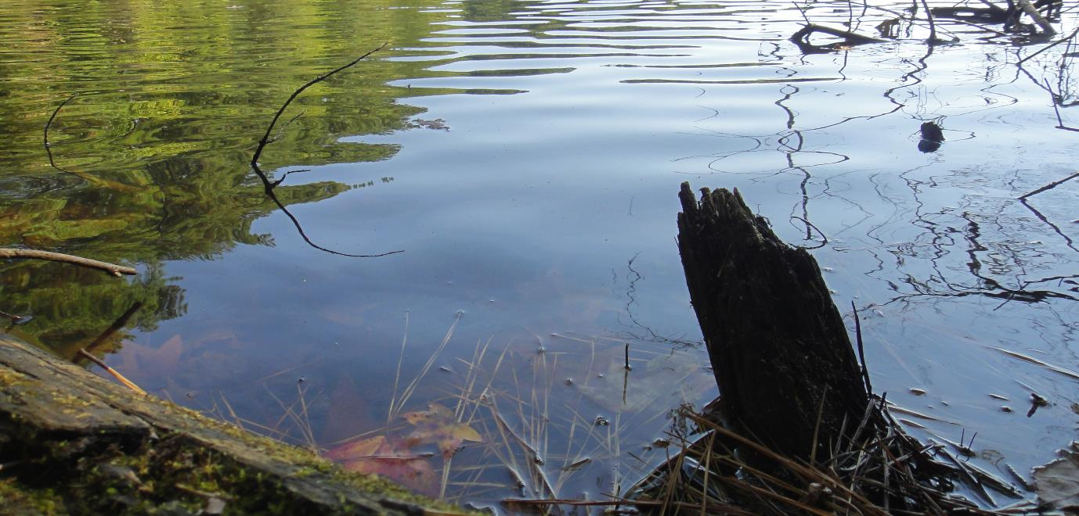
Future Work
Expand geographic scope
Refine methodology
Create educational aids based on study results
Photo by Miriam Harris, Sandy Bottom State Park, Hampton, VA

Slide 29
Acknowledgements
Dr. Kenton Ross
NASA DEVELOP National Program- Science Advisor
James Favors
NASA DEVELOP National Program- International Lead
David Ullrich
Great Lakes and St. Lawrence Cities Initiative
David Sweetnam
Georgian Bay Forever
Mike Robertson
Ontario Ministry of Natural Resources
Nathan Owen
NASA DEVELOP - Langley Center Lead
Fall 2014 Great Lakes Climate I
This material is based upon work supported by NASA through contract NNL11AA00B and cooperative agreement NNX14AB60A.

Slide 30
References
Assel, R. A., F. H. Quinn, and C. E. Sellinger (2004), Hydroclimatic factors of the recent record drop in Laurentian Great Lakes water levels. Bull. Amer. Meteor. Soc., 85, 1143-1151.
Breiman, L. (2001), Random forests. Mach. Learn., 45, 5-32.
Bardecki, M. J. (1991), Wetlands and climate change: a speculative review. Can. Water Resour. J., 16, 9-22.
Canada Department of Fisheries and Oceans (2014), Historical monthly and yearly mean water level graphs 1918-2013 [Available online at http://waterlevels.gc.ca/C&A/netgraphs-eng.html].
Chow-Fraser, P. (1998), A conceptual ecological model to aid restoration of Cootes Paradise Marsh, a degraded coastal wetland of Lake Ontario, Canada. Wetl. Ecol. Manag. , 6, 43-57.
Chow-Fraser, P., V. Lougheed, V. Le Thiec, B. Crosbie, L. Simser, and J. Lord (1998). Long-term response of the biotic community to fluctuating water levels and changes in water quality in Cootes Paradise Marsh, a degraded coastal wetland of Lake Ontario. Wetl. Ecol. Manag., 6, 19-42.
Cvetkovic, M., and P. Chow-Fraser (2011), Use of ecological indicators to assess the quality of Great Lakes coastal wetlands. Ecol. Indic., 11, 1609-1622.
Herdendorf, C.E. (2004), Morphometric factors in the formation of Great Lakes coastal wetlands. Aquat. Ecosyst. Health & Manage., 7, 179-197.
Keddy PA, and AA. Reznicek (1986), Great lakes vegetation dynamics: the role of fluctuating water levels and buried seeds. J. Gt. Lakes Res.,12, 25-36.
Li J., and W. Chen (2005), A rule-based method for mapping Canada’s wetlands using optical, radar and DEM data. Int. J. Remote. Sens. 26, 5051-5069.
Mcleod, E., G.L. Chmura, S. Bouillon, R. Salm, M. Bjork, C.M. Duarte, C.E. Lovelock, W.H. Schlesinger, and B.R. Silliman (2011), A blueprint for blue carbon: toward an improved understanding of the role of vegetated coastal habitats in sequestering CO2. Front. Ecol. Environ., 9, 552-560.
Midwood, J., D. Rokitnicki-Wojcik, and P. Chow-Fraser (2012), Development of an inventory of coastal wetlands for eastern Georgian Bay, Lake Huron. ISRN Ecology 2012, 1-13.
Mortsch, L.D. (1998), Assessing the impact of climate change on The Great lakes shoreline wetlands. Climatic Change, 40, 391-416.
——, and F.H. Quinn (1996), Climate change scenarios for Great Lakes Basin ecosystem studies. Limnol. Oceanogr., 41, 903-911.
——, H. Hengeveld, M. Lister, L. Wenger, B. Lofgren, F. Quinn, and M. Slivitzky (2000), Climate change impacts on the hydrology of the Great Lakes-St. Lawrence system. Can. Water Resour. J., 25, 153-179.
Sellinger, C.E., C.A. Stow, E.C Lamon, and S.S. Qian (2008), Recent water level declines in the Lake Michigan-Huron System. Environ. Sci. Technol., 42, 367-373.
Whillans, T. (1982), Changes in marsh area along the Canadian shore of Lake Ontario. J. Gt. Lakes Res., 8, 570-577.
Whillans, T. (1996), Historic and comparative perspectives on rehabilitation of marshes as habitat for fish in the lower Great Lakes basin. Can. J. Fish. Aquat. Sci., 53, 58-66.
Wilcox, D. A. and Y. Xie, (2007), Predicting wetland plant community responses to proposed water-level-regulation plans for Lake Ontario: GIS-based modeling. J. Gt. Lakes Res., 33, 751-773.

