Slide 1
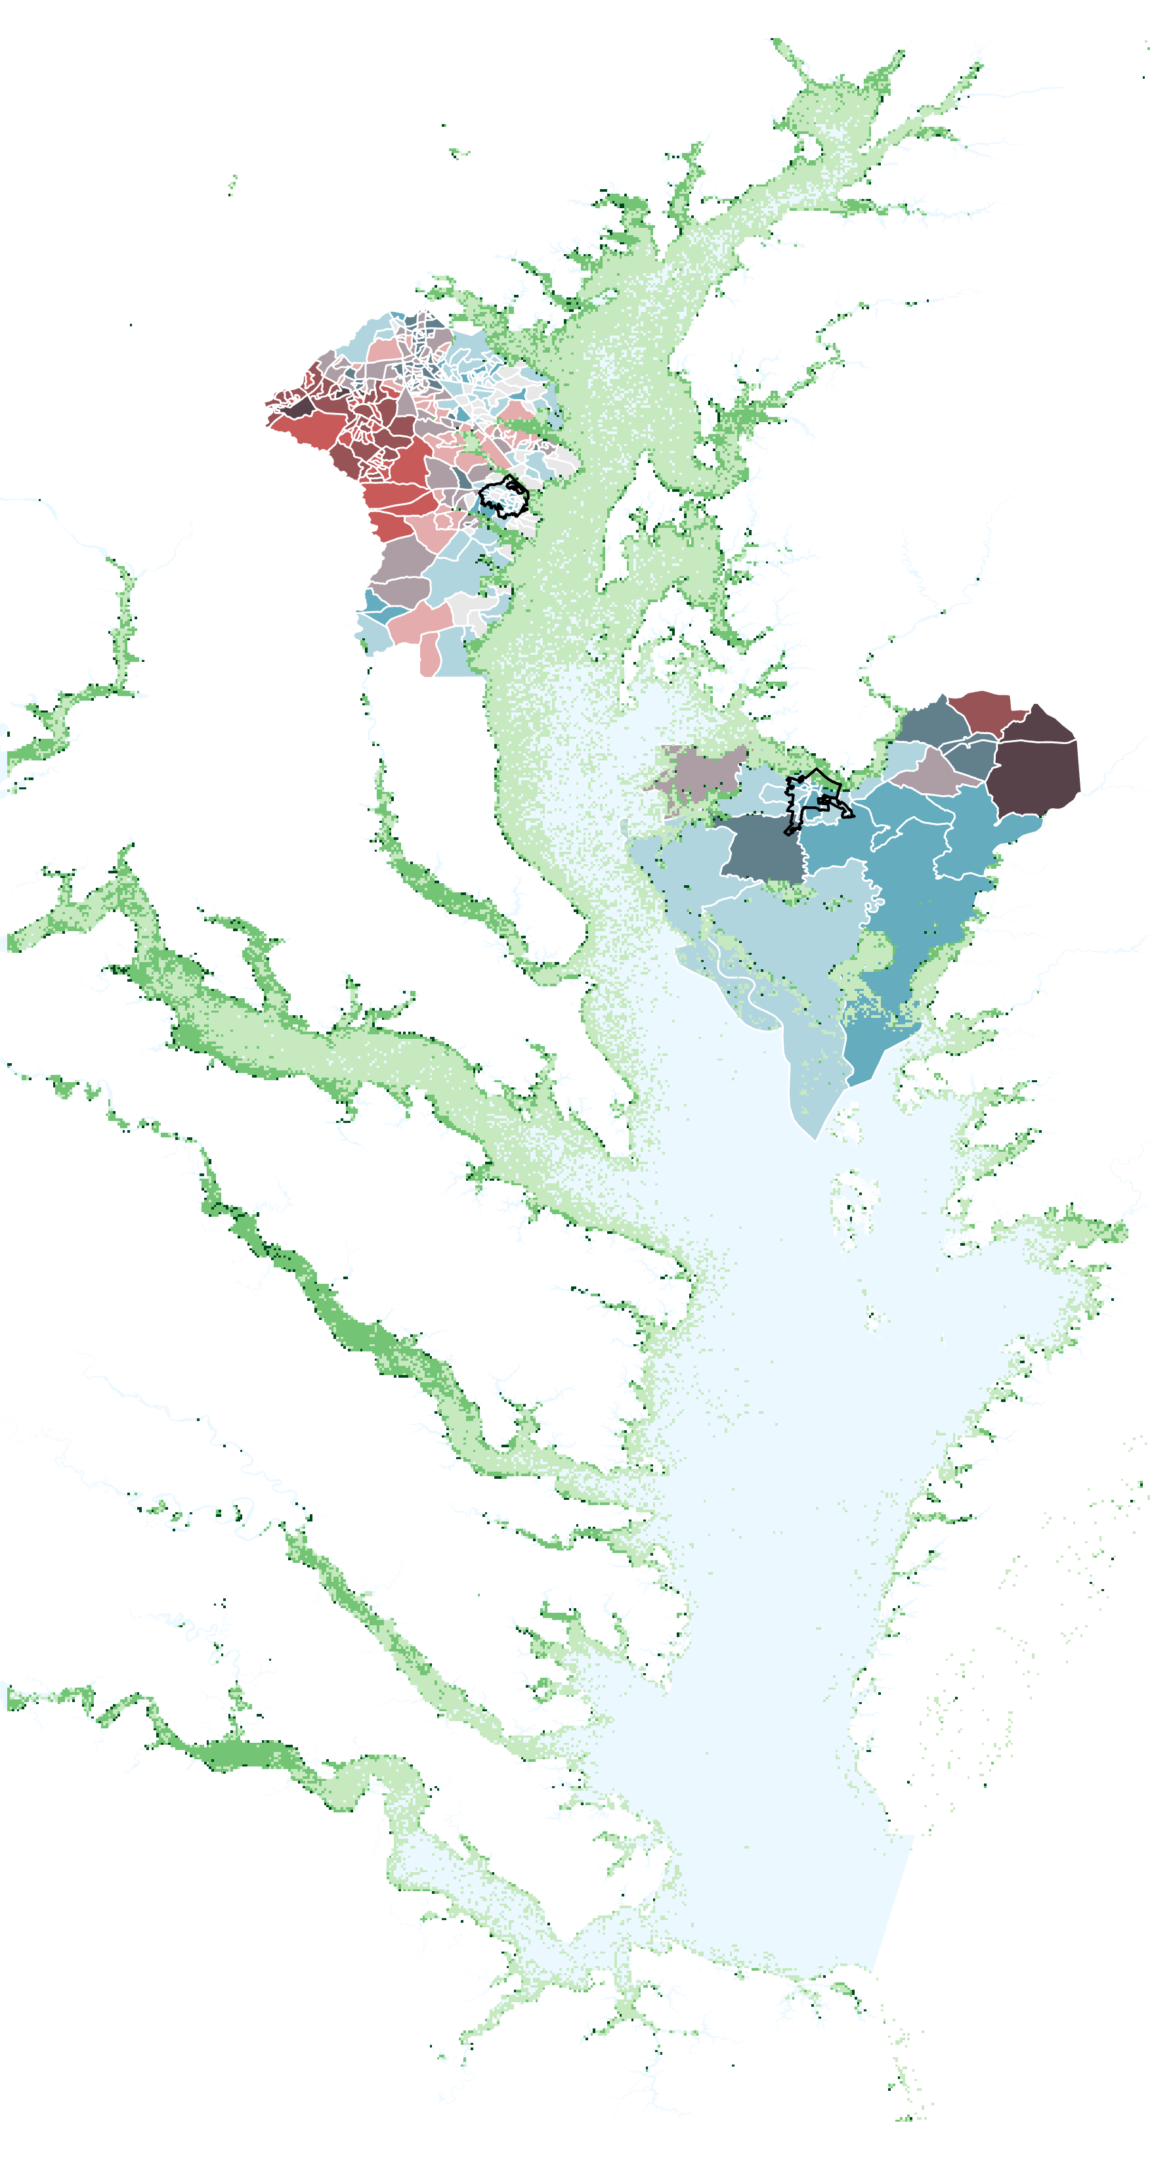
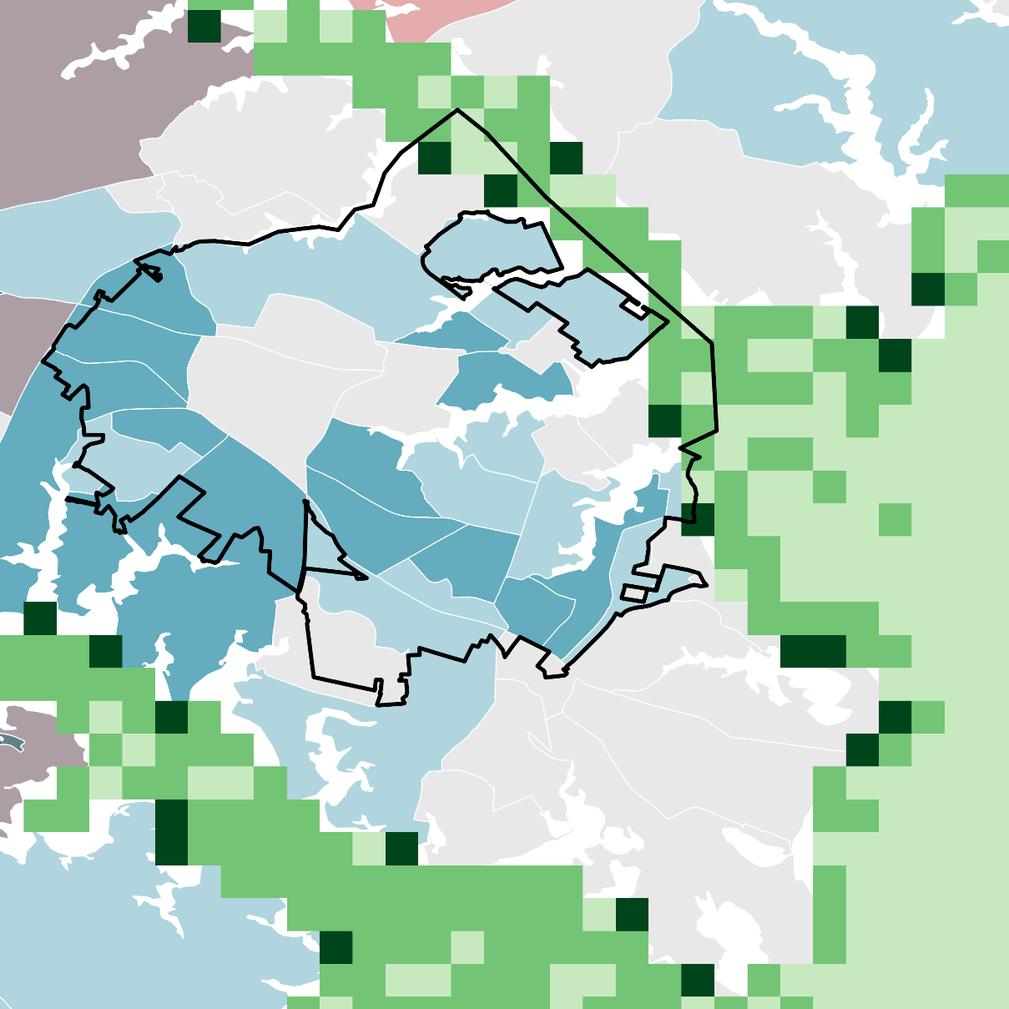
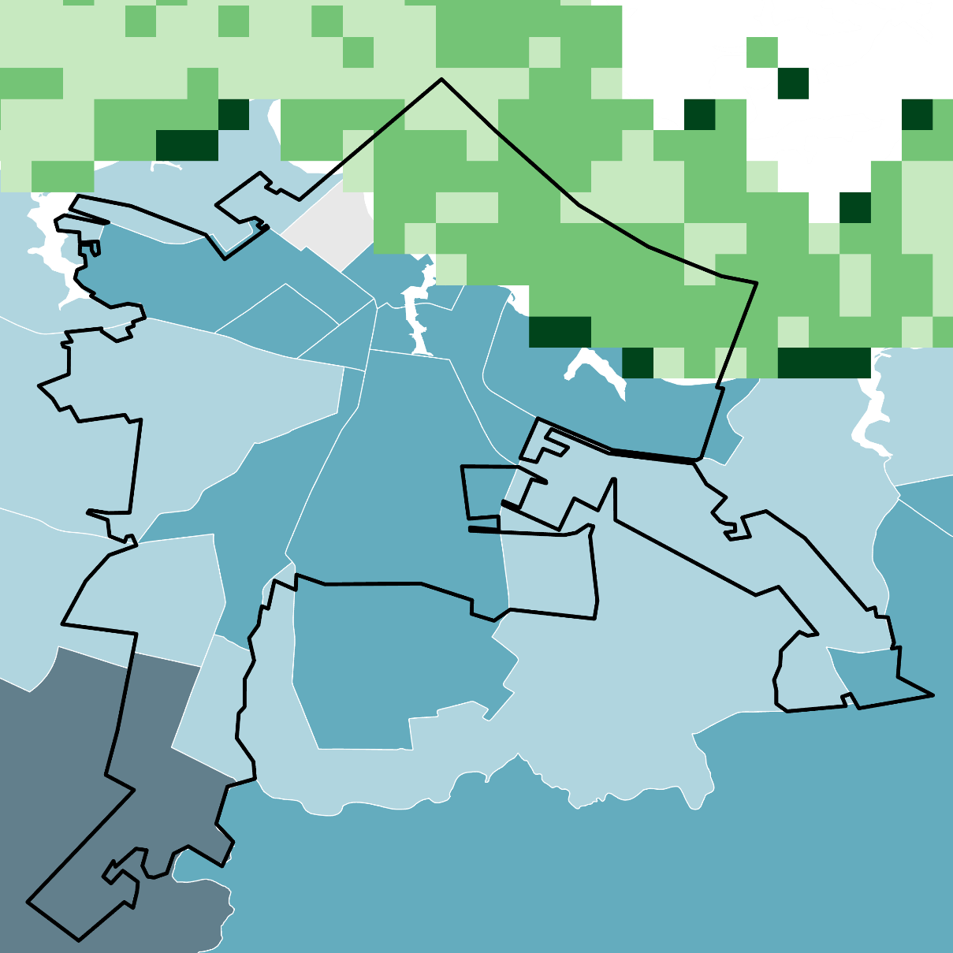
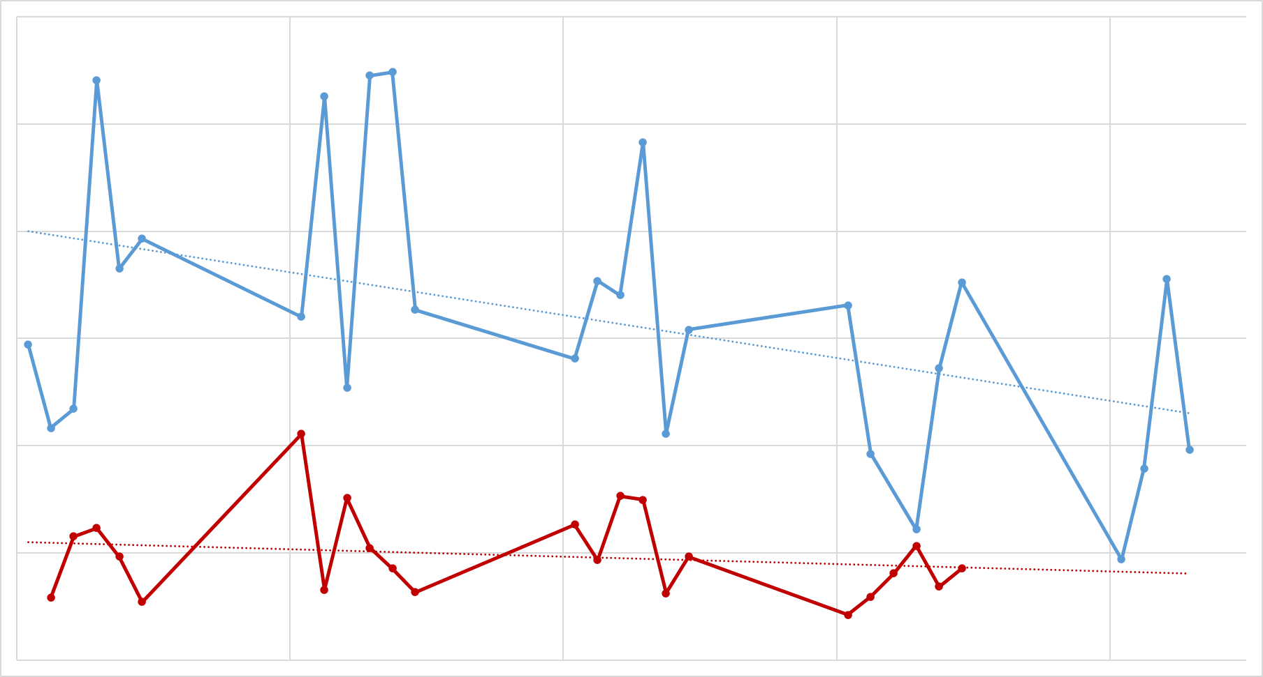
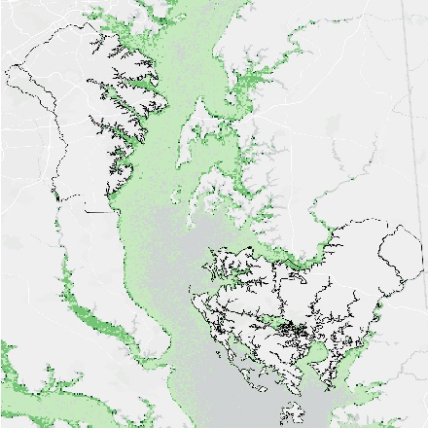
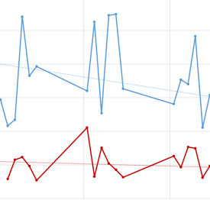
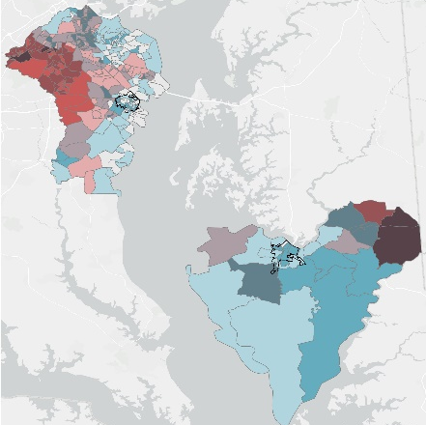
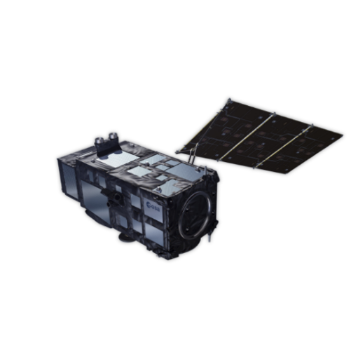
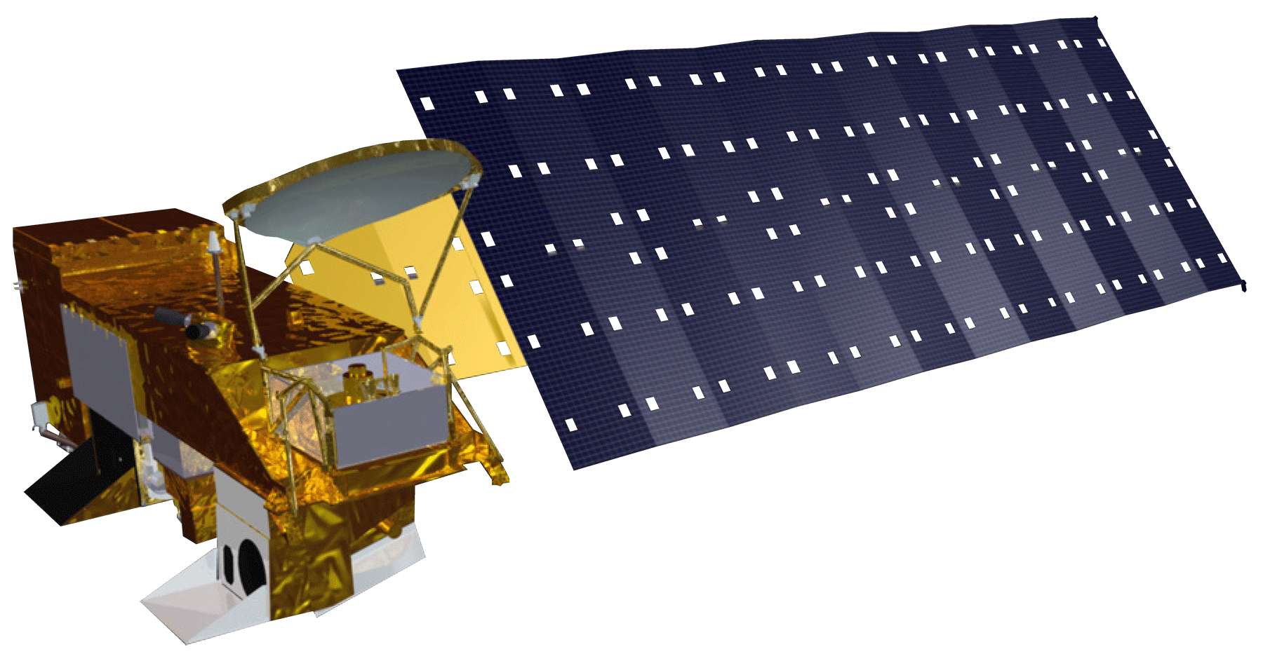
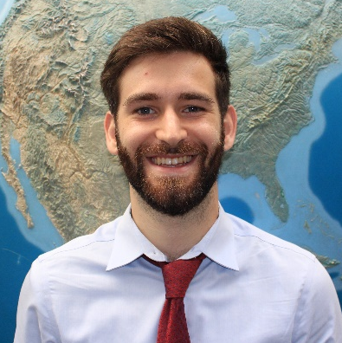
Chesapeake Bay Water Resources
Using Earth Observations to Assess Spatial and Social Disparities in Water Quality Trends Shaping Fishing and Swimming Access in the Chesapeake Bay
Year
Project Synopsis
Results
Harmful algal blooms in the Chesapeake Bay affect recreational access sites and vulnerable communities along the coast. To investigate these issues, the project team used NASA Earth observations to create persistence maps of chlorophyll-a concentration, bivariate maps that compared social
vulnerability to recreational access, and chlorophyll-a time
series trends. This work was completed in support
of the Ocean Conservancy and the
Blacks of the Chesapeake Foundation.
Social Vulnerability & Fishing/Swimming Site Access
Annapolis
High
ANNE ARUNDEL
Social Vulnerability
Objectives
Low
Near
Far
Visualize chlorophyll-a and turbidity levels over time and compare to in-situ monitoring stations
Identify communities with high social vulnerability and low access to recreational fishing and swimming locations
Map areas with persistent chlorophyll-a over harmful thresholding levels
Distance to Public Recreation Site
0
2
4 km
Basemap Credit: VGIN, Esri, TomTom, Garamin, SafeGraph, METI/NASA, USGS, EPA, NPA, USDA, USFWS, County of AnneArundel​
Cambridge
Methodology
DORCHESTER
High
Medium
Sentinel-3 OLCI L2
Low
0
2
4 km
Bi-weekly Composites
Variations in Chlorophyll-a Levels at a Cambridge Site
60
Satellite Sentinel - 3
50
In Situ Station
Satellite Linear Trend
40
In Situ Linear Trend
Chlorophyll – a (μg/L)
C h e s a p e a k e B a y
30
20
10
0
2021
2022
2023
2020
2024
Fishing/Swimming Access Sites
Year
Conclusions
At recreation sites near Cambridge, there has been a downward trend in chlorophyll-a over the past 5 years.
Many recreational sites lack nearby in situ turbidity monitoring.
While we were not able to tease out broad trends in chlorophyll-a persistence across the entire Chesapeake Bay, we noticed certain recreation sites experienced sustained algal blooms, such as Long Wharf.
No significant relationship was found between socially vulnerable populations and distance to recreation sites.
Sociodemographic Data
Earth Observations
Project Partners
Study Area
The Ocean Conservancy
Blacks of the Chesapeake Foundation
AQUA MODIS
Sentinel-2 Ocean and Land Color Instrument
Anne Arundel and Dorchester, two MD counties in the Chesapeake Bay
Team Members
Acknowledgements
Partners: The Ocean Conservancy and the Blacks of the Chesapeake Foundation
Science Advisor: Sean McCartney (NASA GSFC)
Node Lead: Isabel Lubitz
Fellow: Marisa Smedsrud
This material contains modified Copernicus Sentinel data (2020-2024), processed by ESA.
Nisuka Williams
Project Lead
Spencer Harman
Simone Schneider
Rima Wahab
Maryland – Goddard | Fall 2024

