Slide 1
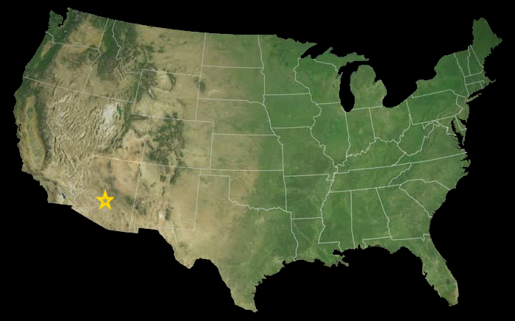
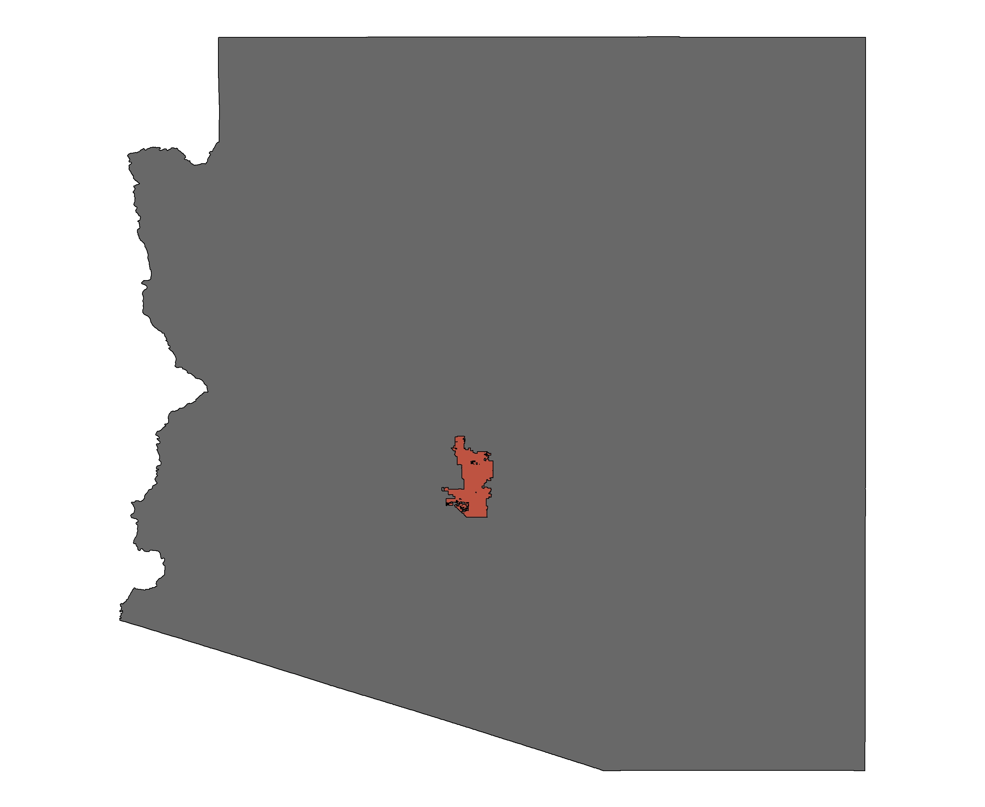
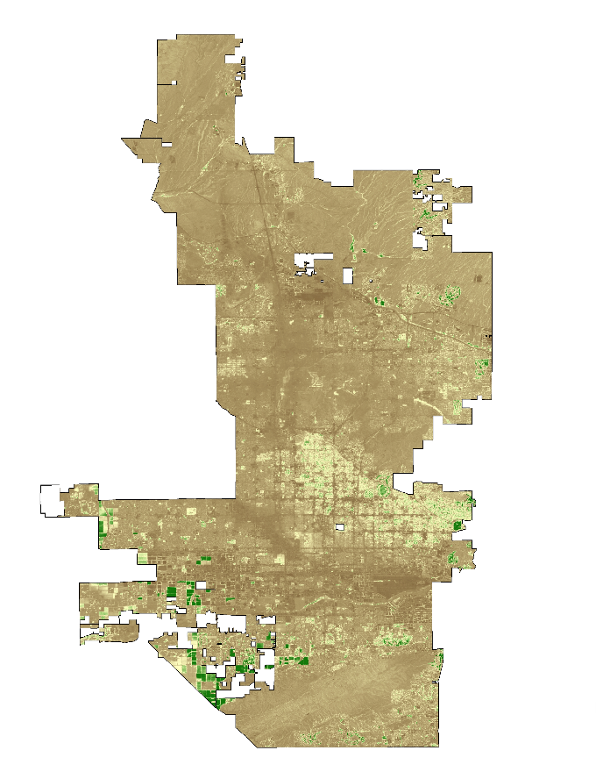
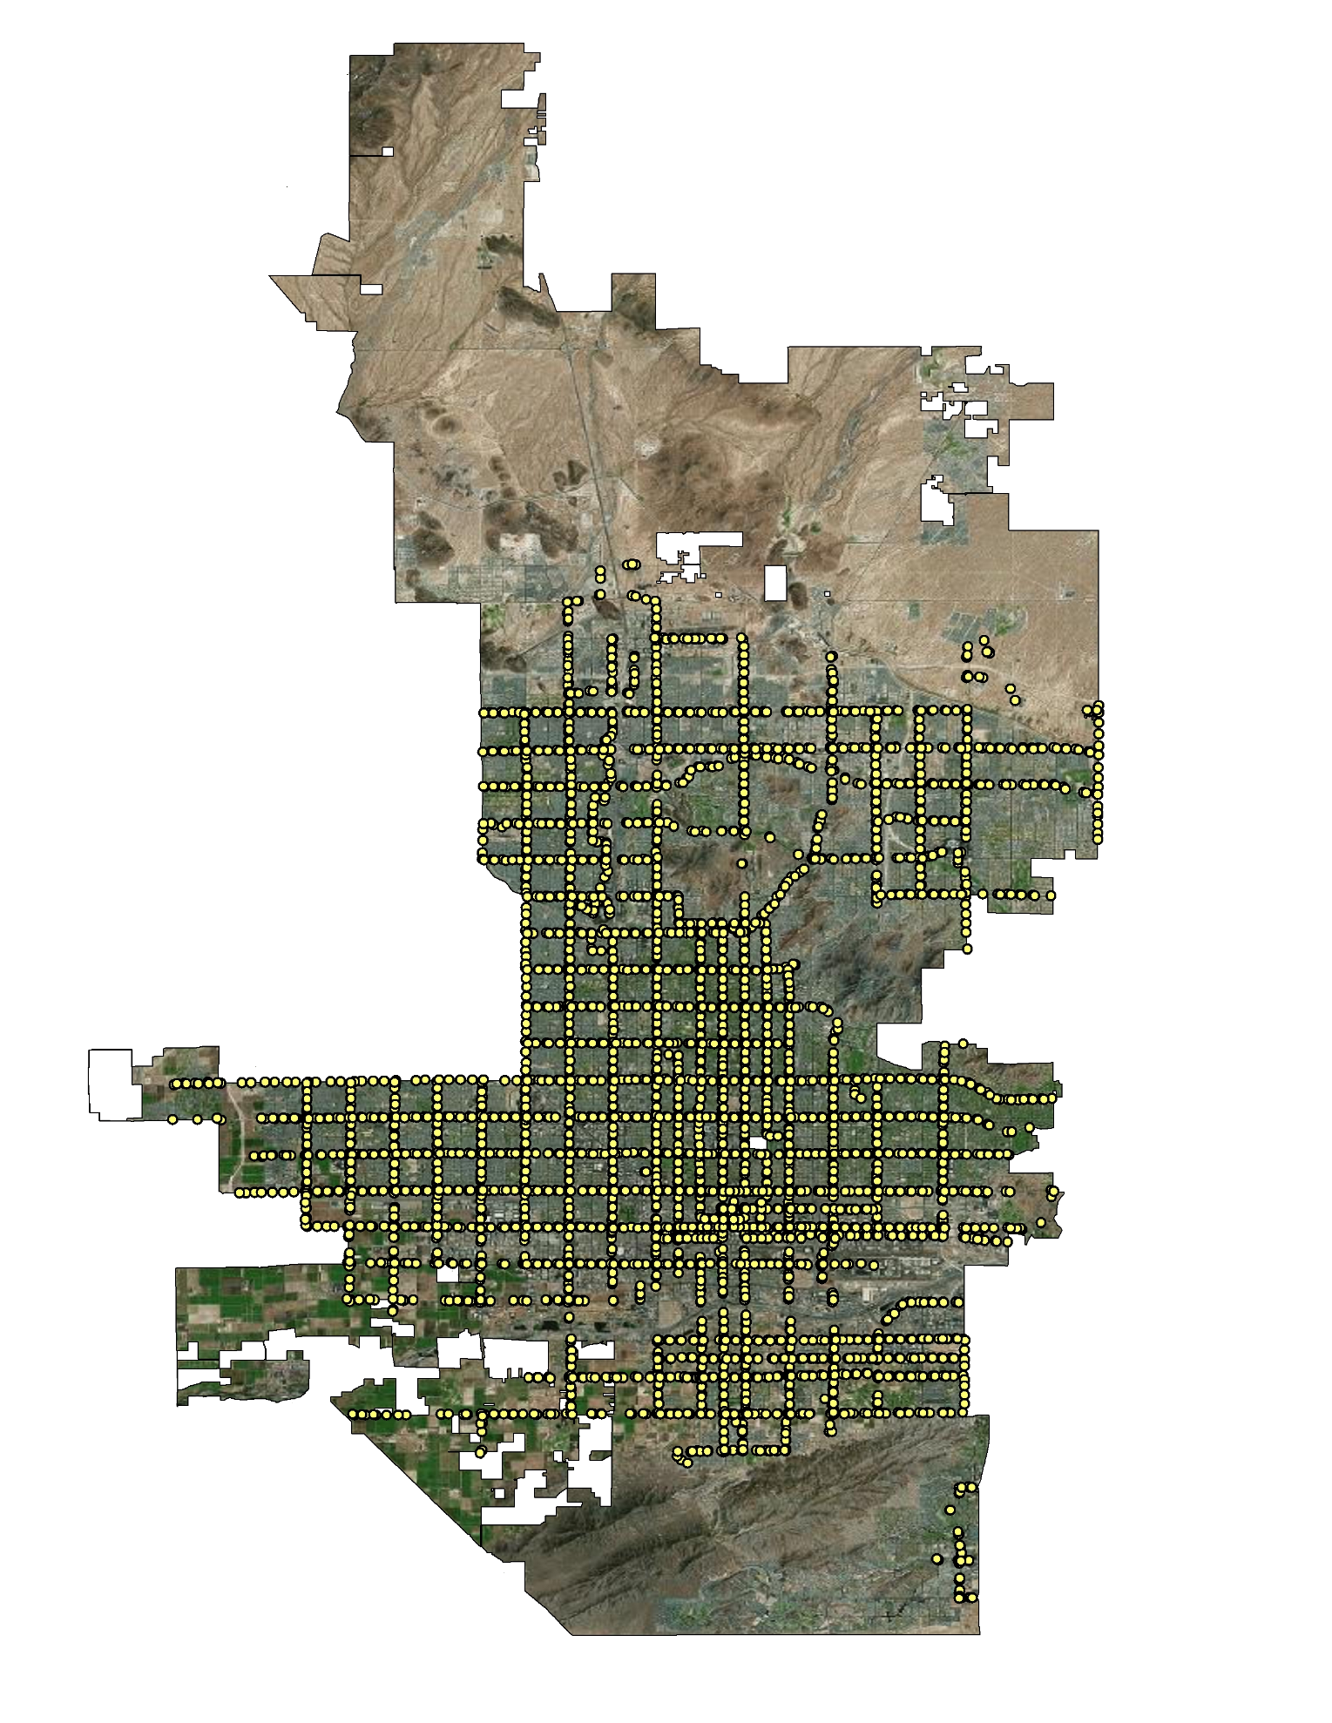
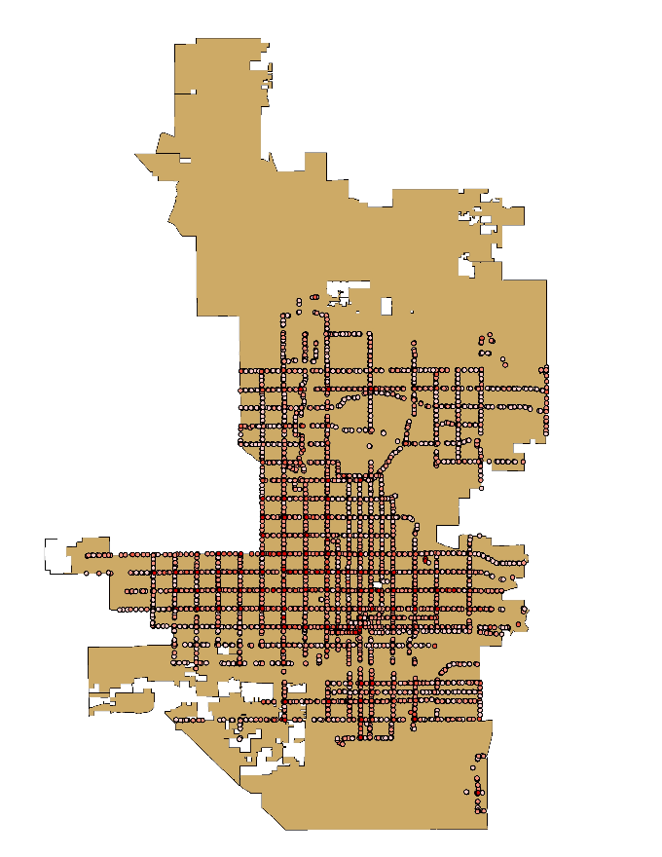
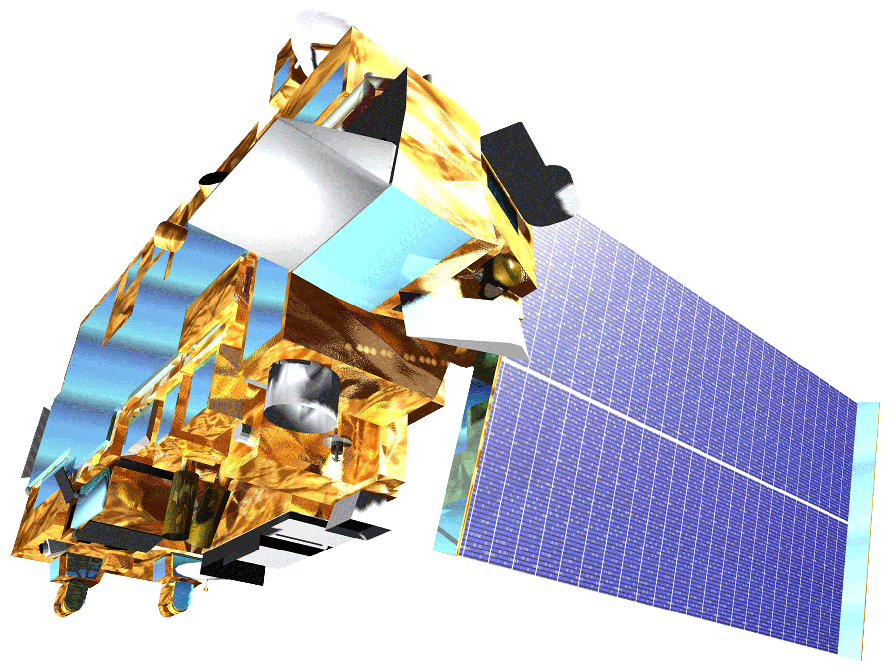
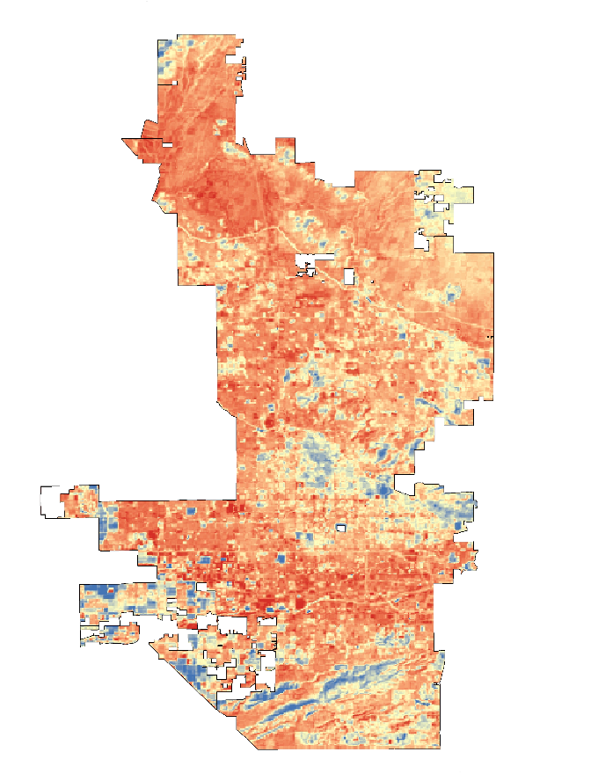
Utilizing NASA Earth Observations to
Assess the Impact of Extreme Heat on
Transit Riders in Phoenix, Arizona
Abstract
Objectives
Phoenix, Arizona is home to over 1.5 million people and summer temperatures regularly exceed 106 °F (42.1 °C). Exposure to extreme temperatures can lead to heat-related illnesses, such as heat stroke and heat exhaustion, and increased heat-related mortality. This has been a chronic public health issue that the City of Phoenix and Maricopa County Department of Public Health have heavily invested in addressing though infrastructure development and initiatives aimed at reducing the risk of heat exposure. While extreme heat is known to have a detrimental impact on the general population, it is of particular concern for the Phoenix Transit Department since bus riders are exposed to extreme heat during their trip to bus stops and while waiting for buses to arrive. The Phoenix Transit Department’s current method of determining priority for implementing improvements like shade structures is based solely upon ridership and the quality of existing structures at each stop. Using Terra Advanced Spaceborne Thermal Emission and Reflection Radiometer (ASTER) and Landsat 8 imagery, the Phoenix Health & Air Quality team enhanced the partner’s current methodology by assessing vegetation prevalence and land surface temperature around the Department’s 4,000 bus stops. Mapping information about vegetation cover and land surface temperature provided the City of Phoenix, Public Transit Department with an estimation of the radiative load riders experience at bus stops. These maps also identify bus stops that could benefit from structures that promote thermal comfort. These results will contribute to the Phoenix Transit Department’s efforts to reduce the risk of heat-related illness.
Collaborate with the Phoenix Transit Department and other local organizations to provide robust analysis of factors that affect extreme heat exposure of transit riders
Create a suitability analysis to be utilized by the Phoenix Transit Department to assist with decision making regarding the allocation of bus stop improvement funds
Integrate a series of geographic information systems overlays to identify bus stops in need of improvement and help reduce the impact of extreme heat on transit riders
Study Area
Methodology
Arizona
Bus Stop Environment and Improvement Suitability Analysis
Bus Stop Locations
Other Local Factors Such as ADA Compliance, Complaint Basis, etc.
LANDSAT NDVI
Average Bus Ridership
Currently Installed Bus Stop Amenities
ASTER Land Surface Temperature
Phoenix
Phoenix Health & Air Quality
Earth Observations
517.9 Sq. Mi.
Terra (1999)
ASTER Land Surface
Temperature (LST)
Landsat 8 (2013)
Normalized Difference
Vegetation Index
(NDVI)
Results
Vegetation
High
Riders Per Day
Low
More than 100 51 - 100 6-50
5 or Less
Bus Stops
Normalized Difference Vegetation Index
Bus Stop Current Ridership
Conclusions
Temperature
Extreme heat has a detrimental effect on transit riders in Phoenix, Arizona.
Heat can be mitigated for transit riders by implementing shelter using a multivariable analysis to determine areas in greatest need of heat relief utilizing land surface temperature and vegetation overlays.
+ 10° C
Median Temp
Amenities
- 10° C
Shelter Bench Only Nothing
Acknowledgements
Bus Stops with Satellite Imagery
Land Surface Temperature
Bus Stop Current Amenities
Dr. David Hondula, Arizona State University, DEVELOP Arizona Advisor
Lance Watkins, DEVELOP Arizona Center Lead
Team Members
Project Partners
City of Phoenix, Public Transit Department
Arizona State University, Center for Policy Informatics
Arizona State University, Urban Climate Research Center
Maricopa County Department of Public Health
Vitalyst Health Foundation
Tamara Dunbarr
Team Lead
Lance Watkins
McKenzie Murphree
Maricopa County Department of Public Health and Arizona State University – 2017 Spring

