Slide 1
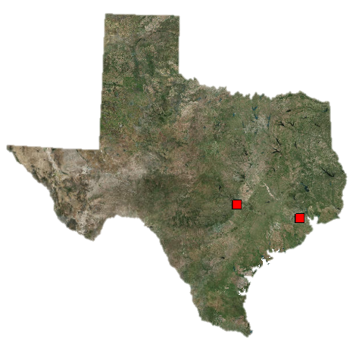
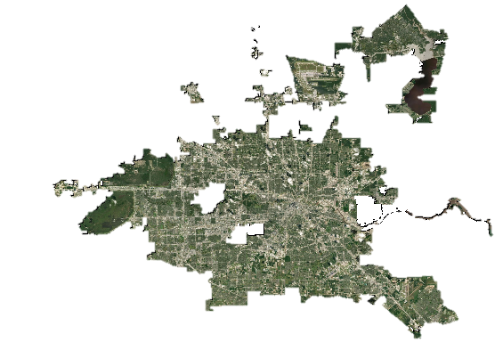
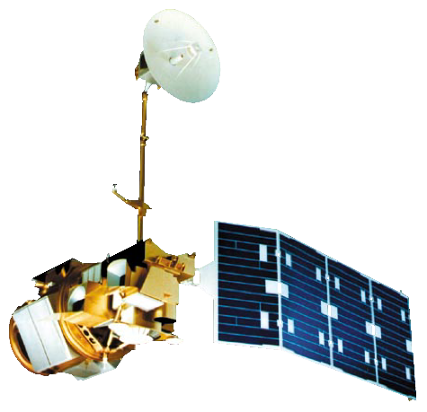
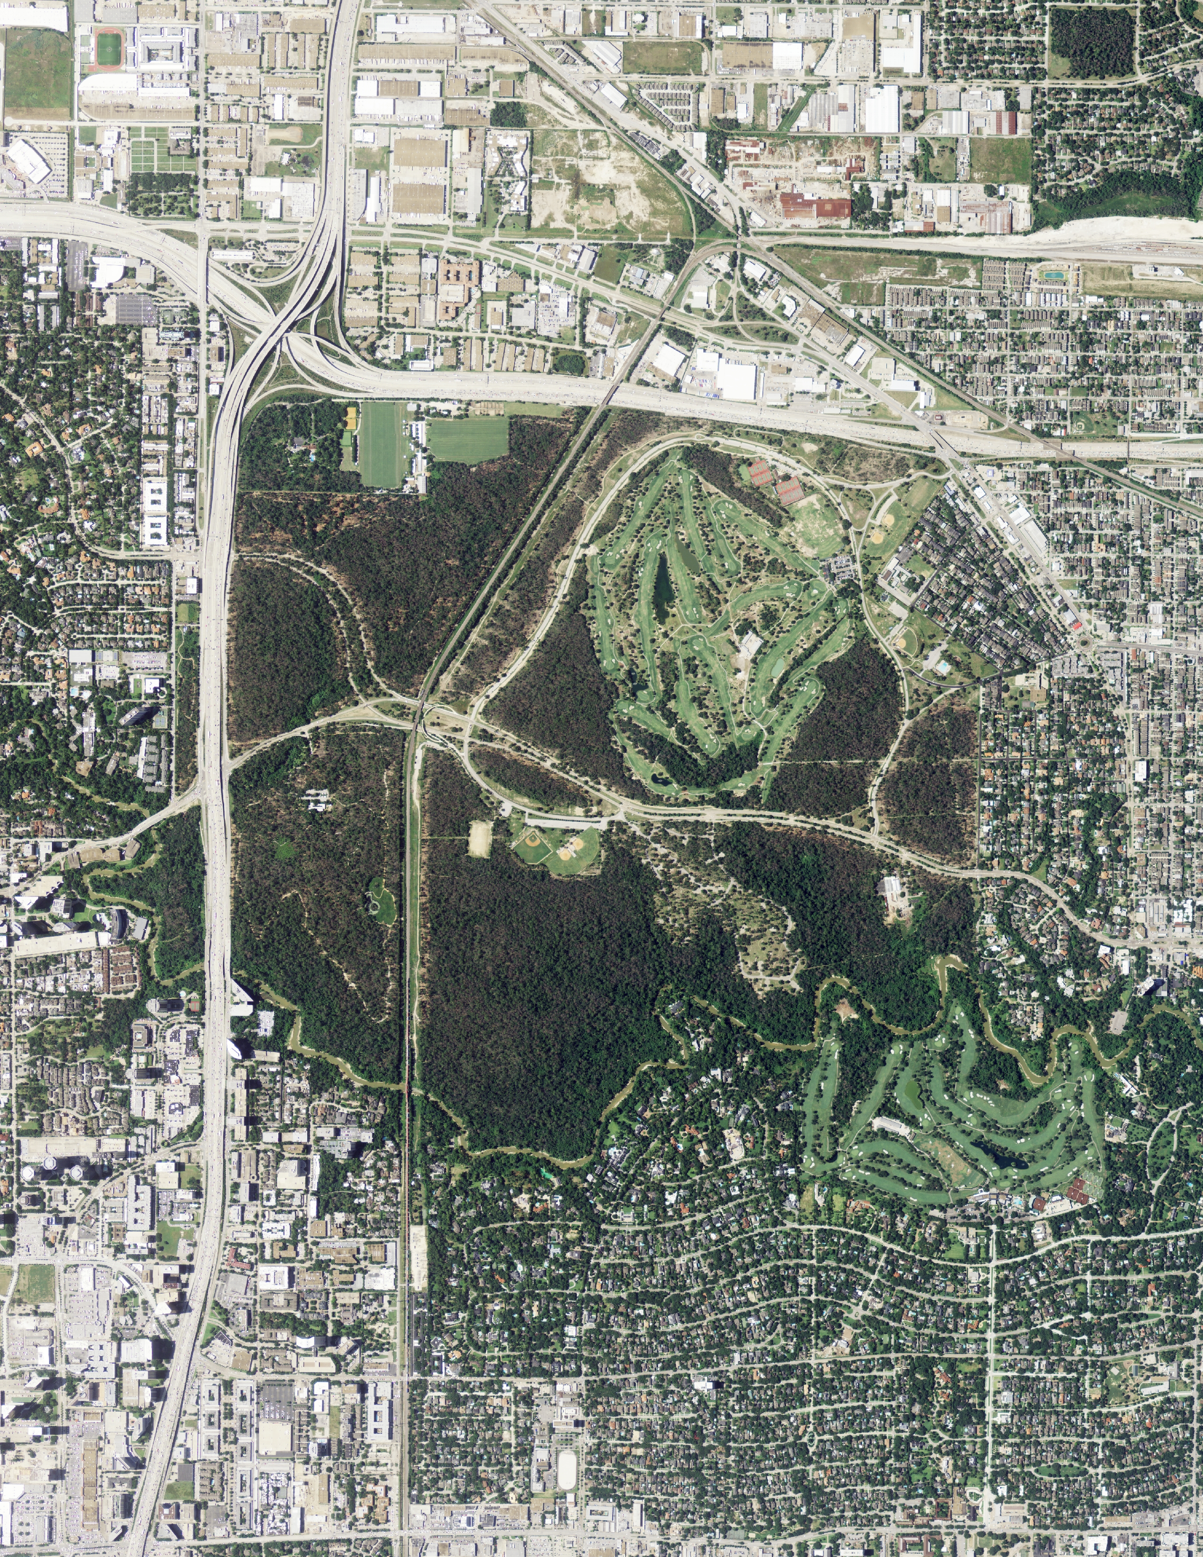
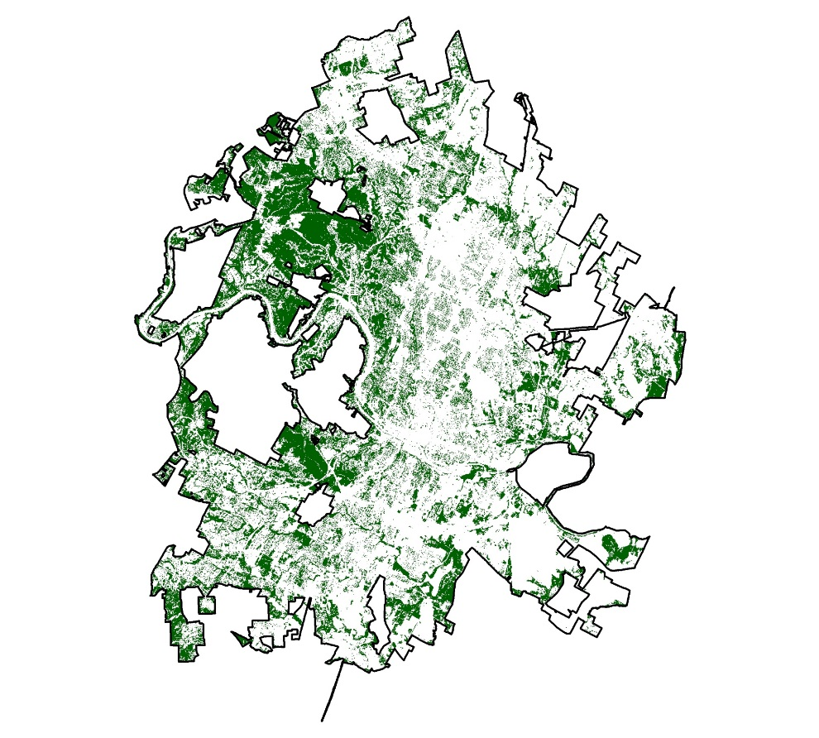
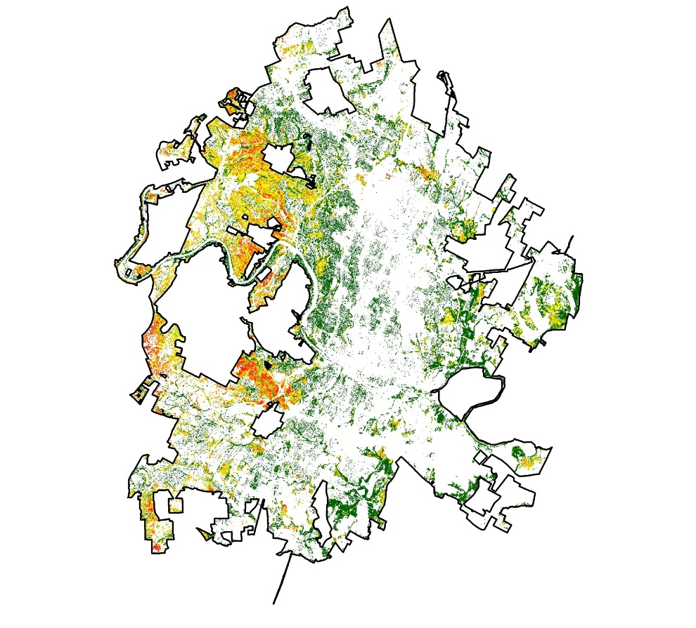
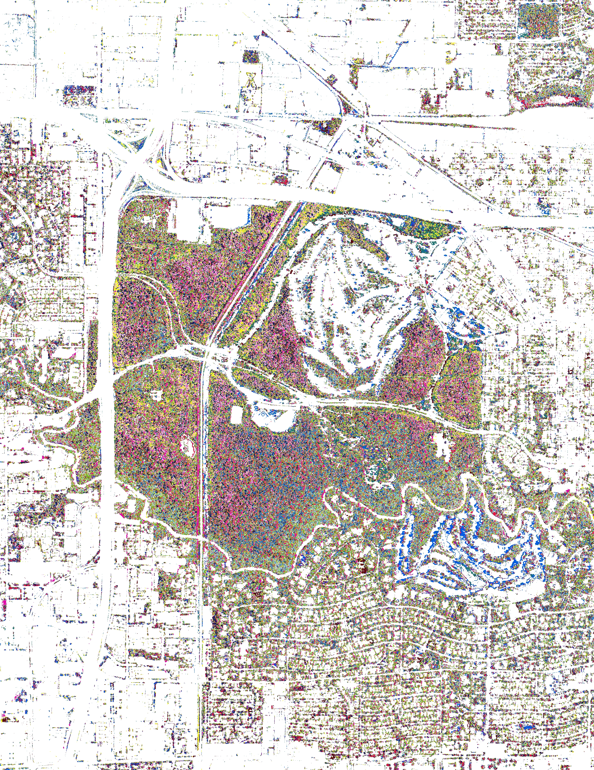
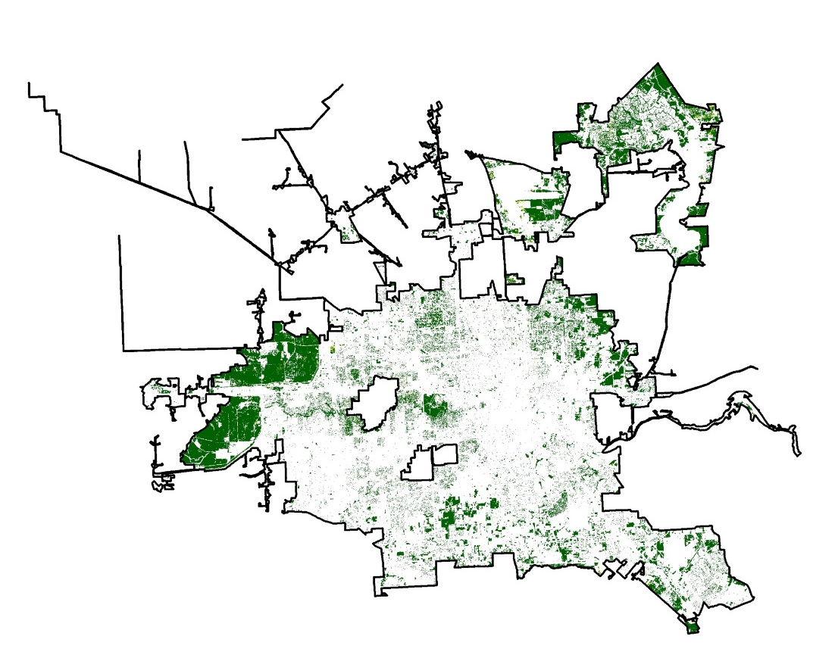
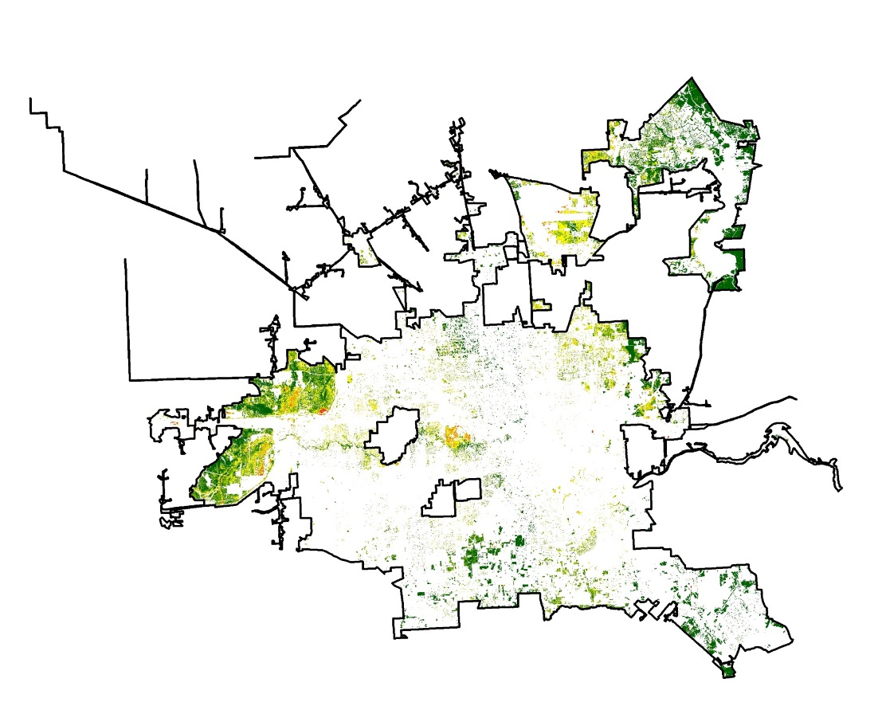
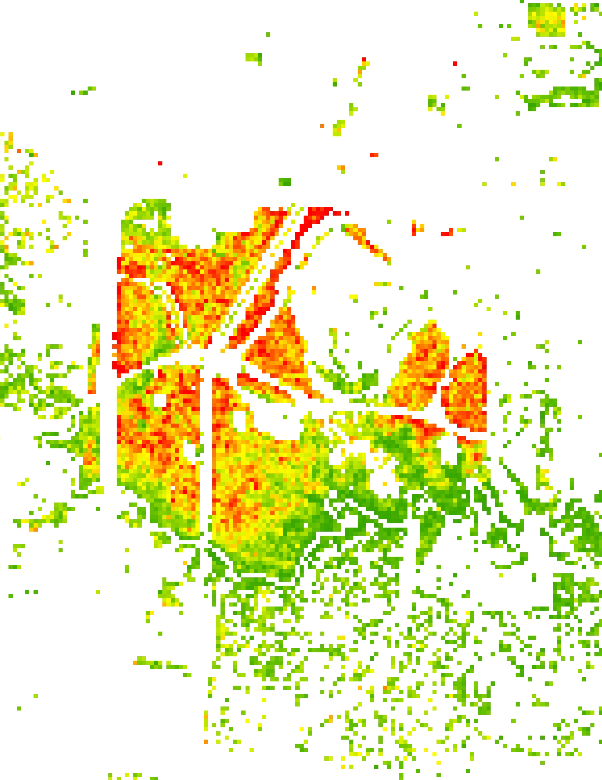
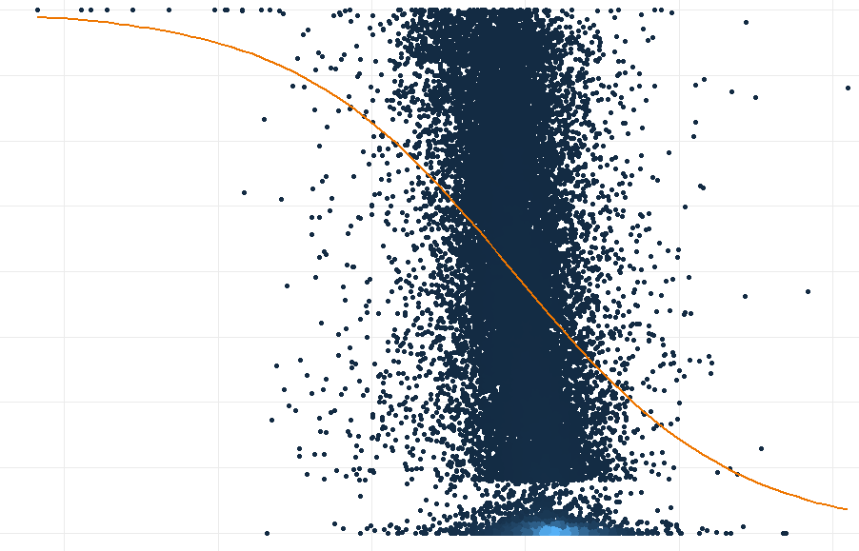
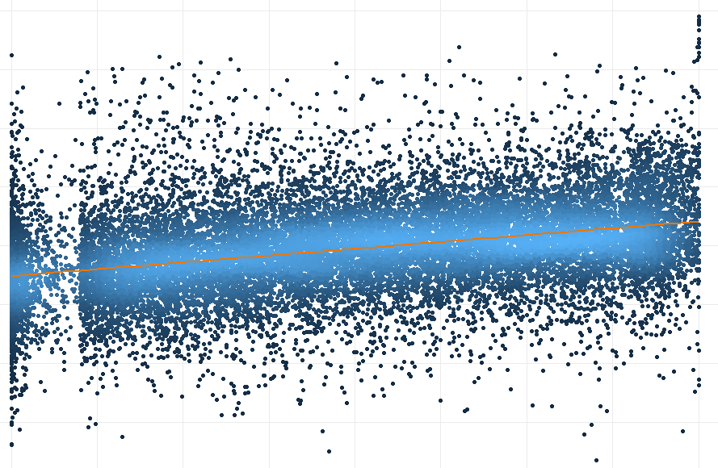
Analyzing Drought-related Impacts on Urban Tree Inventory Conditions and Recovery in Texas
Abstract
Study Area
Objectives
Texas Water Resources
In 2011, Texas experienced a severe drought that caused substantial economic and environmental losses. The Texas A&M Forest Service (TFS) estimated that 300 million trees succumbed to the severe drought conditions, with urban areas, in particular, losing about 5.6 million shade trees. For these estimations, the TFS uses resource-intensive in situ data collection methods. Studies have shown that ground-based inventories of the Urban Tree Canopy (UTC) can be augmented with remote sensing data. To explore this, the TFS Sustainable Forestry Department and the US Forest Service Southern Research Station partnered with NASA DEVELOP. For this project, our team aimed to assess pre- and post-drought canopy mortality in Austin and Houston. We implemented an unsupervised classification technique on National Agriculture Imagery Program (NAIP) high-resolution aerial imagery to determine the extent of the UTC. Then, using the Normalized Difference Vegetation Index (NDVI) derived from Landsat 5 Thematic Mapper (TM), Landsat 7 Enhanced Thematic Mapper Plus (ETM+), and Landsat 8 Operational Land Imager (OLI) data, we analyzed the relationship between NDVI anomalies and canopy mortality. Additionally, we utilized the Standardized Precipitation-Evapotranspiration Index (SPEI) derived from the National Oceanic and Atmospheric Administration’s nClimGrid dataset to give a broader context of climatic variables surrounding canopy loss. Ultimately, our results will be used by the TFS to identify areas that are likely to experience higher instances of UTC mortality and to monitor trends in recovery.
Employ NASA Earth observations (EO) and National Oceanic and Atmospheric Administration (NOAA) drought indices to monitor drought impacts
Analyze the response of UTC cover in Austin and Houston to drought using unsupervised classification methods
Investigate the relationship between NDVI anomalies and canopy mortality
Austin
Texas
0 10 20
Earth Observations
km
Landsat 5 TM
Landsat 8 OLI
Houston
Landsat 7 ETM+
Methodology
Results
Tree Cover Isolation
Mosaic NAIP imagery and calculate NDVI
Mortality Detection
Isolate tree canopy layer
Landsat Aggregation
Create texture layer to help distinguish between grass and trees
Run an Iso unsupervised classification
Run an Iso unsupervised classification to identify dead and live canopy
Aggregate percent mortality layer to 30-m resolution and filter for density
Calculate Landsat NDVI anomalies
Perform a regression analysis between NDVI anomalies and dead canopy
Reclassify dead/live canopy to create a “percent mortality” layer
Percent Mortality at 30-meter Resolution
Austin
Percent Mortality
2010
0 - 10
2012
10 - 25
25 - 50
Houston
50 - 75
75 - 100
2010
2012
2012
Prediction Model of % Canopy Mortality
Predicted vs. Observed % Mortality Rates
Conclusions
From 2010 to 2012, canopy mortality increased from 1.75% to 19.64% (Austin) and from 1.99% to 19.56% (Houston). Accuracy of classification was 82% (Austin) and 88% (Houston).
Out of four proposed logistic regression models, the model using stratified random sampling and simple NDVI anomalies performed the best, with the lowest Akaike information criterion and most accurate residual plot.
TFS can use our model and methods as a framework for comparing changes in tree canopy to NDVI anomalies derived from Landsat or other high spatial/temporal resolution sensors. Future work can incorporate ground-based measurements to refine the model and apply it to different disaster scenarios.
0 50 100
50 100
Percent
Predicted
Density
High
Low
-0.5 0 0.5
0 50 100
NDVI Anomalies
Percent
Project Partners
Texas A&M Forest Service, Sustainable Forestry Department
USDA, US Forest Service, Southern Research Station Threat Assessment Center
Acknowledgements
Team Members
We thank our advisors Dr. Jessica Matthews and Joe Spruce for their mentorship and Center Lead Andrew Shannon for his guidance. We also thank our partners Rebekah Zehnder, Burl Carraway, Lars Pomara, and Steve Norman for their expertise and insightful suggestions and comments.
Additionally, we would like to extend our thanks to the National Integrated Drought Information System (NIDIS), and to the NOAA NCEI employees that have helped support this project.
Anna Stamatogiannakis
Project Lead
Millie Smith
Nicholas Roberts
Sally Ross
North Carolina – NCEI | Spring 2019

