Slide 1
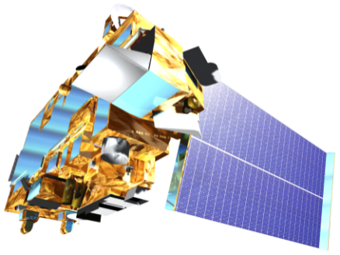
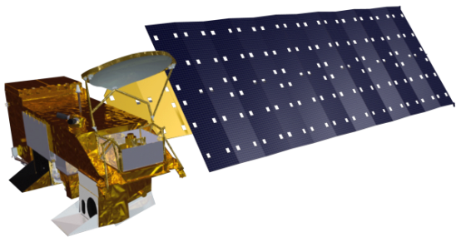
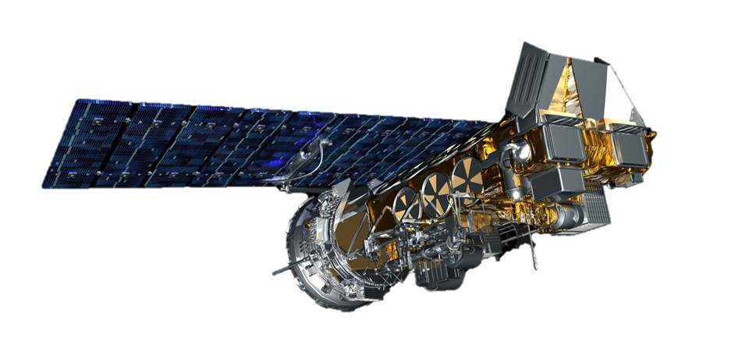
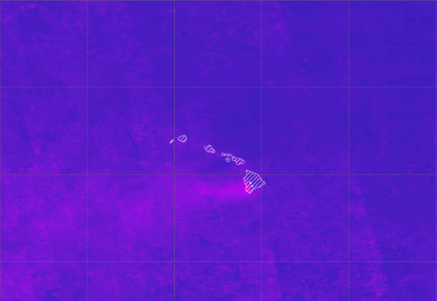
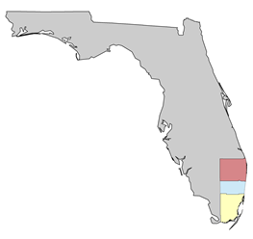
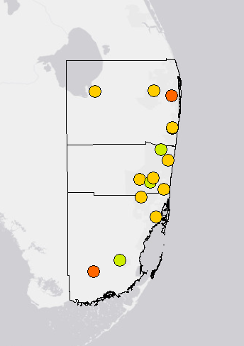
Understanding the Temporal and Spatial Variation of Air Quality to Support the Use of NASA Earth Observations
Abstract
Study Area
Outdoor air pollution can have severe impacts on human health, with particulate matter (PM) contributing to an estimated 800,000 premature deaths each year. The Environmental Protection Agency (EPA) and the Centers for Disease Control and Prevention (CDC) provide air quality assessments to properly mitigate such adverse health effects. The EPA monitors air quality levels for the United States with AirNow by using in situ data to provide real-time air quality updates. This tool is limited to locations of monitoring stations covering the terrestrial United States. As a result, there is no long-term record of air quality measurements for the US coastlines. This project utilizes NASA’s Aerosol Optical Depth (AOD) and NOAA’s Aerosol Optical Thickness (AOT) datasets to create a long-term analysis of coastal Hawaii and Florida air quality from January 1981 to December 2015. This analysis will be used to identify trends in aerosol concentrations across months, seasons, and significant events. Satellite and ground station data verification will provide quantitative support for incorporating satellite data into both the EPA’s and CDC’s current air quality reporting efforts and further serve their needs by building the foundation for comprehensive air quality studies.
Hawaii Coast
Earth Observations
NASA Terra MODIS
0.1° resolution daily
NASA Aqua MODIS
0.1° resolution daily
NOAA AVHRR
0.1° resolution monthly
Florida Coast
Methodology
Regression Analysis &
Data Verification
Objectives
Research
Data Processing
Statistical Evaluation
Create a comprehensive climatology for Hawaii and Florida to aid the EPA and CDC in assessing abnormally high aerosol estimates
Analyze long-term trends in air quality levels through seasonal variations and case studies with Hawaii’s VOG and Florida’s sugarcane burning events
Evaluate satellite and in situ aerosol measurements using statistical methods
Trend
Analyses
Climatologies
Anomalous
Events
Data Acquisition
Data Analysis
End-Product Creation
Coastal US Health & Air Quality
NASA
MODIS
in situ
PM_{2.5} PM₁₀
NOAA
AVHRR
Data Download
Long-Term Study
Statistical Support for Satellite Integration
Conclusions
Results
The map above displays mean July aerosol levels for 2002 – 2015 based on Hawaii Aqua MODIS AOD data. Darker colors represents low aerosol levels and lighter colors represent high aerosol levels. The pink cluster demonstrates elevated aerosol levels emitted from Kilauea Volcano, HI.
Jan-1981
Jan-1984
Jan-1987
Jan-1999
Jan-2002
Jan-2005
Jan-2008
Jan-2011
Jan-2014
Jan-1982
Jan-1983
Jan-2000
Jan-2001
Jan-2009
Jan-1985
Jan-2003
Jan-2010
Jan-2012
Jan-1986
Jan-1990
Jan-1993
Jan-1996
Jan-2004
Jan-2013
Jan-2015
Jan-1991
Jan-1988
Jan-1992
Jan-1994
Jan-1989
Jan-1995
Jan-1998
Jan-2007
Jan-1997
Jan-2006
The graph above demonstrates the general pattern for monthly AOT, AOD, and ground station PM2.5 measurements in Miami Beach, Florida. Moving averages are included for better visualization of overall aerosol trends from 1981 – 2015. The shaded region highlights a period in which all three datasets align fairly well.
Conclusions
AOT and AOD values follow similar trends as ground station PM2.5 values when comparing monthly averages from 1981 - 2015.
Satellite-observed measurements generally show a stronger correlation with in situ values in Florida than they do Hawaii, possibly due to the high variability of Hawaii’s wind regimes.
Providing satellite-derived climatologies to our end-users will enable them to incorporate long-term aerosol trends into further studies.
The graphic to the right represents correlation values between MODIS AOD measurements and ground station PM2.5 observations. Three Florida counties with high population densities were selected (top-bottom): Palm Beach, Broward, and Miami-Dade. A majority of the stations show correlation values over 0.2, representing an overall low positive correlation between satellite and ground station measurements.
<0.0
Correlation Coefficient
0.0 – 0.2
0.2 – 0.4
0.4 – 0.6
0.6 – 0.8
0.8 – 1.00
Team Members
Project Partners
Acknowledgements
We would like to thank Annette Hollingshead, Science Advisor, Global Science and Technology, Dr. Xuepeng Zhao, NCEI , Alec Courtright, Center Lead at NOAA NCEI, Emma Baghel, Assistant Center Lead at NOAA NCEI and the US EPA and CDC, end-users.
Any opinions, findings, and conclusions or recommendations expressed in this material are those of the author(s) and do not necessarily reflect the views of the National Aeronautics and Space Administration. This material is based upon work supported by NASA through contract NNL11AA00B and cooperative agreement NNX14AB60A.
Christie Stevens
Project Lead
Toni Strauch
Alec Courtright
Environmental Protection Agency
Centers for Disease Control and Prevention
National Oceanic and Atmospheric Administration
NOAA National Centers for Environmental Information – Summer 2016

