Slide 1
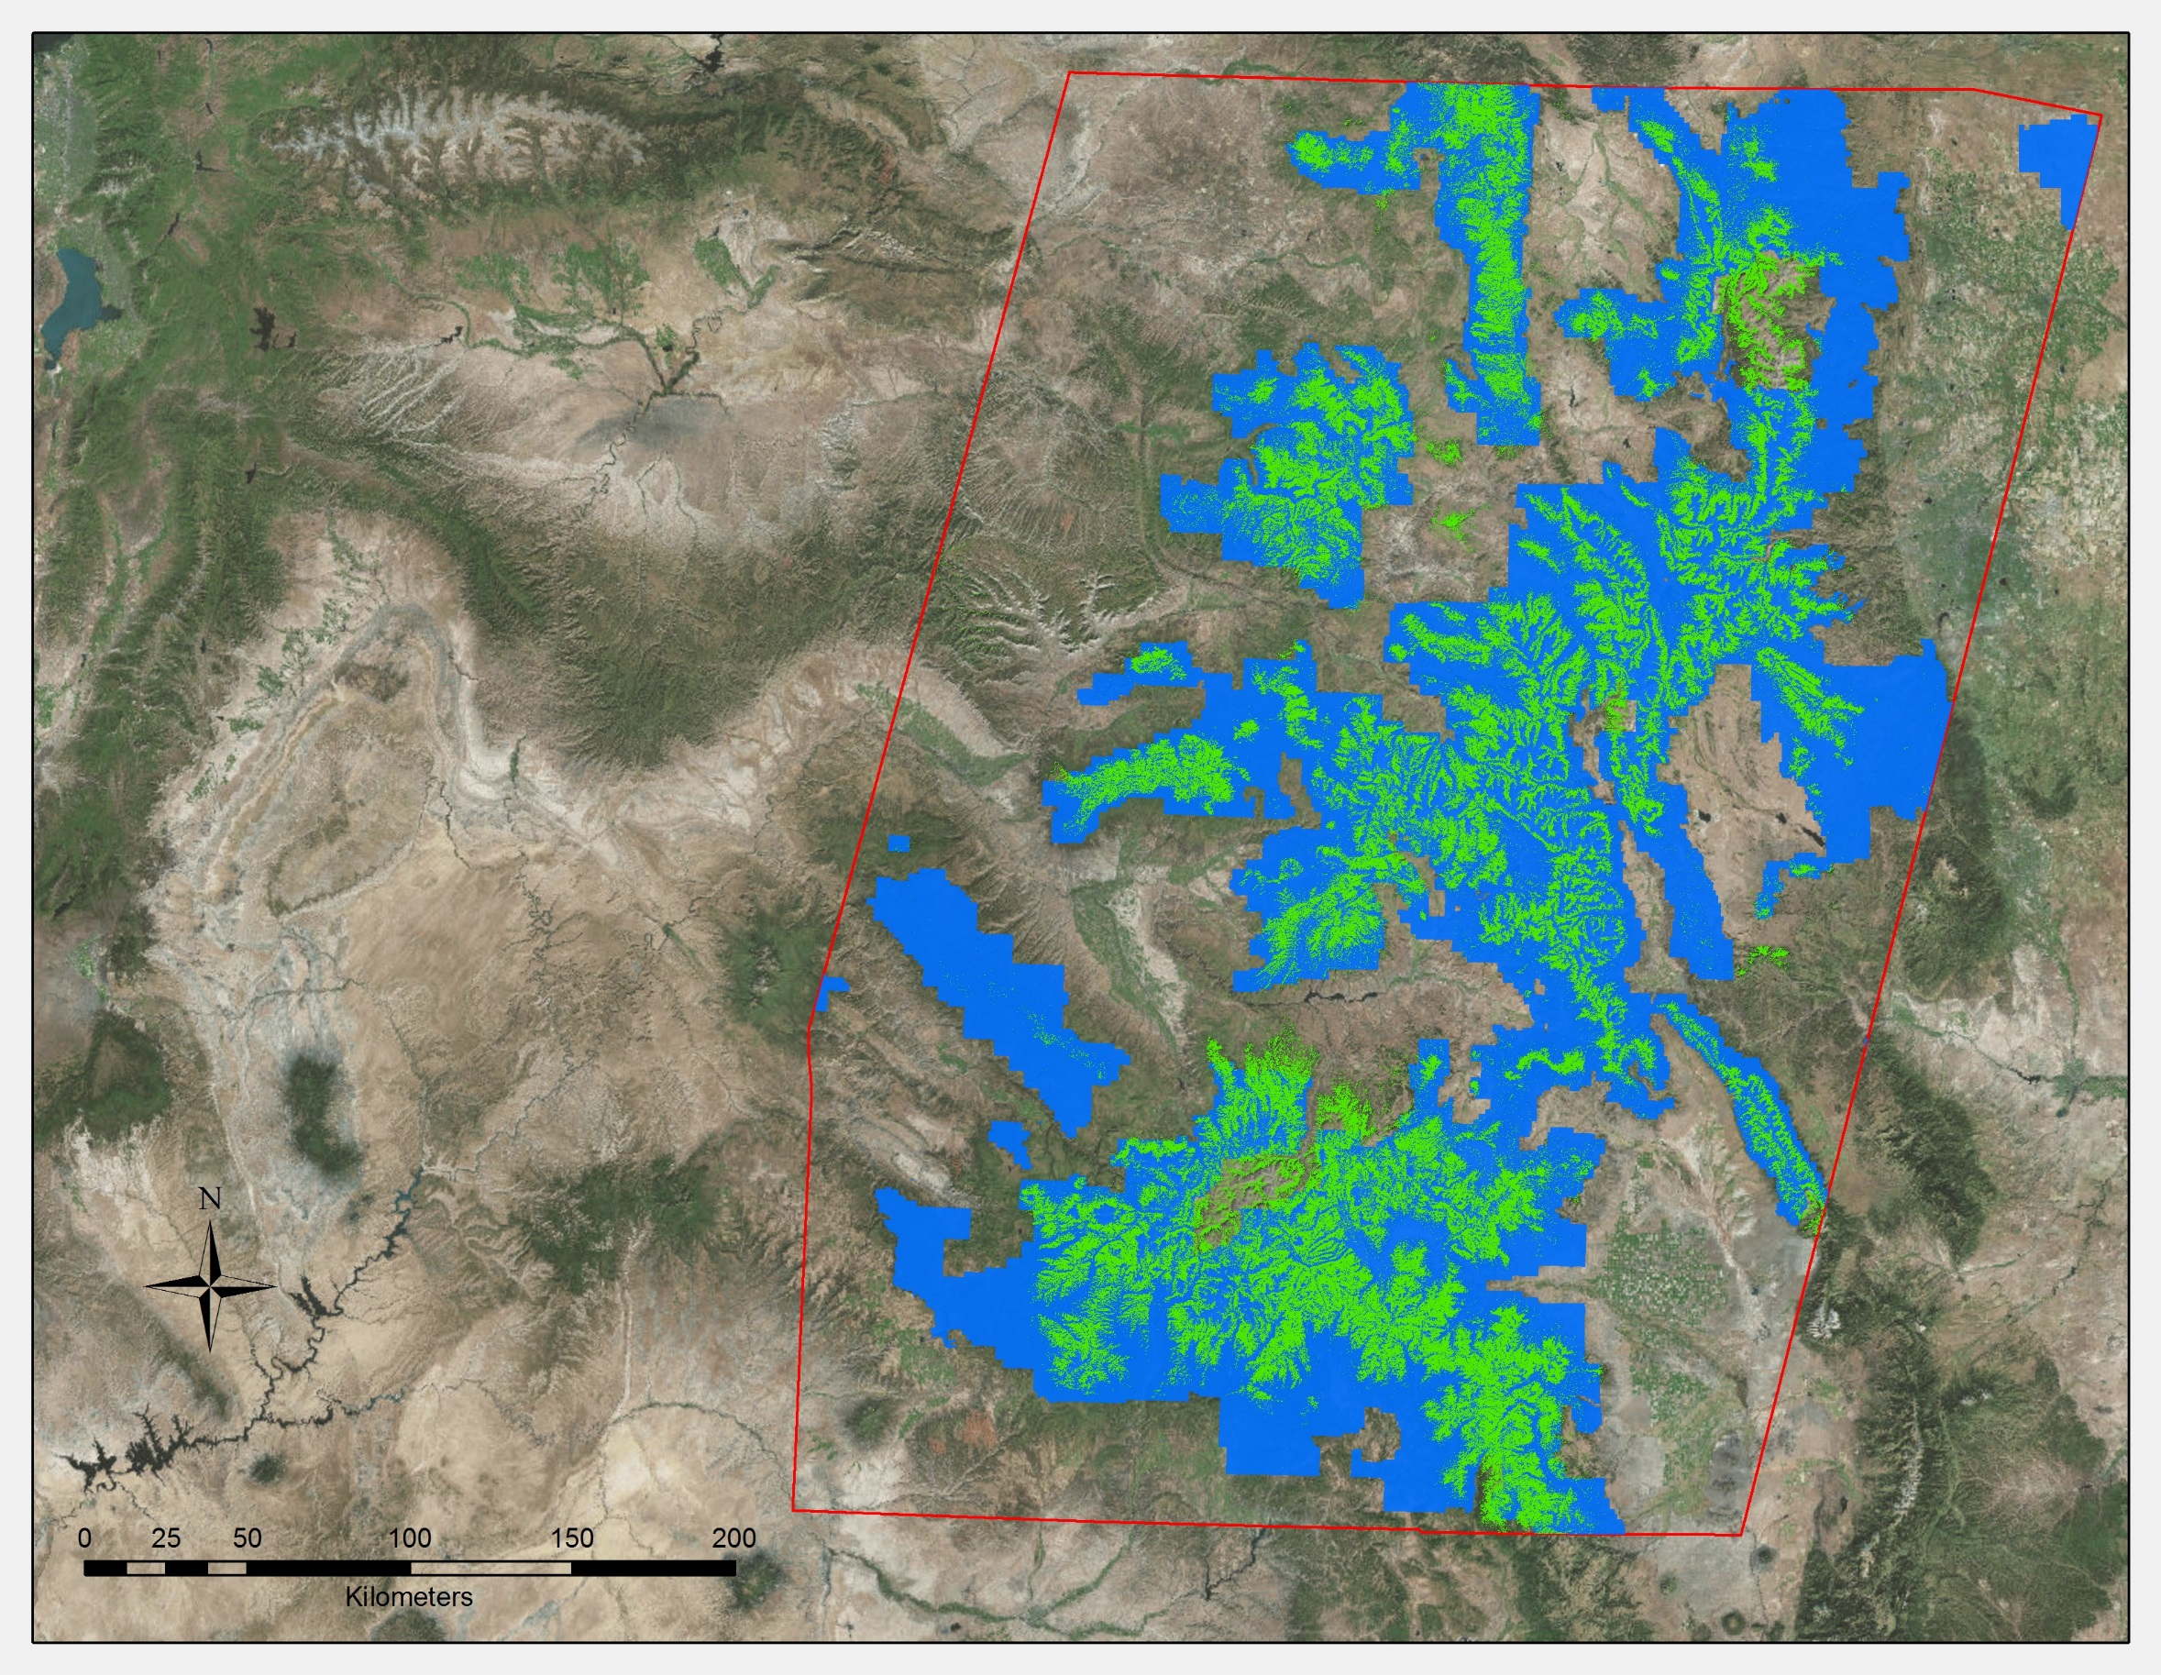


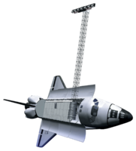
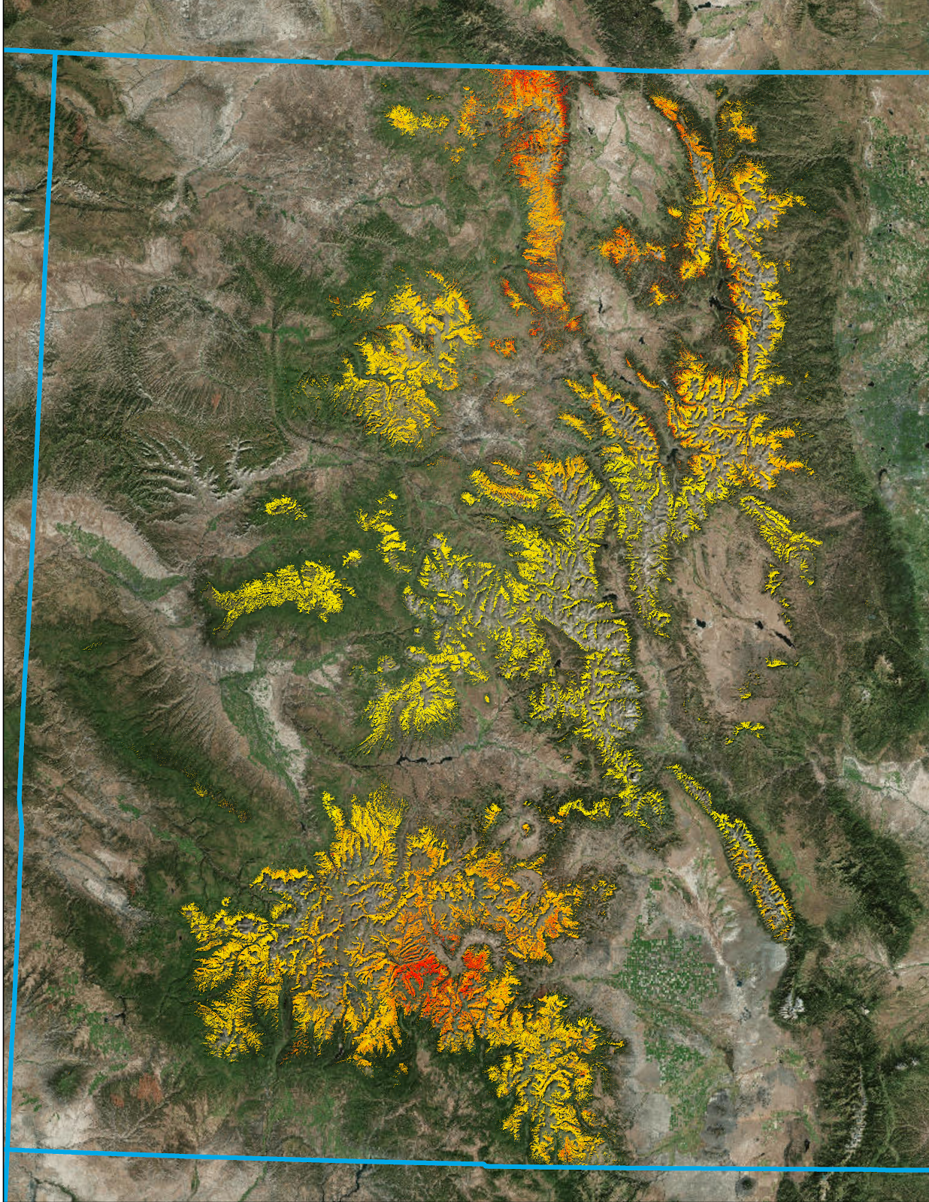
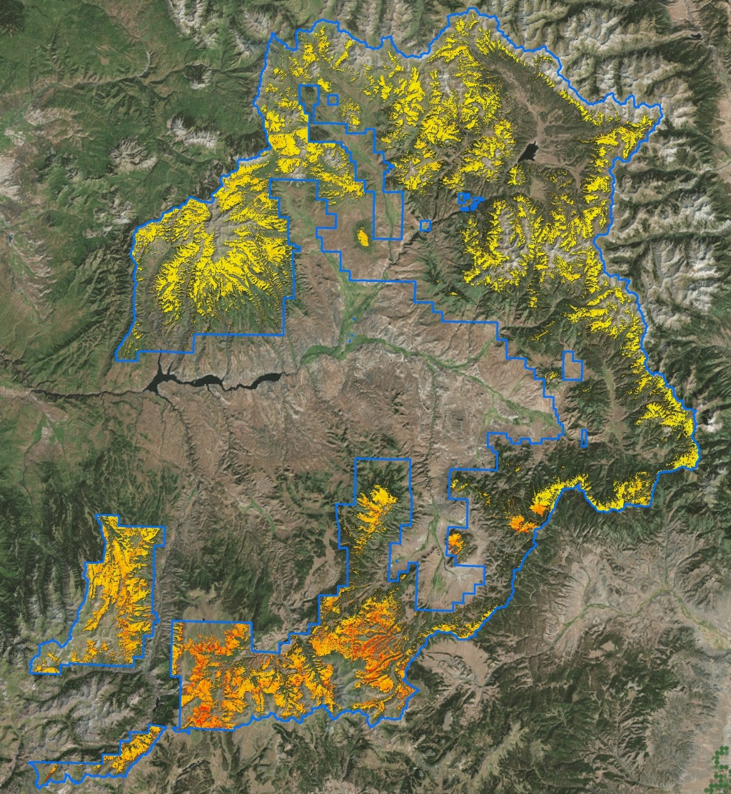
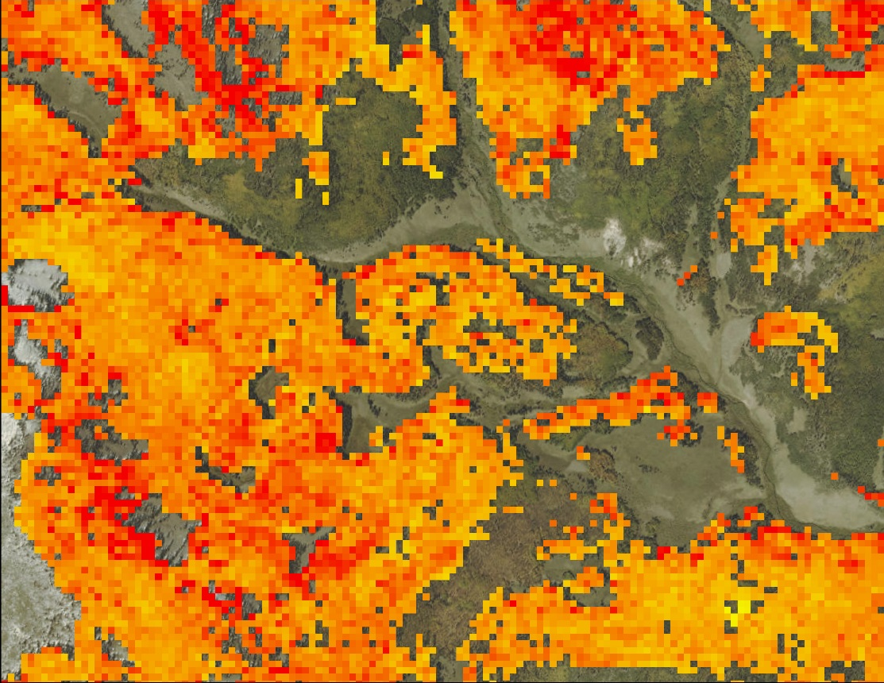
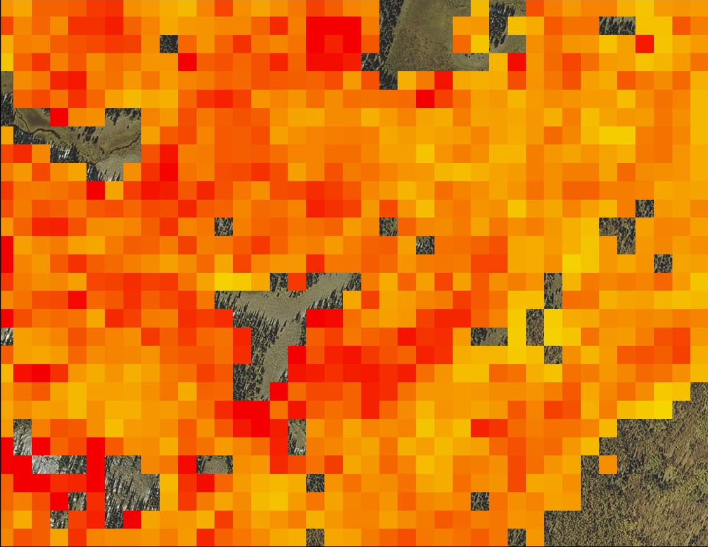
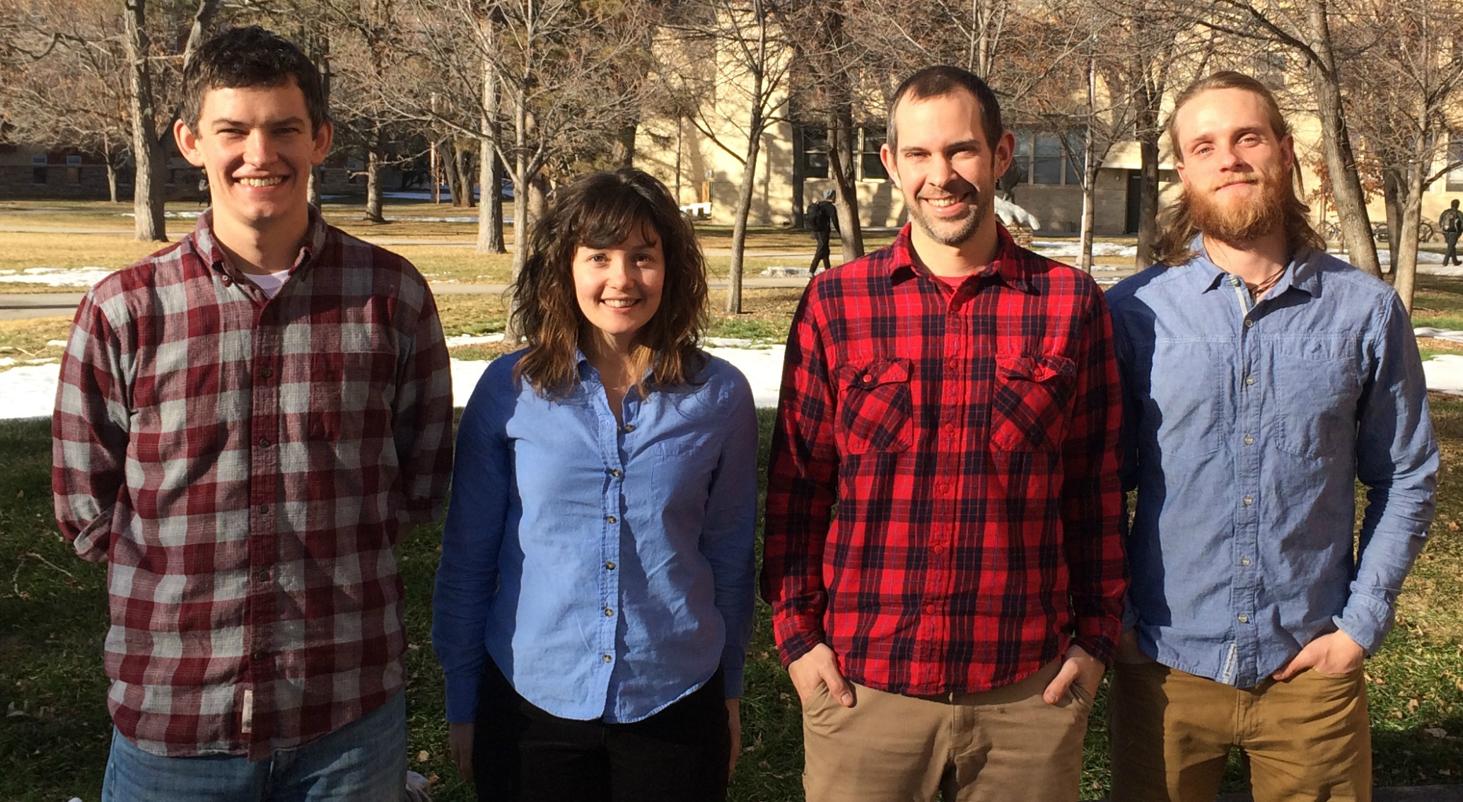
Gunnison National Forest Agriculture
Mapping spruce beetle outbreak severity and distribution in Gunnison National Forest using Landsat and integrative spatial modelling
Eric Rounds (Project Lead), Sarah Carroll, Oliver Miltenberger, Peder Engelstad
DEVELOP National Program at USGS at Colorado State University, Fort Collins
Abstract
Objectives
Over the last fifteen years, Colorado forests have experienced epidemic bark beetle outbreaks with increasing severity. The outbreaks have wide-reaching impacts on forest health, wildlife habitat, wildfire regimes, and the safety of recreational forest users. These impacts are of great concern to land managers and project partners at the US Forest Service (USFS) who are working to maintain ecological integrity and safe public access in national forest lands. While there is substantial research focused on mountain pine beetles (Dendroctonus ponderosae), there are fewer resources available to land managers concerned with the ongoing spruce beetle (Dendroctonus rufipennis) outbreak, which is currently the largest active outbreak in Colorado. This project utilized Landsat 8 Operational Land Imager (OLI), Thermal Infrared Sensor (TIRS), Landsat 5 Thematic Mapper (TM), and high-resolution Microsoft Global Ortho Program imagery to produce spruce mortality data. These data were utilized in an integrative spatial model developed by researchers at Montana State University’s Spatial Sciences Center to produce a fine scale map of spruce mortality across Colorado for the year 2011. This product provides a baseline of spruce mortality that can be utilized by partners to model mortality for more recent years. To facilitate this, we processed imagery for the years 2013 and 2015 and constructed a novel, repeatable sampling method protocol. These products have the potential to be an improvement on the roughly estimated maps available to our partners and will be used to plan treatment operations and estimate aboveground biomass in the study area.
Create reference data using a novel data collection methodology
Produce fine scale maps of spruce mortality in southwest Colorado
Inform forest management plans that address wildlife habitat analyses and biomass estimation
Study Area
Methodology
Legend
Classify Land Cover (live/dead trees) within 30m pixels using 1m resolution imagery
Calculate percent mortality of trees for each randomly selected pixel
Spruce-Fir Forest
Reference Data
Reference Data Creation
Imagery Processing
Model Processes
Inputs
Outputs
National Forest Lands
Creating Model Inputs
Study Area
Imagery Processing
Stack 2006/13 & 2015 imagery separately and clip to study area
Extract spectral values of stack layers that correspond to each reference data point
Model Step 1
Binary classification
Presence = 1
Absence = 0
Binary map of study area
Percent Mortality & Spectral Values of reference points
Combine outputs to create final map of spruce mortality in southwest Colorado
Earth Observations
Model Step 2
Continuous classification of study areas for each species
Continuous Map of Study Area
Results
Colorado Spruce-Fir Forests Mortality Percent Cover
Shuttle Radar Topography Mission (SRTM)
High: 61
Landsat 8 OLI & TIRS
Landsat 5 TM
Low: 1
Colorado Boundary
Conclusions and Future Studies
Our novel methodology is effective in training these models, and is reasonably efficient and repeatable both within this study area and elsewhere.
The continuous spruce mortality map will provide a baseline of data and supplement current records to support operations both for end-users’ management decisions and future scientific inquiries.
Integrating the 2006, 2013, and 2015 processed data will show trends in spread over time, and can be created at finer scale.
Gunnison District Spruce-Fir Forests
Mortality Percent Cover
High : 47
Low : 1
Gunnison National Forest Boundary
Team Members
Project Partners
Acknowledgements
Bioenergy Alliance Network of the Rockies (BANR)
Spatial Sciences Center, Montana State University
Natural Resource Ecology Laboratory (NREL)
USFS, Gunnison District
USFS Rocky Mountain Research Station
This project was made possible through the support and mentorship of select individuals and organizations. We extend a kind thanks to the following:
Dr. Paul Evangelista, Colorado State University (CSU), Natural Resource Ecology Laboratory (NREL)
Tony Vorster, CSU, NREL, Bioenergy Alliance Network of the Rockies (BANR)
Brian Woodward, DEVELOP - Fort Collins Center Lead
Shannon Savage, Spatial Sciences Center of Montana State University (MSU)
(Left to Right): Eric Rounds, Sarah Carroll, Peder Engelstad, and Oliver Miltenberger
NASA DEVELOP National Program USGS at Colorado State University

