Slide 1
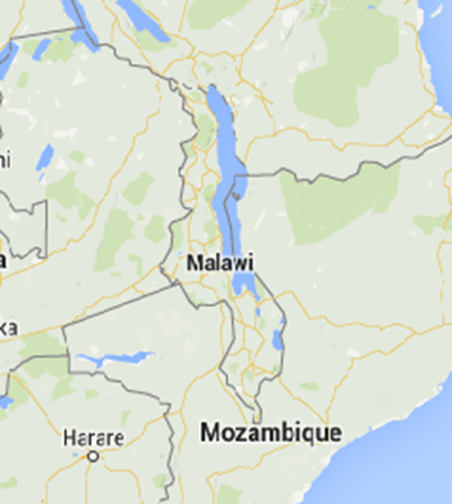
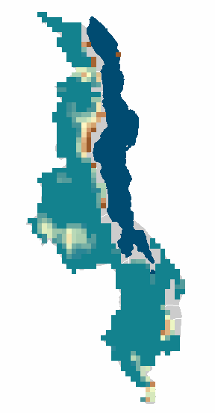
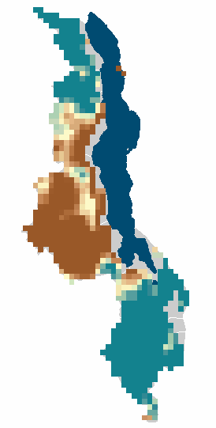
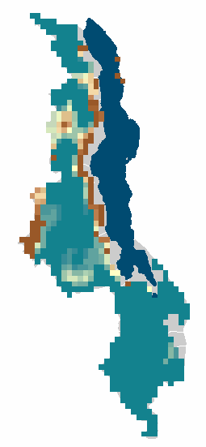
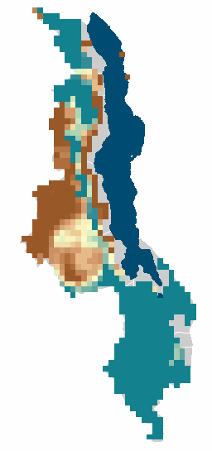
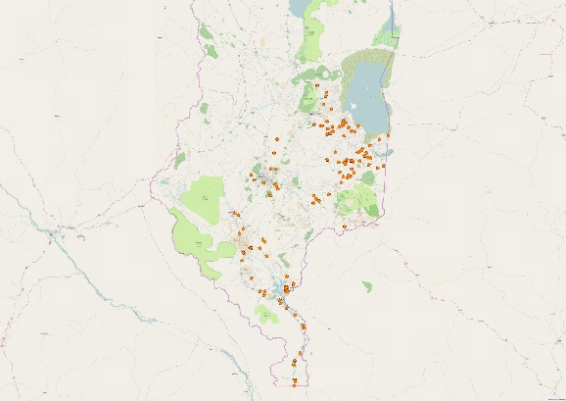
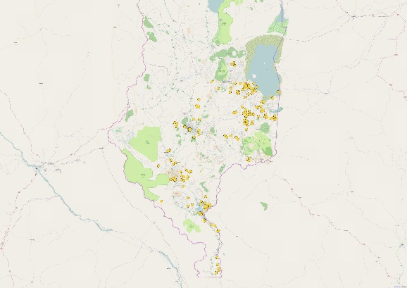
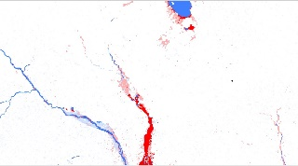
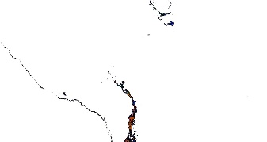
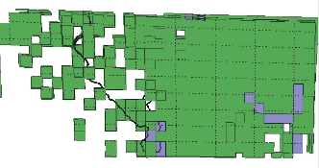
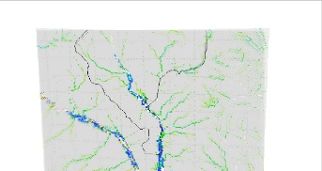
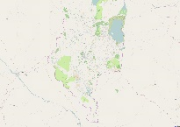
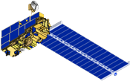
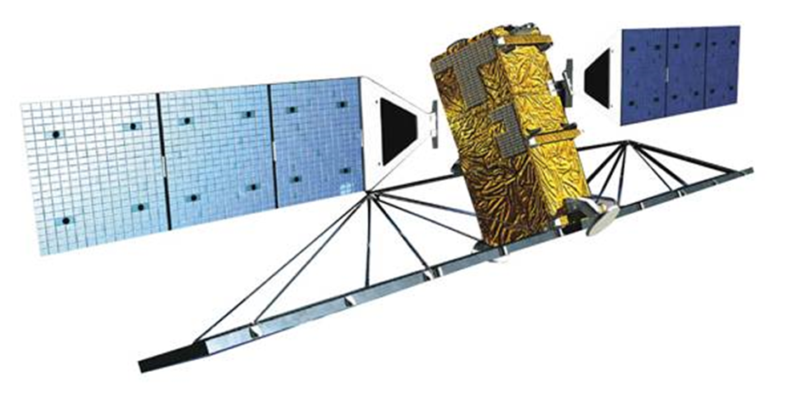
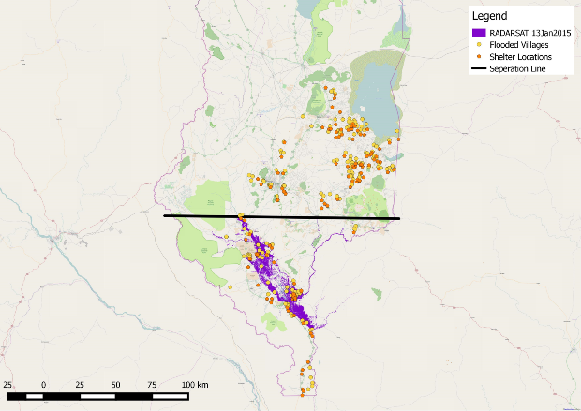
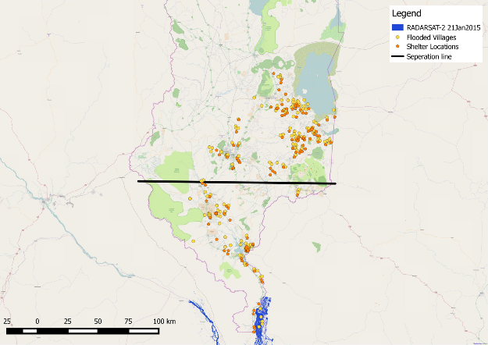
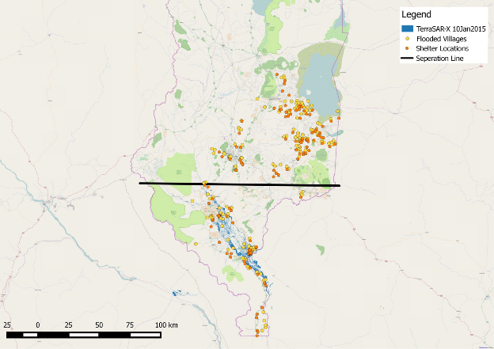
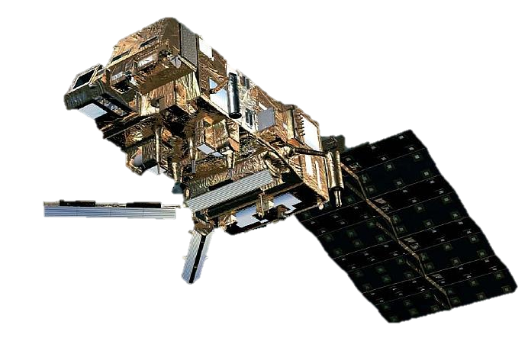
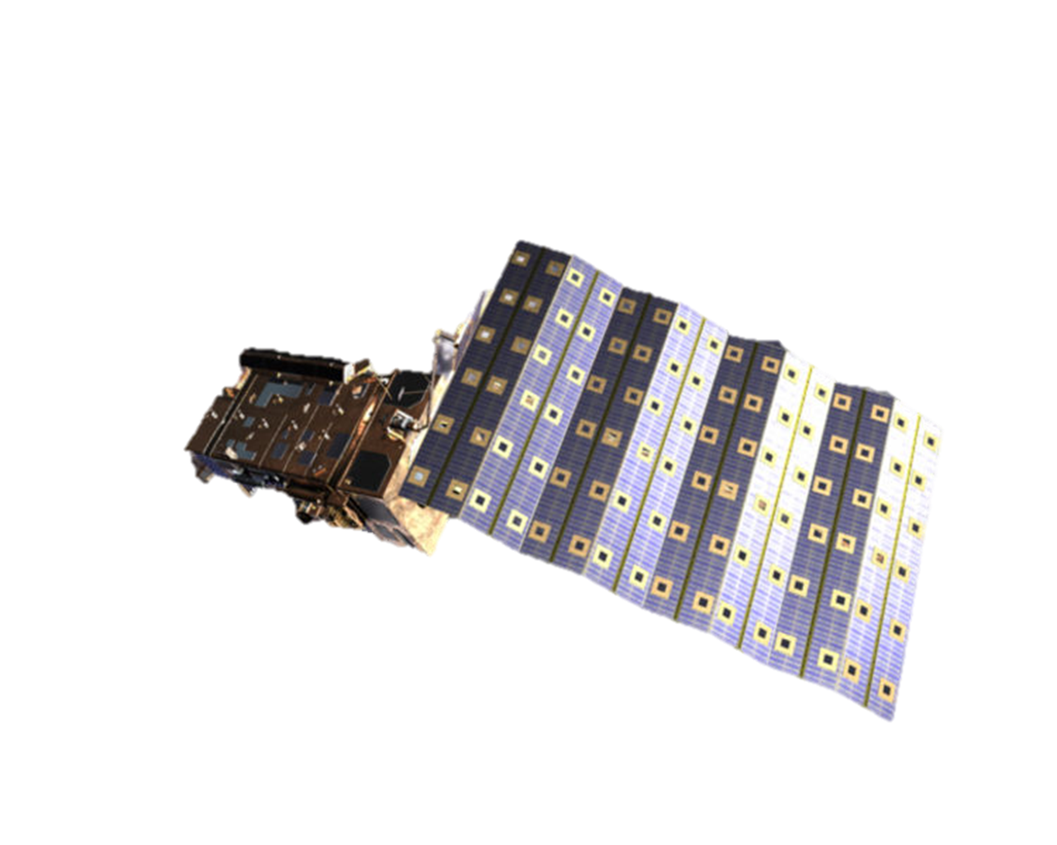
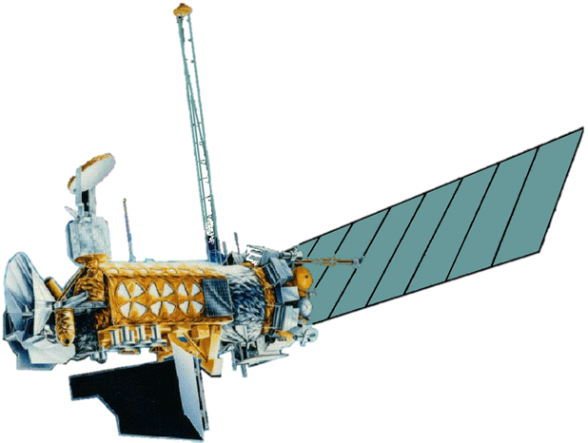
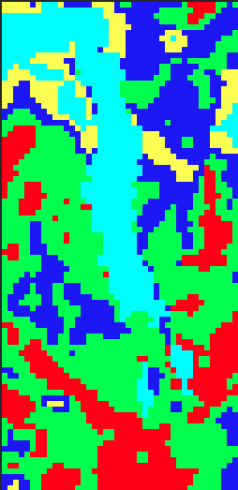
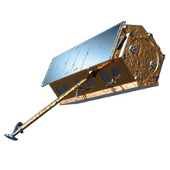
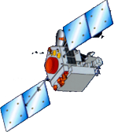
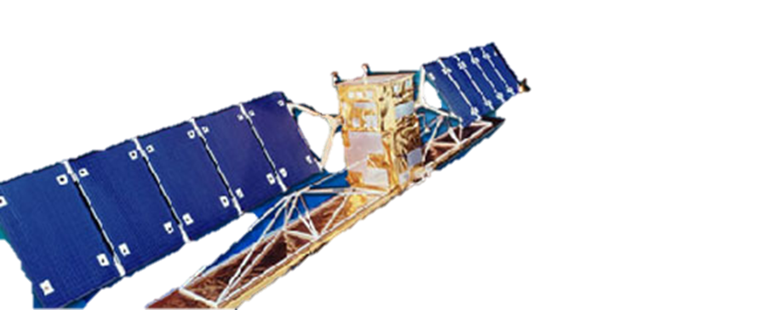
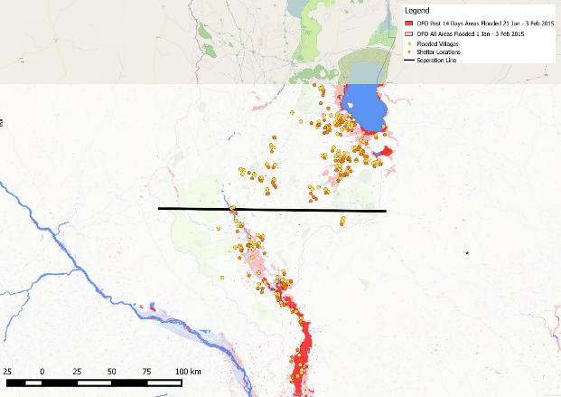
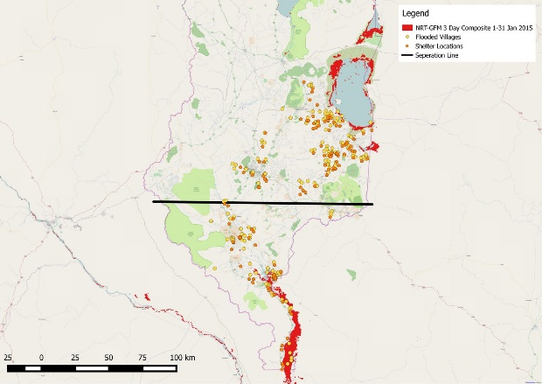
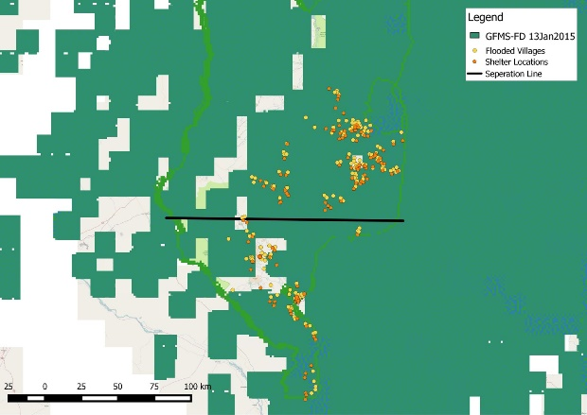
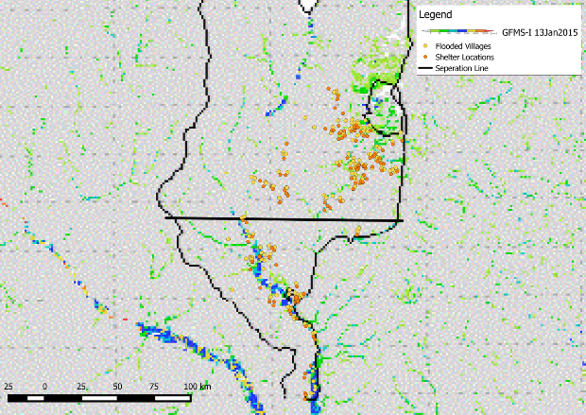
Malawi Disasters II
Applications of Flood Definitions and NASA Earth Observations to Create a Flood Forecasting Methodology
Andrew Kruczkiewicz (Project Lead), Helen Cen, Brigitte Moneymaker
International Research Institute for Climate and Society
Abstract
Objectives
Keep this blank for now.
Body text point size should be at least 24.
Caption text point size should be at least 16.
Feel free to rename, move, and resize sections as needed.
Use the January 2015 floods in Malawi to compare various inundation detection tools
Validate flood maps with ground truth data provided by the Malawi Red Cross
Explore soil moister detection products in relation to flooding
Study Area
Malawi
Study Period: January 2015
Methodology
Flood Product
Soil Moisture Product
Acquire & Process Ground Truth Data
Group Flood Products
Comparison & Validation
Group 1: SAR Products (Zoomed-in)
Flooded Villages Layer
Flood Detection Products (RADARSAT, RADARSAT-2, TerraSAR-X, DFO, NRT-GFM, GFMS-FD, & GFMS-I)
Shelter Sites Layer
Base Layer (Open Street Map)
RADARSAT
RADARSAT-2
TerraSAR-X
Shelter Sites
Group 2: Near Real Time Products
DFO
NRT-GFM
Jan 11, 2015
Jan 14, 2015
Group 3: University of Maryland Global Monitoring System Products
Flooded Villages
GFMS-FD
GFMS-I
Results
Earth Observations
Flood Product Spatial Analysis
Soil Moisture Product Analysis
Group 1
Aqua
Terra
RADARSAT-2
RADARSAT
RADARSAT-2
TerraSAR-X
MetOp-A
MetOp-B
DMSP
Group 2
TerraSAR-X
TRMM
RADARSAT
Results forthcoming
Conclusions
Use bullets.
Use complete sentences with periods.
DFO
Group 3
NRT-GFM
GFMS-FD
GFMS-I
Project Partners
Team Members
Acknowledgements
Andrew Kruczkiewicz, Helen Cen & Brigitte Moneymaker
Red Cross/Red Crescent Climate Centre:
Erin Coughlan
Malawi Red Cross Society:
Hastings Kandaya
Dr. Pietro Ceccato
Lead Environmental Monitoring Program, IRI
(Science Advisor)
International Research Institute for Climate and Society

