Slide 1
Northwest United States Agriculture III
Assessing Current and Future Plant Hardiness Zones for Apple Production in Washington State using Climate Models and NASA Earth Observations
Madeline Ruid (Team Lead)
Teresa Fenn
Matthew Mullen
Sarah Philbrick
James Hendrickson

Slide 2
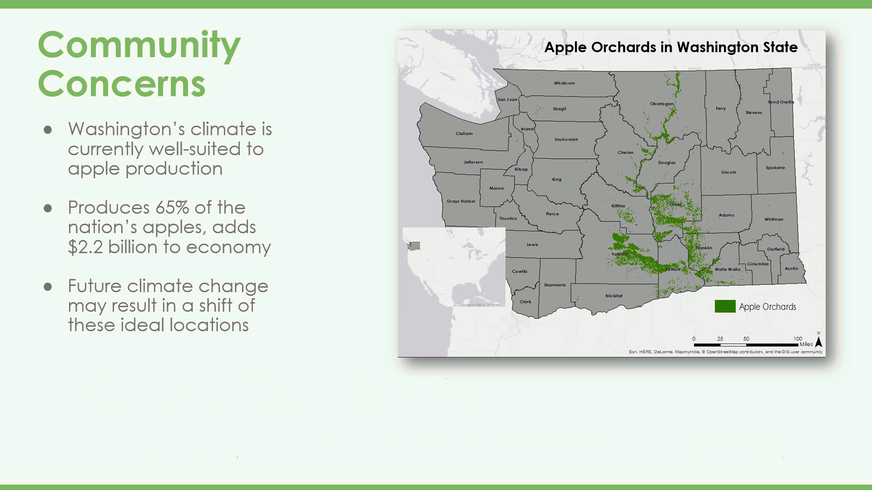
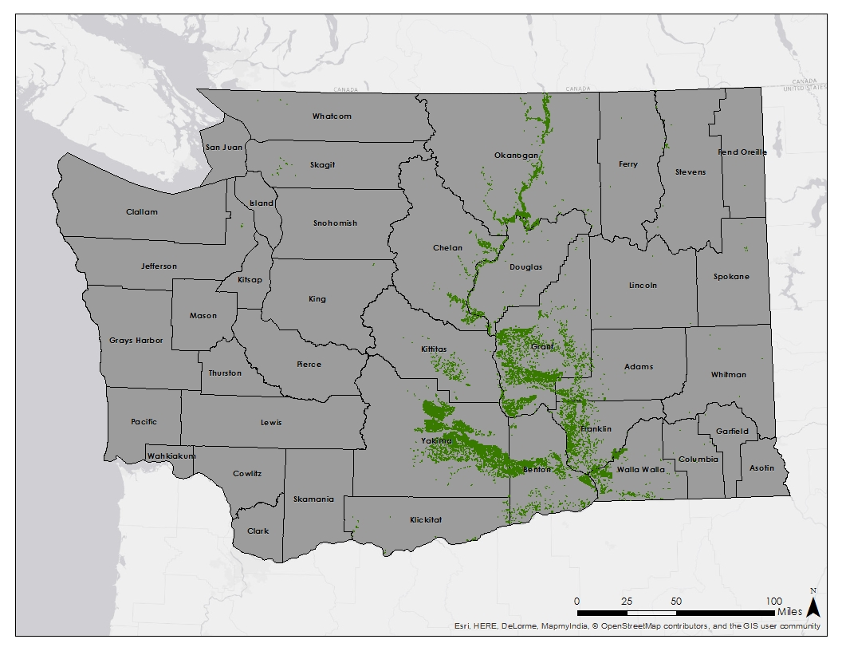
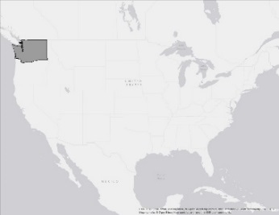
Community Concerns
Apple Orchards in Washington State
Washington’s climate is currently well-suited to apple production
Produces 65% of the nation’s apples, adds $2.2 billion to economy
Future climate change may result in a shift of these ideal locations
Study Area/ Time Periods:
Washington State
Present: (2002-2015) & Future: 2045 (2040-2049), 2065 (2060-2069), 2095 (2090-2099)
Notes:
Washington State’s climate is currently well-suited for apple production with its warm, dry summers and cool, wet winters. As a result, the state produces 65% of the nations apples and adds 2.2 billion dollars to the nations economy. The map on the right shows where the apples are primarily grown, which is to the right of the Cascade mountains in high apple-producing counties like Yakima and Grant counties. The community concern is that future climate change, especially rising temperatures, will result in a shift of these ideal growing conditions. Therefore, our study area is the state of Washington and our study periods are both the present-day period to assess the climate that apples currently grow in, and the future decades of the 2040s, 2060s, and 2090s to assess how these growing conditions may shift.
NOTE: currently an animation that adds the study area/periods at the bottom after ~20 seconds. Could make it all one static slide, but may look too busy?

Slide 3
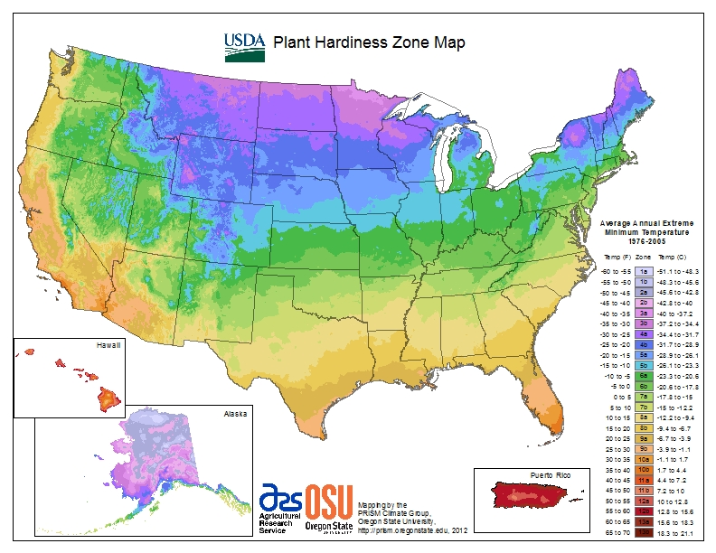
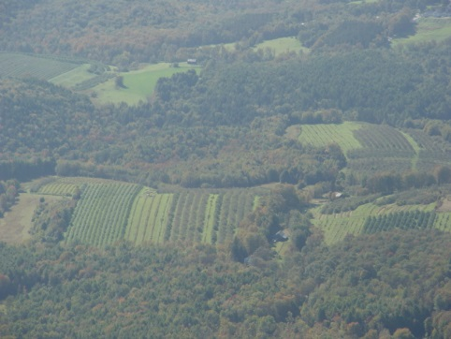
Plant Hardiness Zones
Based on average annual extreme minimum temperature
Divided into 10 degree Fahrenheit zones
Guide as to which plants will thrive at a given location
Apples grow best in zones 5 and 6
Image Source: Placeuvm, Flickr
Notes:
So how do we project changes in growing season suitability? One way to determine plant suitability is with Plant Hardiness Zones. These 10 degree F. zones are calculated by the USDA and based on average annual extreme minimum temperature. They act as a guide to determining which plants will thrive at a given location based on their tolerance to cold. For apples, one of the main limitations for production is winter injury, so it is very important to know the lower temperature limits of an area and whether or not an apple could survive there. In addition, apples need cooler climates that allow for an accumulation of chill hours, so apples do not thrive in the hotter zones either. Therefore, Apples grow best in zones 5 & 6, but the species span through ones 4-9.

Slide 4
Apple Suitability
Plant Hardiness Zones
Based on average annual extreme minimum temperature
Growing Degree Days
Heat accumulation formula:
([Tmax + Tmin]/2) - 5 °C
Growing Season Temperature
Ideal average temperature of 19 °C
Notes:
In addition to plant hardiness zones, growing degree days and average growing season temperature can both be estimated using temperature data and directly relate to whether an area is suitable for growing apples. Growing degree days look specifically at how many days are above and below the minimum and maximum thresholds of a species. For our project, high growing degree days is inversely reltated to apple suitability because we are calculating the amount of days for the codling moth, which can greatly destroy apple crops. In addition, it is important to look at the average growing season temperature. The growing season lasts from May through September, and the ideal temperature for apples is 19 degrees Celsius.

Slide 5

Objectives
Project Partner
Map Plant Hardiness Zones
  Current
  Forecasted (2045, 2065, and 2095)
Map areas suitable for apple growth
  Current
  Forecasted (2045, 2065, and 2095)
Dr. Michael Glen, Ph.D. United States Department of Agriculture
Notes:
We have partnered with Dr. Michael Glenn from the UDSA’s Agricultural Research Service for this project. This is his third term with DEVELOP and he has been with the Northwest U.S. Agriculture project since it’s inception. In partnership with Dr. Michael Glenn, we created current and forecasted PHZ maps; as well as suitability maps that combine PHZs, GDDs, and AGSTs.

Slide 6
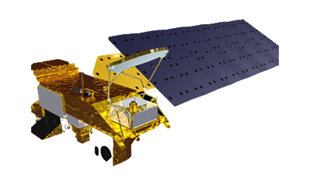
NASA Earth Observations & Projections
MODIS Land Surface Temperatures in Washington State from 2002-2015
NASA Earth Exchange Downscaled Climate Projections (NEX-DCP30) for 2045, 2065, and 2095
Aqua
Notes:
Our project uses 2 NASA datasets to complete our objectives. First, the present-day maps were calculated based on daily land surface temperature measurements from the MODIS instrument on NASA’s Aqua satellite from January 2002 to June 2015. MODIS was chosen because of it’s….For future temperature projections, we used NASA’s Earth Exchange Downscaled Climate Projections, or the NEX-DCP30 dataset. With 800m resolution, the NEX-DCP30 dataset has much higher resolution than many other climate projections. Currently-Modis data clipped, projected but not converted to air temperature.

Slide 7
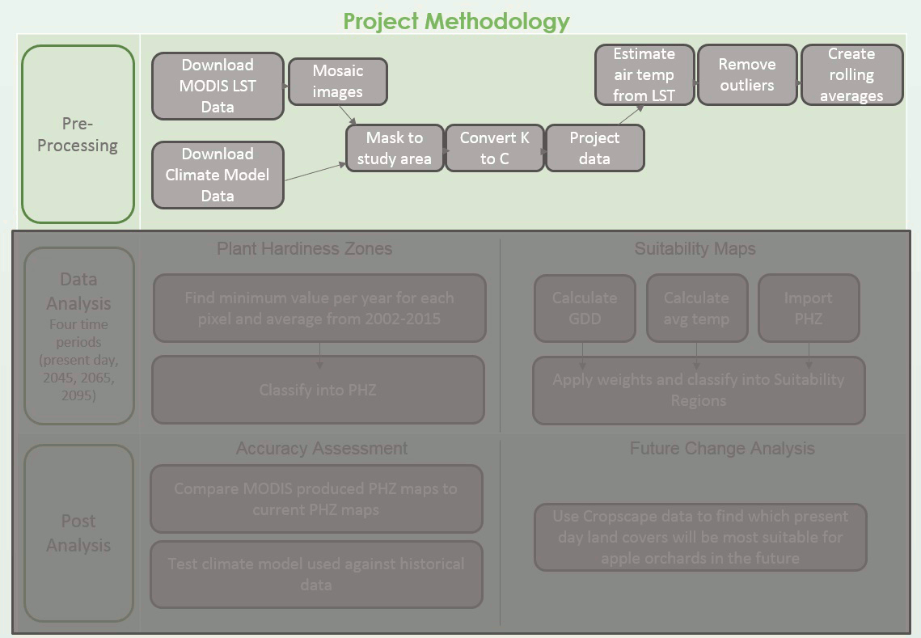
Notes:
Once the data was processed, it was converted to air temperature using a linear regression obtained from historic weather station data, then combined into five day rolling averages to calculate GDD. The annual minimum values were averaged together to create the PHZ maps. Once all three parameters were calculated, they were ranked on a standard scale and combined to create suitability maps. The accuracy of the maps was assessed by comparing our maps to the map currently used by the USDA, and a map created with PRISM data that spans 2002 to 2015 which is the dataset that USDA uses and the time period for the MODIS data.
Note, methodology an animation which cycles between the three stages

Slide 8
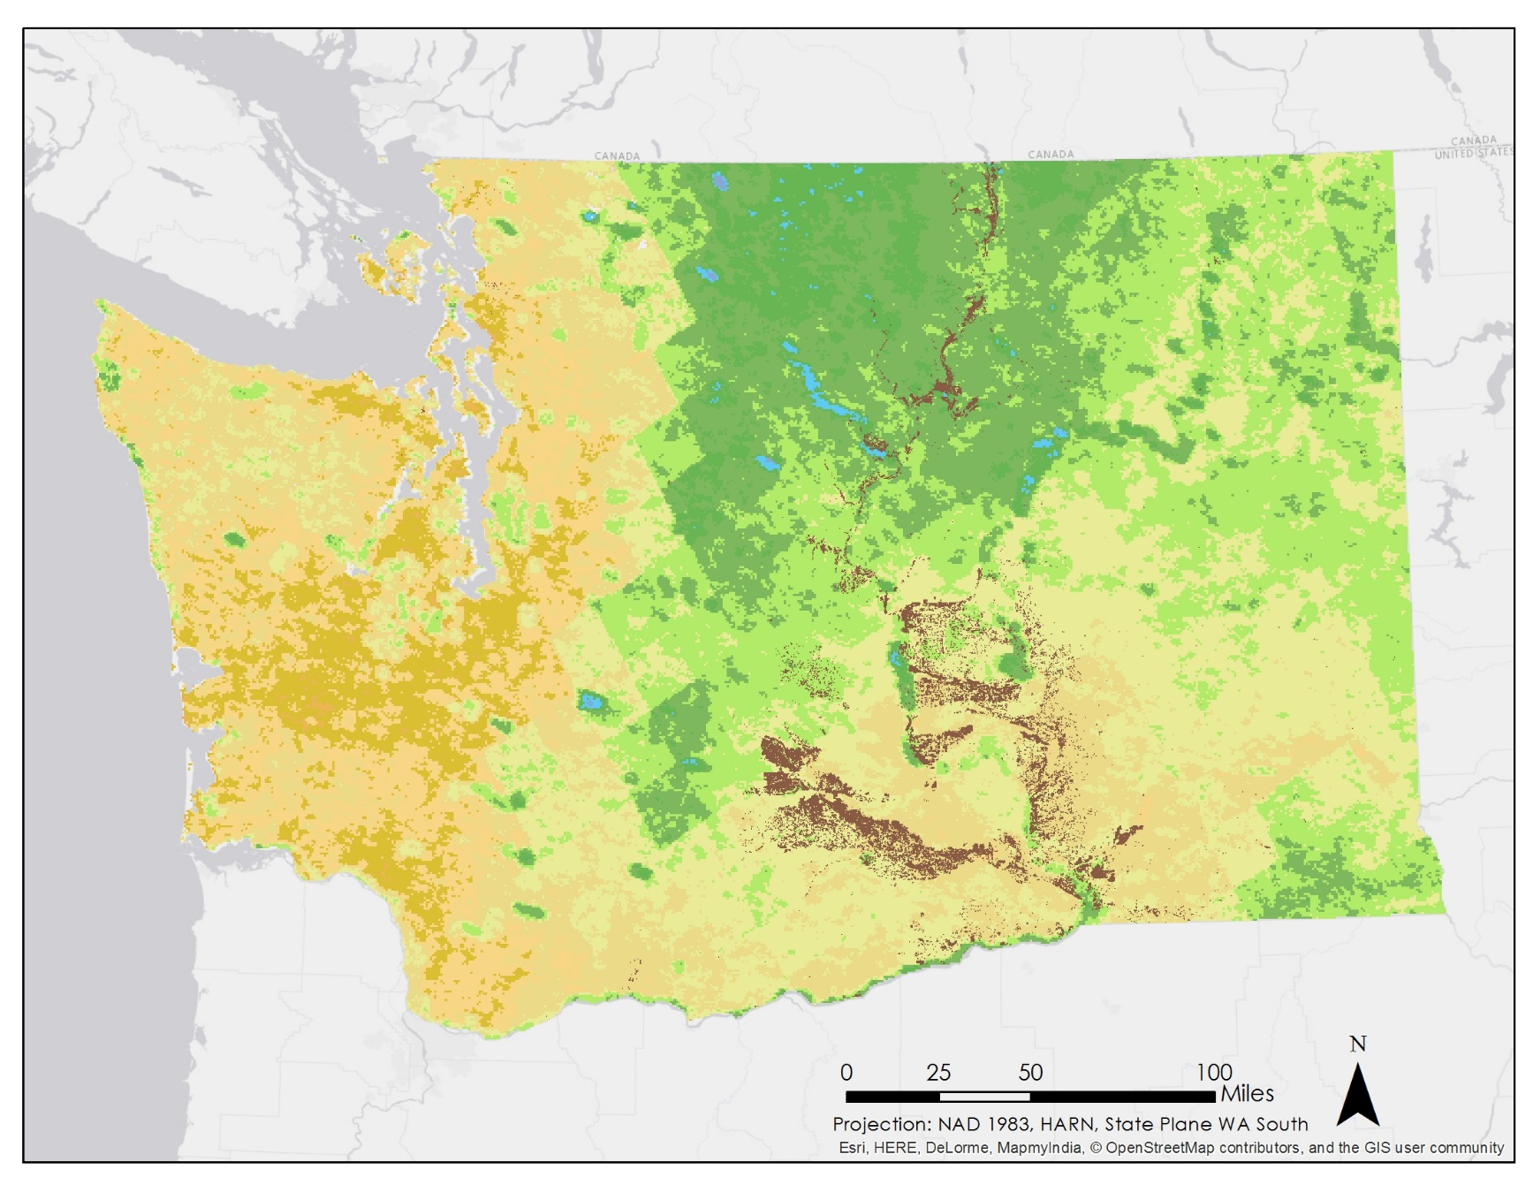
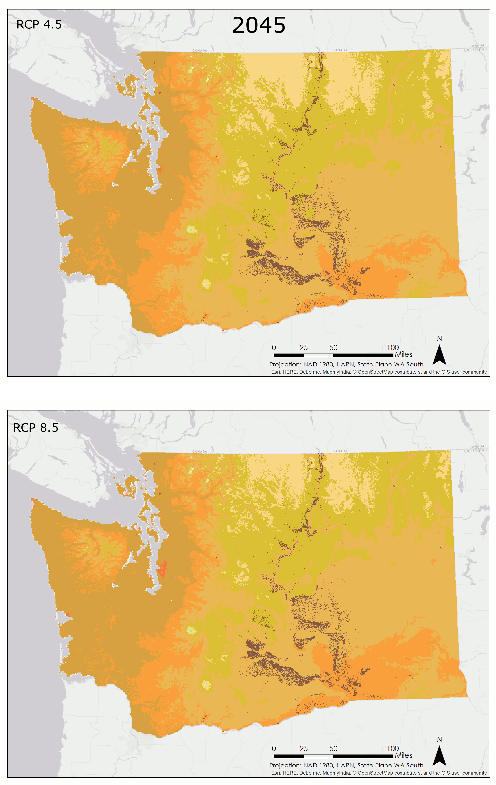
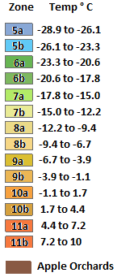
Conclusions: PHZs
Present-day with MODIS
Notes:
The large map on your left shows the current plant hardiness zones that were produced with the MODIS data. Based on this map, apples currently are produced in the suitable zones of 6b through 8a. However, as seen on the right, by 2045, the plant hardiness zones shift towards a much warmer climate. The suitable zone of 6-8a completely disappear from the entire state in both the moderate emissions scenario (on top right) and extreme emissions scenario (bottom right) and apple-growing zones are now zones 9a-10a. The zones shift towards warmer zones even more by 2065, and by 2095, the apple growing region is dominated by unsuitable zones like 10a-11b. Interestingly, the zone layout of 2095 is similar to the current zones of Florida!
NOTE: Animation with the two right panels rotating between scenarios, with timing staying on 2045 longer than the next two scenarios. It totals 30 seconds.

Slide 9
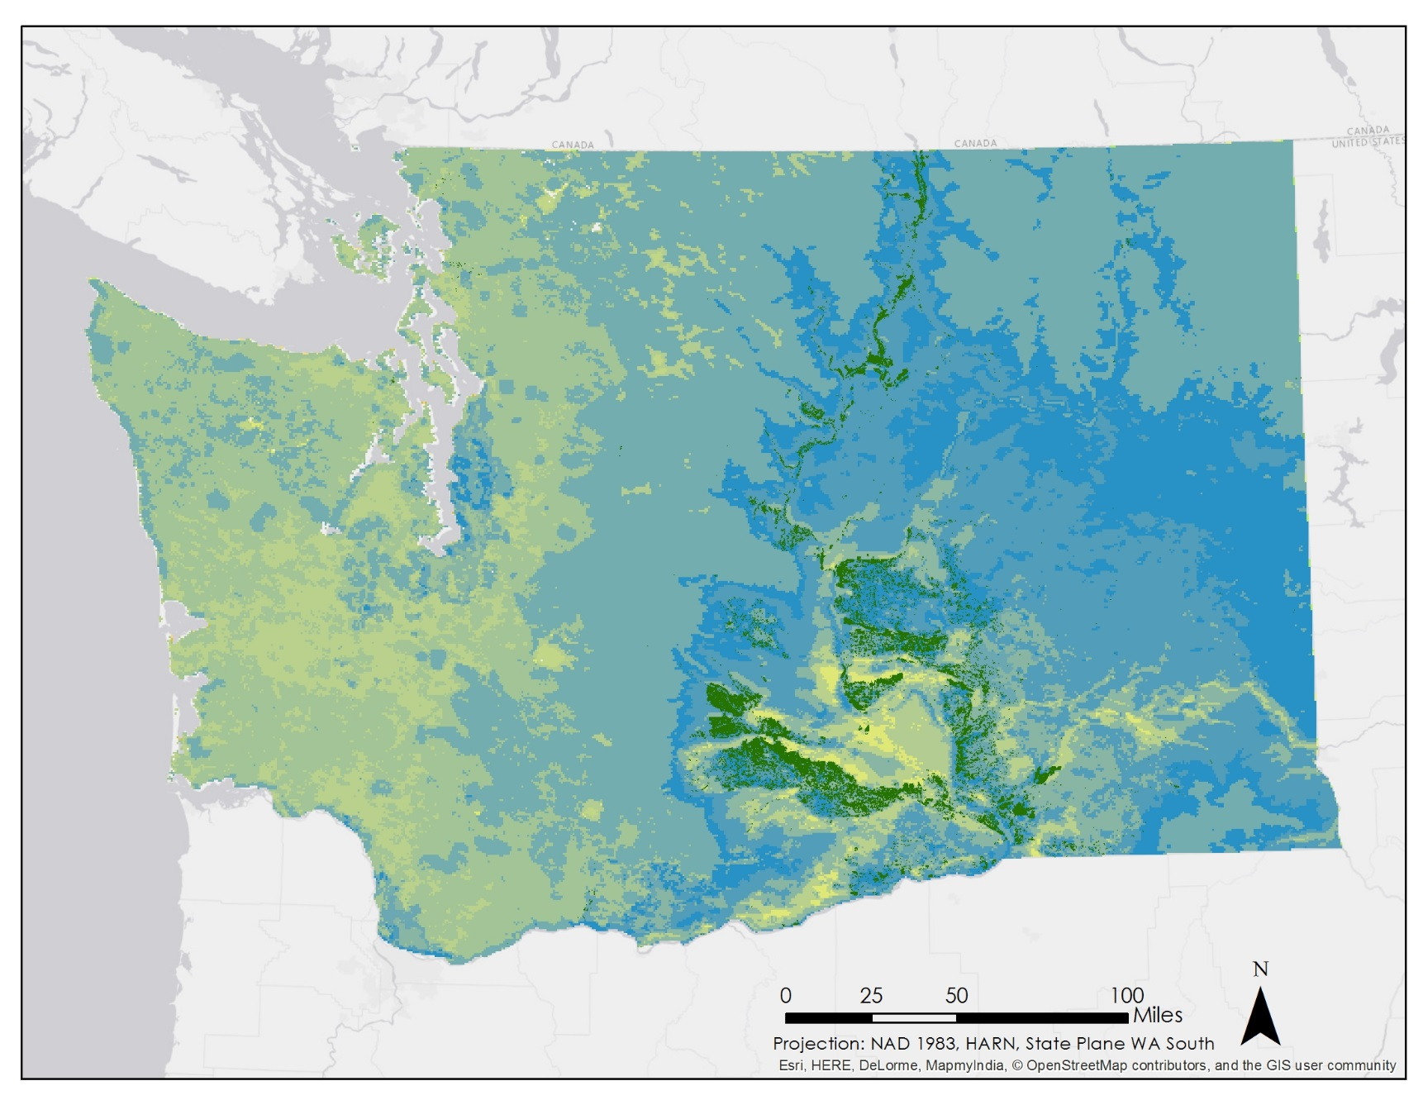
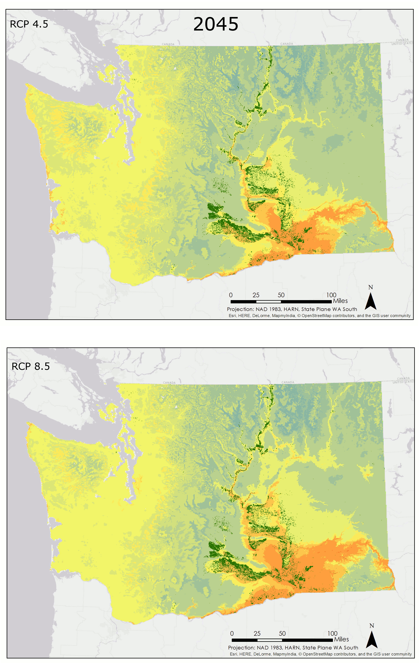

Conclusions: Apple Suitability
Present-day with MODIS
Notes:
By combining PHZ, GDD, and AGST, we created suitability maps for Washington state. Suitability is ranked on a scale of 0 to 100, 100 being the most suitable. Currently, orchards are within zones of high to moderately high suitability. Suitability significantly decreases in 2045. In the north, conditions are moderately suitable; while in the south, conditions are moderately unsuitable. In 2065, the unsuitable areas have expanded. The extreme scenario shows strips of very low suitability appearing in the south. The moderate scenario shows very little change between 2065 and 2095; however, the extreme scenario shows a drastic change in conditions. Suitability is extremely low for all apple orchards.
NOTE: right panel an animation with similar timing to that on previous slide

Slide 10
Conclusions
Current Conditions
PHZ and suitability map shows good conditions for apples.
Moderate Scenario
Conditions steadily worsen. Marginally suitable in the north by 2095.
Extreme Scenario
Significant worsening of conditions. By 2095, Washington very unsuitable.
Notes:
In conclusion, the current conditions show that the apple orchards are currently located in areas with ideal apple growing climates. However, the moderate emissions scenarios show that conditions will steadily worsen, with unsuitable conditions already occurring by 2045. The north will be the only marginally suitable area by 2095. For the extreme scenarios, the phzs and the suitability maps both show a significant worsening of conditions, and by 2095, the entire state of Washington is very unsuitable for apple growth.

