Slide 1
Peru Disasters II
Identifying and mapping flood prone regions in the La Libertad Region of Peru using NASA’s Earth Observations
William Wilson (Project Lead)
Anthony Donzella
Grant Bloomer
Josh Hammes
Allison Daniel

Slide 2
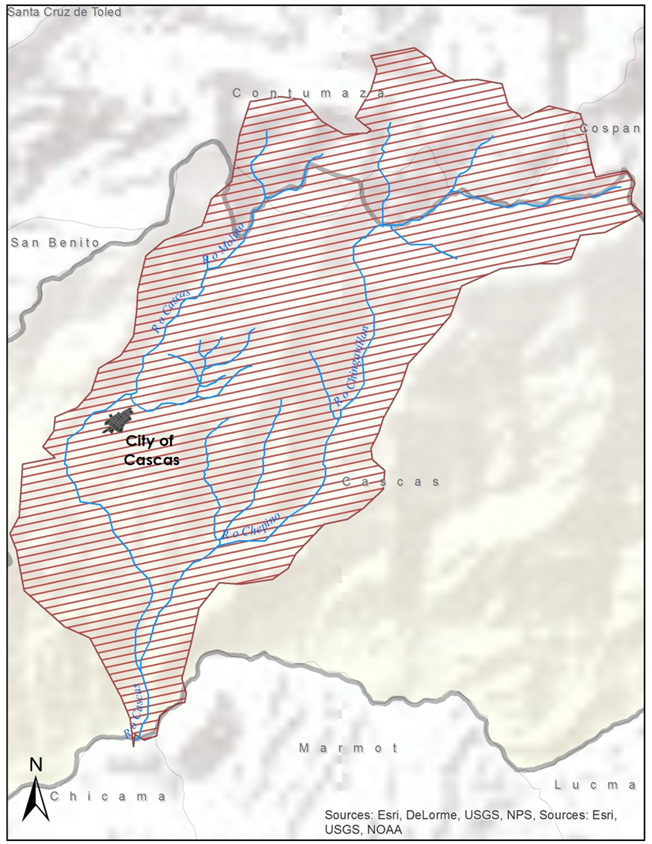
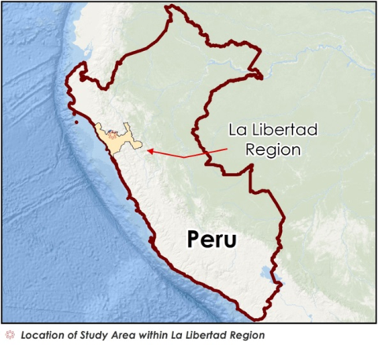
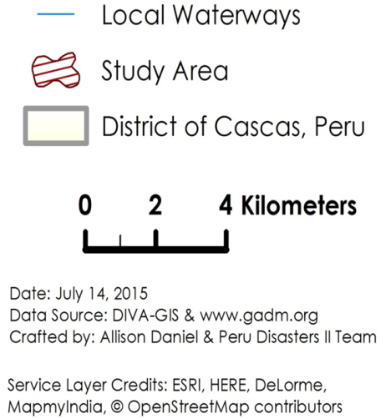

Study Area
Ochape Sub-Basin, District of Cascas, La Libertad, Peru
Andes Mountain highlands cut by converging river systems and gorges
Farms and villages located in river valleys – central city is Cascas
Notes:
The study area (217 sq km) covers about half of the District of Cascas (465 sq km & the lighter yellow region in background) and is 110 km inland from the coastal city of Trujillo.
The mountains are covered with woody and herbaceous vegetation which protects from large scale erosion and landslides. >> Stream channels tend to be steep, yet stable from this dense land cover >> Water levels are intermittent and can fluctuate rapidly >> The rainy season is from November to April
The area is predominantly rural with the economy revolving around agriculture and livestock-rearing. >> Agriculture of the sub-basin’s river valleys includes wheat, beans, rice, alfalfa, tomatoes, fruits, and wine-making.
This basin was selected as the study area due to its active involvement in projects done by Water for People

Slide 3
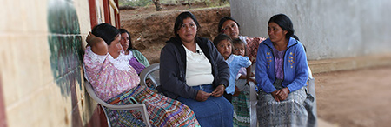
Community Concerns
Credit: Water for People
Seasonal flooding events claim lives, disrupt the local economy and damage property.
Current flood disaster management plans are largely incomplete
Lack of accurate / site-specific geophysical data.
Notes:
Image source: Water for People
Peru listed in top 20 in report by World Bank & GFDRR of countries at ‘high sconomic risk multiple hazards’ ---almost a quarter of population lives in flood prone areas.
>> This report noted “Monitoring systems and technology tools for modeling and assessment need to be scaled up to address subnational government and sectoral knowledge needs in particular”
Rainy season flooding from November to April >> Concern that El Nino event in 2015 will exasperate conditions >> Major flood events in 2008, 2013, 2014 during rainy season in central Peru were especially intense and this year is true
Development of a flood warning system as not been accurately created due to a lack of accurate rainfall and geophysical data, as well as the inability to produce near real time flood maps using topographical data from the region.

Slide 4
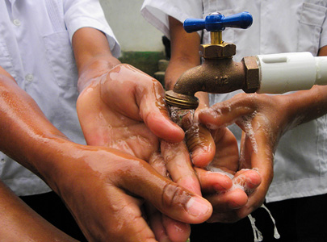
Project Partners
Water for People is a non-profit organization that works to provide water security for countries around the world.
INDECI is directly responsible for disaster management in Peru.
Partners from Water for People are currently in contact with INDECI and Consejo de Cuenca.
Credit: Water for People
Notes:
Image source: Water for People
In Peru Water for People work within the Cascas and Asuncion districts.
DEVELOP has been assisting Water for People with creating tools and methodologies for water resource efforts. Peru Disasters I saw the incorporation of ArcSWAT into their work as a tool for water budgeting.
Flood risk assessment is not a usual part of Water for People’s workload. Because of their enduring prescence on the ground however, expanding the scope of their role is vital for these outlying regions where local governments are often ill-equipped.

Slide 5
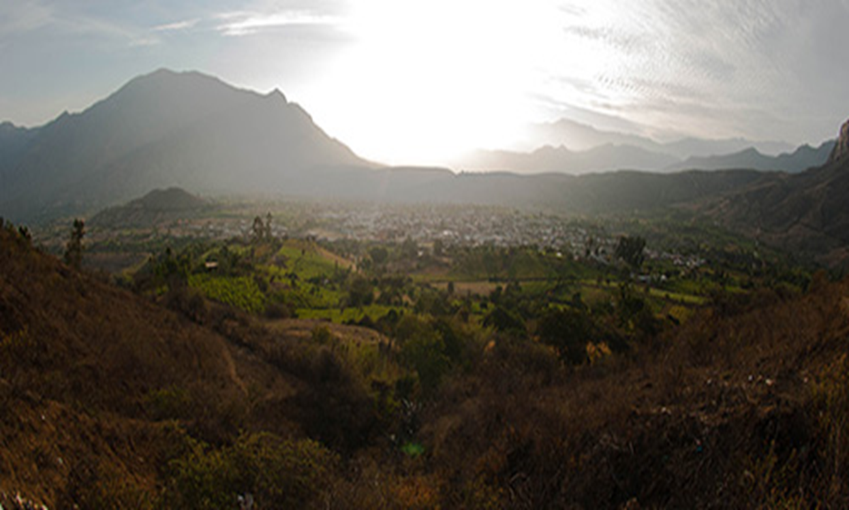
Objectives
Improve upon the resources necessary to provide a preliminary flood risk analysis
Obtain a successful calibration of the CREST 2.0 model
Produce historic flood maps / time series data utilizing NASA’s Earth observation satellites and mathematical models for requested area within the La Libertad Region of Peru in order for partner analysis.
Credit: Water for People
Notes:
Image source: Water for People
Resources include directions / materials for partner replication of CREST workflow. Could also include data directory for basin as well as project folder itself.

Slide 6
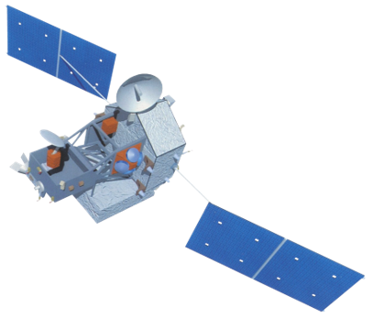
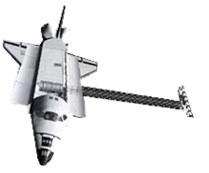
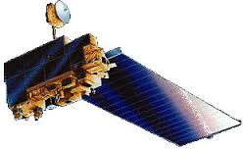
NASA Earth Observations
Satellite: Tropical Rainfall Measuring Mission (TRMM)
Sensor: TRMM Microwave Imager (TMI)
Data: Rainfall
Satellite: Shuttle Radar Topography Mission (SRTM)
Sensor:
Data: Topography
Satellite: Terra
Sensor: MODIS
Data: MOD16
Notes:
Image source: developdia
Analysis of this project was conducted using remotely sensed data from NASA’s Earth Observation Systems (EOS) as input for the hydrological NASA/OU CREST 2.0 model.

Slide 7
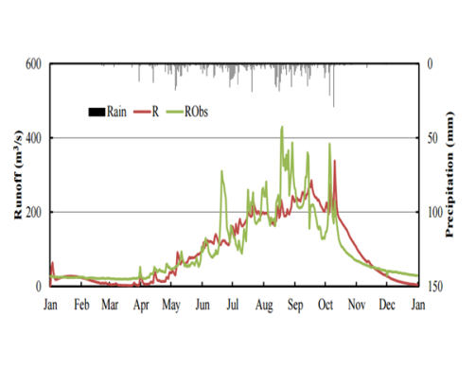
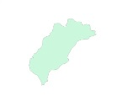
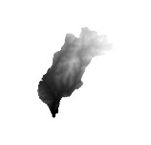


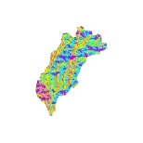
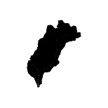
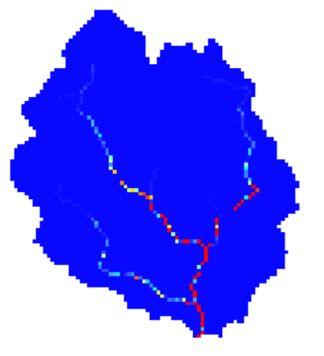
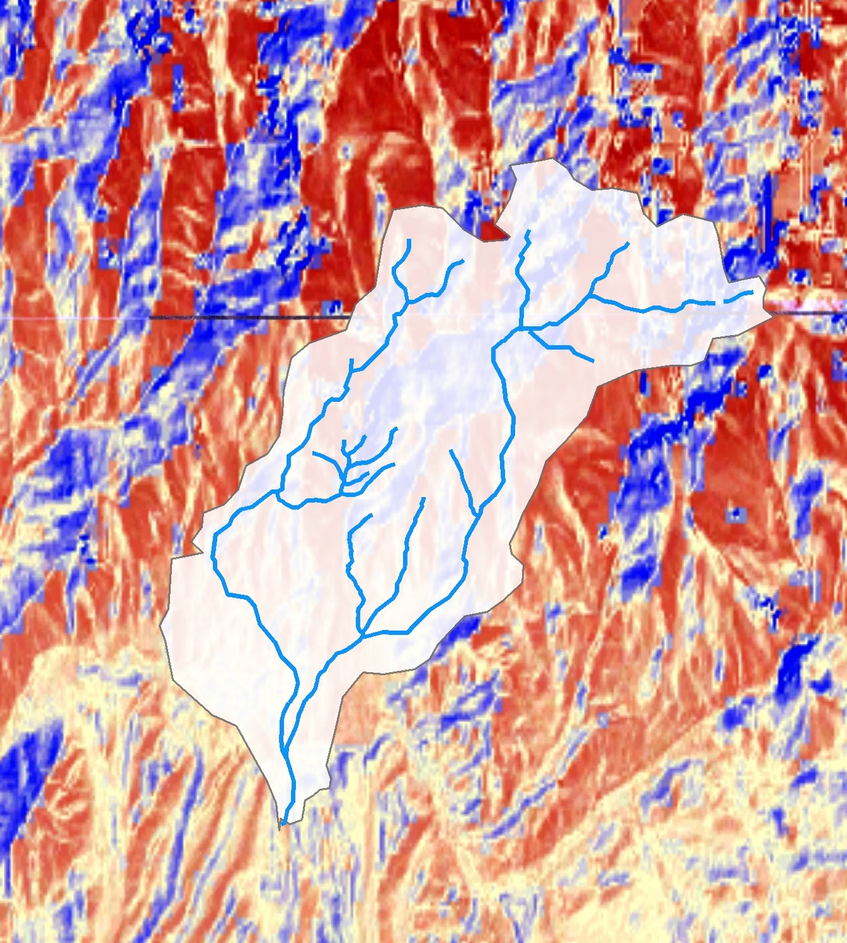
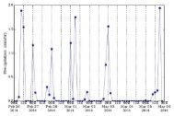
Methodology
Shapefile of Study Area
(DIVA-GIS)
Digital Elevation Model
(HydroSHEDS)
Time Series Data
Flow Direction
(HydroSHEDS)
Flow Accumulation
(HydroSHEDS)
Potential Evapo-
Transpiration (MOD16)
3- Hourly Rainfall Data
(Giovanni)
Distributed Outputs
Notes:
The CREST model required datasets for the study area encompassing precipitation data, DEM, FDR, FAC and potential evapotranspiration (PET) data.
Ideally, time series data would be matched against known observed data but unlikely in remote basins. Thus, CREST is run in simulation mode.
Distributed out puts include streamflow (discharge)….can be converted to KML for Google Earth display.

Slide 8
Results & Limitations
Deactivated functionality with 2014 MATLAB version, → 2015 update (CREST v2.1.3) was released mid July.
CREST code inaccessible, makes trouble-shooting cumbersome.
Late switch to FORTRAN version for compatibility with partner resources.

Slide 9
Conclusions & Outlook
Dialogue between partners, CREST developers, and SEVIR to continue into interim. Goal is to:
Perform trial runs of basin data over selected time intervals to produce results.
Have forcing inputs formatted for availability with model. Allows partners flexible incorporation with years of data on hand.
Provide manual for obtaining data for other basins.

Slide 10
Advisors
Dr. Kenton Ross, (NASA DEVELOP/Langley Research Center)
Dr. DeWayne Cecil, (Global Science and Technology, Inc.)
Partners
Mark Duey, Water for People
Francisco Soto, Water for People
Others
Jordan Bates, Center Lead (NASA DEVELOP WC)
Lance Watkins, Geoinformatics Team (NASA DEVELOP)
Jack Kennedy, Clerk of Circuit Court for Wise County
Ms. Melanie Salyer, Principal Investigator (NASA DEVELOP WC)
Dr. Xinyi Shen, HYDROS Lab (University of Oklahoma)
Xianwu Xue, HYDROS Lab, (University of Oklahoma)
Ashutosh S. Limaye, NASA SERVIR
Manabendra Saharia, Graduate Research Assistant (University of Oklahoma)

Slide 11
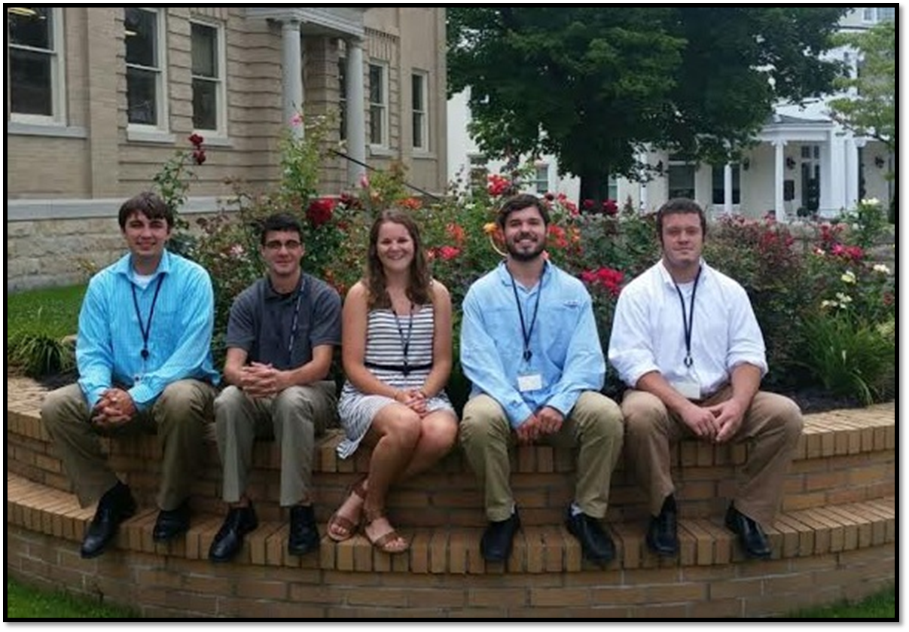
Peru Project Team
Notes:
Left to Right: Grant Bloomer, Anthony Donzella, Allison Daniel, Josh Hammes, Will Wilson
Photo Credit: Jordan Bates

