Slide 1
Colombia Mi Pronóstico Flood Application
Updating and improving the Mi Pronóstico Flood Web Application to Include an Assessment of Flood risk
Stephanie Rushley (North Carolina State University)
Matthew Carter (United States Air Force)
Charles Chiou (Old Dominion University)
Kevin Haywood (United States Air Force)
Rick Farmer (Mathews High School)
Anthony Pototzky (Old Dominion University)
Adam White (Christopher Newport University)
Daniel Winker (University of Virginia)

Slide 2
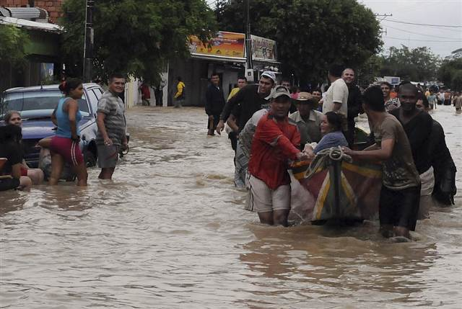
Community Concerns
Mountainous regions are highly vulnerable to flooding
Flood warnings and weather predictions are sent to users through IDEAM’s Mi Pronóstico Web Application
Percentage of Reported People Affected
Prevention Web
NBC News

Slide 3
Project Partners
Dr. Angelica Gutierrez
Pilar Galindo
Ricardo Quiroga
IDEAM

Slide 4
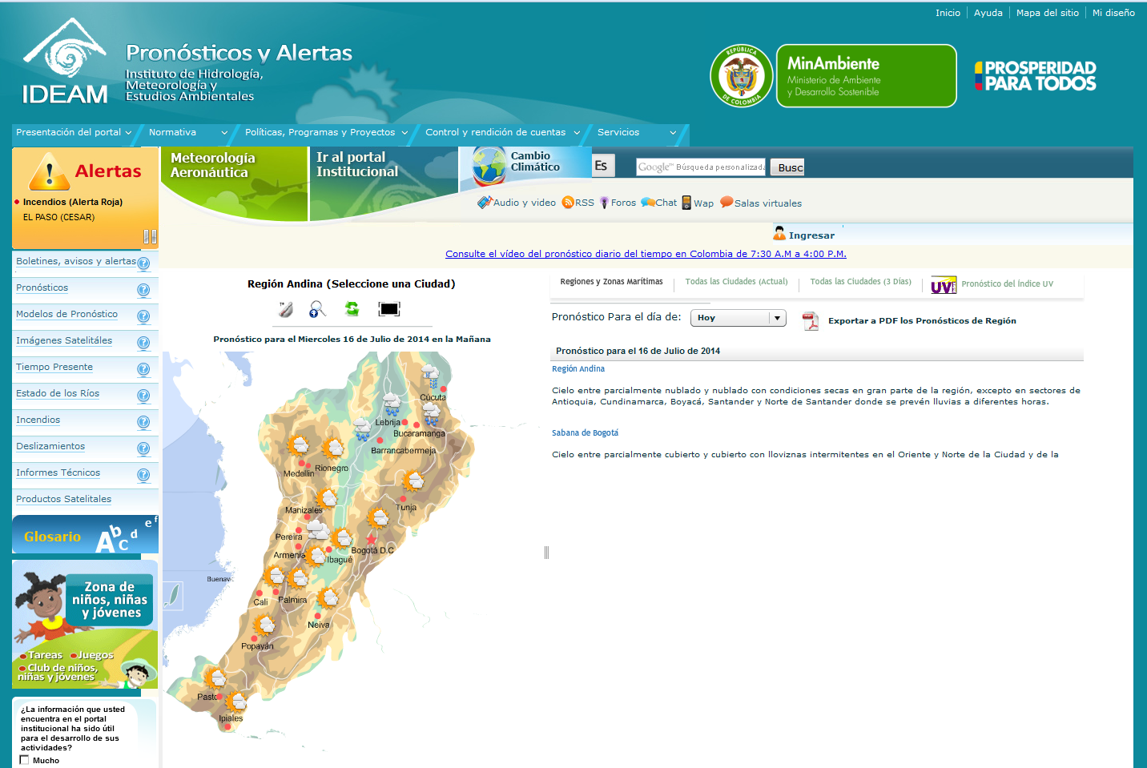
Objective
Flood Risk Assessment
Update existing Mi Pronóstico web application to include flood risk analysis and flood warnings
IDEAM

Slide 5
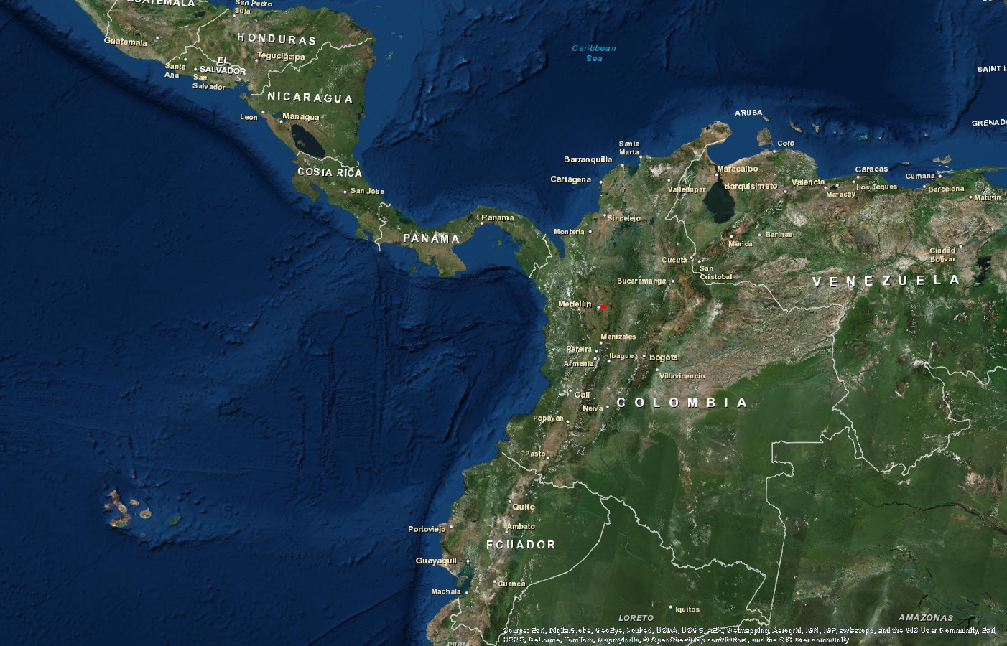
Study Area
La Mosca River Basin

Slide 6
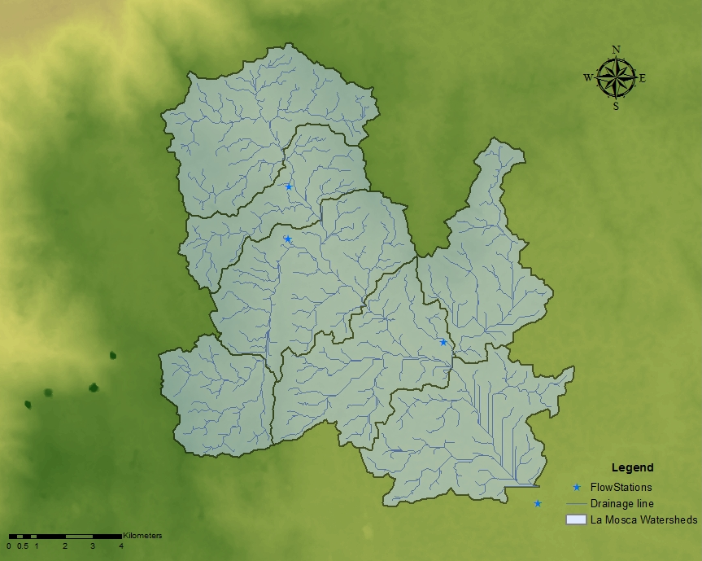
Study Area
La Mosca River Basin
1
2
4
3
6
5
7

Slide 7
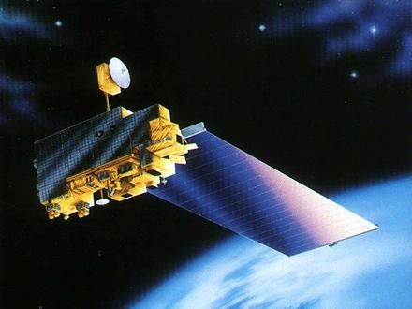
ASTER
Advanced Spaceborne Thermal Emission and Reflection Radiometer
Terra Satellite
Infrared Cameras
30-m grid

Slide 8
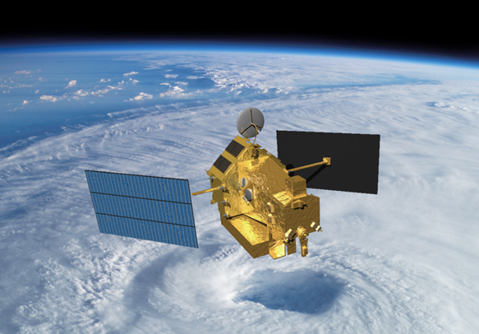
TRMM
Tropical Rainfall Measuring Mission
Near-real-time dataset
Precipitation Radar
0.25° grid

Slide 9
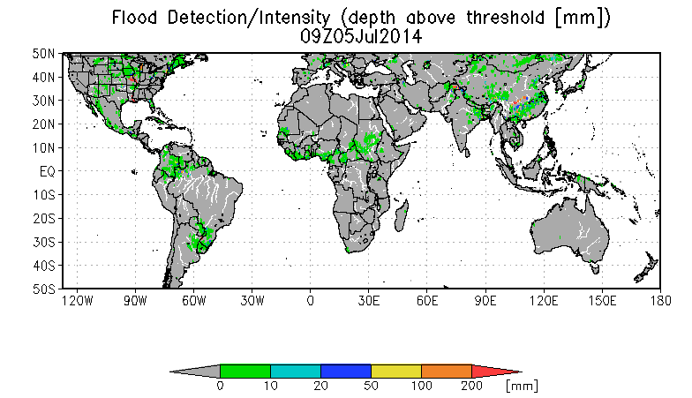
Other Data
Streamflow and precipitation (IDEAM)
Global Flood Monitoring System and DRIVE model (Dr. Huan Wu, University of Maryland)

Slide 10
Methods
Data
Slope developed using the ASTER DEM
Analysis
Calculate watershed area
Application
Flood Risk Map
Precipitation and streamflow from in situ data
Update Mi Pronóstico web application
Create visualization of flood indices for users in Colombia
Calculate flood indices
Data
Application
Slope using ASTER
Precipitation and Streamflow from in situ data
Analysis
Autocorrelations for precipitation and streamflow
Cross correlation between precipitation and a streamflow lag time
Flood Risk Map
Update Mi Pronostico web application
Visualization of flood indices for users

Slide 11
Flood Indices: Morphometric Classification Torrential Index
Drainage Density (km/km²) | Total length of all streams and rivers in a drainage basin divided by the total area of the drainage basin
Mean Basin Slope (degree) | Average slope of the drainage basin
Coefficient of shape | The coefficient of the shape of the drainage basin. Shape values range from round to oval to rectangular

Slide 12
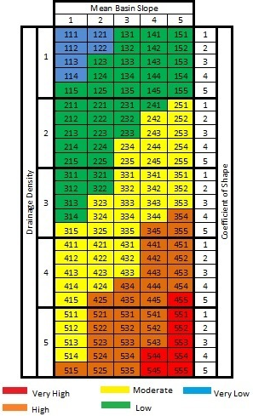
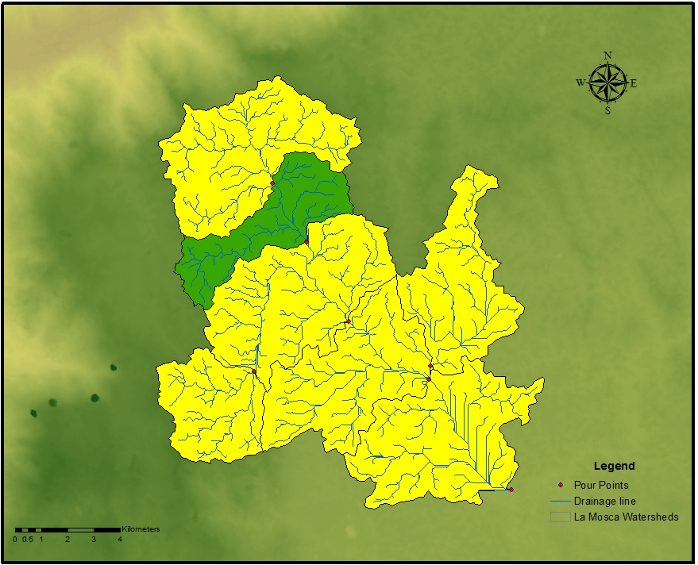
Morphometric Classification Torrential Index

Slide 13
Index of Variability
Variability Index | Vulnerability
<10° | Very Low
10.1° - 37° | Low
37.1° - 47° | Average
47.1° - 55° | High
>55° | Very High
Variability Index | Station 23087670 | Station 23087860 | Station 23087170 | Station 23087030
40%-60% | 30.2022 | 38.9326 | 30.4553 | 38.2458
30%-70% | 31.7183 | 35.2720 | 29.2970 | 38.0296
20%-80% | 32.0733 | 32.8636 | 27.3563 | 36.2351
10%-90% | 31.5347 | 31.0470 | 26.5651 | 34.7007

Slide 14
Vulnerability Index for Torrential Events
Variability Index | Morphometric Classification Torrential Index
 | Very Low | Low | Medium | High | Very High
Very low | Low | Low | Medium | High | High
Low | Low | Medium | Medium | High | Very High
Medium | Low | Medium | High | High | Very High
High | Medium | Medium | High | Very High | Very High
Very high | Medium | High | High | Very High | Very High

Slide 15
Vulnerability Index of Torrential Events

Slide 16
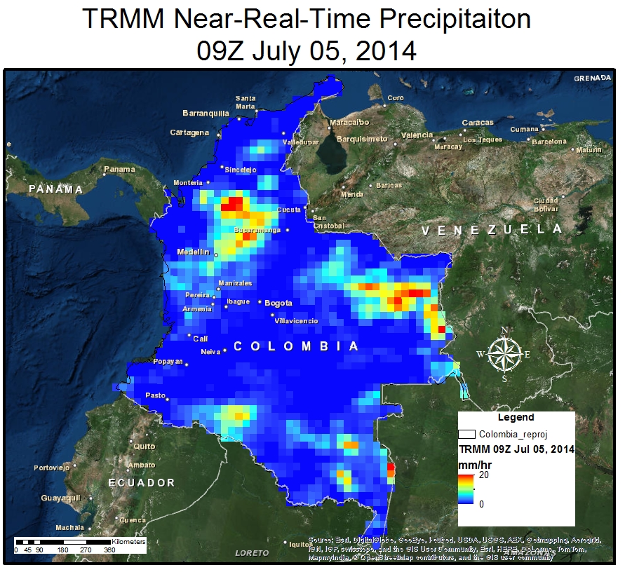
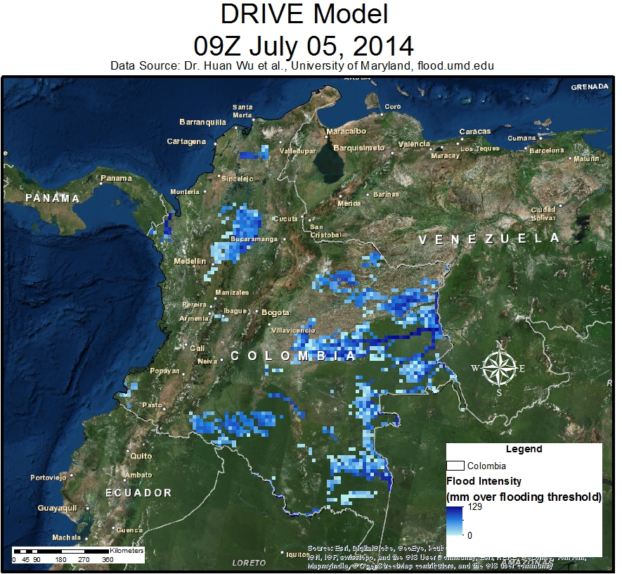
TRMM and DRIVE

Slide 17
TRMM and DRIVE
La Mosca Watershed

Slide 18
TRMM and DRIVE
La Mosca Watershed

Slide 19
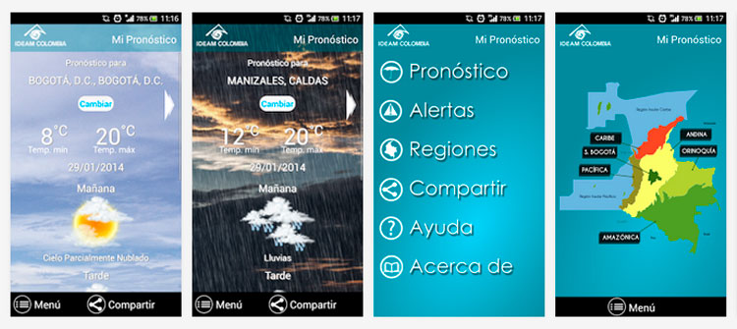
Future Work
Streamline use of DRIVE and TRMM in the application
Expand Pilot Study area to watersheds and sub basins across Colombia
Update the Mi Pronóstico Web and mobile Application

Slide 20
Acknowledgements
Dr. Kenton Ross
NASA DEVELOP National Science Advisor
Lauren Childs
NASA DEVELOP Operations Lead

