Slide 1
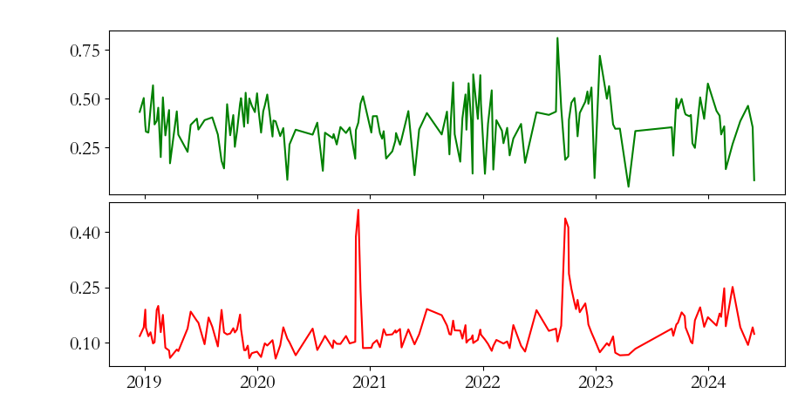
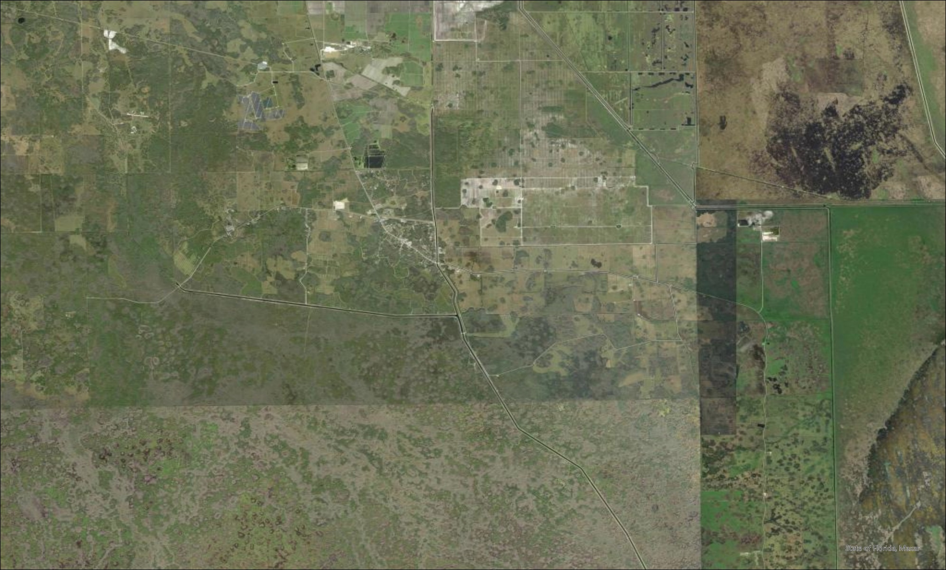
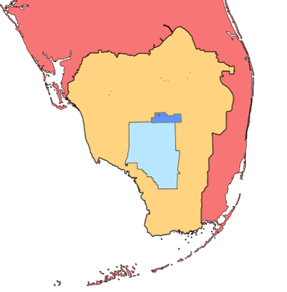
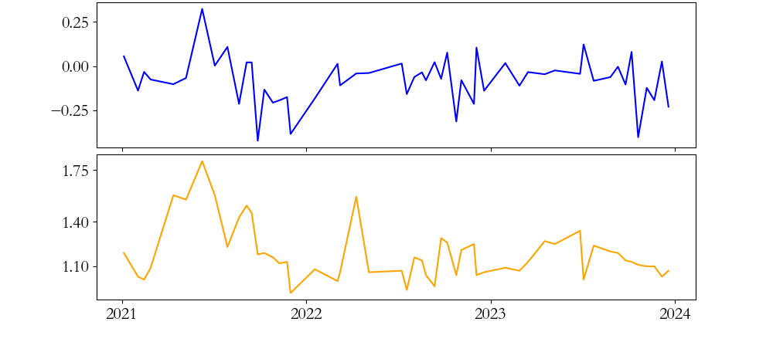
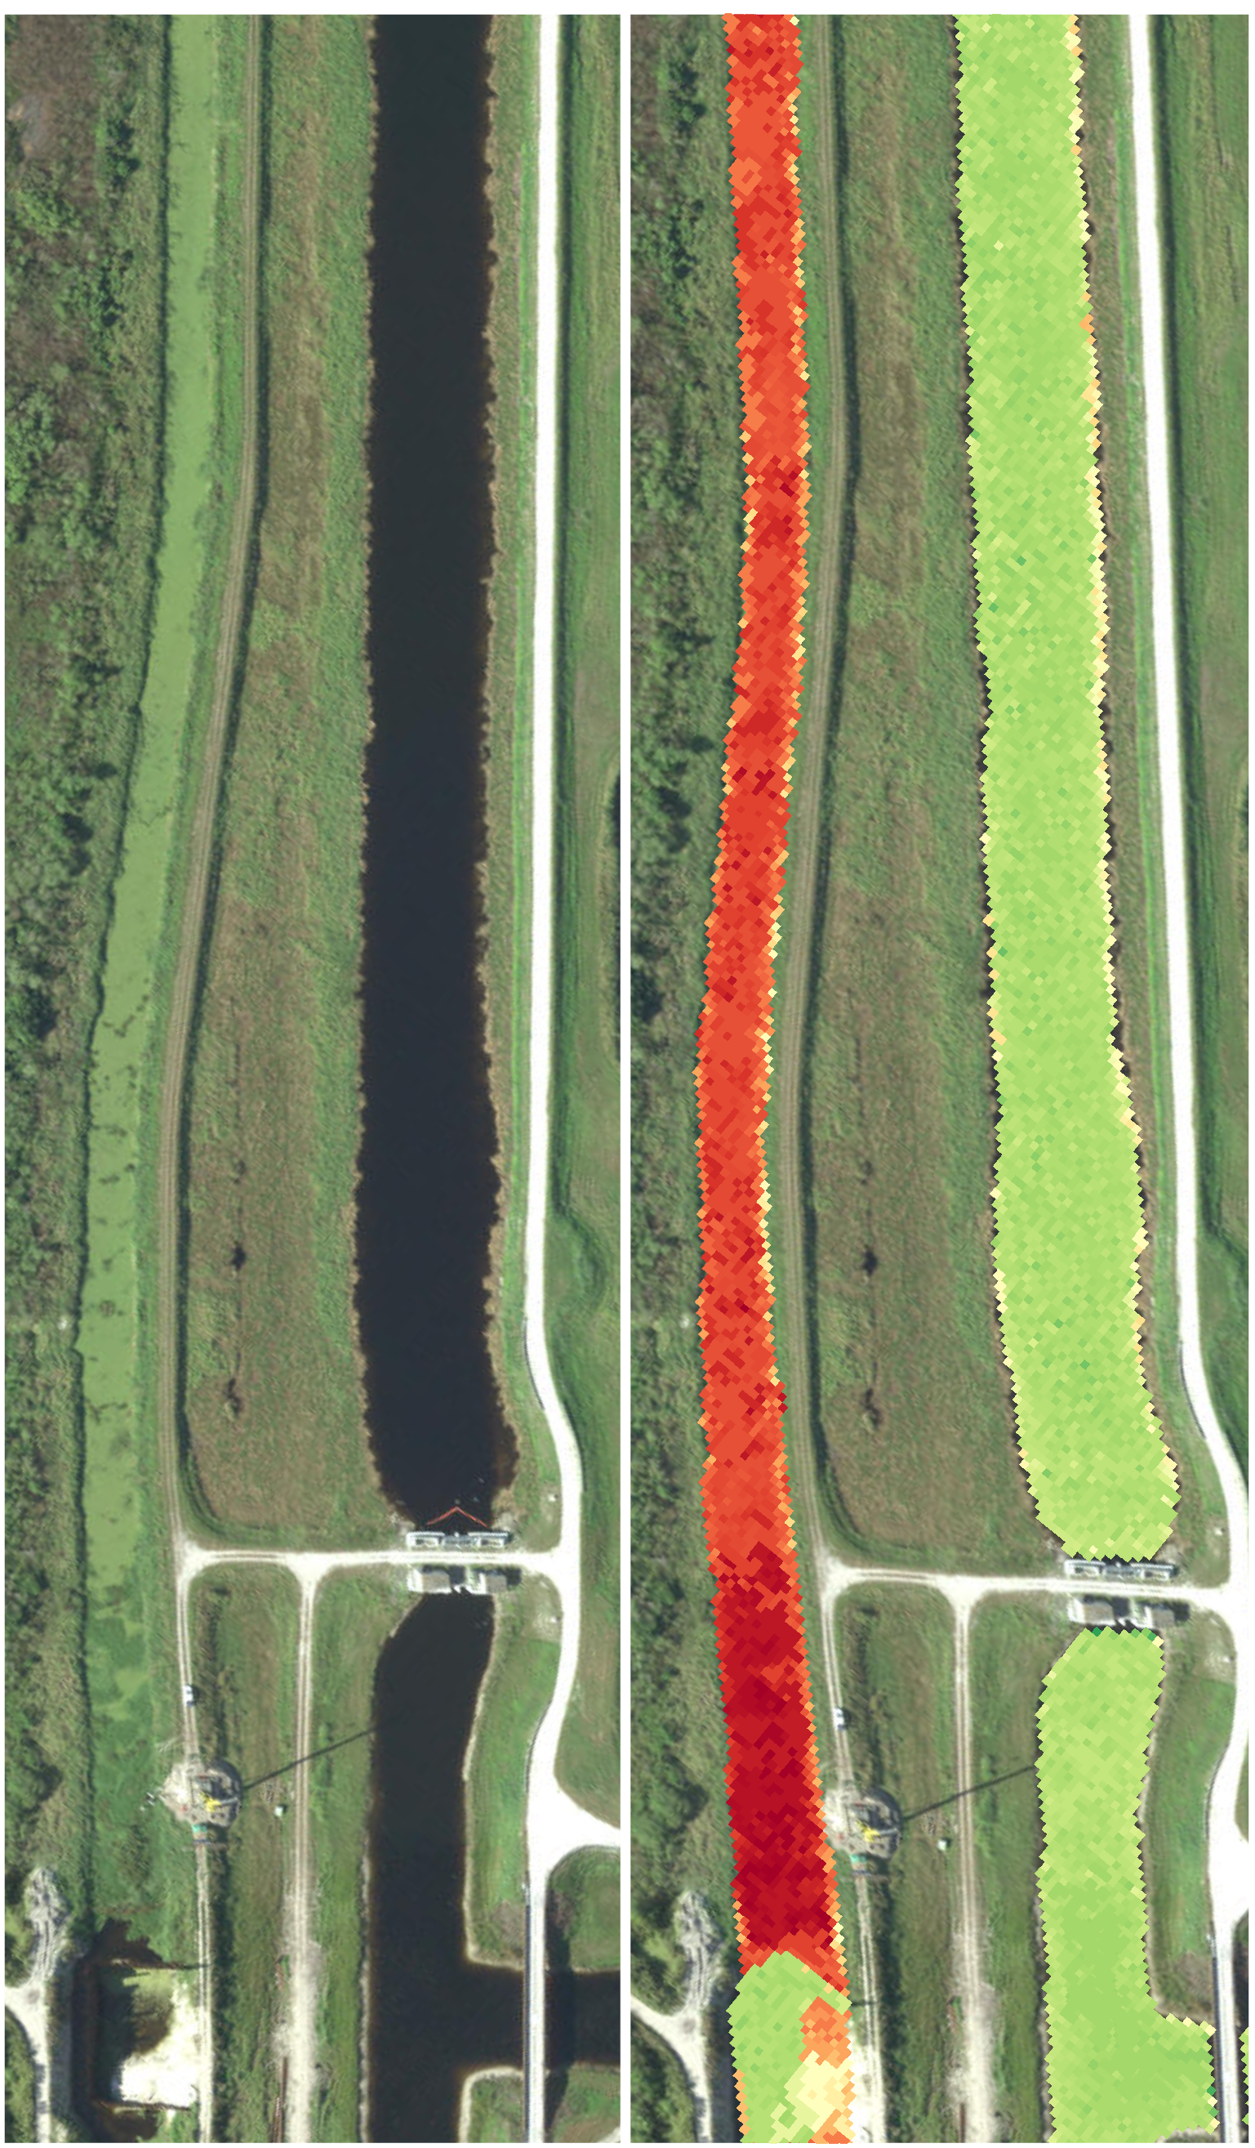
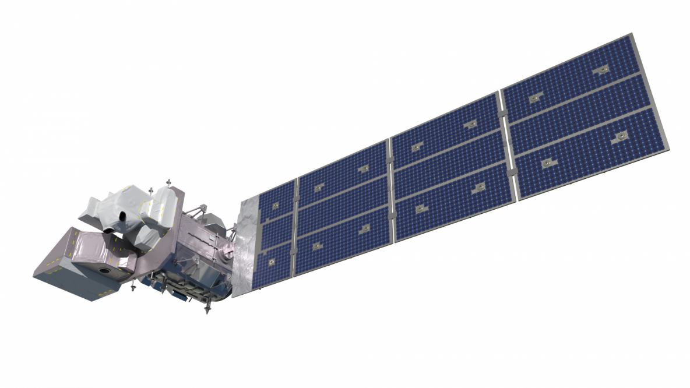
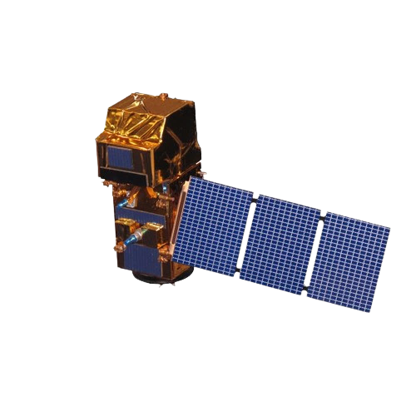
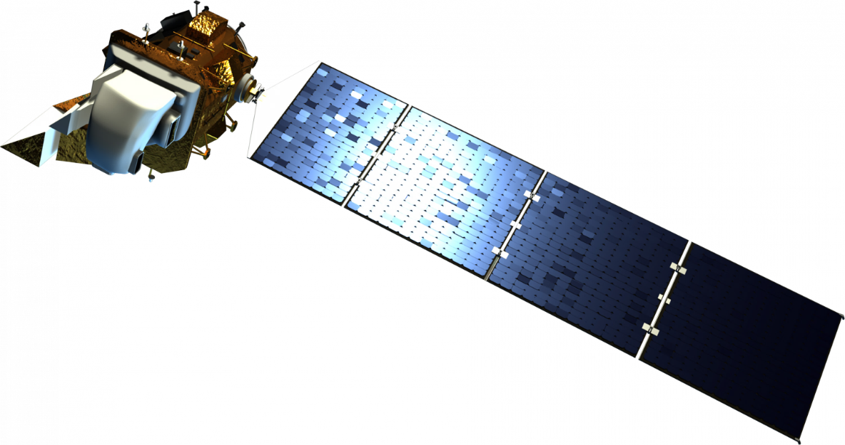
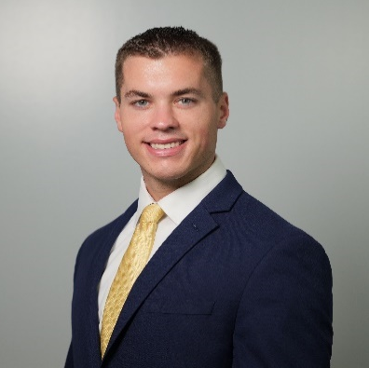
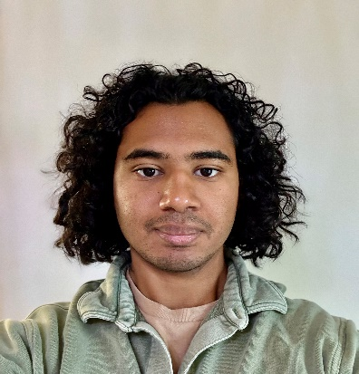
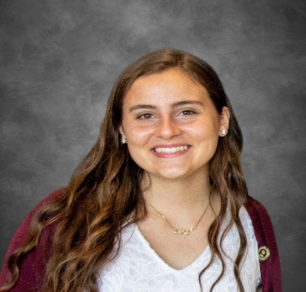
Big Cypress Water Resources
Using Earth Observations to Assess Water Quality in Big Cypress Reservation, FL
Project Synopsis
Results
The Seminole Tribe of Florida Environmental Resource Management Department (ERD) investigates water quality in the Big Cypress Reservation (BCR). The BCR’s primary form of water management includes storm water retention ponds and a series of man-made canals. Concerns about water resource quality have generated interest in implementing remote sensing into the water monitoring methodology of the ERD, with a particular concern for determining sources of nutrient loading and highlighting water bodies that are at risk for algal blooms. This project utilized NASA Earth observations and Sentinel-2 to create time series and maps for areas of interest around BCR to inform ERD water management decisions and investigations.
Fig. 1: Sentinel 2 NDCI & In Situ Total Phosphate Concentration (USSO Site)
Fig. 2: NDCI & TP Seasonal Decomposition
0.75
NDCI
C
NDCI Seasonal Component
0.1
0.50
0.0
0.25
-0.1
Study Area
Total Phosphate (mg/l)
0.40
TP Seasonal Component
0.05
0.25
0.00
0.10
2019
2020
2021
2022
2023
2024
Jan
June
Dec
Date
Garcia Farm Pond
Confusion Corner NW
Confusion Corner N
Fig. 1 & Fig. 2. The times series of Sentinel-2 NDCI and in situ Total Phosphate portray an inconsistent relationship with similar seasonal trends. Due to this inconsistency, it was not feasible to conclusively correlate between NDCI and Total Phosphate. However, the seasonal decomposition shows a potential association between NDCI and Total Phosphate.
West Feeder
North Feeder
Confusion Corner (USSO)
Fig. 3: Sentinel 2 CDOM Index & In Situ Total Nitrogen Concentration (S190 Site)
Fig. 4: CDOM & TN Seasonal Decomposition
C
CDOM Seasonal Component
Northwest Feeder (S190)
CDOM
0.25
0.1
0.00
0.0
Big Cypress Reservation
-0.25
-0.1
Big Cypress National Preserve
Legend
Surrounding Sub-Basins
Sampling Gauges
Total Nitrogen (mg/l)
1.75
Florida
Big Cypress Reservation
1.75
7 Kilometers
0
75
150
300 Kilometers
Canals
0
3.5
1.40
TN Seasonal Component
0.1
Objectives
1.10
0.0
2021
2022
Date
2023
2024
-0.1
Jan
June
Dec
Develop temporal maps of indices using earth observations.
Validate indices using in-situ water quality data.
Share a workflow and GIS tutorial with our partner for reproducibility.
Evaluate the feasibility of using Earth Observations for monitoring water quality in the Big Cypress region.
Fig. 1 & Fig. 2. The times series of Sentinel-2 CDOM and in situ Total Nitrogen portray an inconsistent relationship with similar seasonal trends. Due to this inconsistency, it was not feasible to conclusively correlate between CDOM and Total Nitrogen. However, the seasonal decomposition shows a potential association between CDOM and Total Nitrogen.
Fig. 5: Comparison of Maxar WorldView-3 NDCI with Sentinel-2 NDCI
Fig. 5. Comparison demonstrates the greater feasibility of using commercial data for monitoring algal blooms in the BCR canal system. Due to legal reasons, the left image is not actually showing Maxar imagery or an index deriver from Maxar imagery. Instead, it is showing a photoshopped image to depict the capabilities of Maxar for this application. The image resembles the results we were able to achieve with Maxar WorlView-3Maxar.
Earth Observations
NDCI Value
Landsat 9 TIRS
Sentinel-2 MSI
Landsat 8 OLI
High
Low
Methodology
0
0.1
0.2 Kilometers
Google Earth Engine
Geemap (Python)
ArcGIS
Maxar True Color
Maxar NDCI
Sentinel-2
True Color
Sentinel-2
NDCI
Data Acquisition
Water Quality Maps
Conclusions
Site Selection & Data Processing
Analysis & Validation
Major challenges in monitoring algal blooms in the BCR canals include varied water flow rates, varied water levels, varied canal width, and lack of daily on-ground and imagery data.
Improved Sentinel-2 or Maxar WorldView-3 indices that account for varied flow rates and water levels could be validated by correlation with on-ground data. Validated indices may identify algal blooms in the BCR canal system.
Earth Observations
NDCI
NDTI
FAI
CDOM
In-situ data (Seminole ERD, SFWMD)
Platform
Action Taken
Project Partner
Team Members
Data
Seminole Tribe of Florida Environmental Resource Management Department (ERD)
Acknowledgements
Dr. Jed Redwine (Seminole Tribe of Florida ERD)
Dr. Kenton Ross (NASA Langley Research Center)
Dr. Rachel Rotz (Florida Gulf Coast University)
Dhruvkumar Bhatt (Florida Gulf Coast University)
Dr. Ahmed Elshall (Florida Gulf Coast University)
Dr. Barry Rosen (Florida Gulf Coast University)
DigitalGlobe/Maxar data were provided by NASA’s Commercial Archive Data for NASA investigators (cad4nasa.gsfc.nasa.gov) under the National Geospatial-Intelligence Agency’s NextView license agreement.
Dominic Fantauzzo
Project Lead
Nathan Hewitt
Gustavo Rosas
Sarah Swiersz
Pop-up Project – Florida Gulf Coast University| Summer 2024

