Slide 1
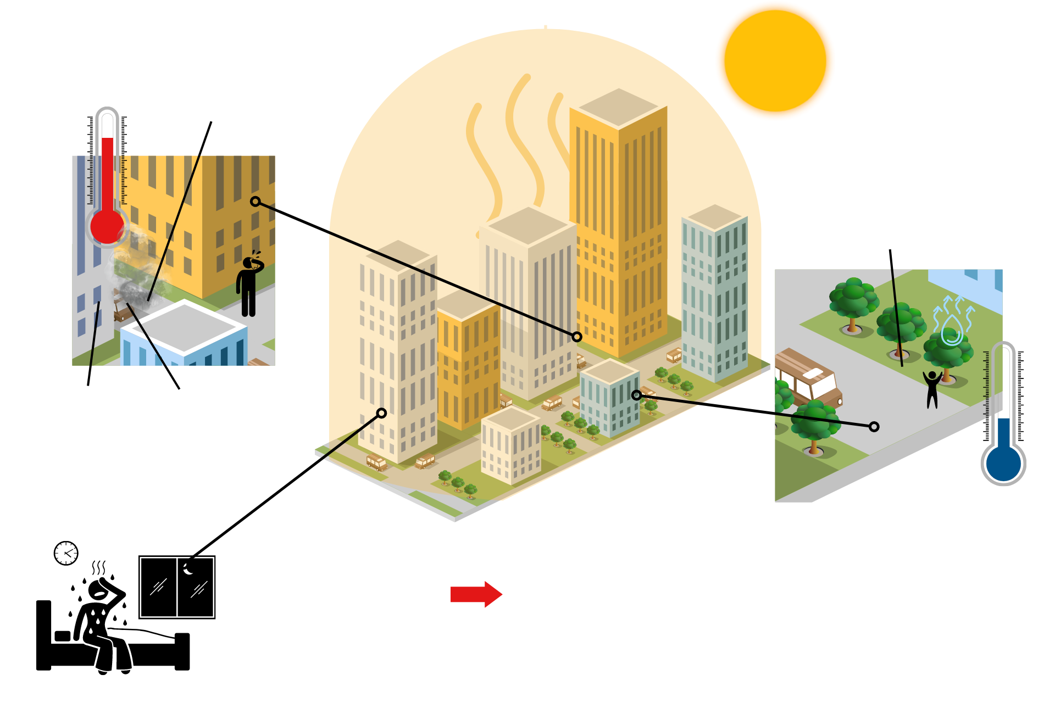
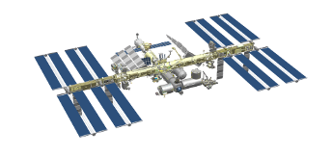
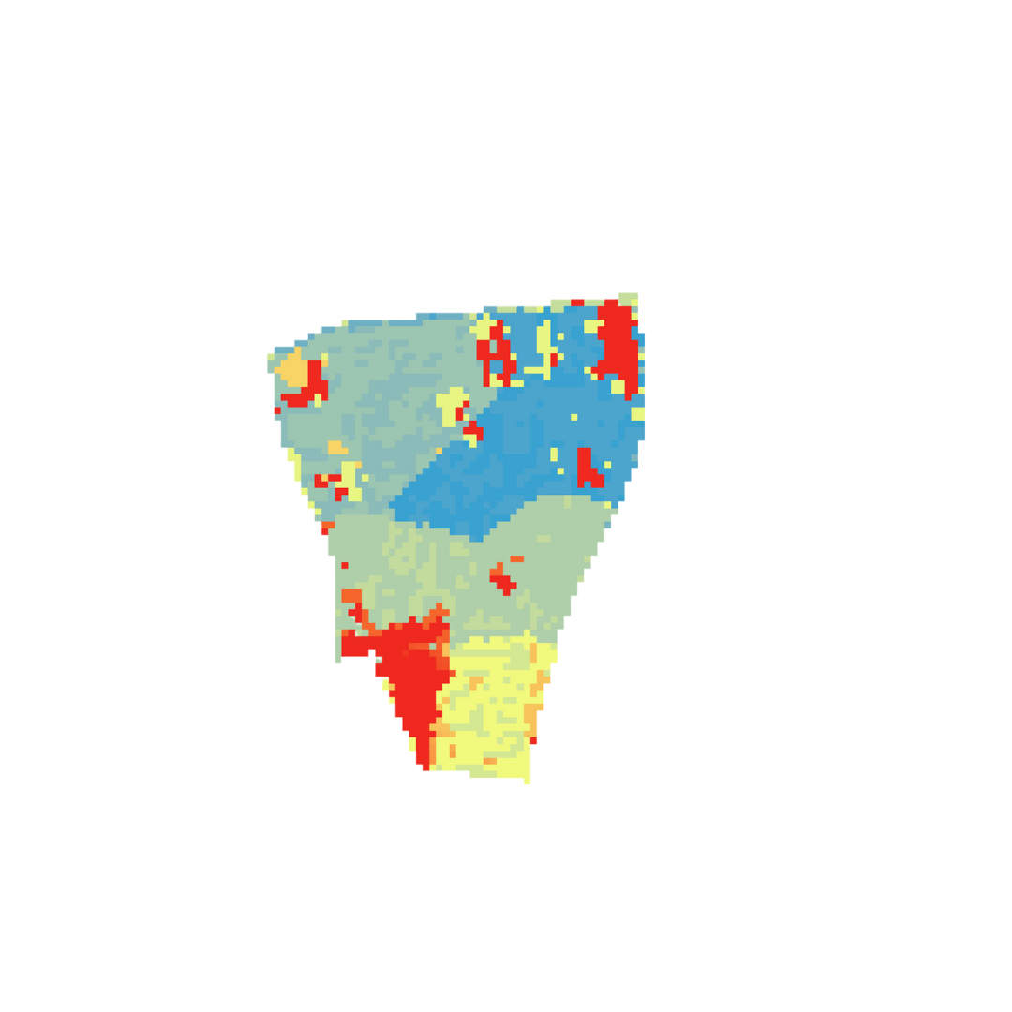
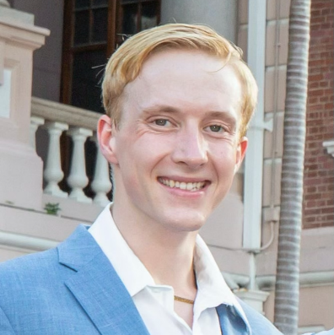
Enhancing Urban Cooling Intervention by Modeling Urban Forestry Through NASA Earth Observations in Albuquerque, New Mexico
Albuquerque is projected to see 4x the current annual number of days with temperatures above 100 °F by 2040
Little space between buildings holds heat
Albuquerque Urban Development
Lack of green space or trees for shade and evapotranspiration or water loss
Why does an urban area like Albuquerque have such extreme temperatures?
The urban heat island effect.
Urban heat islands can be dangerous, but the cooling effect of trees can help lower city temperatures.
Dark, compact surfaces like concrete absorb and trap heat
Waste heat from vehicles and machinery
Inequities in access to A/C, medical care and housing impact one's adaptive capacity, or ability to beat the heat
Image Credit: Skechtify, Alexel, Pesky, Viktor Morozuk, Leremy Gan, gstudioimagen, and vectorwin
Where should trees be planted in Albuquerque to provide maximum cooling impact? Satellites can help us find out:
Extreme heat impacts different populations in the same city in different ways, which is heat inequity
We can combine these factors to find human heat risk by vulnerable area:
Social
Vulnerability
Environmental
Vulnerability
Landsat 8 TIRS
ISS ECOSTRESS
Heat Mitigation Index
Based on current tree canopy cover in Albuquerque, NM
% of cover from tree canopy
If the amount of
tree shade in Albuquerque
increases by 30%
Heat Mitigation Index
Based on increased tree canopy cover in Albuquerque, NM
vulnerable
neighborhoods, such as this one near Westgate, can be cooled down by a large difference.
.66 (more able to lower heat)
.03 (less able to lower heat)
Currently, this area has a very poor ability to lower its own heat
But with more trees, this area can mitigate, or lower, extreme heat better!
0
Miles
2.5
Strategic cooling interventions are a step forward to help combat the effects of climate change and support the health of vulnerable communities.
The team would like to thank:
Partners: Let's Plant Albuquerque, City of Albuquerque Department of Environmental Health and Department of Parks and Recreation
Advisors: Dr. David Hondula (Arizona State University), Dr. Kenton Ross (NASA LaRC)​
DEVELOP Fellow: Ryan Hammock (DEVELOP AZ)
Special thanks: Yonkers Urban Development II AZ Fall 2021 Project, UHEAT Urban Development PUP Spring 2022 Project, Monique Howlett (DEVELOP GA)
Max Stewart
Christina Dennis
Ritisha Ghosh
Richard Kirschner
Steven Nystrom
Arizona – Tempe

