Slide 1
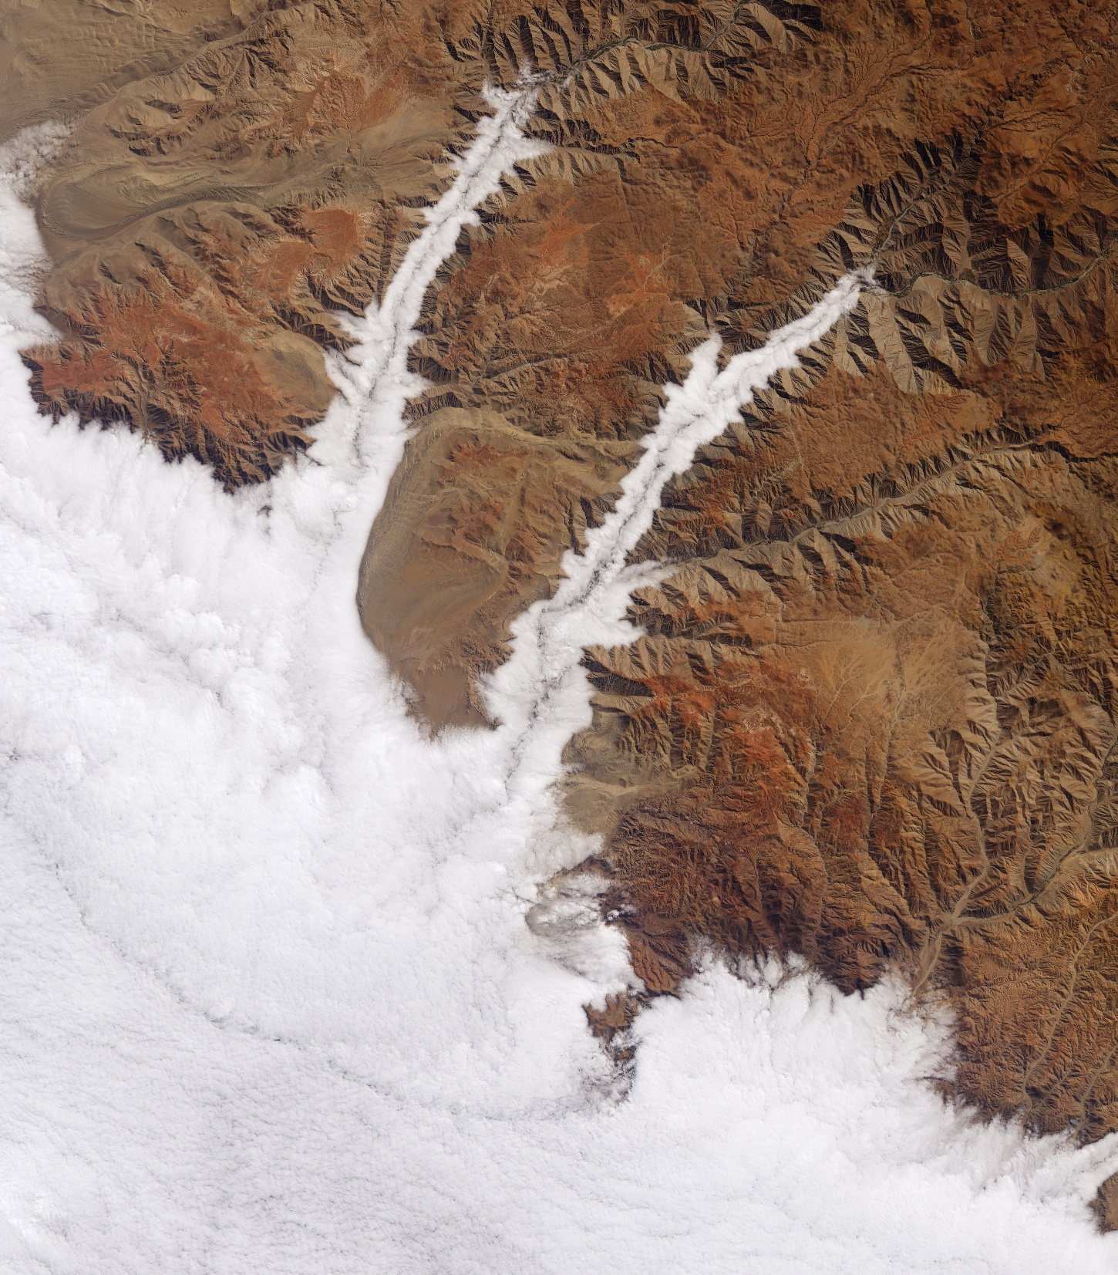
DEVELOP National Orientation (2022)
Module 8. Resources

Slide 2

DEVELOP Resources

Slide 3
RESOURCES
Note: DEVELOPedia underwent a MediaWiki update & we’re currently working to restore some links & broken functionality. Don’t worry if things look a little off – we’re working on it!
DEVELOPedia
DEVELOPedia is an internal wiki intended to serve three purposes:
  Enhance project workflow
  Capture lessons learned and make them available to future project teams
  Record data required for operational metrics
DEVELOPedia is a collaborative effort and living document, constantly adapting to meet the needs of the NASA DEVELOP National Program and the people that make the program great (That’s you!).
Virtual DEVELOP term & training resources
Completing Your Personal DEVELOPedia Page is a Week 1 Deliverable!
Make sure to include a picture, a long-term email address, information about your background & interests, & even include a link to your LinkedIn profile!
POCs:
Danny Mangosing & Amanda Clayton
http://www.devpedia.developexchange.com

Slide 4
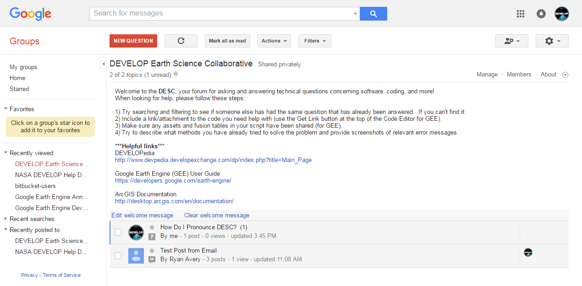
RESOURCES
DEVELOP Earth Science Collective
A forum for software, geospatial, and coding questions
Can email forum directly like a regular email address
Copy link, go join, and bookmark the DESC on your favorite browser!
https://groups.google.com/d/forum/developesc

Slide 5




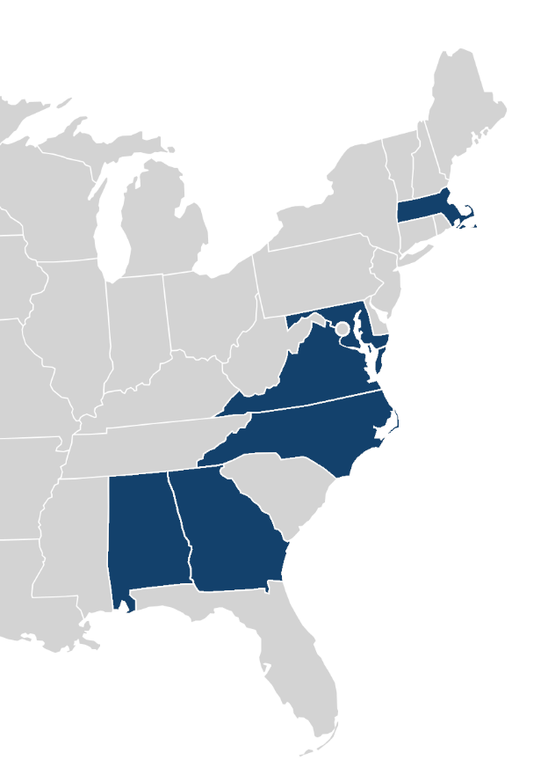

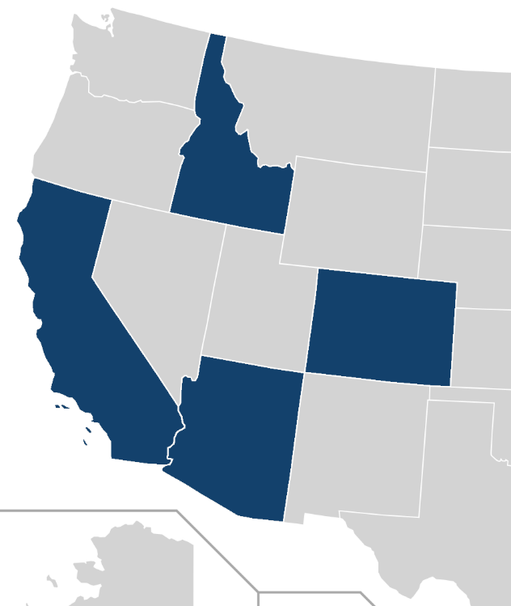









FELLOW MAP
Caroline
Pop-up Projects (PUP)
Project Coordination
Cecil (LaRC)
Laramie (LaRC)
Brandy (ID)
Lisa (ARC)
Impact Analysis
Celeste (GSFC)
Sarah (GA)
Geoinformatics
Sarah H. (CO)
Katie L. (JPL)
Carli (GSFC)
Caroline (PUP)
Communications
Tyler (MA)
Brianne (MSFC)
Katie C. (NC)
Julianne (VEJ)
Brandy
PC
Tyler
Comm
Lisa
PC
Carli
Geo
Celeste
IA SF
Katie
Geo
Laramie
*PC
Cecil
PC SF
Sarah
Geo
Kathryn
Comm
Brianne
Comm
Sarah
IA
Julianne
Virtual Environmental Justice (VEJ)

Slide 6
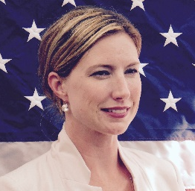
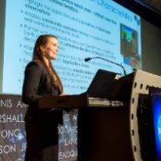


Note: for Virtual Machine questions, ask the Geoinformatics team or James Davis (SSAI) in the VM Support channel on Teams!
Questions? Contact…
Operational & SSAI Processes
Participant application system/process, outreach & recruitment, professional development, logistical support, SSAI processes, travel, Senior Fellow positions
Stephanie: 757-864-4498 Stephanie.Burke@ssaihq.com
Impact Analysis
Impact analysis, personal growth assessments, surveys
Celeste: celeste.gambino@ssaihq.com
Projects & Publications
Projects, publications, presentations, conferences, deadlines, international work, webinars, partners, project hand-offs, proposals, Fellow positions
Amanda: 757-864-5552 Amanda.L.Clayton@nasa.gov
Project Coordination
Deliverables, Export Control, DEVELOPedia
Cecil: robert.byles@ssaihq.com
Human Resources
Human resources, Employment status, offer letters, Space Systems onboarding systems, employment verifications, payroll, schedule adjustments, paperwork, employment verifications
Jolona: 757-864-3762 jolona.davis@ssaihq.com

Slide 7
External Resources:
Data & Trainings

Slide 8
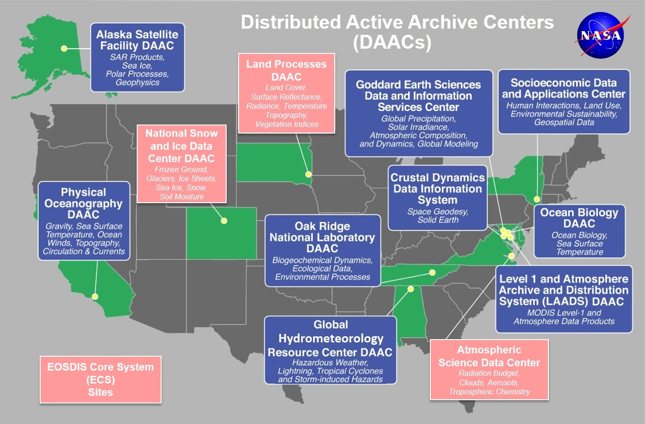
NASA Data Centers
By The Way
DAAC websites are a great way to access NASA Earth observation data! You can also find thorough documentation and metadata attached.
The Earth Observing System Data and Information System (EOSDIS) is designed as a distributed system, with major facilities at Distributed Active Archive Centers (DAACs) located throughout the United States.
These institutions are custodians of EOS mission data and ensure that data will be easily accessible to users.
The EOSDIS DAACs process, archive, document, and distribute data from NASA's past and current Earth-observing satellites and field measurement programs.
DAACs provide services to users whose needs may cross the traditional boundaries of a science discipline, while continuing to support the particular needs of users within the discipline communities. User services include:
  Assistance in selecting and obtaining data
  Access to data-handling and visualization tools
  Notification of data-related news
  Technical support and referrals

Slide 9
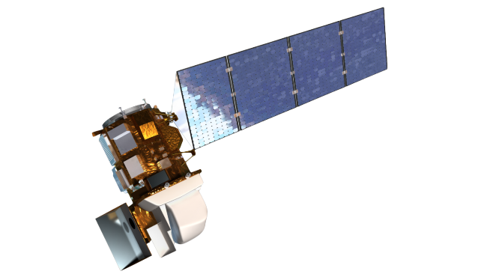
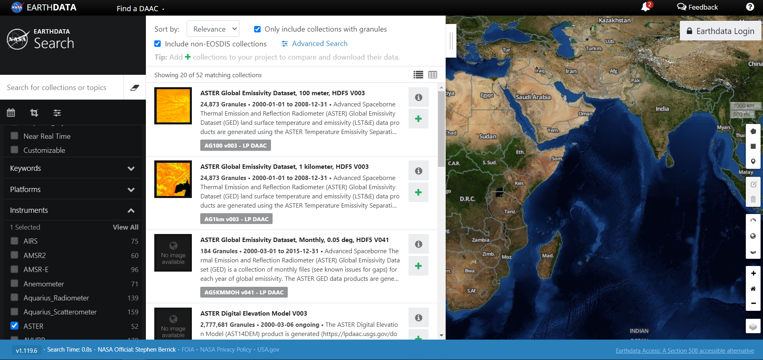
NASA Data Center Resources
Need access to NASA data? Check out the following sites:
EOSDIS Distributed Active Archive Centers (DAACs) https://earthdata.nasa.gov/about/daacs
Earth Data Search https://search.earthdata.nasa.gov/search
Earthdata Forum https://forum.earthdata.nasa.gov/
  Ask questions about data types, access, issues, etc.
LP DAAC AppEEARS https://lpdaac.usgs.gov/tools/appeears/
  Simple and efficient data access and transformation
Now where did I put those data…?
New to using NASA Earth science data?
Data Pathfinders provide direct links to commonly-used datasets across NASA’s Earth science data collections
· Agriculture & Water Resources
· Biological Diversity & Eco Forecasting
· Geographic Information Systems
· Disasters· Health & Air Quality· Wildfires

Slide 10
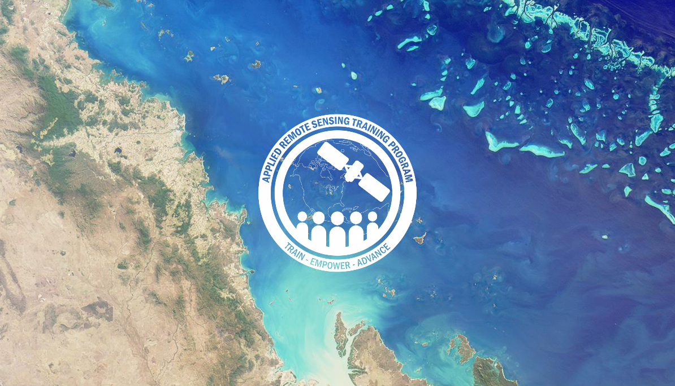
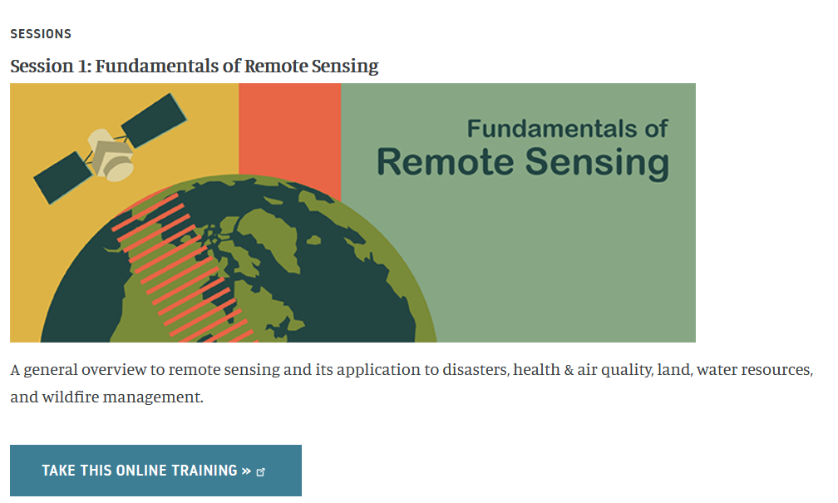
ARSET
By The Way
ARSET is a great resource for brushing up on your remote sensing skills!
Through ARSET trainings, you can learn how to:
Use NASA data for environmental management
Search and access NASA resources relevant to your needs
Visualize, interpret, and apply remote sensing data and imagery
Remote Sensing Fundamentals: These webinars are available for viewing at any time. They provide basic information about the fundamentals of remote sensing and are often a prerequisite for other ARSET trainings. https://appliedsciences.nasa.gov/join-mission/training/english/fundamentals-remote-sensing
  Session 1: Fundamentals of Remote Sensing
  Session 1A: NASA’s Earth Observing Fleet
  Session 2A: Satellites, Sensors, Data and Tools for Land Management and Wildfire Applications
  Session 2B: Satellites, Sensors, and Earth Systems Models for Water Resources Management
  Session 2C: Fundamentals of Aquatic Remote Sensing
https://appliedsciences.nasa.gov/what-we-do/capacity-building/arset

Slide 11
Thank You.
Explore all of the resources available to you! And if you find helpful resources, share them!

