Slide 1

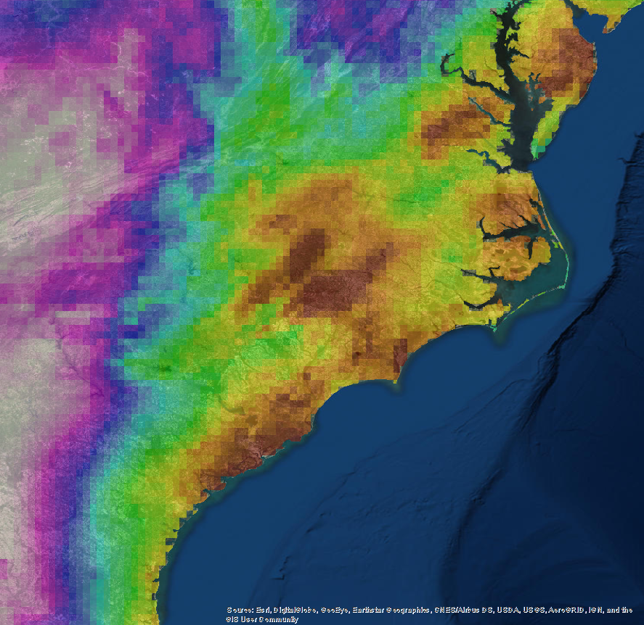

CAROLINA DISASTERS
Utilizing Precipitation Estimates from NASA Earth Observations & NOAA Climate Data Records to Enhance Understanding of Extreme Events in the Carolinas
Shelby Ingram
Andrew Shannon
Michael VonHegel
Notes:
Hello, my name is ___________, ___________, and ___________, and we represent the Carolinas Disasters team here at NCEI. Our project focused on “Utilizing Precip Estimates from NASA EO to enhance the understanding of Extreme Events in the Carolinas”.
Image source: DEVELOP team website image

Slide 2
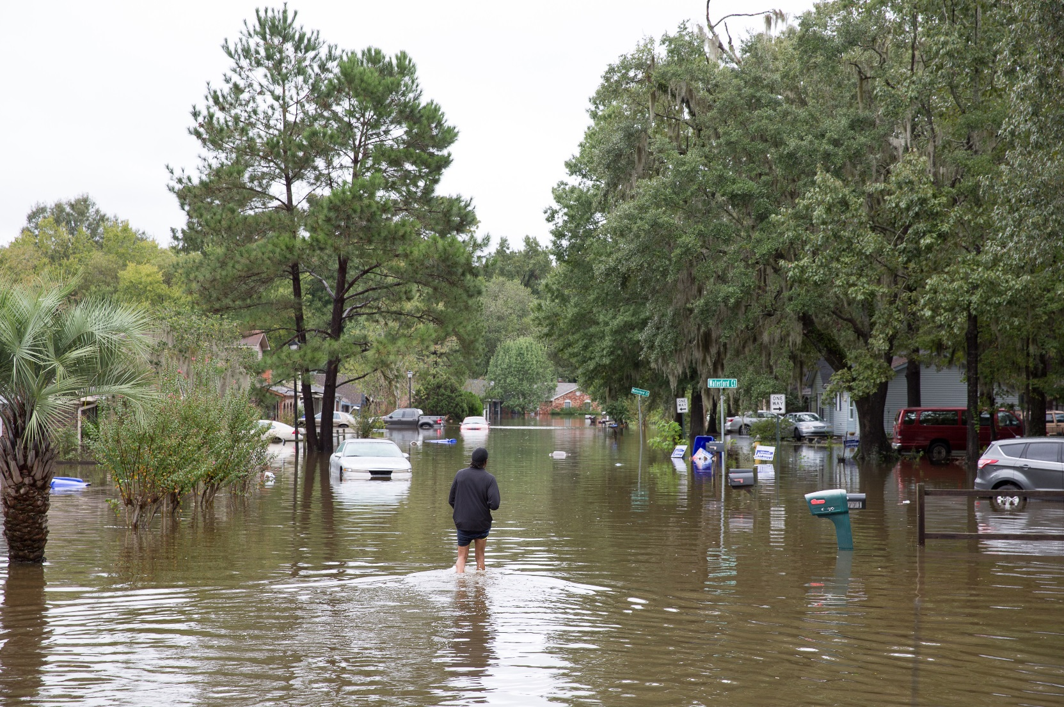
Community Concerns
Source: North Charleston
October 2015
“…we simply must make flooding and drainage our city's top long-range priority.“
-Mayor Tecklenberg (Charleston, SC)
2018 State of the City Address
Image Credit: SC National Guard
Notes:
Why do we care about extreme precipitation? It presents a climate stressor that results in impacts, such as flooding, landslides, and erosion. For example, in October 2015, South Carolina experienced a record-breaking precipitation event that caused over a billion dollars in damages to infrastructure and other assets, and 19 causalities. Researchers, resource managers, and regional decision makers are interested in expanding their access to actionable information regarding precipitation, including the Mayor of Charleston who noted in the 2018 State of the City Address that flooding must become the city’s top-long range priority.
Image source: https://www.flickr.com/photos/northcharleston/21787458760/in/album-72157659102336620/

Slide 3
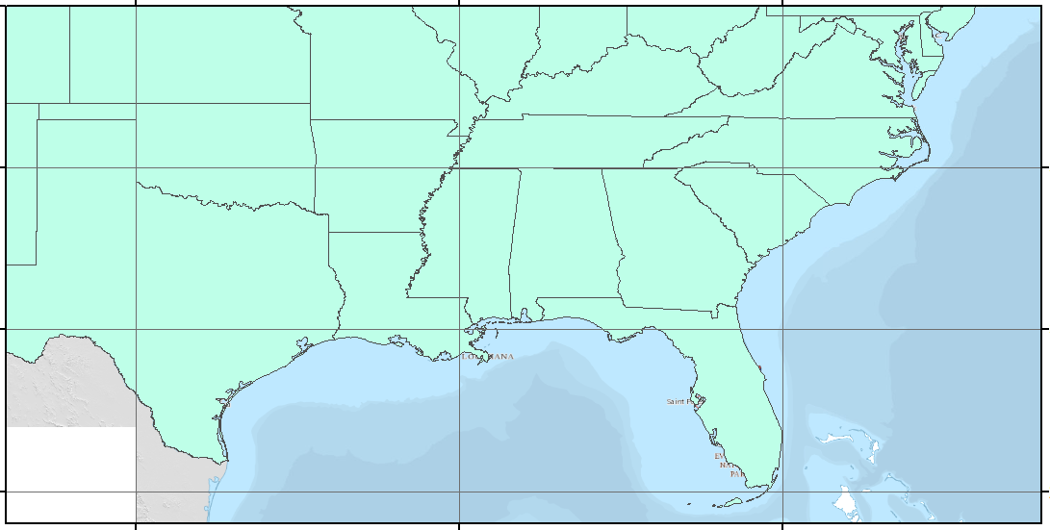
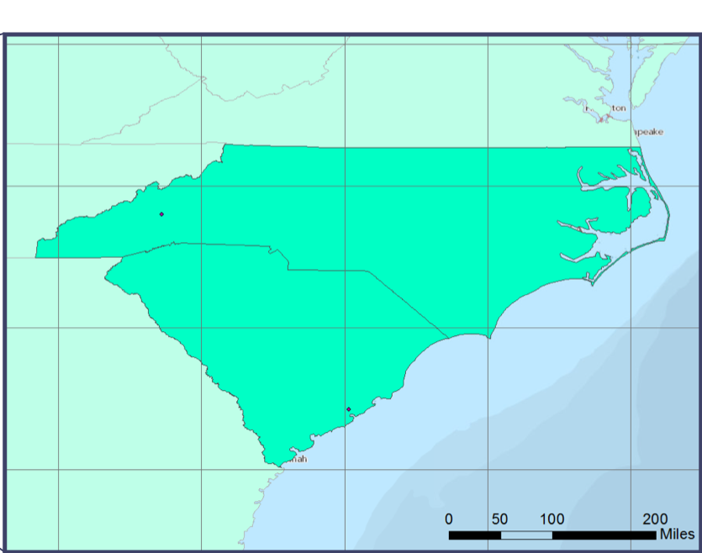
Project Objectives
40 ° N
Demonstrate utility of satellite-derived products to measure extreme precipitation in the Southeastern US
Evaluate performance of satellite estimates to rain-gauge observations
Collaborate with project partners to engage data-user needs
35 ° N
30 ° N
25 ° N
100 ° W
90 ° W
80 ° W
Notes:
To address the need for expanded precipitation information, our team met three project objectives:
Demonstrate utility of satellite-derived products to measure extreme precipitation in the Southeastern US and for the Carolinas, in particular
Evaluate performance of satellite estimates to rain-gauge observations
Collaborate with project partners to engage data-user needs
Image source: DEVELOP Team study area

Slide 4
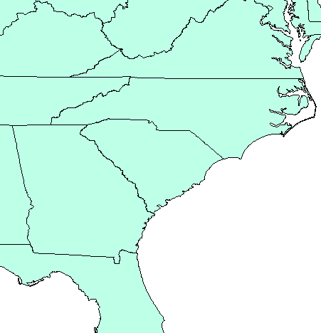
Project Partners
National Environmental Modeling & Analysis Center (NEMAC)
  Develops decision support tools, such as the Climate Resilience Toolkit, for communities
  Synthesizes climate data and builds applications to evaluate assets and identify climate risks
NEMAC
NOAA Office of Coastal Management (OCM)
  Provides coastal communities access to science and environmental intelligence
  Assists with decision making process for storm preparedness, development, sea level, etc.
OCM
Notes:
Our project partners include NEMAC based at the University of North Carolina - Asheville and the NOAA OCM based in Charleston, SC, who work to identify risks from climate stressors, such as precipitation, and to develop resilience and management practices at the local, regional, and national level. They do not currently emphasize use of satellite-based climate data in their work, so our project serves to bridge the gap between their resilience planning efforts and their knowledge of reliable and actionable precipitation information from satellite data.
Image Source: DEVELP Team Study Area

Slide 5
Process
Quantify “extreme” precipitation
Illustrate bias from rain gauges
Visualize precipitation data sets
Create Precipitation Data User’s Guide
Percentile Values
Threshold Exceedance
Extreme Events
Image Credit: SC National Guard
Data Collection
Processing
Computation
Analysis
GPM-IMERG
TRMM TMPA
PERSIANN-CDR
Subset to area of interest
Creation of scatterplots, cumulative density functions (cdf's), averages, accumulation, bias
Location and time comparisons
Visualization and synthesis of statistical results
Data Collection
Processing
Computation
Analysis
GPM-IMERG
TRMM TMPA
PERSIANN-CDR
Subset to area of interest
Creation of scatterplots, cumulative density functions (cdf's), averages, accumulation, bias
Location and time comparisons
Visualization and synthesis of statistical results
Data Collection
Processing
Computation
Analysis
GPM-IMERG
TRMM TMPA
PERSIANN-CDR
Subset to area of interest
Creation of scatterplots, cumulative density functions (cdf's), averages, accumulation, bias
Location and time comparisons
Visualization and synthesis of statistical results
Data Collection
Processing
Computation
Analysis
GPM-IMERG
TRMM TMPA
PERSIANN-CDR
Subset to area of interest
Creation of scatterplots, cumulative density functions (cdf's), averages, accumulation, bias
Location and time comparisons
Visualization and synthesis of statistical results
Notes:
-The process for the project is outlined here
-These bullet points provide an overview our analysis in a nutshell
-The last mention of a conceptual framework is a newer stage in our project → we hope to come up with something that can be handed off in an organized manner
→ We hope to answer the question: when looking for data for a specific time and location, where does the user go and what do they do?
Image source: https://www.flickr.com/photos/thenationalguard/sets/72157659506260005/with/21415289763/

Slide 6


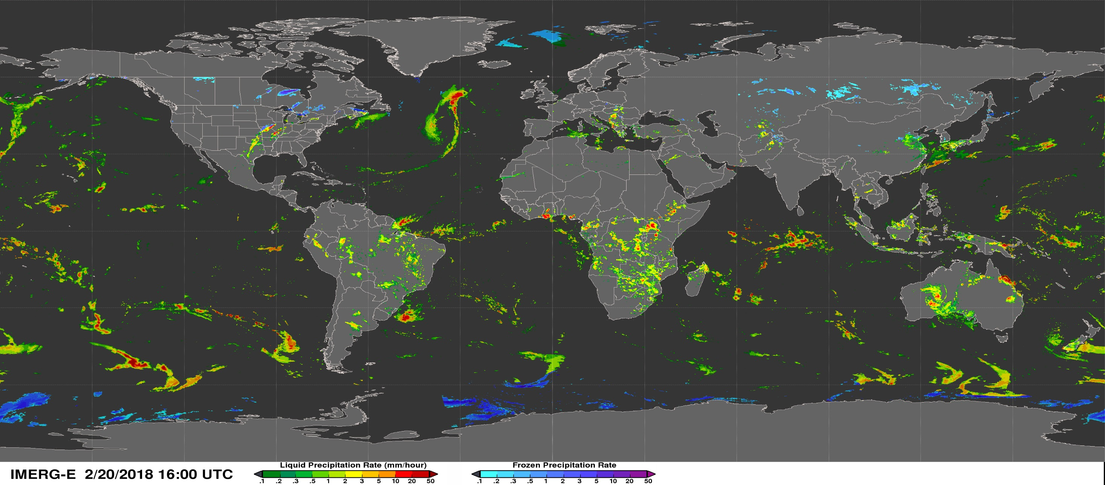
Precipitation Estimates
NASA Earth Observations (EO)
NOAA Climate Data Record (CDR)
NOAA Rain Gauge
TRMM-TMPA
GPM-IMERG
PERSIANN-CDR
GHCN-D
Image Credit: NASA PMM
Notes:
PERSIANN and GHCN – NOAA
GPM and TRMM – NASA, IMERG is new, TRMM is old
“We compare precipitation estimates from NOAA-CDR’s, NASA EO’s, and in-situ data, which represent a range of spatial resolutions, estimation methods, and periods of records to show the variety of products available to our partners and how they compare to one another”
Image source: https://pmm.nasa.gov/gpm/imerg-global-image

Slide 7
Results: Percentile Values
CDF Comparison 2014-2016
Estimates vary
Large differences at the top 10%
Percentile
MM/DAY
CDF comparison of all three satellites from 2014-2016, NC and SC (mm per day)
Notes:
-This CDF or Cumulative Distribution Functions illustrates the rainfall patterns observed by each satellite. A CDF encompasses ordering the data from highest to lowest, and the finding precipitation values (mm/day) that correspond to top 10%, top 1% events and so on. When we say 90th percentile we mean top 10% of all rainfall events are above this value.
-

Slide 8
A closer look
CDF Comparison 2014-2016
29.17 (T)
21.34 (I)
Percentile
14.28 (P)
MM/DAY
Focused CDF comparison of all three satellites from 2014-2016, NC and SC (mm per day)
Notes:
-This CDF or Cumulative Distribution Functions illustrates the rainfall patterns observed by each satellite. A CDF encompasses ordering the data from highest to lowest, and the finding precipitation values (mm/day) that correspond to top 10%, top 1% events and so on. When we say 90th percentile we mean top 10% of all rainfall events are above this value.
-we observe a 200% difference at the top 10% events with just three satellite measures, for the states of NC and SC.

Slide 9
Adding the rain gauges
CDF Comparison 2014-2016
29.20 (G)
Percentile
MM/DAY
Focused CDF comparison for gauge and all three satellites from 2014-2016, NC and SC (mm per day)
Notes:
-We can see the gauge falls right on top of TRMM and best matches TRMM’s value

Slide 10
Results: Percentile Values
NOAA CDR: PERSIANN
NASA EO: TRMM
NASA EO: IMERG
Percentile
MM/DAY
CDF comparison of Gauge vs Satellite percentile values for entire periods of record. Note: IMERG 14-16
Notes:
-This slide is a small showcase of the end products created thus far
-CDF’s shown on the left → presenter will describe what it illustrates
-Maps highlight rainfall in our area of interest, and are self explanatory

Slide 11
A closer look
NOAA CDR: PERSIANN
NASA EO: TRMM
NASA EO: IMERG
Percentile
MM/DAY
CDF comparison of Gauge vs Satellite percentile values for entire periods of record Note: IMERG 14-16
Notes:
-This slide is a small showcase of the end products created thus far
-CDF’s shown on the left → presenter will describe what it illustrates
-Maps highlight rainfall in our area of interest, and are self explanatory

Slide 12
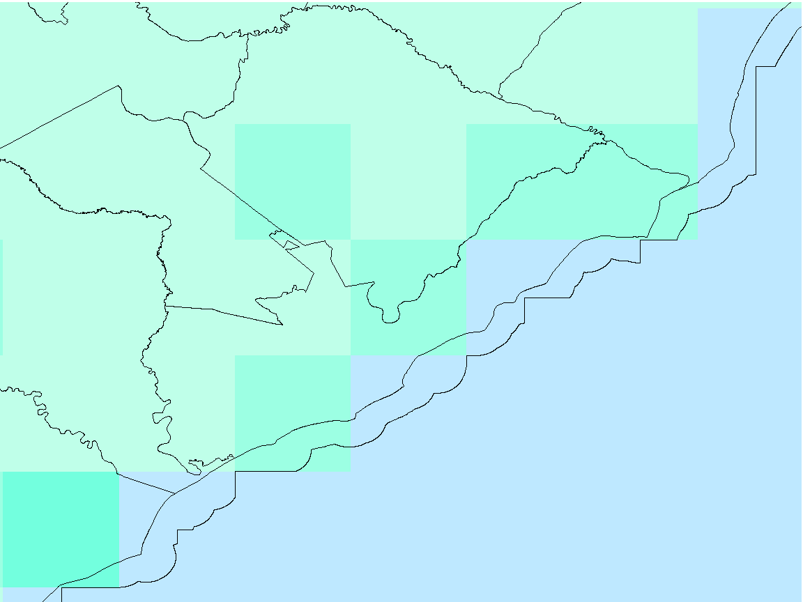
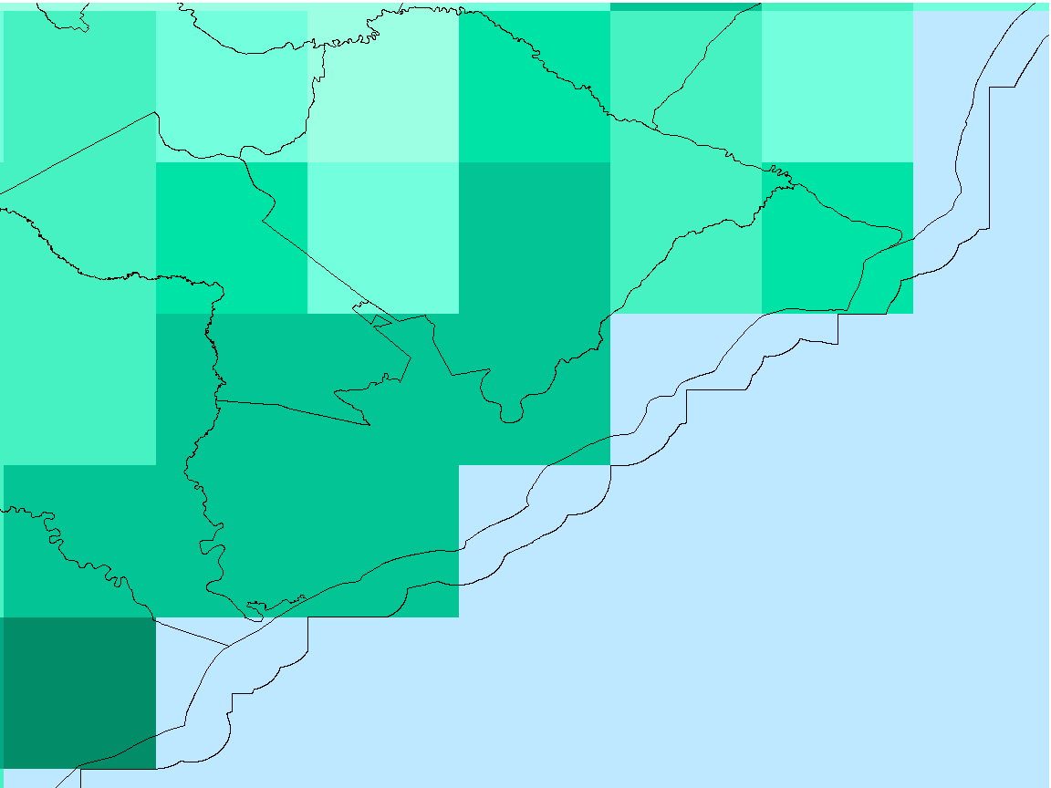
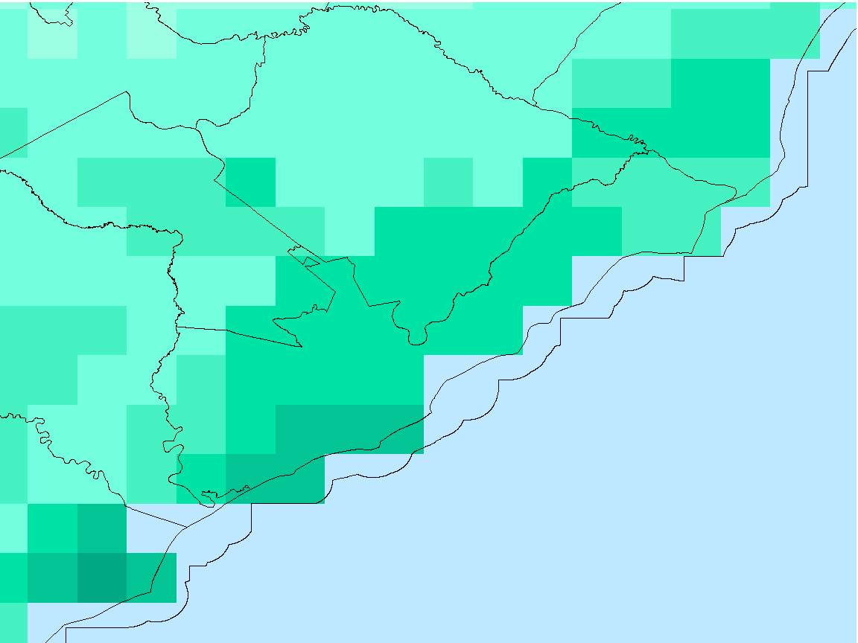
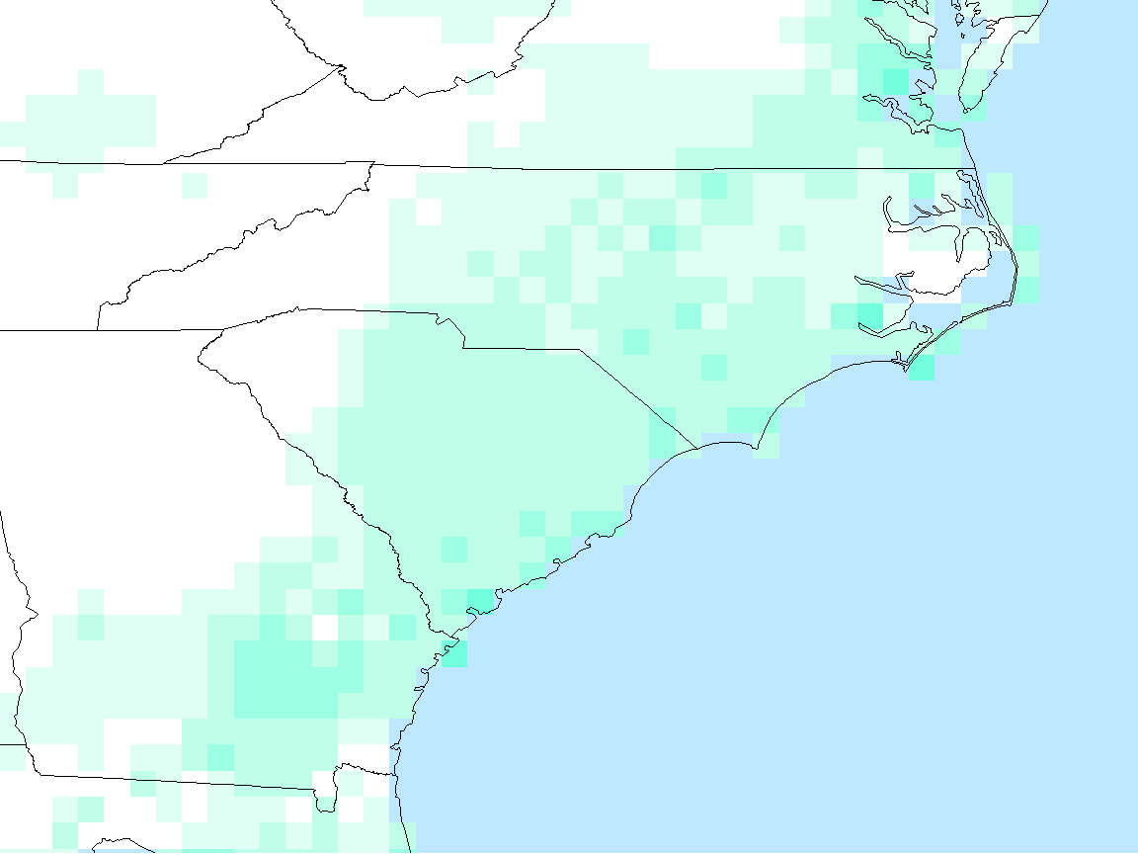
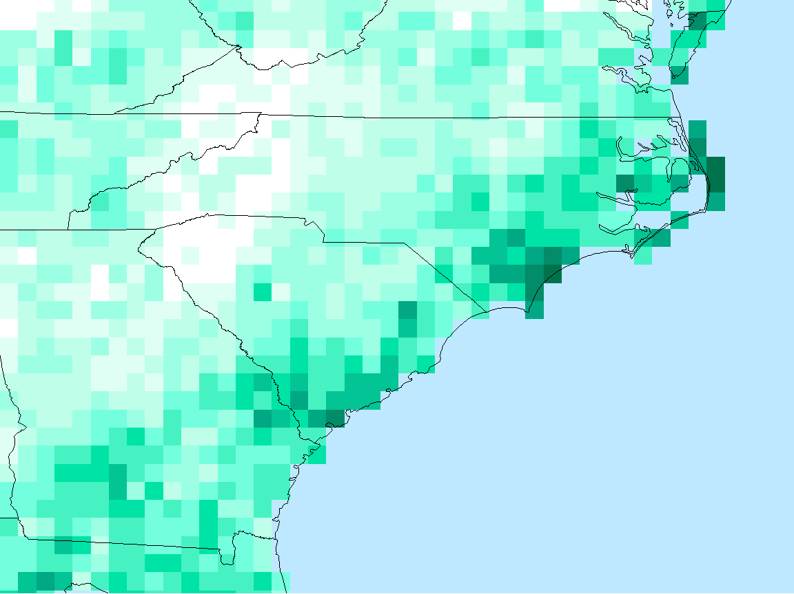
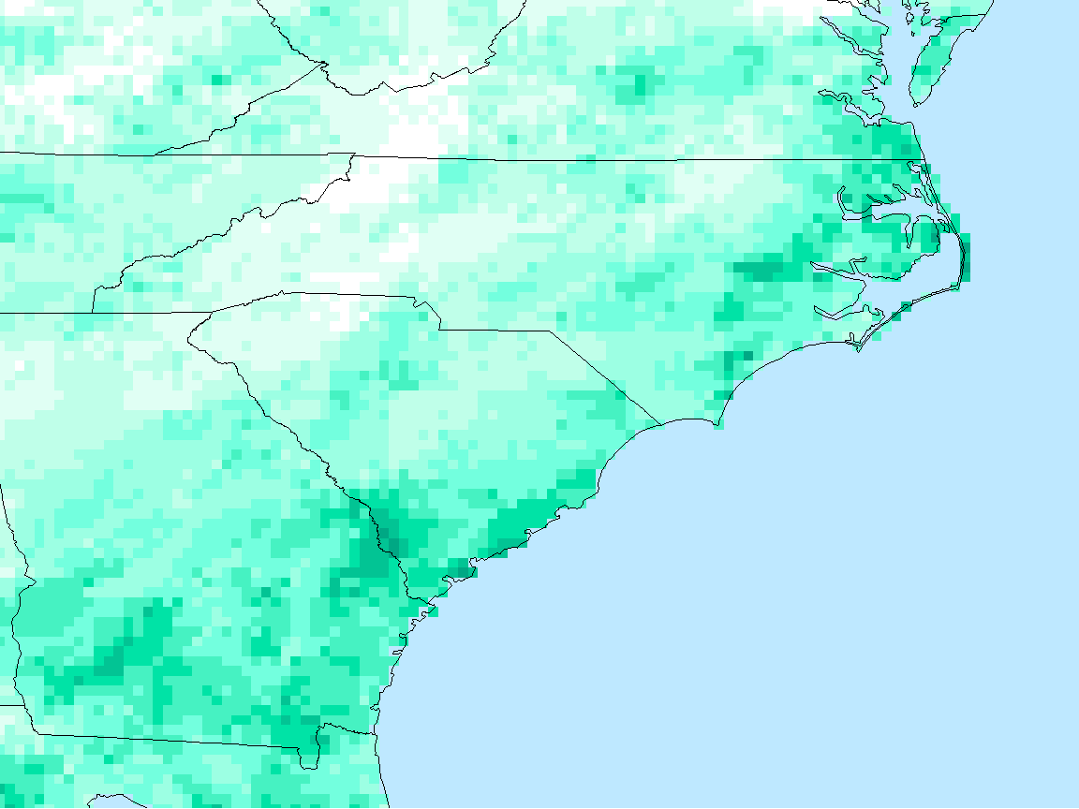
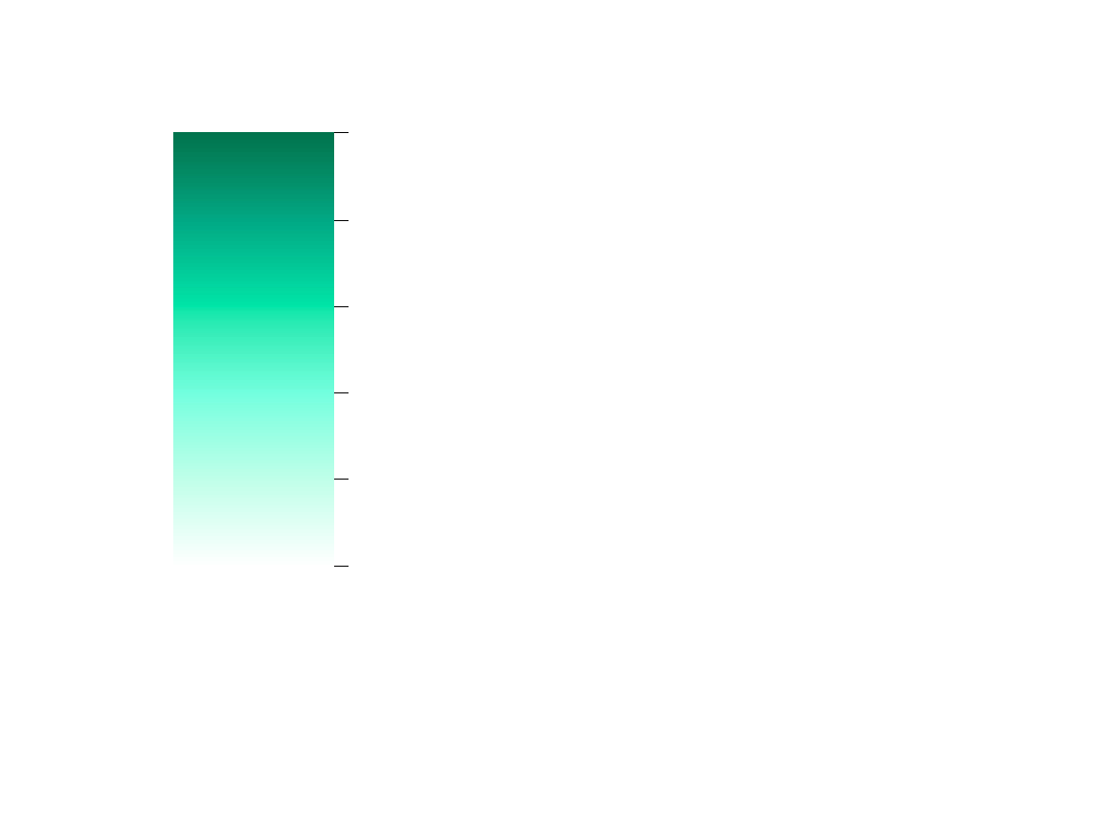
Results: Threshold Exceedance
NOAA CDR: PERSIANN
NASA EO: TRMM
NASA EO: IMERG
Exceedance days: 3
Accumulation: 10.7”
% of 2016 Acc. (56”): 19%
Exceedance days: 7
Accumulation: 25.1”
% of 2016 Acc. (52”): 48%
Exceedance days: 6
Accumulation: 24.4”
% of 2016 Acc. (55”): 45%
2 in/day Threshold Exceedance for 2016 (days)
0
2
4
6
8
10
Threshold value: 2in/day Time period: 2016
Notes:
The second way we measure extreme precipitation was via threshold exceedance, or the number of days recorded above a certain value. These maps show the number of days recorded above 2in/day for the most recent, full year of data on record, 2016. 2in/day corresponds to about the top 5% of daily rainfall values, and in these maps we see that the NASA EO generally record more days above 2in/day than the NOAA CDR, and GPM has a finer spatial resolution.

Slide 13
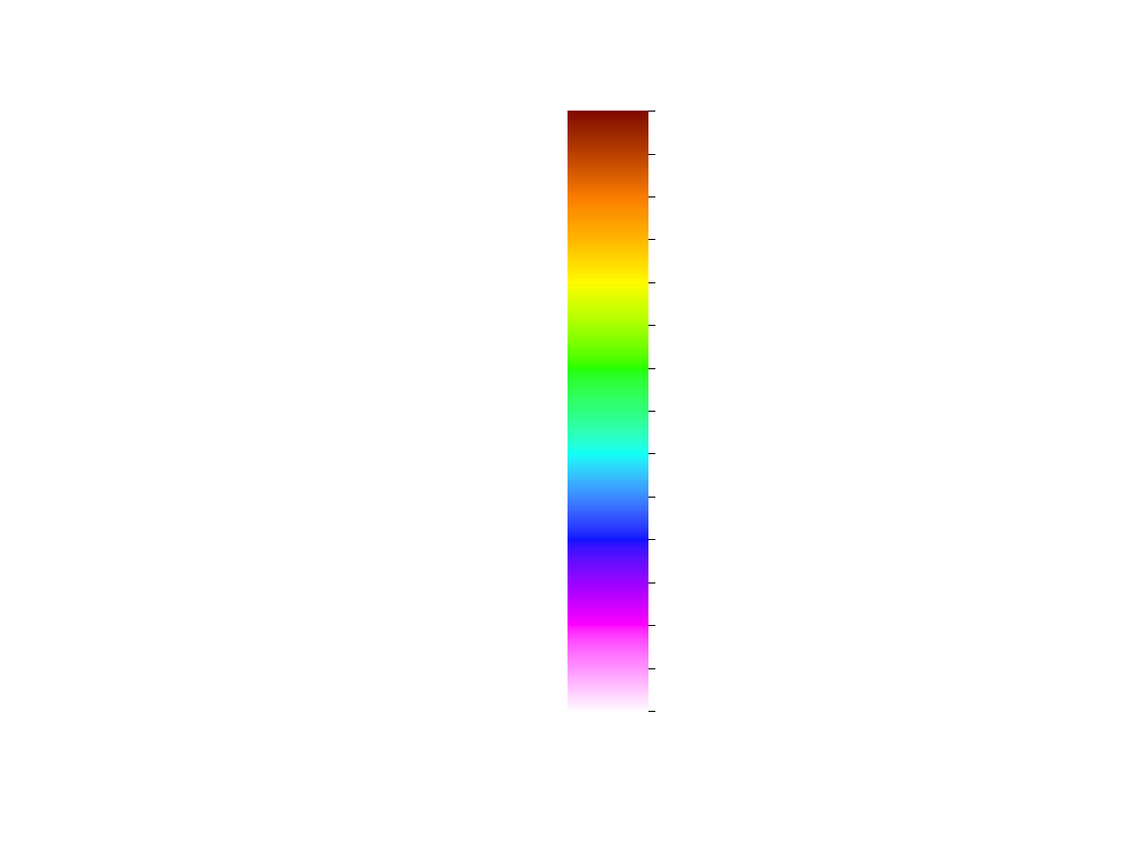
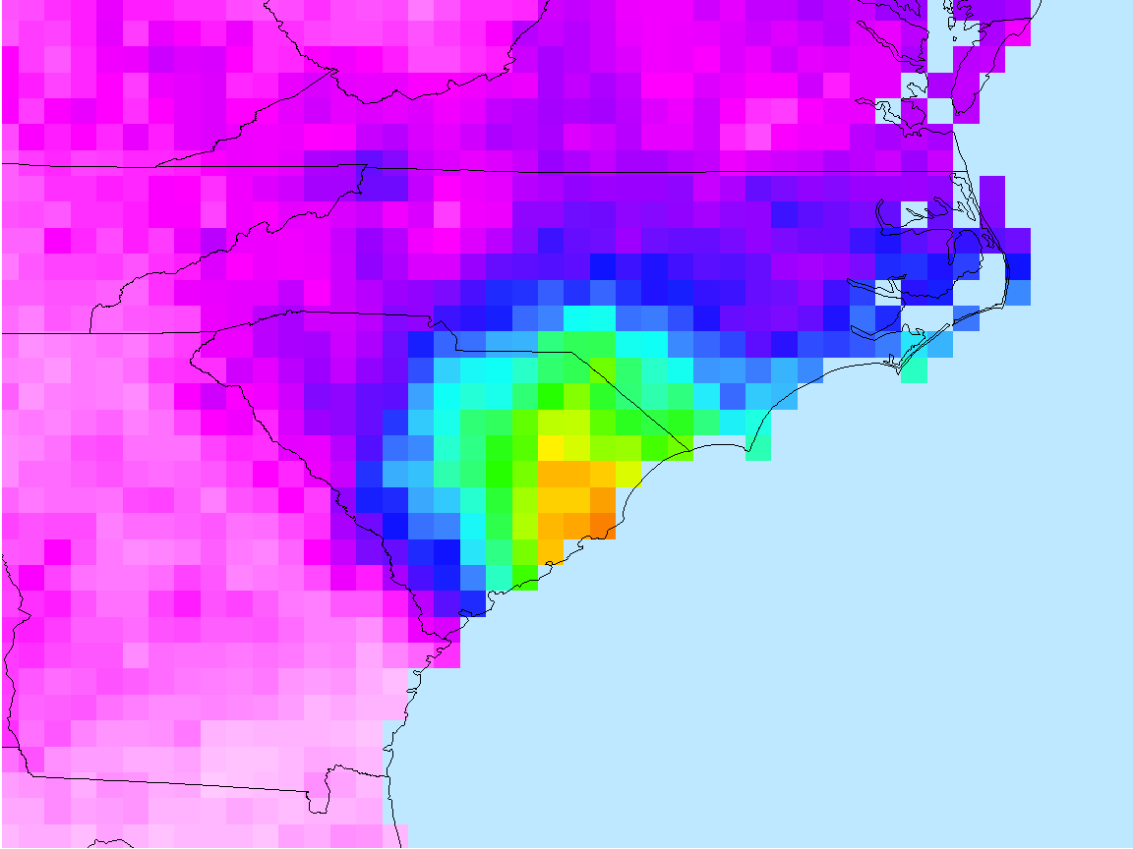
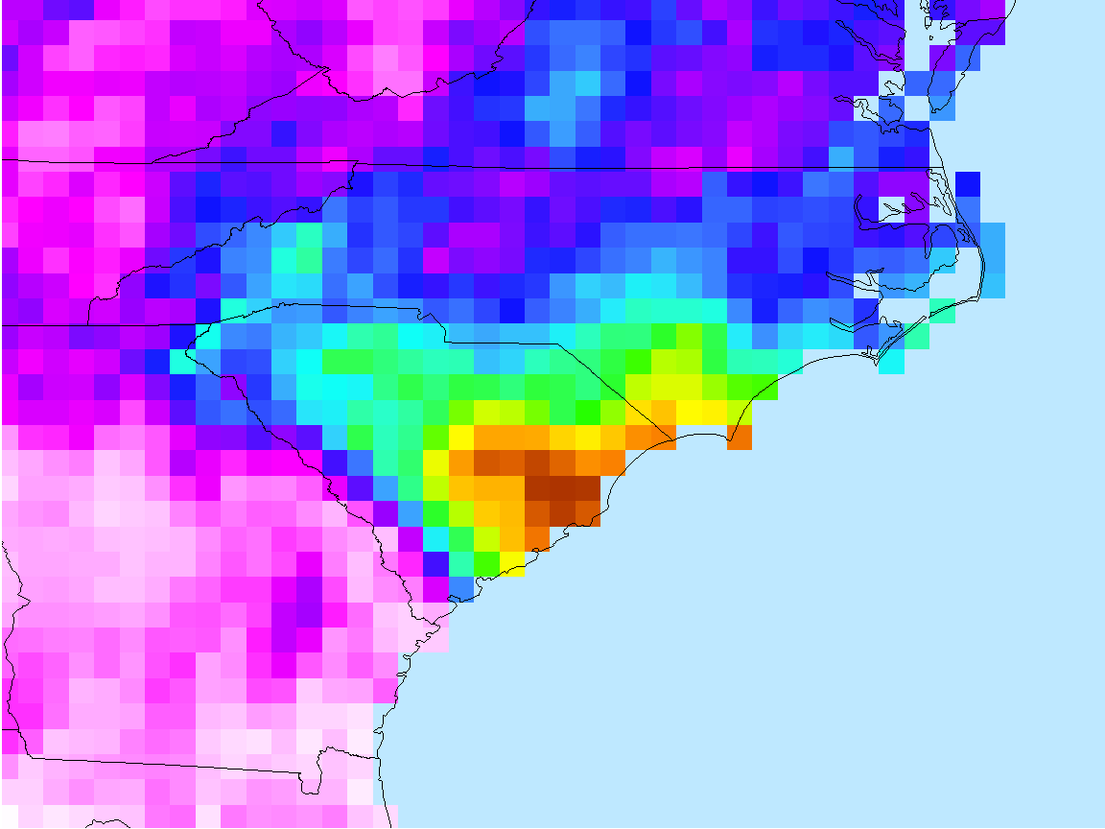
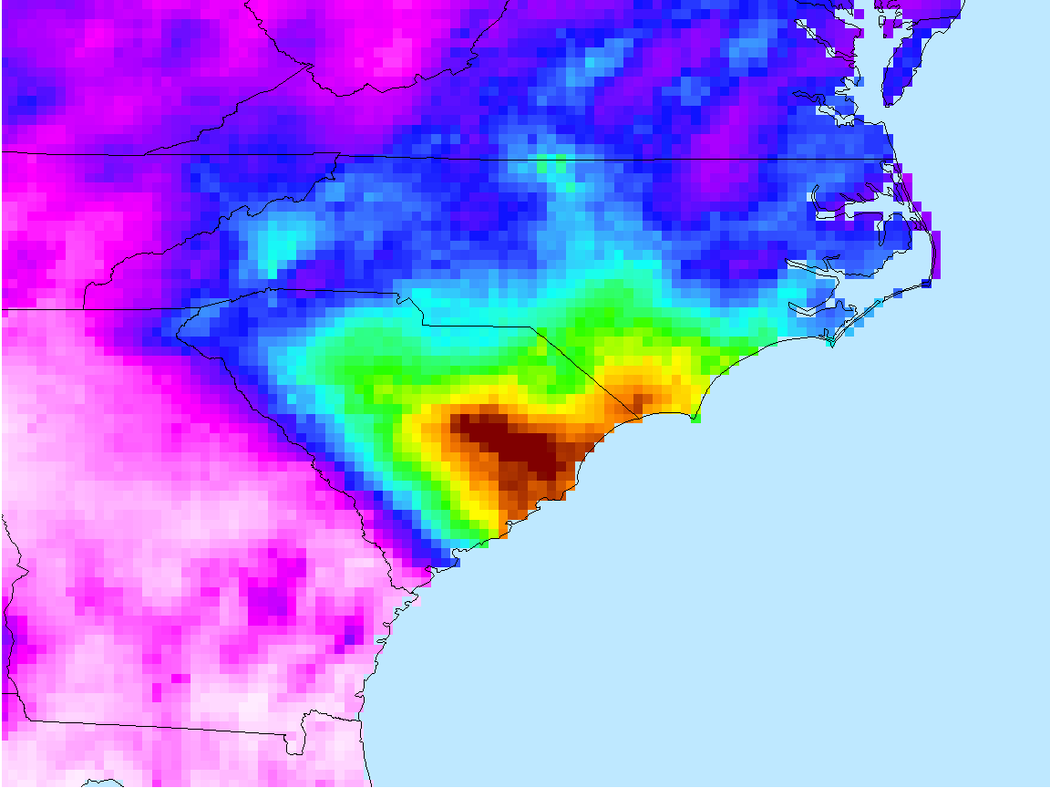
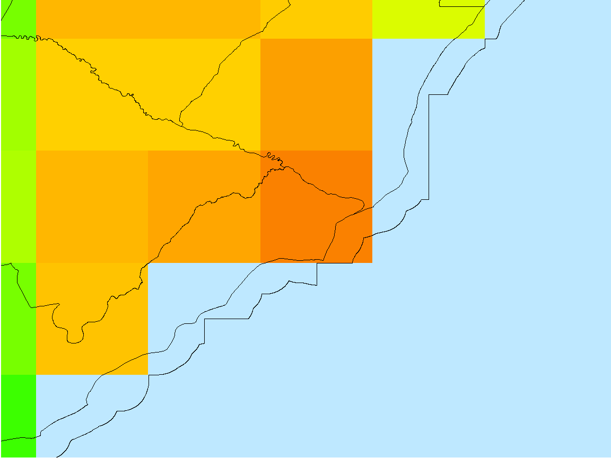
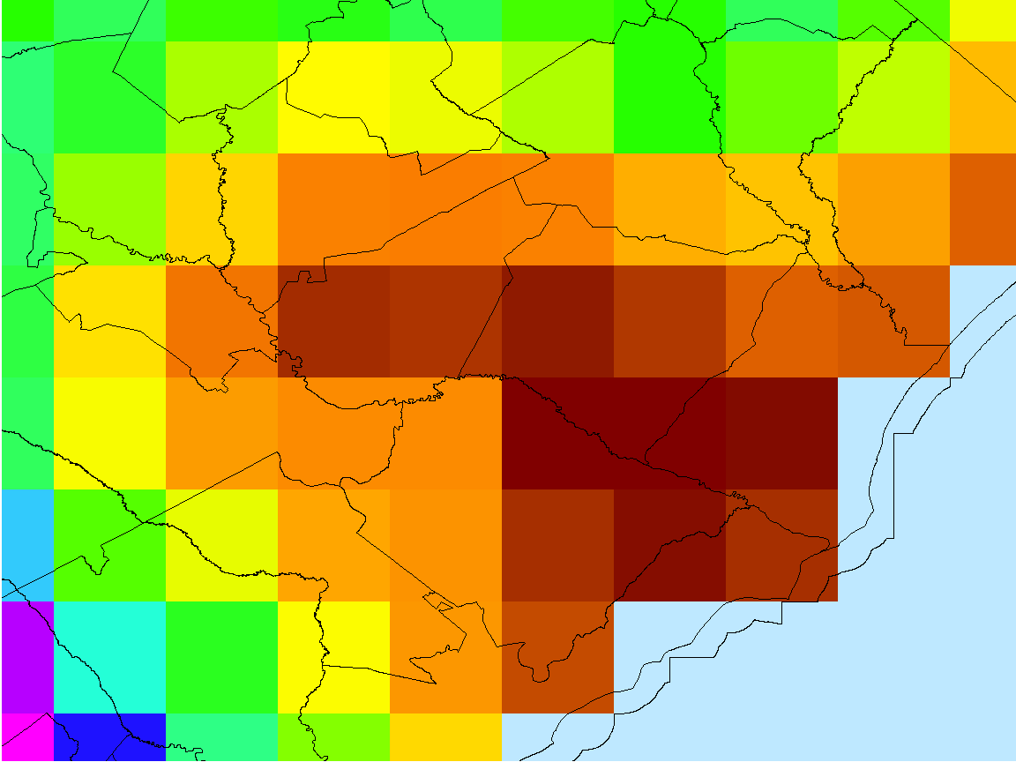
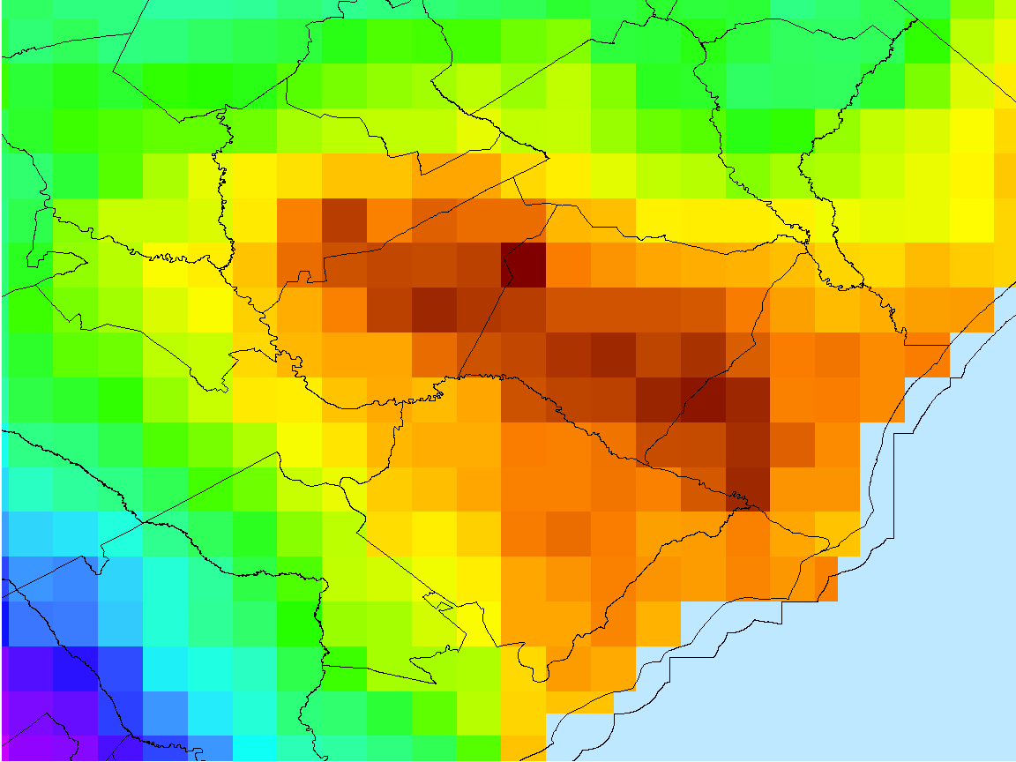
Results: Extreme Events
NOAA CDR: PERSIANN
NASA EO: TRMM
NASA EO: IMERG
Hurricane Joaquin-related Accumulation (mm): 29 Sept – 07 Oct 2015
Max acc.: 12”
% of 2015 acc. (64”): 18%
Max acc.: 13”
% of 2015 acc. (62”): 21%
Max acc.: 15”
% of 2015 acc. (64”): 24%
0
50
100
150
200
250
300
> 350
Hurricane Joaquin-related Accumulation: 29 Sept – 07 Oct 2015
Notes:
The third way we measured extreme precipitation is by extreme events, typically tropical cyclones. These maps show how each satellite measured accumulation for Hurricane Matthew in 2016. We see that the NASA EO have matching patterns and capture a larger area of higher values over 350 mm or about 14 in.
The NASA EO measure the max accumulation value in the same location at Fort Bragg, NC, while the PERSIANN max is located further north at a lower value. For all satellites, this maximum accumulation from Hurricane Matthew represents about 20% of the total rainfall for 2016 in this one event. This is important information for resource managers wanting to better understand the influence of tropical cyclones and other storms on the water budget of a locale or region.
350 mm is about 14in

Slide 14
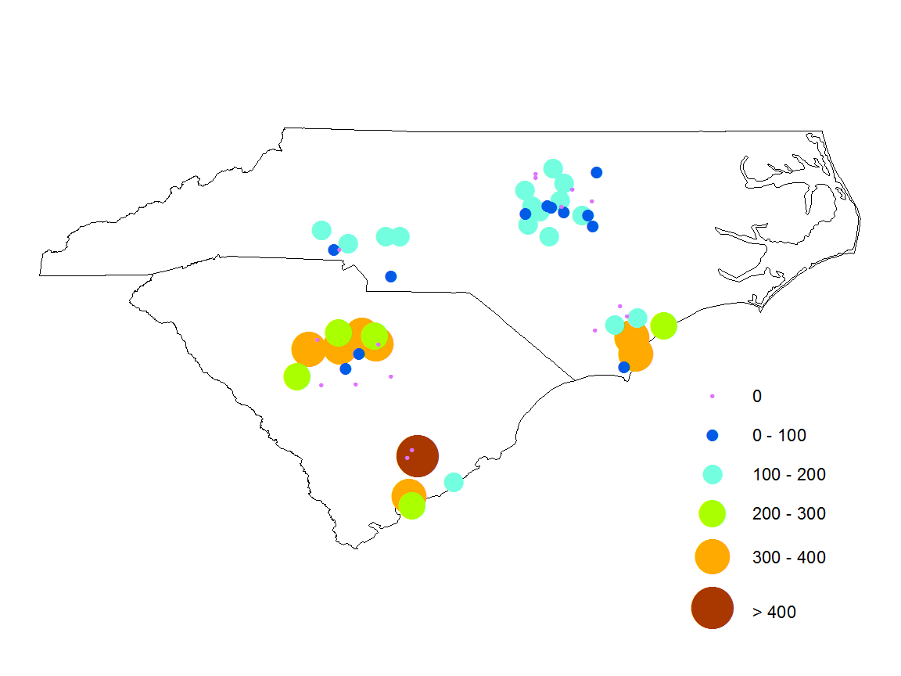
Results: Extreme Events
Hurricane Joaquin-related Accumulation
NOAA Rain Gauge (GHCN)
accumulation (mm) at gauges within 50 km of population centers
Raleigh
0
Charlotte
0 - 100
100 - 200
Wilmington
200 - 300
Columbia
300 - 400
Charleston
> 400
Notes:
Here, we compare the satellite record of the TC-related precip to rain gauge. We see that the max is greater for the rain gauge, but that a number of gauges within 50 km of population center did not record accumulation

Slide 15
Results: Bias
Definition:
  The difference between an expected value and a true value.
  Desired value is close to 1
Two forms
  Unconditional
  Conditional
Notes:
-A value of 1 is desired as the bias because the ratio would mean that the satellite and gauge are close.
-Conditional bias is when we use the top 1%, or another percentage, of precipitation for the gauge and make it the true value of precipitation then we compare that value to the precipitation accounted for by the satellite.
-Conditional Bias also displays the number of gauges that reached the top 1%. Which we’ll talk more about in the following slides
-unconditional bias is when we test the gauge precipitation compared to the satellite precipitation with no stipulations of a percentage

Slide 16
Results: Unconditional Bias
NOAA CDR: PERSIANN
NASA EO: TRMM
NASA EO: IMERG
Bias of Satellite vs Gauge precipitation estimates
Notes:
In the unconditional bias we see that PERSIANN has a large spread of bias and is most often below one, meaning it underestimates. GPM has less spread in its values of bias and centers around 1 pretty well meaning that the bias is consistent. TRMM reflects the least range in bias variability and is mostly centered at 1 so it is more consistent than GPM.
We can also see the number of gauges for each satellite changing on the x axis. This shows that there were far fewer gauges reporting precipitation greater than 0 when the satellite also reported greater than 0 for PERSIANN than TRMM.

Slide 17
Results: Conditional Bias
NOAA CDR: PERSIANN
NASA EO: TRMM
NASA EO: IMERG
Bias of Satellite vs Gauge precipitation estimates
90th percentile
Notes:
At the top 1% we still see PERSIANN having a lot of spread in it’s bias. GPM has a more focused bias but still shows a great span of variability. TRMM shows the least variability.
We can also see the number of gauges for each satellite changing on the x axis. This shows that there were far fewer gauges reporting precipitation greater than 1% when the satellite also reported greater than 0 for PERSIANN than TRMM.

Slide 18
Results: Conditional Bias
NOAA CDR: PERSIANN
NASA EO: TRMM
NASA EO: IMERG
Bias of Satellite vs Gauge precipitation estimates
99th percentile
Notes:
At the top 10% of precipitation value, PERSIANN displays great spread and variability in its bias. GPM bias displays some variability but a clear pattern can be marked. TRMM at the top 10% reports a bias of about .5. Having this centered bias allows precipitation users to predict the variability that will be seen.
We can also see the number of gauges for each satellite changing on the x axis. This shows that there were far fewer gauges reporting precipitation greater than 10% when the satellite also reported greater than 0 for PERSIANN than TRMM.

Slide 19
Caveats
Opportunities
Different methods of data retrieval & algorithms
Compare satellites at varying time periods & spatial domains
Different periods of record
Larger sample size in the future
Missing gauge records
Conduct ‘best’ gauge analysis
Notes:
There are some caveats to our research.
Different methods of physical observation and statistical adjustment applied to the satellite observations will affect how the satellites record end values of precip, so we can include more data to further reduce uncertainity
The satellite were initiated at different times, meaning that the NOAA CDR has more than 30 yrs of data, while the GPM NASA EO only has 3. This means that the statistics (CDF and bias) use in our analysis are relying upon a small sample size of rainy days
During some major events, rain gauges lose data due to human sampling error or equipment error.

Slide 20
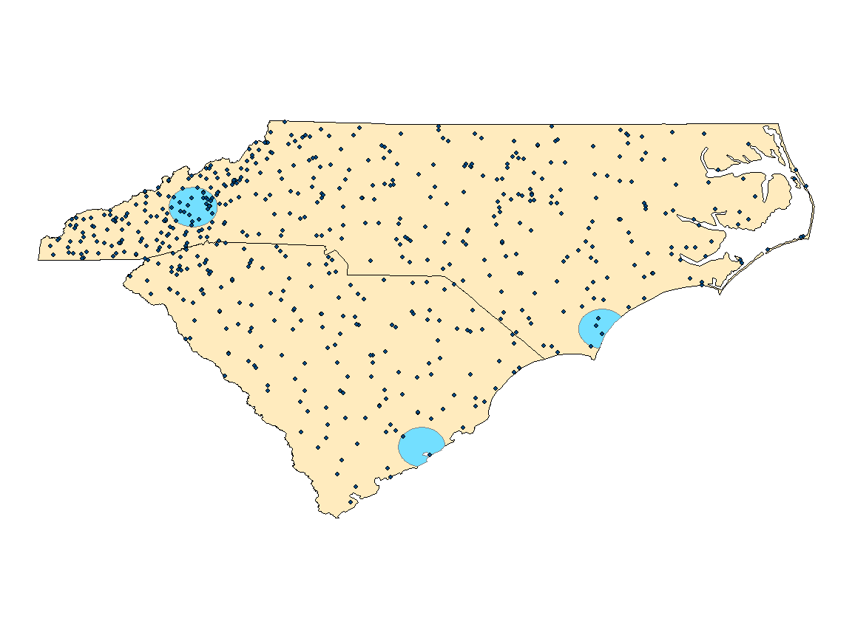
Conclusions
NASA EO extreme estimates are greater than NOAA CDR extreme estimates
NASA EO estimates more closely match rain-gauge observations than the NOAA CDR
Satellites provide homogenous spatial coverage
Extreme events contribute 20-50% to annual water budget
Satellites expand the information available to data users
Locations of Rain Gauges in the Carolinas within 25km of cities
Asheville
Wilmington
Charleston
Notes:
During extreme precipitation events NASA EO’s display higher values for precipitation than the NOAA CDR. These values when compared to ground based data through percentage above a value and bias closely match rain gauge data. Even with limitations we get a better pictures of precipitation events through NASA EO and NOAA CDR than gauge data due to the spatial coverage of the satellites. Here, we can see that especially on the coast, gauge station are sparse: only 2-3 stations within 25km of coastal cities Charleston and Wilmington compared to numerous in Asheville.
We also learned that extreme events that account for only a handful of days throughout the year can account for 20-50% of a year’s rainfall.
Satellites are another piece to add to the decision making process as they reduce uncertainty by providing addition information for communities.

Slide 21
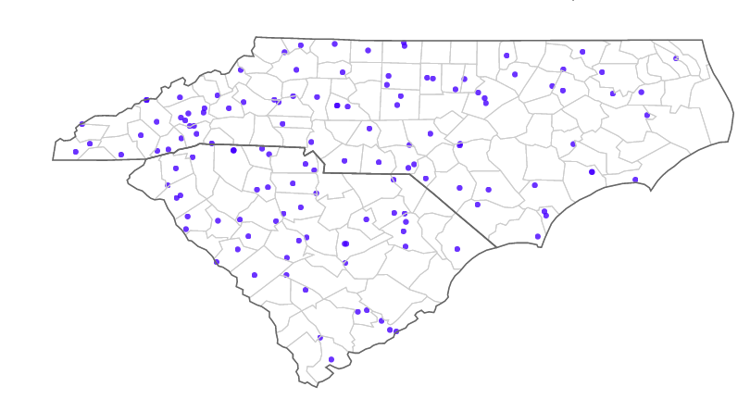
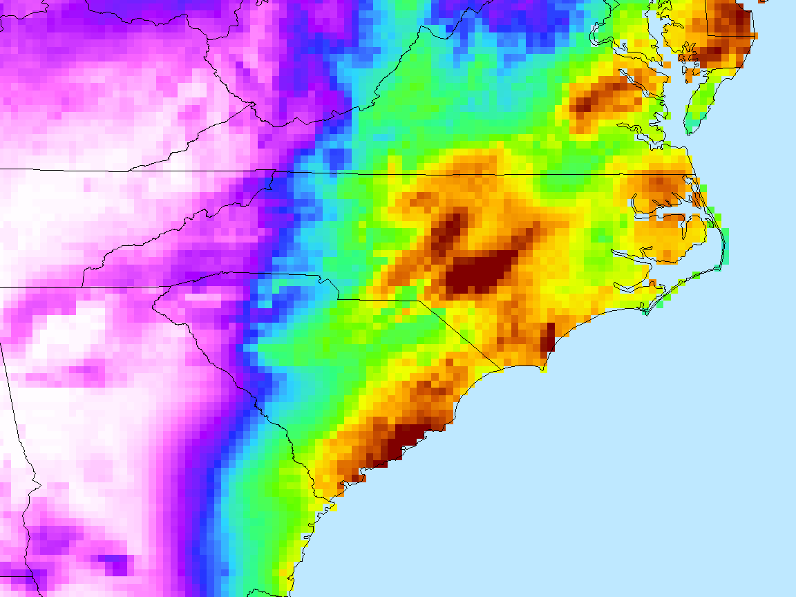
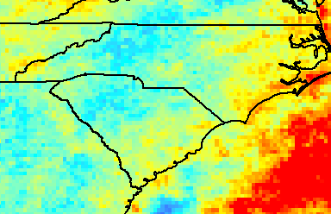
End-Products & Future Work
Precipitation Data Users’ Guide
Interactive Precipitation Tool
Climate Resilience Toolkit Case Studies
Notes:
We will be creating a precipitation users guide for our partners at NEMAC and OCM that highlights the benefits and limitations of using satellite data and explores how the data can be used to provide information on extreme precipitation through our analyses. This guide will demonstrate the kinds of information that satellite can provide for management and resilience planning.
This guide will also provide the conceptual framework for a future tool that relies on satellite precipitation estimates to provide interactive maps, charts, and other analyses specific to a data user’’s interests will the goal of showing how the magnitude and frequency of heavy rain events are changing over time.
Ultimately, we hope this project will serve to inform precipitation-related case studies on climate resilience (such as further exploring the relationship between precipitation and flooding in coastal Carolinas) to be incorporated in the Climate Resilience Toolkit operated by our partner, NEMAC.

Slide 22
Acknowledgements
Olivier Prat, Cooperative Institute for Climate and Satellites, NOAA National Centers for Environmental Information
Brian Nelson, NOAA National Centers for Environmental Information
Adam Stein, NOAA, Office for Coastal Management , Coastal Hazards Specialist
Matt Hutchins, University of North Carolina Asheville, National Environmental Modeling and Analysis Center, Research Scientist and Environmental Change Project Lead
National Space Grant College and Fellowship Program and the NC Space Grant Consortium
Notes:
-Here we acknowledge science advisors and partners

Slide 23

Notes:
Ask for questions

Slide 24
Notes:
Ask for questions

Slide 25
Further Satellite Information
PERSIANN-CDR (.25 x .25,1983-present) - infrared product, up-scaled then downscaled to daily for correction. Algorithm out of UC Irvine.
TRMM-TMPA (.25 x .25, 1998-present) - Infared product designed to capture precipitation
GPM-IMERG (.10 x .10, 2014-present, ) – microwave product and NASA’s newest satellite, also called GOES-EAST. Designed to capture frozen precipitation as well as liquid.
GHCN-D (in-situ, 1983-present) – 607 gauges throughout SC and NC, encompass quality control measures into their estimates, 3hr delay for daily summaries
Image Credit: NASA PMM
Notes:
-extra satellite information for the informed audience member
“We compare precipitation estimates from NOAA-CDR’s, NASA EO’s, and in-situ data, which represent a range of spatial resolutions, estimation methods, and periods of records to show the variety of products available to our partners and how they compare to one another”
Image source: https://pmm.nasa.gov/gpm/imerg-global-image

Slide 26
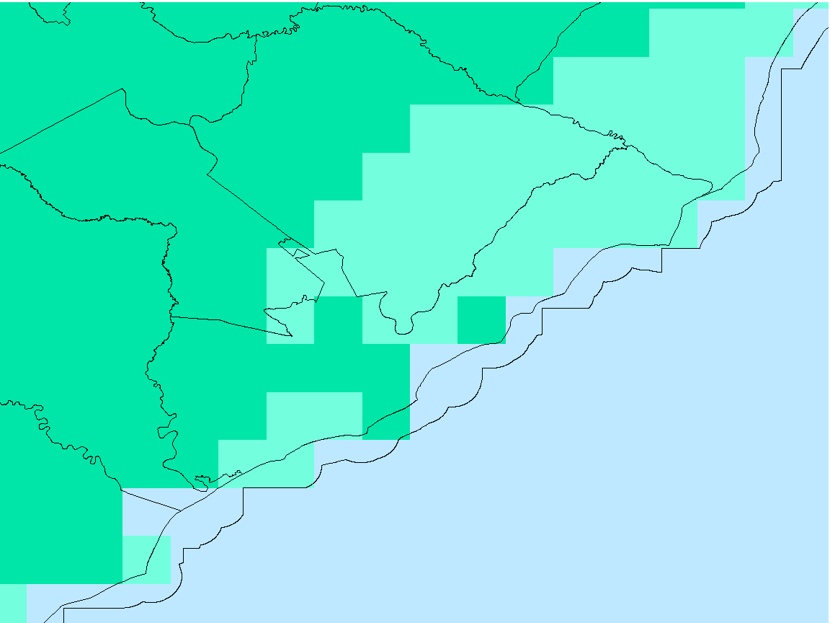
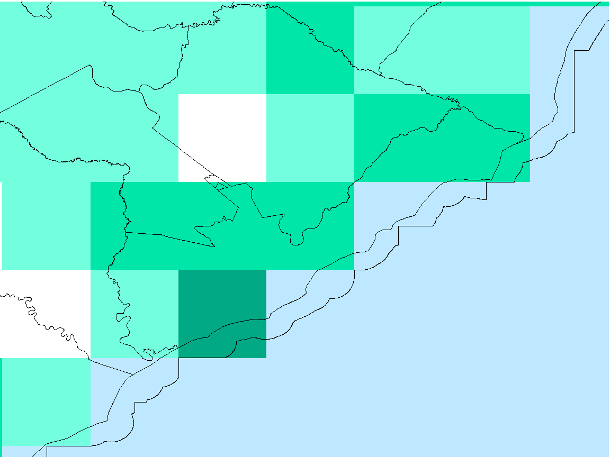
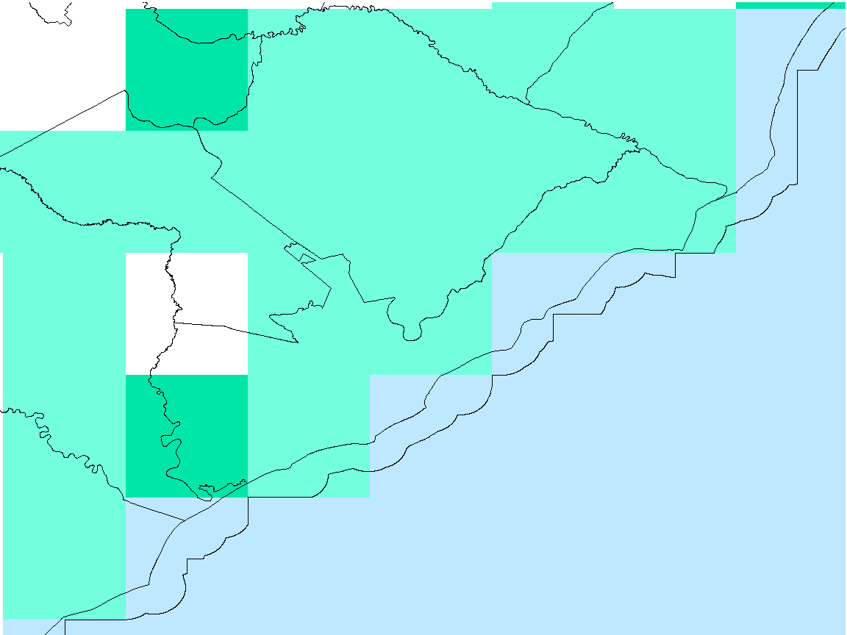
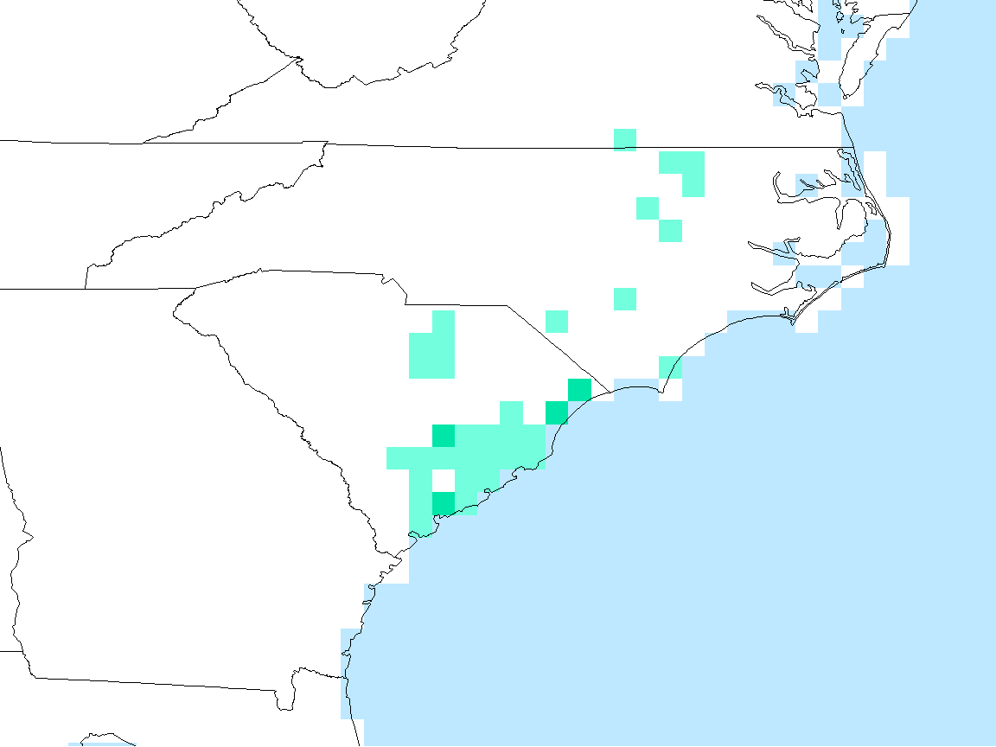
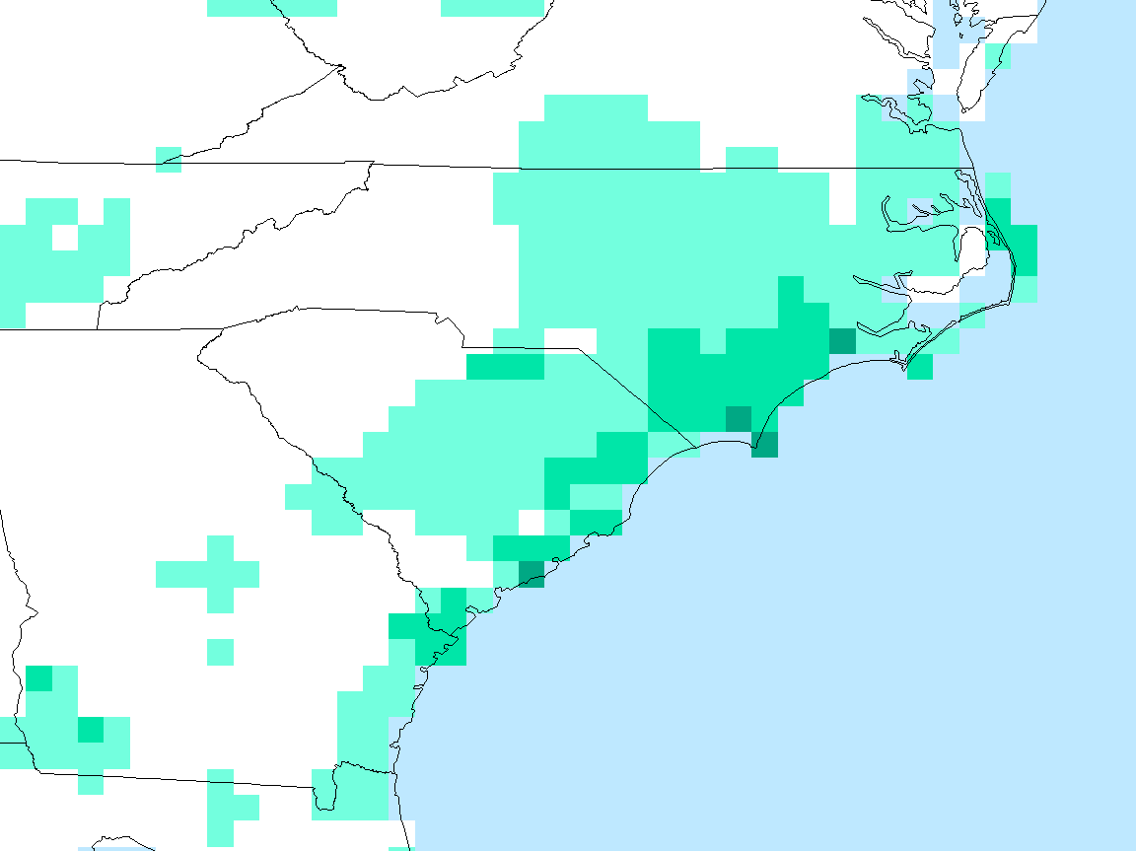
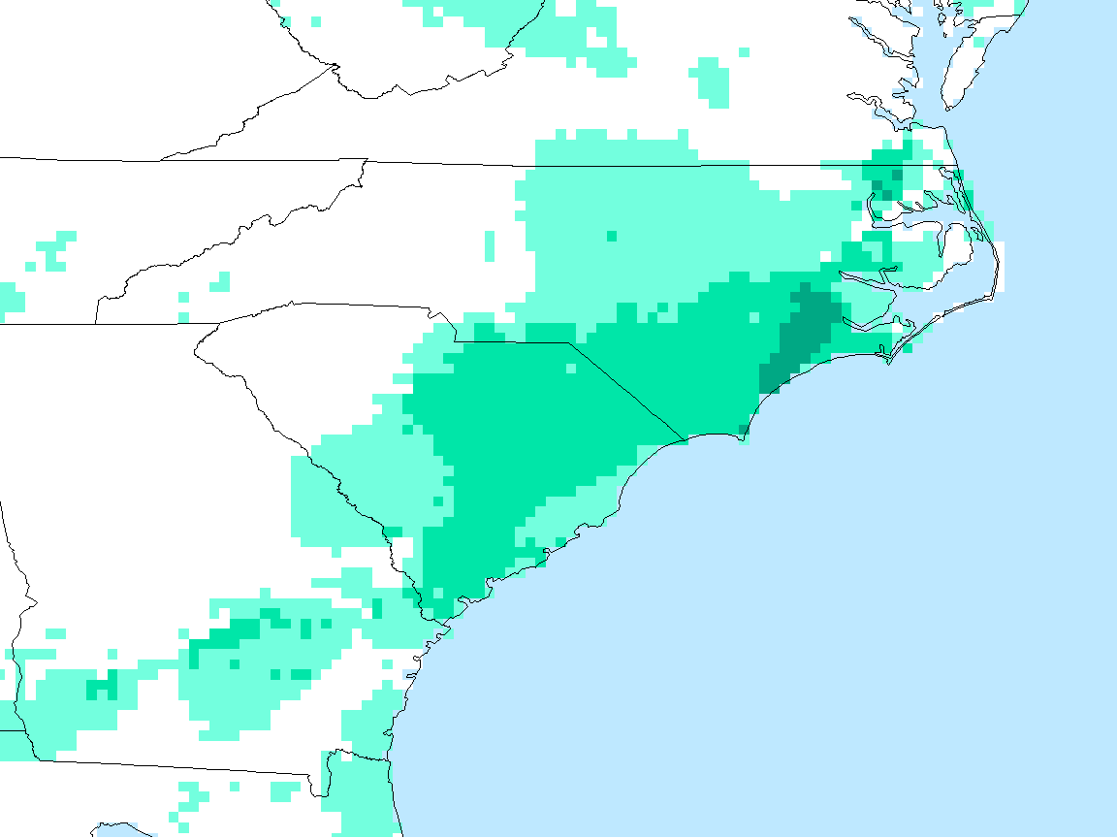

Results: Threshold Exceedance
NOAA CDR: PERSIANN
NASA EO: TRMM
NASA EO: IMERG
Exceedance days: 1
Accumulation: 4.7”
% of 2016 Acc. (56”): 8%
Exceedance days: 2
Accumulation: 10.6”
% of 2016 Acc. (56”): 20%
Exceedance days: 1
Accumulation: 8.1”
% of 2016 Acc. (56”): 15%
4in/day Threshold Exceedance for 2016 (days)
0
2
3
Threshold value: 4in/day Time period: 2016
1
Notes:
We see similar patterns for 4in/day, which corresponds to the top 1% of daily rainfall. Higher counts of exceedance tend to be on the coast.

Slide 27
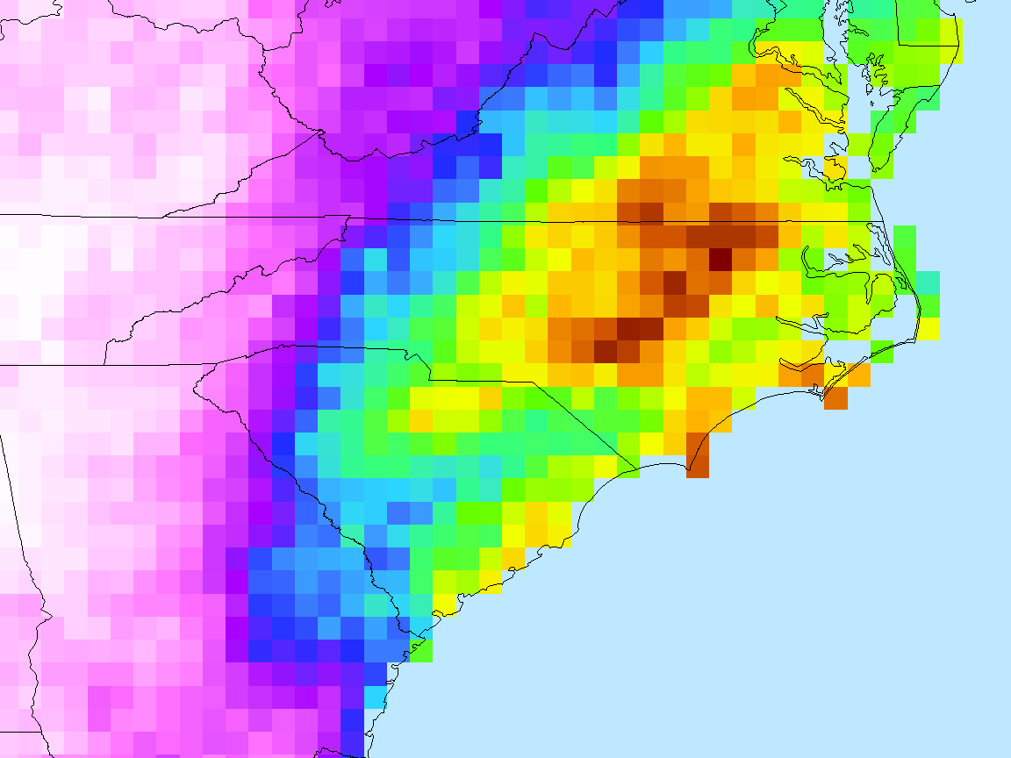
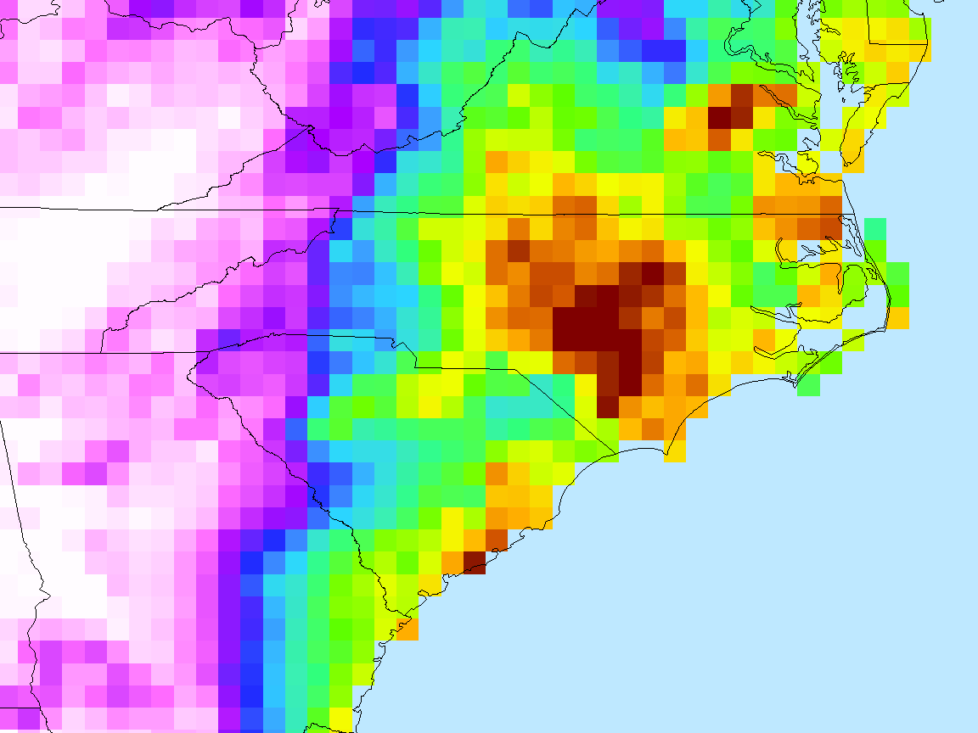
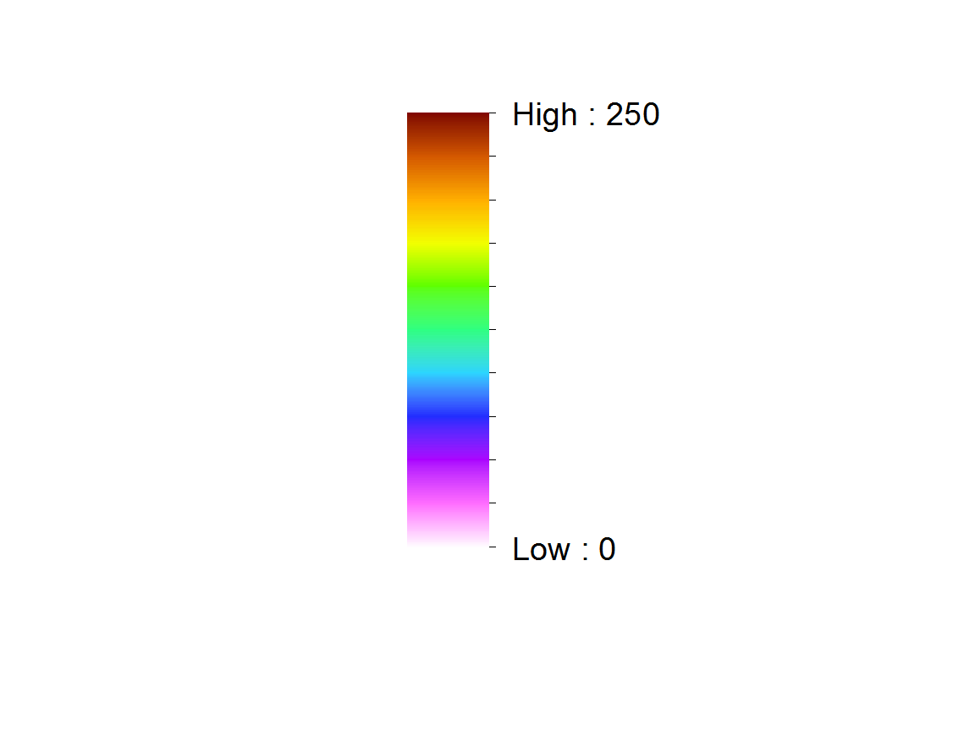
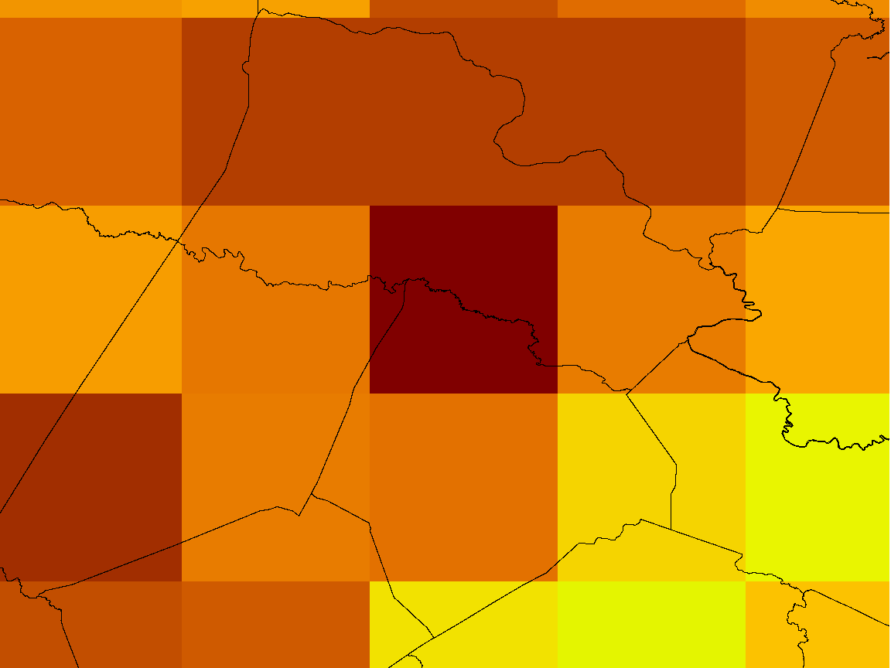
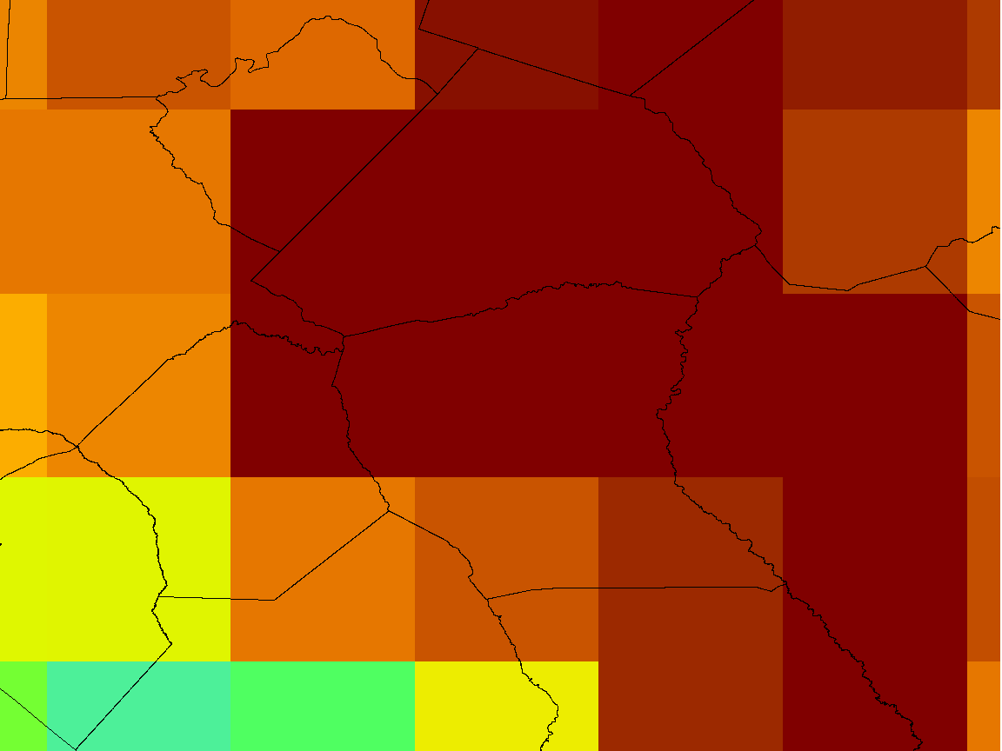
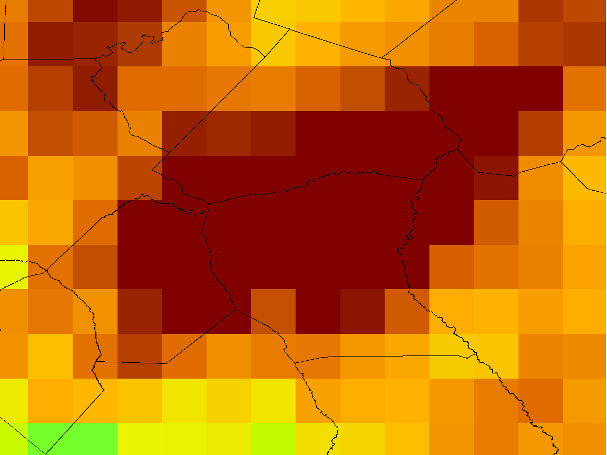
Results: Extreme Events
NOAA CDR: PERSIANN
NASA EO: TRMM
NASA EO: IMERG
Hurricane Matthew Accumulation (mm): 25 Sept – 10 Oct 2016
Max acc.: 257 mm
% of 2016 Acc.: 19%
Max acc.: 300 mm
% of 2016 Acc.: 22%
Max acc.: 280 mm
% of 2016 Acc.: 21%
0
100
Hurricane Matthew Accumulation (mm): 25 Sept – 10 Oct 2016
50
150
200
> 250
Notes:
The third way we measured extreme precipitation is by extreme events, typically tropical cyclones. These maps show how each satellite measured accumulation for Hurricane Matthew in 2016. We see that the NASA EO have matching patterns and capture a larger area of higher values over 250 mm or about 10 in.
The NASA EO measure the max accumulation value in the same location at Fort Bragg, NC, while the PERSIANN max is located further north at a lower value. For all satellites, this maximum accumulation from Hurricane Matthew represents about 20% of the total rainfall for 2016 in this one event. This is important information for resource managers wanting to better understand the influence of tropical cyclones and other storms on the water budget of a locale or region.

Slide 28
Extra Slides
A further examination of TRMM and PERSIANN Gauge/Satellite comparisons for 2014-2016, NC and SC (mm per day)
Notes:
-This slide is a small showcase of the end products created thus far
-CDF’s shown on the left → presenter will describe what it illustrates
-Maps highlight rainfall in our area of interest, and are self explanatory

