Slide 1
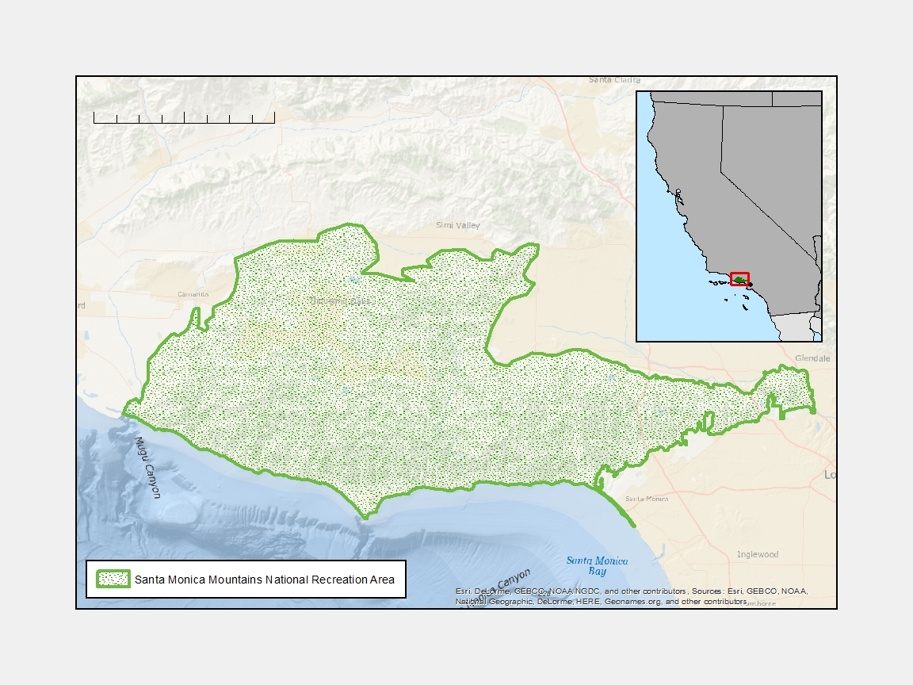
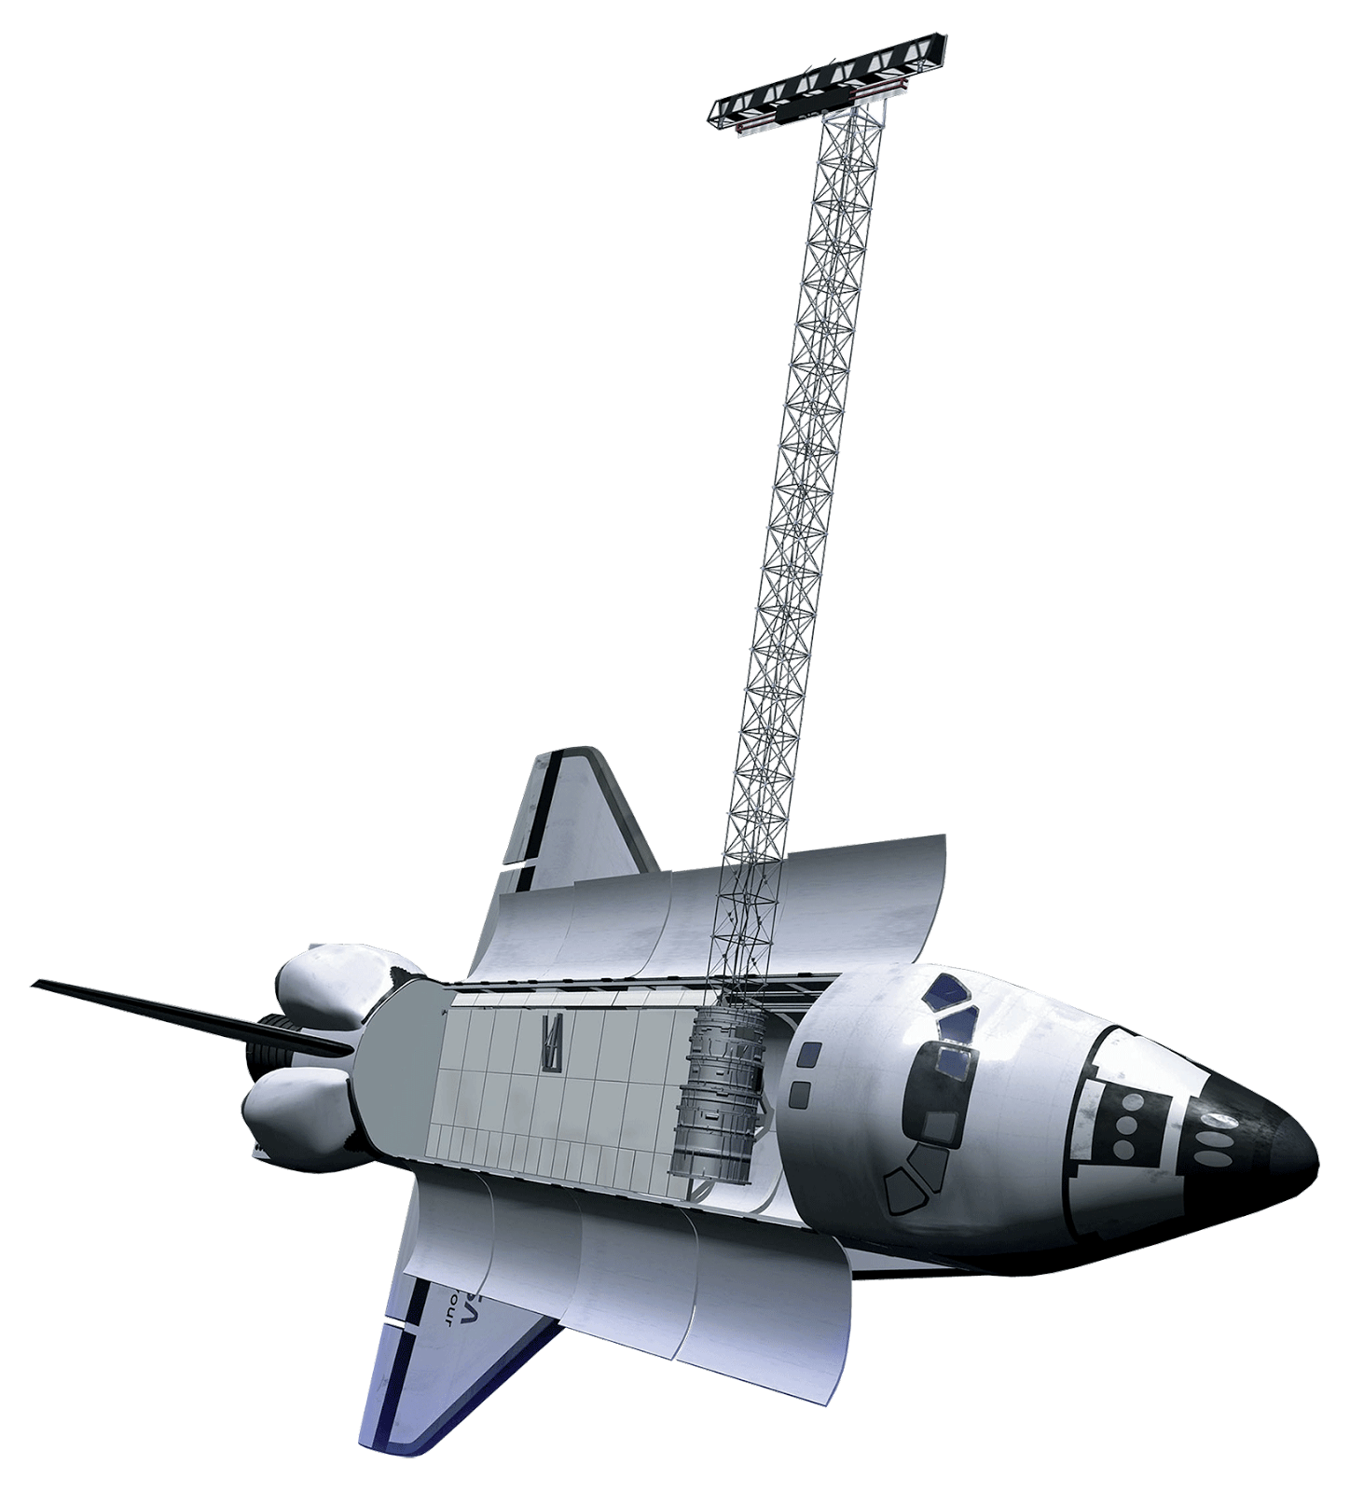
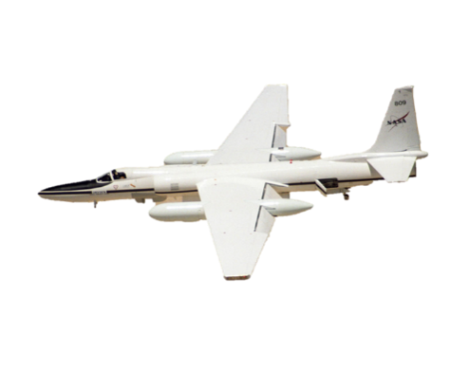
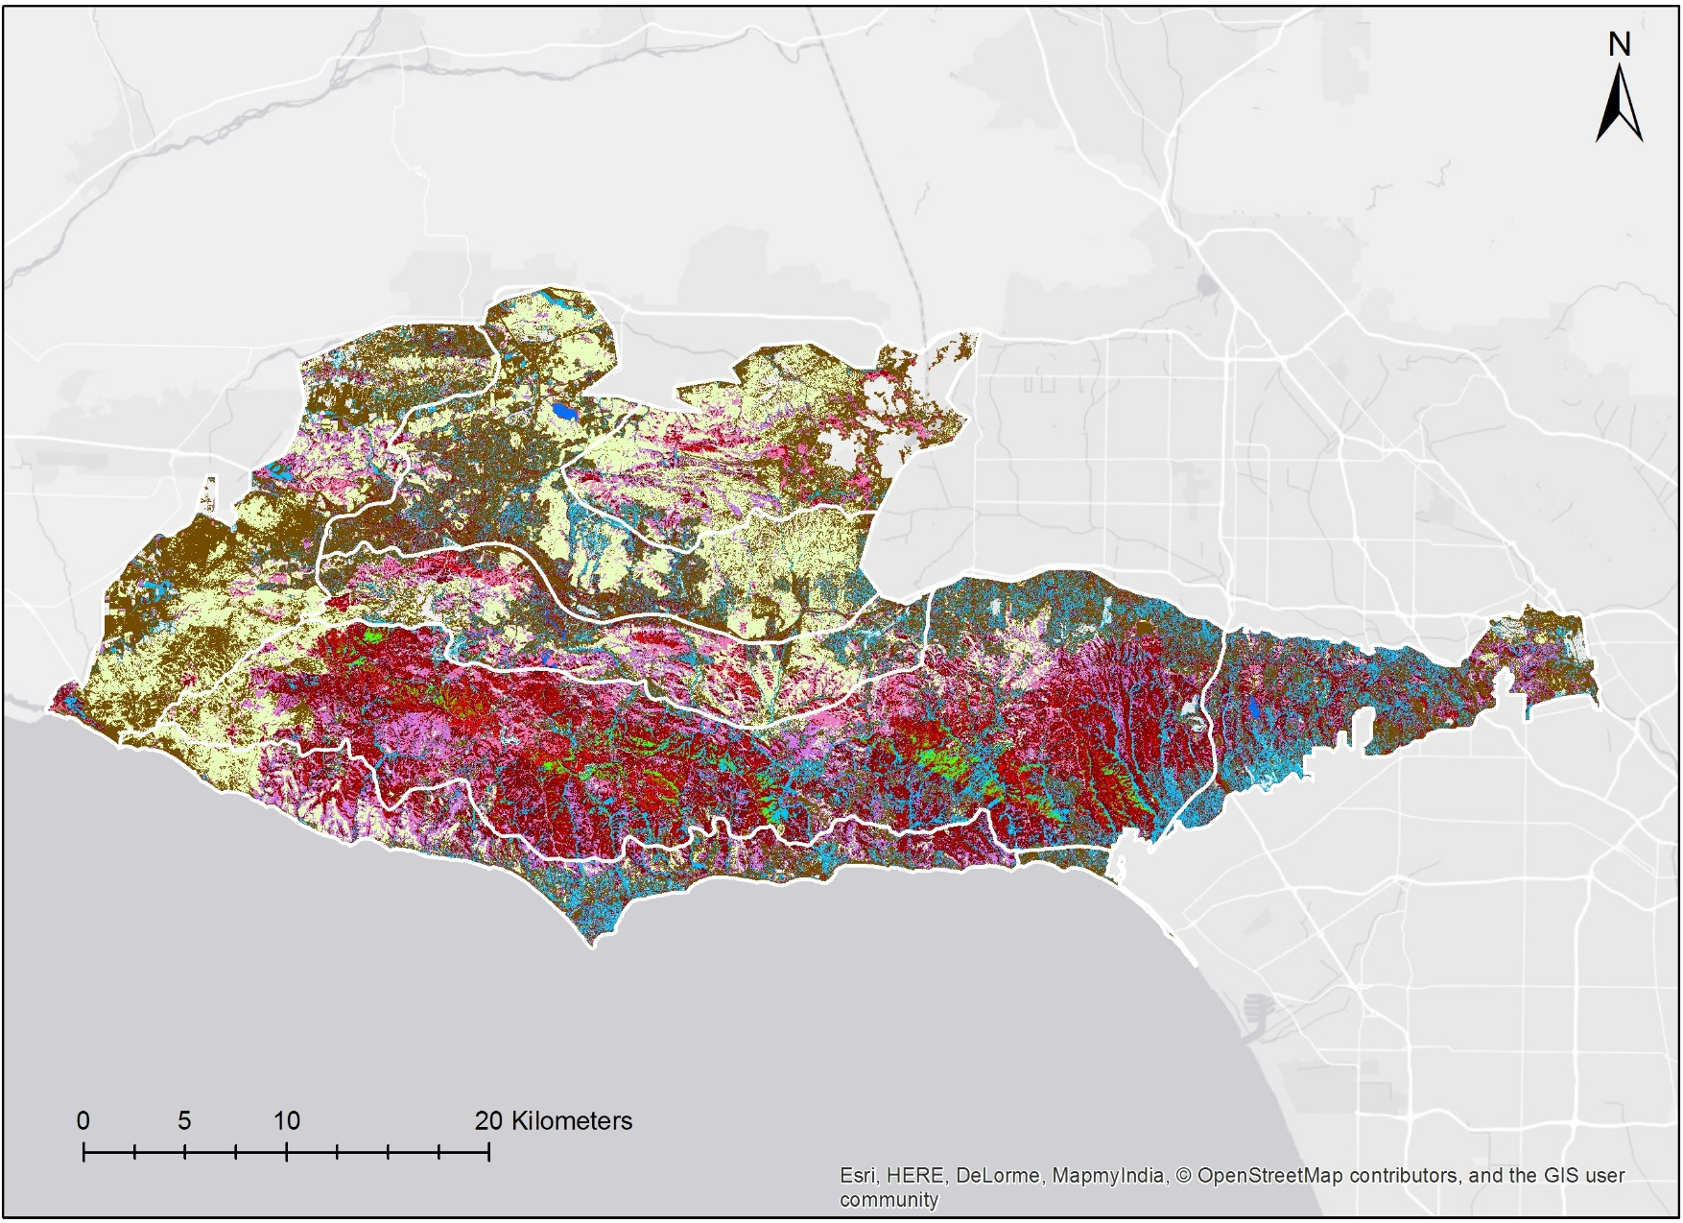
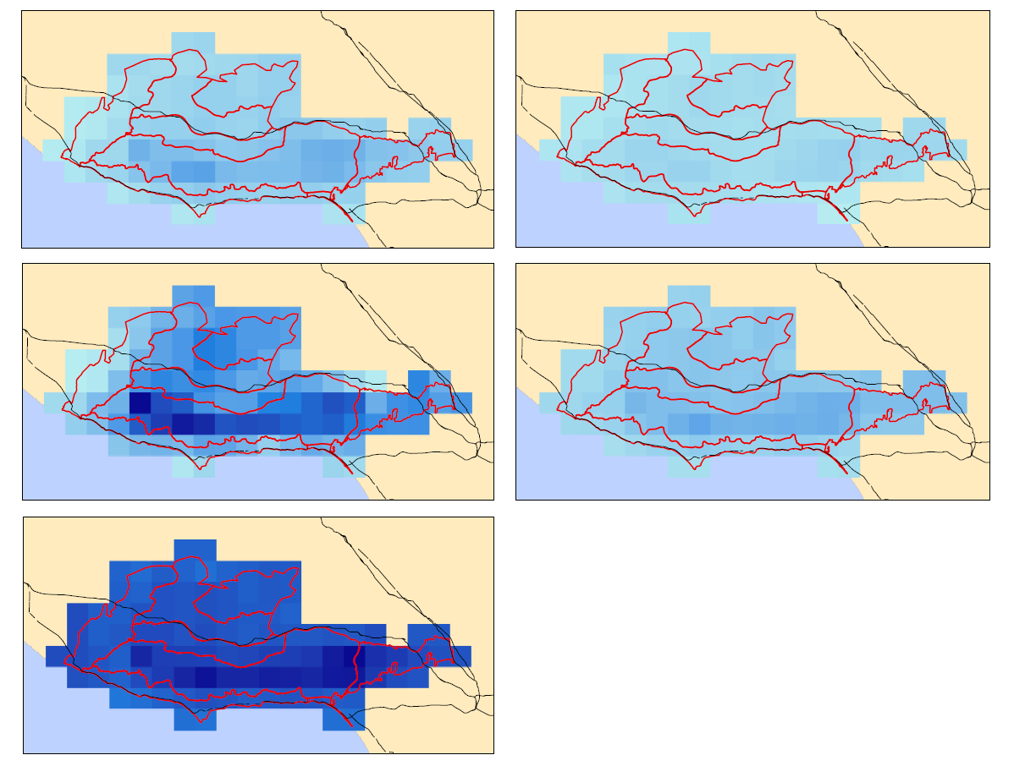
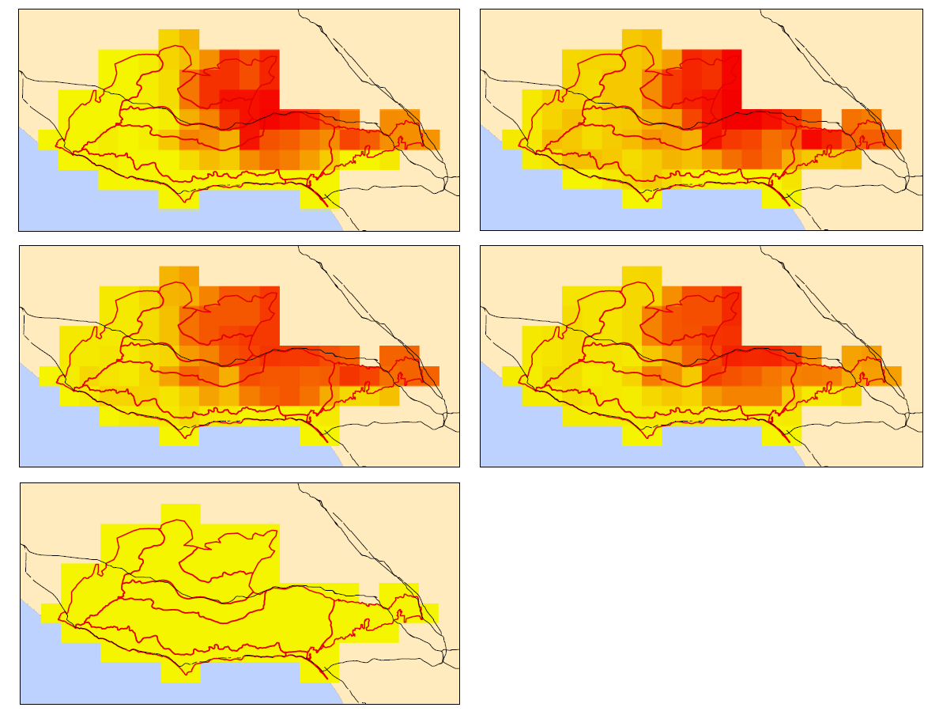
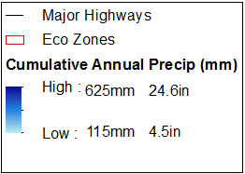
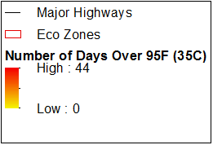
Utilizing NASA Earth Observations to Determine Drought Dieback and Insect-related Damage in the Santa Monica Mountains, California
Abstract
Objectives
The Santa Monica Mountains (SMM) lie between the city of Los Angeles and the San Fernando Valley, California, enduring as a steadfast haven for native vegetation, wildlife, and recreational activities. Both public and private conservation agencies have secured protection for much of the mountain range, however the severe California drought from 2011-2017 had a major impact on vegetation, including 11,000 acres of oak woodlands. The fall Santa Monica Mountains Ecological Forecasting II project explored how and why vegetation has changed from 2013-2017, a continuation study from the spring term that further investigated the effect of climate, harmful beetles, and varying topography on dieback. The heavy rains of the 2016-2017 winter allowed our team to investigate initial response to post-drought conditions. The team used ER-2 Airborne Visible Infrared Imaging Spectrometer (AVIRIS) imagery, climate data, digital elevation models, and in situ beetle and oak data to analyze the extent of vegetation loss over the course of the drought, including which areas will be most vulnerable to drought in the future. The results from these analyses will help the Resource Conservation District of the Santa Monica Mountains determine how to focus efforts towards regaining oak woodland vigor.
Determine how much green vegetation has been lost in the SMM over the span of the drought
Analyze the role of physical constraints (topographical and climatic) and harmful beetle infestations on oak dieback
Determine areas in the SMM particularly likely to suffer from future drought
Study Area
0
5
10
20 Kilometers
CA
NV
Methodology
Los Angeles
MEXICO
Species Mapping Methods
Build spectral library using NPS veg map
Use MESMA to map target vegetation types for 2016
Locate “dead” pixels for each veg. type
Find change in # dead pixels per veg type from 2013 to 2016
Calculate acreage lost per veg type
Santa Monica Mountains National Recreation Area
Regression Analysis Methods
Earth Observations
Decide spatial resolution for climate, topography, and live fraction
Run regression between predictor and response variables
Check regression results against hypotheses
Shuttle Radar
Topography Mission
Project Partners
Airborne Visible/Infrared
Imaging Spectrometer
Resource Conservation District of the Santa Monica Mountains
National Parks Service, Santa Monica Mountains National Recreation Area
California Department of Parks and Recreation, Los Angeles District
California Department of Forestry and Fire Protection (CAL FIRE)
County of Los Angeles Fire Department, Prevention Services Bureau, Forestry Division
University of California, UC Cooperative Extension
Conclusions
Santa Monica Mountains Ecological Forecasting II
The severe drought weakened oak trees, making them more susceptible to attack from harmful beetles and resulting in greater dieback.
The combination of NASA EOs and field data allow for an understanding of the affects of drought on multiple spatial scales (from landscape level to individual tree).
Results
Santa Monica Mountains Species Map
2013
2014
2013
2014
2015
2016
2015
2016
2017
50 miles
2017
0
12.5
25
50 miles
0
5
10
20 kilometers
0
12.5
25
Annual grass
Malosma laurina
Major Highways
Major Highways
Ceanothus megacarpus
Coast live oak woodland
Eco Zones
Eco Zones
Data Source: PRISM
Pixel size: 4km
Cumul. Annual Precip
Data Source: PRISM
Pixel size: 4km
# Days Over 95F (35C)
Riparian
High: 625mm 24.6in
High: 44
Ceanothus spinosus
Jan. 1st – Mar. 31st, 2017
Low: 115mm 4.5in
Jan. 1st – Mar. 31st, 2017
Low: 0
Chaparral - common
Substrate
Coastal sage – drought deciduous
Water
Coastal sage – summer active
Data Source: AVIRIS
Team Members
Acknowledgements
Dr. Natasha Stavros (NASA Jet Propulsion Laboratory, California Institute of Technology)
Erika Higa (NASA DEVELOP, NASA Jet Propulsion Laboratory)
Rosi Dagit (Resource Conservation District of the Santa Monica Mountains)
Emil Chang (NASA DEVELOP, NASA Jet Propulsion Laboratory)
Kelsey Foster
Project Lead
Natalie
Queally
Ariana Nickmeyer
Nick Rousseau
California – JPL
Fall 2017

