Slide 1
Gunnison National Forest Agriculture
Mapping Spruce Beetle Outbreak Severity and Distribution in Gunnison National Forest Using Landsat and Integrative Spatial Modeling
Eric Rounds (Project Lead)
Sarah Carroll
Oliver Miltenberger
Peder Engelstad

Slide 2
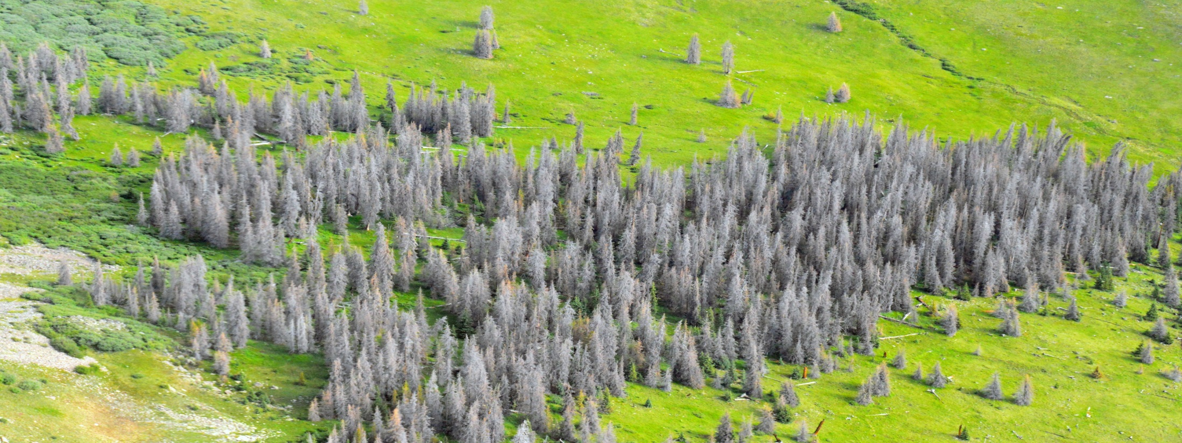
Image Credit: William M. Ciesla, Forest Health Management International, Bugwood.org licensed under a Creative Commons Attribution-Noncommercial 3.0 License.
Community Concerns
1.4 million acres of spruce forests in Colorado affected by spruce beetle since 1996
Reduction in habitat coverage and quality
Change in wildfire regimes and intensity
Hazards to recreational activity
Notes:
Image Source: William M. Ciesla, Forest Health Management International, Bugwood.org licensed under a Creative Commons Attribution-Noncommercial 3.0 License. http://www.forestryimages.org/browse/detail.cfm?imgnum=5540364

Slide 3
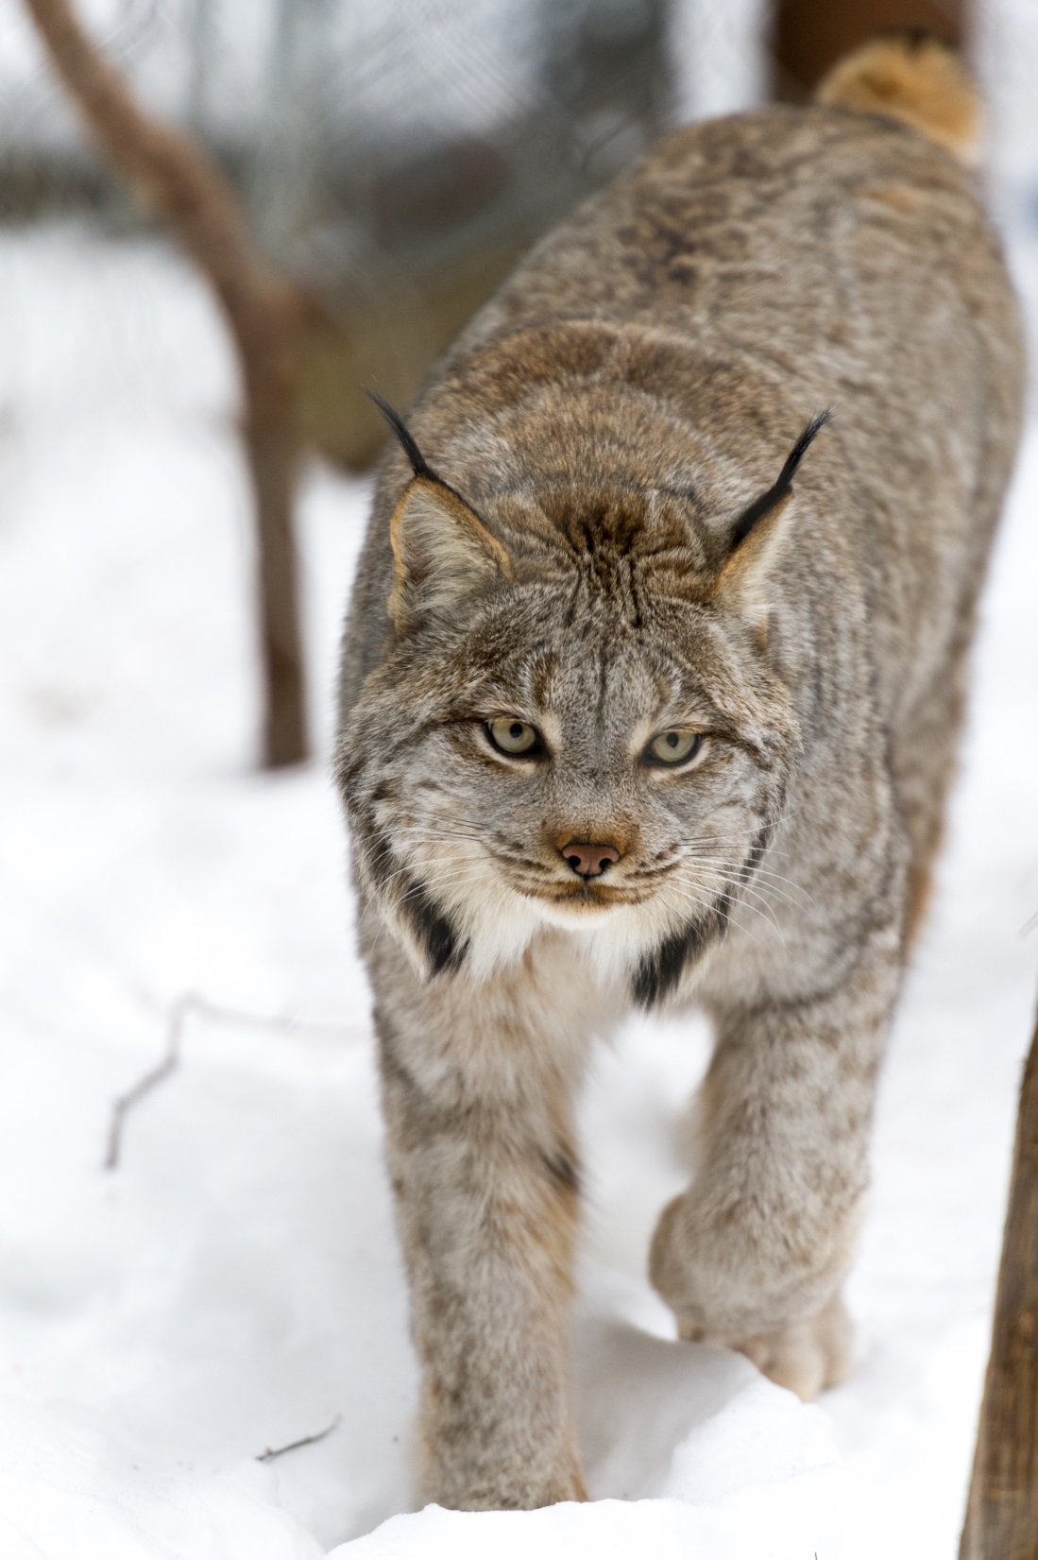
Objectives
Create spruce mortality reference data using a novel data collection method
Produce fine-scale maps of spruce mortality extent and severity for southwestern Colorado
Inform forest management plans that address wildlife habitat analyses and biomass estimation
Image Credit: “Canada Lynx Walking in the Snow” by Eric Kilby Licensed under a Creative Commons Attribution 2.0 Generic (CC-BY2.0). Accessed 1 March 2016. https://www.flickr.com/photos/ekilby/24600297443/
Notes:
Image Source: “Canada Lynx Walking in the Snow” by Eric Kilby Licensed under a Creative Commons Attribution 2.0 Generic (CC-BY2.0). Accessed 1 March 2016. https://www.flickr.com/photos/ekilby/24600297443/

Slide 4
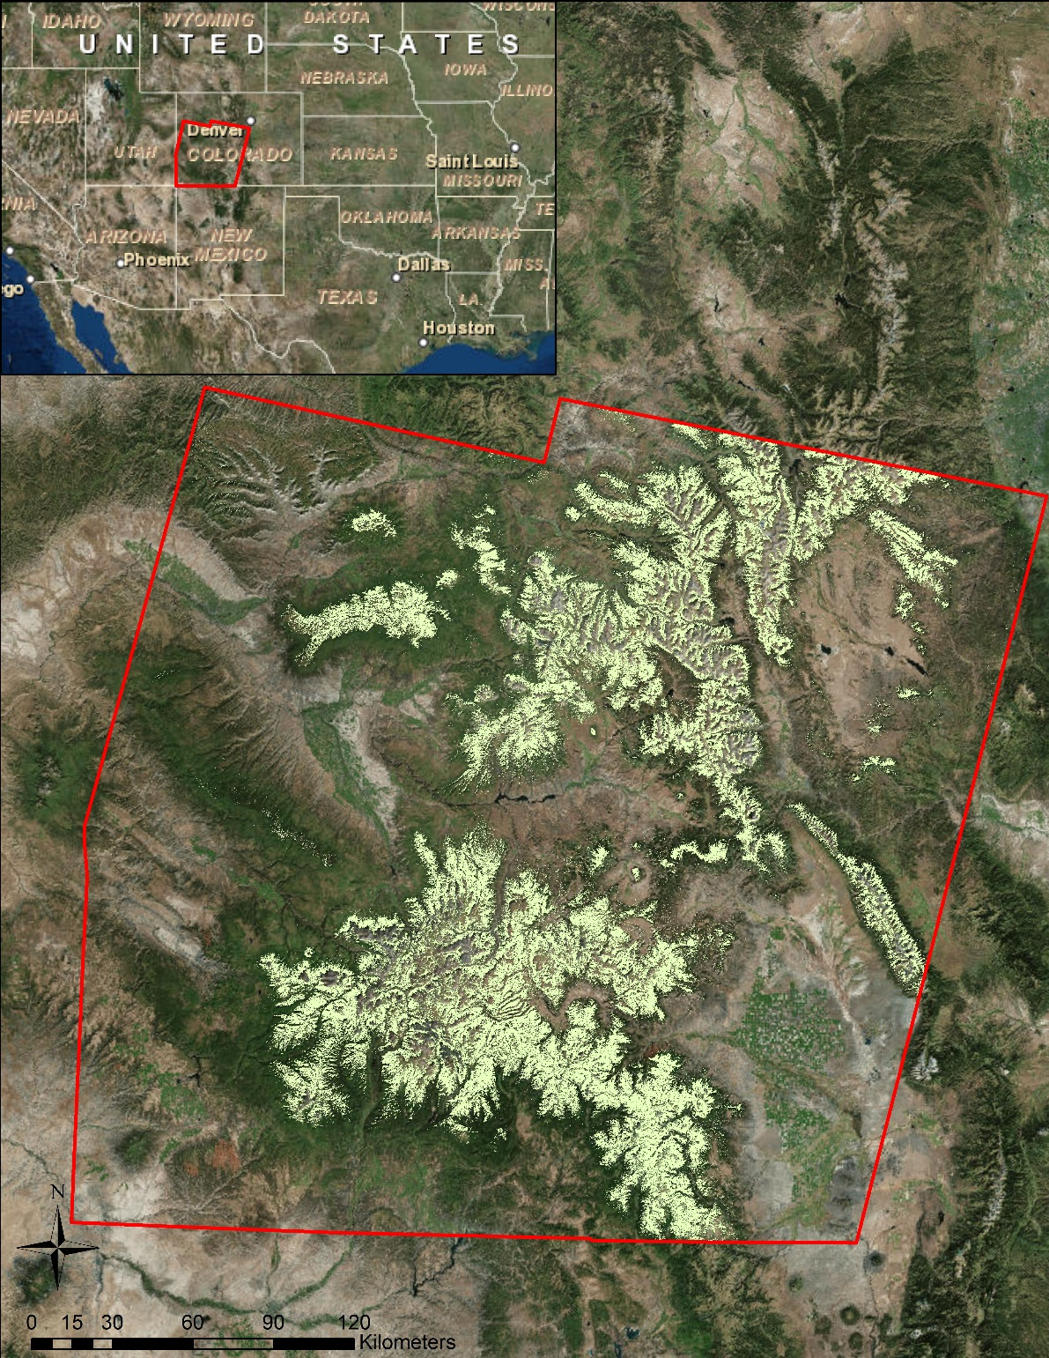
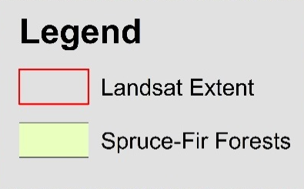

Study Area & Study Period
Location
Spruce-Fir Forests in Southwestern Colorado
Time Period
September 2005 – October 2015
Notes:
Image Source: http://commons.wikimedia.org/wiki/File:Claude_Monet_-_The_Magpie_-_Google_Art_Project.jpg

Slide 5


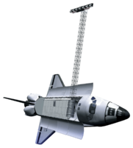
Earth Observations
Platform | Data Product | Resolution | Source
Landsat 8 | OLI, TIRS | 30 meter | USGS Earth Explorer
Landsat 5 | TM | 30 meter | USGS Earth Explorer
SRTM | Digital Elevation Model | 30 meter | USGS Earth Explorer
National Agricultural Imagery Program (NAIP) | Aerial Imagery | 1 meter | USDA

Slide 6
Methodology
Classify Land Cover (live/dead trees) within 30m pixels using 1m resolution imagery
Calculate percent mortality of trees for each randomly selected pixel
Reference Data
Reference Data Creation
Imagery Processing
Model Processes
Inputs
Outputs
Creating Model Inputs
Imagery Processing
Stack 2006/13 & 2015 imagery separately and clip to study area
Extract spectral values of stack layers that correspond to each reference data point
Binary classification
Presence = 1
Absence = 0
Binary map of study area
Model Step 1
Percent Mortality & Spectral Values of reference points
Combine outputs to create final map of spruce mortality in southwest Colorado
Model Step 2
Continuous classification of study areas for each species
Continuous Map of Study Area

Slide 7
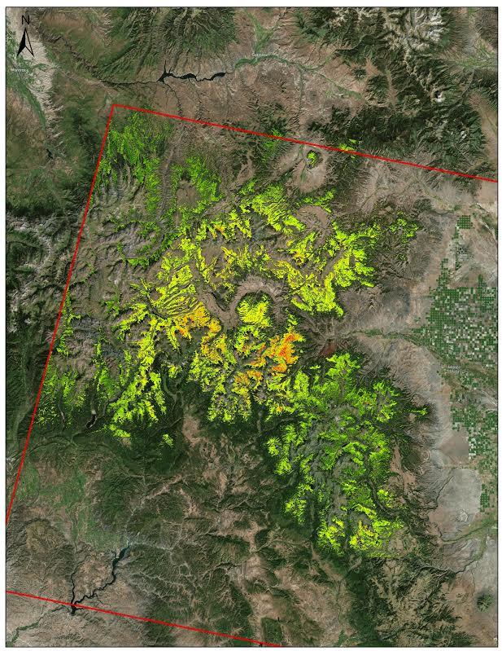
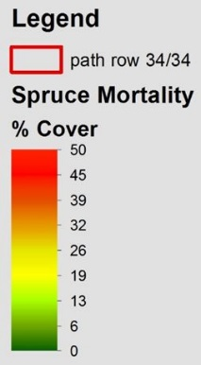
Results
More coming soon.

Slide 8
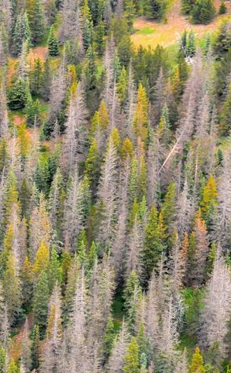
Errors and Uncertainties
Coming Soon
Image Credit: William M. Ciesla, Forest Health Management International, Bugwood.org licensed under a Creative Commons Attribution-Noncommercial 3.0 License.

Slide 9
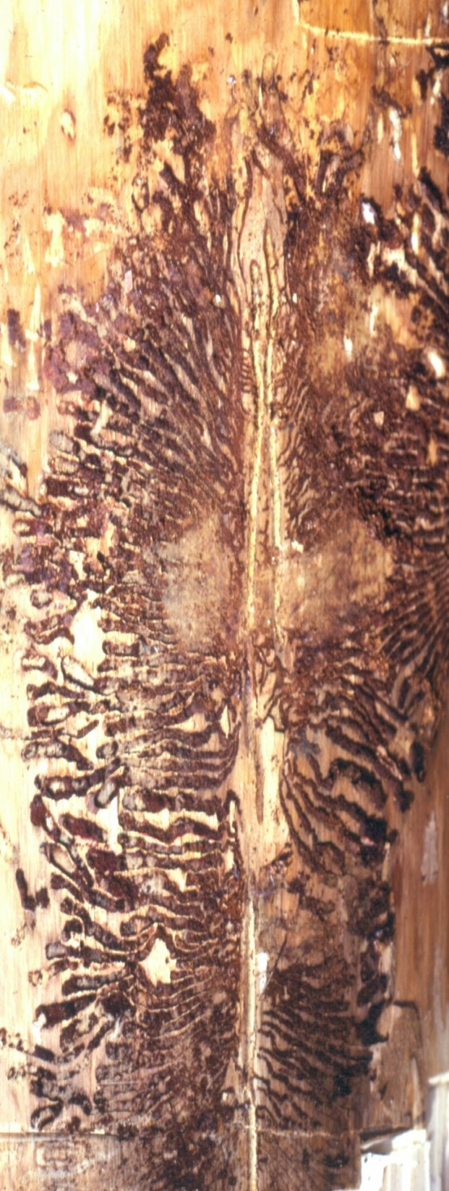
Conclusions and Future Work
Coming soon…
Image Credit: Darren Blackford, USDA Forest Service, Bugwood.org licensed under a Creative Commons Attribution-Noncommercial 3.0 License.
Notes:
Image Source: Darren Blackford, USDA Forest Service, Bugwood.org licensed under a Creative Commons Attribution-Noncommercial 3.0 License. http://www.forestryimages.org/browse/detail.cfm?imgnum=2181027

Slide 10
Advisors
Dr. Paul Evangelista (Natural Resources Ecology Lab, Colorado State University)
Tony Vorster (Bioenergy Alliance Network of the Rockies)
Brian Woodward (DEVELOP – Fort Collins Center Lead)
Partners
Bioenergy Alliance Network of the Rockies (BANR) (End-User) POC: Anthony Vorster
Montana State University, Spatial Sciences Center (End-User) POC: Dr. Rick Lawrence
Colorado State University, Natural Resource Ecology Laboratory (NREL) (End User) POC: Nick Young
USDA Forest Service, Gunnison Ranger District (End User) POC: Matt Vasquez
USDA Forest Service, Rocky Mountain Research Station (End User) POC: Dr. Mike Battaglia

