Slide 1
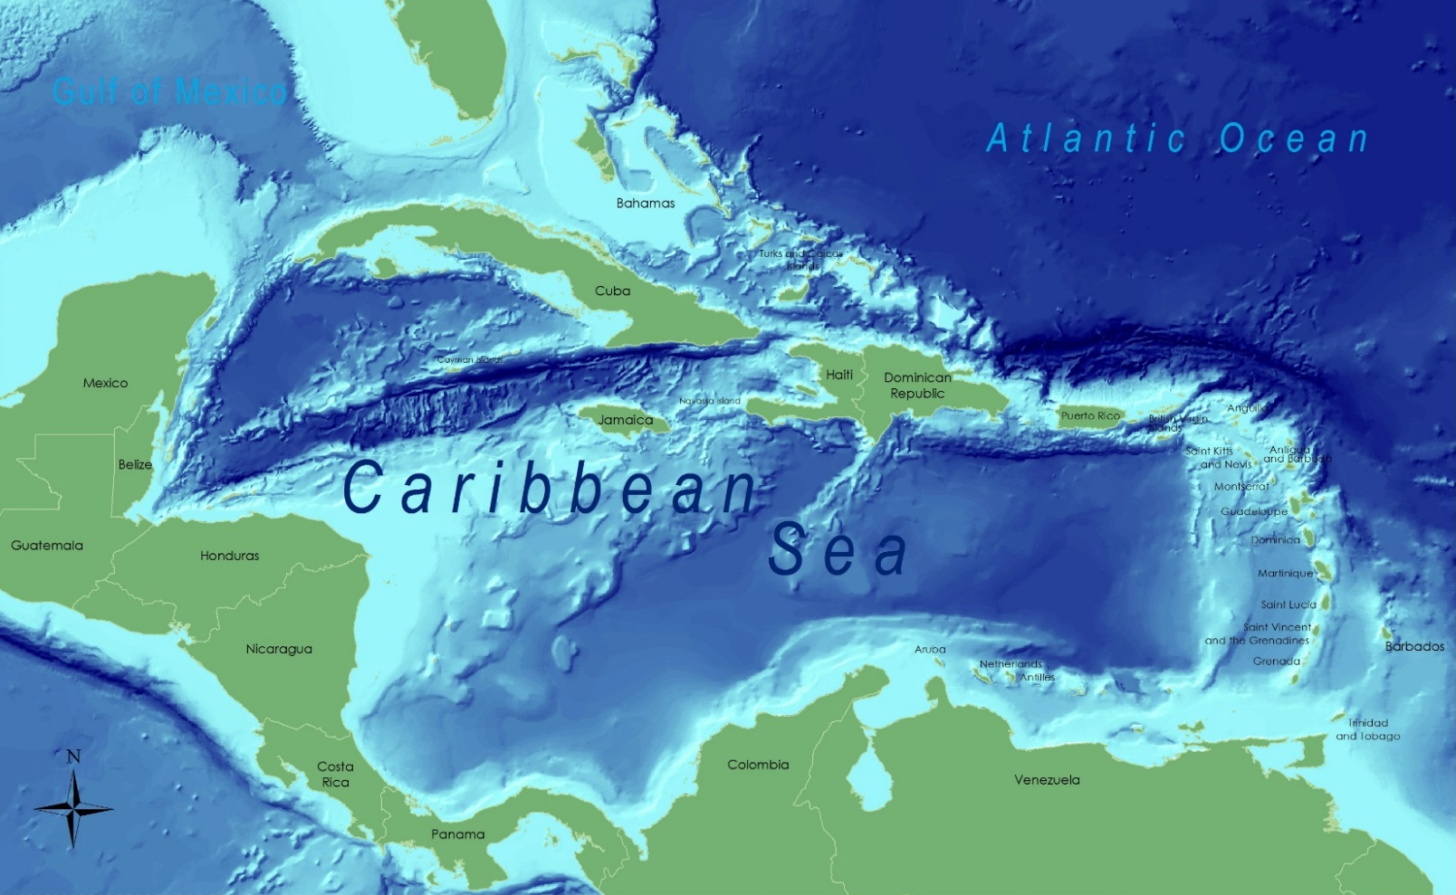
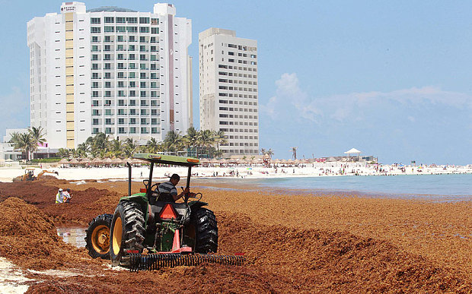
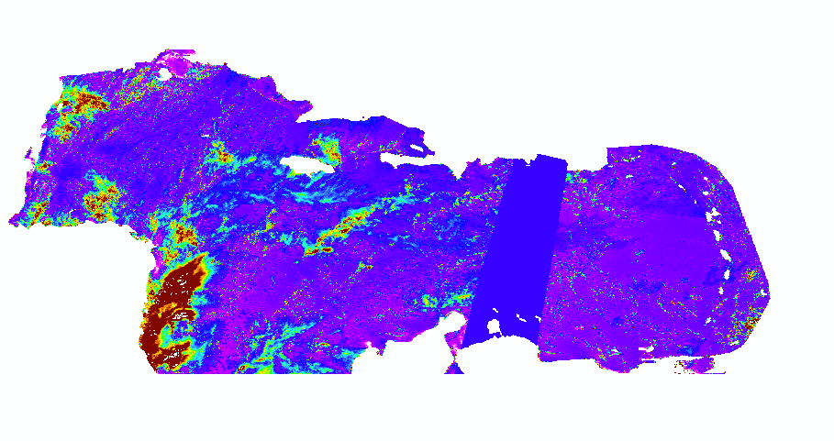
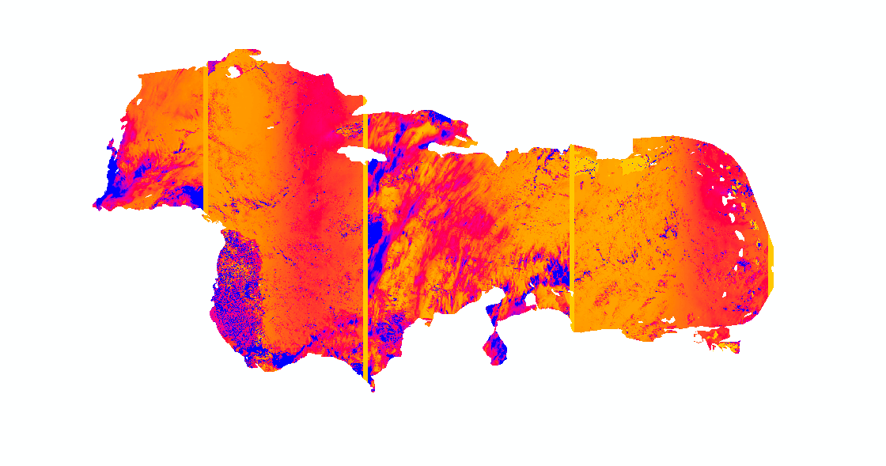
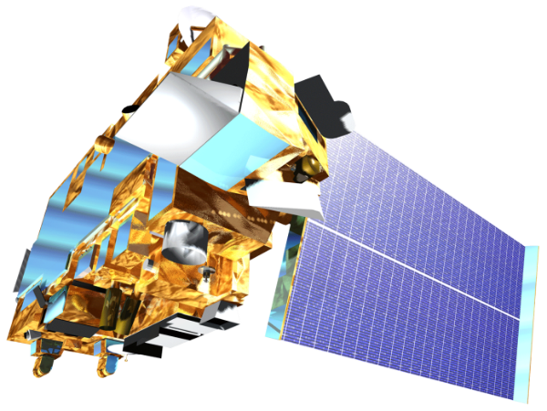
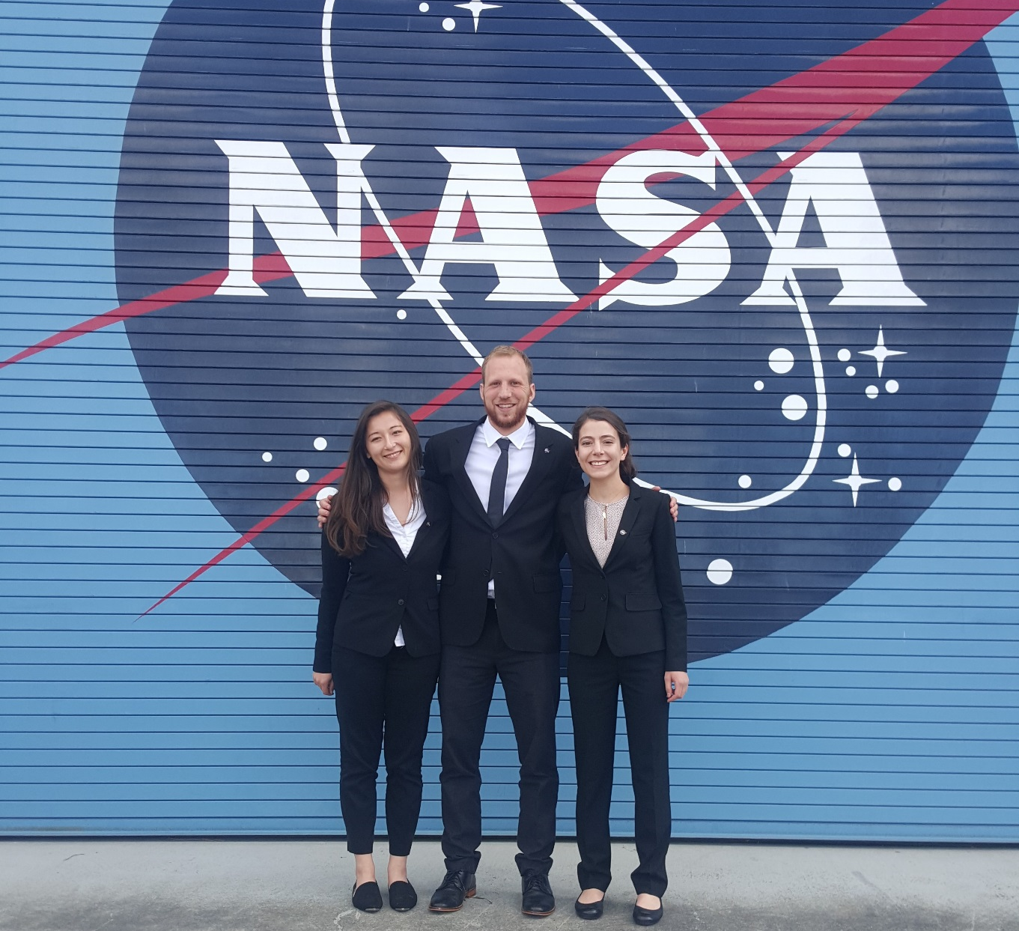
Caribbean Oceans
Detection and Monitoring of Sargassum Utilizing NASA Earth Observations in Response to Unprecedented Levels Observed in the Caribbean Sea
Jordan Ped¹ (Project Lead), Erica Scaduto¹, Emma Accorsi¹
¹DEVELOP National Program at NASA Ames Research Center
Abstract
Objectives
In the years 2011 and 2015, the nations of the Caribbean Sea were overwhelmed by a substantial quantity of Sargassum that washed ashore. As part of the international response, this project used NASA Earth observations to detect Sargassum across the region, model its growth, and predict its proliferation. These recent Sargassum events have been observed throughout the Caribbean at reportedly unprecedented levels. In the open ocean, Sargassum mats serve an important ecological function. Some of the ecosystem services provided by the Sargassum include nutrient cycling, habitat for endemic species, and fish nurseries. However, large quantities have threatened both the tourist industry, a critical part of local economies, and the near-shore ecosystems within the study region. In order to address these issues, this project utilized the Floating Algal Index (FAI) derived from Terra MODIS data from 2002 to present (2016). This index was then modeled with various oceanic variables to determine the ideal pelagic environment for Sargassum growth. Finally, the model was used to track the spread of Sargassum throughout the region on a yearly basis and identify its origins. As part of the international effort to better understand the life cycle of Sargassum in the Caribbean, the results of this project will help local economies and promote sustainable management practices.
Trace historic patterns of Sargassum movement and growth in the Caribbean by utilizing NASA Earth observations from 2002 to January 2016.
Assess if 2015 Sargassum levels are anomalous to trends since 2002 via quantitative analyses .
Identify key oceanic environmental variables correlated with Sargassum presence using NOAA Ocean Watch data.
Determine the geographic origin of Caribbean Sargassum.
Methodology
Study Area
The Floating Algal Index (FAI) and Maximum Chlorophyll Index (MCI) were used to detect Sargassum.
Pixels identified as Sargassum via threshold values were correlated with oceanic variables using TerrSet Earth Trends Modeler.
Model outputs were used for predictive modeling.
Floating Algal Index (FAI)
Retrieved from: http://www.theyucatantimes.com/2015/07/90-tons-of-sargassum-algae-washed-up-on-cancuns-beaches/
Figure 1. The study examined oceanic conditions in the Caribbean Sea from January 2002 to January 2016.
Figure 2. During influx events, Sargassum accumulates on Caribbean beaches in large quantities.
Oceanic Variables:
Photosynthetically available radiation
Chlorophyll-a
Primary productivity
Wind stress
Wind diffusivity
Sea surface salinity
Sea surface temperature
Earth Observations
Maximum Chlorophyll Index (MCI)
Moderate Resolution Imaging Spectroradiometer (MODIS) - Terra
TerrSet Earth Trends Modeler
Results
Conclusions
Team Members
Project Partners
Acknowledgements
Consorcio de Instituciones de Investigación Marina del Golfo de México y del Caribe (CiiMarGoMC): Dr. Porfirio Alvarez-Torres, Executive Secretary
Centro Interdisciplinario de Ciencias Marinas: Instituto Politécnico Nacional (CICIMAR-IPN): Dr. Francisco Arreguin, Researcher, Dr. Norma Patricia Muñoz, Secretary of Postgraduate Research, Dr. Mariana Elvira Callejas Jiménez, Research Scientist
Comisión Nacional para el Conocimiento y Uso de la Biodiversidad (CONABIO): Dr. Sergio Cerdeira, Marine Monitoring Coordinator
El Colegio de la Frontera Sur (ECOSUR): Dr. Laura Carillo, Oceanographer
Universidad Autónoma de Baja California (UABC), Dr. Eduardo Santamaria del Angel, Professor and Researcher
University of Puerto Rico, Department of Marine Sciences: Dr. Roy A. Armstrong, Bio-optical Oceanography Laboratory
We would like to thank our Center Lead, Chippie Kislik, our Assistant Center Lead, Victoria Ly, and our science advisor, Dr. Juan Torres-Pérez, for their support and mentorship throughout this project.
We would also like to acknowledge:
Chase Mueller: NASA Ames Research Center
Frédérique Fardin: SPAW Regional Activity Center
Amy Siuda, Deb Goodwin, Jeffrey Schell: Sea Education Association (SEA)
and everyone else at ARC who gave us guidance along the way.
Left to right: Erica Scaduto, Jordan Ped (Project Lead), Emma Accorsi
NASA Ames Research Center

