Slide 1
Peru Water Resources and Disasters
Utilizing NASA Earth Observations to Develop a Comprehensive Water Budget for the Asunción district in Peru
Sarah Medley(Project Lead)
Kieran Blakemore
Jordan Bates
Scott Arnette
Grant Bloomer
Azeb Shewago
Michael Mullins

Slide 2
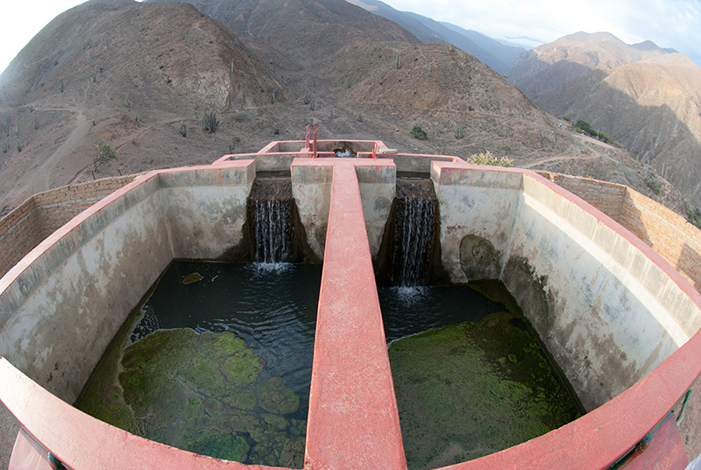
Background Information
In rural areas of Peru, only about 65% of residents have access to satisfactory water resources
Only 37% of residents have access to satisfactory sanitation facilities
45,012 people affected by flooding in Peru
Source: Water for People
Notes:
Source: http://www.waterforpeople.org/making-a-difference/peru

Slide 3
Study Area
Asunción District, Cajamarca Province, Cajamarca Region of Peru

Slide 4
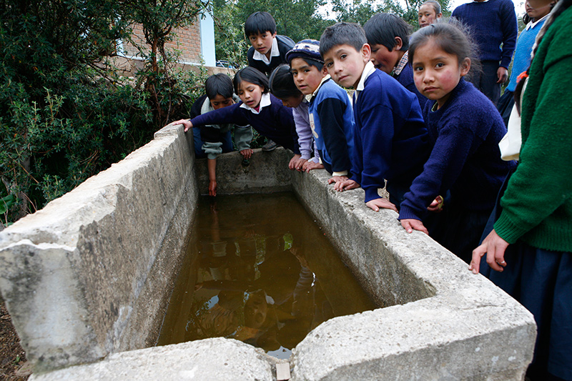
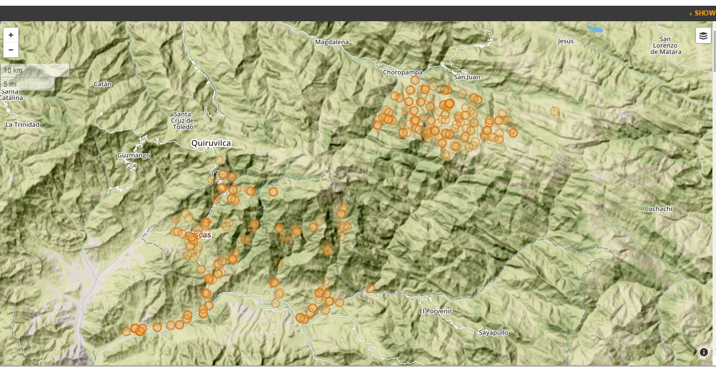
Community Concerns
Inadequate Water Resource Management Systems
Limited in-situ data
Inadequate water resource and flood risk management plans
Partners:
Water For People
Instituto Nacional de Defensa Civil del Peru (INDECI)
Source: Water for People
Source: Water for People and Akvoflow
Notes:
Source: http://www.waterforpeople.org/making-a-difference/peru and http://wfp.akvoflow.org/

Slide 5
Objectives
Build a SWAT model for the Jequetepeque river watershed to study the hydrological processes in the study area
Help develop a comprehensive water resources inventory and datasets for the Asunción district
Transfer the knowledge to build, calibrate, and validate SWAT models through provided tutorials and tools to partners
Identify preliminary models and data to estimate the flood risk assessment and research best prediction models
Source: Juan Francisco (Water for People)

Slide 6
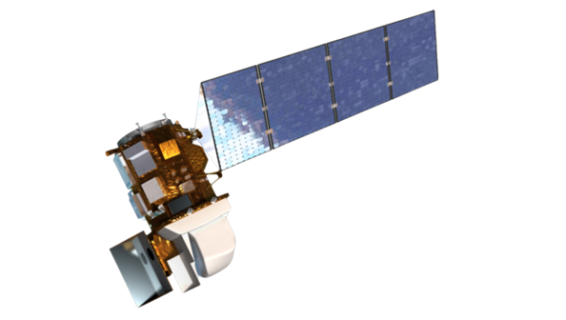
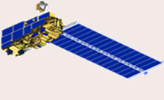
NASA Earth Observations
Satellite | Sensor/Instrument | Function
Landsat 8 | OLI | Land Cover and Surface Reflectance
Terra | ASTER | Digital Elevation
 | PR VIRS TMI LIS | Precipitation
 | MODIS | Land Cover
TRMM
Aqua

Slide 7
Acquisition & Processing
Notes:
Acquisition
Elevation data collected from ASTER, a satellite used to produce digital elevation models using infrared cameras.
Soil inputs to SWAT collected from the Food and Agriculture Organization of the UN’s Digital Soil Map of the World.
Land use and land cover derived from NASA’s MODIS instrument on board the TERRA and AQUA satellites.
Processing
SWAT functions as a continuous simulation of watersheds.
Simulation of the watershed is separated in the land phase, controlling the amount of sediment loadings, and the routing phase, the actual water movement of water and sediments.
SWAT reads observed data based on monthly statistics and creates simulations of water flow.

Slide 8
Analysis
Sensitivity analysis
Calibration
Validation
Notes:
Before final analysis of the model is performed, sensitivity analysis, calibration and validation occur.
Sensitivity analysis helps determine which variables affect the SWAT model most when changed.
Calibration adjusts variables within the SWAT model along with actual observed data to create a more accurate model.
Validation verifies the model’s accuracy by comparing the results with a separate data set than what was used for calibration.
This analysis of data helps to create a more accurate representation of the water model being studied.
Work in progress

Slide 9
Results
Watershed Delineation
Supervised Land Classification
Notes:
Discussion
Necessary models and data to estimate the flood risk assessment were identified. The final maps, models, datasets and tutorials developed in this project will enable Water For People and the Peruvian government to improve water management programs.
Work in progress
Needs Legend and North Arrow

Slide 10
Results

Slide 11
Results: Flood Areas

Slide 12
Potential Application of Results
Disaster Management
Environmental Projects
Flood Risk Assessment
Agriculture

Slide 13
Conclusions
The final results can be used to serve as decision support tools in Water for People’s projects in Peru.
Tutorials developed can be used to assist other regions facing similar challenges.
In the future, flood models will be developed for the located flood risk areas.
Source: Water for People
Notes:
Source: http://www.waterforpeople.org/making-a-difference/peru

Slide 14
Acknowledgements
Advisors
Dr. Kenton Ross (NASA DEVELOP National Science Advisor)
Partners
Water for People
Instituto Nacional de Defensa Civil del Peru (INDECI)
Others
Dr. Kenton Ross, NASA DEVELOP National Program (Science Advisor)
Dr. DeWayne Cecil, Global Science and Technology Inc. (Science Advisor)
Dr. Ryan Stewart (Virginia Tech)
Ms. Melanie Salyer, NASA DEVELOP Wise
Steve Padgett-Vasquez (University of Georgia)
This material is based upon work supported by NASA through contract NNL11AA00B and cooperative agreement NNX14AB60A.

