Slide 1
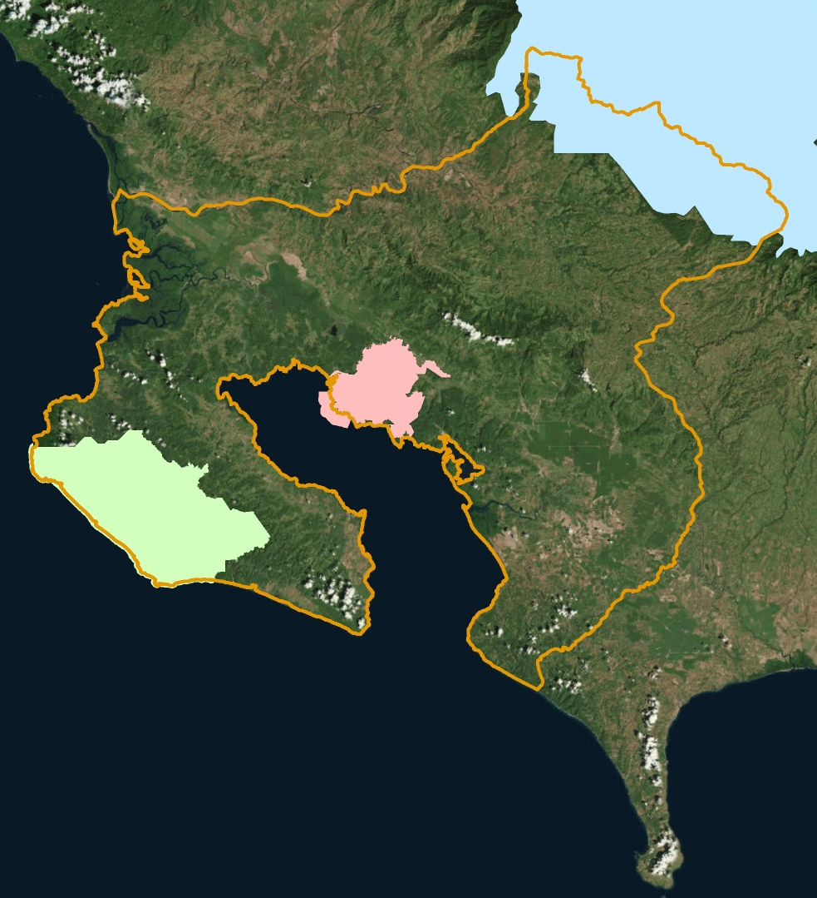
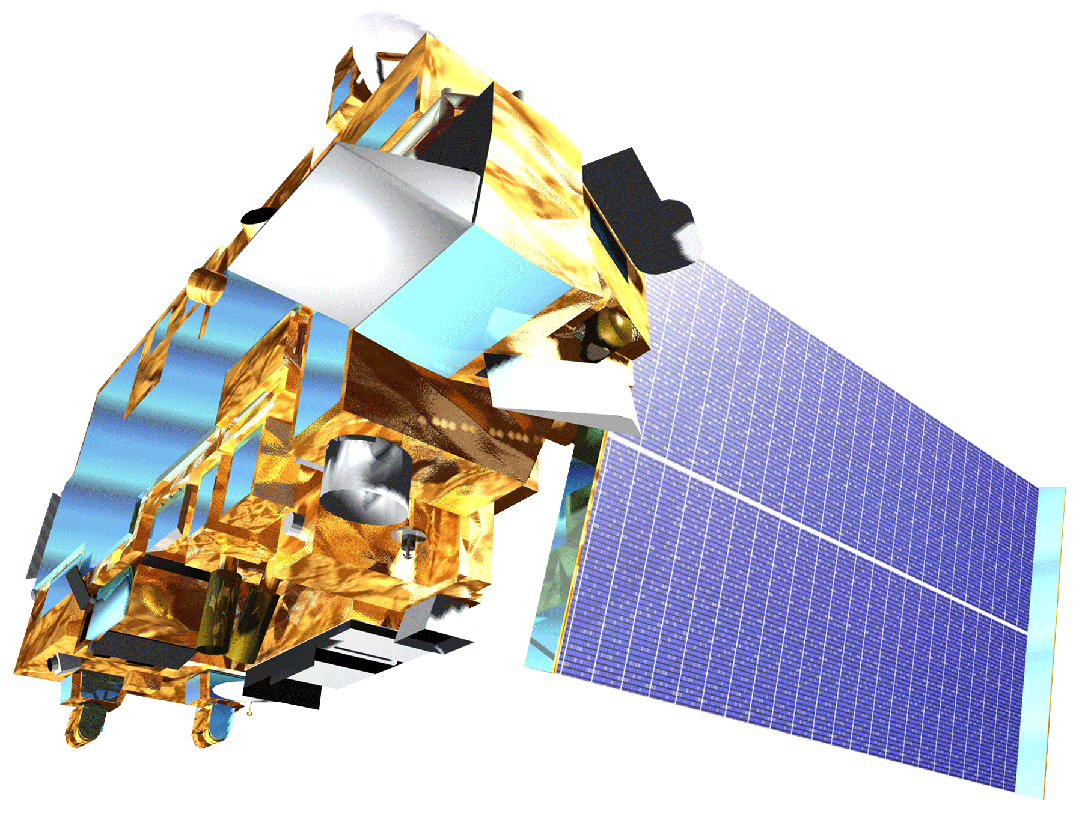
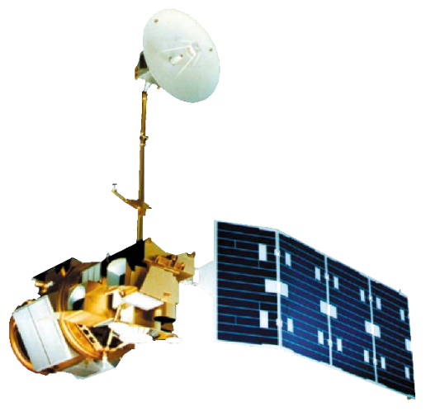
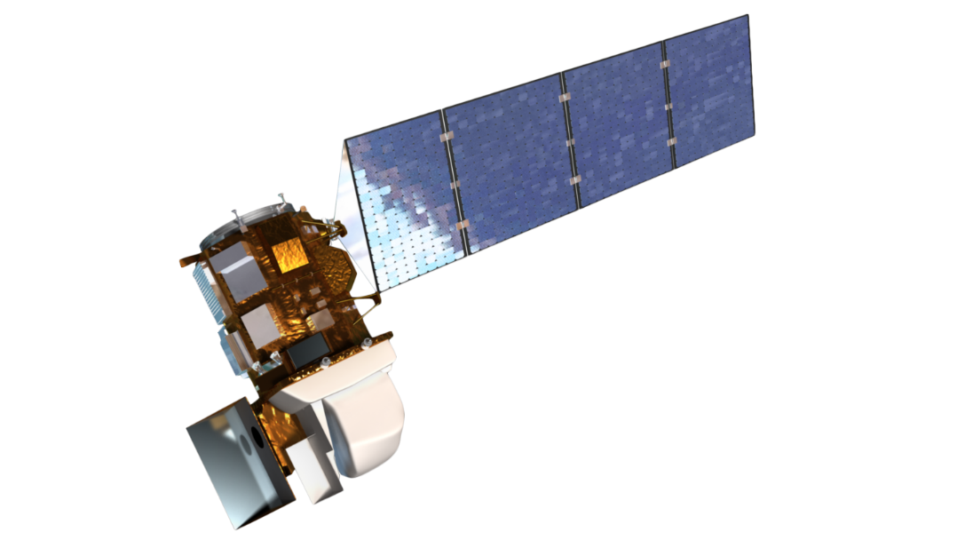
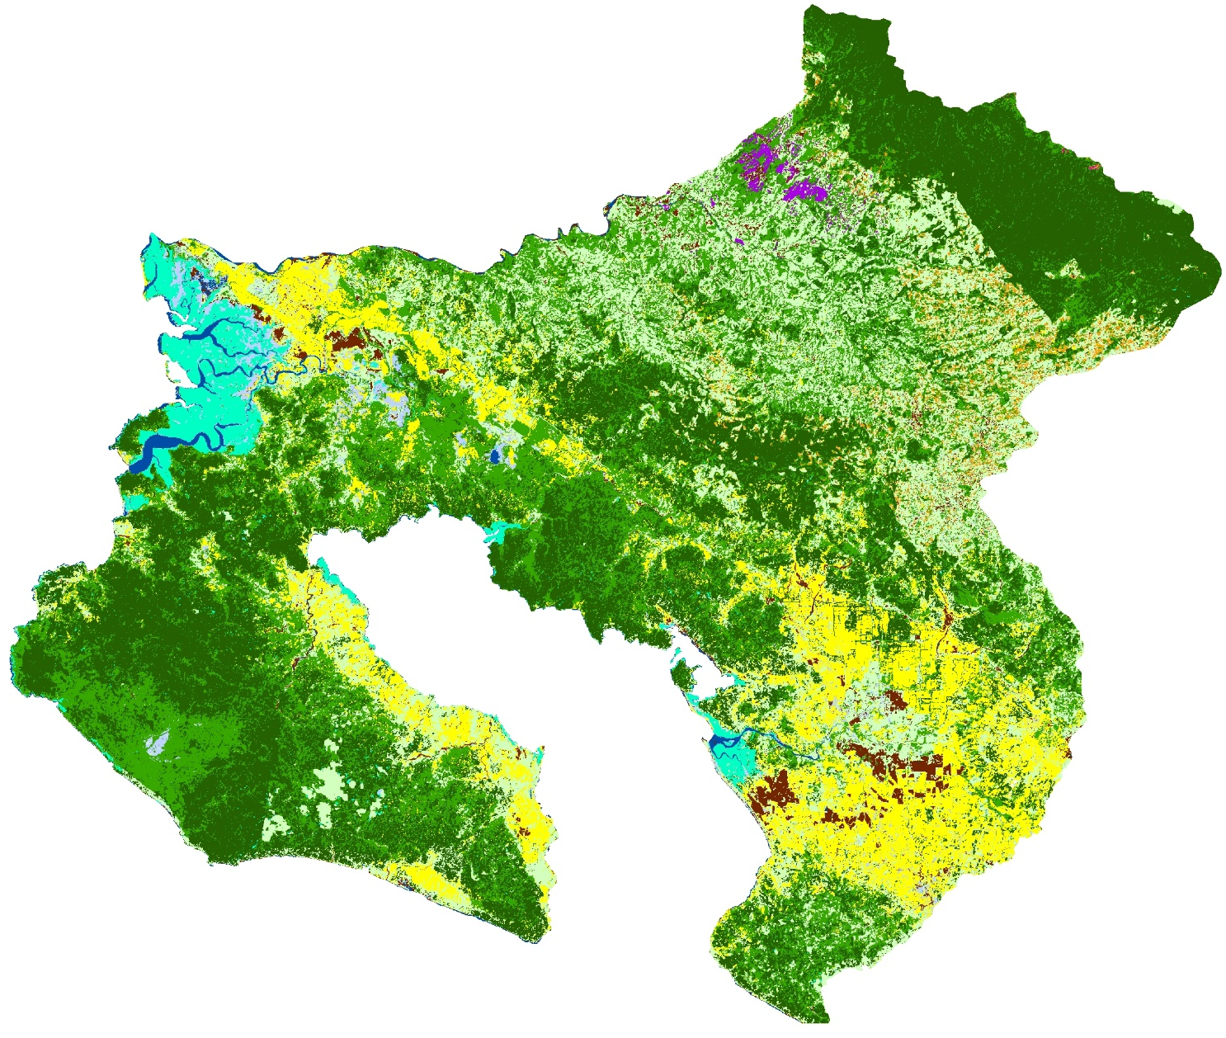
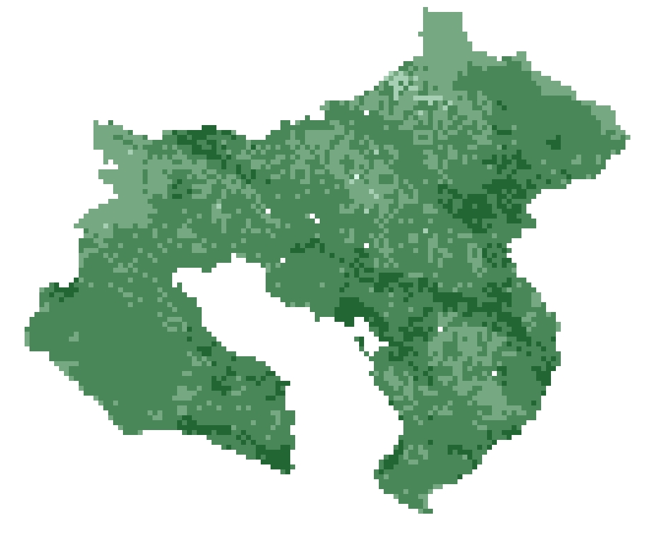
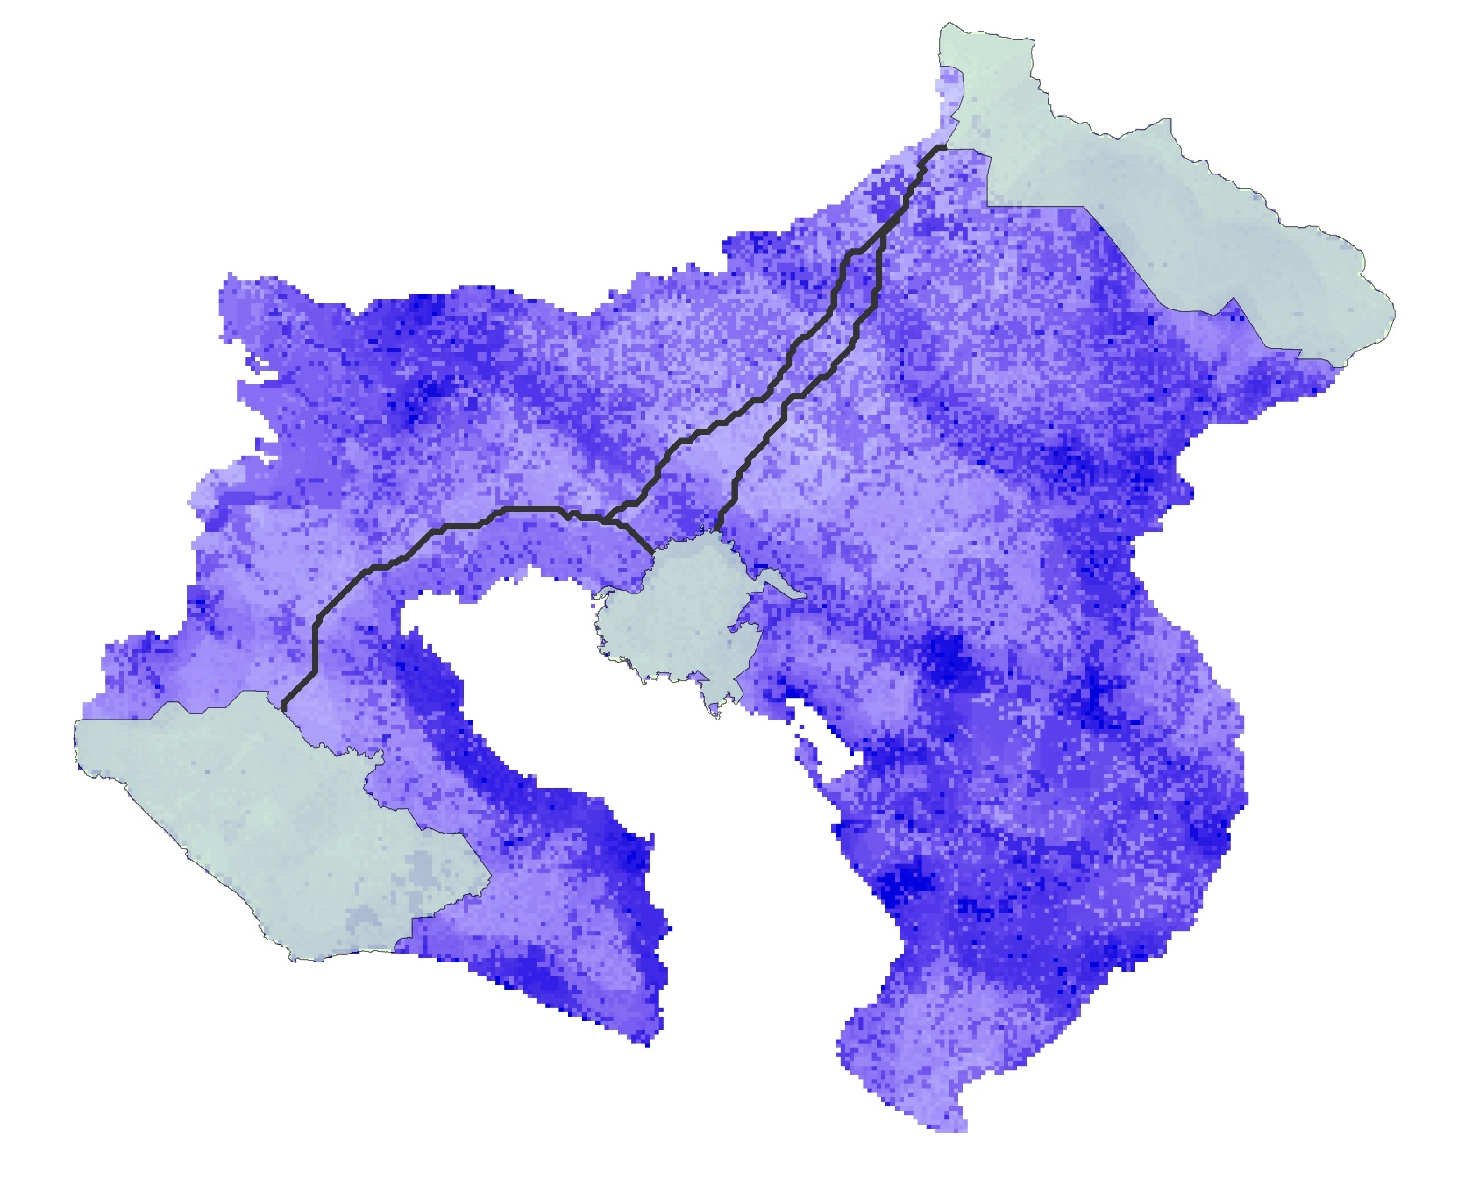
Assessing Habitat Suitability and Human-Jaguar Conflict Areas to Identify Potential Jaguar Corridors Connecting La Amistad and Corcovado National Parks in Costa Rica
Abstract
Study Area
Talamanca-Osa Ecological Forecasting II
La Amistad International Peace Park in the Talamanca Mountains and Corcovado National Park on the Osa Peninsula in Costa Rica are home to two isolated jaguar (Panthera onca) populations. As agricultural and urban land uses have expanded in Costa Rica, jaguar home ranges have been reduced by 40 percent. NASA DEVELOP collaborated with the Arizona Center for Nature Conservation – Phoenix Zoo and Osa Conservation to design optimal corridors between these two protected areas to reconnect isolated populations. This project used Landsat 5 Thematic Mapper (TM) and Landsat 8 Operational Land Imager (OLI) to assess trends in land use and land cover (LULC) from 1987 to 2019. From these analyses in conjunction with elevation data from Terra Advanced Spaceborne Thermal Emission and Reflection Radiometer (ASTER) and vector data of roads and urban centers, we forecasted LULC to 2030 using the TerrSet Land Change Modeler. These data were then used to identify forecasted human-jaguar conflict risk areas, created by urban and agricultural expansion. A compilation of these inputs informed a suitability assessment that was used in Linkage Mapper to model wildlife corridors. The results from Linkage Mapper highlighted a potential corridor through the Buenos Aires Canton of the study area. Our partners will use these findings for monitoring and educational outreach efforts and the implementation of a jaguar corridor.
Costa Rica
0 5 10 20 30 40
km
Objectives
Study area
Corcovado National Park
Piedras Blancas National Park
La Amistad National Park
N
Conduct a historical land use and land cover analysis (1987 and 1997)
Forecast land use and land cover classifications to the year 2030
Create a human-jaguar conflict risk map based on environmental and human use factors
Model corridors to aid jaguar movement between La Amistad International Peace Park and Corcovado National Park in Costa Rica
Methodology
Landsat 5 TM
1987 1997
GEE
Land Use and Land Cover Maps
Earth Observations
Landsat 8 OLI
Planetscope
2018 2019
Transition Potential Maps
Land Change Modeler
TerrSet
2030 Land Use and Land Cover Map
Ancillary Datasets
Terra ASTER
Landsat 5 TM
Terra ASTER Digital Elevation Model
Results
Landsat 8 OLI
1999-2011
Jaguar Corridor Suitability Map
Human-Jaguar Conflict Risk Map
Coffee
Exposed Soil/Urban
Grassland/Pasture
Mangrove
Wetland
0.20 – 1.50
1.50 – 2.05
2.05 – 2.70
2.70 – 3.35
3.35 – 3.95
3.95 – 4.60
4.60 – 5.20
5.20 – 5.90
5.90 – 6.90
6.90 – 8.50
Palm Plantation
Páramos
Pineapple
Primary Forest
Secondary Forest
Water
1.6
1.7 – 2.0
2.0 – 3.0
3.0 – 4.0
4.0 – 5.0
N
N
N
0 5 10 20 30 40
0 5 10 20 30 40
0 5 10 20 30 40
Km
Km
Km
Projected land use and land cover classification for 2030
Projected human-jaguar risk assessment for 2030
Preliminary corridor connecting La Amistad and Corcovado National Parks
Conclusions
Acknowledgements
Palm plantation will increase by 1.8 percent, continuing to dominate the area surrounding the Pan-American Highway in 2030.
In 2030, secondary forest will decrease by 2.2 percent, most likely being replaced by palm plantation.
The results of the projected 2030 risk assessment indicates higher associated risk around the Pan-American Highway and in populated areas, specifically in Playa Pan Dulce, Pavones, Puerto Jiménez, Golfito, Paso Canoas and San Vito.
Corridors modeled in Linkage Mapper showed two potential jaguar corridors through the Buenos Aires Canton of the study area.
Dr. Jan Schipper (Arizona Center for Nature Conservation – Phoenix Zoo)
Hilary Brumberg (Osa Conservation)
Dr. Marguerite Madden (University of Georgia, Department of Geography)
Dr. Steve Padgett-Vazquez (University of Georgia, Department of Geography)
Dr. Sergio Bernardes (University of Georgia, Center for Geospatial Research)
Hikari Murayama, Brooke Bartlett, Ryan Palmer (Talamanca-Osa I team)
Team Members
Project Partners
Arizona Center for Nature Conservation – Phoenix Zoo
Osa Conservation
Samuel Furey
Project Lead
Iris Fynn
Olivia Landry
Samantha Trust
Georgia – Athens | Summer 2019

