Slide 1
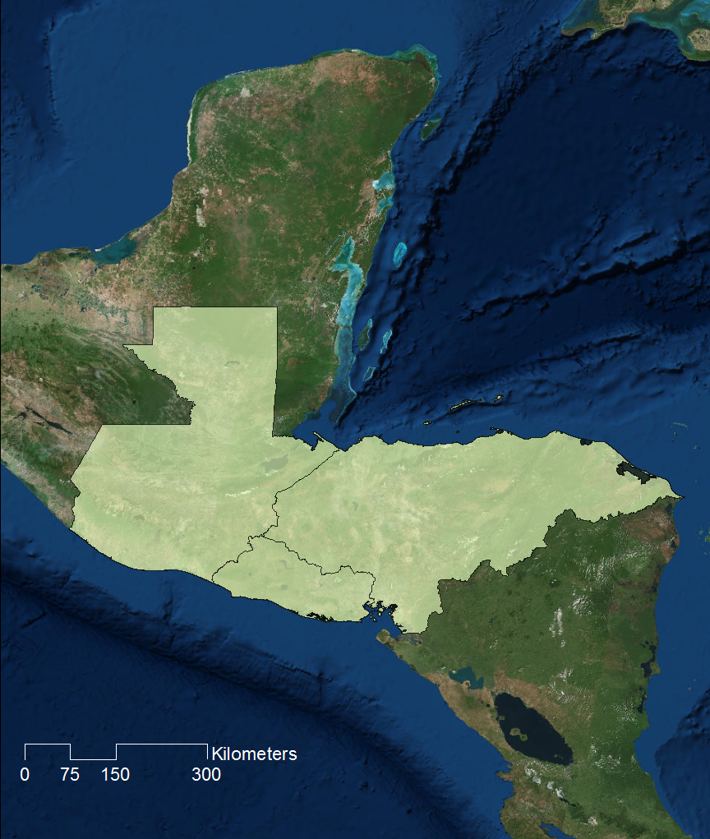

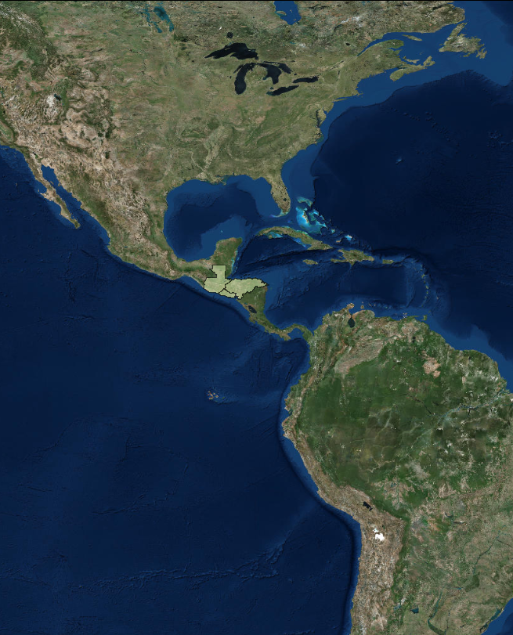


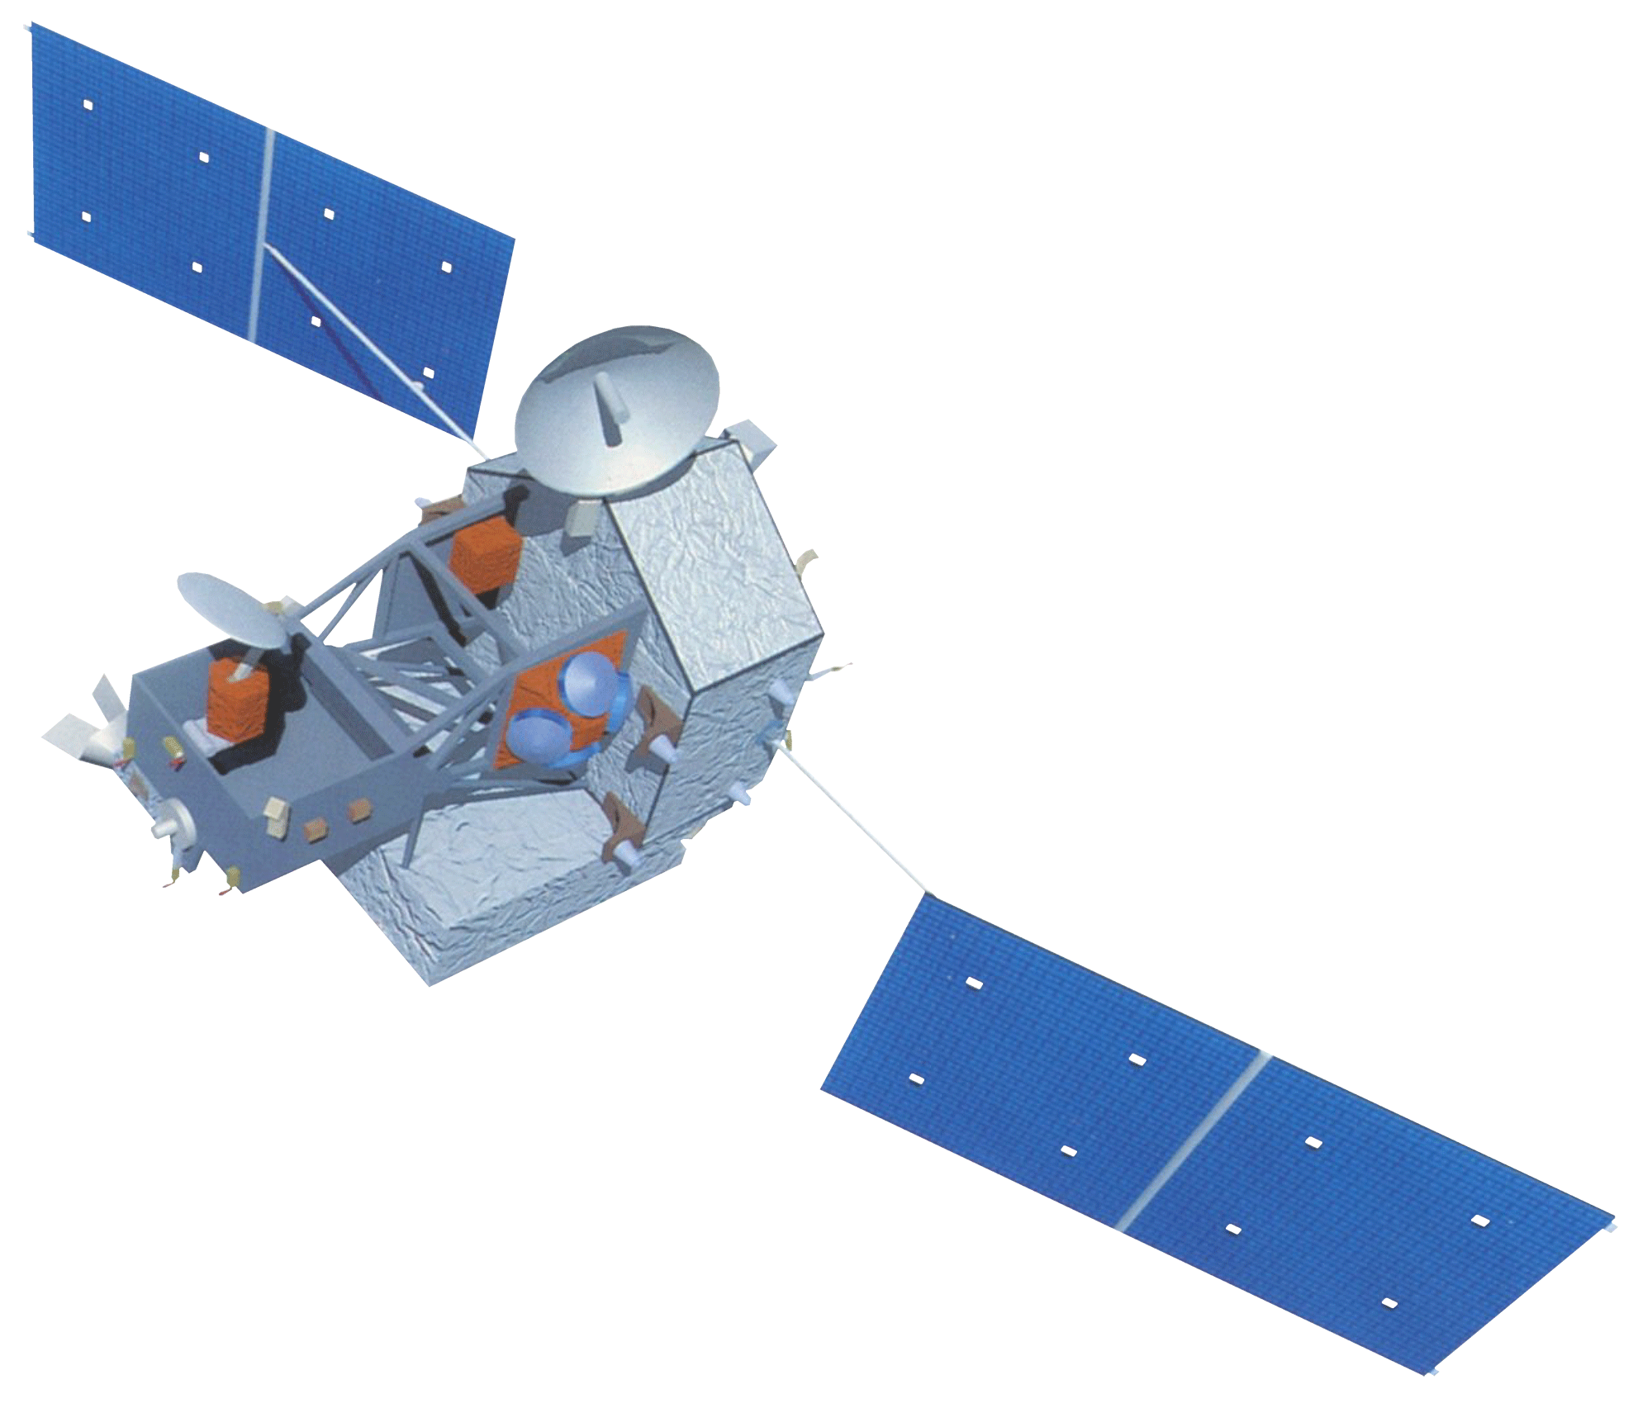
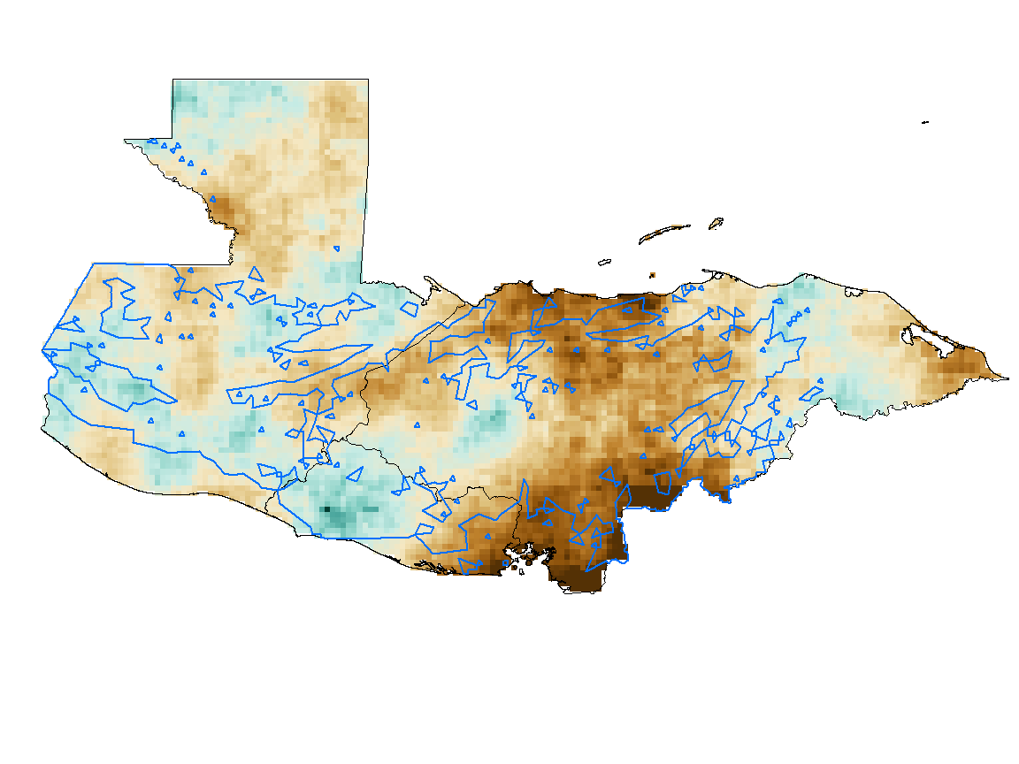
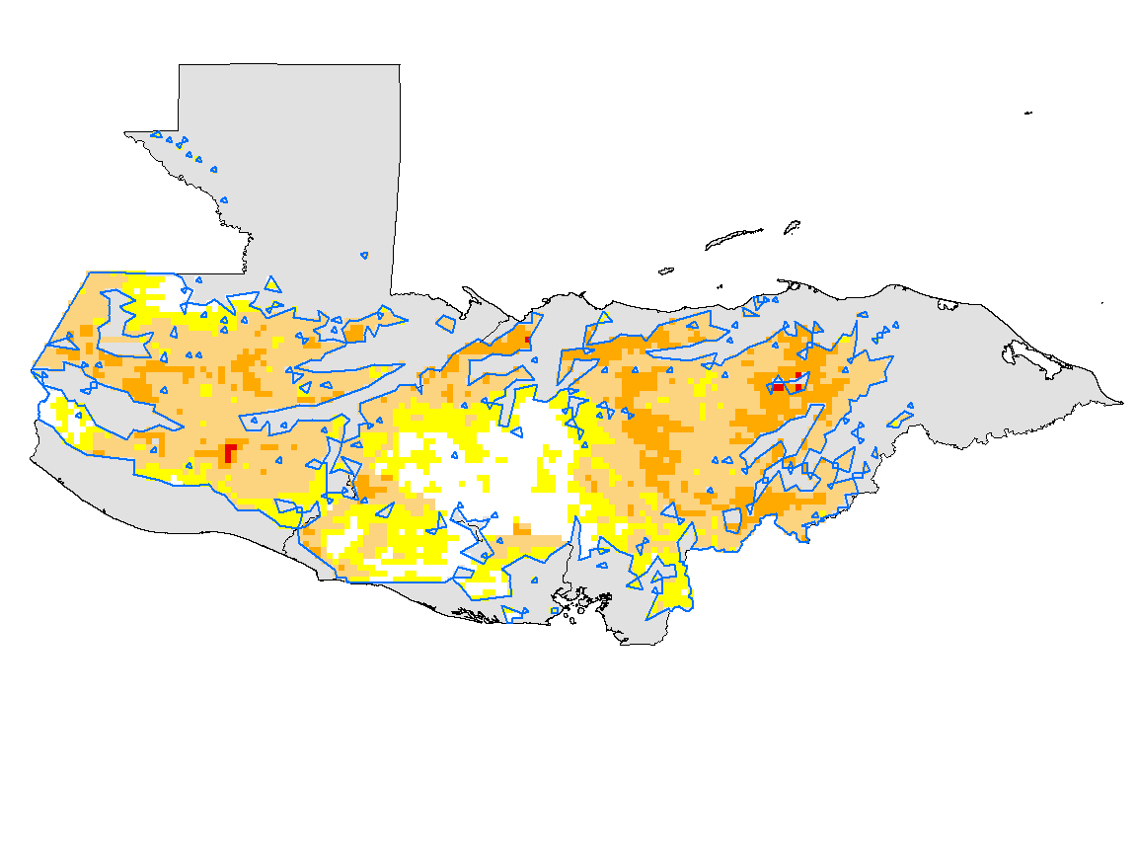
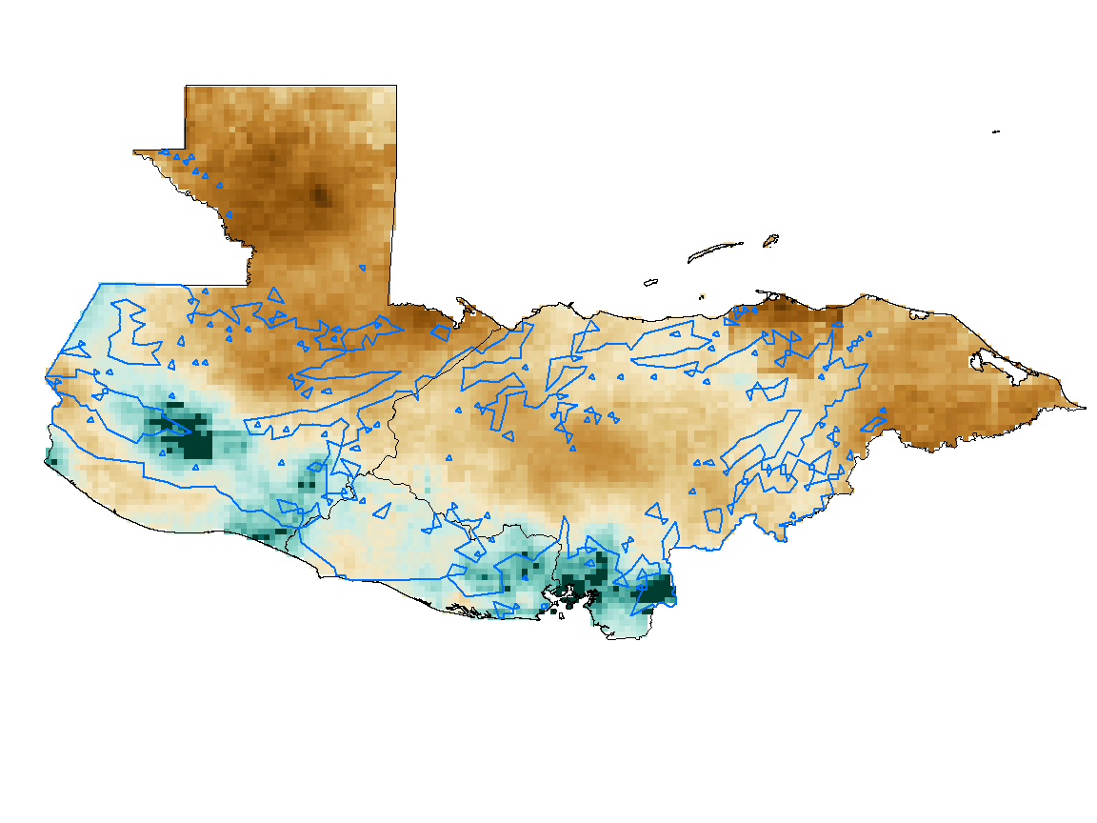
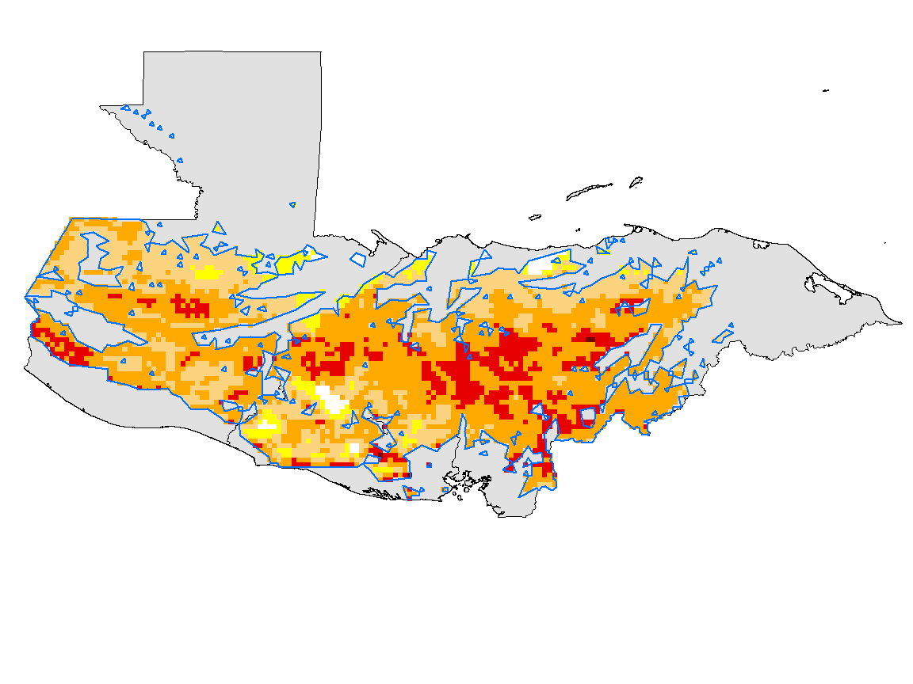
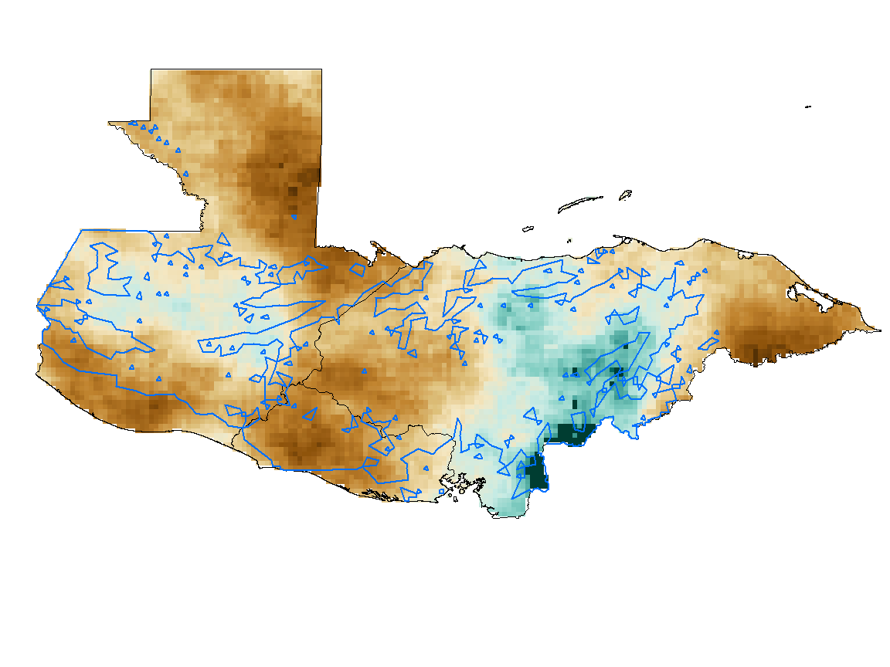
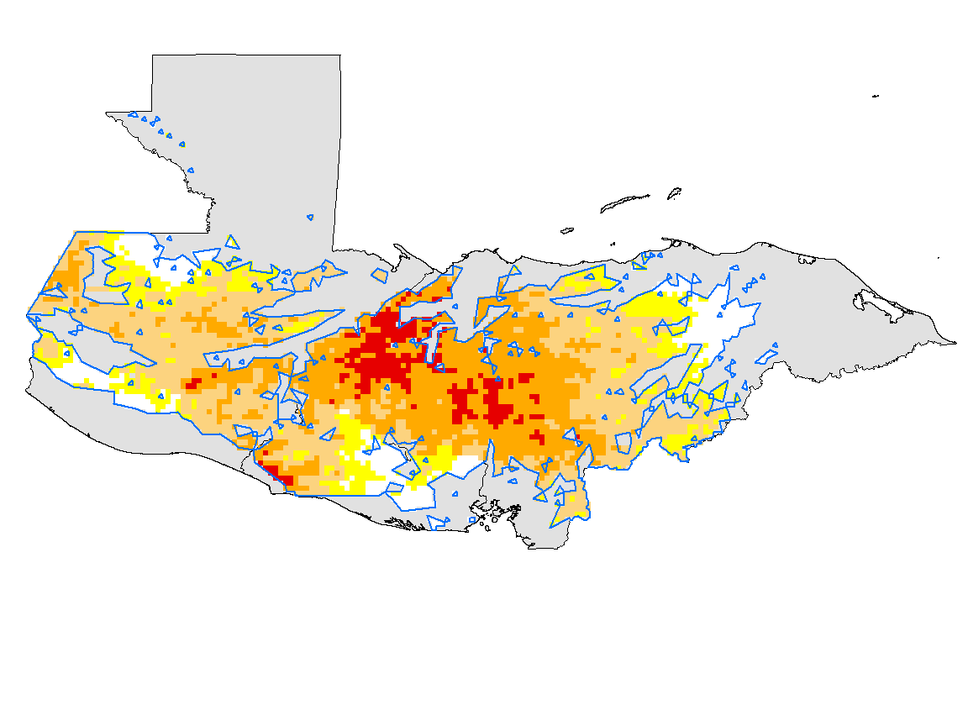
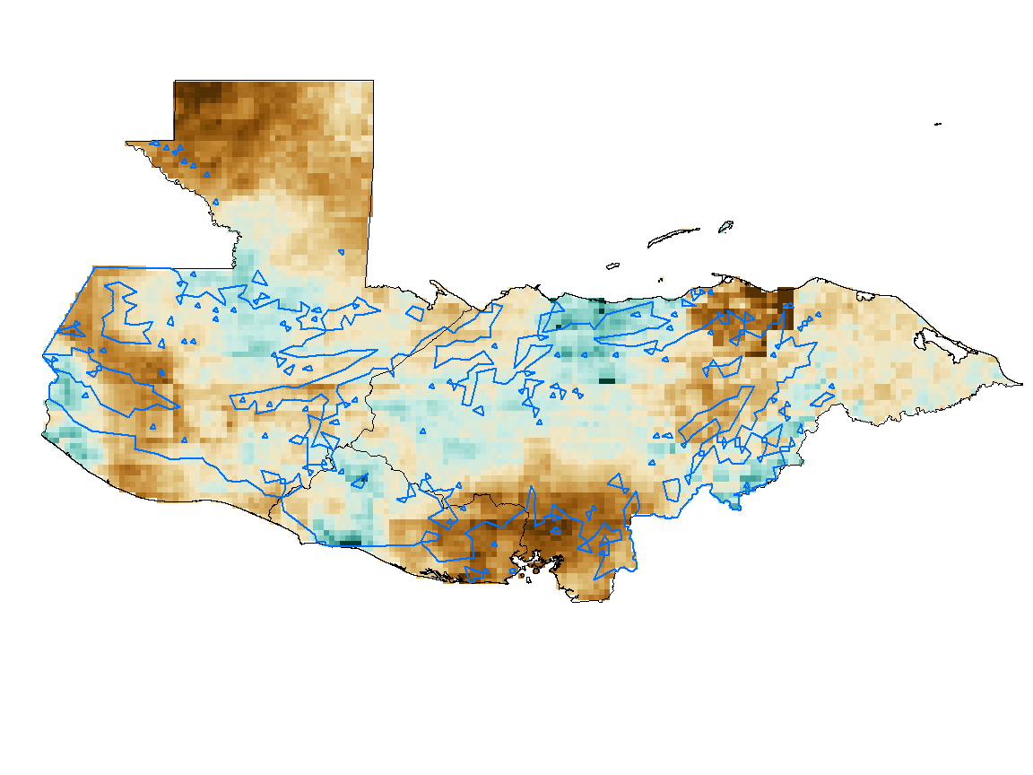
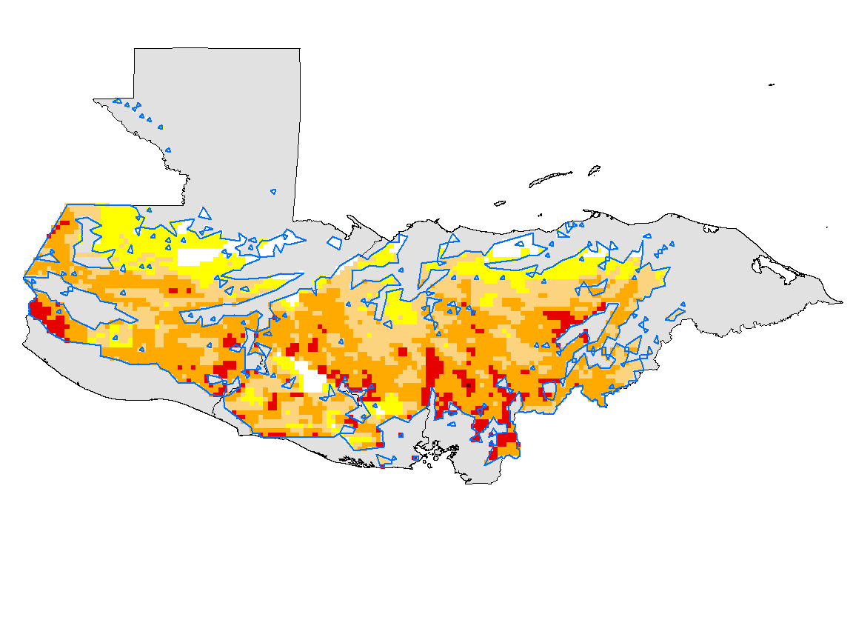

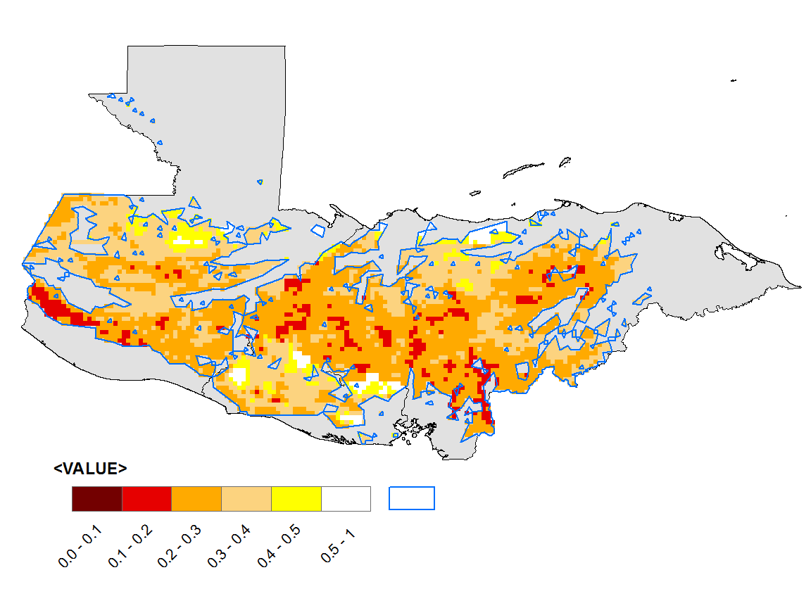



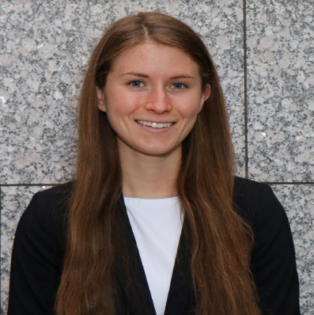
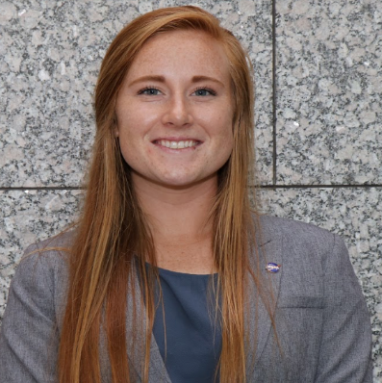
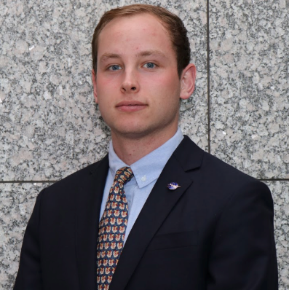
Utilizing NASA Earth Observations and NOAA Climate Data Records to Monitor Drought and Precipitation Patterns for Coffee Agriculture Management in Guatemala, Honduras, and El Salvador
Abstract
Study Area
Objectives
In November of 2017, Guatemala, Honduras, and El Salvador produced over 12 million kg of coffee combined, accounting for half of Central America’s total output. However, in the last 20 years Central America has experienced crop declines between 50% and 90%, due largely to drought and irregular rainfall. These irregularities in the weather patterns have increased coffee crop vulnerability to diseases, such as coffee rust, as well as significantly decreased the productivity and overall quality of coffee crops. In particular, the 2015-2016 El Niño spurred a drought lasting for two years, the most severe drought in Central America in recent history. This project partnered with the Hanns R Neumann Stiftung Feed the Future Alliance for Resilient Coffee (ARC), International Center for Tropical Agriculture, and Conservation International to produce detailed analyses of precipitation anomalies for next generation coffee farmers, co-ops, and regional planners. The team created an atlas of El Niño-Southern Oscillation (ENSO) phases using the Climate Hazards Group InfraRed Precipitation with Station data (CHIRPS), and a time-series analysis of the frequency and intensity of historical drought periods using the Scaled Drought Condition Index (SDCI). Analyses will be used to assist partners in early warning detection by observing anticipated rainfall conditions aiding in determining adaptive management options.
Produce a 37-year atlas detailing precipitation anomalies associated with moderate-strong, neutral, and weak ENSO phases through use of remotely-sensed precipitation data
Compute a Scaled Drought Condition Index based on remotely-sensed precipitation, NDVI, and land surface temperature data to provide a historical context on spatial and time series drought trends
Enhance the ability of agriculture extension workers and other coffee industry stakeholders to make farm management decisions based on remotely-sensed climate data
Guatemala
Honduras
Project Partners
El Salvador
Katherine Selengia, Hanns R Neumann Stiftung, Feed the Future Alliance for Resilient Coffee
Christian Bunn, International Center for Tropical Agriculture
Karyn Tabor, Conservation International
Jenny Hewson, Conservation International
Methodology
Earth Observations
ENSO Precipitation Anomaly Analysis
SDCI Analysis
NOAA-18 contributor to Advanced Very High Resolution Radiometer (AVHRR) dataset
Data Acquisition (1981 – 2017)
Seasonal Climatology Processing
ENSO Phase Categorization
Precipitation from CHIRPS
3 mo. seasonal means (Jan-Mar, Feb-Apr, Mar-May, etc.)
ENSO Phase Anomaly Measurement
La Niña
Neutral
El Niño
Year of onset (Year 0)
Year after onset (Year +1)
Input Data Acquisition (2000 – 2017)
Scaled Input Processing
SDCI Calculation: 0 (driest) to 1 (wettest)
NDVI from AVHRR
Precipitation (PR) from CHIRPS
LST from MODIS
(X_{max} – X) / (X_{max} – X_{min})
(.25) scaled NDVI + (.5) scaled PR + (.25) scaled LST
*regional maxima/minima scaled from 0 to 1
Terra satellite with Moderate Resolution Imaging Spectroradiometer (MODIS) sensor
TRMM Microwave Imager used to calibrate Climate Hazards Group InfraRed Precipitation with Station data (CHIRPS) dataset
Results
Conclusions
Moderate/Strong El Niño
Sept-Nov (Year 0)
SDCI
Oct 2015
Moderate/Strong El Niño
Jan-Mar (Year +1)
SDCI
Feb 2016
With ENSO outlook reports, ENSO anomaly maps can be used as an early warning system for anticipated precipitation changes.
Scaled Drought Condition Index exhibits strong seasonality influenced by wet vs. dry season precipitation cycles and do not display expected drought patterns associated with ENSO phase.
El Niño and La Niña phases exhibit mirrored precipitation anomalies, especially in areas experiencing greatest wet vs. dry season cycles in the Dry Corridor along the Pacific coast.
Coffee industry stakeholders will be able to replicate ENSO anomaly and SDCI analyses within varying periods of record, seasons, and coffee growing locations across the globe.
Future work should examine the weight of SDCI inputs in tropical areas like Central America to improve its applicability in regions with wet and dry season cycles, large elevation ranges, and year-round vegetation greenness.
Moderate/Strong La Niña
Sept-Nov (Year 0)
SDCI
Oct 2010
Moderate/Strong La Niña
Jan-Mar (Year +1)
SDCI
Feb 2011
ENSO Precipitation Anomaly (%)
Exceptional Drought
SDCI Severity
No Drought
Coffee Suitability Regions
Team Members
Acknowledgements
EXAMPLE
We would like to thank our advisor, Mike Kruk, and other mentors (Alec Courtright, Jessica Sutton, Anand Inamdar, Jonathan Brannock) at the NOAA National Centers for Environmental Information, as well as the team from NASA DEVELOP National Program Office, for their critical guidance and support in completion of this project.
Alexa Kennedy
Project Lead
Danielle Curtis
Meghan Russell
Andrew Shannon
Central America Agriculture & Food Security
North Carolina - NCEI| Summer 2018

