Slide 1
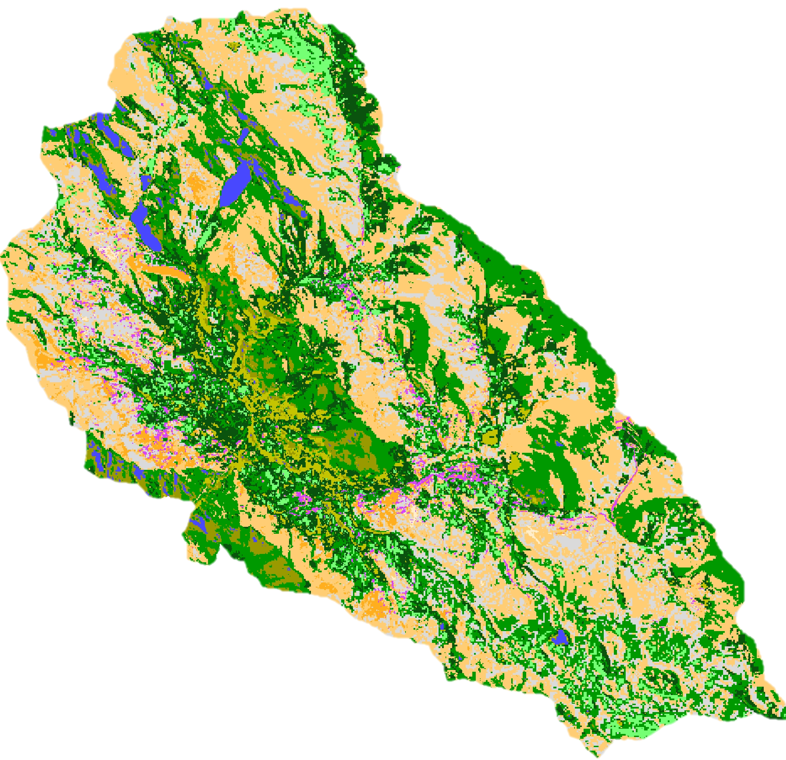
Perú Climate III
Caren Remillard (Project Lead)
Monitoring and Forecasting Shifting Climate and Land Change Impacts in Perú’s
Parque de la Papa for Enhanced Agricultural Management
Shirin Esmaeili
Dorris Scott
Parul Singh
Notes:
This is a continuation of a Fall 2015 project that started at Langley Research Center and continued throughout two more terms.

Slide 2
Background
Climate change is increasingly affecting agriculture around the world
Tropical montane areas are particularly vulnerable
The livelihoods of people in these areas are threatened
Image Credit: David Ellis
Image Credit: David Ellis
Notes:
Shifting precipitation and increase in average global temperature due to climate change is impacting agricultural practices around the world. The livelihoods of people living in tropical montane regions such as the Andean Highlands, will be especially affected.

Slide 3
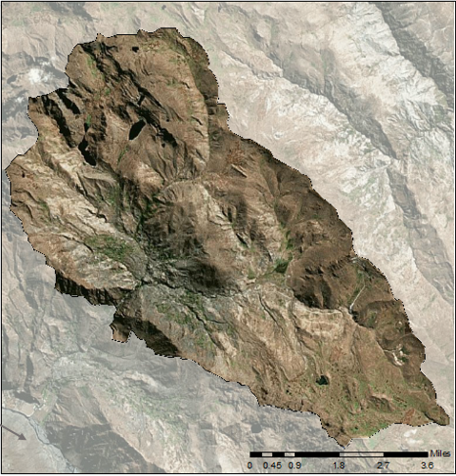
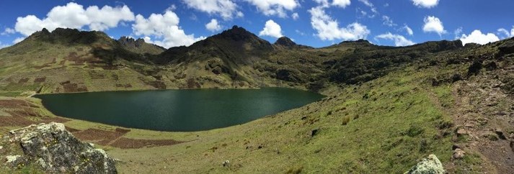
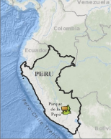
Study Area
Indigenous biocultural heritage area
8,661 ha
3,200-5,000 m above sea level
Study Period: 1973 - 2016
Image Credit: David Ellis
Notes:
This project was conducted in the Parque de la Papa located in the Cusco region of Southeastern Perú. The Parque de la Papa is an Indigenous Biocultural Heritage Area collectively owned by six local communities belonging to the Quechua people. It is located roughly 25 km away from Cusco, the nearest city, and is 8,661 ha in size ranging from 3,200- 5,000 m above sea level. The indigenous communities consist of some 7,000 people who pursue traditional lifestyles and agricultural cultivation as practiced in the region for centuries…

Slide 4
Partner Organizations
International Center for Potatoes (CIP)
Association for Nature and Sustainable Development (ANDES)
Image Credit: David Ellis
Notes:
During the course of this project, we collaborated closely with the International Center for Potatoes (CIP) and Association for Nature and Sustainable Development (ANDES). These two organizations work to assist farmers in maintaining potato biodiversity and their traditional agricultural practices.
Additionally, they assist the indigenous communities within the Parque de la Papa by helping them translate field data and scientific research into management plans that they can implement.

Slide 5
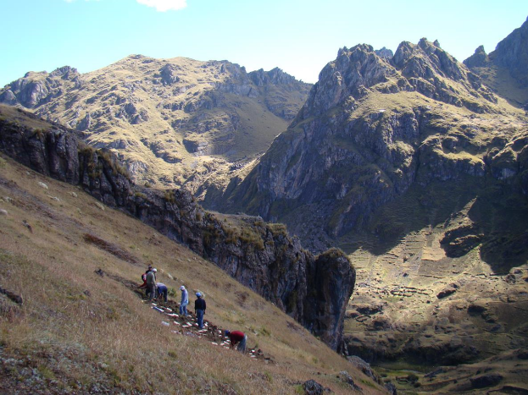
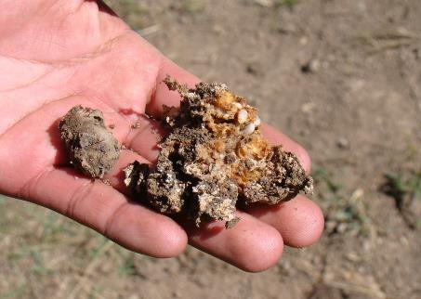
Community Concerns
Local farmers have been forced to move potato crops to higher elevations in response to changing temperatures and increased pest survival
Image Credits: David Ellis
Notes:
And The main concern is that farmers have moved their potato crops to higher and higher elevations due to shifting precipitation and increase in temperatures, as well as crop predation by weevils. Because they are determined not to resort to pesticides and to continue traditional farming practices, their way of life is becoming increasingly imperiled. These pests cause irreparable damage to crops as well as surrounding fields.
With respect to climate, potato production must occur during a time period that is both “heat free” and “frost free,” (Haverkort et al. 2013). Risk of frost increases below 3°C, and tuber production decreases at mean temperatures above 22°C (Hijmans et al, 2000). In addition to regulating plant growth, temperature also affects insect growth and development (Jamieson et al., 2002). Warming temperatures may also increase vulnerability of plants to insect damage, especially if water availability is reduced (Jamieson).

Slide 6
Objectives
Create a suitability model to identify areas for optimal potato cultivation
Develop a risk assessment model to forecast unsuitable areas for potato cultivation in the future
Enable indigenous communities to continue using traditional agricultural practices
Image Credit: David Ellis
Notes:
In response to these community concerns, our team decided to focus on 1) Creating a planting suitability model to identify areas for optimal potato cultivation, 2) Develop a risk assessment model to predict unsuitable areas for the future and 3) the overarching goal of the project is to use applied sciences to study land while preserving the traditional agricultural practices of these communities.

Slide 7
Methodology
Suitability Map
Landsat Image from May, 2 2016
Landsat 8 OLI
Data Acquisition
Climate data
Data Acquisition
Data Acquisition
Terra (Aster)
Risk Assessment
Soil Capacity
Notes:
Besides these Earth Observations, we acquired historical climate data from NOAA and future data provided by WorldClim to predict areas at risk of becoming unsuitable in 2050.

Slide 8
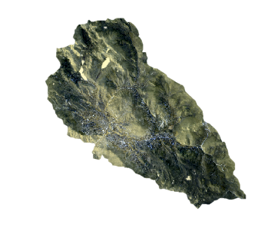
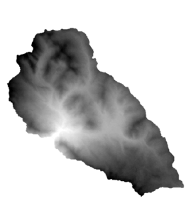
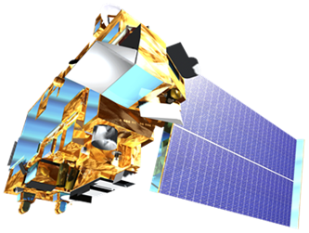
Earth Observations
Landsat 8 (OLI TIRS)
Land Cover
Terra (ASTER)
Slope
Elevation
Notes:
Level 1 GeoTIFF imagery for Landsat 8 Operational Land Imager (OLI) was downloaded from the United States Geological Survey (USGS). The image was taken on May 2, 2016, just before the harvest time- which reflects maximum vegetation. An ASTER Global Digital Elevation Model was used to determine slope and elevation.

Slide 9
Atmospheric
correction
Calculate monthly averages
El Niño + Non El Niño years
Data Processing
Re – project DEM
Digitize soil data
Pansharpen
and perform
atmospheric
correction
Separate by
El Niño
and non
El Niño years
Data Processing
Create weights
and buffers
based on input
Obtain soil use
and capacity information
Derive slope
and aspect
Notes:
All of these data were processed, reclassified, and assigned values based on their biophysical importance. The assignemtn of these mathematical alues were informed by the indigenous communities’ traditional knowledge.

Slide 10
El Niño Years Average Temperature from 1973-2015 in Parque de la Papa, Peru
January
February
March
April
May
June
July
August
14.4 ° C
September
October
November
December
2.2 ° C
Notes:
We used Environmental lapse rate to project them as rasters. This slide shows the average temperature of El Nino Years from 1973 to 2015. May through September is relatively colder than October through April.

Slide 11
Non El Niño Years Average Temperature from 1973-2015 in Parque de la Papa, Peru
January
February
March
April
May
June
July
August
14.4 ° C
September
October
November
December
2.2 ° C
Notes:
This slides shows the average temperature from 1973 – 2015 for non El Nino years.

Slide 12
Notes:
Overall the temperature is increasing from 1973 to 2015 for El Nino and non El Nino years as shown in this graph. 2015 shows the highest El Nino year.

Slide 13
Unsupervised classification
Environmental Lapse Rate
Data
Analysis
Derive slope + elevation
Soil classification
Notes:
For Land cover we did unsupervised classification using ISO Data in Envi, We used the Environmental lapse rate equation to get the current climate data, We used the reclassified tool to get the suitable elevation and slope for the potatoes and did a soil classification based on the soil capacity in Parque de la Papa.

Slide 14
Suitability Map
Data Acquisition
Data Results
Risk Assessment
Notes:
The remaining information was combined in a model which assigned mathematical values to each parameter according to its biophysical importance. The resulting model was then used to predict optimal potato growing areas within the Parque de la Papa.

Slide 15
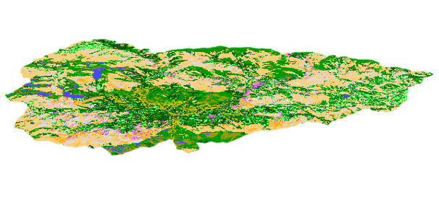
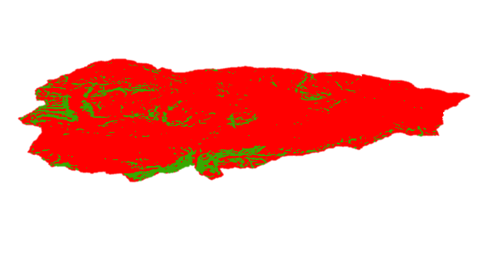
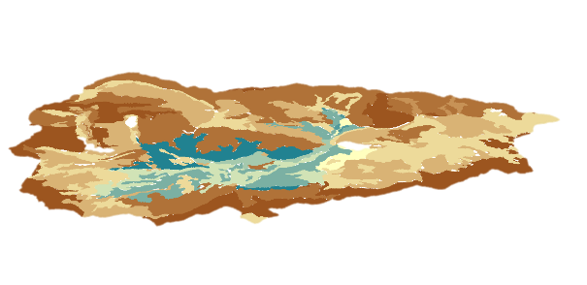
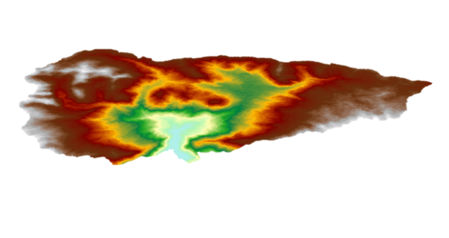
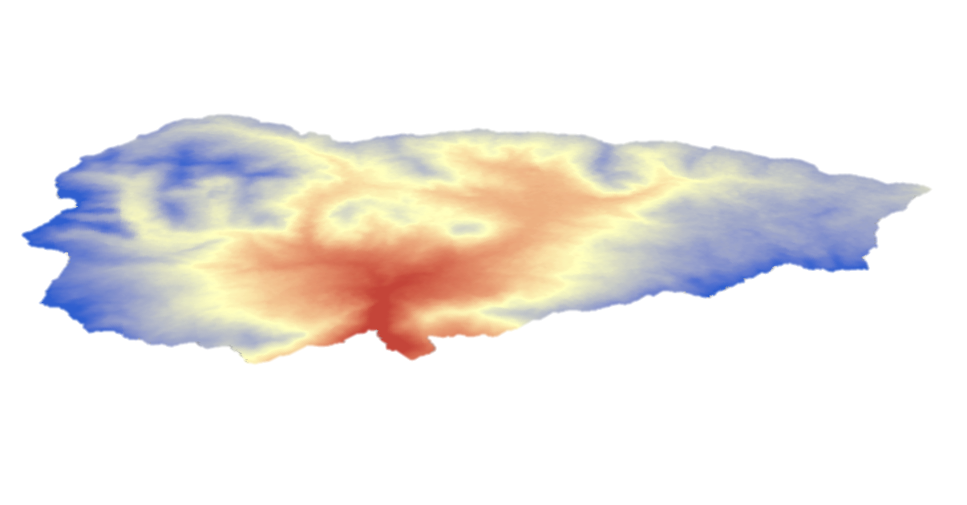
Suitability Variables
Land Cover
Slope
Soil Capacity
Elevation
Temperature
Notes:
Here you can see the input layers that were incorporated into our suitability and risk assessment model.
*All weights given to these were ranked from least suitable to somewhat suitable to most suitable based on ideal environmental requirements for the potato according to local knowledge and research. *

Slide 16
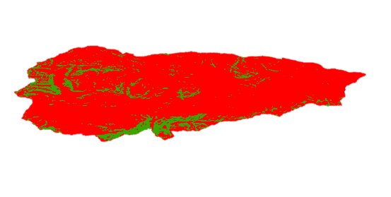
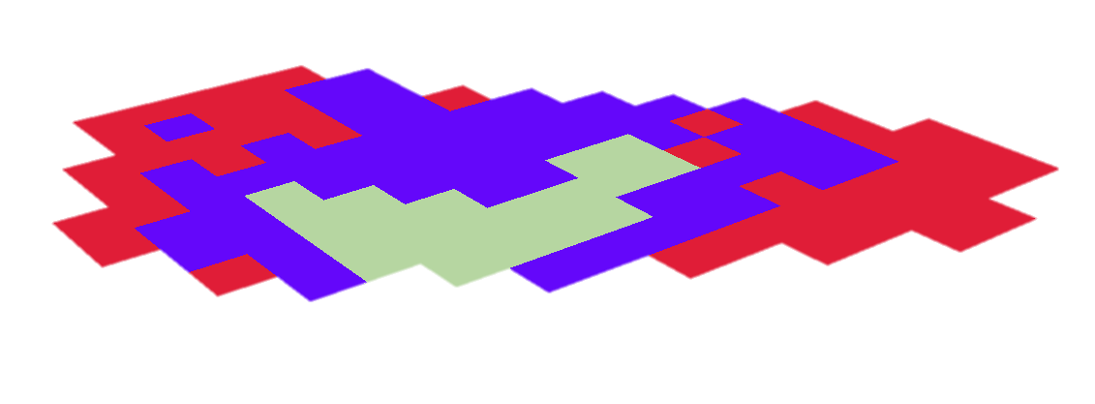
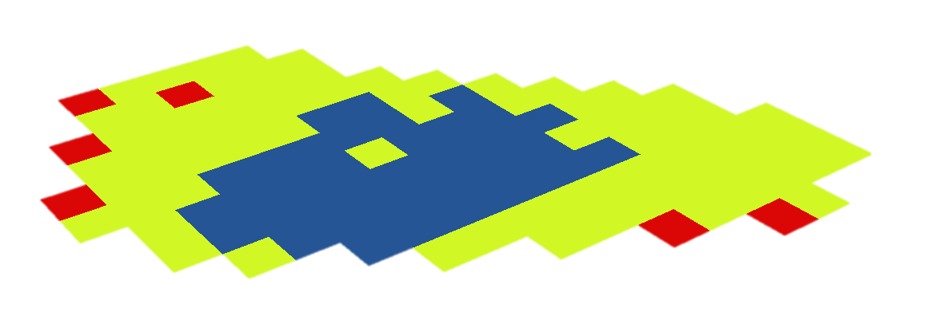
Risk Variables
Land Cover
Slope
Soil Capacity
Elevation
Potato Temperature
Potato Weevil Temperature
Precipitation
Notes:
Here you can see the input layers that were incorporated into our suitability and risk assessment model.
*All weights given to these were ranked from least suitable to somewhat suitable to most suitable based on ideal environmental requirements for the potato according to local knowledge and research. *

Slide 17
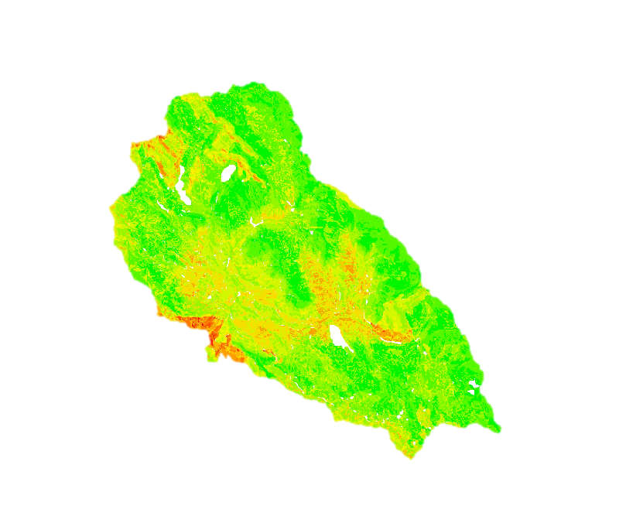
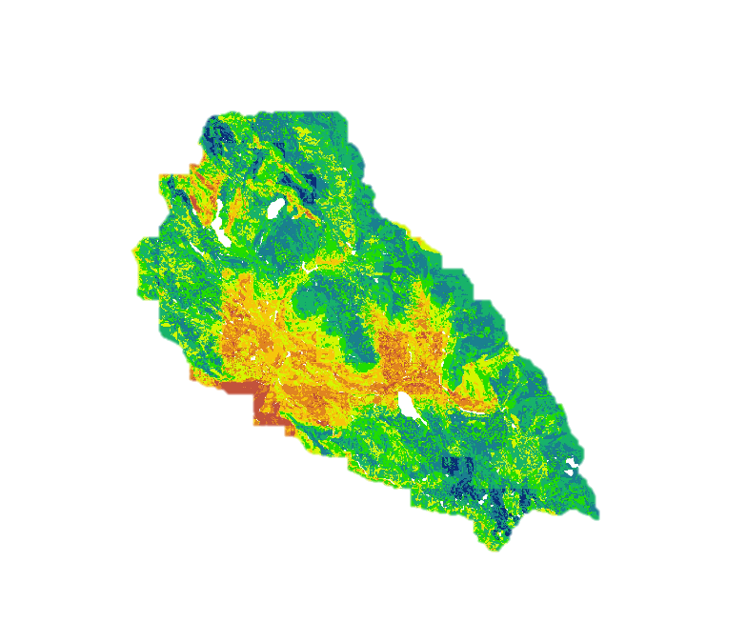
Results
Current Potato Suitability
Future Risk Assessment
High Suitability
Low Suitability
Low Risk
High Risk
Notes:
This slide shows our results for current potato suitability and future risk assessment for the month of December. The map on the left shows areas that have higher suitability in green and low suitability in red. The risk assessment on the right suggests that there will be an increase in areas that could be unsuitable based on 2050 climate projections.

Slide 18
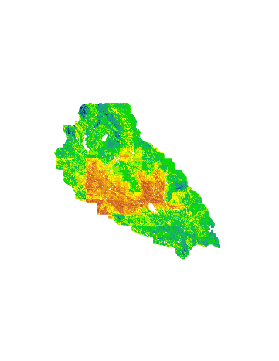
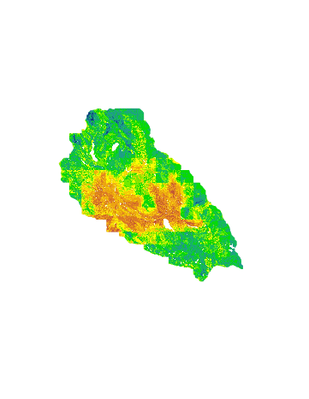
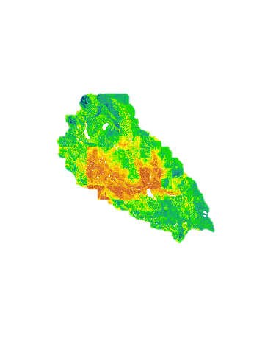
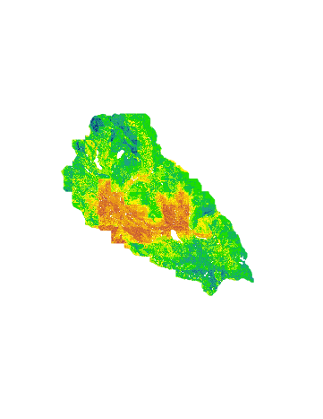
Results – Risk Assessment (2050)
November
December
January
February
March
April
Notes:
This slide we decided to show the at risk areas during the planting, growing and harvesting months. November and December Is the planting months which tells which areas will be suitable for the potato plants. We chose to show January, Feb, March and April because we wanted to see how the potato weevil has a huge impact on the Potatoes. As these months have higher temperature and precipitation, it is the perfect time for the potato weevil to grow and affect the potatoes.

Slide 19
Conclusions
NASA satellite data were successfully used to model current and future suitability for potato cultivation
The potato suitability model incorporated multiple datasets, including local knowledge, that identified areas of high, moderate, and low suitability
The future risk assessment model, based on 2050 climate projections, suggested an increase in areas that reflect low suitability
NOAA climate data provided information about temperature trends of El Niño vs non El Niño periods over the past 42 years
The suitability and risk assessment models are flexible and can be adjusted by the user to inform current and future management plans
Notes:
In conclusion, NASA satellite data was successfully used to model current and future suitability for the Peruvian Potatoes
The future risk assessment model, suggests that there will be an increase in areas at risk of becoming unsuitable for Potatoes in the future
The Suitability and risk assessment model are flexible and can be adjusted by user to inform current and future management plans.

Slide 20
Errors & Uncertainties
Land cover classification
Total Accuracy = 65%
Kappa Coefficient = 64.1% (fair to good)
Future climate projection data from WorldClim - resolution is coarse
Image Credit: David Ellis
Notes:
The land cover classification was refined and improved, but the total accuracy for the classification was approximately 65% accurate. This was primarily due to pixels in shadow areas mixed up with water. The future data for the climate and precipitation was so coarse that

Slide 21
ERROR MATRIX
PREDICT | GRIDCODE | AERIAL2 | AERIAL3 | AERIAL4 | AERIAL5 | AERIAL6 | AERIAL7 | Row total
1- water | 0 | 0 | 0 | 10 | 0 | 0 | 0 | 10
2- agriculture | 0 | 8 | 0 | 1 | 1 | 0 | 0 | 10
3- bare soil | 0 | 1 | 9 | 0 | 0 | 0 | 0 | 10
4- bare rock | 0 | 2 | 6 | 2 | 0 | 0 | 0 | 10
5- shrubland | 0 | 0 | 0 | 1 | 9 | 0 | 0 | 10
6- urban | 0 | 0 | 1 | 0 | 0 | 9 | 0 | 10
7- grassland | 0 | 2 | 0 | 0 | 0 | 0 | 8 | 10
Column Total | 0 | 13 | 16 | 14 | 10 | 9 | 8 | 70
Omission Error | 0 | 5/13=0.38 | 7/16= .44 | 12/14= 0.86 | 1/10= .1 | 0 | 0
Notes:
In the error matrix, we saw that the most bare rock pixels were misclassified, which should have belonged to the bare soil class.

Slide 22
Advisors
Dr. Marguerite Madden, UGA Center for Geospatial Research
Dr. Sergio Bernardes, UGA Center for Geospatial Research Dr. Kenton Ross, NASA DEVELOP National Program
Partners
Dr. Noelle Barkley, CIP Dr. David Ellis, CIP
Rene Gomez, CIP Henry Juarez, CIP
Genesis Abreu, ANDES
Past Contributors
We would also like to acknowledge the contributions of the Perú Climate I & II team: Dajon Begin, Brandon Hays, Kayla McDonald, Rebekke Muench, Kayla McDonald, Benjamin Page, Richard Rose, Adam Salway, Michael Sclater, Sam Weber, Ryan Murphy, Xuan Zhang
Notes:
We would like to acknowledge our since advisors, project partners and our past contributors. Thank you

