Slide 1
Colorado Agriculture and Ethiopia Ecological Forecasting
New Tools and Techniques to Expedite Landsat 1-8 Time Series Data Processing for Land Change Detection
Brian D. Woodward
Stephen M. Chignell
Notes:
-Combined presentation between SC, Ethiopia Team Leader and BW, Center Lead and COAG Team Leader.
- After a long term of working with the full LS time series, we thought it would make for an interesting presentation to share what we learned regarding the creation of a full time series, the challenges, advantages, and issues we encountered.

Slide 2
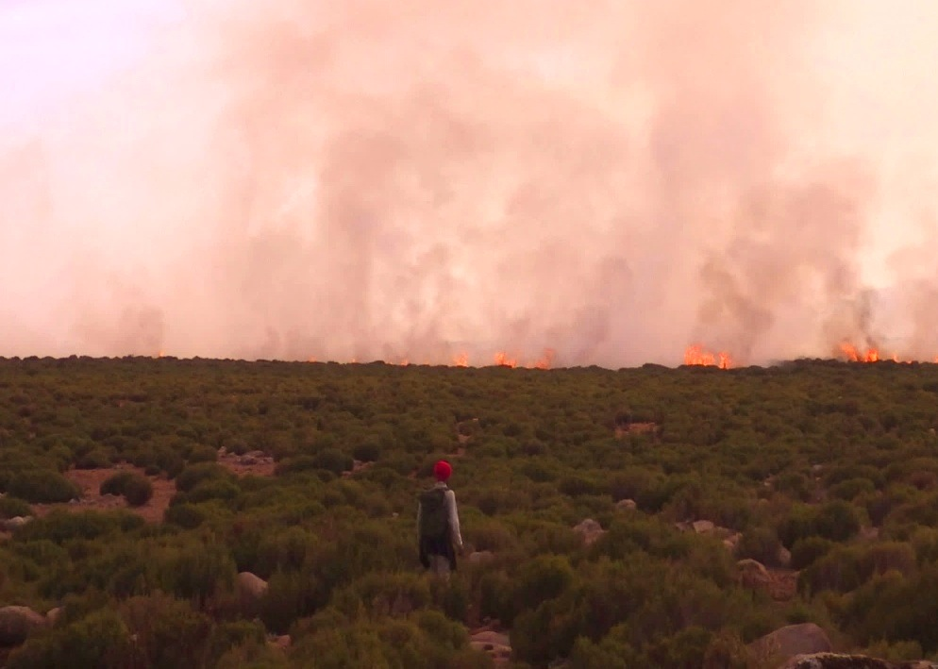
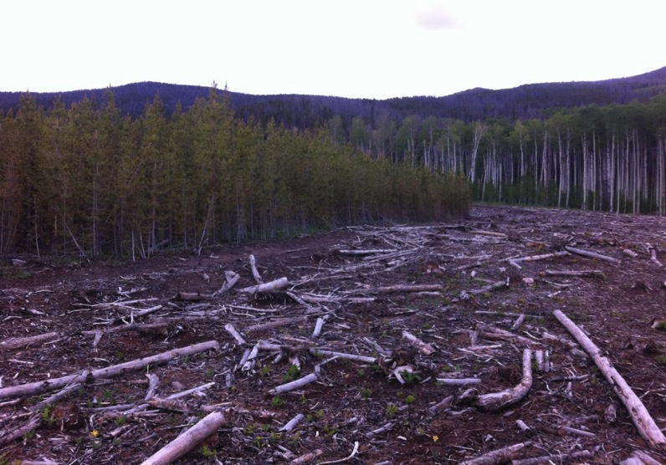
Fort Collins Summer Projects
Similar Methodology Employed for Different Continents, Land Change Processes
Ethiopia Ecological Forecasting
Fire History
Colorado Agriculture
Forest Harvest History
Image Credit: (From left)Colorado Agriculture Team, Stephen Chignell
Notes:
Colorado Agriculture:
Harvest records scattered and incomplete
Partners need better spatial, temporal depiction of harvests to inform forest management decisions, biomass models- want full record of forest disturbances
Ethiopia Ecological Forecasting
Community Concerns
Pastoralists in the south-central Ethiopian highlands have a long history of burning Ericaceous shrublands to improve their livelihoods; burning shrubs increases grazing value, controls toxic caterpillars, and reduces predator attacks on livestock.
Natural and intentional burning of Afro-alpine grasslands and Ericaceous heath shrublands in the Bale-Arsi massif may reduce the critical habitat of the endangered Mountain Nyala and increase soil erosion.
Cessation of intentional burning is expected to allow shrubs to replace Afro-alpine grasslands, to grow out of reach of pastoralists’ cattle, and to create high fuel loads susceptible to much larger, high-intensity fires when they do eventually burn.
Previous efforts to establish conservation areas in the Bale Mountains have had limited and varying success, and limited data availability for fire history in the Bale Mountains impedes future fire management planning.

Slide 3
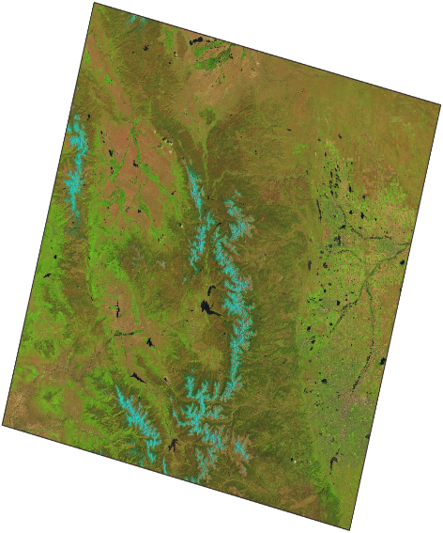
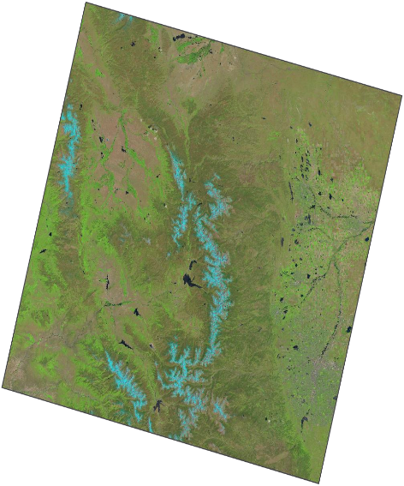
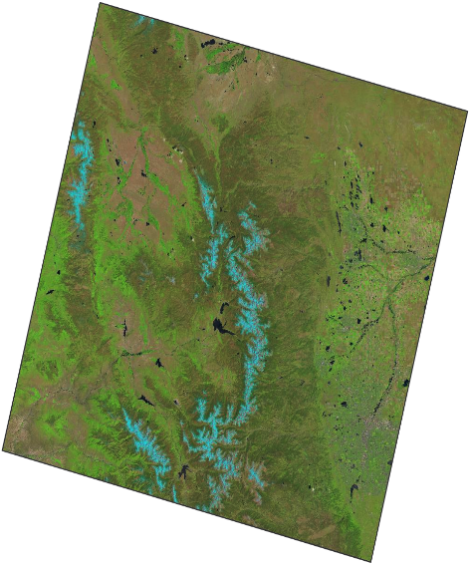
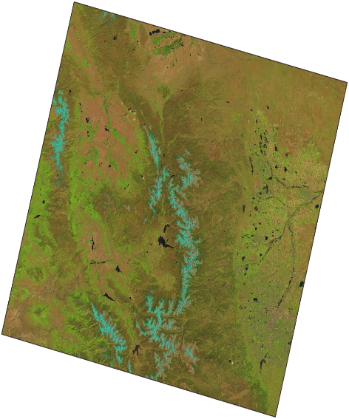
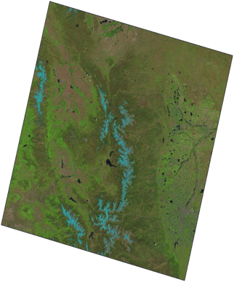
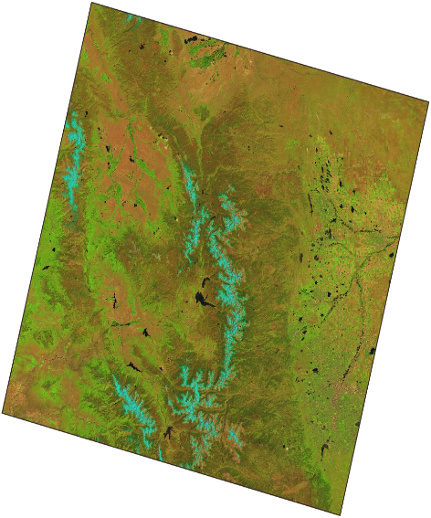


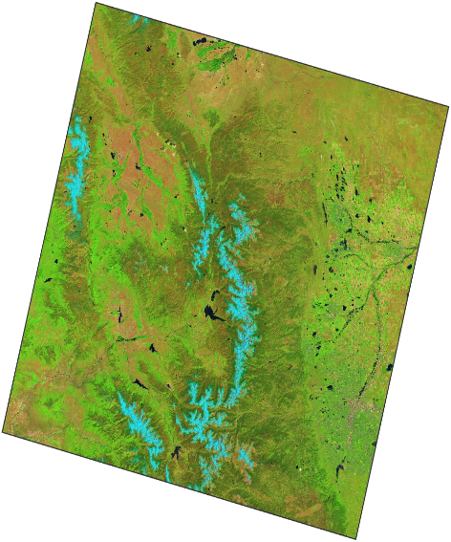
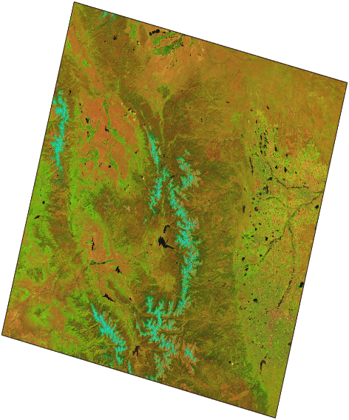

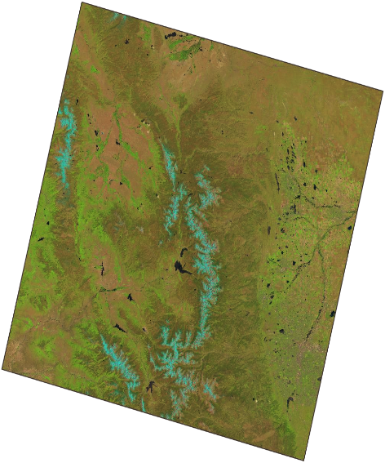
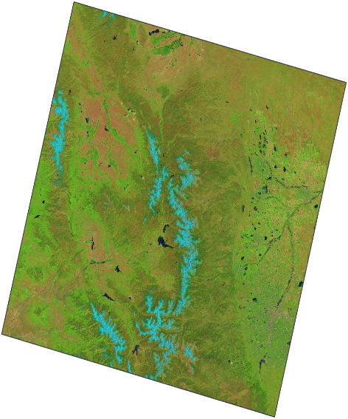
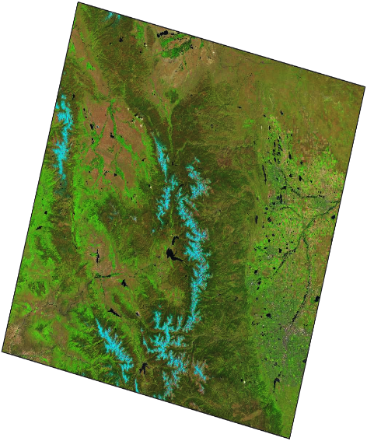
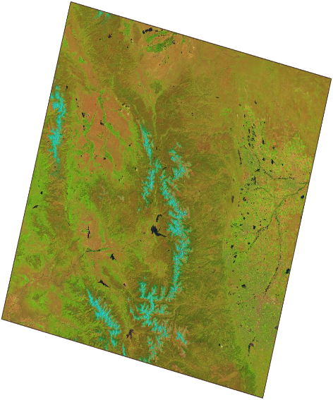

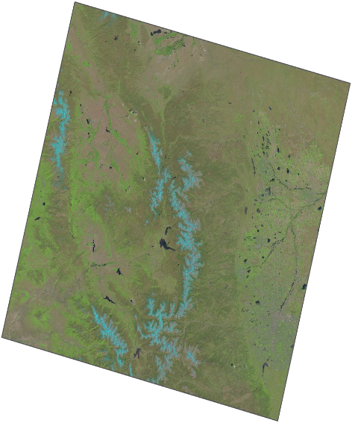
1973
2015
Building a Landsat Time Series:
A powerful, yet resource-intensive endeavor
Landscapes are dynamic - why not employ full Landsat time series to better understand disturbance history/land change processes?
Landsat offers an excellent temporal record, yet full time series are rarely employed
Challenges:
  Time series are computationally intensive and time consuming
  Multiple sensors, different spatial/spectral resolutions, WRS 1 vs. WRS 2
  Need tools and streamlined processes to make research more efficient
Notes:
Brian
During the summer term, both teams at the Fort Collins node wanted to integrate the entire Landsat time series in their land change detection research.
Land change processes are dynamic- they are not simply a contrast between two points in time. Few data sources offer the temporal resolution necessary to fully understand land change processes over time.
We all know the Landsat program has the most consistent temporal record available documenting the changes that have occurred on earth’s surface over the past 40 or more years- but why aren’t more researchers employing the full Landsat time series in land change detection work?
Some of the issues the teams had to overcome to successfully link over 40 years of Landsat data included:
Massive amounts of data and pre-processing were required. Both teams downloaded a 40+ year record of Landsat data, with 2-3 captures per year. How do you manage all this data and efficiently preprocess it?
Landsat 1-8 satellites have multiple different types of sensors with different spectral resolutions. How do you link these sensors in a way that results in a meaningful data analysis process?
The different satellites also have different Worldwide reference systems, so multiple WRS-1 scenes ares needed to equal the same land area as a WRS-2 scene.

Slide 4
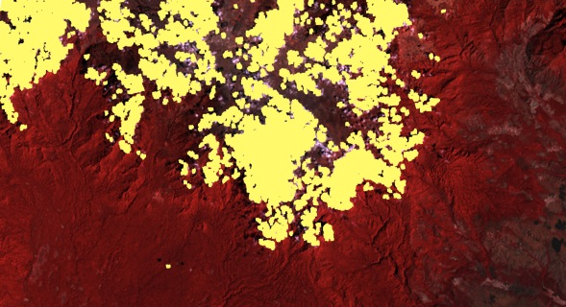
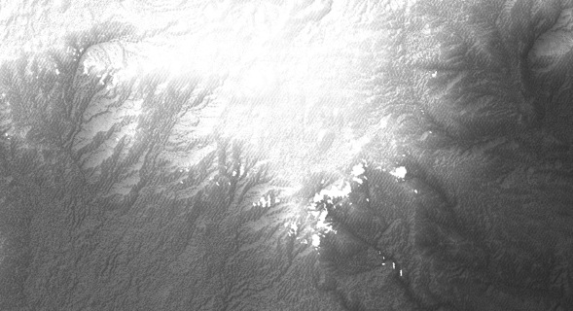
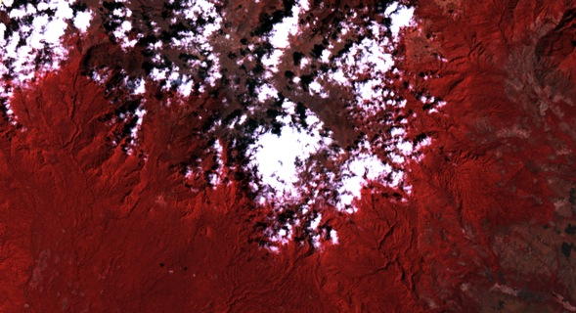

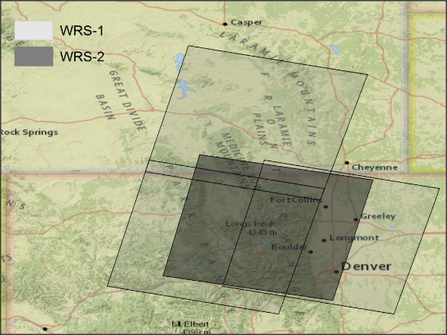
LandsatLinkr
Powerful, open source R package for intensive, automated Landsat processing
MSS cloud masking
Spectrally linking sensors
Spatially linking WRS 1 and WRS 2
Notes:
Introduction to LandsatLinkr
What is it? How is it useful?
Availability as R package
Particularly Useful Aspects of LandsatLinkr:
Spatially linking WRS 1/2 scenes
Spectrally linking sensors throughout time
Cloudmasking
Gap filling

Slide 5
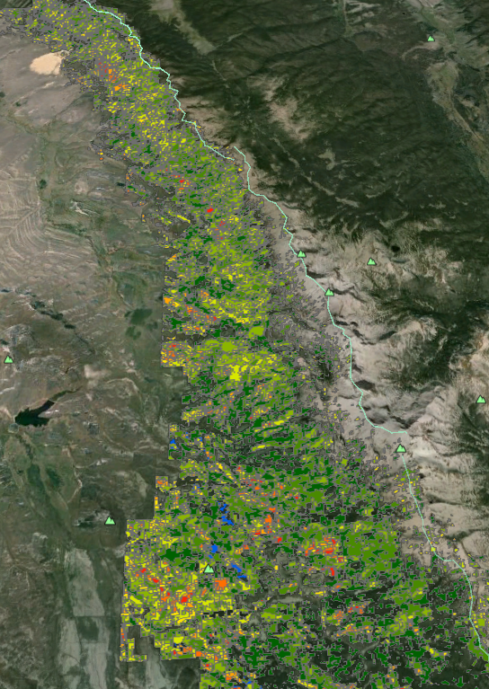
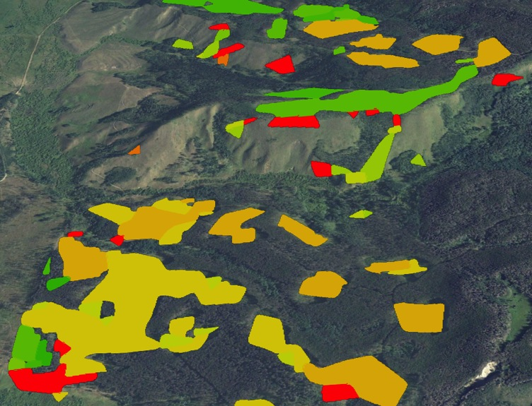
Forest Harvest History in Colorado
LandTrendr
Output:
All Disturbances in Study Area, scaled by magnitude
How will our partners use this data?
Colorado State Forest: The state forest will use the data and associated maps to prioritize forest management activities, such as thinning, and to plan future harvests of beetle killed wood.
Bioenergy Alliance Network of the Rockies: Harvest data will be used as a supplementary dataset in models to estimate aboveground forest biomass through time.
Ben Delatour Scout Ranch: The maps will be used to evaluate effectiveness of their forest management activities conducted through time, and to develop a long term forest management plan for the scout ranch.
Delineated Harvests:
Harvests by Year, each color represents a different year of harvest
LLR outputs are input to LandTrendr
Algorithm analyzes pixel trajectory over full time series
Results in 3 band “Greatest Disturbance” output
Delineate disturbance of interest in GIS
Partners use in variety of ways- biomass models, forest management planning
Notes:
Colorado Agriculture team used their LLR outputs for input into LandTrendr, an advanced change detection algorithm developed by Dr. Robert Kennedy at Oregon State University.
Uses 25+ years of Landsat data, identifies periods of stability and of change for every pixel (30 by 30 meters in size) within a study area, over the time series.
Changes in pixel trajectory display a disturbance, sharp jumps in pixel trajectory correspond to forest harvest.
Outputs from LandTrendr are mapped to show when events happened, or how fast processes such as regrowth are occurring.

Slide 6
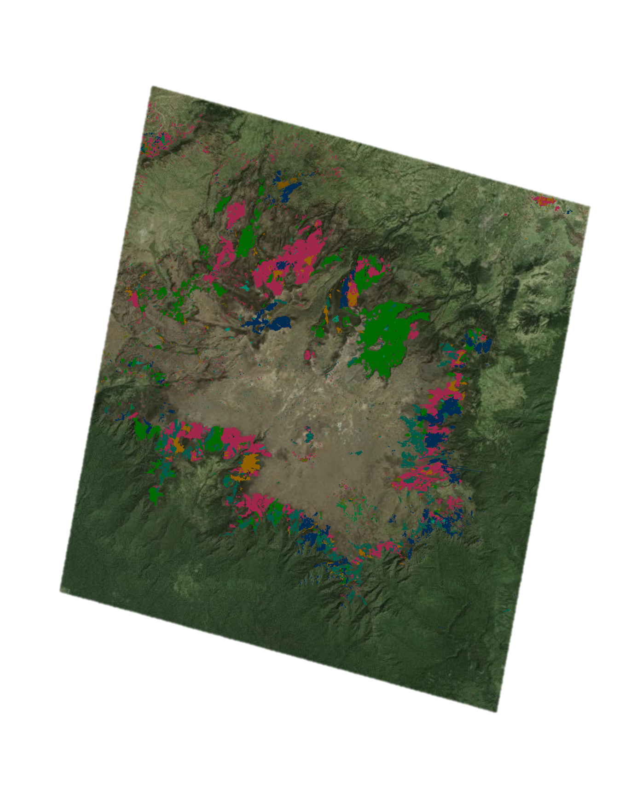
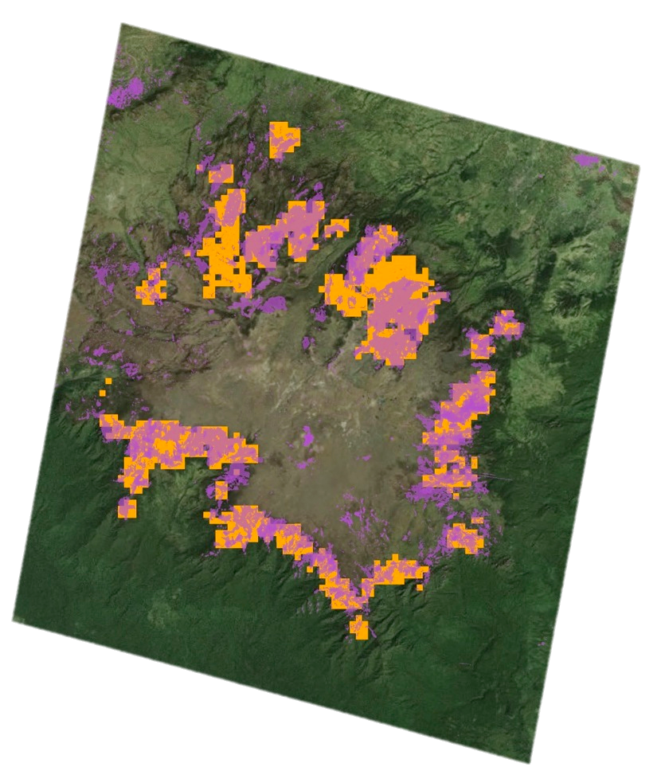
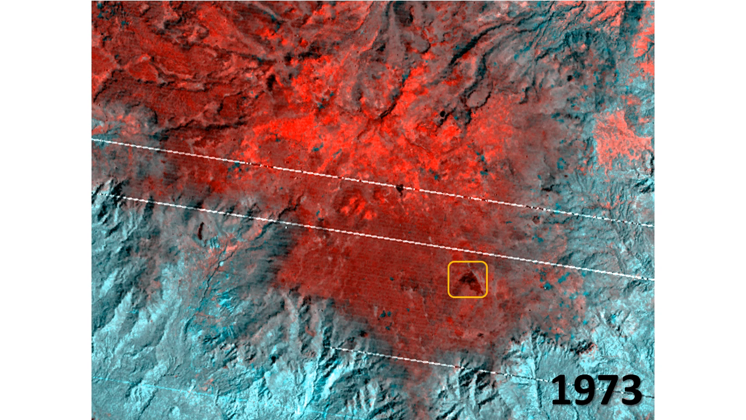
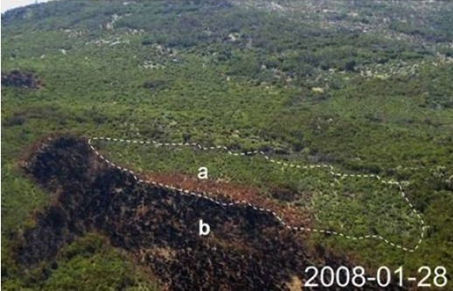
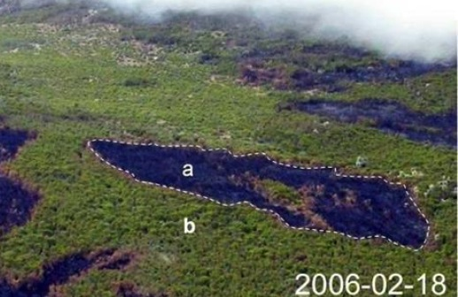
Mapping Fires in Ethiopia
Data source
How will our partners use this data?
MODIS Burned Area Product
The Murulle Foundation:
Fire maps will inform management prescriptions and provide valuable tools for Ethiopian land managers
Natural Resource Ecology Laboratory at CSU: Spatial data will be used to further understanding of the role of fire in the region’s unique and vulnerable social-ecological systems.
Landsat results
Year of fire
1995
2010
1999
2012
2000
2013
2007
2015
2008
(Photo credits: Johansson et al. 2012 Ecology and Society)
Notes:
Ethiopia Eco-forecasting team took outputs from LandsatLinkr and applied NBR thresholds to extract burn scars.
LandsatLinkr→ calibration →aggregation → NBR +thresholding → validation against MODIS and literature→ Fire extent results+ spatial & temporal patterns of burning

Slide 7
Advisors
Dr. Paul Evangelista, Natural Resource Ecology Laboratory, Colorado State University
Partners
Colorado Agriculture: Colorado State Forest, Bioenergy Alliance of the Rockies, Ben Delatour Scout Ranch
Ethiopia Ecological Forecasting: The Murulle Foundation, Natural Resource Ecology Laboratory at Colorado State University
Others
Justin Braaten, Oregon State University
Resources
LandsatLinkr: www.landsatlinkr.weebly.com
Check it out! Code available freely on website above.

