Slide 1
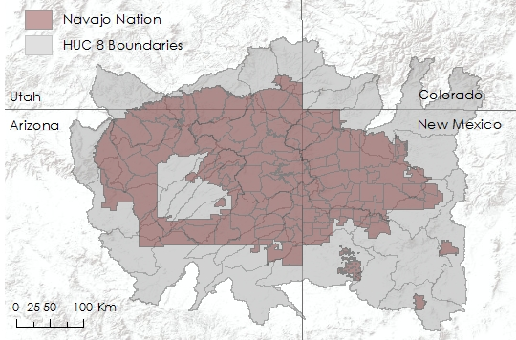
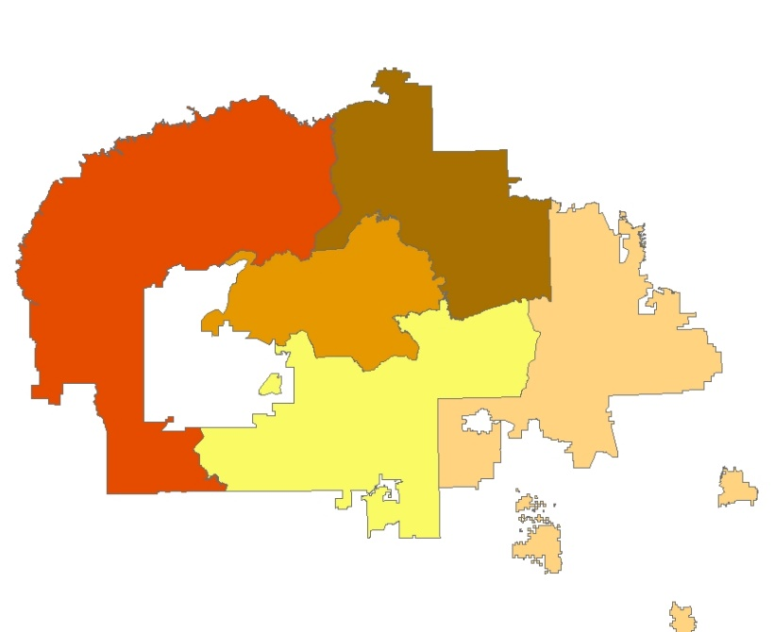
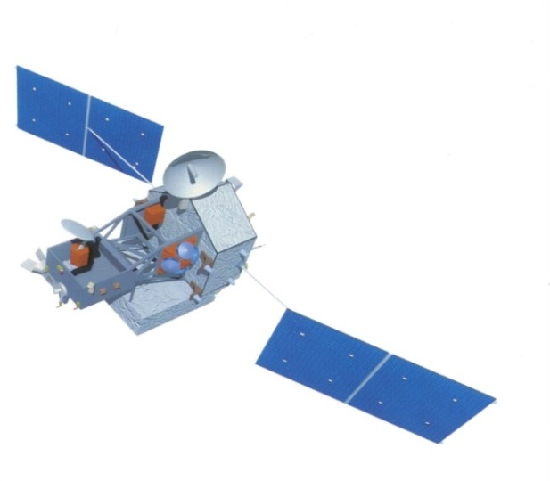
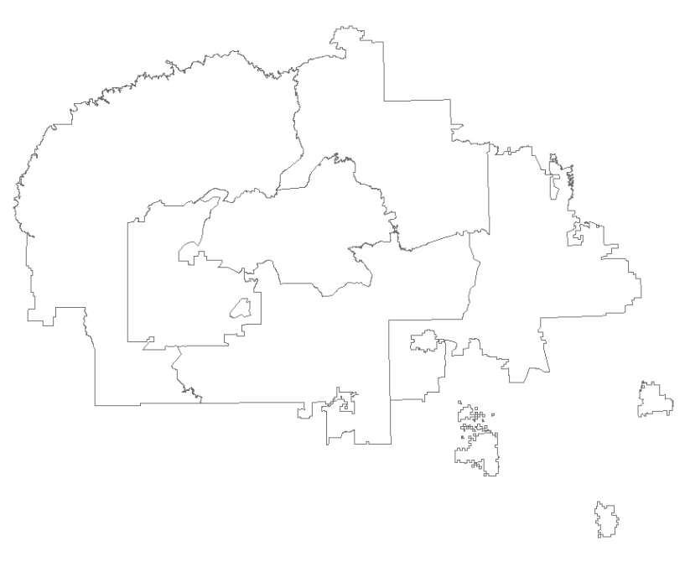
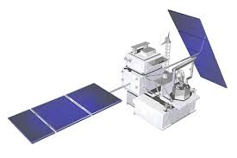

Navajo Nation Climate II
Monitoring drought conditions in the Navajo Nation using NASA Earth observations
Cheryl Cary^{1,6} (Project Lead), Michael Gao^{2,6}, Vickie Ly^{3,6}, Anton Surunis^{4,6}, Sophie Turnbull-Appell^{5,6}
¹University of California, Santa Cruz; ²Johns Hopkins University; ³University of California, Berkeley; ⁴University of California, Davis; ⁵University of California, Los Angeles; ⁶DEVELOP National Program
Abstract
Objectives
The Navajo Nation, a 65,700 km² Native American territory located in the southwestern United States, has been increasingly impacted by severe drought events and changes in climate. These events are coupled with a lack of domestic water infrastructure and economic resources, leaving approximately one-third of the population without access to potable water in their homes. Current methods of monitoring climate and drought are dependent on national-scale state-based monthly drought maps calculated by the Western Regional Climate Center. These maps do not provide the spatial resolution needed to illustrate differences in drought severity across the vast Nation. To better understand and monitor drought events and drought regime changes in the Navajo Nation, this project investigated methodologies to create a tool that calculates Standard Precipitation Index rasters for the study area, and created a geodatabase of historical climate information for use by the tool. The tool and geodatabase use Tropical Rainfall Monitoring Mission observed precipitation data and Parameter-elevation Relationships on Independent Slopes Model modeled historical precipitation data. These products allow resource managers in the Navajo Nation to utilize current and future NASA Earth observation data for increased decision-making capacity regarding future climate change impact on water resources.
Create a Standardized Precipitation Index tool specific to Navajo Nation boundaries
Compare SPI drought intensity to other climate variables in the area
Methodology
Study Area
SPI Raster Calculation:
User -chosen SPI Algorithm
SPI Rasters
The Navajo Nation is a 65,700 km² Native American territory. The project used USGS Hydrologic Unit Code 8 (HUC 8) watershed boundaries that intersect with the political boundary of the Nation.
Monthly Accumulated Rainfall Rasters
ex. 6-, 9-,
12-month SPI
Boundary Specific SPI:
SPI Rasters
Figure 1: Study area map
Zonal Statistics
-1.7
-1.4
Earth Observations
-1.2
-0.6
Tropical Rainfall Monitoring Mission (TRMM)
-0.9
Average SPI values for a
user chosen polygon
Global Precipitation Monitor (GPM)
Results
Conclusions
Use images.
Make sure that it has some sort of flow, that it makes sense. Show your results in a logical order.
No bullets.
Use bullets.
Use complete sentences with periods.
Team Members
Project Partners
Acknowledgements
.
Navajo Technical University
Navajo Nation Department of Water Resources: Water Management Branch
Dr. Jay W. Skiles, NASA Ames
Dr. Venkat Lakshmi, University of South Carolina
Clayton Sodergren
Amber Brooks, Chippie Kislik and Andrew Nguyen, NASA
DEVELOP National Program.
Vickie Ly, Michael Gao, Anton Surunis,
Cheryl Cary (Project Lead), Sophie Turnbull-Appell
NASA Ames Research Center

