Slide 1
DEVELOP National Program
North Carolina Water resources
Nasa Langley research center
Spring 2015
Final Imagery

Slide 2
Checklist for Each Image:
Image is derived from NASA sensor data
Not from an outside source
Not a photograph of the team/issue
Preferably, At least one image provided is derived from recent data (2014-2015)
This is mandatory for inclusion in any highlight to NASA HQ
Some kind of processing has taken place
Not a raw image or a photograph
The team actually created the image
Not from some other source/world wide web/etc.
High-resolution (over 300 dpi)
Saved as a JPEG or TIFF
Also:
While there are three slides, you can have more imagery. Minimum of one, max of ten.
The “best” image should have a SVG version, saved as a separate file, that will be used on the DEVELOP website and brochures

Slide 3
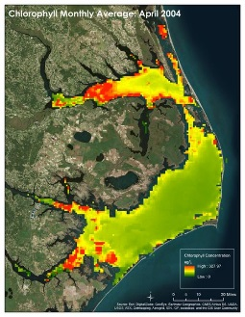
LaRC
CALIPSO Health & Air Quality
Caption Here -
Chlorophyll concentrations as calculated in SeaDAS using MODIS data for April 2004

