Slide 1
Los Angeles Oceans
Using Remotely Sensed Observations to Detect Wastewater Plumes and Assess Their Impact on Public Water Quality in Los Angeles County, California
Rebecca Trinh (Project Lead)
Lindsay Almaleh
Mark Barker

Slide 2
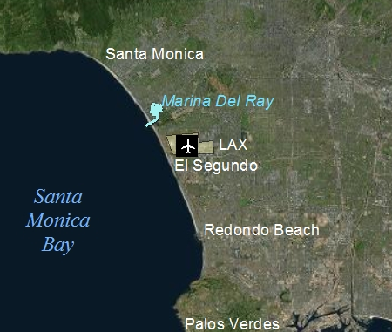
Study Area
Notes:
The project takes place in Los Angeles, California, focusing on the waters of Santa Monica Bay. The location is sloth of Malibu, West of Marina Del Ray, and North of the Palos Verdes Peninsula. The Santa Monica Bay is an ecologically important marine habitat and a valuable resource in terms of commercial and recreational fishing and tourism.

Slide 3
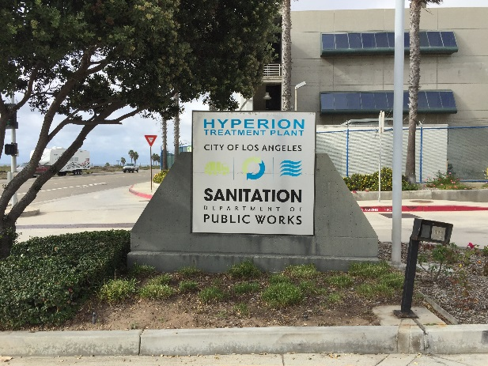
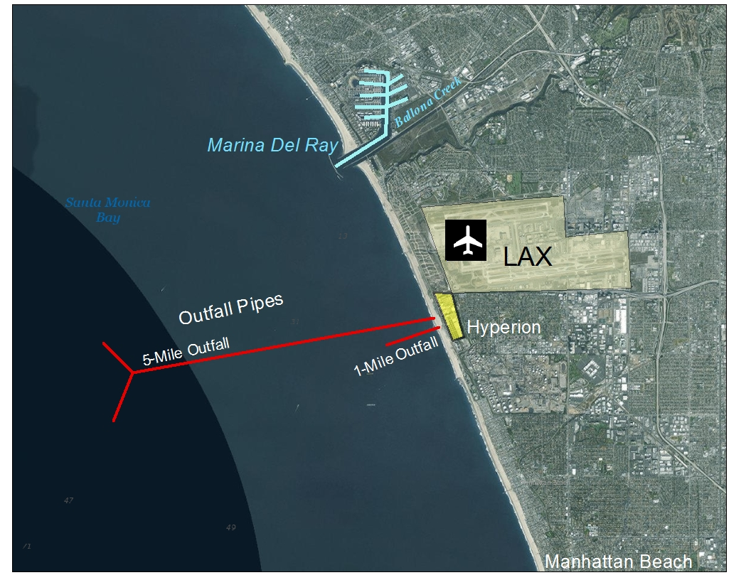
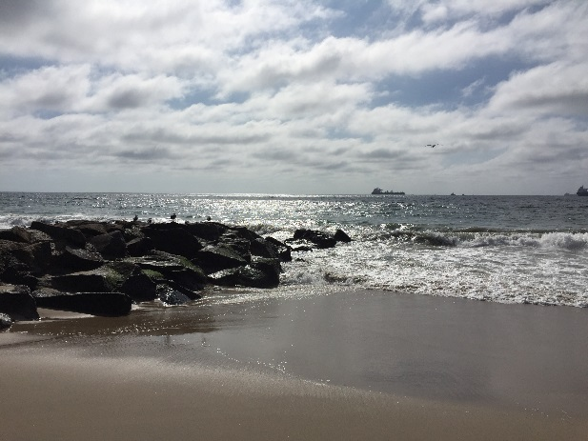
Hyperion Treatment Plant (HTP)
362 Million Gallons/Day
5-mile pipe
  57m deep
  Wastewater dilutes
Repair = DIVERSION to 1-mile pipe
  15m deep
  Wastewater can reach surface
Notes:
Hyperion Treatment Plant is a wastewater treatment facility located adjacent to the coast and just south of Los Angeles’s major airport, LAX.
Hyperion is one of the largest wastewater plants on the west coast of the United States. They release an average of 362 million gallons of treated sewage per day into the Santa Monica Bay.
In normal operation, they release treated wastewater, also called effluent, into the ocean through a 5-mile-long outfall pipe where it is pumped 57m deep into the head of the marine canyon. The water it mixes with the seawater, which dilutes it before it can reach the surface.
In the rare instance that they need to do maintenance or repair the 5-mile pipe, they have to divert all the effluent to a backup 1-mile long pipe that is only 15m under the ocean’s surface.
This event is called a DIVERSION.
Hyperion conducted a similar diversion in 2006, and they have done it again this year to make repairs to their system.

Slide 4
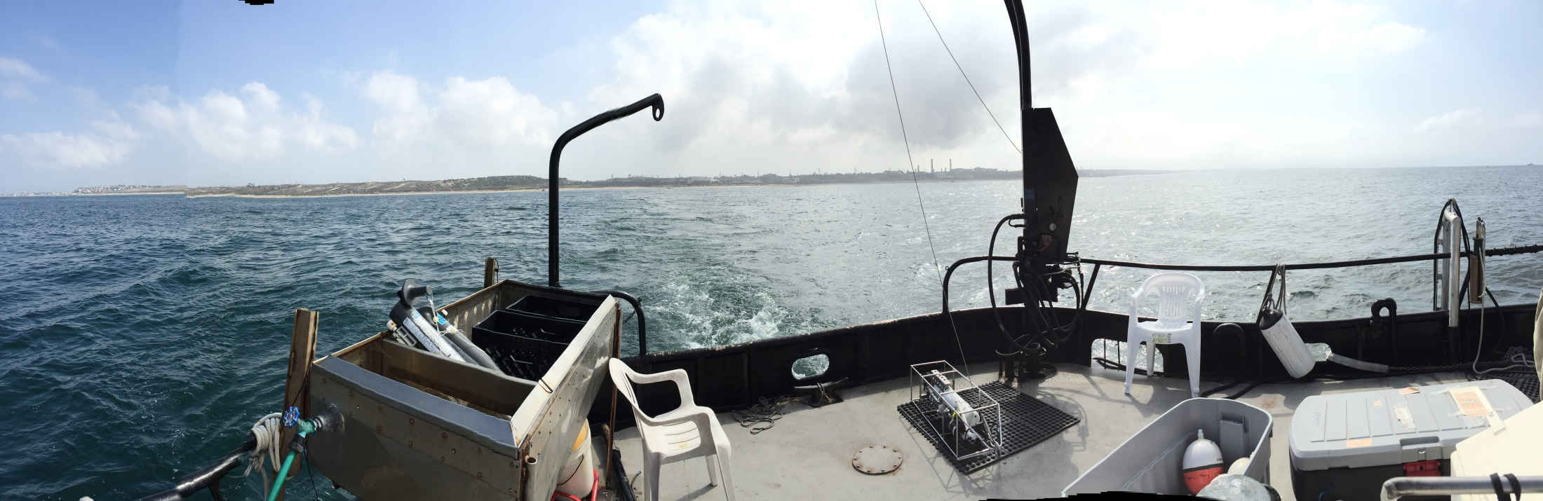
Study Period
Before
Diversion
After
8/30
9/21
10/26
11/19
Image Credit: Ben Holt, JPL
Notes:
The diversion just so happened to coincide with our DEVELOP term.
We processed satellite imagery from August 30th to Septemer 20th to get a pre-diversion baseline of what the ocean signatures around Hyperion’s outfall looked like.
On September 21st Hyperion’s diversion was under way, and from then until October 26th, we analyzed all the signatures from the effluent that was being emitted from the 1 mile outfall.
After October 16th until the end of the term, we analyzed imagery post-diversion to monitor ocean restoration and detect any long-term effects.
Pre-Diversion: Aug 30-Sept 22, 2015
Diversion: Sept 21-Oct 26, 2015
Post-Diversion: Oct 27-Nov 19, 2015

Slide 5
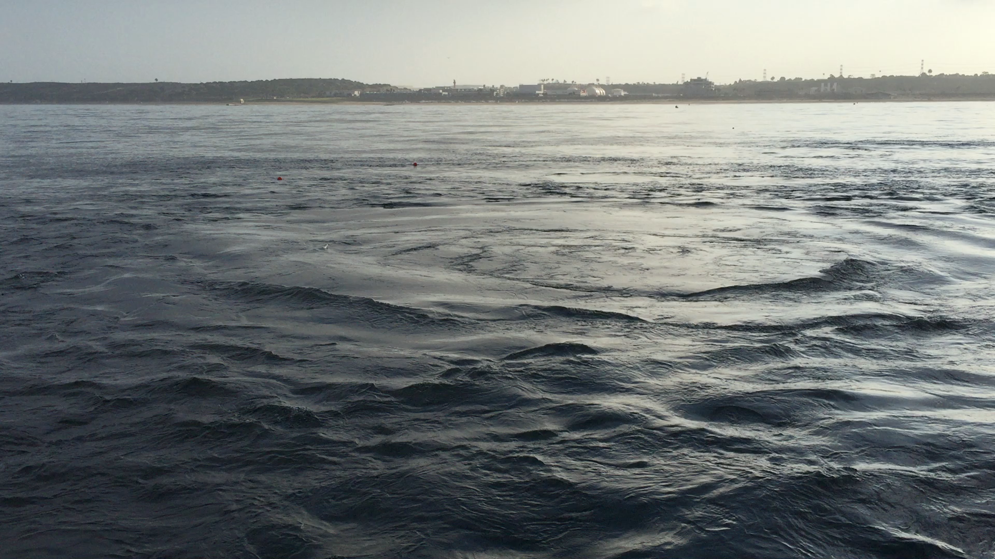
Video Credit: Ben Holt, JPL
Notes:
This is a video of the treated wastewater percolating up to the surface at the 1-mile outfall during the diversion.
The water is colder than the ambient water, contains nutrients and oils, and is freshwater.
Under normal treatment operations, the wastewater does not get a chance to reach the surface.

Slide 6
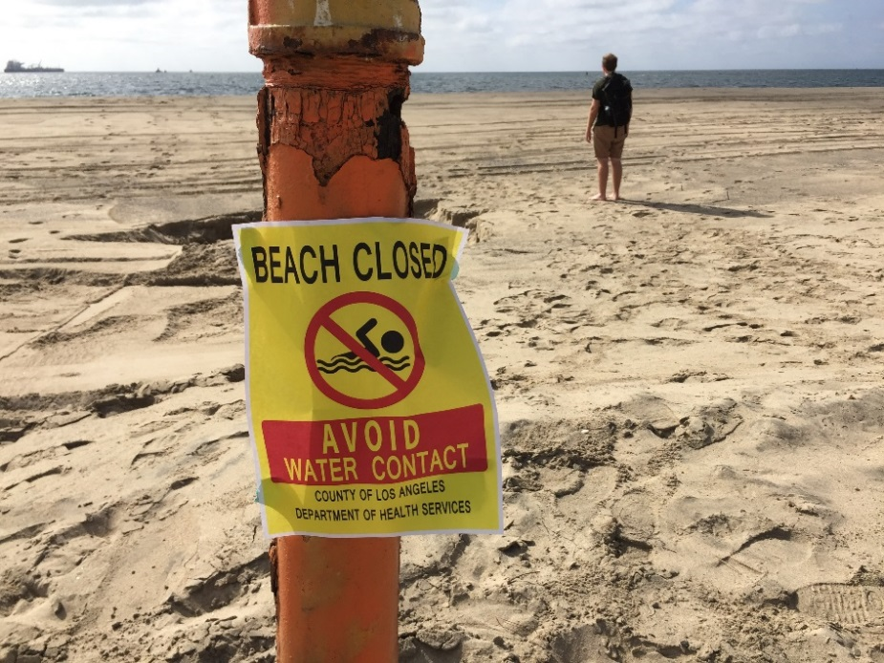
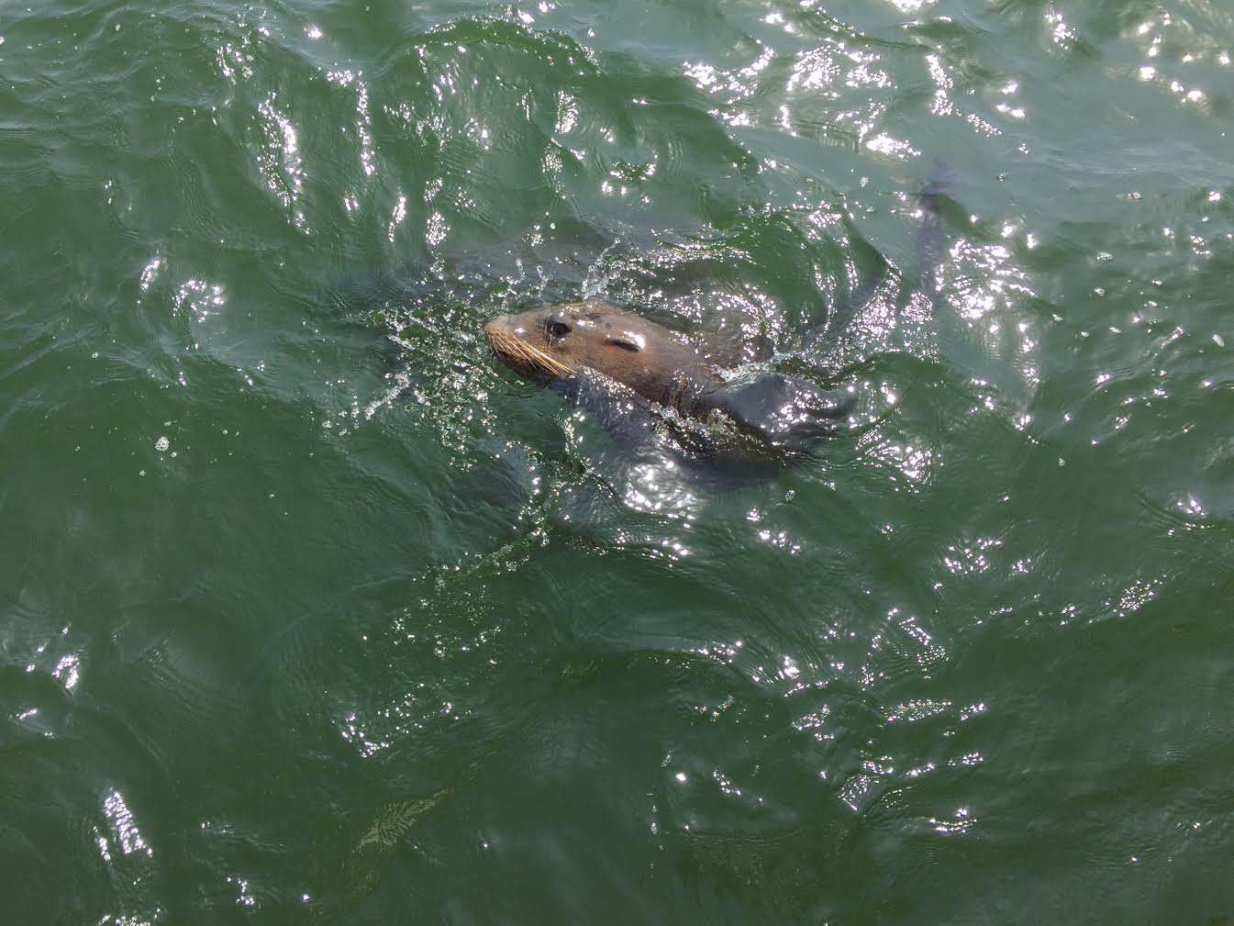
Concerns
Humans
Ecosystem
Commercial fishing
Tourism/Recreation
Polluted water for beachgoers
Media
Algal blooms
Depleted oxygen levels, increased temperature, oil slicks
Disrupted food web
Image Credits: Mark Barker
Notes:
This event has raised public concerns. In terms of human impacts, commercial fishing patterns could change, tourists may be discouraged from visiting the beaches, and beachgoers may be exposed to harmful contaminants. The media has taken a strong hold of this issue and has put pressure on scientists to analyze the diversion’s impacts.
In terms of ecosystem health, algal blooms may occur due to the increased oxygen and nutrient levels in the effluent, this may lead to depleted oxygen levels which may harm macroorganisms. There will also be an increased presence of oils and organics in the ocean’s surface. And the water temperature around the 1-mile outfall is reduced due to the cold signature of the fresh water being released. All these factors may disrupt the local food web in Santa Monica Bay.

Slide 7
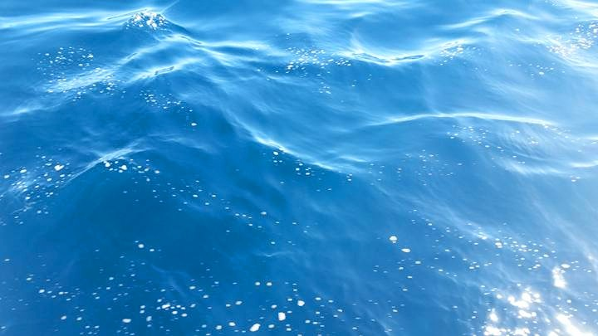
Objectives
Process & Analyze Remote Sensing data
Compare to in situ data
Investigate ecosystem impacts (present & future)
Image Credit: Rebecca Trinh
Notes:
The objectives of this study are to: (1) evaluate plume signatures, using remote sensing techniques, from HTP’s 5 week planned effluent diversion, (2) coordinate with Hyperion and other institutions to compare the results of processed satellite imagery to measurements of in situ data, and (3) analyze potential ecosystem impacts of this diversion event and future effects.

Slide 8

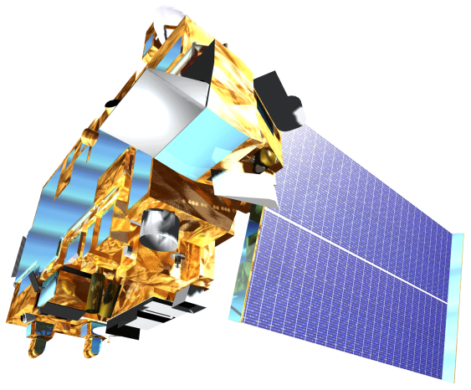

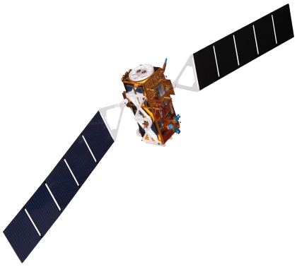
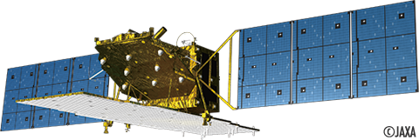
Instruments Utilized
Remote Sensing
Landsat 8
NASA
Terra-ASTER
NASA
Aqua – MODIS
NASA
Sentinel – 1
ESA
ALOS – 2
JAXA
Notes:
Field measurements are often very labor-intensive, expensive, and limited in spatial and temporal coverage.
We have the benefit of using satellites to do Remote sensing. It is relatively inexpensive and provides much greater spatial coverage.
However, remote sensing only images the surface of the sea, versus the ability to obtain data at depth when gathered in situ.
We used multiple sensors on multiple satellites to determine the best techniques of imaging the extent of these surfaced wastewater plumes. Each sensor has its own benefits an limitations, which we explored in our images.

Slide 9
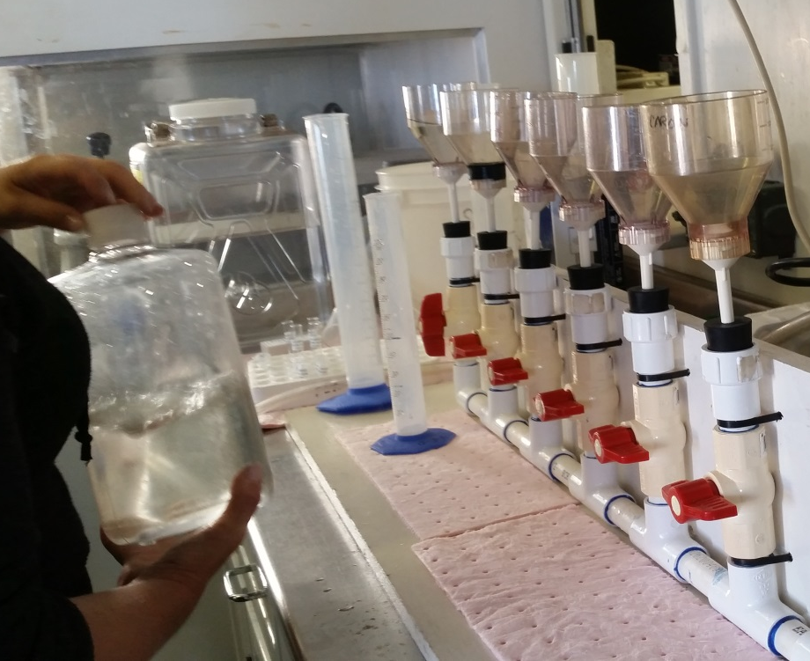
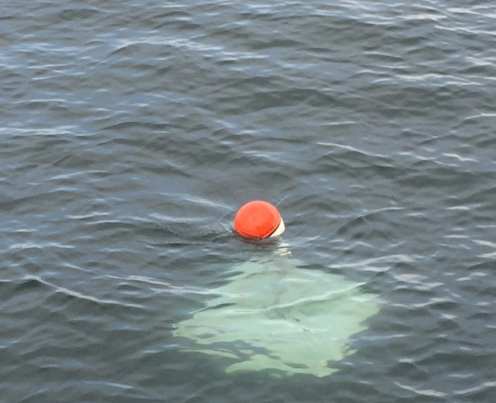
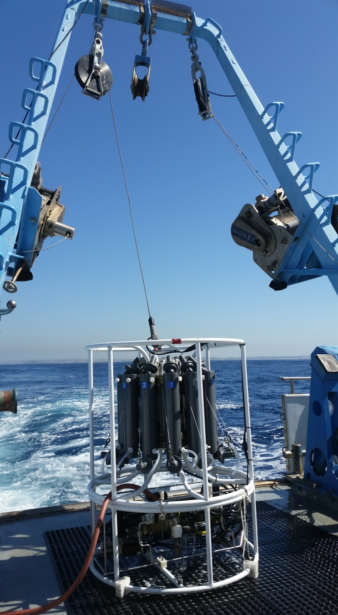
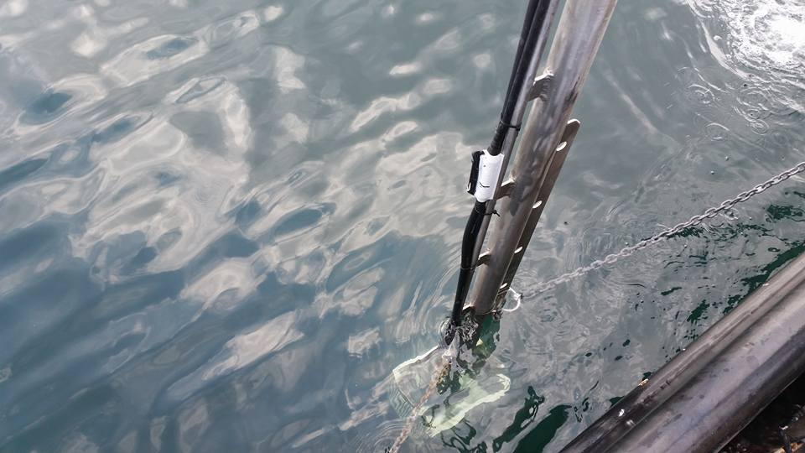
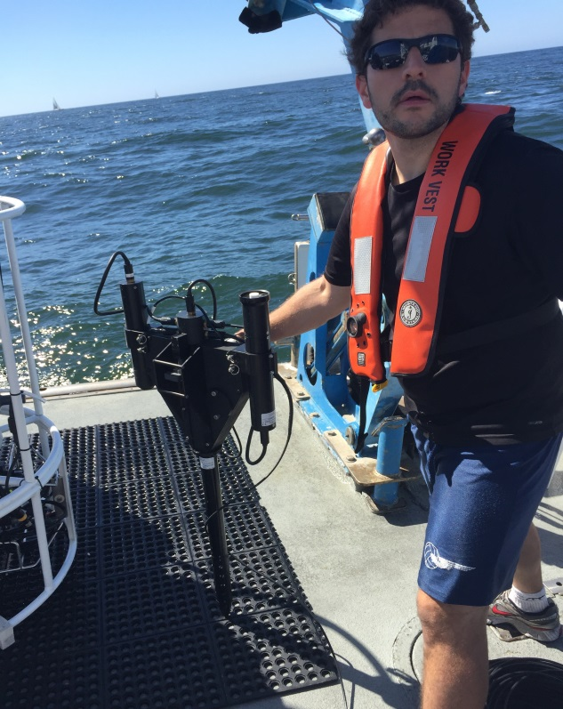
Instruments Utilized
In Situ Data Verification
Lagrangian Drifters
UCSB
Phytoplankton
Water Chemistry
USC
CTD Sensor
City of LA
YSI Sensor
City of LA
Hyperspectral Instrument
JPL/NASA
Image Credits: Rebecca Trinh
Notes:
Hyperion has invited us to come aboard their 2 City of Los Angeles owned boats.
Many collaborators go out into the Santa Monica Bay at least once a week to take in situ measurements of the diversion plume.
Some of the instruments used are:
Hyperion’s CTD, which stands for and measures Conductivity, Temperature, and Depth.
Hyperion’s YSI Sensor takes surface measurements such as temperature, dissolved oxygen, turbidity, and pH.
University of California Santa Barbra has installed GPS drifters in the ocean to track the plume’s movement over time.
University of Southern California uses laboratory methods to test the sea water for phytoplankton levels.
A collaborator at JPL uses his hyperspectral instrument to measure reflectance, Absorbance, chlorophyll, and CDOM.
We have access to all the results found in the field via a shared information website, and we can compare their in situ results to our remote sensing results to validate our conclusions.

Slide 10
Project Methodology
NASA EOS Observations:
Landsat 8
MODIS
Chlorophyll-a
Surface Sediment
Effluent
impact
on local
plant
and wildlife
Spatiotemporal
Analysis of combined
datasets
ASTER
Sea Surface Temperature
Partner Agency Data:
ALOS – 2
(JAXA)
Sentinel – 1
(ESA)
Sea Surface Roughness
In Situ Measurements
Notes:
The 3 general signatures we are looking for in our processed satellite imagery are 1) chlorophyll and sediment, 2) Sea surface temperature, and 3) sea surface roughness.
Both LANSAT-8 and MODIS can detect chlorophyll, sediment, and sea surface temperature. ASTER can also detect sea surface temperature. We used Synthetic Aperture Radars (SAR) on ALOS-2 and Sentinel-1 to give us sea surface roughness data.
We collected and have access to in situ data to cross-reference our satellite imagery data in time and space.
Ultimately, this analysis should give us a solid platform to answer our questions and address public and ecological concerns.

Slide 11
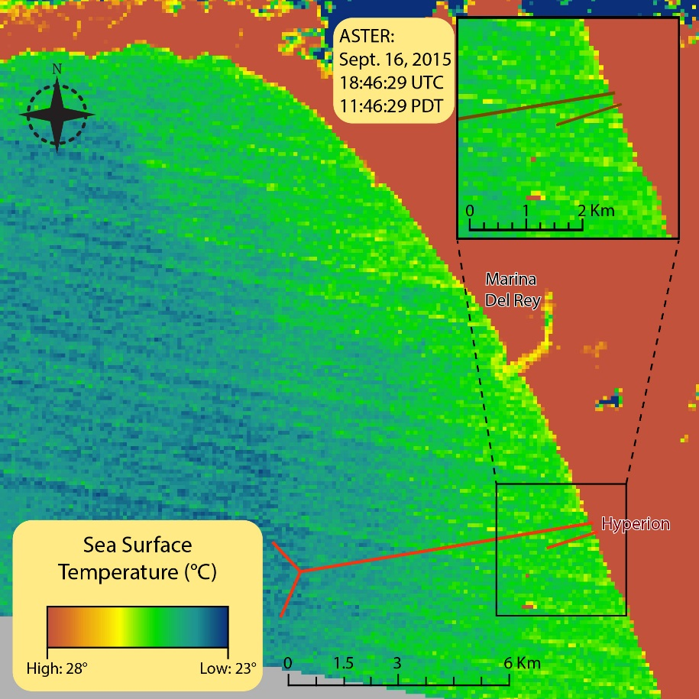
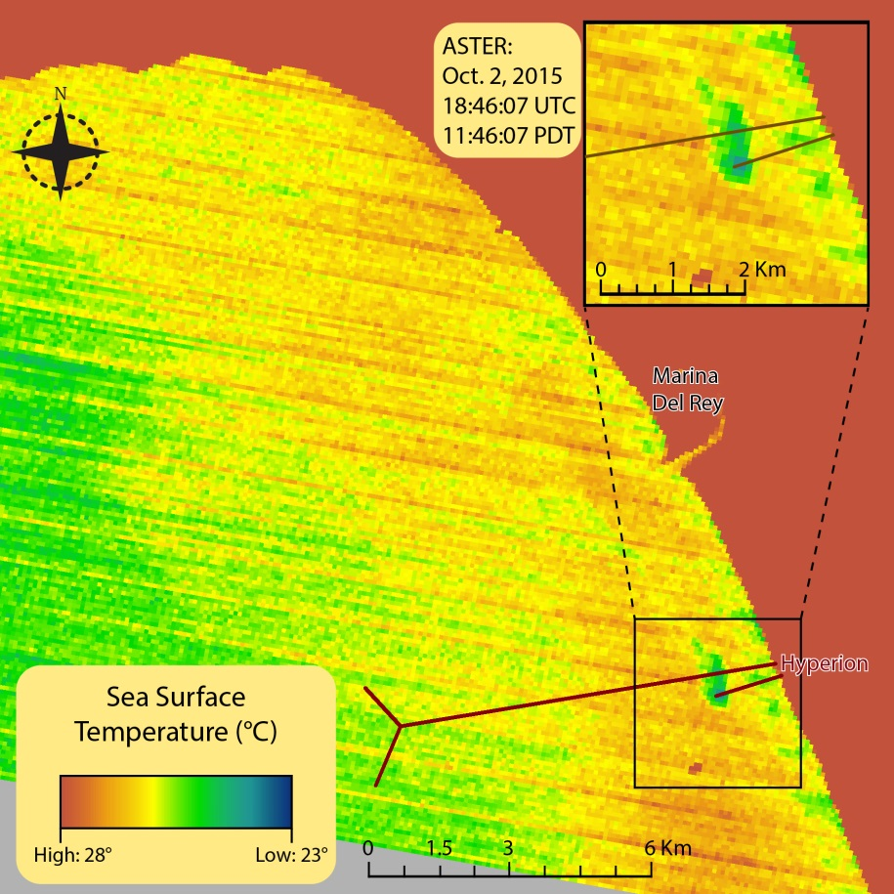
ASTER Sea Surface Temperature
Before
During

Slide 12
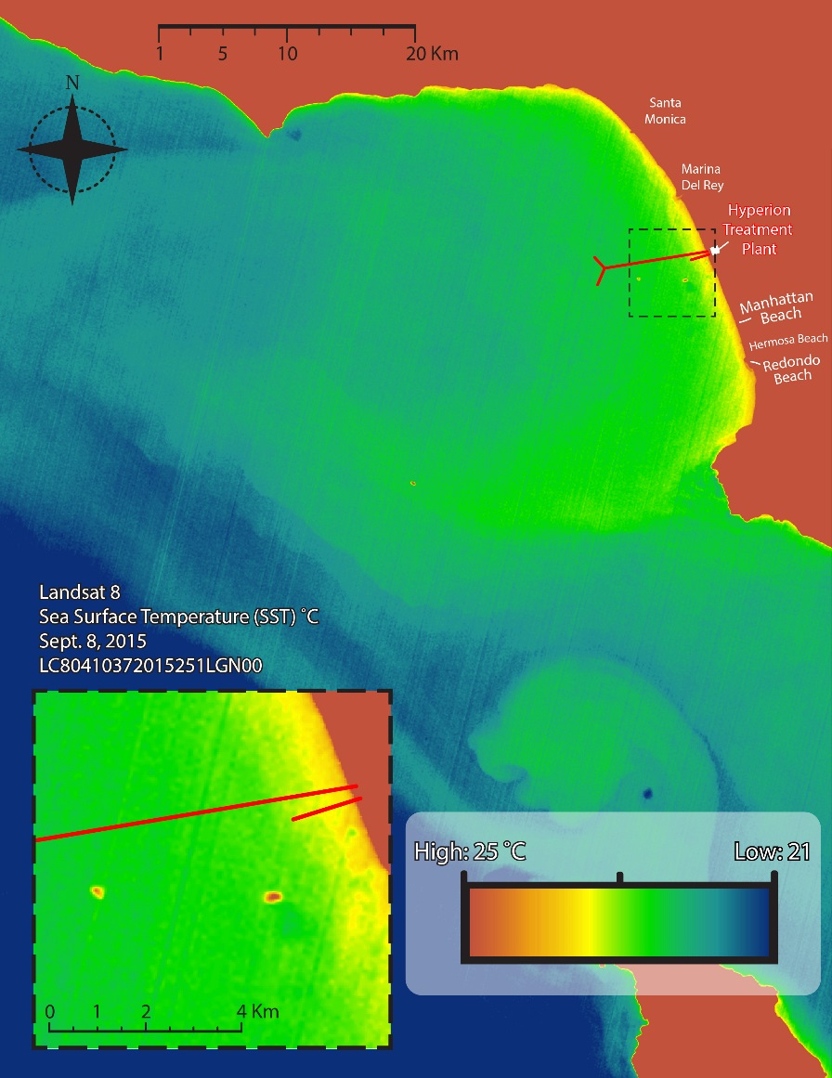
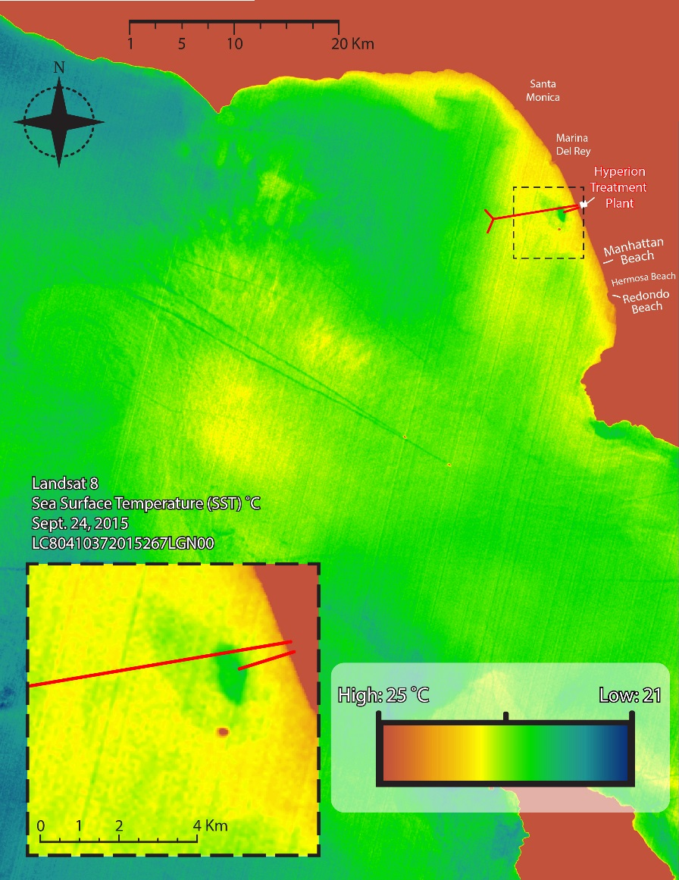
Landsat -8 Sea Surface Temperature
Before
During

Slide 13
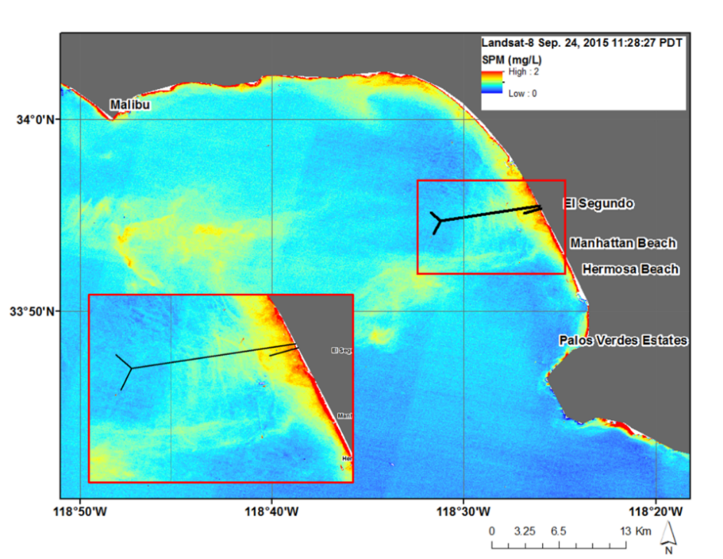
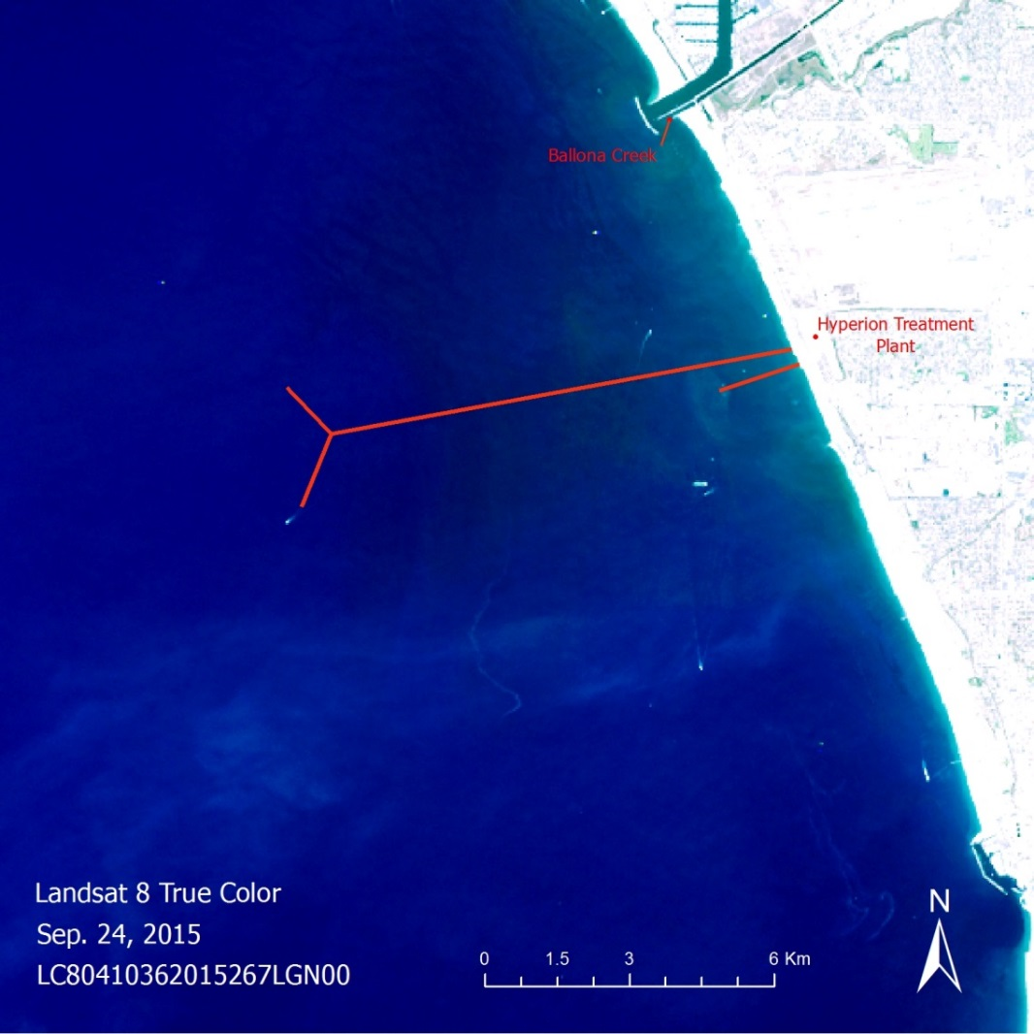
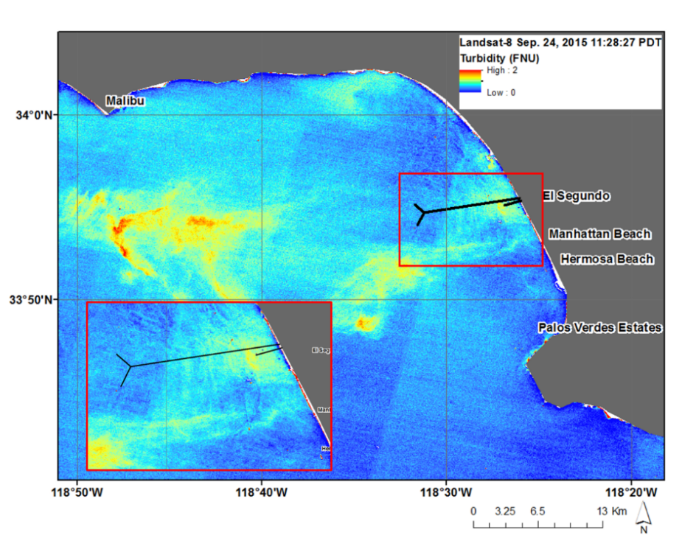
Landsat -8 True Color

Slide 14
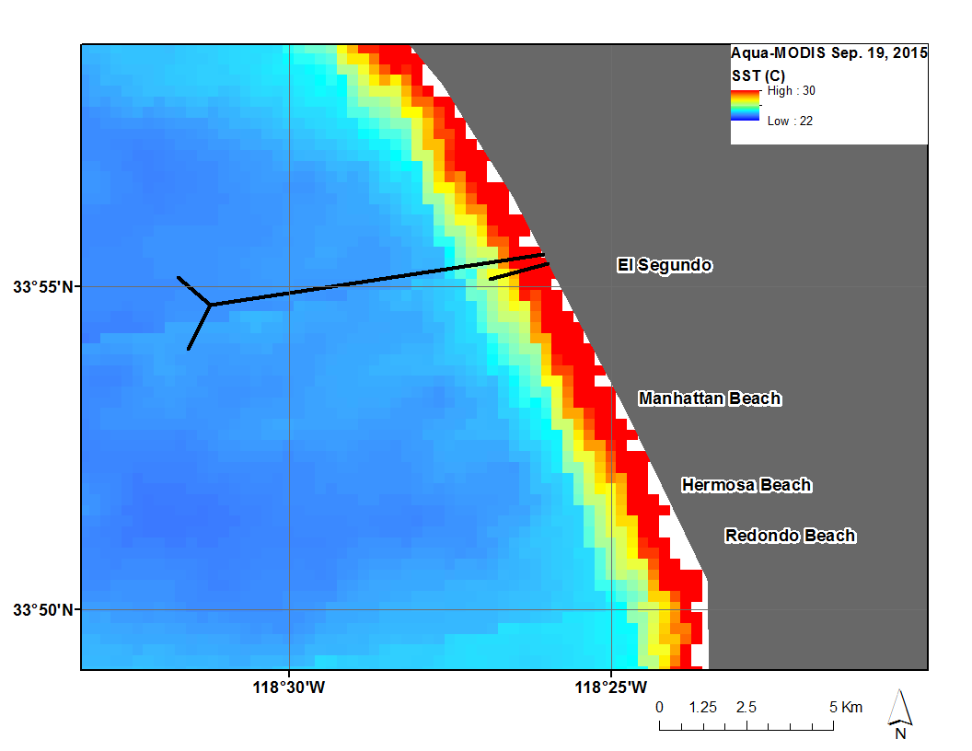
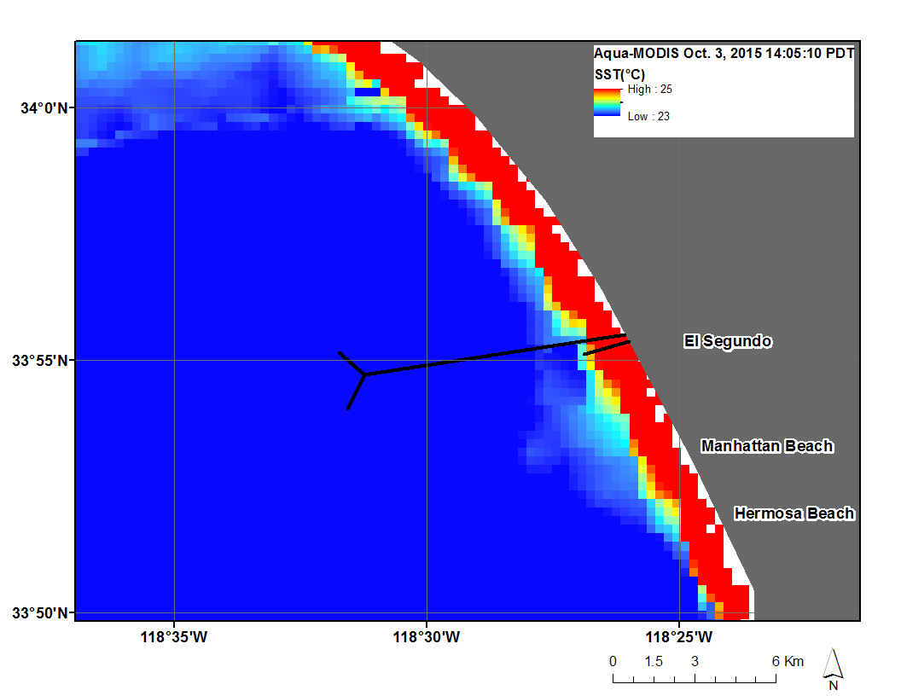
Aqua Modis Sea Surface Temperature
Before
During

Slide 15
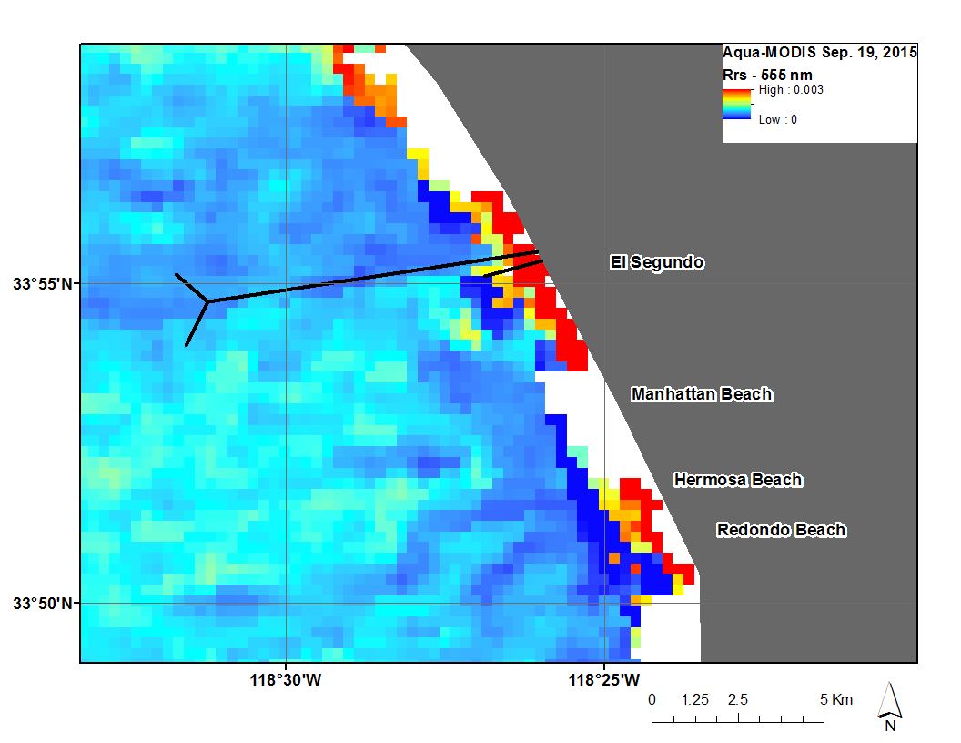
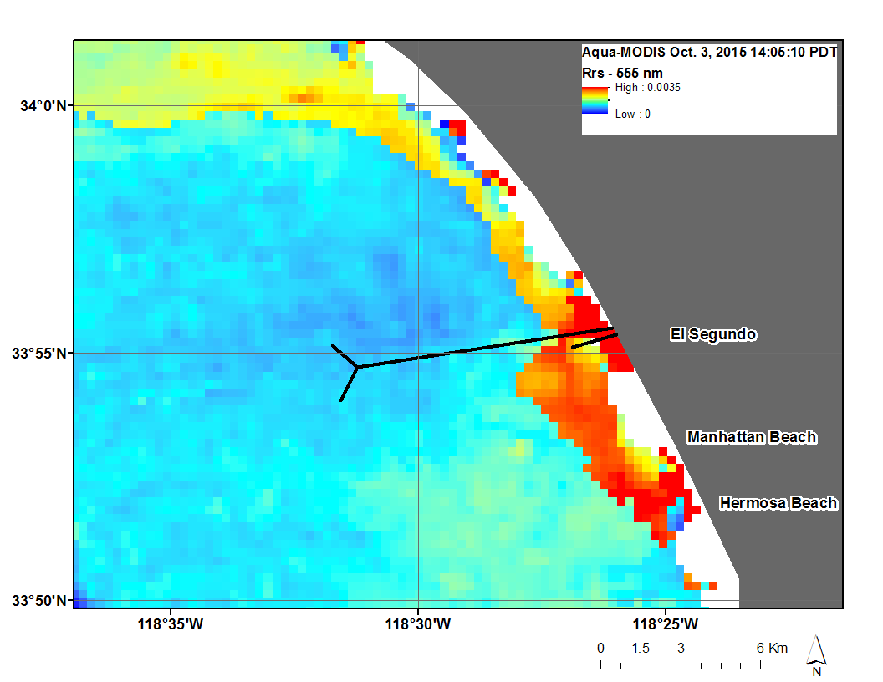
Aqua Modis Reflectance
Before
During

Slide 16
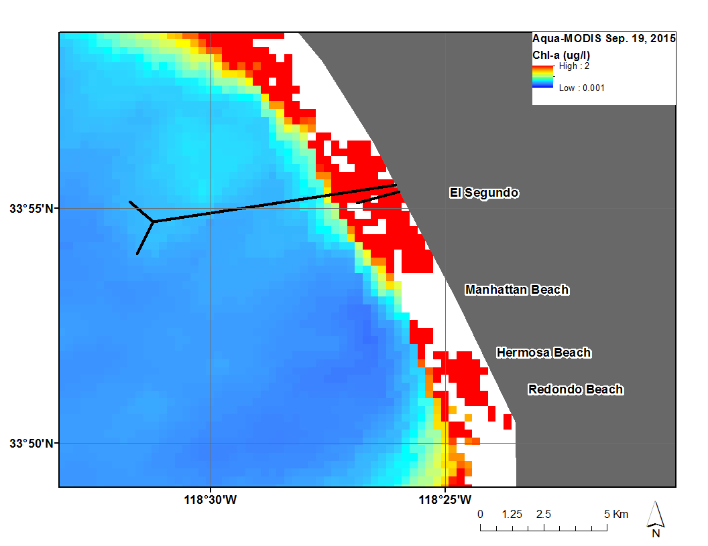
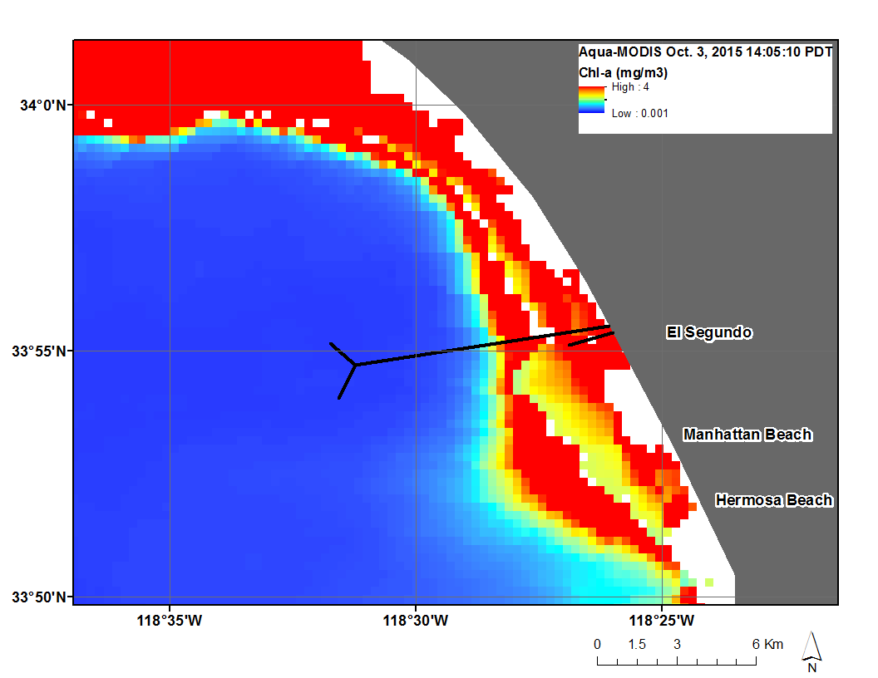
Aqua Modis Chlorophyll-a
Before
During

Slide 17
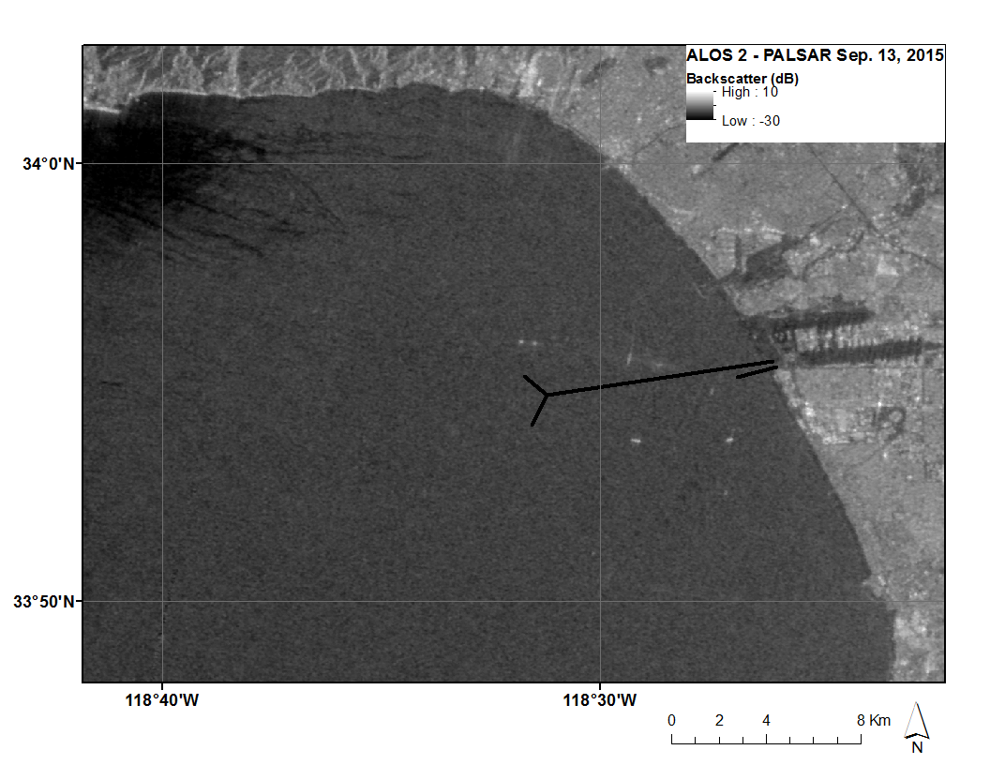
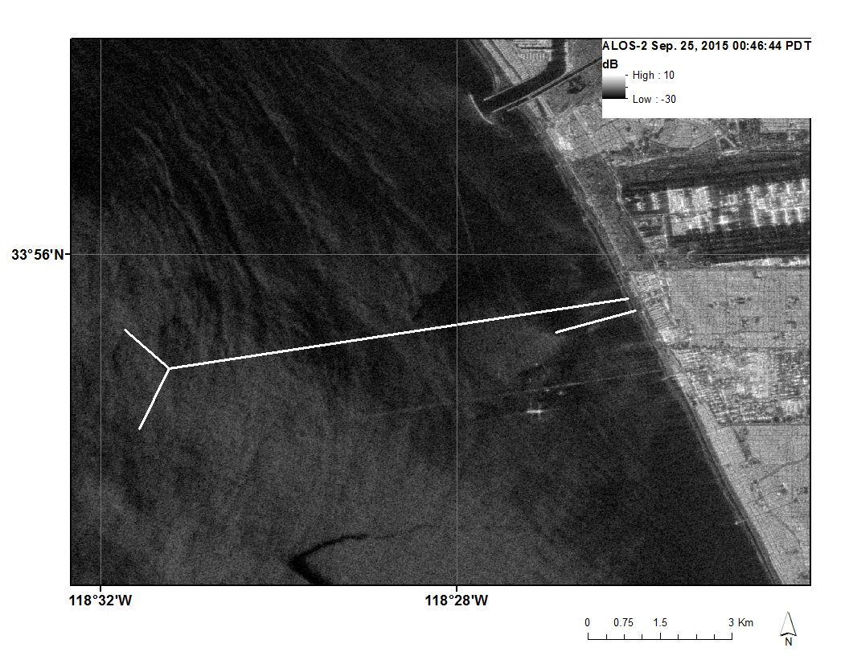
ALOS-2 PALSAR
Before
During

Slide 18
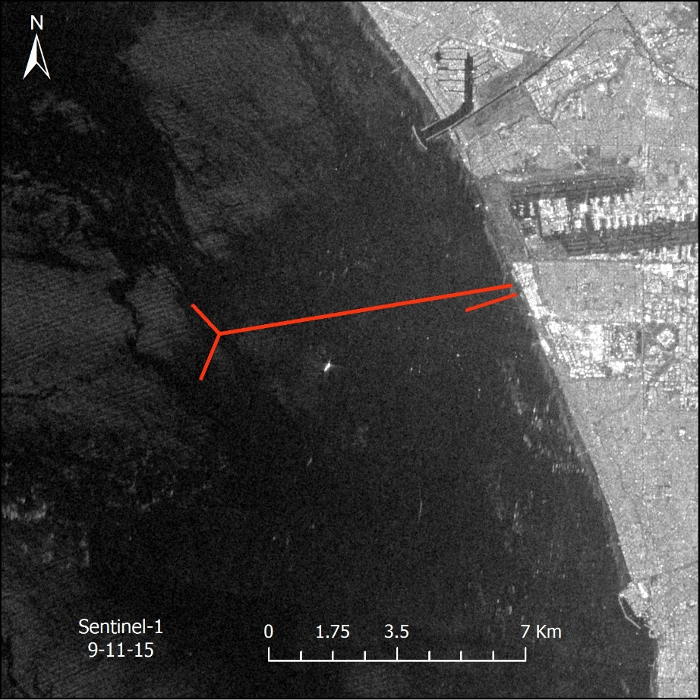
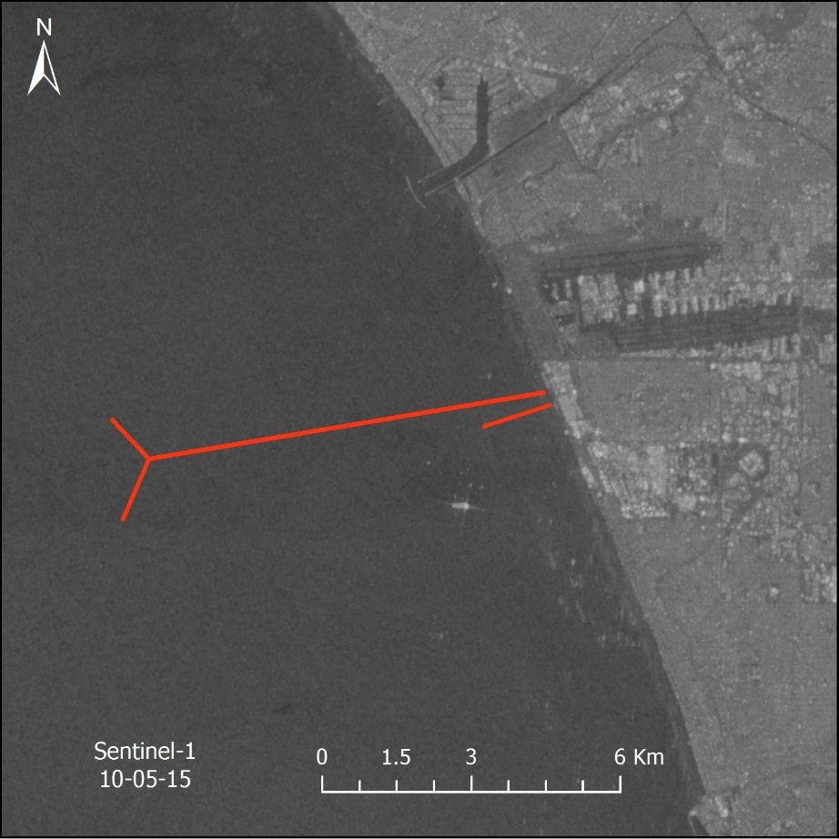
Sentinel-1
Before
During

Slide 19
Results
TBD

Slide 20
Conclusions
TBD

Slide 21
Errors & Uncertainties

Slide 22
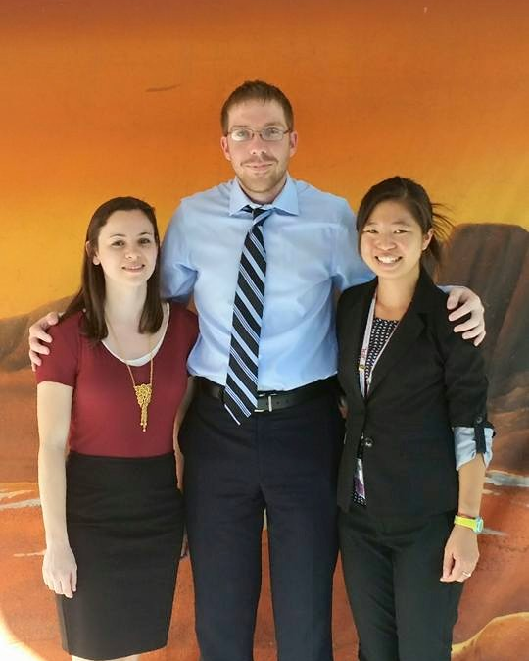
Future Work
Spring 2016
Further analysis of In-Situ Data
Published Paper
DEVELOP Los Angeles Oceans team, JPL: (from left to right) Lindsay Almaleh, Mark Barker, Rebecca Trinh (Team Lead)

Slide 23
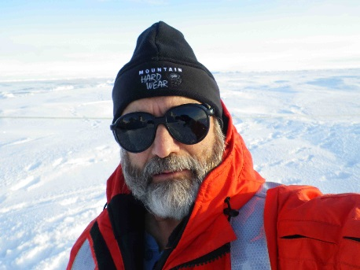
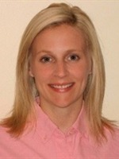
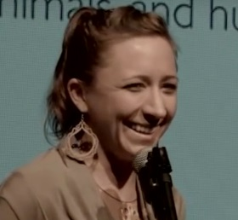
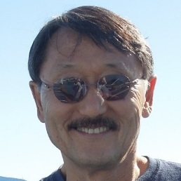
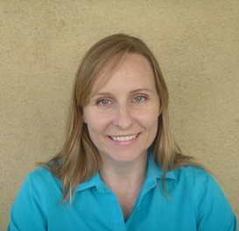
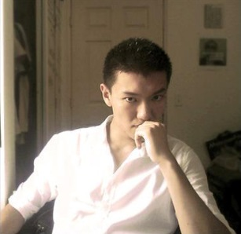
Advisors
Ben Holt & Michelle Gierach (NASA JPL)
Partners
Curtis Cash, Ashley Booth, & Mas Dojiri of Los Angeles City Hyperion Treatment Plant
Past Contributers
Christine Rains & Jack Pan

Slide 24
General Guidelines I
Things that are typically included in a presentation:
The slides provided in the template are just a starting point for teams. Feel free to expand upon these topics, alter the headings, and change the order of the slides to fit your needs.
Study area
Study period
Objectives
Community concerns
NASA satellites/sensors used
Methodology
Results
Conclusions
Errors & uncertainties
Future work
Acknowledgements
Backup slides
Required Statement

Slide 25

General Guidelines II
Header text point size should be between 40 and 60 on most slides.
Body text point size should be at least 20.
Use Century Gothic.
Keep text to a minimum.
Try to use a consistent font size between slides.
Image Credit: Monet
Notes:
Image Source: http://commons.wikimedia.org/wiki/File:Claude_Monet_-_The_Magpie_-_Google_Art_Project.jpg

Slide 26
Image Credit: Monet
General Guidelines III
Include speaker notes for each slide (see below).
Include a visual on each slide, if possible.
Arrange content to minimize white space.
Notes:
These notes should be thorough enough for someone not familiar with the project to clearly present the material.
Image Source: http://commons.wikimedia.org/wiki/File:Claude_Monet_-_The_Magpie_-_Google_Art_Project.jpg

Slide 27
Maps & Logos
Maps
Import the legend separately.
Make sure all text is legible and editable.
Cite base layer source in speaker notes.
Logos
US Federal logos only.
No state, NGO, local and or international government logos, or software logos.

Slide 28
Photos & Figures I
You may only use images taken by your team, provided by your partners (as long as you have permission from them), from a Federal Agency, from the new DEVELOP stock imagery collection on DEVELOP’s Flickr page, or Creative Commons images.
Obtain a media release form from all people in photos that your team has taken — no children!
All image sources should be cited using a consistent format and should be visible on the slide.

Slide 29
Photos & Figures II
Please do not include the image URL in the source text box but rather place it in the notes section below.
If you use a border for your images include it on all photographs to keep your presentation consistent.
Keep all images and text boxes editable, including individual elements of flowcharts.
Background images are discouraged. If you use one, make sure that your text remains clear and legible.

