Slide 1
DEVELOPedia
NASA DEVELOP’s Wiki
Stephanie Rushley (North Carolina State University)
Matthew Carter (United States Air Force)
Charles Chiou (Old Dominion University)
Rick Farmer (Mathews High School)
Kevin Haywood (United States Air Force)
Anthony Pototzky (Old Dominion University)
Adam White (Christopher Newport University)
Daniel Winker (University of Virginia)

Slide 2
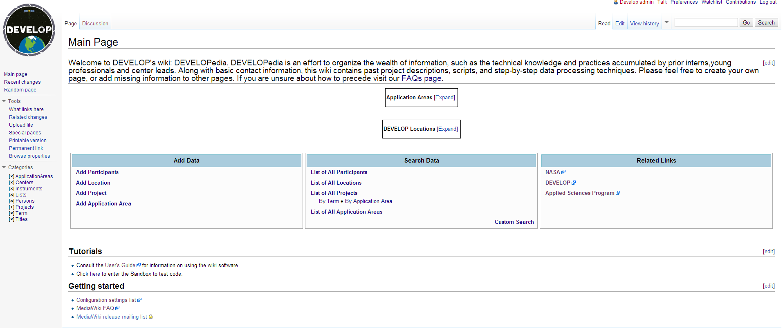
DEVELOPedia
Notes:
Hint at the key features of the blue directories – explained later

Slide 3
DEVELOP Locations
Image taken from develop.larc.nasa.gov/locations.html

Slide 4
Why DEVELOPedia?
User-friendly repository
Structured organization
Resource for new projects
Projects
Project Year
Project page
Notes:
Discuss the purpose of DEVELOPedia; why it is necessary.

Slide 5
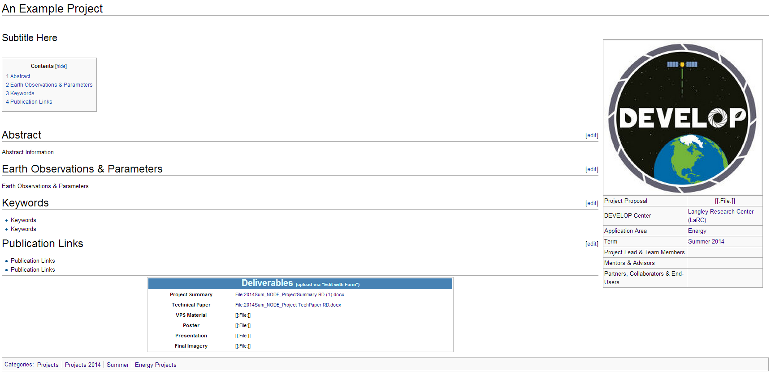
DEVELOPedia Overview
Example Project Page
Project Showcase – Organization – Deliverable Access
Notes:
The main purpose – Project Display. Highlighting the info box on the side followed by the sections according to the project summary sections.

Slide 6
Main Page
Notes:
Hint at the key features of the blue directories – explained later

Slide 7
Main Page – Expandable Displays
Notes:
Hint at the key features of the blue directories – explained later

Slide 8
Main Page – Adding Data
Notes:
Hint at the key features of the blue directories – explained later

Slide 9
Main Page – Searching Data
Notes:
Hint at the key features of the blue directories – explained later

Slide 10
Main Page – Related Links
Notes:
Hint at the key features of the blue directories – explained later

Slide 11
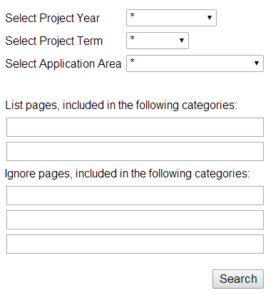
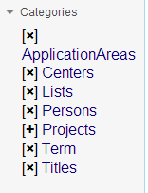
Navigation – Search Bars
Multi-Category Search
Category tree
Search bar
Notes:
Mention Category trees, search bars, and multi-search

Slide 12
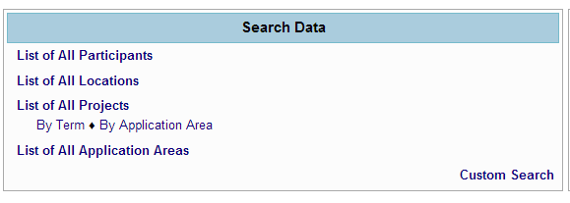
Navigation – Search Tools
Search Directories
Lists & Categories
Notes:
Discuss the convenience of the many search abilities. Discuss the efficiency with sortable tables for various projects and their application areas.
Search for lists by term years, application areas, etc.

Slide 13
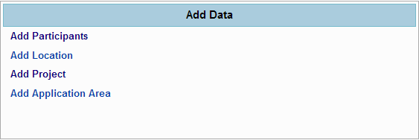
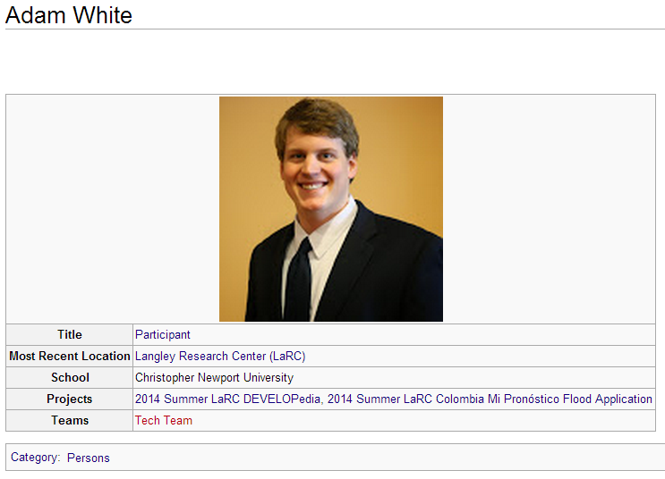
Adding Data
Links in the “Add Data” on the main page take a user to forms for creating pages
Notes:
Adding data process – user-friendly. Sections are laid out for users to input.

Slide 14
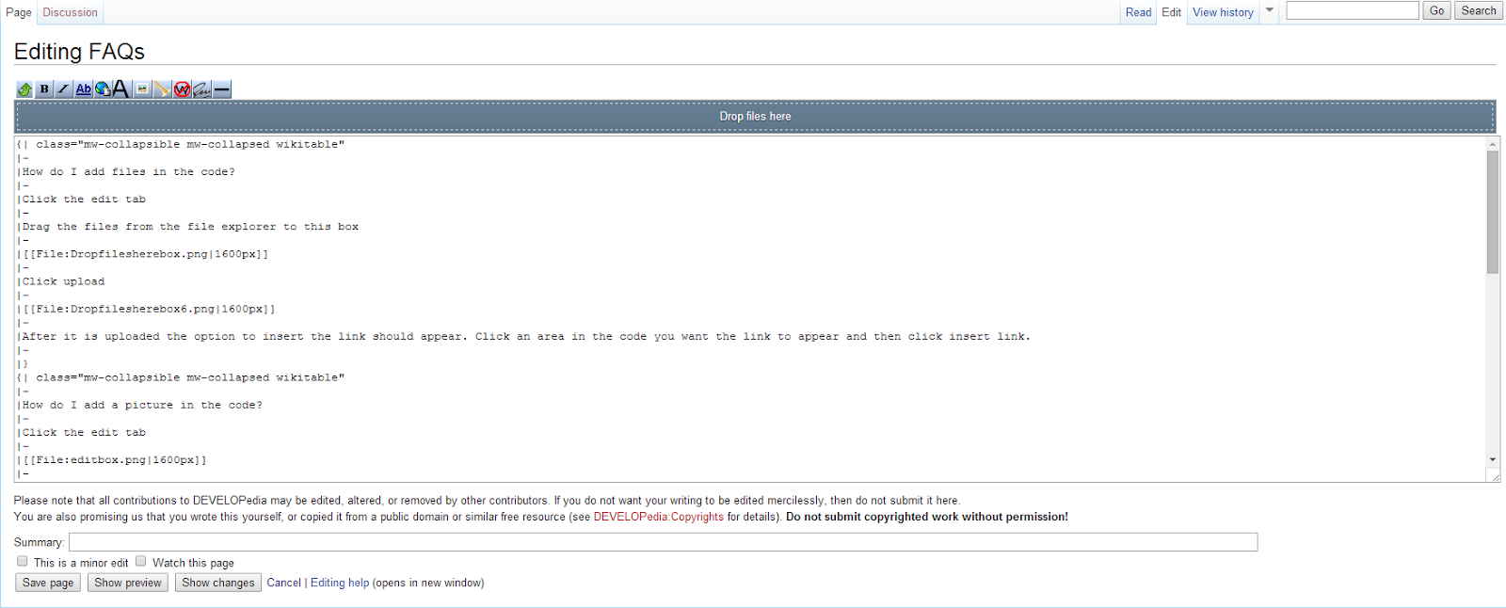
Editing Data - Edit
The Edit tab allows in-depth editing of code
Notes:
More advanced, syntax-heavy editting.

Slide 15
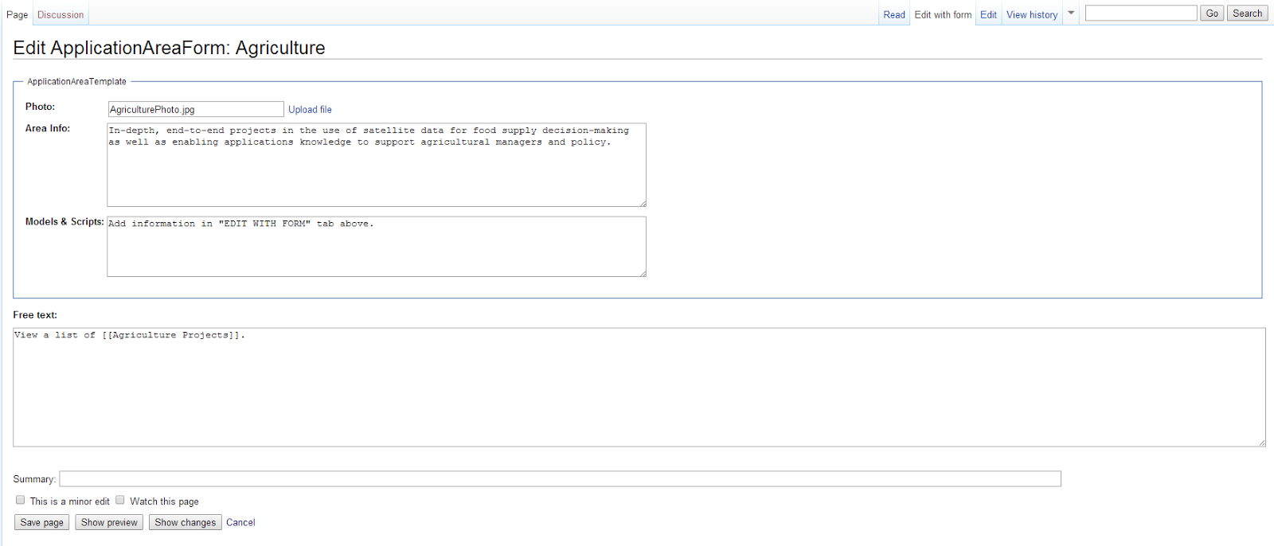
Editing Data – Edit With Form
The Edit with Form tab allows the user to edit the page with ease.
Notes:
Easy to use – no need to use syntax. Simply copy & paste information

Slide 16
Future Work
Models & Scripts
Problem forums

Slide 17
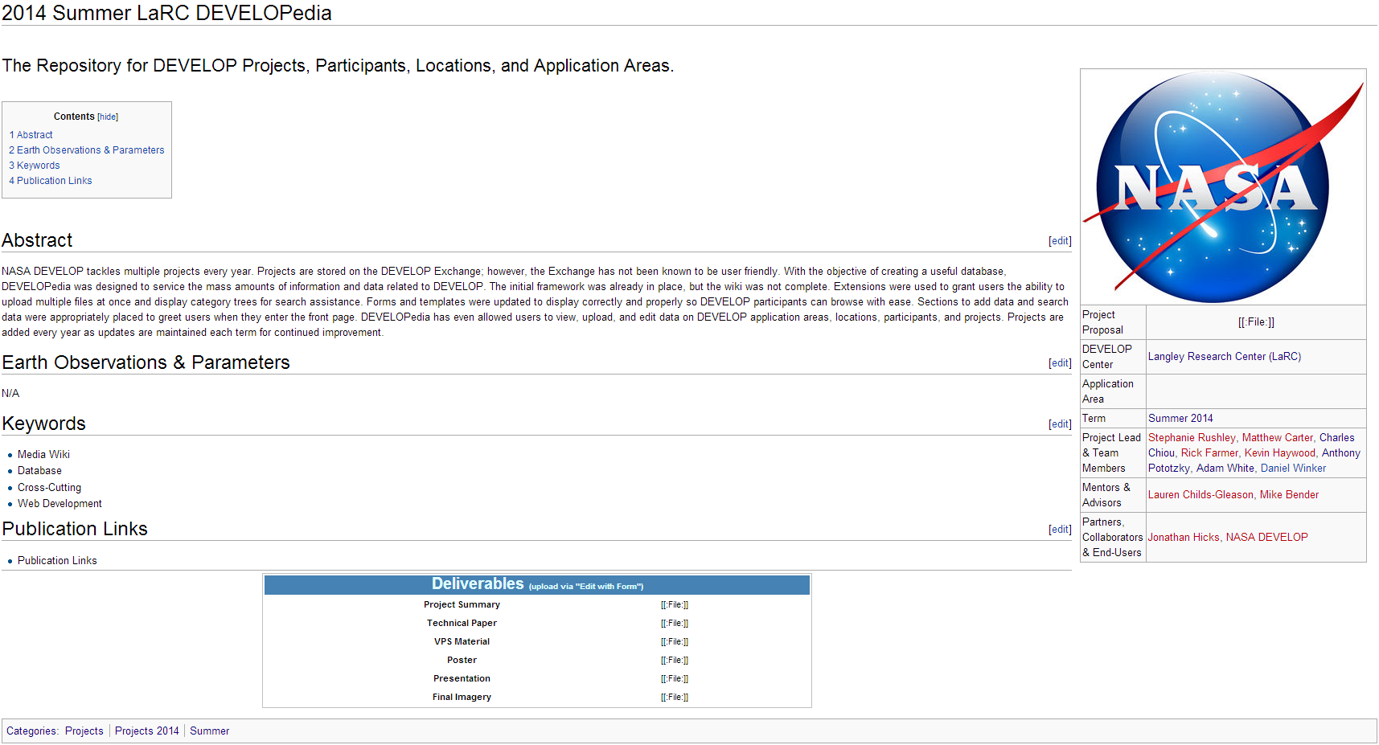
Future Work – Populate

Slide 18
Acknowledgements
Michael Bender National Technical Lead
Lauren Childs-Gleason National Lead
Jon Hicks
SSAI

