Slide 1
Western Montana
Ecological Forecasting
Modeling Habitat Suitability of Mustelid Species to Guide Detection Dog Surveys for Contaminants Monitoring in River Systems in Western Montana
Anna Winter, Kergis Hiebert, Kjirsten Coleman, & Madeleine Gregory
Maryland – Goddard
Notes:
Anna
Hello everyone and thank you for coming to the Spring 2021 DEVELOP closeout with the Goddard node. My name is Anna Winter and I am joined by Kergis Hiebert, Kjirsten Coleman, and Madeleine Gregory. We are the Western Montana Ecological Forecasting team and have spent the past 10 weeks working on the project Modeling Habitat Suitability of Mustelid Species to Guide Detection Dog Surveys for Contaminants Monitoring, via Collected Scats, in River Systems in Western Montana.

Slide 2
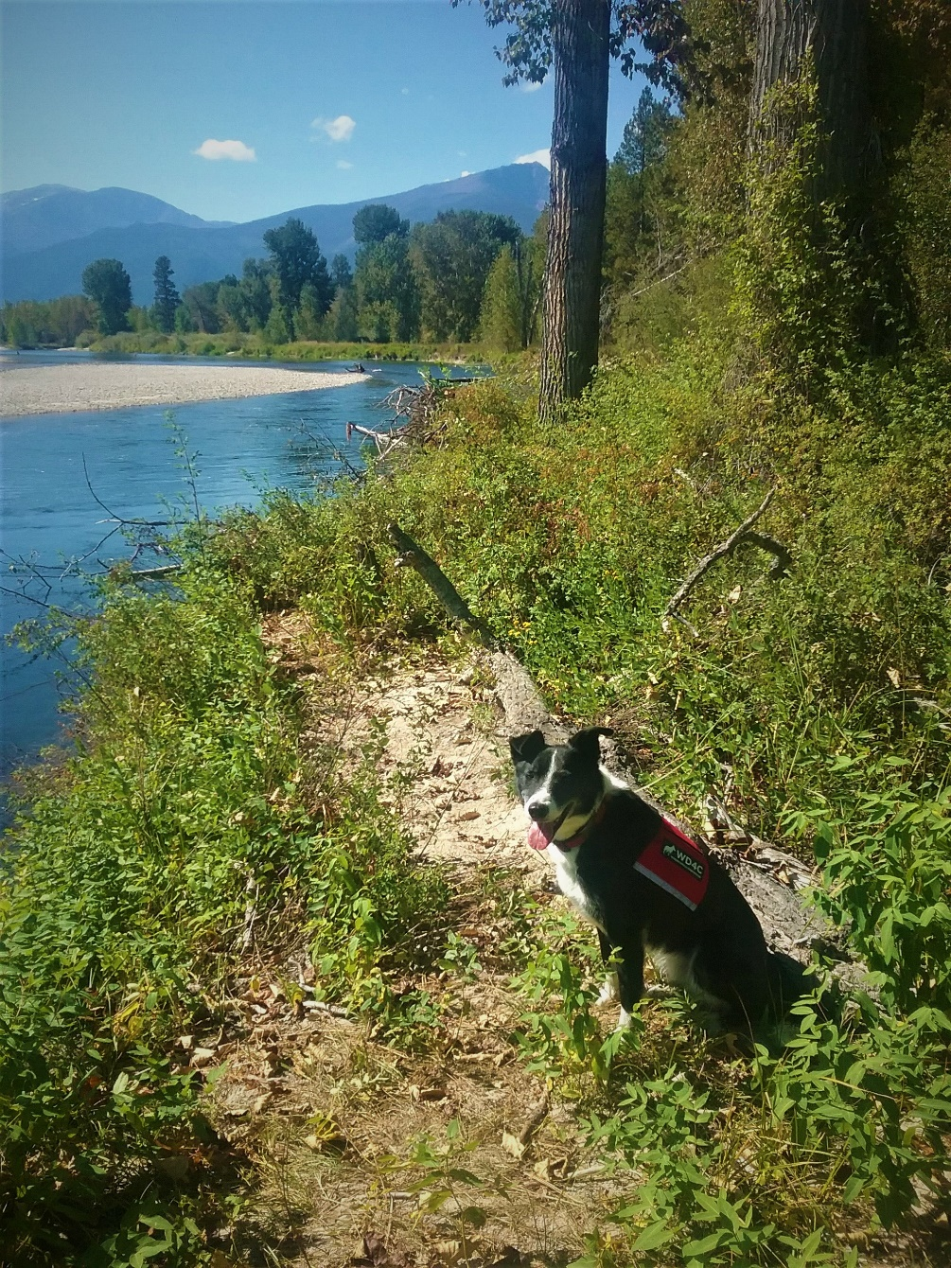
Outline
Background
Community Concerns
Partners
Objectives
Workflow/Methodology
Results
Future Work
Image credit: N. Richards
Notes:
Anna
We want to begin with an outline of our presentation. We will start with some project background and community concerns, and move into our project partners and objectives. We will then discuss our workflow and methodology, our results, and future work.
------------------------------Image Information Below ------------------------------
•Image Credit: Ngaio Richards
•Image Source: Provided by partners with permission to use

Slide 3
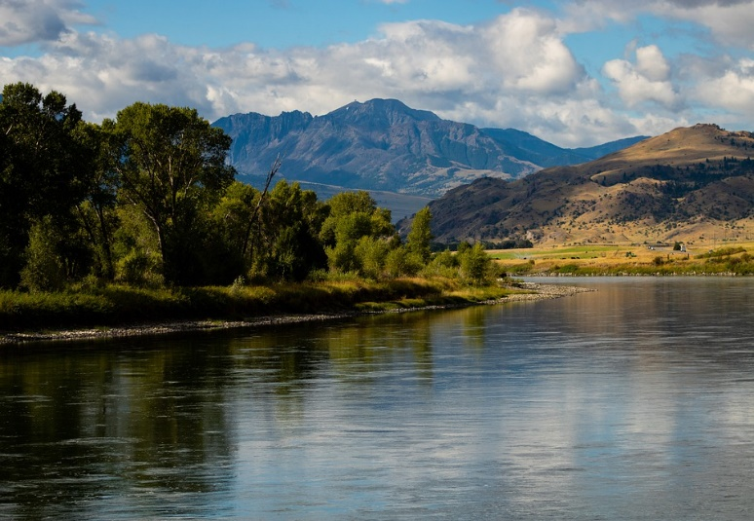
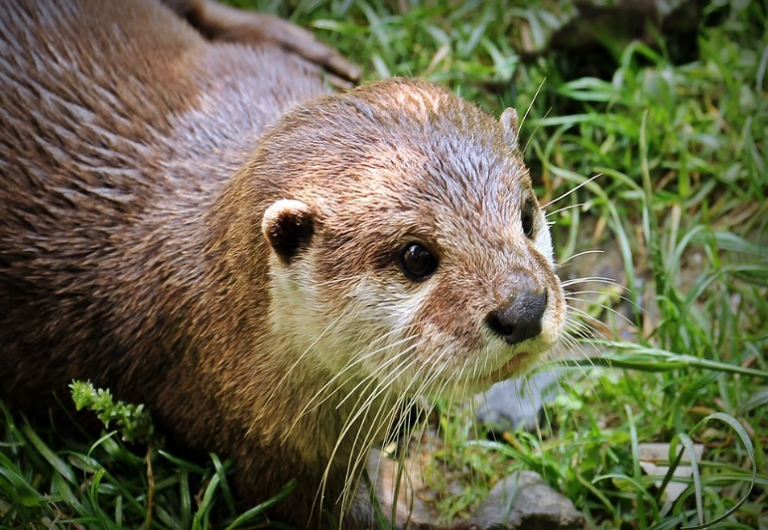
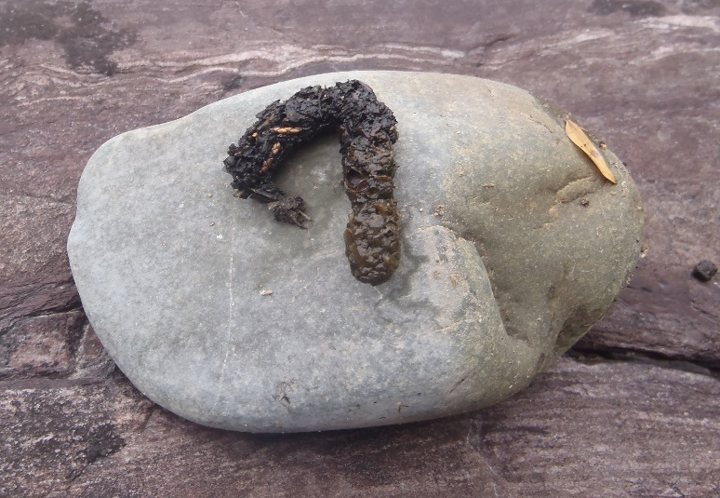
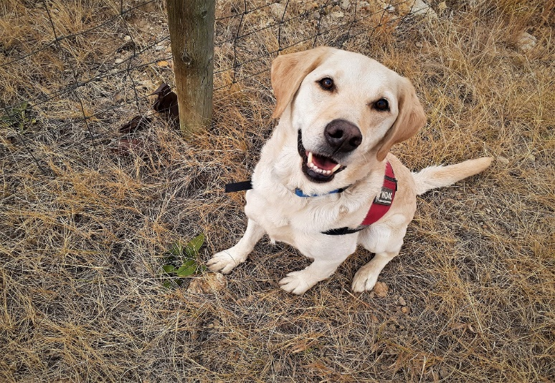
Background Information
Ecological and economic importance of western Montana’s river systems
Status of contaminants is largely unknown
Image credit: ewindsch
Bioaccumulation of contaminants in North American river otter and American mink
Image credit: pixel2013
Image credit: N. Richards
Scat analysis is a noninvasive contaminant monitoring method
Image credit: N. Richards
Notes:
Anna
##### CLICK TO ANIMATE
Western Montana’s river systems have profound economic and ecological importance. These rivers supply clean water to nearby communities, support the livelihoods of hunters and trappers, and provide invaluable habitat for many species including river otter and mink.
##### CLICK TO ANIMATE
Contaminants in these relatively pristine waterways threaten both human and ecosystem health, but the status of contaminants in these rivers is largely unknown. It is important to monitor contaminants because even in trace amounts, contaminants such as heavy metals, brominated flame-retardants, and pharmaceuticals can have significant negative endocrine, neurological, and reproductive effects.
##### CLICK TO ANIMATE
Contaminants work their way up the food chain and bioaccumulate. As apex predators with largely aquatic diets, the North American river otter (Lontra canadensis) and American mink (Mustela vison) can provide a clear picture of the presence of contaminants in the ecosystem and their effects on wildlife.
##### CLICK TO ANIMATE
Scat analysis is a noninvasive contaminant monitoring method that can provide insight abut what contaminants individuals have been exposed to. In recent years, detection dogs have been employed to find scat samples. This utilizes dogs’ strong sense of smell to locate scats. However, mink and otter have been relatively difficult to find due to their elusive nature. This is where our project comes in!
------------------------------Image Information Below ------------------------------
•Image 1 Credit: ewindsch
•Image 1 Source: https://pixabay.com/photos/montana-river-landscape-scenic-5203545/
(Licensed under CC0)
•Image 2 Credit: pixel2013
•Image 2 Source: https://pixabay.com/photos/otter-otter-baby-otter-baby-nature-1438381/
(Licensed under CC0)
•Image 3 Credit: Ngaio Richards
•Image 3 Source: Provided by partners with permission to use
•Image 4 Credit: Ngaio Richards
•Image 4 Source: Provided by partners with permission to use

Slide 4
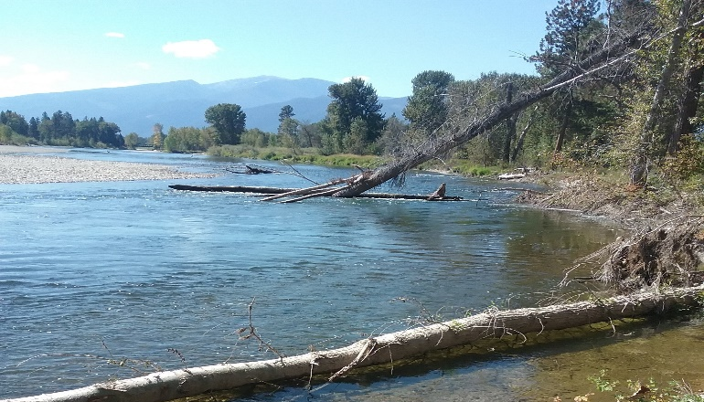
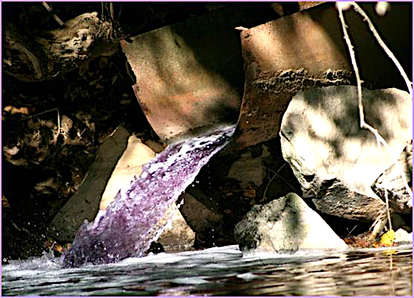
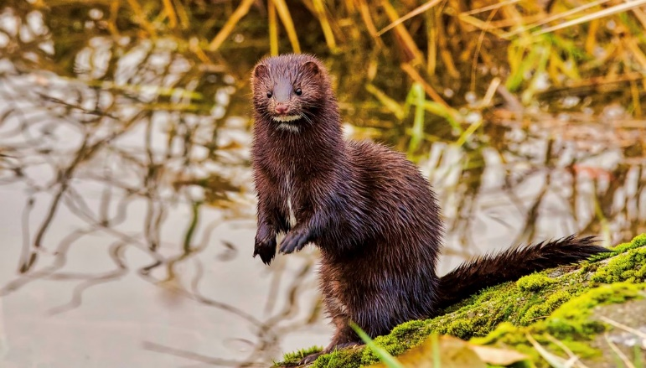
Community Concerns
Contaminants threaten the health of humans and wildlife
Image credit: N. Richards
Sources of contaminants are likely to increase with increasing urbanization in western Montana
Image credit: M. LaGuardia
Lack of information about contaminants limits the ability of policymakers to respond
Image credit: nicolebeaulac
Notes:
Anna
Now that you have a little background on our project, we will talk about the community concerns that our project addressed.
##### CLICK TO ANIMATE
Contaminants such as heavy metals, brominated-flame retardants, and pharmaceuticals in western Montana’s river systems threaten both human and wildlife health with long-term biological effects.
##### CLICK TO ANIMATE
Sources of contaminants such as wastewater plants and runoff from urban areas are likely to increase with increased urbanization in western Montana.
##### CLICK TO ANIMATE
Finally, the lack of information about the presence of contaminants in these ecosystems limits the ability of policymakers and land managers to respond to the hazards.
------------------------------Image Information Below ------------------------------
•Image 1 Credit: Ngaio Richards
•Image 1 Source: Provided by partners with permission to use
•Image 2 Credit: Mark LaGuardia
•Image 2 Source: Provided by partners with permission to use
•Image 3 Credit: nicolebeaulac
•Image 3 Source: https://search.creativecommons.org/photos/f25676df-243f-43cd-bab1-0dd62e30c4df
(Licensed under CC BY-NC-ND 2.0)

Slide 5
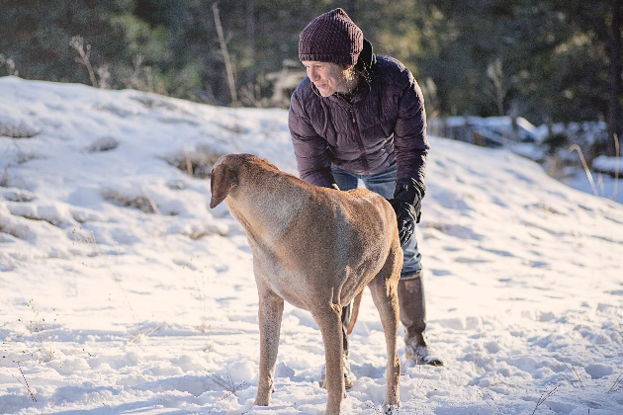
Partners
Working Dogs for Conservation
Virginia Institute of Marine Science
Image credit: J. Lessard
Image credit: M. LaGuardia
Point of Contact:
Point of Contact:
Ngaio Richards
Mark LaGuardia
Notes:
Anna
We partnered with both Working Dogs for Conservation and the Virginia Institute of Marine Science for our project.
##### CLICK TO ANIMATE
Working Dogs for Conservation is a Montana-based nonprofit organization that has pioneered a method for using dogs’ extraordinary sense of smell to protect wildlife and ecosystems. Dr. Ngaio Richards from Working Dogs for Conservation has used detection dogs to locate scat of mink and otter for the purpose of contaminant monitoring in western Montana’s river systems. Working Dogs for Conservation would like incorporate NASA Earth observations in future studies to help inform survey site selection and streamline the sample detection effort using detection dogs.
##### CLICK TO ANIMATE
The Virginia Institute of Marine Science is one of the largest marine research and education centers in the world. Dr. Mark LaGuardia from the Virginia Institute of Marine Science conducts the laboratory analysis of the samples collected in the field for contaminants.
------------------------------Image Information Below ------------------------------
•Image 1 Credit: Jess Lessard
•Image 1 Source: Provided by partners with permission to use with Media Release Form
•Image 2 Credit: Mark LaGuardia
•Image 2 Source: Provided by partners with permission to use with Media Release Form
Clipart provided by PowerPoint

Slide 6
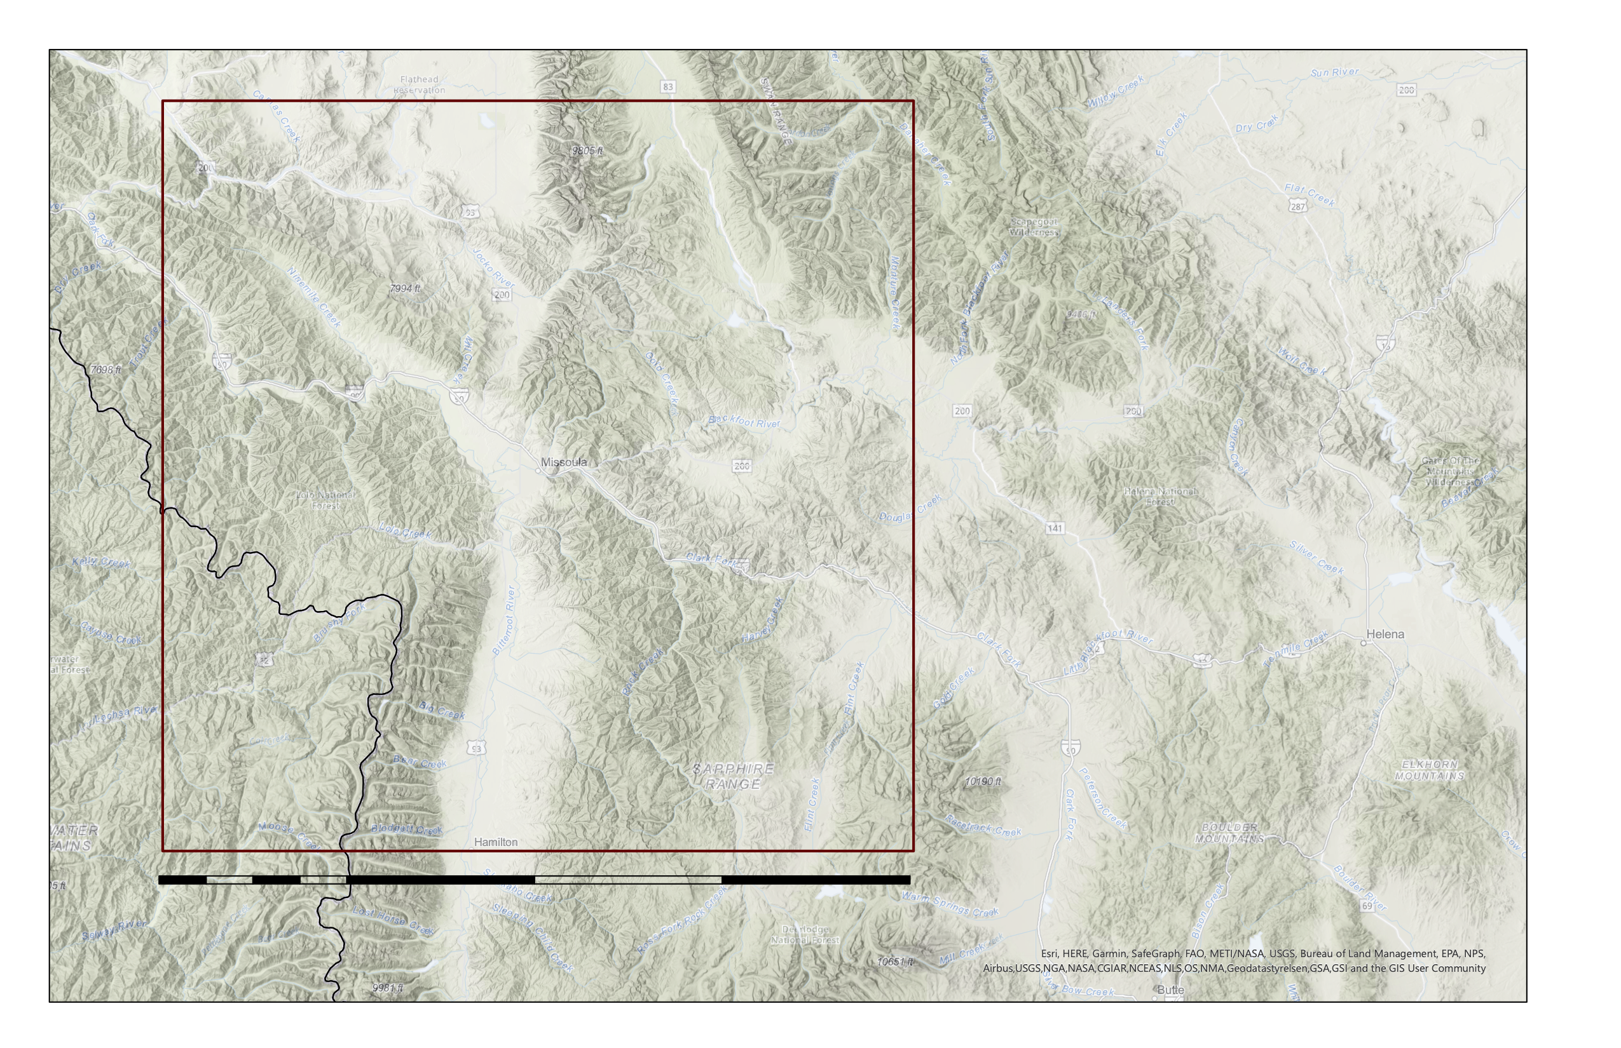
Study Area and Period
Study Area Boundary
N
Study Area:
Western Montana
200 km² region centered around Missoula, MT
Missoula
Study Period:
September-November
2013-2020
Spatial Reference
Name: 1984 Web Mercator Auxiliary Sphere
PCS: 1984 Web Mercator Auxiliary Sphere
0
100
200 km
Notes:
Kergis
##### CLICK TO ANIMATE
Our study area is a 200-kilometer squared region centered on Missoula, Montana. Missoula is located in Western Montana, at the convergence of five mountain ranges within the Rocky Mountains, and near the confluence of the Blackfoot, Bitterroot, Clark Fork, Madison, and Yellowstone river systems.
##### CLICK TO ANIMATE
We focus primarily on the autumn months, from September to November, as the streamflow is generally lower during this time and the partners can safely conduct their surveys with the detection dog teams. Our study period utilizes data from the years 2013-2020 to incorporate partner field data beginning in 2013.
------------------------------Image Information Below ------------------------------
Basemap Credit: ArcGIS Pro
Basemap Sources: Esri, HERE, Garmin, SafeGraph, FAO, METI/NASA, USCS, Bureau of Land Management, NPS, Airbus, USGS NGA, CGIAR, NCEAS, NLS, OS, NMA, Geodatastyrelsen, GSA, GSI, and the GIS User Community

Slide 7
Project Objectives
1. Create habitat suitability models for mink and otter for 2013-2020
2. Generate habitat suitability models for mink and otter projected to 2040
3. Produce maps of suggested survey areas
Notes:
Kergis
We had three project objectives that we set out to accomplish.
##### CLICK TO ANIMATE
The first objective was to create habitat suitability maps for mink and otter in western Montana for the years 2013-2020.
##### CLICK TO ANIMATE
The second objective was to generate future habitat suitability maps for mink and otter in western Montana projected to 2040.
##### CLICK TO ANIMATE
The final objective was to produce maps of suggested survey areas based on habitat suitability maps and feasibility of research.
------------------------------Image Information Below ------------------------------
Clipart provided by PowerPoint

Slide 8
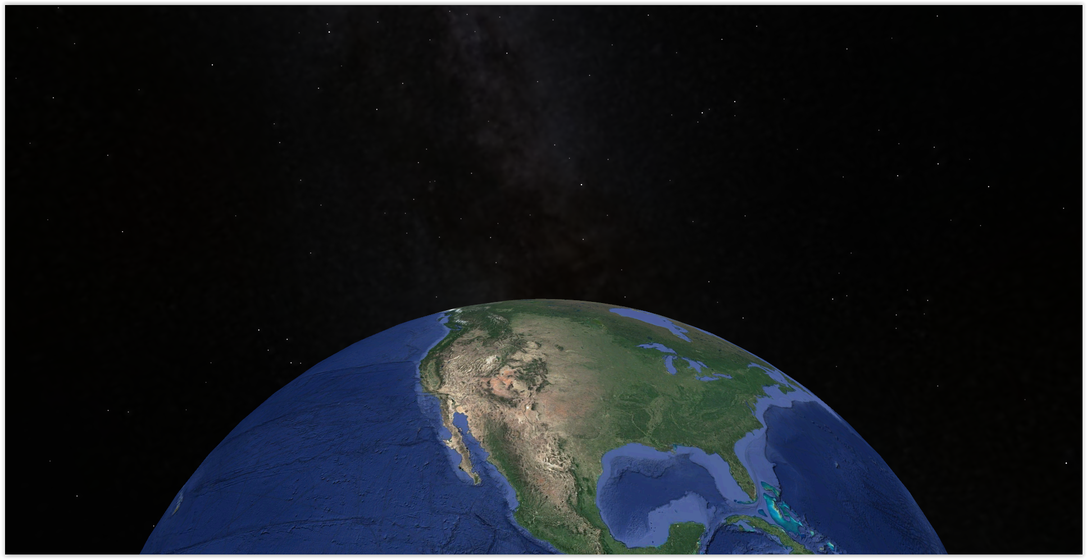
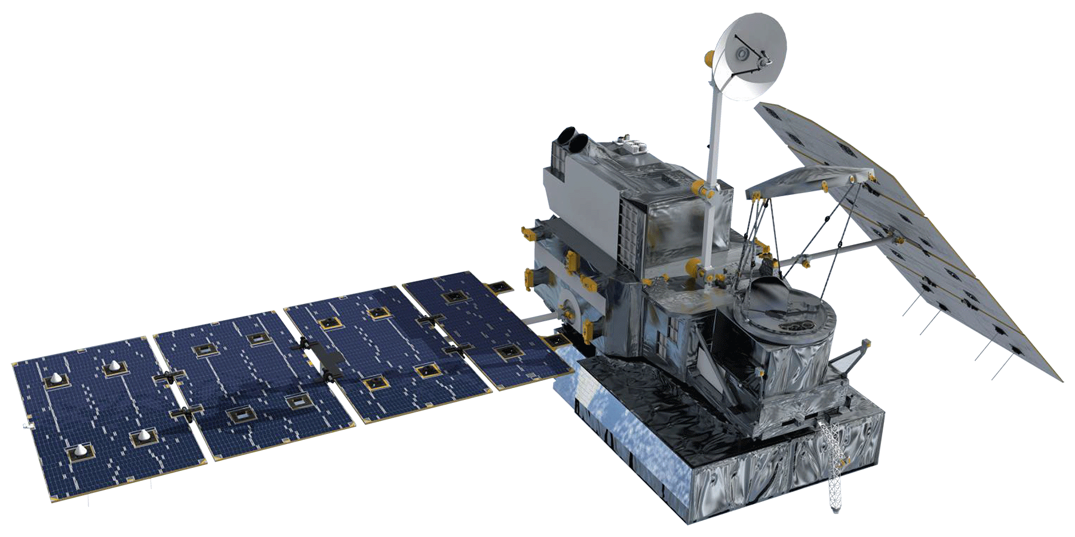
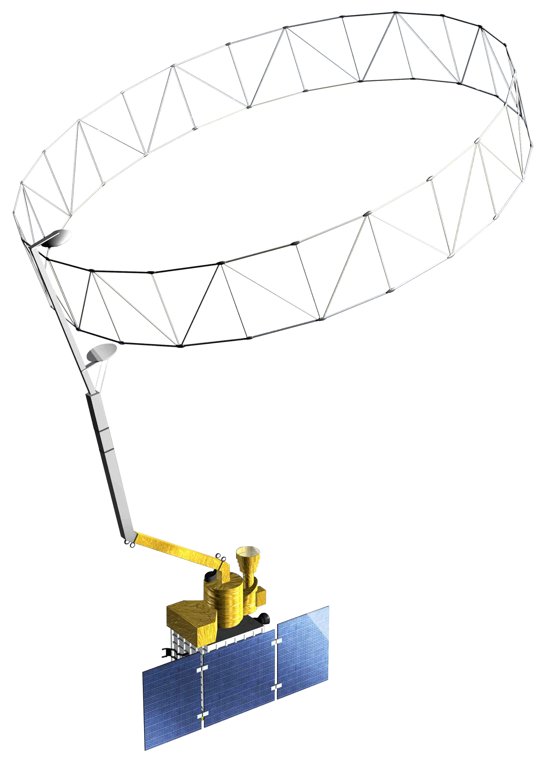
NASA Satellite/Sensors Used
Global Precipitation Measurement
(2013-2020)
Landsat 8
Operational Land Imager
(2013-2020)
Soil Moisture Active Passive
(2015-2020)
Terra
Moderate Resolution Spectroradiometer
(2013-2020)
Shuttle Radar Topography Mission
(2013-2020)
Image credit: Google Earth, NASA
Notes:
Kergis
We utilized data from a handful of NASA satellites and sensors to gather predictor variable data for our habitat suitability models.
##### CLICK TO ANIMATE
We derived normalized difference vegetation index (NDVI) information from Landsat 8 Operational Land Imager (or OLI).
##### CLICK TO ANIMATE
We utilized Terra Moderate Resolution Spectroradiometer (MODIS) for land surface temperature and burned area variables.
##### CLICK TO ANIMATE
The Global Precipitation Measurement (GPM IMERG) satellite provided us with precipitation information.
##### CLICK TO ANIMATE
We utilized the Shuttle Radar Topography Mission (SRTM) for topographic variables.
##### CLICK TO ANIMATE
Finally, we utilized the Soil Moisture Active Passive (SMAP) satellite for soil moisture variables.
------------------------------Image Information Below ------------------------------
•Image Credit: Google Earth
•Image Source: NASA DEVELOP Team
All satellite images:
•Image Credit: NASA
•Image Source: DEVELOPedia

Slide 9
Methodology | General Project Workflow
Data Acquisition
Data Analysis
Mapping
Google Earth Engine
Current habitat suitability maps
Software for Assisted Habitat Modeling (SAHM)
Preprocessing
Model runs
WorldClim
Partner occurrence data
Future habitat suitability maps
GBIF
Survey feasibility maps
Open Street Map
Notes:
Kjirsten:
Here is an overview of our general workflow for this project
##### CLICK TO ANIMATE
We utilized landcover, climatic, and topographic predictor variables from Google Earth Engine. We also used historical and future climatic data from WorldClim. Our partners provided 164 occurrence data points for mink and otter for our species occurrence data. We utilized the Global Biodiversity Information Facility (GBIF) data to visually validate the model. Finally, we used Open Street Map data to determine potential contaminant locations.
##### CLICK TO ANIMATE
We used software for Assisted Habitat Modeling, or SAHM, to produce our habitat suitability models. SAHM was created to expedite habitat modeling and to help maintain a record of the various input data, pre- and post- processing steps, and modeling options incorporated in the construction of a habitat suitability model. We utilized the Random Forest model in SAHM.
##### CLICK TO ANIMATE
Utilizing the SAHM habitat suitability models and ArcGIS Pro, we created maps of current habitat suitability for mink and otter in western Montana, future habitat suitability maps, and feasibility maps to guide the partner’s field site selection.

Slide 10
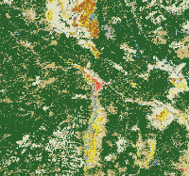
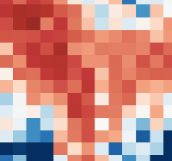
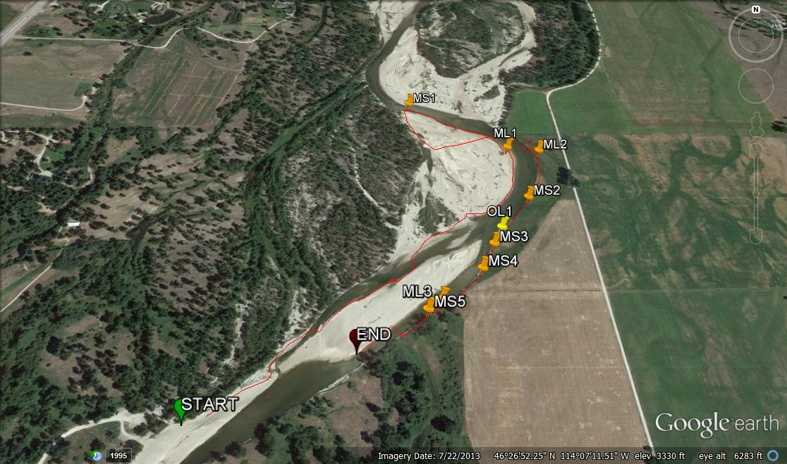
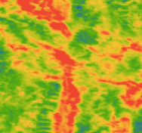
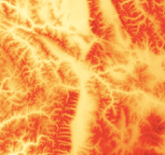
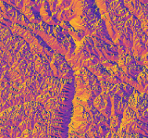
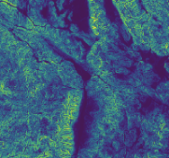
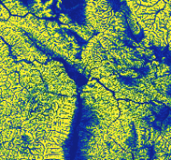
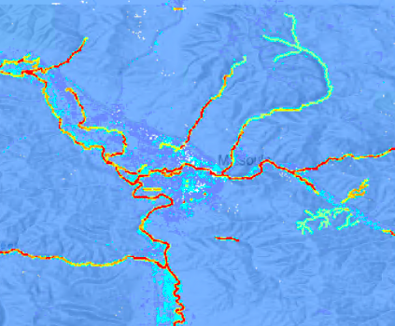
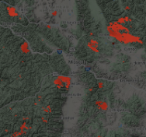
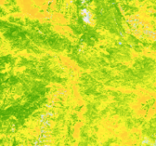
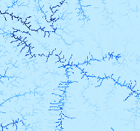
Methodology | Current Habitat Suitability Models
Occurrence data
Predictors
Analysis
Land Cover
NLCD
1. Random Forest Model
ssm
ppt
Climatic
LST
elev
aspect
Topographic
2. Probability Map
Image credit: N. Richards
Species occurrence data
slope
HAND
burn
NDVI
Other
river dist
depth
Notes:
Kjirsten: We will now discuss the specific methodology behind our current habitat suitability models. We generated these models to help inform survey site selection for our partners.
##### CLICK TO ANIMATE
Our partners collected mink and otter scat samples in river ecosystems around Missoula using detection dogs. Whenever a scat was located, the partners recorded the waypoint. The partners conducted their main surveys in 2013 and 2014, and conducted follow up surveys in 2019. The combined mink and otter occurrence data from our partners was used to train the models.
##### CLICK TO ANIMATE
We worked closely with the partners to determine important variables for mink and otter habitat. We also conducted a thorough literature review. Based on these discussions, we included land cover, climatic, and topographic predictor variables in our models. We utilized the National Land Cover Database for our land cover classification.
##### CLICK TO ANIMATE
For our climatic predictor variables, we utilized soil moisture, precipitation, minimum temperature, maximum temperature, and land surface temperature.
##### CLICK TO ANIMATE
We included elevation, slope, aspect, northness, eastness, and height above nearest drainage as topographic predictor variables.
##### CLICK TO ANIMATE
Finally, we also included distance to river, river depth, burned area, and NDVI as predictors.
##### CLICK TO ANIMATE
We input the predictor variables and occurrence data into the random forest model. Random forest is a machine learning algorithm that consists of many decision trees that are trained on bootstrap samples of the data. Within SAHM, the random forest model output a probability map, which shows the probability of observing the species given the sampling design of the field data used to train the model.
------------------------------Image Information Below ------------------------------
•Image Credit: Ngaio Richards
•Image Source: Provided by partners with permission to use
All Predictor Variables:
•Image Credit: Google Earth Engine
•Image Source: NASA DEVELOP Team

Slide 11
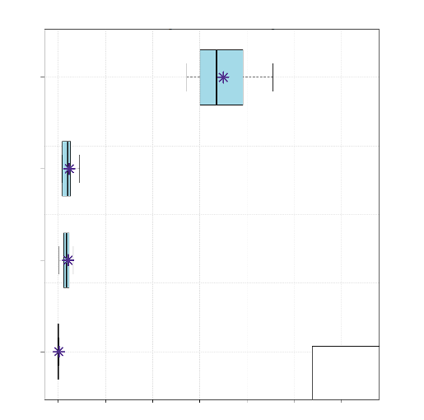
Results | Current Models
Importance using the change in Area Under the Curve when each predictor is permuted
Correlated variables over .70 were removed
Distance to River
Final Predictor Variables
Distance to River
River Depth
Land Surface Temperature
Land Cover
River Depth
Variables
LST
NLCD
CV
*
Train
0.00
0.05
0.10
0.15
0.20
0.25
0.30
Importance
Notes:
Kjirsten:
##### CLICK TO ANIMATE
SAHM generates a correlation matrix showing the correlation between all the predictor variables using the maximum of the Pearson, Spearman and Kendall coefficients. If two variables were correlated above 0.70 with any of these coefficients, we removed the variable with the lowest deviance explained.
Our final predictor variables for the current model were distance to river, river depth, land surface temperature, and land cover.
##### CLICK TO ANIMATE
Here we show the variable importance plot for our model, with the Variables on the y axis and the Variable Importance on the x-axis.
Distance to river was the most important variable in the model. River depth was the second most important variable, with higher mink and otter occurrence corresponding with deeper river locations. Within the land cover variable, the most important land cover type was emergent herbaceous wetlands. This type of land cover is often found along riverbanks.

Slide 12
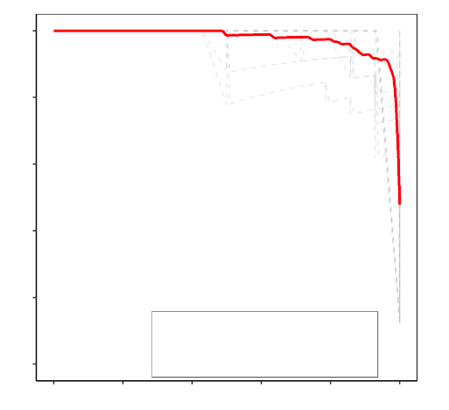
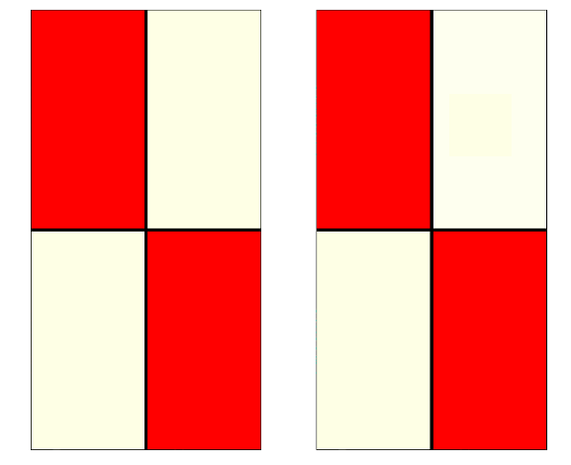
Results | Current Models
AUC-PR Plot
Confusion Matrix for Training Data
Confusion Matrix for Cross Validation Data
1.0
100
0.8
Presence
141
21
Presence
141
15
80
0.6
Precision
(TP)
(FP)
60
Predicted
0.4
40
0.2
Absence
3
979
Absence
3
985
Training Split (AUC=0.978)
20
Cross Validation Mean (AUC=0.976)
(FN)
(TN)
0.0
0
0.0
0.2
0.4
0.6
0.8
1.0
Presence
Absence
Presence
Absence
Recall
Observed
Correlation Coefficient: 0.895
Notes:
Kjirsten:
##### CLICK TO ANIMATE
As our models were trained with presence-only data, one of the metrics we used to evaluate the models was the Area Under the Curve Precision-Recall score, or AUC-PR.
For the AUC-PR score, anything above 0.9 is considered to be excellent, with 1.0 being a perfect model. In the plot, an ideal model would have a point in the upper right corner. Our model had an AUC-PR of 0.978, which meant the model was performing well.
##### CLICK TO ANIMATE (change to less technical info)
AUC-PR utilizes the precision metric and the recall metric, which are both generated from the confusion matrix. For machine learning classification models, which is what we are using, the confusion matrix is important in determining how the model is performing. In this figure, red indicates a high percentage of values, so ideally, we want the true positives and the true negatives to be red.
##### CLICK TO ANIMATE
Our model also had a Pearson’s correlation coefficient of 0.895, which shows that the model is predicting well.

Slide 13
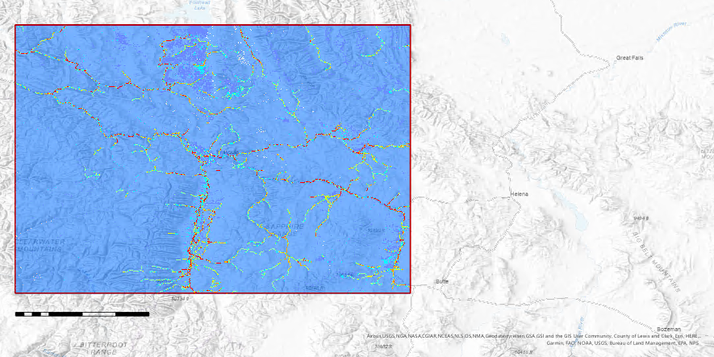
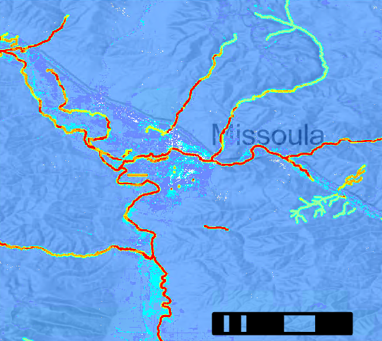
Results | Current Models Probability Map
N
Missoula
0
10
20 km
0
25
100 km
Habitat Probability
Spatial Reference
Name: 1984 Web Mercator Auxiliary Sphere
PCS: 1984 Web Mercator Auxiliary Sphere
0.000 - 0.039
0.467 – 0.639
0.040 - 0.137
0.640 - 0.823
0.138 - 0.286
0.824 - 1.000
0.287 - 0.466
Study Area
Notes:
Kjirsten:
The probability maps for our current model shows the probability of a species occurrence given the sampling design of the field data, with blue indicating low probability and red indicating high probability. From a distance, the map generally outlines rivers. However, when you zoom closer into the map, you can see the variability in the habitat provided by the river depth, land cover, and land surface temperature variables. Higher probability generally corresponded with areas near deeper river and emergent herbaceous wetland.
------------------------------Image Information Below ------------------------------
Basemap Credit: ArcGIS Pro
Basemap Sources: Esri, HERE, Garmin, SafeGraph, FAO, METI/NASA, USCS, Bureau of Land Management, NPS, Airbus, USGS NGA, CGIAR, NCEAS, NLS, OS, NMA, Geodatastyrelsen, GSA, GSI, and the GIS User Community

Slide 14
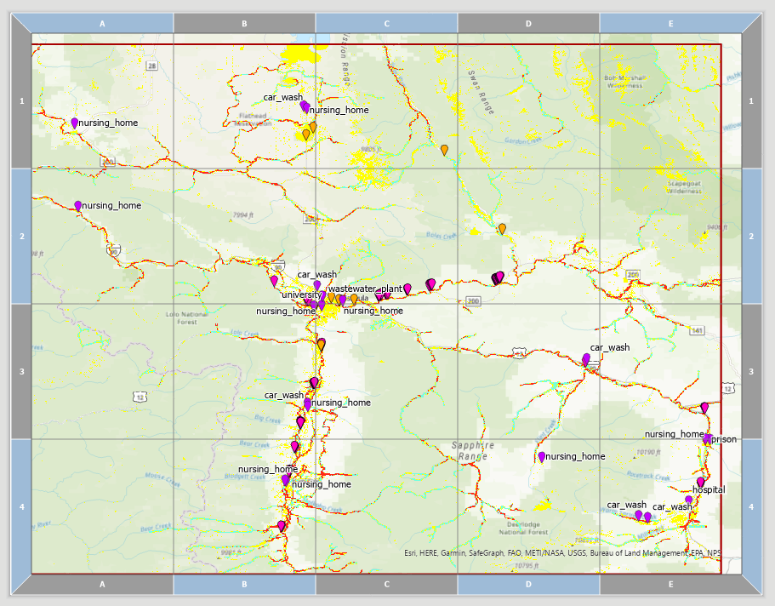
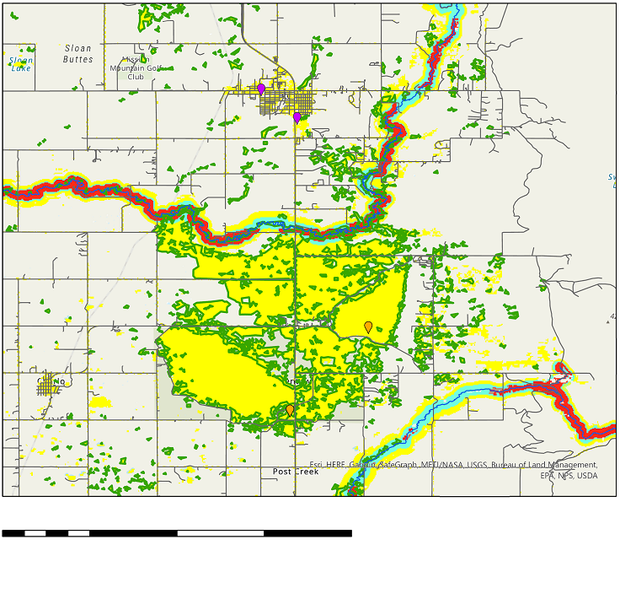
Results | Survey Site Feasibility Maps
N
Car Wash
Nursing Home
0
2.5
5
7.5
10 km
Points of Interest
Roads
Habitat Probability
GBIF Otter Presence
Rivers
0.000 - 0.070
0.071 - 0.294
Study Area
0.295 - 0.635
Emergent Herbaceous Wetland
0.636 - 1.000
Notes:
Kjirsten:
Our partners were interested in specific sources of contamination such as wastewater treatment plants and hospitals. Using Open Street Map data, we overlaid these points of interest on our habitat suitability maps. We made the lower habitat suitability transparent on the maps, as our partners will likely not survey in these areas. We included roads in our feasibility map so partners can see how they can access an area. We also included emergent herbaceous wetland areas in these maps. Areas with a high habitat suitability with a contaminant source nearby will be suggested to partners as potential future survey sites.
As you can see in the location in this inset map, there is a high habitat probability for mink and otter and nearby potential contaminant sources with a car wash and nursing home. There are also previous otter occurrences as reported in the GBIF data - this is shown by the orange markers. This would be a good place to conduct a future survey.
------------------------------Image Information Below ------------------------------
Basemap Credit: ArcGIS Pro
Basemap Sources: Esri, HERE, Garmin, SafeGraph, FAO, METI/NASA, USCS, Bureau of Land Management, NPS, Airbus, USGS NGA, CGIAR, NCEAS, NLS, OS, NMA, Geodatastyrelsen, GSA, GSI, and the GIS User Community

Slide 15
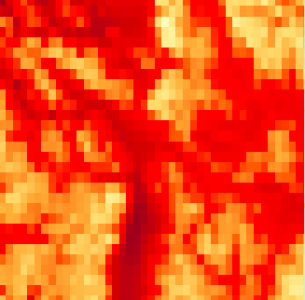
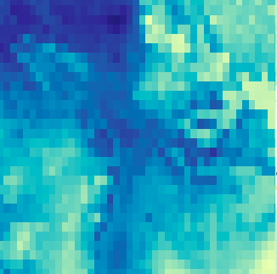
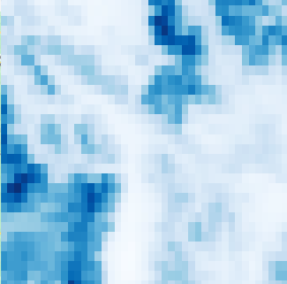
Methodology | Future Habitat Suitability Models
Occurrence data
Predictors
Analysis
1. Random Forest Model
tmax
tmin
2. Probability Map
Image credit: N. Richards
ppt
Species occurrence data
Climatic
Notes:
Madeleine:
In addition to present-day habitat suitability models, we also generated future habitat suitability models for 2040. This followed a similar workflow to the present-day models.
##### CLICK TO ANIMATE
We utilized the same occurrence data collected by our partners.
##### CLICK TO ANIMATE
To project into the future, we first had to adjust our current models. We focused on variables that were projected to change in the next twenty years: maximum monthly temperature max, minimum monthly temperature, and precipitation.
For our current model, we used 2010-2018 averages of monthly minimum temperature, maximum temperature, and total precipitation from WorldClim. We then applied that model to 2021-2040 averages of the same variables under the projected scenario SSP2-4.5. This is a relatively low-emissions scenario, but the climate warming effects are similar among warming scenarios at this time scale.
##### CLICK TO ANIMATE
We again utilized the Random Forest model and generated a probability map for our future habitat suitability model.
------------------------------Image Information Below ------------------------------
•Image Credit: Ngaio Richards
•Image Source: Provided by partners with permission to use
All Predictor Variables:
•Image Credit: Google Earth Engine
•Image Source: NASA DEVELOP Team

Slide 16
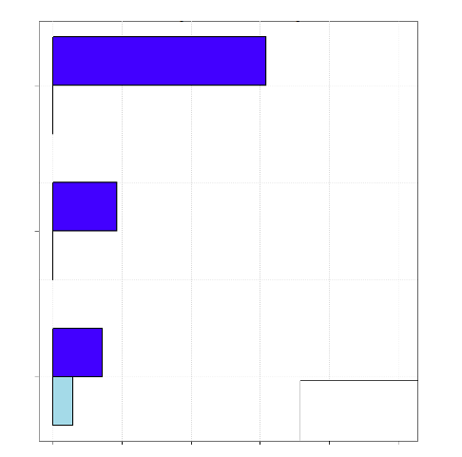
Results | Future Models
Importance using the change in AUC when each predictor is permuted
Maximum Temperature
Included all variables
Final Predictor Variables
Monthly Average Maximum Temperature
Monthly Average Minimum Temperature
Monthly Total Precipitation
Variables
Minimum Temperature
Precipitation
Train
Eval. Split
0.00
0.05
0.10
0.15
0.20
0.25
Importance
Notes:
##### CLICK TO ANIMATE
Madeleine: Because we only had three predictor variables to begin with, we included all of these in our final model. Of note, maximum temperature and precipitation were correlated above 0.7. Having two correlated variables makes the model less effective at predicting distribution.
##### CLICK TO ANIMATE
In this variable importance plot, the variables are on the y-axis and the variable importance is on the x-axis.
Maximum temperature was the most important variable in the current climate models, followed by minimum temperature and precipitation. Precipitation was the most important in the future model.

Slide 17
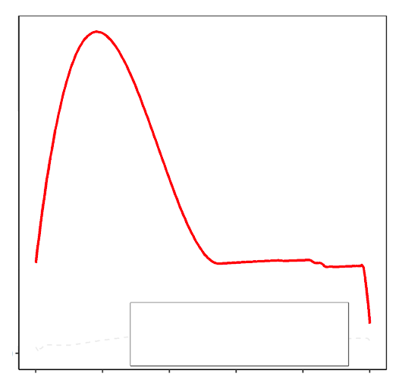
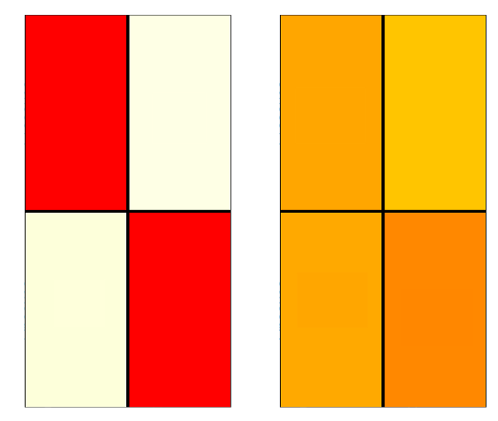
Results | Future Models
AUC-PR Plot
Confusion Matrix for Training Data
Confusion Matrix for Applied Model
1.0
100
0.8
Presence
139
27
Presence
73
423
80
0.6
Predicted
60
Precision
0.4
40
Absence
5
973
Absence
71
577
0.2
20
Training Split (AUC=0.862)
Applied Model (AUC=0.133)
Presence
Absence
Presence
Absence
0
0.0
Observed
0.0
0.2
0.4
0.6
0.8
1.0
Recall
Notes:
##### CLICK TO ANIMATE
Madeleine: We again utilized the AUC-PR score to evaluate the model. This first graph looks different than our current models, largely because of the difficulty of predicting into the future. As you'll recall, AUC-PR is a measure of accuracy of our models. For the training model—the one that uses just current variables—the AUC-PR was .862, or relatively high. That means that, even using just climate variables, the model could predict where mink and otter might be pretty well. However, once we applied that model to the WorldClim climate projections, that AUC-PR score dropped to .133. This low AUC-PR indicates that our model has low transferability, meaning that it cannot easily be applied to a different time period or region.
##### CLICK TO ANIMATE
Here again is that confusion matrix. As you can see, the matrix for the training data looks fairly similar to our current models: it does a pretty good job of predicting presence and absence. The applied model, however, shows a lot more confusion. The model was much less successful at predicting presence and absence, and it has a lot of false positives, meaning that it predicted mink and otter occurrence where there wasn't any.
This highlights several difficulties of projecting habitat suitability models into the future. As WorldClim is a global dataset, the resolution was fairly coarse over our small study area. Additionally, the variables included in our future models did not have high explanatory power in our present-day models. The future model does not include distance to river, which was driving the current model and would likely improve the performance of the future model if it was included. However, this variable is not projected into the future, so we did not utilize it in our future model.

Slide 18
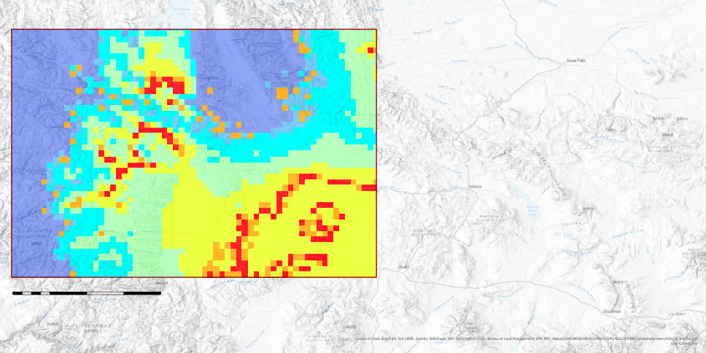
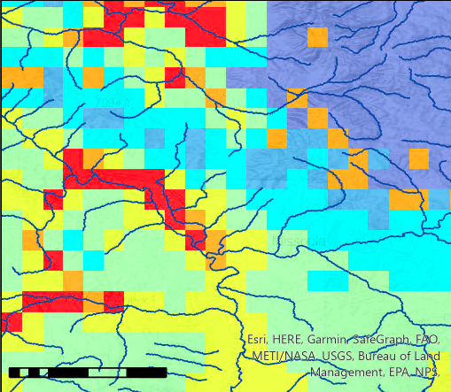
Results | Future Models Probability Map
N
Missoula
0
10
40 km
Habitat Probability
0
25
100 km
0.000 - 0.007
0.063 - 0.091
0.008 - 0.035
0.092 - 0.151
0.036 - 0.045
0.152 - 0.236
Spatial Reference
Name: 1984 Web Mercator Auxiliary Sphere
PCS: 1984 Web Mercator Auxiliary Sphere
0.046 - 0.062
Study Area
Notes:
Madeleine:
In this future probability map, blue indicates low probability and red indicates high probability. In the zoomed in inset map, you can see the future model sometimes predicts suitable habitat to be near rivers, but it also misses some rivers, and the resolution is coarse.
Projecting into the future was a useful exercise, and our workflow could easily be applied and expanded in future projects. However, as you can see, the predicted habitat is very different from our current model, and doesn't track as closely to known otter habitat, such as rivers. The model does predict occurrence close to some rivers, but could be improved by adding more covariates.
------------------------------Image Information Below ------------------------------
Basemap Credit: ArcGIS Pro
Basemap Sources: Esri, HERE, Garmin, SafeGraph, FAO, METI/NASA, USCS, Bureau of Land Management, NPS, Airbus, USGS NGA, CGIAR, NCEAS, NLS, OS, NMA, Geodatastyrelsen, GSA, GSI, and the GIS User Community

Slide 19
Errors and Uncertainties
SMAP (10 km)
SRTM (30 m)
Resolution of predictor variable data
Range from 30 m to 10 km
Bias in sample collection of species occurrence data
Additional important variables for otter and mink habitat
River width, flow rate
Notes:
Madeleine: Inherent to any project, there were several limitations we encountered.
##### CLICK TO ANIMATE
The resolution of the predictor variable data played a role, as our predictor variables had spatial resolutions ranging from 30 meters to 10 kilometers. The lower spatial resolution variables may not be able to explain some of the detailed spatial variability of mink and otter habitat.
##### CLICK TO ANIMATE
Additionally, there is inherent bias in the sample collection of the species occurrence data. Partners collected the data in generally easily accessible areas such as fishing piers, and this may not be completely reflective of mink and otter habitat.
##### CLICK TO ANIMATE
Finally, literature review found additional important explanatory variables for otter and mink habitat that were not available via satellite, such as river width and flow rate. These variables could be useful information to note in future surveys.
------------------------------Image Information Below ------------------------------
•Image 1 Credit: Google Earth Engine
•Image 1 Source: NASA DEVELOP Team
•Image 2 Credit: Google Earth Engine
•Image 2 Source: NASA DEVELOP Team

Slide 20
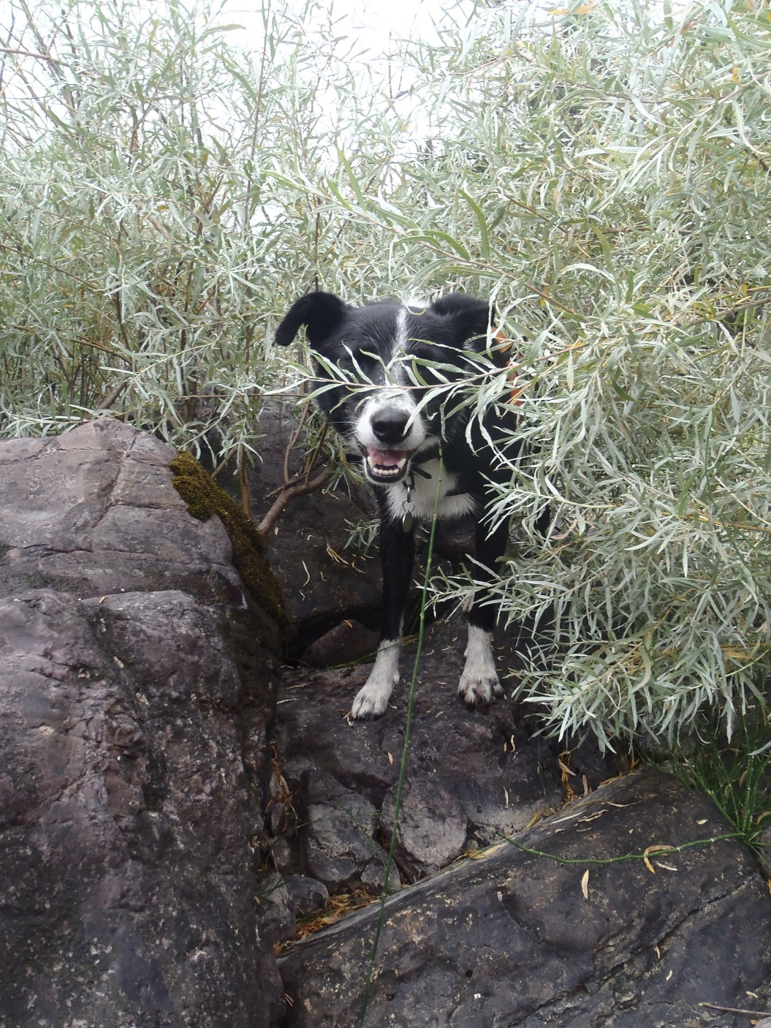
Conclusions
Mink and Otter Habitat
Distance to river is very important for mink and otter habitat.
Satellite Data in Habitat Suitability Models
Satellite data can add variables to habitat suitability models that may not be measurable in the field.
Application
Results can guide survey site selection for WD4C.
Image credit: N. Richards
Notes:
Kergis
Overall, we had several main takeaways from this project.
##### CLICK TO ANIMATE
First, distance to river is an important variable in mink and otter habitat. Additionally, landcover types such as emergent herbaceous wetland play a notable role.
##### CLICK TO ANIMATE
Satellite data can be used to supplement field data in habitat suitability models. This data can add variables that may not be measurable in the field that can improve these habitat suitability models.
##### CLICK TO ANIMATE
The results and methodology developed in this study can guide future survey site selection for Working Dogs for Conservation.
------------------------------Image Information Below ------------------------------
•Image 1 Credit: Ngaio Richards
•Image 1 Source: Provided by partners with permission to use

Slide 21
Future Work
Create a land use land cover classification that can be updated more frequently than NLCD
Include additional hydrologic variables in models
Apply current models to other regions of interest
Notes:
Kergis
##### CLICK TO ANIMATE
To continue work on this project, we would like to include additional hydrologic variables in our current models such as river width and flow rate and improve the general accuracy of our models. We would also like to try including variables such as river distance in our future models even though we do not have projected values for these variables.
##### CLICK TO ANIMATE
As the NLCD is updated every five years, we would also like to incorporate a land use land cover classification that can be updated more frequently than this interval.
##### CLICK TO ANIMATE
Finally, we would like to apply this model to other regions of interest, such as Virginia where Dr. Mark LaGuardia is based.
------------------------------Image Information Below ------------------------------
Clipart provided by PowerPoint

Slide 22
Dr. Allison Howard
University of Georgia
Dr. John Bolten
NASA Goddard Space Flight Center
Dr. Kenton Ross
NASA Langley Research Center
SCIENCE ADVISORS
Partners
Dr. Nicole Ramberg-Pihl
Lead/Fellow, NASA DEVELOP GSFC Node
SPECIAL THANKS
Dr. Ngaio Richards
Forensics and Field Specialist; Working Dogs for Conservation
Dr. Mark LaGuardia
Senior Marine Scientist; Virginia Institute of Marine Science
Dr. Peder Engelstad
Colorado State University
SAHM Point of Contact
Notes:
Kergis
We would like to thank our science advisors: Dr. Allison Howard from the University of Georgia, Dr. John Bolten from NASA Goddard Space Flight Center, and Dr. Kenton Ross from NASA Langley Research Center; our partners: Dr. Ngaio Richards from Working Dogs for Conservation, and Dr. Mark LaGuardia from the Virginia Institute of Marine Science; Peder Engelstad for his extensive help with the SAHM software; and our fellow Nicole Ramberg-Pihl.

Slide 23
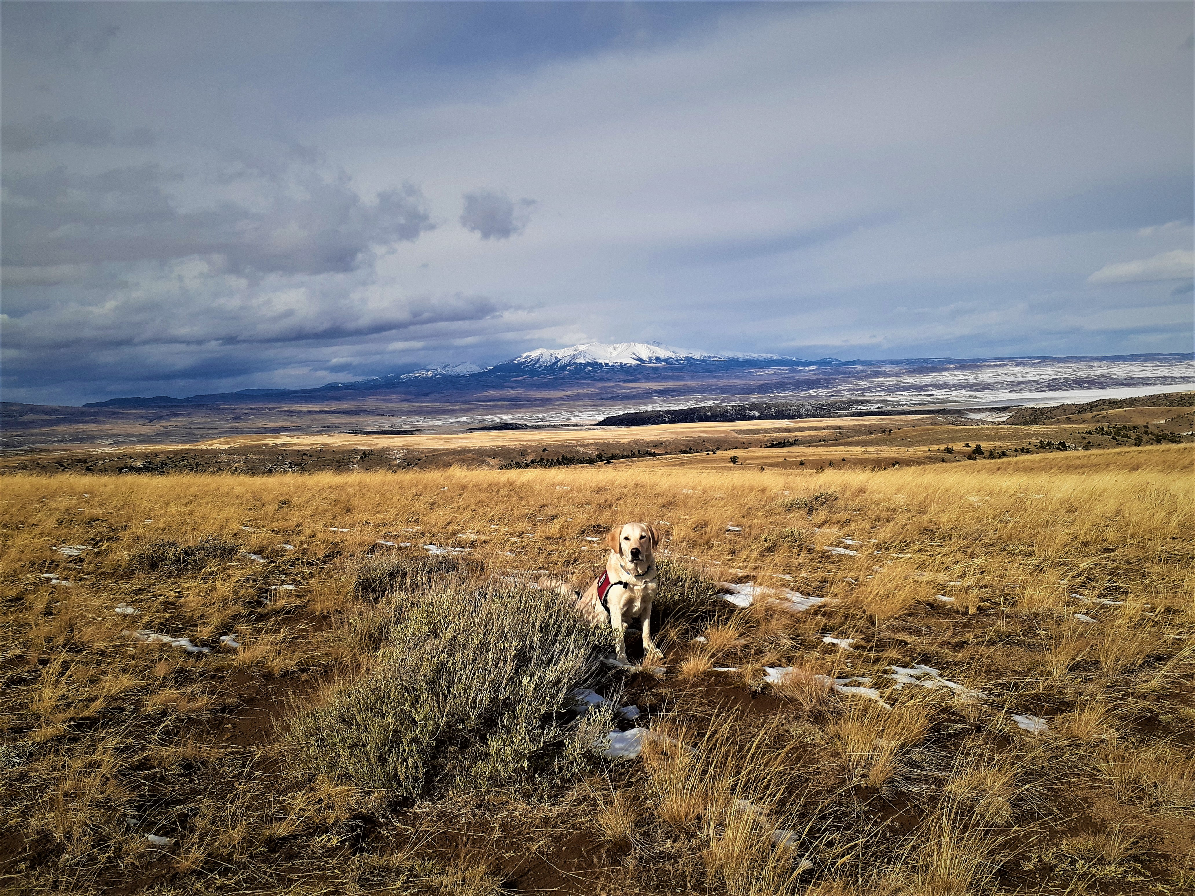
Thank you! Questions?
Image credit: N. Richards
Notes:
Anna
Thank you and we would like to open it up for questions!
------------------------------Image Information Below ------------------------------
•Image Credit: Ngaio Richards
•Image Source: Provided by partners with permission to use

Slide 24
Backup Slide

Slide 25
StoryMap
Notes:
Project team StoryMap created in AGOL to share project outcomes with project partners at Working Dogs for Conservation

