Slide 1
Thailand Agriculture
Monitoring Food Crop Health and Stress Due to Changing Climate for Enriched Agricultural Land Management
Tim Klug (Project Lead)
Arom Boekfah
Chayanit Choomwattana
Komsan Rattanakijsuntorn
Watanyoo Suksa-ngiam
Atipat Wattanuntachai
Notes:
[Tim: Team Introduction ]

Slide 2


Background
Thailand: the world’s largest exporter of rice
Rain-fed agriculture in the northeastern region
Source: Kim Seng
Notes:
[Komsan]
First of all, let me introduce my country a little bit. Thailand is one of the world’s leading producers and exporters of rice. The rice is grown in most areas of the country, with each region’s rice having its own characteristics and needs. Thailand experiences three seasons: cool dry, hot dry, and wet season. These seasons play a significant role in rice cultivation. The rice-planting season usually starts in May when showers signal the end of the dry season. By late November, it is ready to be harvested. While the Central and Western regions are able to grow rice year-round because of an extensive irrigation network, some parts of Thailand can grow rice during only the wet season.
[ Corner rice plant logo designed by DEVELOP participant Komsan Rattanakijsuntorn at NASA MSFC.]
Image source: https://www.flickr.com/photos/captainkimo/6462574499

Slide 3
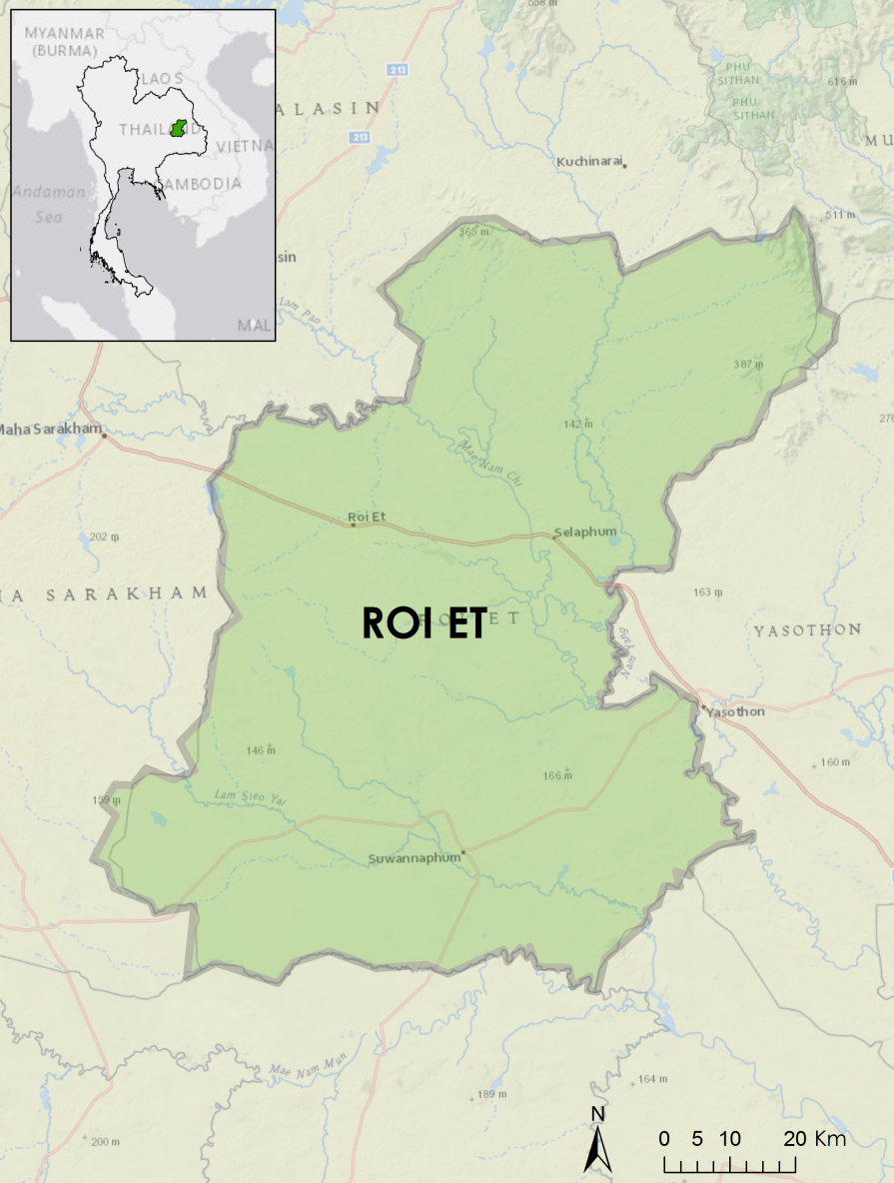
Study Area
Roi Et: a province located in the northeastern Thailand
Roi Et: one of the largest producers of Jasmine rice
Notes:
[Komsan]
Unlike other regions in Thailand, the northeastern region’s rice is dependent on rain instead of irrigation.
Our study area, Roi Et, is a province located on the Mekong basin area in northeastern Thailand. It is well known for producing large quantities of Jasmine rice, which is a premium product that plays an important role in Thai economy.
Image credits: Esri, National Geographic, DeLorme, MapmyIndia, UNEP-WCMC, NASA, ESA, METI, NRCAN, GEBCO, NOAA, increment P Corp., © OpenStreetMap contributors, and the GIS user community.

Slide 4

Community Concerns
Relatively low rice crop yield compared to other areas in the Mekong region
Rice fields in Roi Et primarily rain-fed dependent, growing during the wet season
The rice crops dependent on rain and vulnerable to climate change
[Image needed]
Source: Pisut Konepun
Notes:
[Komsan]
Although Roi Et produces large quantities of Jasmine rice, the rice crop yield is relatively low compared to other areas in the Mekong region.
Since the rice fields in Roi Et are primarily rain-fed, the rice crop yield is vulnerable to climate change.
Image source: https://www.flickr.com/photos/pondpisut/16790458290

Slide 5
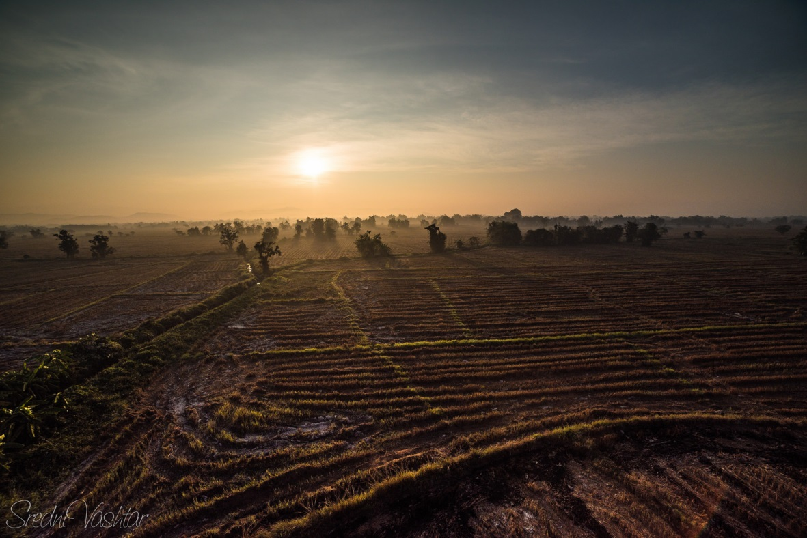
Objectives
Monitor agricultural lands under the change of environmental variables
Improve the understanding of agricultural lands under changing climate patterns
Produce models that can be used to predict rice yields from NASA remote sensing imagery
Source: Diego F. Garcia P.
Notes:
[Tim]
The objectives of this project are to monitor agriculture in Thailand using NASA Earth Observations and to improve understanding of the relationship between crop output and climate.
Agricultural health and stress can be monitored using remote sensing data products such as land cover classifications, land surface temperature, precipitation, and vegetation indices.
Analysis of these products over time can expose patterns and correlations between rice yield and environmental factors such as climate and water availability.
These products can then be compiled into a linear regression model and compared against government reports of rice yield. Such a model could be used to estimate a season’s rice yield based on remotely sensed data.
Image source: https://www.flickr.com/photos/gogeid/17005078875/

Slide 6
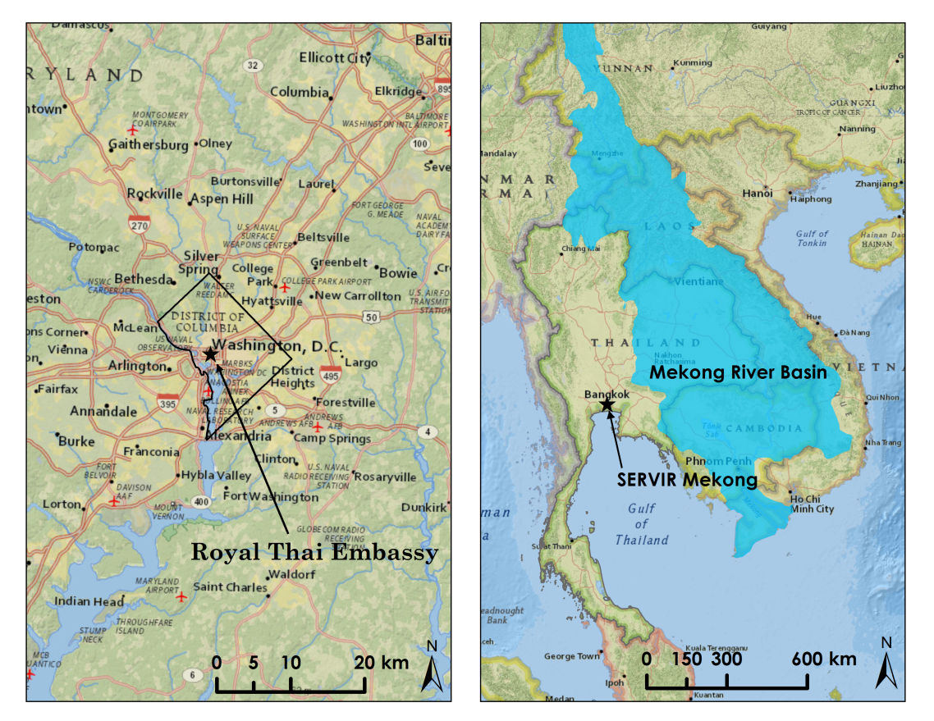
Project Partners
Royal Thai Embassy
SERVIR Mekong
Notes:
[Tim]
This project is partnered with the Royal Thai Embassy and NASA SERVIR Mekong to monitor and improve the understanding of climate change patterns and environmental variables on agricultural lands in Thailand. SERVIR is a joint initiative of NASA and USAID and part of NASA’s Capacity Building Program. SERVIR Hubs are located at Marshall Space Flight Center, in Panama, Kenya, Nepal, and newly in Mekong, Thailand.
Image credits: National Geographic, Esri, DeLorme, HERE, UNEP-WCMC, USGS, NASA, ESA, METI, NRCAN, GEBCO, NOAA, increment P Corp.
Gassert, F., P. Rai, P. Reig, and M. Luck. 2012. “Mekong River Basin Study.” Working Paper. Washington, DC: World Resources Institute.

Slide 7

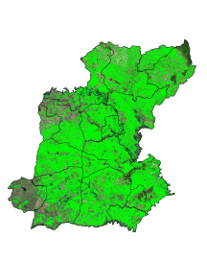


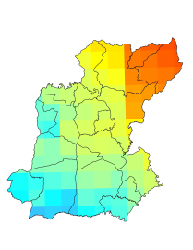
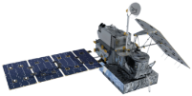
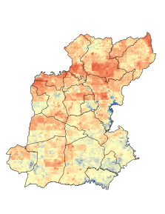
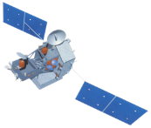
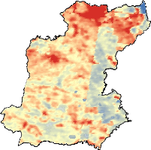
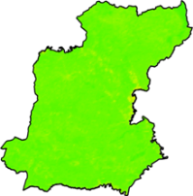
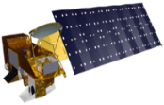
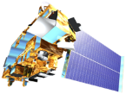
Methodology
Satellites/Sensors
Intermediate Data
End Products
Analysis
Land Cover Classification
Time series maps
Government Rice Yield Data
Landsat 5, 7, 8
TM, ETM+, OLI
Monthly Precipitation (mm)
GPM
Microwave Imager
SDCI
Scaled Drought Condition Index
Prediction Models
Linear Regression
TRMM
Precipitation Radar
Land Surface Temperature
Degrees C
NDVI
Normalized Difference Vegetation Index
Aqua/Terra
MODIS
Notes:
[Tim]
For the methodology of the Thailand Agriculture project
Three main classes of satellites and sensors were used in this project.
First, high resolution sensors from Landsat suite were used to classify rice area.
Second, precipitation radar data from GPM and TRMM were used to average monthly rainfall in part of calculating SDCI.
Third, land surface temperature and NDVI from Aqua/Terra were used in part of calculating SDCI.
Using Land Cover Classification, SDCI, Precipitation, and NDVI , we can develop prediction models.

Slide 8
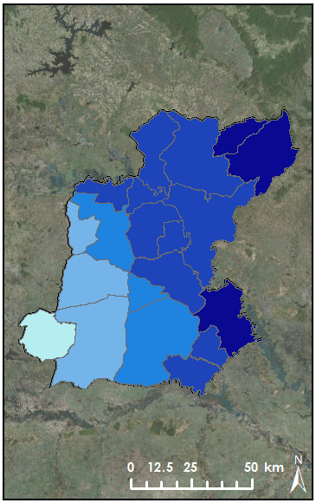

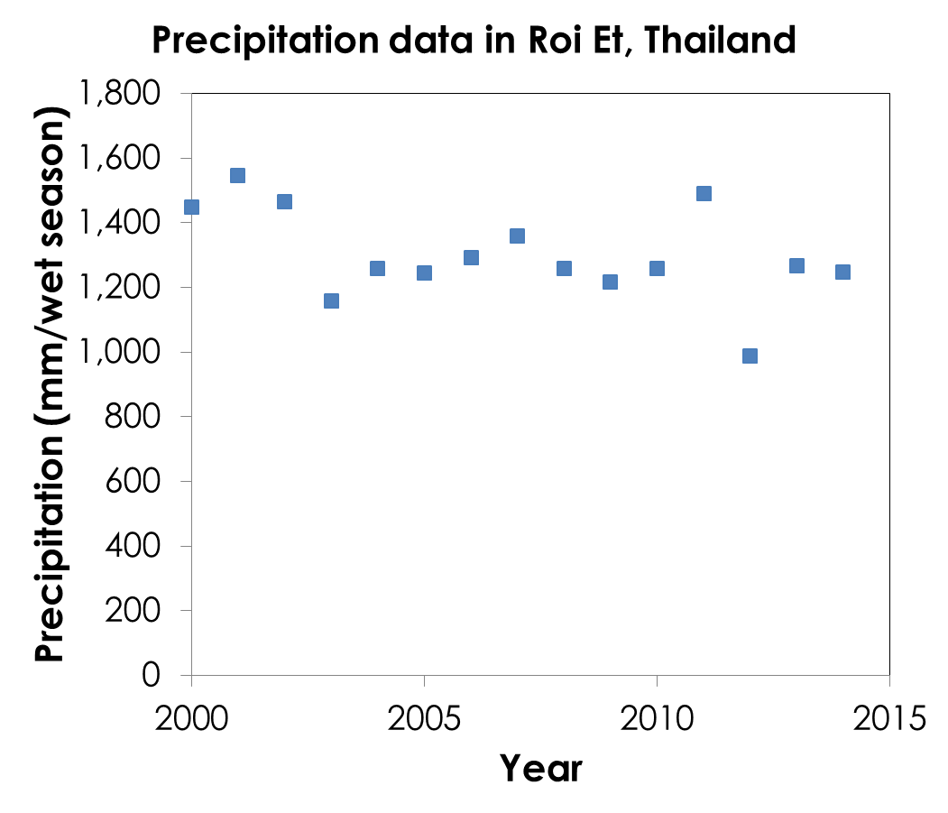
Precipitation Data
Precipitation
(May-Oct 2014)
in mm/wet season
Seasonal precipitation data (wet season)
Year 2000 - 2014
Notes:
[Atipat]
In our project we use monthly precipitation data from TRMM and GPM accumulated for 6 months during the wet season starting from May to October . The graph on the lower left corner shows that there is a fluctuation and slight downward trend between 2000 and 2014. The picture on the right shows seasonal precipitation over Roi Et province in 2014.

Slide 9
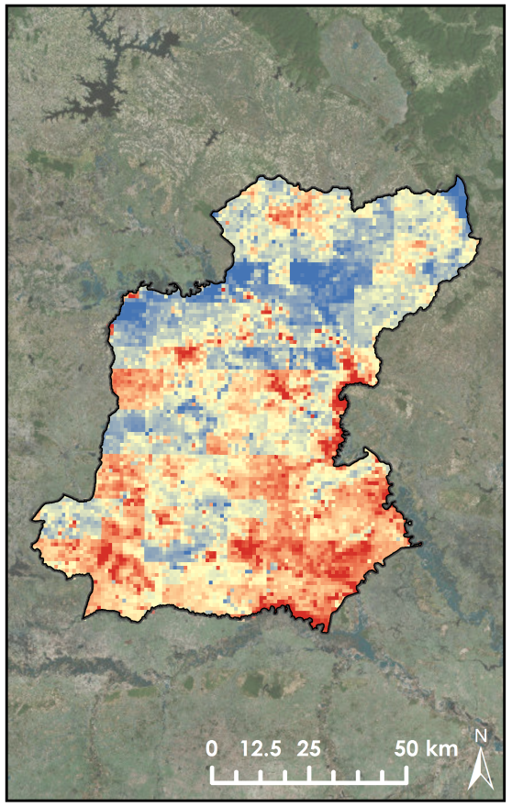
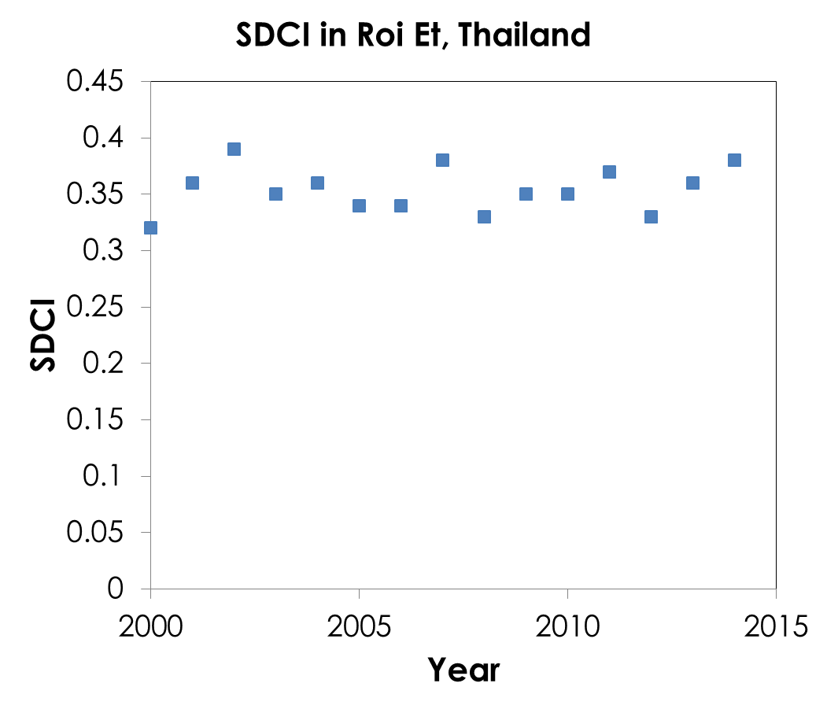
Scaled Drought Condition Index
SDCI (September 2014)
SDCI calculated from NDVI, land surface temperature, and precipitation data
Seasonal SDCI = avg (6 monthly SDCI)
Notes:
[Atipat]
The monthly Scaled Drought Condition Index model is provided by Thailand Disasters team. In our project we use monthly SDCI to calculate 6-month average SDCI during the wet season . The graph indicates that averaged seasonal SDCI over Roi-Et province oscillated between 0.30 and 0.40 during the year 2000 and 2014. However, analysis showed that there is no linear relationship between time and SDCI. The picture on the right shows the geographical distribution of SDCI within Roi Et province.
Image credits: NASA, USGS, Esri, DigitalGlobe, GeoEye, Earthstar Geographics, CNES/Airbus DS, USDA, AEX, Getmapping, Aerogrid, IGN, IGP, swisstopo, and the GIS User Community

Slide 10
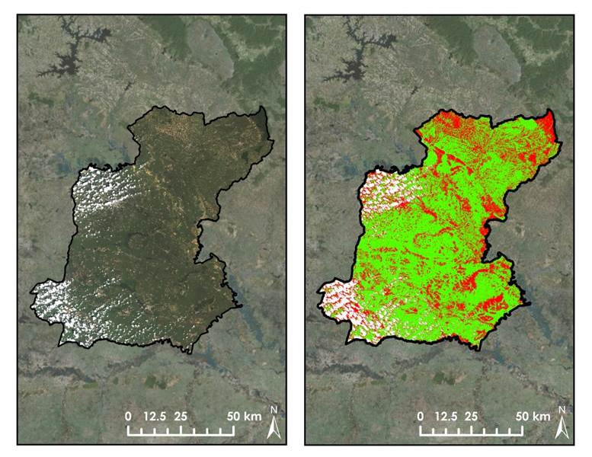
Land Cover Classification
Landsat 8 Imagery (October 2014)
Land Cover Classification
LCC’s from Landsat 5, 7, and 8 imagery during wet season months
Validation with Google Earth
Notes:
[Arom]
We used Landsat imagery that has relatively high spatial resolutions to classify the type of land covers.
The left picture shows an example Landsat image for October 2014 and the right picture shows the possible rice area in green.
Then, we partially validated our classified rice fields using Google Earth and other possible resources.
A supervised land cover classification was conducted over the study area by drawing training sample polygons around known terrain types. Three classes of pixel values were defined: rice fields, non-rice land cover, and cloud cover.
Classifications were partially validated using Google Earth, Esri’s Basemaps, and by comparing the spectral signature of rice across all Landsat band wavelengths to classification results.
Image credits: NASA, USGS, Esri, DigitalGlobe, GeoEye, Earthstar Geographics, CNES/Airbus DS, USDA, AEX, Getmapping, Aerogrid, IGN, IGP, swisstopo, and the GIS User Community

Slide 11
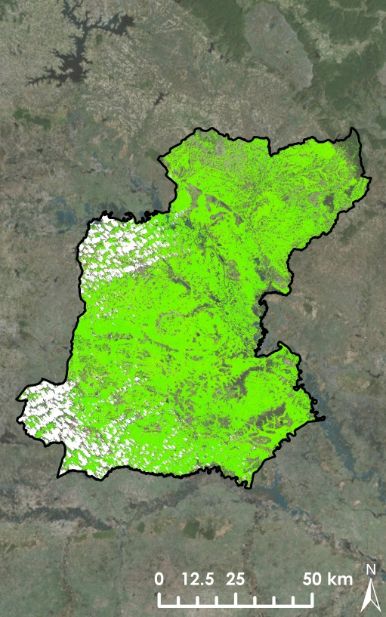
Normalized Difference
Vegetation Index
Landsat: NDVI over classified rice area
NDVI (10/2014)
Mean = 0.663, SD = 0.064
Notes:
[Arom]
With Landsat imagery, we can calculate vegetation indices (NDVI) over the classified rice area. The NDVI runs from -1 to 1. Higher numbers mean healthy vegetation. Finally, we can include the NDVI in our prediction analysis.
Image credits: NASA, USGS, Esri, DigitalGlobe, GeoEye, Earthstar Geographics, CNES/Airbus DS, USDA, AEX, Getmapping, Aerogrid, IGN, IGP, swisstopo, and the GIS User Community

Slide 12
Results
Pearson’s Correlation Table (N = 120)
 | Statistical Rice Yield | Yield per Area | Classified Rice Area | SDCI | NDVI | Precipitation
 | (ton) | (ton/km²) | (km²) |  |  | (mm/wet season)
Statistical Rice Yield | 1
Yield per Area | -0.0002 | 1
Classified Rice Area | 0.750*** | -0.245** | 1
SDCI | 0.095 | -0.099 | 0.252** | 1
NDVI | 0.116 | 0.304*** | -0.040 | -0.238** | 1
Precipitation | -0.114 | -0.220* | -0.013 | 0.347*** | 0.030 | 1
Two tailed significance, * p < 0.05;** p < 0.01; *** p < 0.001
Notes:
[Arom] For the results, we made a correlation matrix that shows relationships between our variables:
We got rice yield and rice yield per area from the National Statistical Office of Thailand.
Classified rice area and NDVI from Landsat.
SDCI and precipitation from other satellite data.
We can see that rice yield is strongly proportional to the rice area.
Yield per area is inversely proportional to classified rice area and precipitation but it is proportional to NDVI.
Rice yield per area slightly depends on NDVI.
Lastly, SDCI is proportional to the precipitation as we expected.

Slide 13
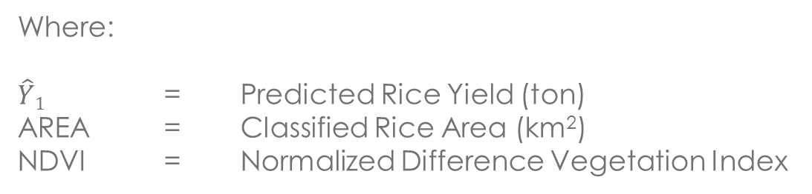
Results(cont.)
Prediction Model:
$${\hat{Y}}_{1}=−116,342+187.91×AREA+213,952 ×NDVI$$
Where,
$\hat{Y}1$ = Predicted Rice Yield (ton)
AREA = Classified Rice Area (km²)
NDVI = Normalized Difference Vegetation Index
Adj R Square = 0.576
The F ratio = 81.918
Significance < 0.001
P-values:
Intercept = 0.017
AREA < 0.001
NDVI = 0.016
Notes:
[Watanyoo]
We then obtain the first regression equation:
$${\hat{Y}}_{1}=−116,342+187.91×AREA+213,952 ×NDVI$$
where
$\hat{Y}1$ is the predicted rice yield (ton)
AREA is the classified rice area (km²)
NDVI is Normalized Difference Vegetation Index
We then conducted multiple-regression analysis for the predicted rice yield (the number of ton). However, only two independent variables provide significant coefficients for the linear regression equation. These variables are Classified Rice Area from Land Cover Classification and NDVI. Hence, we conducted multiple-regression analysis again. The results in this table show that both variables can provide Adjusted R Squared as much as 0.576. We can say that 57.6 % of the variance of predicted rice yield can be explained by both Classified Rice Area and NDVI.
The F ratio is also significant, saying that the variance explained by the regression model is significantly larger than the unexplained variance. Hence we can accept this predicting model.
The coefficients of the intercept, classified rice area, and NDVI are all significant, the p-values are less than 0.05 .

Slide 14
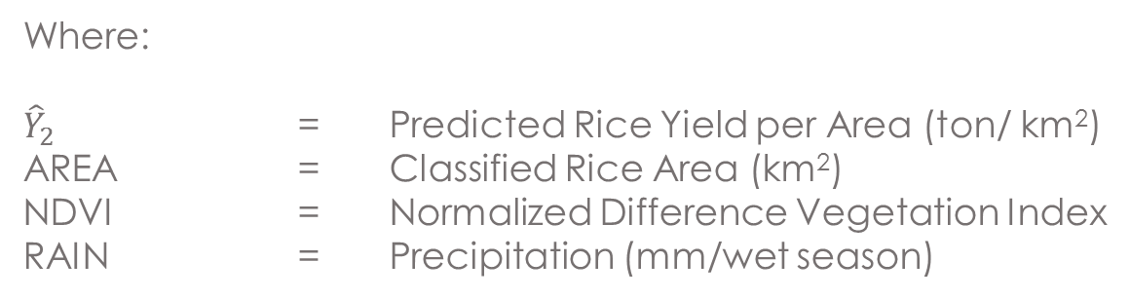
Results(cont.)
Prediction Model:
${\hat{Y}}_{2}=121.05−0.07×AREA+491.03 ×NDVI−0.08×RAIN$
Where,
${\hat{Y}}_{2}$ = Predicted Rice Yield per Area (ton/ km²)
AREA = Classified Rice Area (km²)
NDVI = Normalized Difference Vegetation Index
RAIN = Precipitation (mm/wet season)
Adj R Square = 0.180
The F ratio = 9.719
Significance < 0.001
P-values:
Intercept = 0.140
AREA = 0.005
NDVI < 0.001
RAIN = 0.006
Notes:
[Watanyoo]
We then obtain this second regression equation
${\hat{Y}}_{2}=121.05−0.07×AREA+491.03 ×NDVI−0.08×RAIN$
where
${\hat{Y}}_{2}$is the predicted yield per area in ton per km²
AREA is the classified rice area km²
NDVI is Normalized Difference Vegetation Index
RAIN is Precipitation in mm in wet season
We proceeded into the second prediction equation. The number of ton per squared kilometer was used as the dependent variable. Only three variables can be used to predict yield per area: the number of ton per square kilometers. These variables are Classified Rice Area, NDVI, and Precipitation. However, the number of adjusted R square is equal to 0.18 and this number is small. We can say that 18% of the variance of the predicted number of ton per square kilometer can be explained by both Classified Rice Area and NDVI.
The F ratio is also significant, suggesting that the variance explained by the regression model is significantly larger than the unexplained variance. Hence we can accept this predicting model.
The coefficients of classified rice area, NDVI, and precipitation are all significant, the p-values are less than 0.05. However, classified rice area and precipitation have a negative relationship with the yield per area.

Slide 15
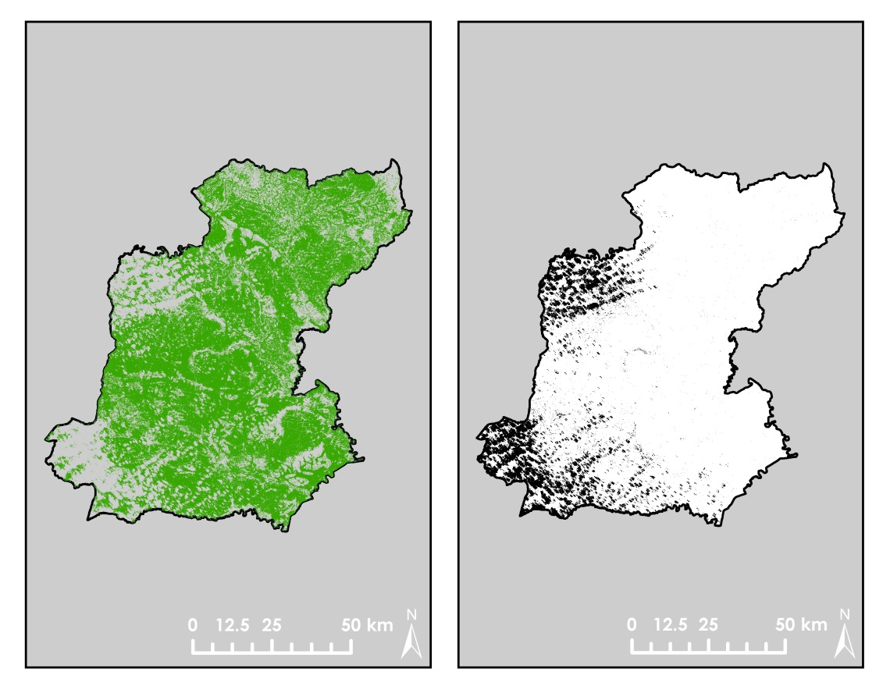
Limitations and Recommendations
Rice Classification
Cloud Mask
Wet season cloud cover
Inconsistent rice growth stages
Landsat 7 gap error
Limited validation resources
Notes:
[Chayanit]
As for limitations and recommendations, major errors and uncertainty in this project come from the nature of using satellite remote sensing to monitor wet season in a tropical region. The availability of cloud-free images was minimal and temporally inconsistent season to season.
Moreover, the onset of the gap error of Landsat 7 images reduced our model’s ability to consistently compare rice crop land cover between seasons.
These problems also limited our ability to perform a multiple regression analysis. Instead, we have prepared a model to compare these data against government reports that can be used to predict rice yield in the future.
Finally, imagery and classifications was validated by many Google Earth and Google Street View images. However, due to the large size of the study area and resolution of imagery, minor errors in validation is likely to occur .

Slide 16
Conclusions
Prediction models of rice yield and yield per area: classified rice area, NDVI, and precipitation
Models for facilitating effective land management strategies to enhance rice production in the future
Notes:
[Chayanit]
In conclusion, we used classified rice area, Precipitation, and NDVI to predict rice yield and rice yield per area in Roi Et, Thailand.
We are also able to adopt effective decision land management strategies to enhance rice production in the future.

Slide 17
Advisors
Dr. Jeffrey Luvall (NASA at National Space Science and Technology Center)
Dr. Robert Griffin (University of Alabama in Huntsville)
Dr. Kenton Ross (NASA Langley Research Center)
Partners
Bunyakiat Raksaphaeng(Royal Thai Embassy)
Dr. Bill Crosson (SERVIR Mekong)
Dr. Peter Cutter (SERVIR Mekong)
Special thanks to NASA DEVELOP Thailand Disasters Team for SDCI calculations.
Notes:
[Chayanit]
We would like to thank our advisors: Dr. Jeffrey Luvall and Dr. Robert Griffin who provided us the helpful direction, suggestion, and guideline.
Also, we would like to thank our partners, Bunyakiat Raksaphaeng from Royal Thai Embassy, Dr. Bill Crosson and Dr. Peter Cutter from SERVIR Mekong. These people provided us tremendous support in advising our project .
Special thanks to NASA Develop Thailand Disasters Team for SDCI index calculations.

Slide 18

Thailand Agriculture Team
(Left to Right): Komsan Rattanakijsuntorn, Watanyoo Suksa-ngiam, Tim Klug, Atipat Wattanuntachai, Arom Boekfah, and Chayanit Choomwattana

