Slide 1
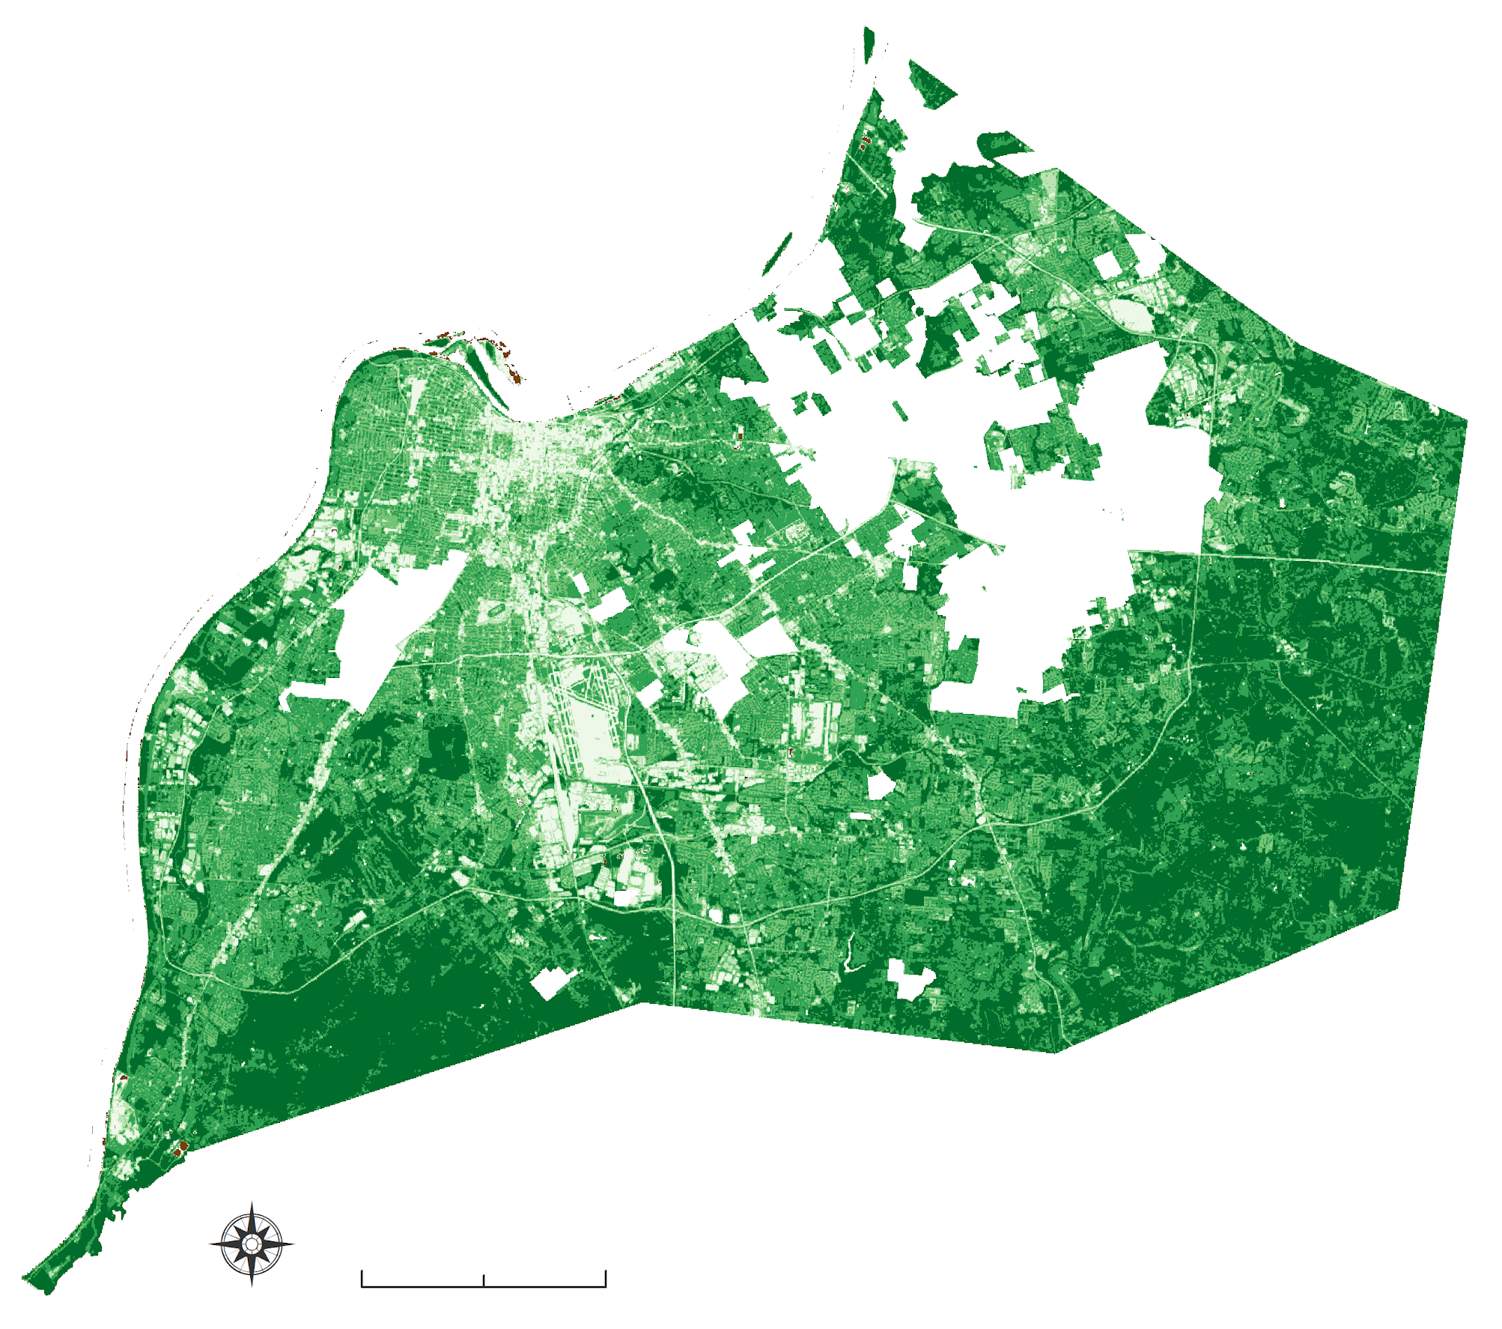
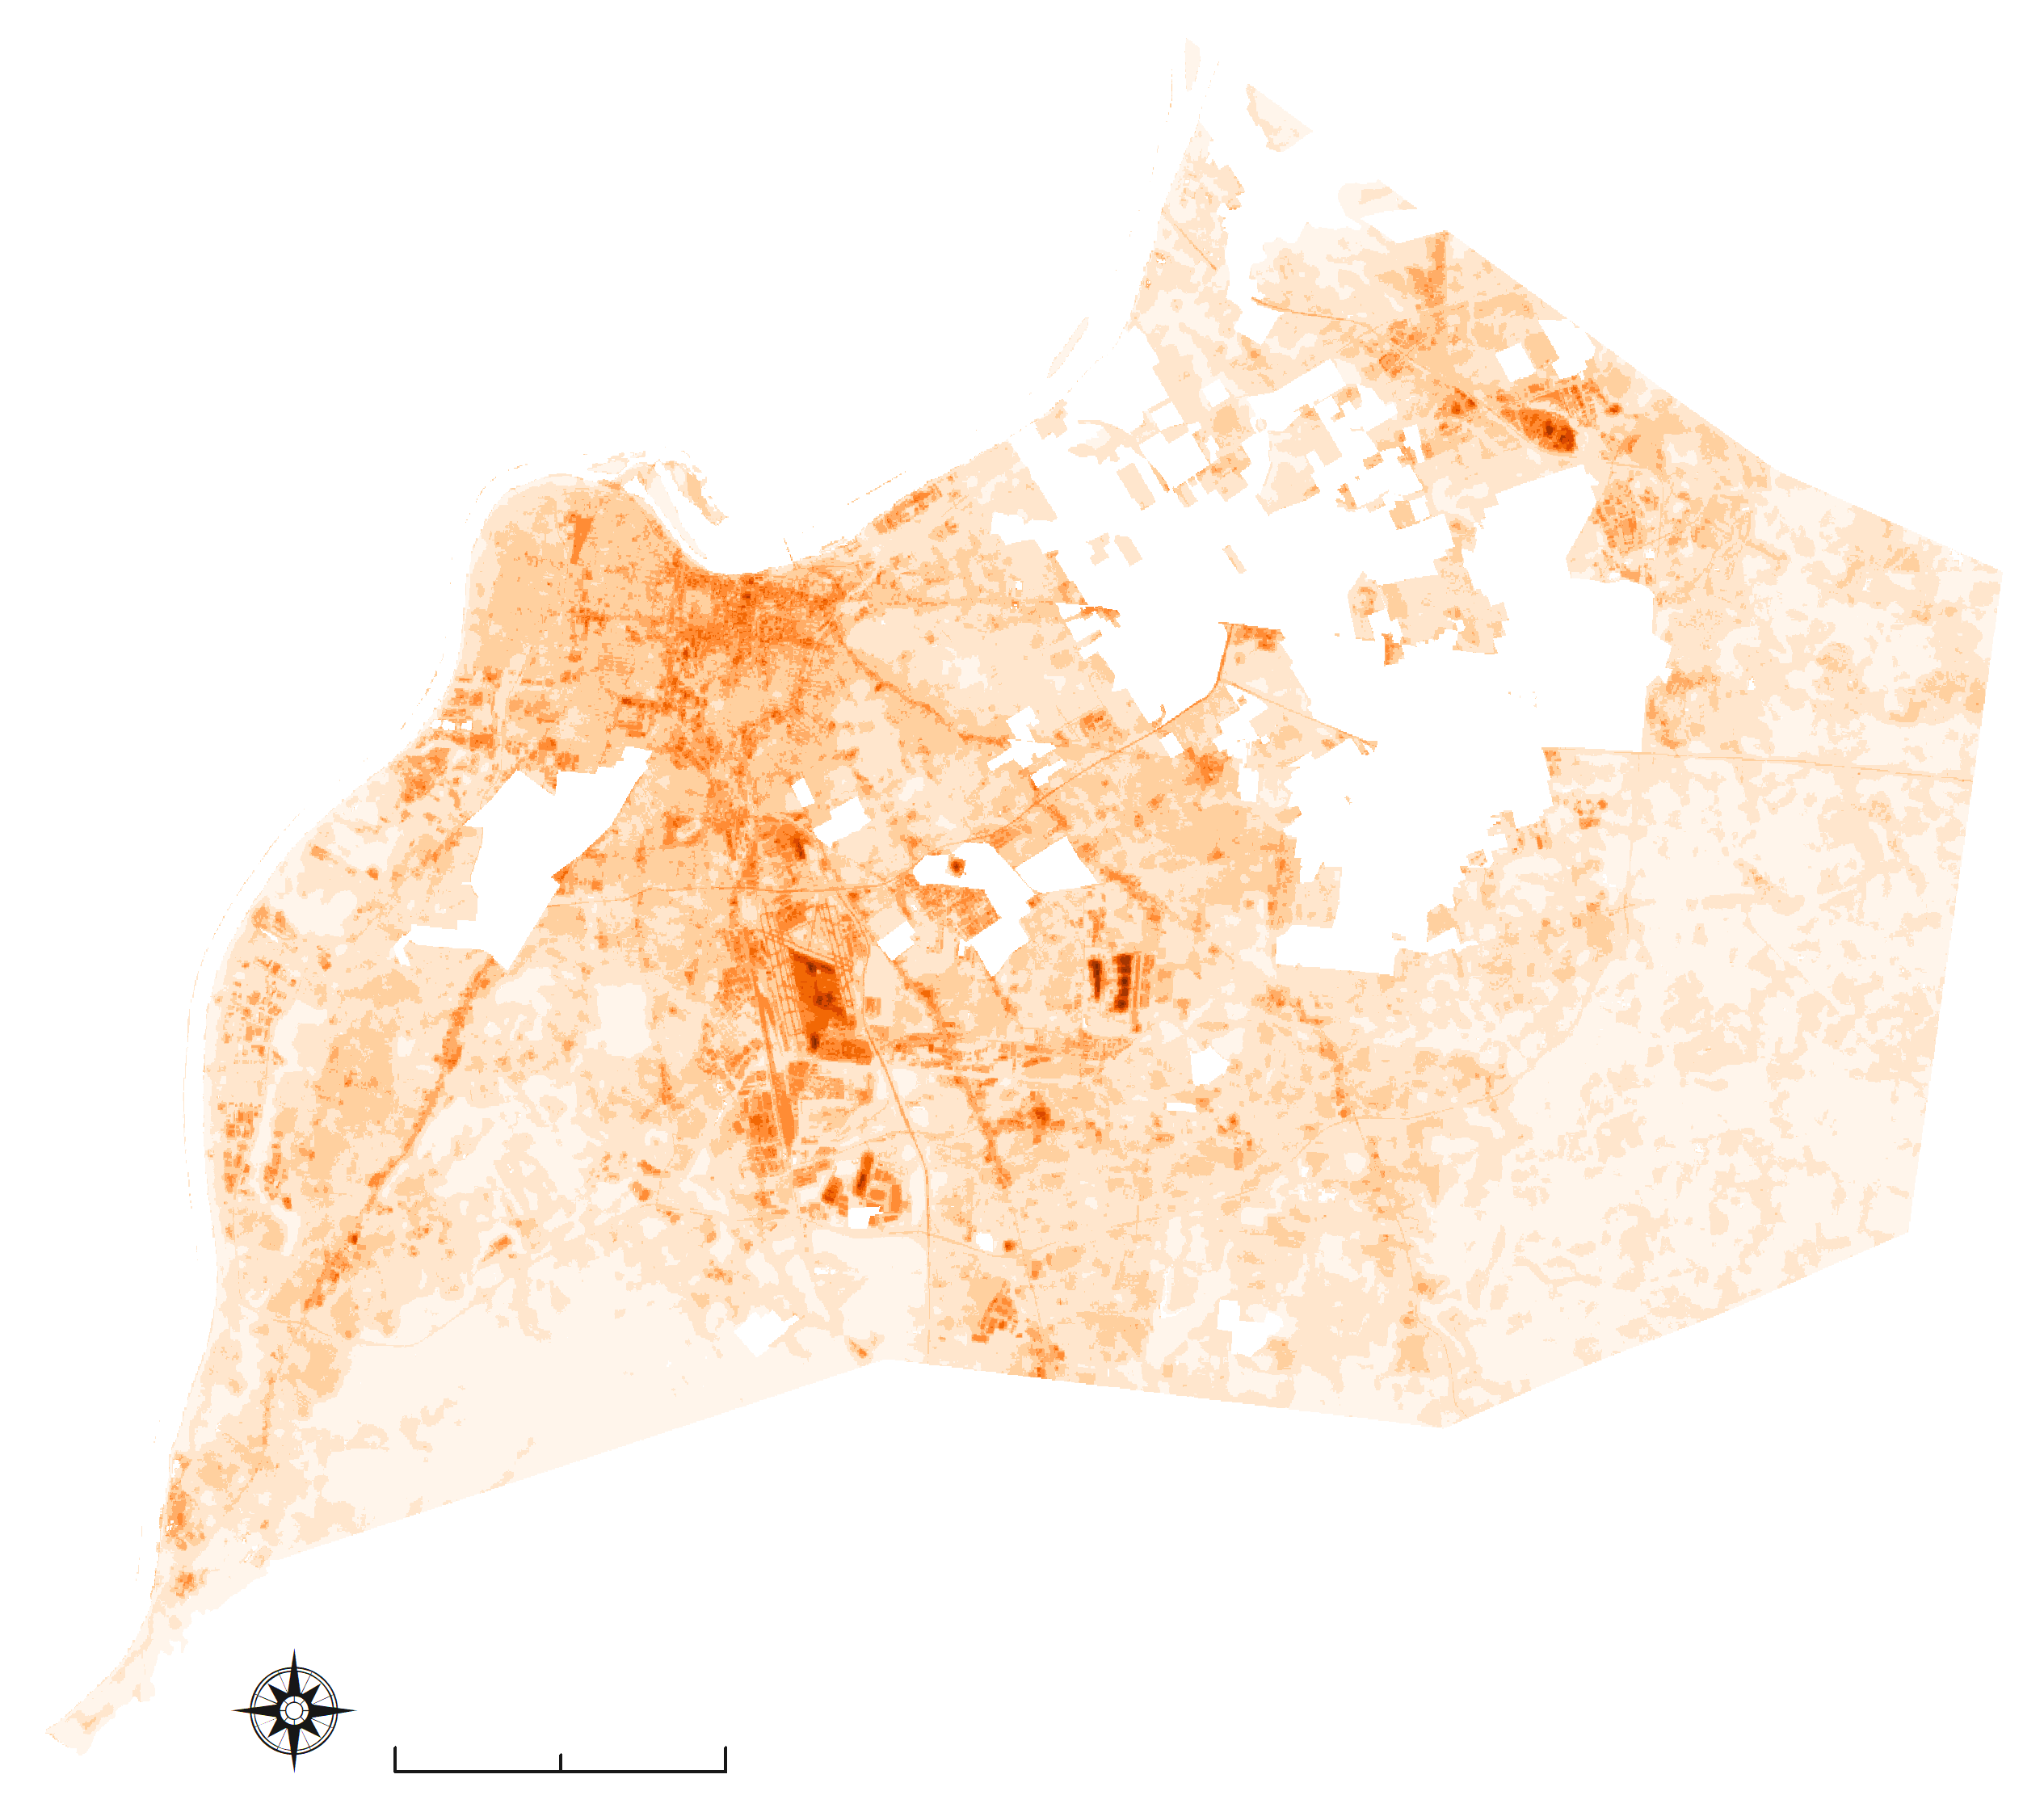
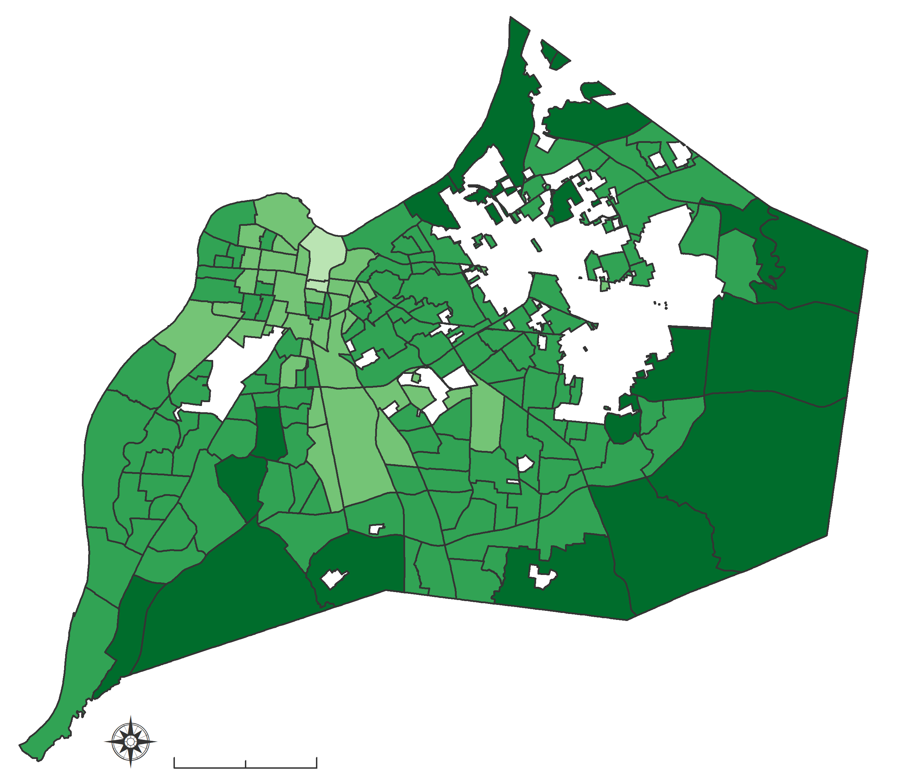
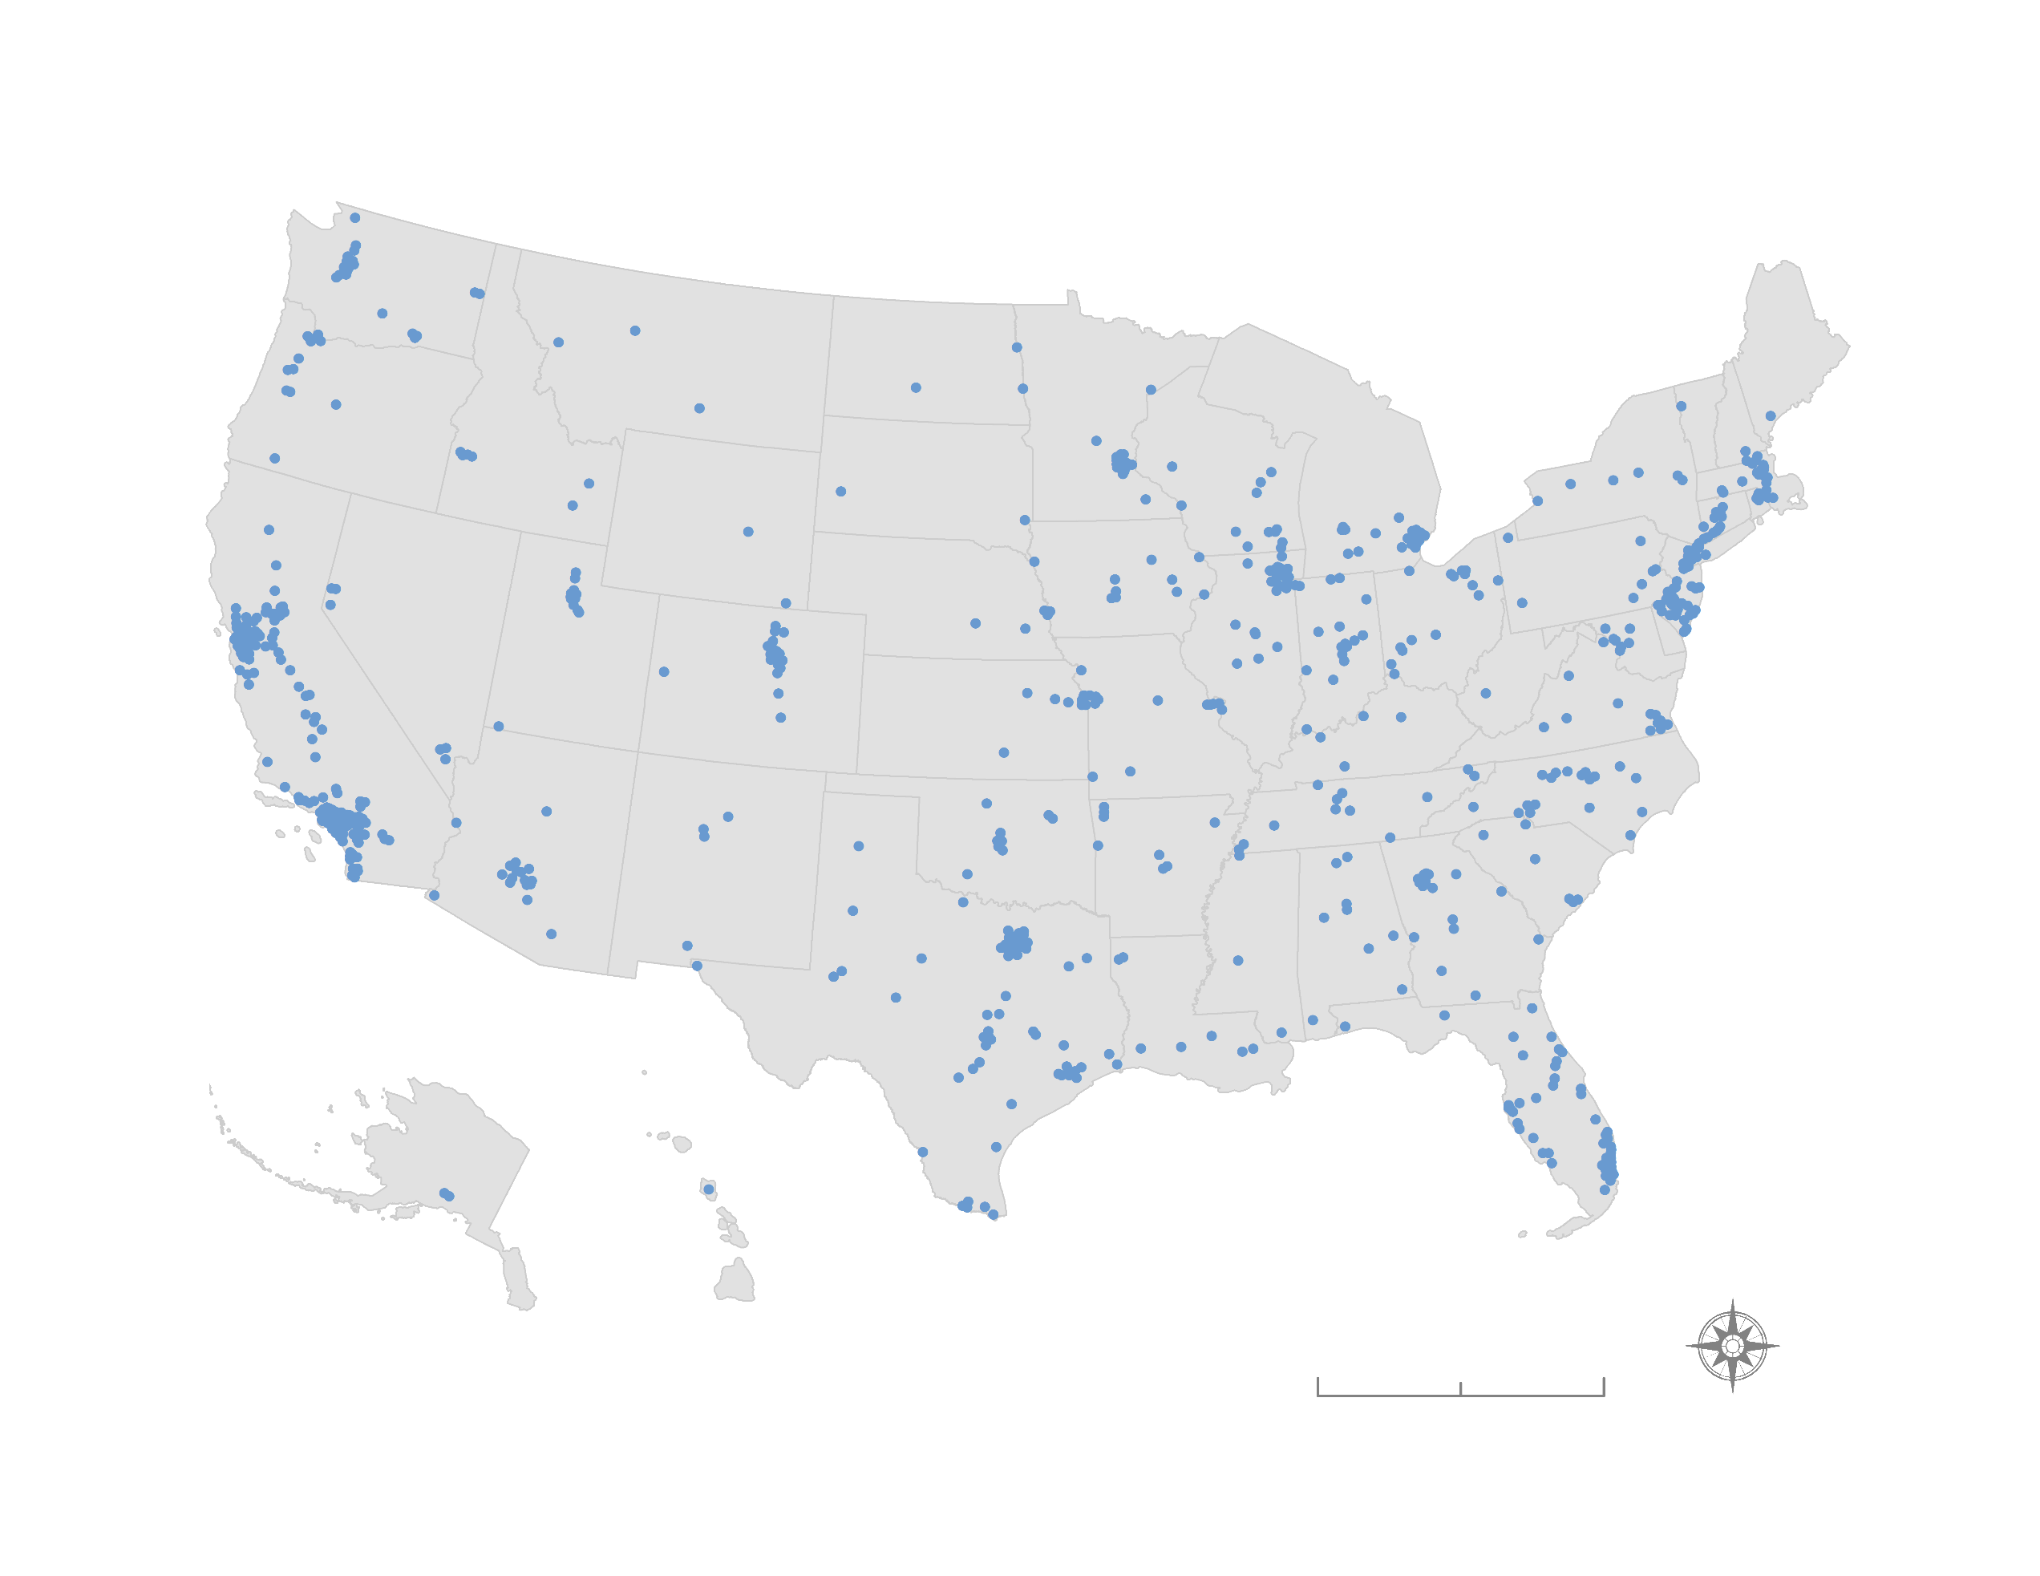
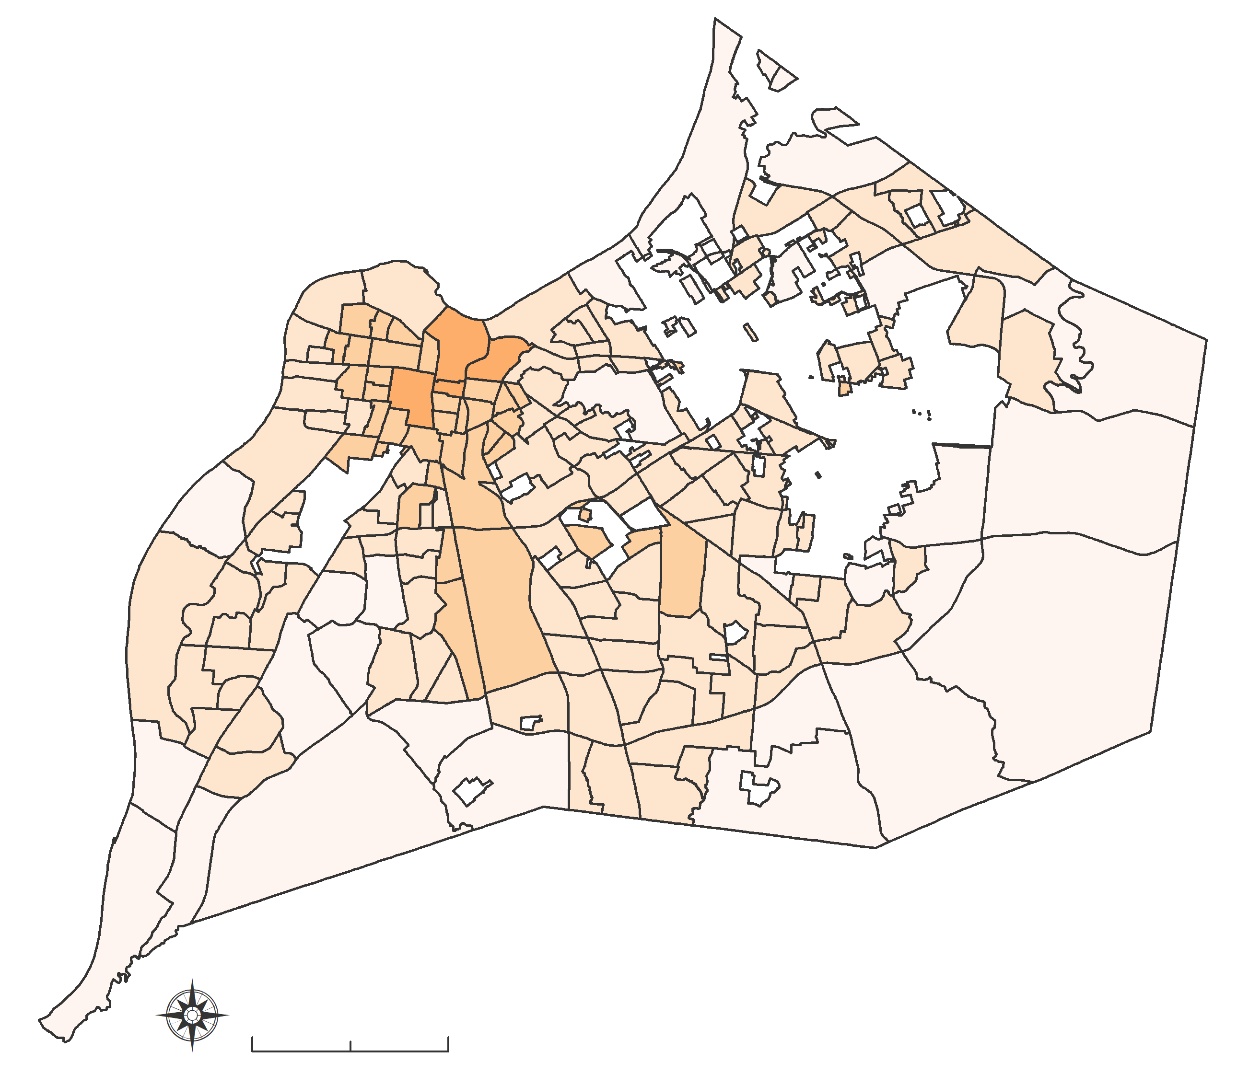
Utilizing NASA Earth Observations to Assess the Overall Greenness and Land Surface Temperature of Cities in Relation to Public Health Outcomes
Abstract
Objectives
Louisville Urban Development
Greenness and land surface temperature (LST) have been extensively correlated to urban public health. Chronic diseases such as diabetes, asthma, and cardiovascular illnesses have been linked to regions of high LST and areas lacking urban green spaces. One of our partners, the University of Louisville Envirome Institute, champions the importance of urban green spaces. Their research has pioneered efforts in increasing the area and accessibility of urban parks and greenspaces as a way to improve public health and combat environmental inequality. Louisville, Kentucky, is currently working to plant and manage urban trees. Our team used NASA Landsat 8 Operational Land Imager (OLI) and Thermal Infrared Sensor (TIRS) imagery to calculate the Normalized Difference Vegetation Index (NDVI) in Louisville at the census tract level and automated the process for use in other cities. The New York University School of Medicine’s City Health Dashboard displays public health metrics across 500 US cities and will use our methods to complete the NDVI analysis for all of these locations plus an additional 293 cities they are adding to their dashboard in the near future. Our NDVI and LST calculations will allow cites across the US to make informed decisions about reducing environmental inequality by focusing on areas with low NDVI and high LST.
Create a replicable method for calculating greenness and land surface temperature metrics
Highlight areas that would benefit from revegetation and heat mitigation initiatives
Support enhanced decision-making and urban planning at the city level
Earth Observations & Methodology
Near Infrared and Red bands
$$NDVI=\frac{\text{NIR}\text{ - }\text{Red}}{\text{NIR}\text{ + }\text{Red}}$$
Emissivity
Study Area
NDVI
Kentucky
Louisville
Brightness Temperature
200mi
10mi
Landsat 8 OLI/TIRS
(2013 to 2019)
LST
Results
PLACEHOLDER FOR RESULTS IMAGES.
DO NOT PLACE IMAGES IN A BOX.
73 - 80
80 - 87
87 - 94
94 - 101
101 - 108
108 - 115
115 - 122
122 - 129
129 - 136
Land Surface Temperature (°F)
0 – 0.2
0.2 – 0.4
0.4 – 0.6
0.6 – 0.8
0.8 – 1.0
Normalized Difference Vegetation Index
5mi
5mi
Seattle, WA
5mi
Louisville, KY
10mi
10mi
793 US Cities
(2019)
500mi
Phoenix, AZ
5mi
Conclusions
Project Partners
Despite Louisville’s efforts to expand green spaces within the city, from 2013 to 2019 the city-wide average NDVI remained relatively constant while LST increased by 4 degrees Fahrenheit.
This method will be used to produce data for future years, helping Louisville and other cities in a variety of climatic regions plan and monitor progress toward urban greenness and heat mitigation goals.
These findings could also be useful for investigating causes of health inequity in Louisville and in cities across the nation.
City Health Dashboard
University of Louisville Envirome Institute
Acknowledgements
NASA DEVELOP
Dr. David Hondula – DEVELOP Science Advisor, Arizona State University
Dr. Kenton Ross – DEVELOP Science Advisor, NASA Langley Research Center
Crystal Wespestad – DEVELOP Fellow
Lance Watkins – PhD candidate & Former DEVELOPer, Arizona State University
University of Louisville Envirome Institute
Dr. Ted Smith – Director of the Center for Healthy Air, Water and Soil
City Health Dashboard
Dr. Ben Spoer – Manager, Data and Analytics
Miriam Gofine – Senior Data Analyst
Peggy Hsieh – Research Analyst
Taylor Lampe – Data Analyst
Leena Abbas – Associate Research Analyst
Team Members
Naji Rizig
Project Lead
Julie Sorfleet
Camille Canivet
Hannah Besso
Arizona – Tempe | Fall 2019

