Slide 1
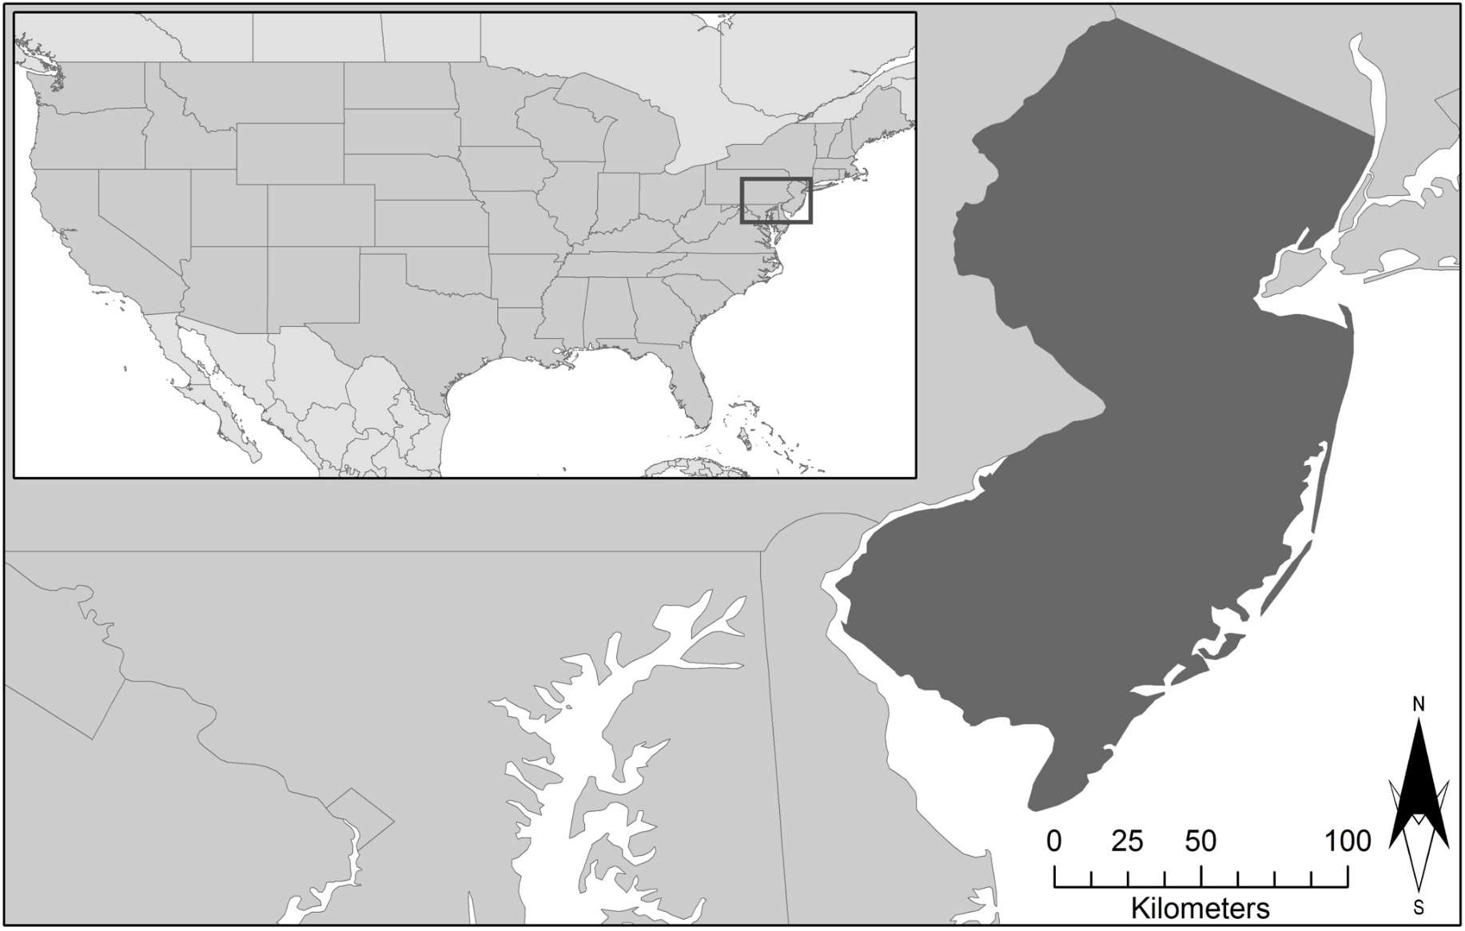
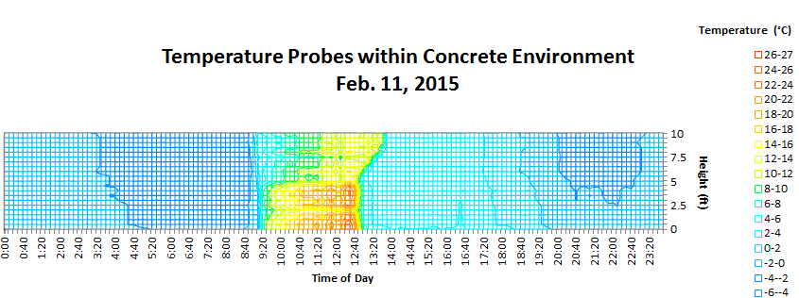
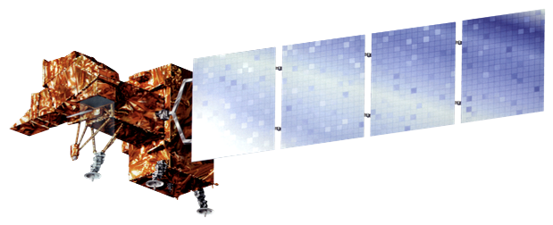
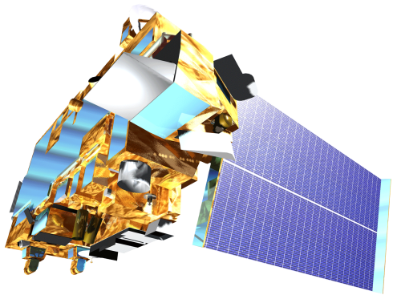
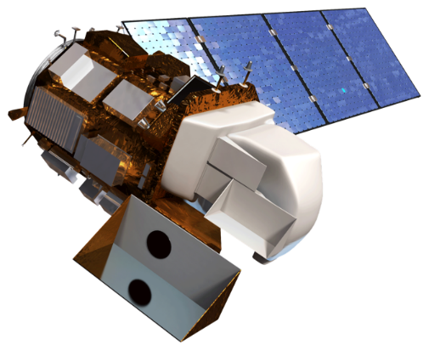
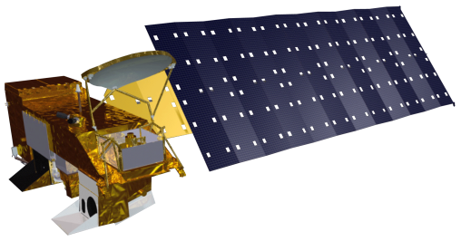
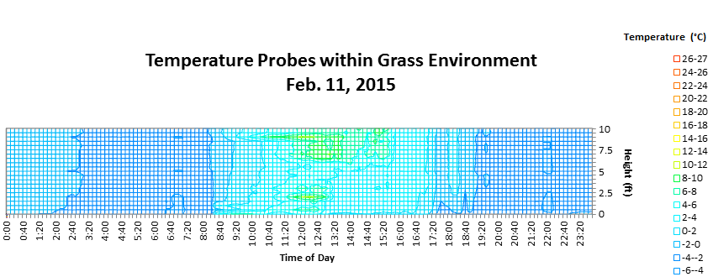
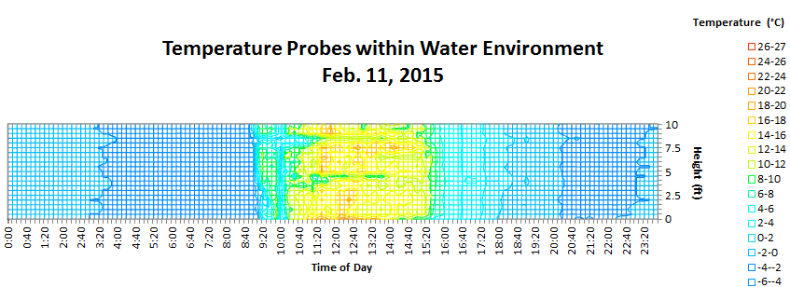
New Jersey Health & Air Quality
Modeling near surface air temperature profiles of complex urban systems based on land surface properties and correlating on-site and satellite data to better understand temperature profiles in urban mircoclimates
Maryam Karimi (Project Lead), Jerrod Lessel
CUNY, The International Research Institute for Climate and Society
Abstract
Objectives
Urbanization has created an increase in what is known as the urban heat island (UHI) effect. The excess heat in these urban environments has led to a rise in heat related illnesses and mortality. There is a little understanding of urban microclimate. To better understand the impact of different land surfaces in an urban system a quantitative study was completed, analyzing on-site locations representing varied microclimates and analyzing satellite imagery of Glassboro Township of New Jersey. A correlation is being developed to be able to obtain the surface temperature and near surface air temperature of a microclimate based on the environmental factors. The on-site study revealed that varied environments (grass, water, and concrete) result in different temperature profiles within the range of 0 to 3 meters. Results indicate; grass was the coolest environment, water was the most temperate, and concrete had the highest peak temperatures. The satellite study revealed that increased levels of urbanization, with no methods of heat mitigation, resulted in higher average temperatures. Both the on-site and satellite data confirm that the increased urbanization leads to increased temperatures within microclimates.
To improve understanding of the effect of the Urban Heat Island (UHI) on the near surface air temperature where humans interact
Mitigating the UHI effects in urban microclimate’s
Develop a correlation identifying the role of surface features on near surface air temperature for new perspectives in urban design for developers and city management
Collect field measurements of temperature profiles
Analyze temperature profiles for specific microclimates
Compare field measurements against remotely sensed data
Study Area
Methodology
New Jersey
Glassboro
Remote sensing images forthcoming in
final draft
Study Area: Glassboro, NJ (Rowan University Campus)
Study Period: September – November 2015
Earth Observations
The sensors were spaced at half foot increments on a 10 foot pvc pole. By doing so, the probes would be able to obtain data at varying heights above the land surface. The temperature probe setup was then employed within varying microclimates located on the Rowan University campus. The chosen microclimates exhibited three different surface types: mainly grass surface, area with a water surface, and a predominantly concrete surface.
The near surface air temperature measurements were gathered from the Onset Temperature Pendants. Each pendant was set to acquire data every 10 minutes. Each of the HOBO Pendant Temp/Light sensors had the ability to measure and record the light intensity at each height above the ground surface. The light intensity at each height was measured in units of lux.
More methods forthcoming in
final draft
Landsat 7
Terra
Landsat 8
Aqua
Conclusions
Results
Using results from this and future work, different constants could be calculated in order to complete an empirical formula.
However, even after a formula is completed there may still be errors due to changes in conditions from those that were used to find the formula’s constants, therefore offset tables should be included in the formulas to correct for this.
Future work on this project could include analysis of varied environments with hourly weather records kept, which would then be statistically analyzed to find an average air temperature offset.
This will likely need to be found by calculating the difference in air temperatures recorded by weather reports and that of the temperature pendants, and then comparing that data to that of known environmental factors that can change air temperature (i.e. cloudy day, rain, heavy winds, etc).
More conclusions forthcoming in final draft.
Examples of daily temperature profiles taken on February 11, 2015.
More results forthcoming in final draft.
Team Members
Project Partners
Maryam Karimi
Jerrod Lessel
Bureau of Environmental Surveillance and Policy, New York City Department of Health and Mental Hygiene
We Act for Environmental Justice
Columbia University, Mailman School of Public Health
Consortium for Climate Risk in the Urban Northeast (CCRUN)
Photo Forthcoming
In Final Draft
Acknowledgements
Thank you very much to Dr. Pietro Ceccato for being an outstanding advisor on this project. We also wish to thank the project partners and collaborators.

