Slide 1
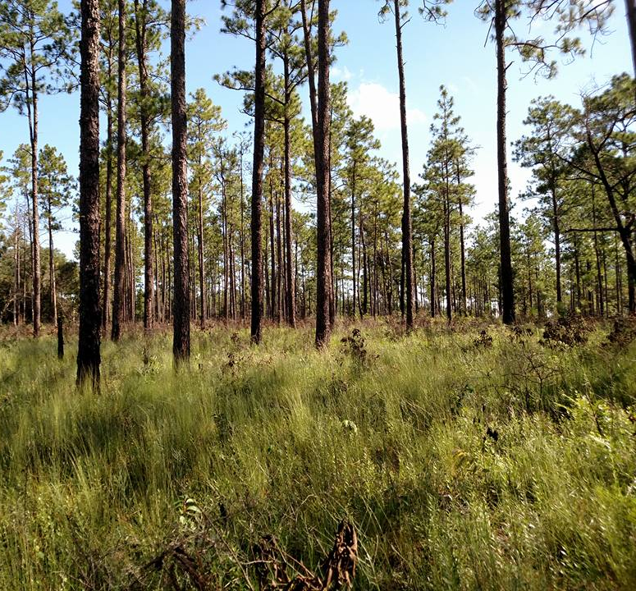
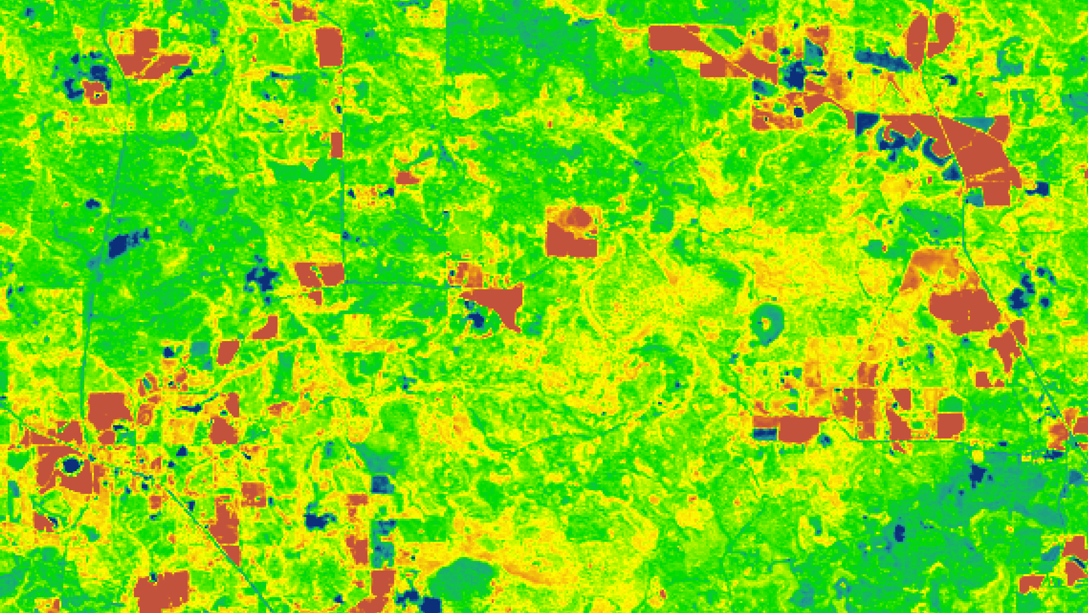
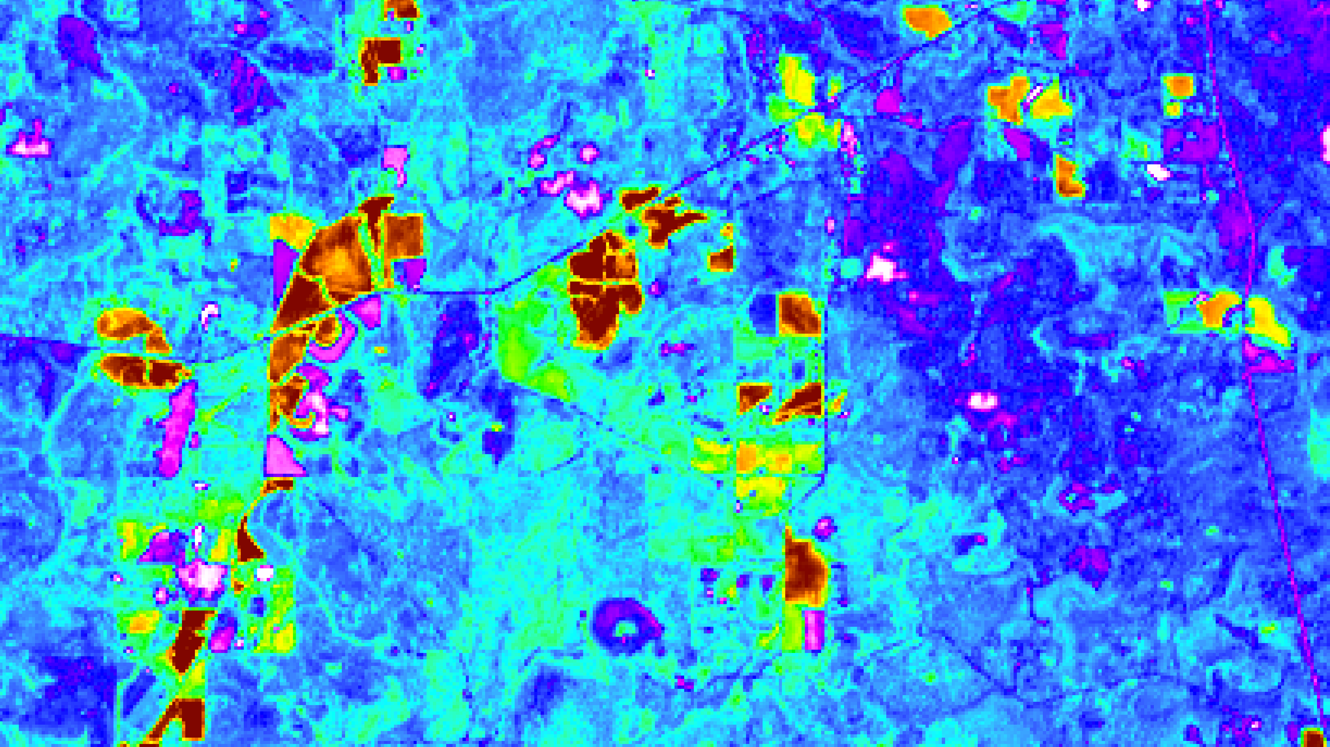
CONECUH NATIONAL FOREST ECOLOGICAL FORECASTING
Evaluating Current and Potential Habitats for the Endangered Gopher Frog by Assessing Wetland Environments and Land Cover Trends in Conecuh National Forest
Kara Cassano
Jacob Goff
Sierra Laltrello
Stefan Perritano
Alabama – Marshall | Summer 2019
Notes:
-Hi! We are the Conecuh National Forest Ecological Forecasting team.
-(Each team member introduces themselves)
-And the goal of our project is to evaluate and model the habitat of the gopher frog in Conecuh National Forest.
-----------------------Image Information Below-----------------------
Image Credit: Conecuh N.F. Ecological Forecasting Team

Slide 2
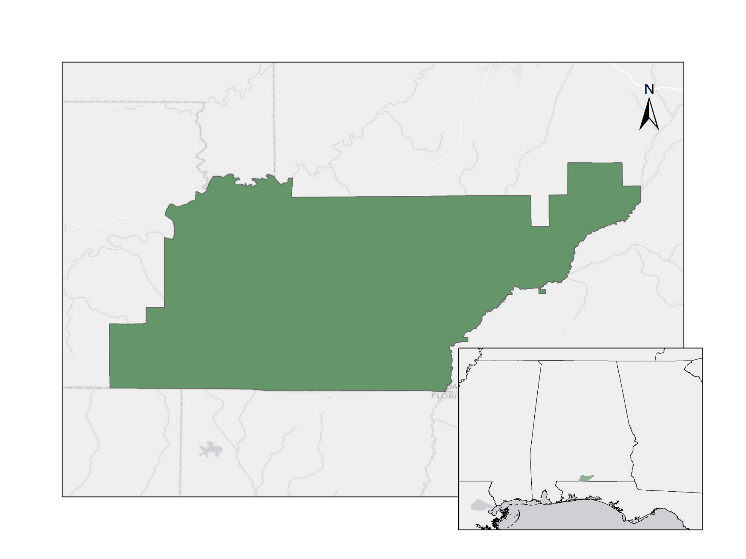
Introduction
Study Area: Conecuh National Forest
Study Period:
2016 through 2019
Environment
Southern long leaf pine
5% remaining of original extent
Alabama
Conecuh National Forest
Mississippi
Georgia
Florida
Alabama
Florida
0
2.5
5
10
15
20
Kilometers
Notes:
-Conecuh National Forest is located in Southern Alabama near the Alabama/Florida border.
-The optimal environment for the gopher frog is a southern long leaf pine environment.
-This type of forest has decreased in natural range by 95%!
-----------------------Image Information Below-----------------------
Image Credit: Conecuh N.F. Ecological Forecasting Team

Slide 3
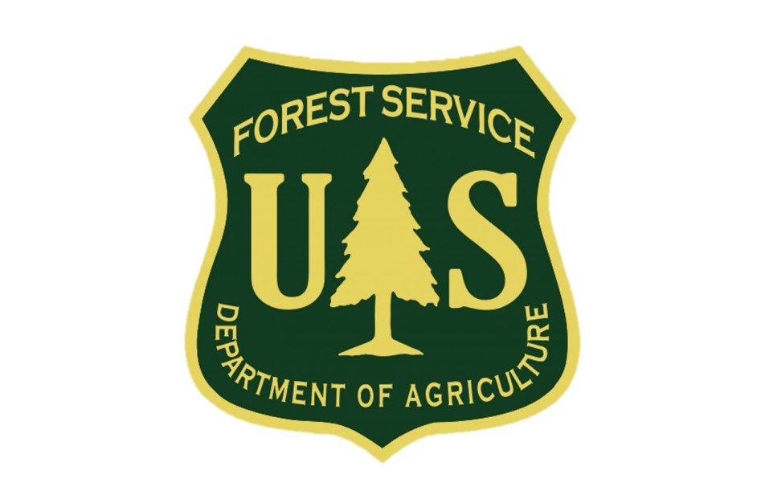
Partners
Alabama Department of Conservation of Natural Resources (ADCNR)
US Forest Service, Conecuh National Forest
Mississippi State University, College of Forest Resources
Notes:
-These partners represent the Gopher Frog Working Group; a collection of groups that have come together to pull resources to better help the declining gopher frog.
-We were fortunate enough to meet some of our partners on a field study trip to Conecuh National Forest!
-----------------------Image Information Below-----------------------
Image Credit: Conecuh National Forest Ecological Forecasting Team

Slide 4
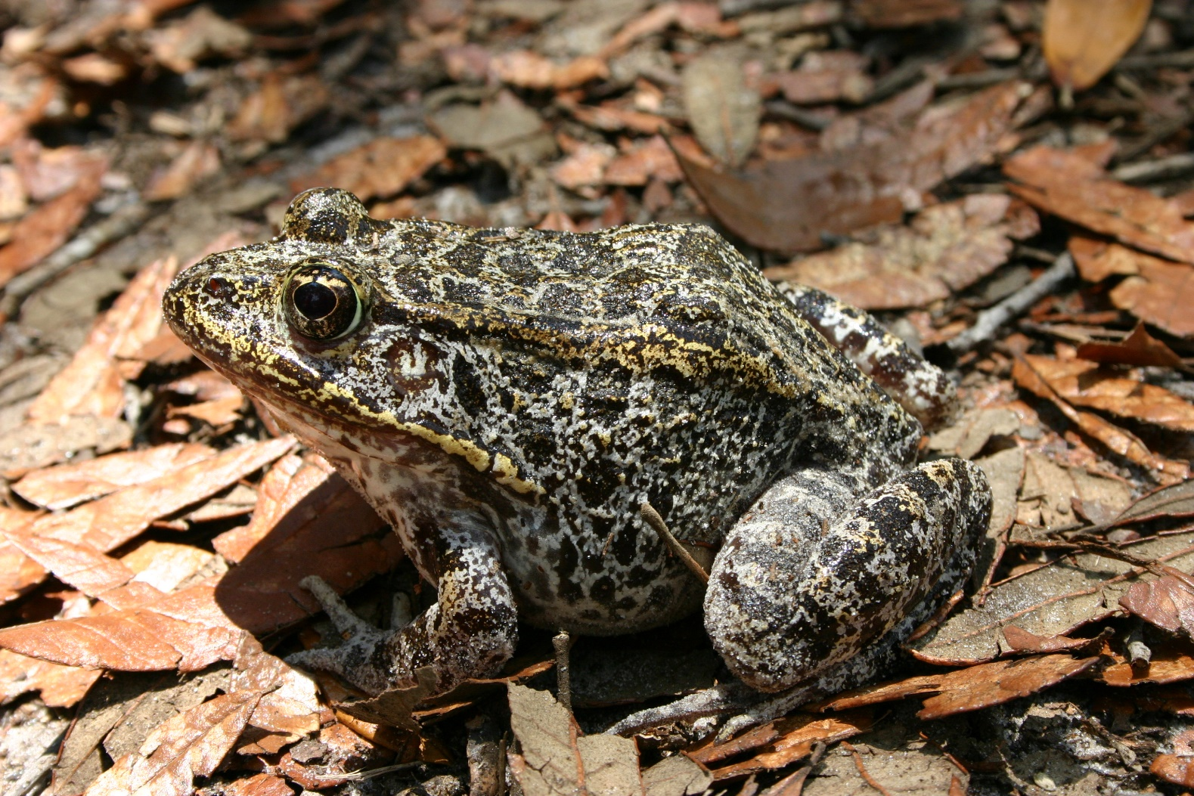
Community Concerns
Amphibians are most susceptible to environmental changes.
Their greatest threats are
Loss/modification of habitat
Fire suppression
Wetland degradation
The loss of amphibians in an area signals the onset of forthcoming ecosystem change.
Image Credit: Eric Soehren
Notes:
-The gopher frog is approaching endangerment, with only 5 breeding ponds left in the State of Alabama.
-This species is native to our study area, with 2 of the breeding ponds in Alabama located in Conecuh National Forest.
-Environmental degradation due to fire suppression and other anthropogenic forcings are the main threats.
-The gopher frog will likely be extinct within 100 years without human intervention according to the Florida Fish and Wildlife Conservation Commission.
-----------------------Image Information Below-----------------------
Image Credit: Mark Bailey (U.S. Forest Service)

Slide 5
Objectives
Predict
Determine
Gauge
Gauge previous and current changes in wetlands and land cover in Conecuh National Forest
Predict and analyze seasonal changes in gopher frog habitat
Determine areas optimal for future habitat development
Image Credit: Mark Bailey
Notes:
-We subdivided the project into three stages.
-Our first segment was focused on gauging the current environment that the gopher frog utilizes in Conecuh National Forest.
-Then, we predicted seasonal changes that can have an impact on the gopher frog habitat.
-Finally, we determined which areas would be most optimal for gopher frog habitat creation.
-Segway into next slide/section by saying:
We will complete these objectives through our end products using NASA and ESA Earth observations which Kara will now touch on..
-----------------------Image Information Below-----------------------
Image Credit: Mark Bailey (U.S. Forest Service)

Slide 6
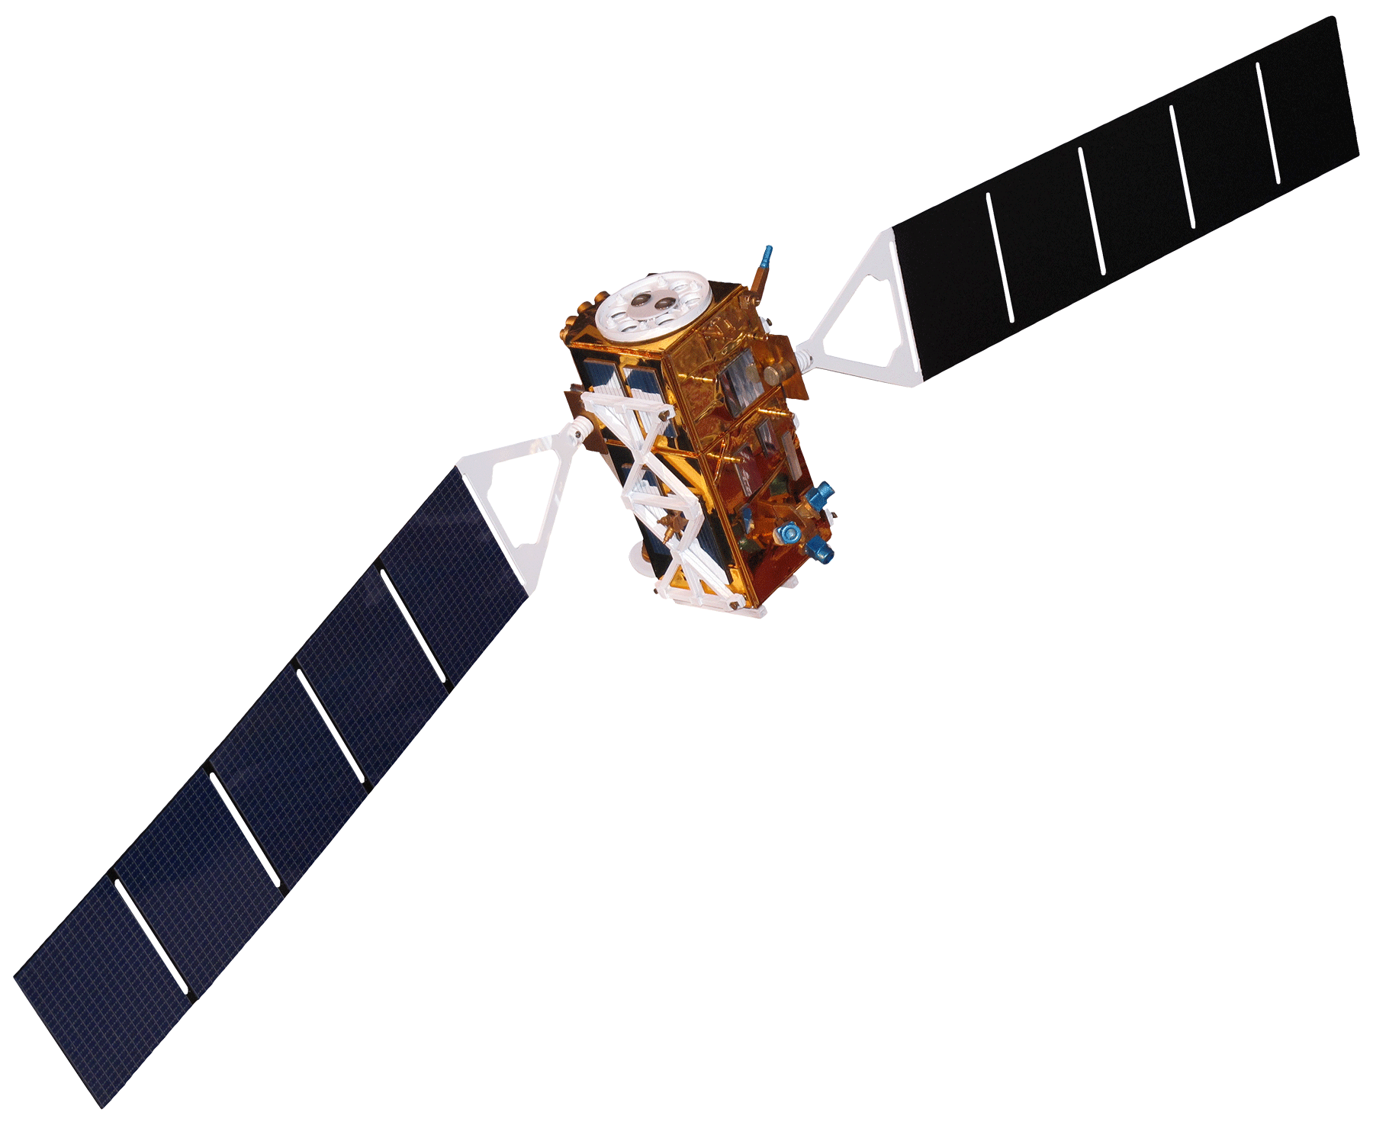
Satellites & Sensors Used
Landsat 5
Thematic Mapper (TM)
Landsat 8
Operational
Land Imager (OLI)
Shuttle Radar
Topography Mission (SRTM)
Sentinel-1 C-band
Synthetic Aperture Radar
(C-SAR)
Image Credit: NASA
Notes:
-We will be using four different sensors for our project, such as Landsat 5 Thematic Mapper to look at previous land cover within the forest, and Landsat 8 Operational Land Imager for surface reflectance values which we used to assess vegetation density.
-Additionally we used the Shuttle Radar Topography Mission, or SRTM, for habitat suitability modelling. And lastly we used Sentinel-1 C-band synthetic aperture radar which is a sensor from the European Space Agency and we used backscatter values to map wetland inundation in Conecuh National Forest.
-----------------------Image Information Below-----------------------
Image Credit: NASA
Image Source: http://www.devpedia.developexchange.com/dp/index.php?title=List_of_Satellite_Pictures

Slide 7
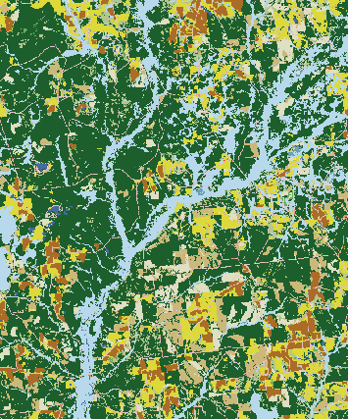
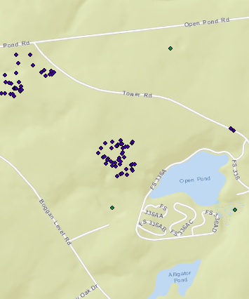
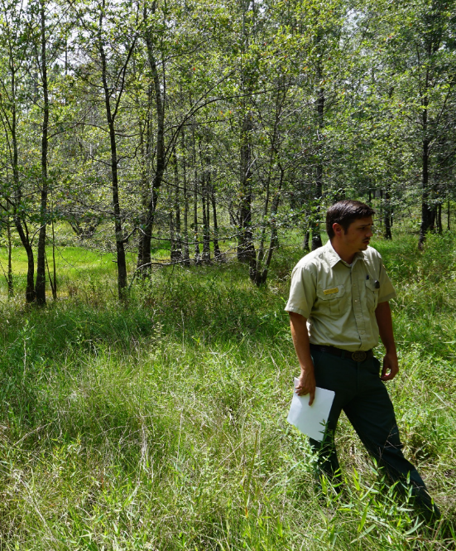
Ancillary Datasets
NLCD
Existing Forest Service Data
In Situ Data
Notes:
-The team used several ancillary datasets to conduct our analysis, one of them being the 2016 version of the National Land Cover Dataset for habitat suitability modelling.
-Our project partners at the Forest Service provided us with data they had previously collected, such as locations of gopher frog breeding ponds and tortoise burrows which are a proxy used for gopher frog movement as they also use the burrows for their habitat.
-We were lucky enough to have to opportunity recently to visit Conecuh National Forest and collect our own in-situ data for validation, which was point data related to our wetland classification map.
-----------------------Image Information Below-----------------------
Image Credit:
NLCD obtained from https://www.mrlc.gov/data?f%5B0%5D=category%3Aland%20cover&f%5B1%5D=category%3Aland %20cover&f%5B2%5D=region%3Aconus&f%5B3%5D=year%3A2016
Derek Colbert (National Forest Service)
Conecuh National Forest Ecological Forecasting Team
Image Source
NLCD: https://www.mrlc.gov/data?f%5B0%5D=category%3Aland%20cover&f%5B1%5D=category%3Aland %20cover&f%5B2%5D=region%3Aconus&f%5B3%5D=year%3A2016

Slide 8
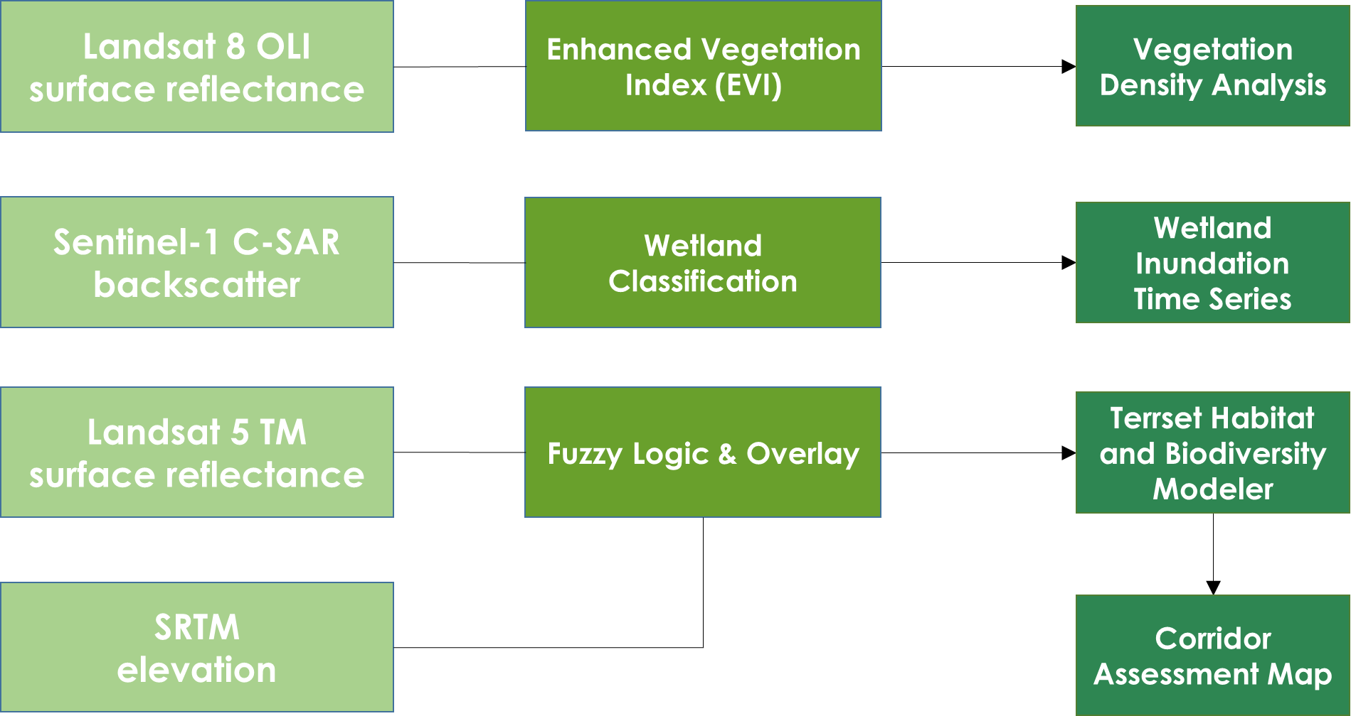
Methodology
Notes:
So this is a graphic depicting an overview of our workflow.
-Using surface reflectance from Landsat 8, we created a vegetation density analysis using the Enhanced Vegetation Index, EVI, which is similar to NDVI but corrects for a few atmospheric conditions and is more sensitive in areas with dense vegetation such as Conecuh.
-Using Sentinel-1 backscatter, we created a series of wetland classification maps from 2016 to 2019 which allowed for us to make a time series to see the changes between the seasons and years.
-Using Landsat 5 and SRTM, and fuzzy logic and overlay we assessed the habitat suitability for the gopher frog.

Slide 9
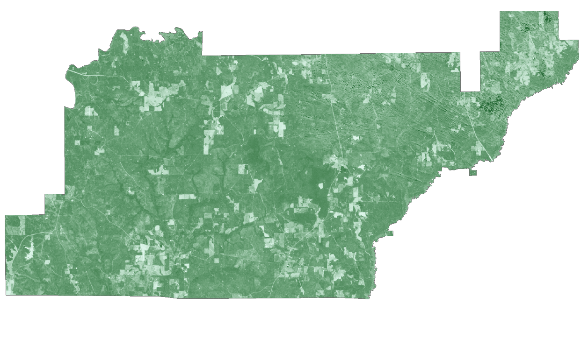
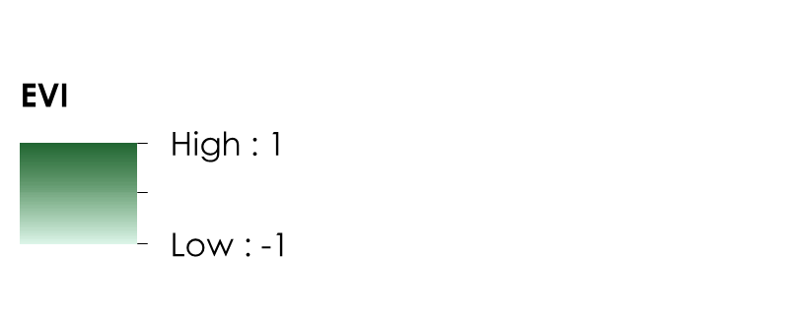
Vegetation Density Analysis
Notes:
Here is our vegetation density analysis during the leaf-off season in Conecuh which is in the winter.
-We chose to assess vegetation density during this time of year because this is when the Forest Service conducts prescribed burns to help manage the health of the southern pine forest.
-Although all of the land within this boundary of the forest is under jurisdiction of the Forest Service, there are private lands and farms which are these areas of low density.
-----------------------Image Information Below-----------------------
Image Credit: Conecuh N.F. Ecological Forecasting Team

Slide 10
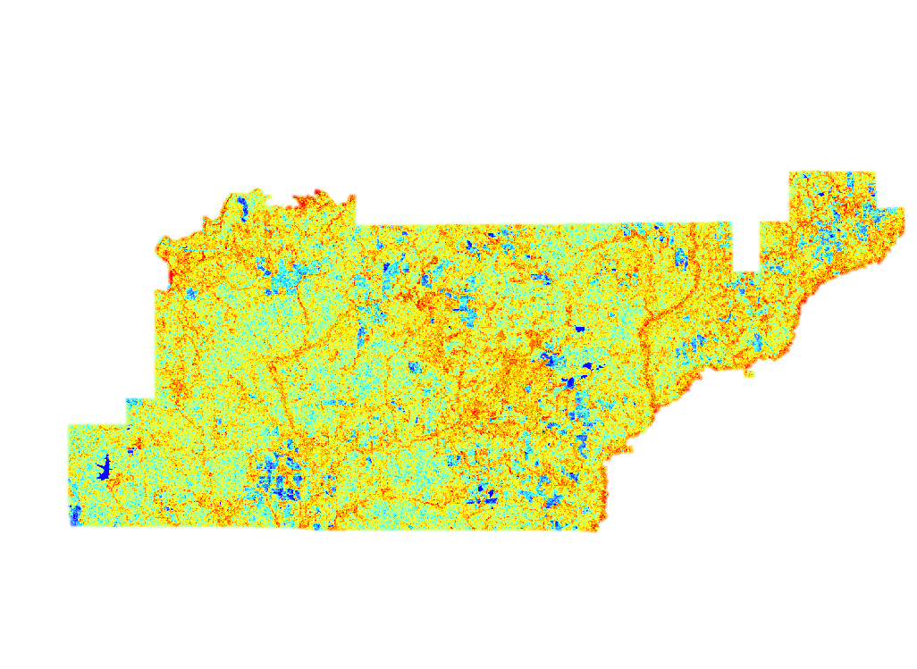
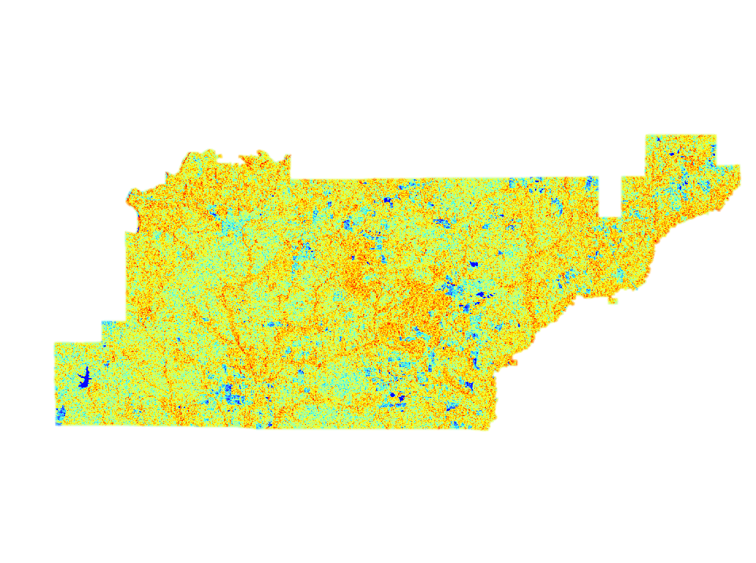
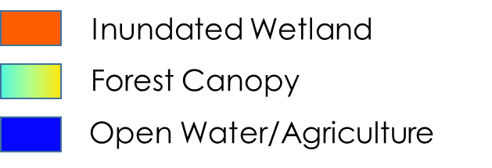
Wetland Inundation
Wet Season (Winter)
Dry Season (Summer)
Notes:
For this end product, we utilized Sentinel C-SAR data to create the wetland inundation maps.
Shown is the Wetland Classification for the forest in winter, the study area’s wet season, and the summer, the study area’s dry season.
You can see more details in the wet season due to less canopy cover in the winter time. The utilization of C-band SAR data limits the view to the top of the canopy.
Future work would benefit from utilizing L-Band SAR data, as the wavelength would allow them to see through the canopy throughout the whole year.
-----------------------Image Information Below-----------------------
Image Credit: Conecuh N.F. Ecological Forecasting Team

Slide 11
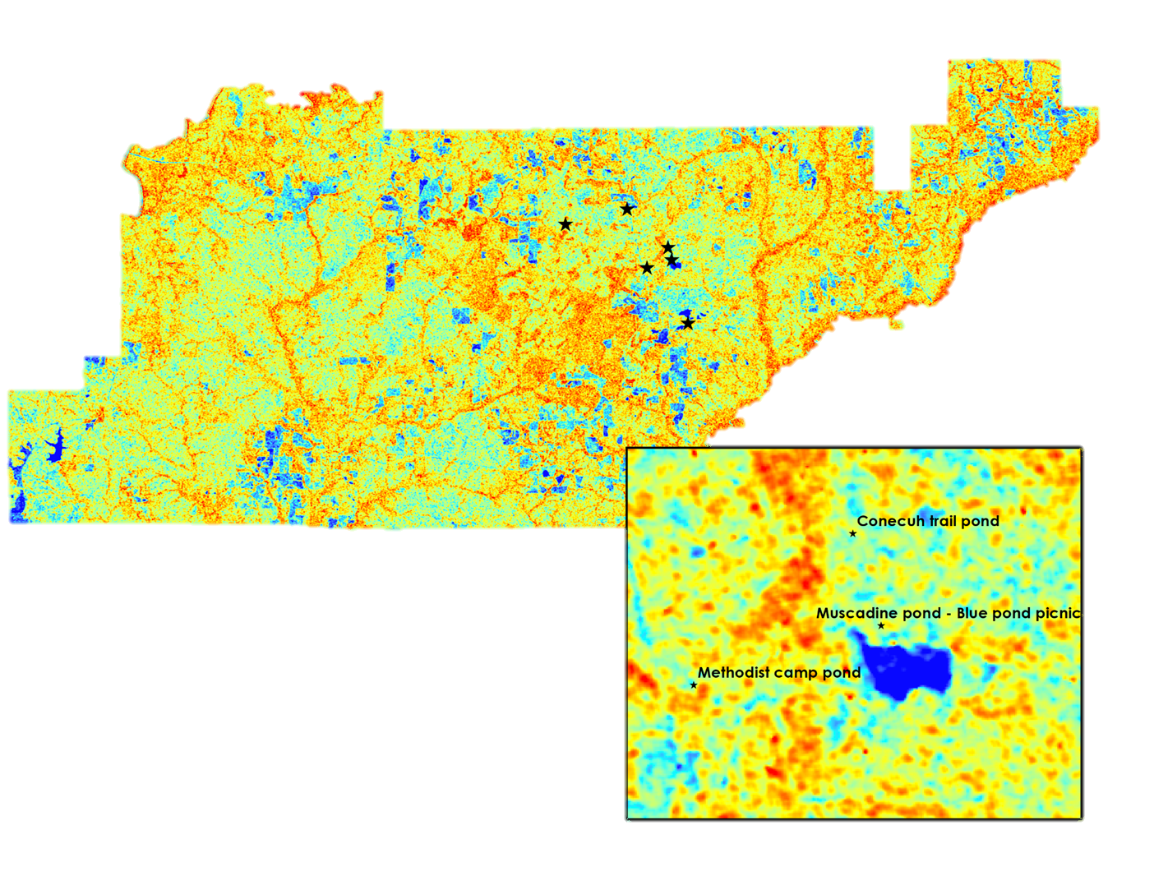
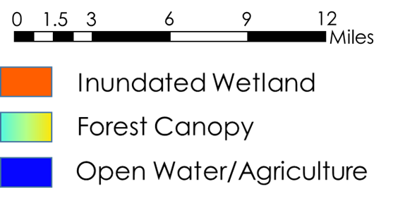
Wetland Inundation
Notes:
Here is a zoomed in image of one of the wetland inundation maps taken in the winter, with the in situ data we received ourselves overlayed.
Interestingly enough, the ponds that we gathered the GPS points of are visible through the maps; however, there are other areas of interest that look similar to our confirmed ponds that we do not have GPS data for.
This map displays the importance of in situ data with these maps to confirm these temporary breeding ponds due to their size!
-----------------------Image Information Below-----------------------
Image Credit: Conecuh N.F. Ecological Forecasting Team

Slide 12
Wetland Inundation Time Series
Notes:
Through the classifications we were able to create a time series of each season from 2016 until 2019.
You can see the variability to more detailed maps in the winter time– from the lesser amount of canopy– verses more ‘noisy’ maps during the summer time due to the increased canopy presence.
-----------------------Image Information Below-----------------------
Image Credit: Conecuh N.F. Ecological Forecasting Team

Slide 13
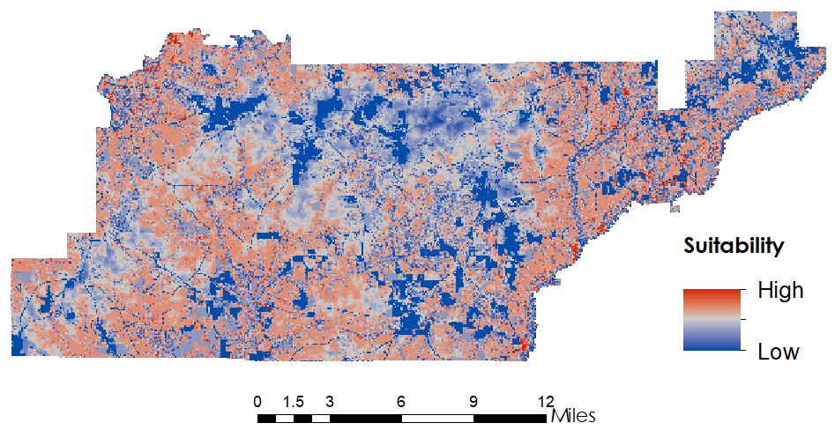
Habitat Suitability Map
Notes:
Areas in blue represent less suitable areas and areas in dark red represent more suitable habitat areas
Most prominent unsuitable areas consists of farmlands, pastures, roads, and open water
Data used to create this product includes NLCD data, SRTM data, and our wetland inundation product
Circled areas quickly indicate where the most highly suitable gopher frog habitat is located.
-----------------------Image Information Below-----------------------
Image Credit: Conecuh N.F. Ecological Forecasting Team

Slide 14
Conclusions
Inundated Vegetation
Inundated vegetation is better identified during the wet season (winter) due to minimal canopy cover and viewing capability of Sentinel-1 C-SAR
Vegetation Density
The Enhanced Vegetation Index can successfully analyze southern pine vegetation during the leaf-off season in Conecuh National Forest
Breeding Ponds
Breeding ponds can be better identified when using in-situ data for validation combined with imagery
Difficult due to the small size of the ponds and imagery resolution
Notes:
Our team gathered data and created products regarding the locations of inundated vegetation, degree of vegetation density, and locations of current and potential breeding ponds for the gopher frog.
Inundated vegetation is easier to identify in the winter wet season due to less canopy cover.
We successfully analyzed the vegetation density of the southern pine forest using the EVI.
Breeding ponds are most effectively identified when using in situ data and imagery. This is due to the small size of the ponds.
-----------------------Image Information Below-----------------------
Image Credit: Conecuh National Forest Ecological Forecasting Team

Slide 15
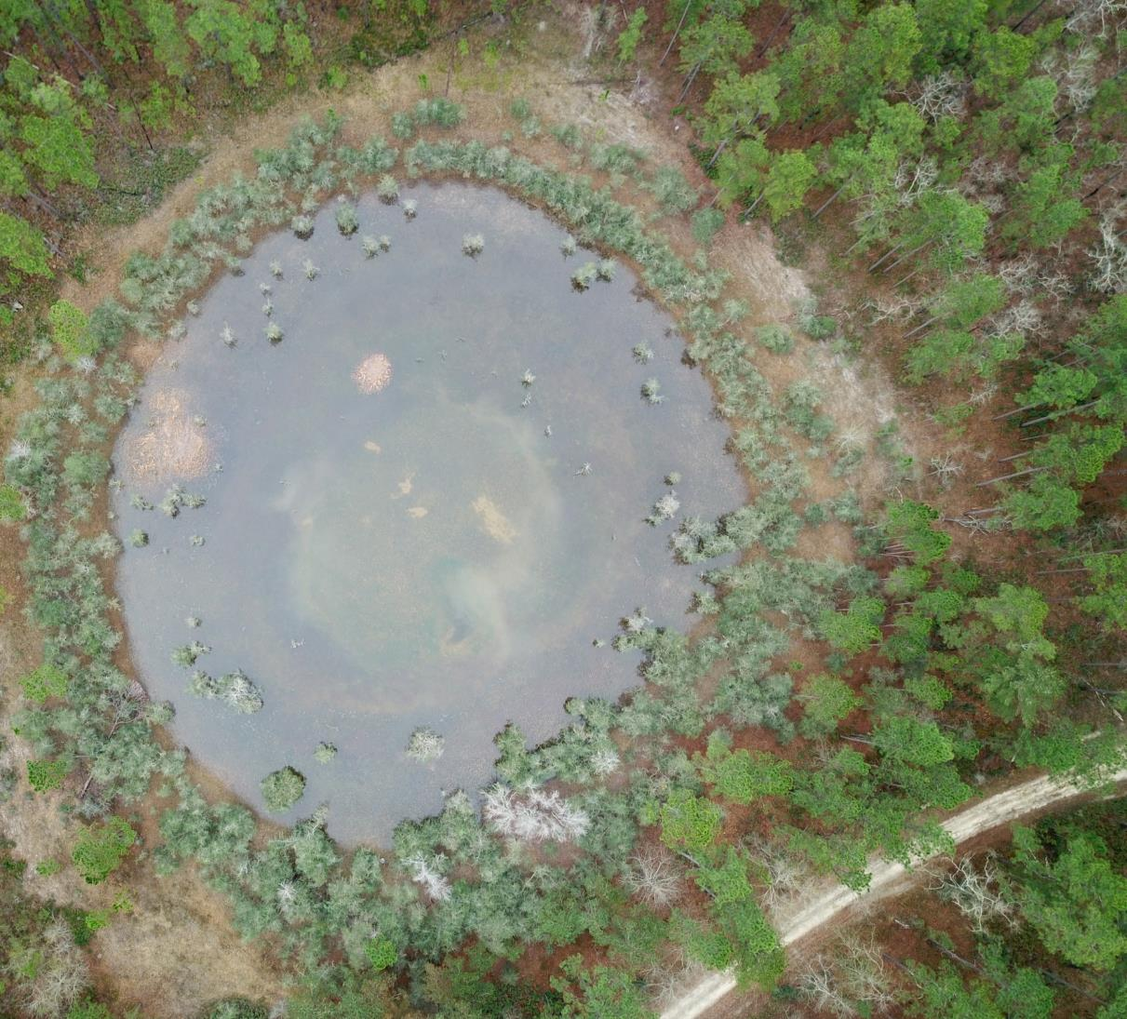
Limitations
C-Band vs. L-Band SAR data
Small size of breeding ponds
Outdated in situ data
Gopher tortoise burrows serving as proxy for exact gopher frog location
Image Credit: Mark Bailey
Notes:
-Various limitations include the small size of the breeding ponds and the limited viewing capability of C-Band during the leaf-on season.
-The in situ data of gopher frog and gopher tortoise burrow locations that our project partners gave us was outdated.
- Using gopher tortoise burrows as a proxy can introduce uncertainty due to the dynamic nature of burrows and the fact that gopher frogs will take shelter in places other than the burrows.
-----------------------Image Information Below-----------------------
Image Credit: Mark Bailey (U.S. Forest Service)

Slide 16
Future Work
Create a robust Software for Assisted Habitat Modeling (SAHM) analysis with more presence points
Utilize a wetland creation assessment and corridor assessment
Validation of TerrSet model outputs
Expand study area for analysis to include private lands surrounding Conecuh National Forest
Improve wetland classification using new sensors
Notes:
-Since this is a two term project, there will be a continuation of the work our team has done into the future work.
The second term– along with validating past end products from the first term—will create a SAHM analysis that will show where statistically the most likely location of the gopher frogs are in the Conecuh National Forest.
The second term will also expand the study area to include private land for potential breeding habitats.
- Future work should also improve wetland classification when L-Band open source data is released from NASA when launched in 2021.
-----------------------Image Information Below-----------------------
Image Credit: Conecuh National Forest Ecological Forecasting Team

Slide 17
Dr. Jeffrey Luvall, NASA Marshall Space Flight Center
Dr. Robert Griffin, The University of Alabama in Huntsville
Joseph Spruce, Science Systems and Applications, Inc.
Maggi Klug, The University of Alabama in Huntsville
Helen Baldwin, NASA SERVIR Science Coordination Office
Leah Parker, The University of Alabama in Huntsville
Tim Mayer, NASA SERVIR Science Coordination Office
Mercedes Bartkovich, ADCNR
Eric Soehren, ADCNR
Ericha Shelton-Nix, ADCNR
Derek Colbert, US Forest Service, Conecuh National Forest
Mark Bailey, US Forest Service, Conecuh National Forest
Tim Mersmann, US Forest Service, Conecuh National Forest
Dr. James Stiles, Auburn University
James C. Godwin Alabama Natural Heritage Program
Dr. Scott Rush, Mississippi State University
Madison Murphy, NASA DEVELOP Center Lead at the Alabama – Marshall & Mobile Nodes
This material contains modified Copernicus Sentinel data (2015-2019), processed by ESA.
Notes:
-Lastly we would like to acknowledge our science advisors, mentors, project partners, our center lead Madison, and those that gave us guidance on our project.

Slide 18
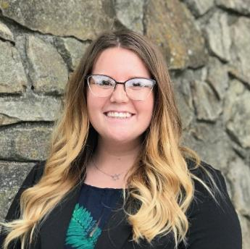
Thank you!
Kara Cassano
Stefan Perritano
Jacob Goff
Sierra Laltrello
Notes:
- Thank you! We will now take any questions.

