Slide 1
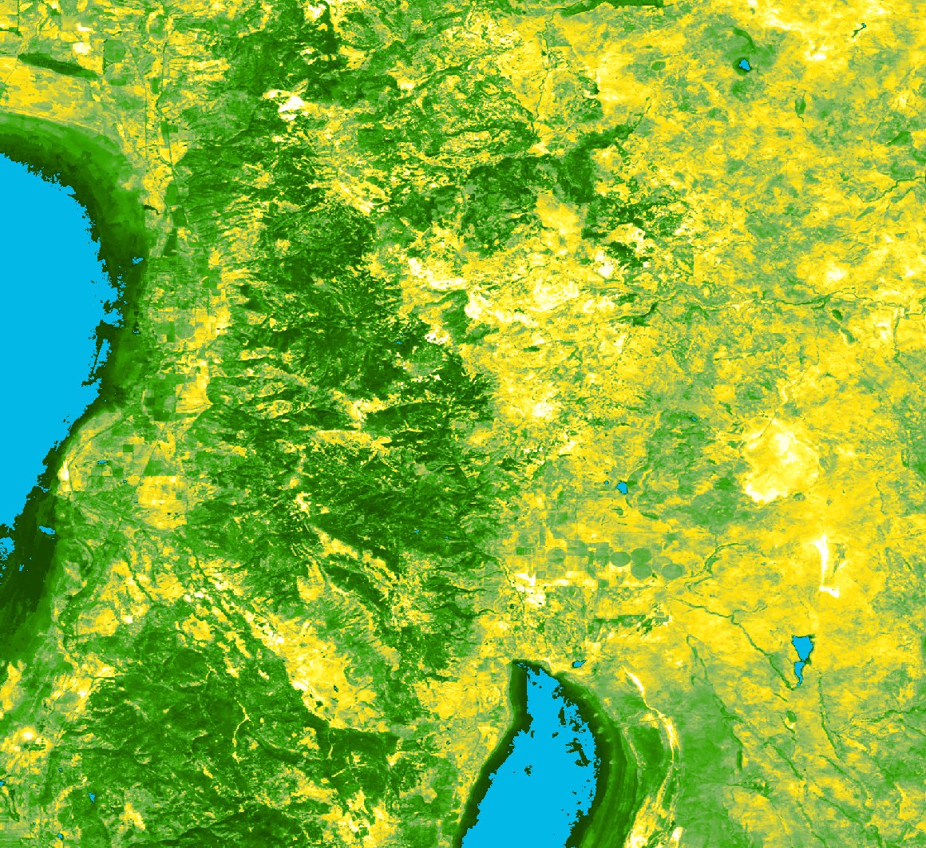
NEVADA & OREGON ECOLOGICAL FORECASTING
Employing NASA Earth Observations to Create Enhanced Bare Ground Layers for Invasive Species Habitat Suitability Modeling
Nicole Pepper
Sophia Leiker
Anastasia Kunz
Rebecca Girma
Colorado – Fort Collins | Spring 2019
Notes:
Hello, my name is _____ and with NASA DEVELOP and I will be talking about employing nasa earth observations to create enhanced bare ground layers for invasive species habitat suitability modeling.

Slide 2
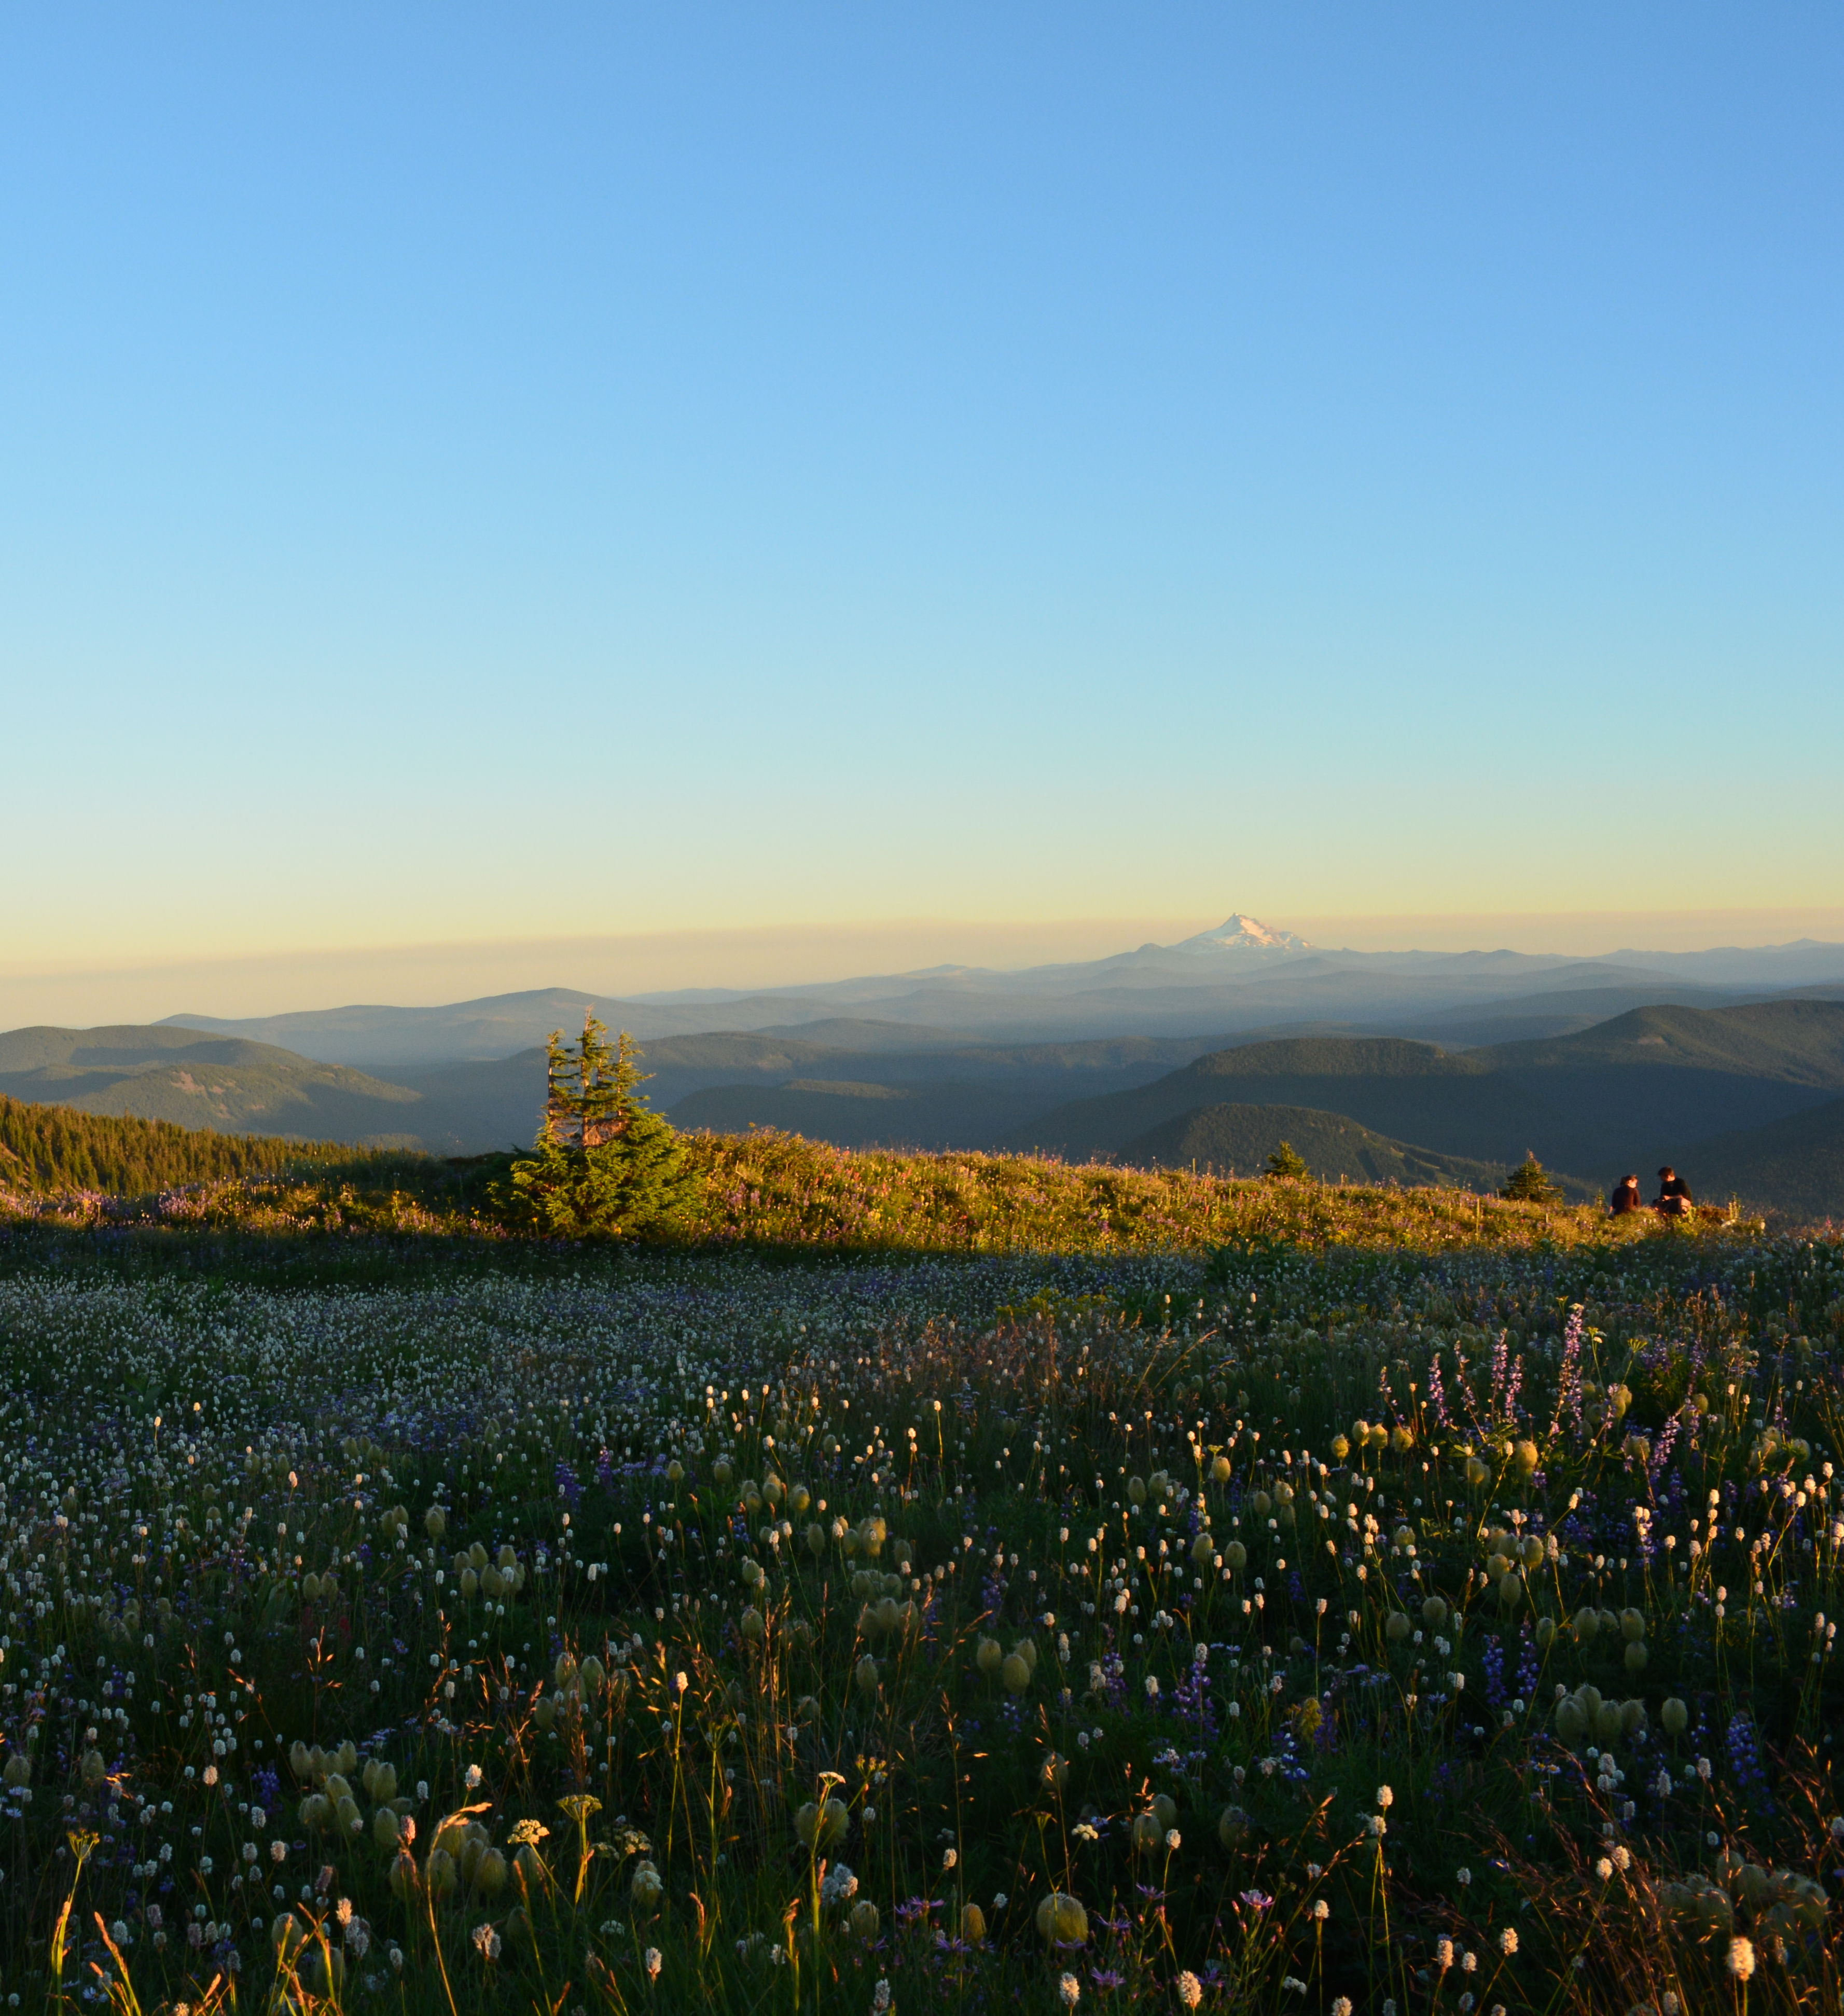
Background
Partner Interest
NPS Exotic Plant Management Team
Provides 290 parks with professional
expertise on invasive species
United States Geological Survey
Applies habitat suitability models
to inform landscape-scale invasive
plant management
Under Executive Order 13112, invasive species are listed as major contributors to ecosystem change
Image Credit: Nicole Pepper
Notes:
Both of our partners are making huge strides to better manage harmful invasive plant species across our public lands. More specifically, the NPS EPMT is tasked with providing 290 parks with professional expertise on invasive species. Dr. Jarnevich from the USGS has for years been dedicated to modeling the distribution of invasive plant species across the US for management purposes.
In 1999 Exec. order 13112 designated invasive species as a major contributor to ecosystem change and established that all federal land management agencies must maintain practices that address problems related to the introduction of such species.
All federal land management agencies must address invasive species issues
https://www.nps.gov/articles/invasive-species.htm april 20, 2017
https://www.doi.gov/sites/doi.gov/files/uploads/invasive_species_impacts_on_federal_infrastructure.pdf
https://files.dnr.state.mn.us/natural_resources/invasives/2017-invasive-species-annual-report.pdf
Photo: Nicole Pepper. Personal Image (DEVELOPer) Used with permission

Slide 3
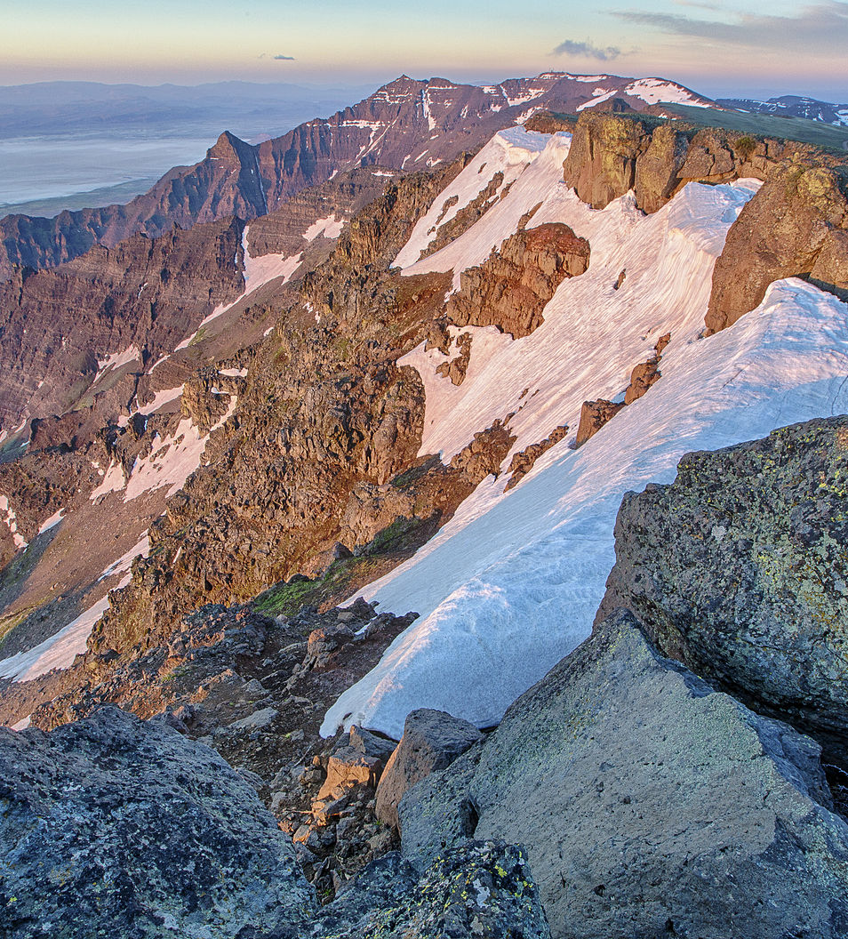
Background
Invasive species… why care?
Invasive species are a threat to
Ecological Integrity
Economic Stability
Human Health
Image Credit: Bureau of Land Management
Notes:
So why are invasive species such a problem?
An invasive species can be any kind of living organism (so think a bacteria, animal, or in this case a plant) that is not native to an ecosystem and that causes said ecosystem harm.
Prominent invasive species are often generalists and can outcompete native vegetation. Making invasive species a potential threat to not only the ecological integrity of an ecosystem, but also the economic stability of a region and the overall general well-being of humans.
Imagine this: in 2011 the US Fish and Wildlife Service published a report assessing the Cost of Invasive Species in the United States, in 2005 the US Department of Interior spent over 120 billion in damages related to invasive species alone. This is because invasive species can cause signicant damage which result in costs for repairs to damaged infrastructure, loss in value of assets, loss of efficiency, lost service time, and costs associated with controlling their spread.
*** Give stat on how much it costs a year for invasive species removal
Photo: https://commons.wikimedia.org/wiki/File:Steens_Mountain_in_eastern_Oregon_(9680486479).jpg
Public Domain

Slide 4
Partners
Dr. Catherine Jarnevich
Research Ecologist
United States Geological Survey (USGS)
Terri Hogan
Invasive Plant Program Manager
National Park Service (NPS)
Exotic Plant Management Team (EPMT)
Notes:
This Spring term, we are partnering up with Dr. Catherine Jarnevich from the United States Geological Survey and Terri Hogan at the National Park Service Exotic Plant Management Team in an effort to enhance their methods for assessing the current and future geographic risk of invasive plant species.

Slide 5
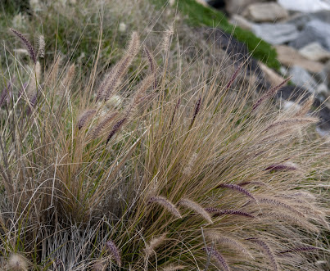
Community Concerns
Understand the geographic patterns of focal species
Enhance distribution models
Use patterns of the past to forecast a habitat’s risk of invasion
Better decision making for land managers!
Medusahead
Taeniatherum caput-medusa
Fountaingrass
Pennisetum Alopecuroides
Image Credit: Julie Kierstead Nelson
Image Credit: Public Domain Pictures
Notes:
Our partners are interested in better understanding the present and future geographic distributions of these focal species. Our team will incorporate spectral data from NASA Earth observations to enhance their habitat suitability models, which will in turn lead to Better decision making for land managers. Used as tools
Species distribution models (SDMs) are being increasingly used
Unique spectral information can improve the accuracy of SDMs
Refinement of environmental variables will improve model accuracy
Patterns from the past and present can be used to forecast a habitat’s risk of invasion
Photo: MedusaHead https://www.calflora.org/cgi-bin/noccdetail.cgi?seq_num=mg63254
Creative Commons
Photo: https://www.publicdomainpictures.net/en/view-image.php?image=280858&picture=fountain-grass
Public Domain

Slide 6
Species of Concern
Medusahead (Taeniatherum caput-medusae)
Fountaingrass (Pennisetum Alopecuroides)
Generalists &
Early Successional Species
Medusahead
Taeniatherum caput-medusa
Fountaingrass
Pennisetum Alopecuroides
Image Credit: Julie Kierstead Nelson
Image Credit: Public Domain Pictures
Notes:
For this project we are proposing to focus on 2 different invasive plant species that are prominent in distribution across Nevada and Oregon. These species are medusahead and fountaingrass. Both of which are known as generalists and early successional species which gives them an edge in outcompeting against native plants.
ECOLOGIC Threat: Native and endangered species outcompeted; changes the fire regime of the landscape
ECONOMIC Threat: depletes food sources for wildlife and grazing livestock; Removal of established sp is more expensive than prevention
Photo: MedusaHead https://www.calflora.org/cgi-bin/noccdetail.cgi?seq_num=mg63254
Creative Commons
Photo: https://www.publicdomainpictures.net/en/view-image.php?image=280858&picture=fountain-grass
Public Domain

Slide 7
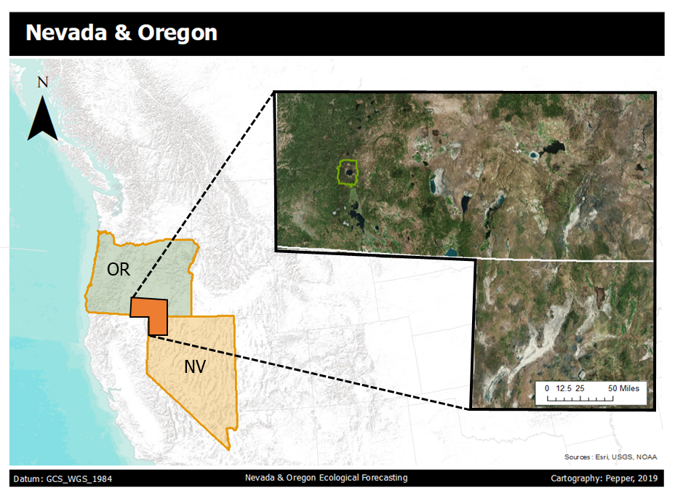
Study Area & Study Period
Region: SE Oregon & NW Nevada
Majority is Public lands managed by the Bureau of Land Management
East of Sierra Nevada range
Low precipitation levels
Arid to semi-arid climate
Dominant vegetation classes are sagebrush, shrubs, cheatgrass
Study Period: 2000 to 2018
Forecasting to 2050
Nevada & Oregon
Study Area
Crater Lake NP
Nevada
Oregon
OR
NV
Image Credit: Nicole Pepper
Notes:
-For our study area we are looking at a region in southeast oregon and northwest nevada which you can see outlined in orange on the right. We are looking at multiple landsat scenes which overlap our study area which are outlined in orange.
-Most of this land is publically owned by the bureau of land management.
-This region sits to the east of the sierra nevada range and therefore experiences a rain shadow effect meaning there are low levels of precipitation defining the ecosystems in the area. Since much of this region is in a high desert, there are extreme temperature seasonally
-The most prominent vegetation classes are sagebrush, shrubs, and cheatgrass.
-Our study area includes 2000 to 2018 and then forcasting habitat suitability models to 2050
Photo: Nicole Pepper. Personal Image (DEVELOPer) Used with permission

Slide 8
Objectives
DERIVE
Bare Ground Layers
MODEL
Habitat Suitability
CREATE
Suitability Map
FORECAST
Habitat Risk
Provide USGS & NPS with 30-meter resolution bare ground layers derived from NASA and ESA Earth observations
Run habitat suitability models integrating bare ground layers and evaluate model performance in SAHM
Create habitat suitability maps based on updated bare ground data for medusahead
Forecast the habitat suitability of medusahead for the year 2050 by incorporating NASA climate predictions
Image Credit: BLM
Notes:
For our objectives we broke them down into 4 major groupings:
Derive Bare ground Layers
Model Habitat Suitability
Create Suitability Map
Forecast Habitat Risk
Photo: https://www.blm.gov/programs/national-conservation-lands/nevada/black-rock-desert-high-rock-canyon-emigrant-trails-nca

Slide 9
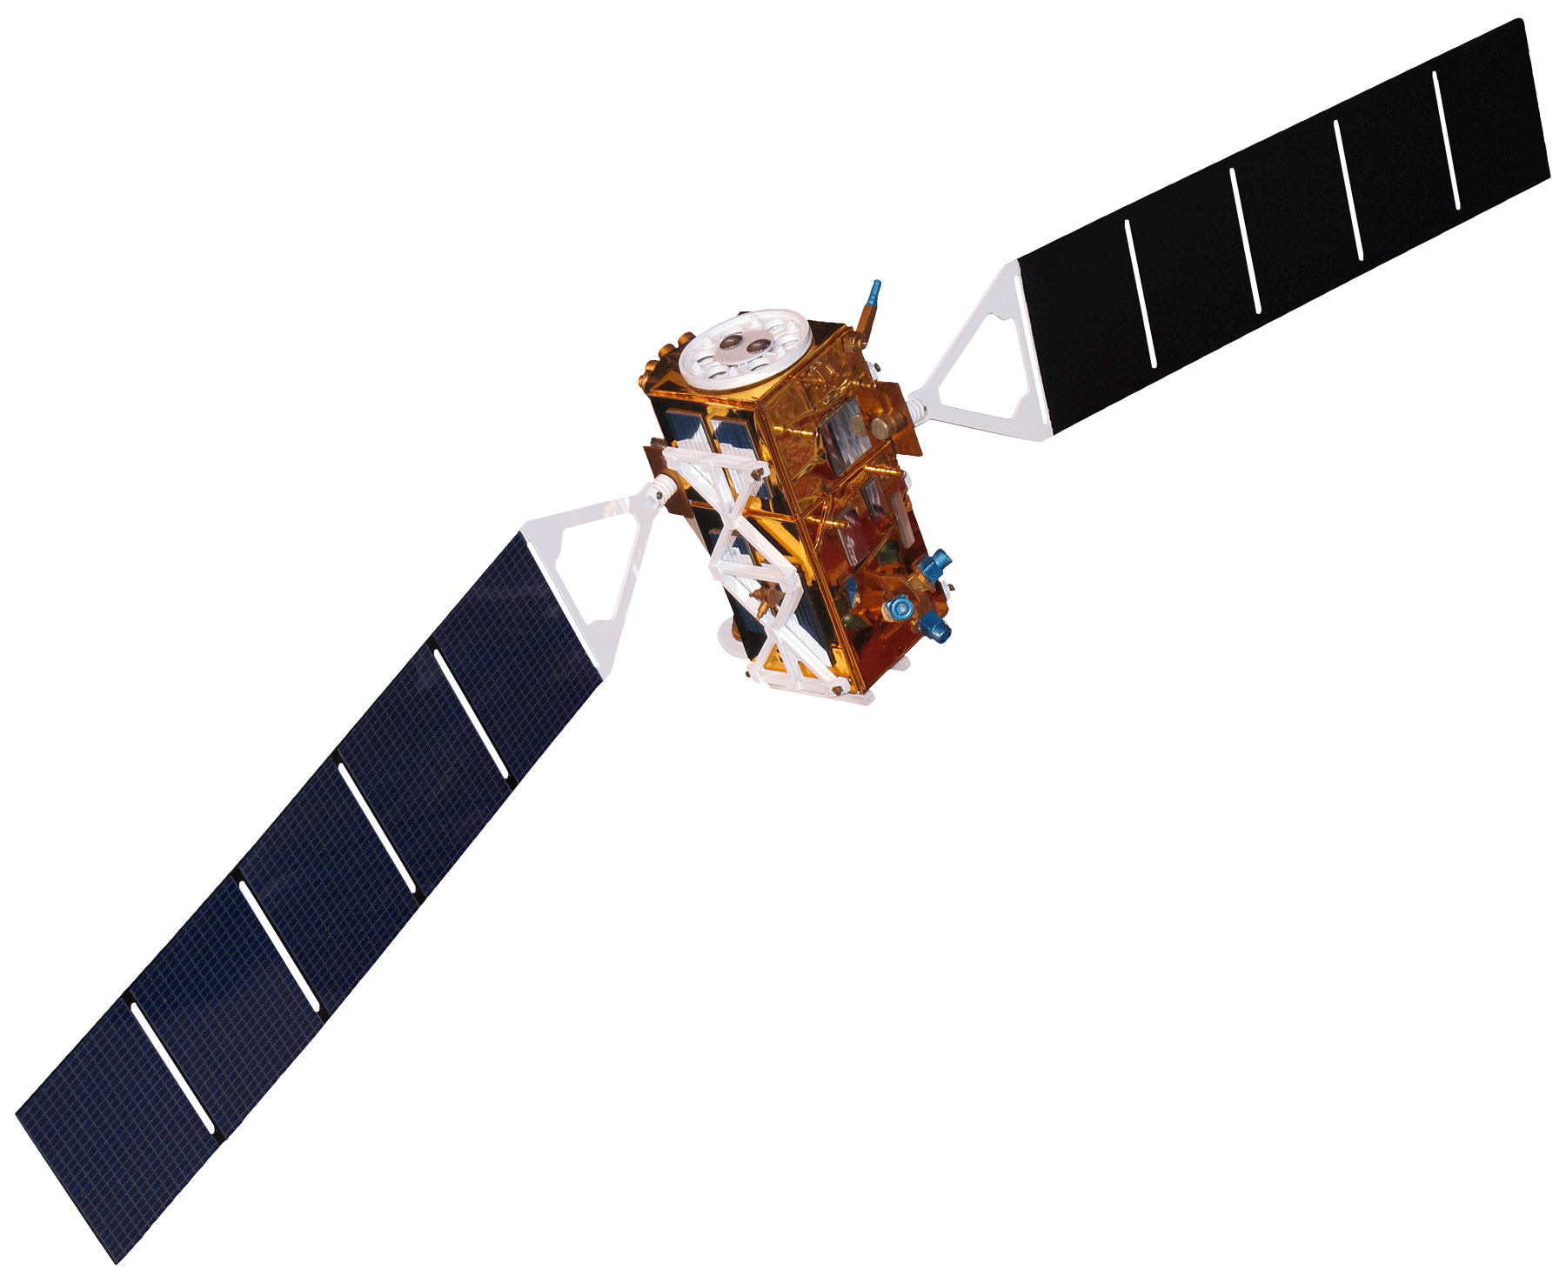
Satellites & Sensors
NASA
Aqua MODIS
Landsat 8 OLI
ESA
Sentinel-1 C-SAR
Image Credit: NASA
Notes:
Different satellites +sensors to derive environmental layers.
Terra MODIS
Aqua MODIS
Landsat 8 OLI
Sentinel-1 C-Sar
Presence and absence data for our SDMs obtained from partners at the USGS
Bioclimatic Vars from Bioclim for climate details. Keeping the other layers the same to see the difference and explanatory power of a higher resolution bare ground layer
Photo: NASA
https://images.nasa.gov/details-iss042e013697.html

Slide 10
Methodology
Bare Ground Layers
Environmental Layers
Modeling Using Classification Trees
Model Outputs
Forecasted Habitat Distribution
Final Habitat Suitability Model
NDBaI
Bare
Ground
NDBI
SAR
Future
Climate
Climate
NLDC
Enviro.
Anthro.
MODIS
Google Earth Engine
SAHM
Notes:
The first portion of our project will focus on creating environmental layers for the USGS to use in their species distribution models.
The first step of this process is to derive the environmental layers the USGS is interested in incorporating.
Then we will model in SAHM
Next we will assess model output and how well they performed with the addition of higher resolution bare ground layers
Finally we will finalize our best distribution model assessing the distribution of our focal species and hand this off to our partners
To assess model agreement we created ensemble models (which we will talk about later)
We also carried out the same methodology but incorporated future climate layers in order to forecast habitat suitability for medusahead into the year 2050

Slide 11
Bare Ground Indices
Name | Formula | Scale
NDBaI: Normalized Difference Bareness Index | $$\frac{(SWIR1 − TIR)}{(SWIR+TIR)}$$ | -1 to 1
NBLI: Normalized Difference Bare Land Index | $$\frac{(Red − TIR)}{(Red+TIR)}$$ | -1 to 1
BSI: Bare Soil Index | $$\frac{\left(Red+Green\right)−(Red+Blue)}{(NIR+Green)+(Red+Blue)} ∗100+100$$ | 0 to 500
SAVI: Soil Adjusted Vegetation Index | $$\frac{(IR −Red)}{(IR+Red+0.5)} ∗1.5$$ | -1 to 1
SAR: Synthetic Aperture Radar | Backscatter values in the Vertical- Horizontal polarization | -27.8 to -9.6 (Specific to our study area)
Notes:
Comparison of Bare ground layers Equations. (Go through the names of each and explain that the scales are different)

Slide 12
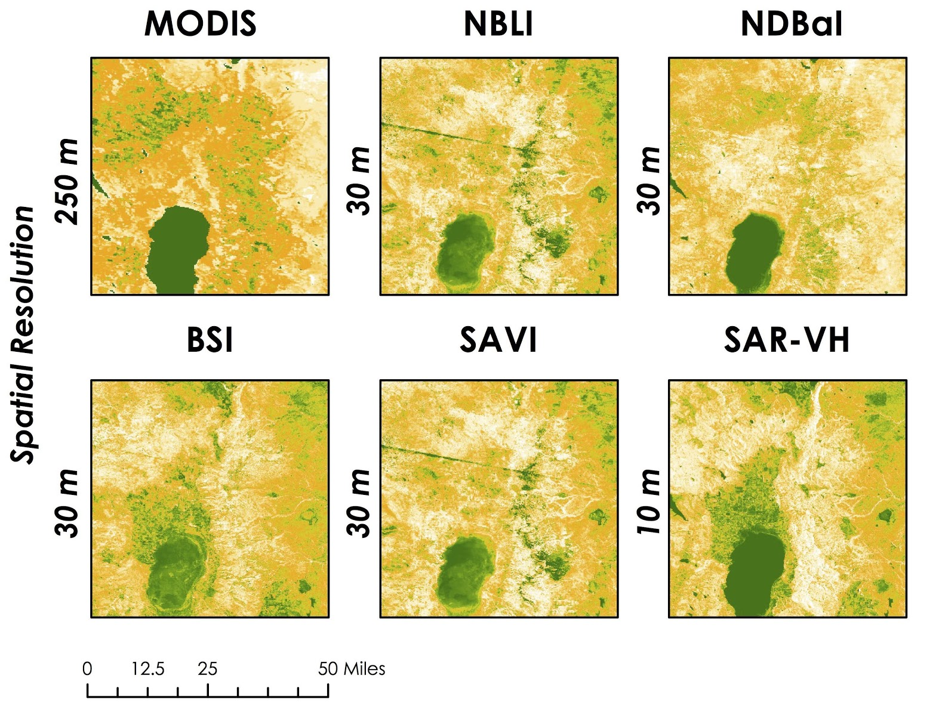
Layer Comparison
Bare Ground Indices
MODIS
NBLI
NDBaI
Each of our layers improved the spatial resolution compared to USGS layer
250m
30m
White → high levels of bare ground
Orange → mixture of bare ground and vegetation
Green → high vegetation
Spatial Resolution
BSI
SAVI
SAR-VH
30m
10m
0
25
50 Miles
High
Low
Bare Ground
Notes:
This is a zoomed in region of Goose Lake in southeast Oregon.
Each of our derived bare ground layers are visualized on the right with the colors representing a scale from high bare ground to low bare ground (high vegetation)
THE USGS MODIS layer you can see in the upper left which as a resolution of 250 so each of the layers we derived greatly improved their spatial resolution.
The colors represent (explain color chart from slide)

Slide 13
Layer Resolution
MODIS Percent Bare Ground SD
250 m
Normalized Difference Bareness Index
30 m
Notes:
Here we can see the current bare ground layer used by the USGS on the left with a resolution at 250m. The white indicates regions with bare ground while the green indicates vegetated regions. On the right you can see one of the bare ground layers we created. As you can see, our layer has more detailed resolution which can help provide land managers more specific information on regions they need to focus/target when carrying out land management decisions.

Slide 14
Independent Data Validation
MODIS
NBLI
NDBaI
$R^{2}$= 0.017871 P=0.005369
$R^{2}$= 0.23515 P=6.5749e-24
$R^{2}$= -0.0022386 P=0.69129
100
-0.2
Assessment
Inventory
Monitoring
80
-0.2
60
-0.3
40
-0.3
-0.4
20
0
40
80
0
40
80
0
40
80
AIM Points
AIM Points
AIM Points
BSI
SAVI
SAR-VH
cv
$R^{2}$= 0.36166 P=9.2216e-39
$R^{2}$= 0.23515 P=6.5785e-24
$R^{2}$= 0.017998 P=3.6383e-18
In - field data collected by the Bureau of Land Management in 2016 and 2017
102
-16
0.6
100
0.5
-20
0.4
98
0.3
-24
0
40
80
0
40
80
0
40
80
AIM Points
AIM Points
AIM Points
Notes:
Plots illustrating the relationship between the bare soil percentage (0-100%) from the AIM field data and our derived bare ground indices.
In this validation process, we included a total of 378 points from the years 2016 and 2017. The assessment of our bare ground indices through the AIM dataset showed slight variations between R-squared (R² ) values. BSI, followed by NBLI had the most agreement with the AIM dataset out of all of the derived indices.

Slide 15
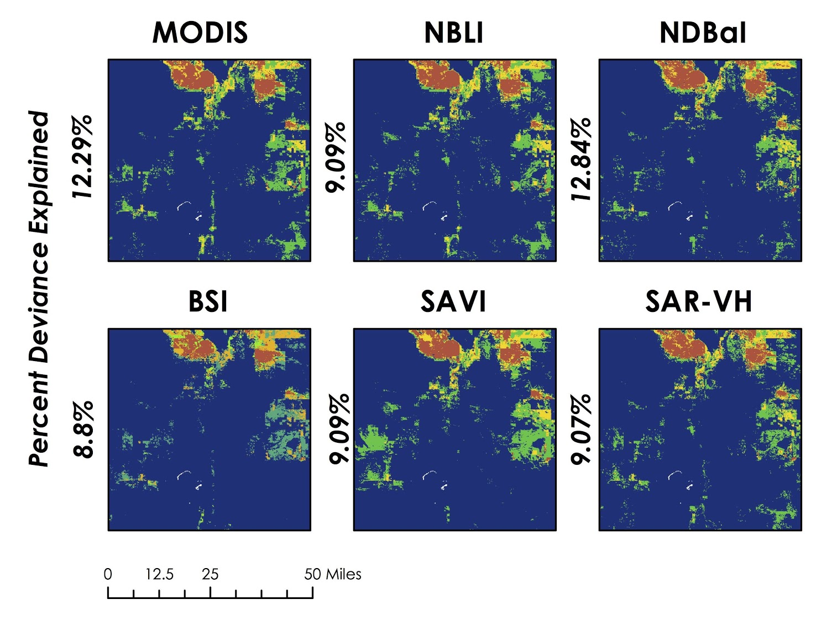
Ensemble Model Comparison
Bare Ground Indices
MODIS
NBLI
NDBaI
Relatively similar spatial & statistical outputs
NDBaI: Highest percent deviance explained
12.29%
9.09%
12.84%
Orange → All models agree designating habitat suitable
Yellow → Two models agree
Green → One model agrees
Blue → No models indicate habitat as suitable
BSI
SAVI
SAR-VH
Percent Deviance Explained
8.8%
9.09%
9.07%
0
1
2
3
0
25
50 Miles
Model Agreement
Notes:
Orange indicates all three models agree in designating the habitat as suitable for that pixel, yellow indicates two models are in agreement, green indicates only one model, and blue indicates that no models designated the habitat as suitable.
The layer with the highest percent deviance explained was NDBaI at 12.84%, followed by MODIS (current USGS layer) at 12.29%. The majority of the other layers (NBLI, BSI, SAVI, SAR_VH) were slightly lower, 9% plus or minus 0.09 deviance explained.
Even though the medusahead habitat suitability models all showed relatively similar spatial and statistical outputs, it is important to note that the higher resolution layers have an impact on the overall resolution of our probability map outputs.

Slide 16
2018 Habitat Suitability Map
Low
High
Probability
Included BSI RF Bare Ground Layer
AUC: 0.98444 PCC: 96.19699
0
25
50 Miles
Notes:
Since BSI (Bare Soil Index) had the highest agreement to the AIM in-field data, we chose the habitat suitability model that incorporated this index as a bare ground layer.
The AUC for this model was 0.98444 and the Percent Correctly Classified was 96.19699 indicating our model did fairly well.

Slide 17
2050 Habitat Suitability
Low
High
Probability
Medusahead
Increase in suitable habitat
NASA’s GISS-E2-R climate forecast
AUC: 0.93 PCC: 90.24%
0
25
50 Miles
Notes:
Our forecasted distribution BSI Random Forest model had an AUC of 0.93464 and correctly classified 90.247% of suitable habitat. This model incorporated 5 variables in total, two being future climate variables (BIO 18 and BIO 7), along with the BSI index and two original USGS environmental layers (percent clay and depth to restriction).
Future bio variables were downloaded from the GISS-E2-R model from NASA’s Goddard Institute for Space Studies.

Slide 18
Conclusions
Provided USGS with portfolio of higher resolution bare ground layers
Exchanged partners’ bare ground layer with our high resolution layers
No significant change in output statistics
Produced current and forecasted HSM for medusahead
Predicted geographic distribution of suitable habitat to expand by 2050
Image Credit: Nicole Pepper
Notes:
This project succeeded in providing the USGS with a portfolio of higher resolution bare ground layers in order to refine their habitat suitability models. Each layer detects bare ground differently, but improve the spatial resolution of model outputs when compared to current USGS practices.
We found that exchanging our partner’s bare ground variable with higher resolution layers didn’t result in a significant change in model outputs statistics. This trend could be attributed to the low importance of bare ground in their habitat suitability models.
We produced a current and future habitat suitability maps for medusahead over our study area. Our forecasting map shows that the geographic distribution of habitat fit for medusahead habitat is expected to increase by the year 2050. Incorporating higher resolution data into habitat suitability models can facilitate more targeted, cost effective management strategies for land managers. These strategies can help mitigate the impacts of medusahead and prevent future impacts to high risk areas.
Photo: Nicole Pepper. Personal Image (DEVELOPer) Used with permission

Slide 19
Limitations
Habitat suitability models are complex
Bare ground not a central driver in focal species habitat distribution
Further validation of bare ground layers
Image Credit: Nicole Pepper
Notes:
We found that carrying out the median reducer in a study area encompassing multiple landsat scenes prior to the index calculations resulted in distorted imagery along the borders of overlapping landsat scenes. This may skew some of the results calculated along this edge imagery such as our bare ground indices. In order to mitigate these errors, calculating the indices before performing the median reducer lessens the distortion in these regions.
One limitation to the validation of our bare ground indices was the lack of updated field data for our study area and study period. The BLM AIM data used to validate the bare ground layers were collected in the years 2016 and 2017 while our study period focused on the year 2018. Due to this discrepancy, the validation may not be wholly accurate because some land use and vegetation cover has likely changed over this time period. For this reason, further research is necessary to update the field data used to validate our bare ground layers to 2018 in order to get a more accurate assessment of our indices.
In future habitat suitability models studying invasive species, it will be necessary to incorporate seasonality and growing season rather than looking at an entire year for calculating bare ground indices. Additionally, it is important to consider how our models change when focusing on a few months of the year or a growing season instead of the entire year. The calculations of our bare ground indices will likely change with the incorporation of seasonality and vegetation variability, therefore affecting the output of our final habitat suitability models.
Our team experienced issues with the background surface generator module in SAHM. We were unable to generate background points and successfully incorporate them into the model through the module itself, and instead relied on inputting the background points directly into our field data CSV. While this tactic was suitable for our purposes in this project, it will be necessary to fix this error in order to apply this workflow to other species and across widers scales.
Photo: Nicole Pepper. Personal Image (DEVELOPer) Used with permission

Slide 20
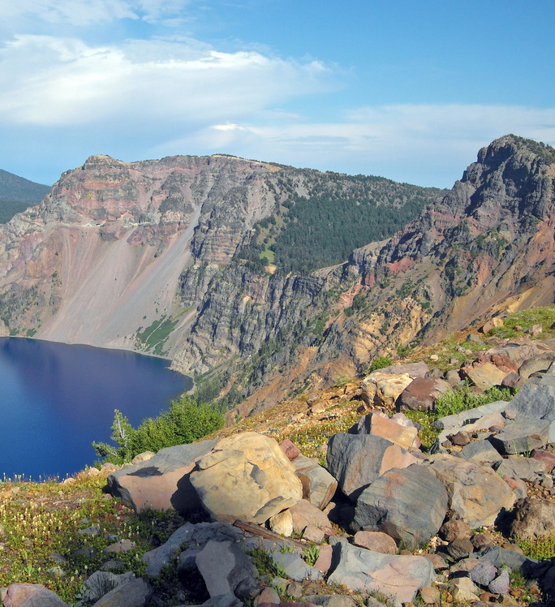
Future Work
Incorporating seasonality into predictor variables
Increase modeling scale from state to national level
Increase the spatial resolution of other important predictor variables
Image Credit: National Parks Service
Notes:
Habitat suitability models are complex and exchanging just one layer wont show as much change in statistical or visual outputs as we would like when trying to assess the effectiveness of these updated layers.
In the context of seeing statistical manipulation of our outputs, bare ground simply did not have a high enough deviance explained in our models to show any significant changes.
Additionally, in the future it will be necessary to validate these layers with field data to see how they perform in different regions.
Photo: Nicole Pepper. Personal Image (DEVELOPer) Used with permission

Slide 21
Dr. Paul Evangelista (Colorado State University, Natural Resource Ecology Laboratory)
Dr. Catherine Jarnevich (United States Geological Survey – Fort Collins Science Center)
Nicholas Young (Colorado State University, Natural Resource Ecology Laboratory)
Tony Vorster (Colorado State University, Natural Resource Ecology Laboratory)
Brian Woodward (Colorado State University, Natural Resource Ecology Laboratory)
Terri Hogan (National Parks Service)
Kristen Dennis (NASA DEVELOP, Center Lead)
This material contains modified Copernicus Sentinel data (2016-2018), processed by ESA.
Notes:
We would like to thank all these people in helping support the completion of this project.

Slide 22
Questions?
Image Credit: Nicole Pepper
Notes:
Photo: Nicole Pepper. Personal Image (DEVELOPer) Used with permission

