Slide 1
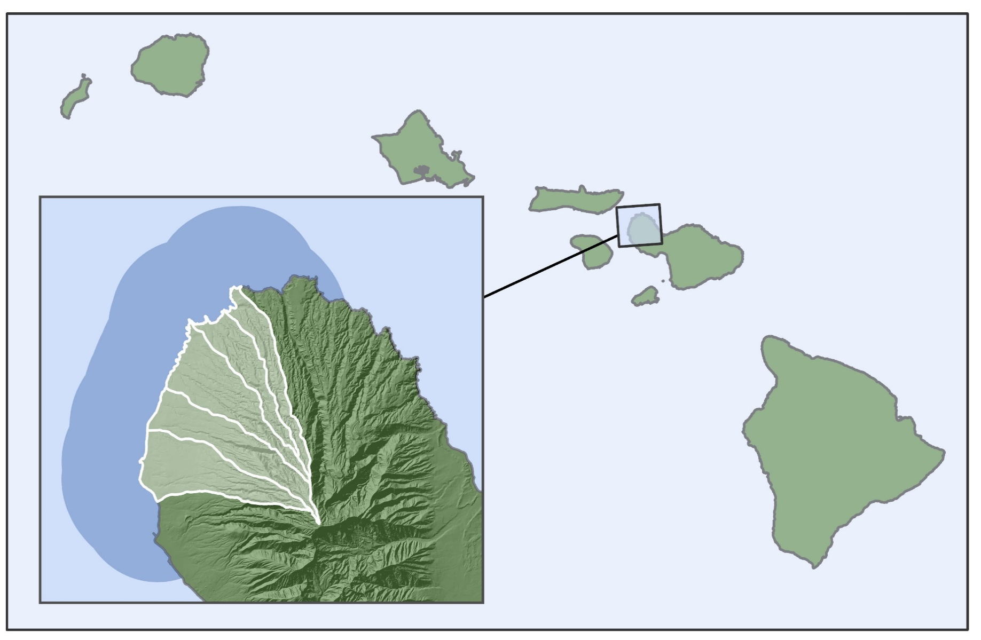
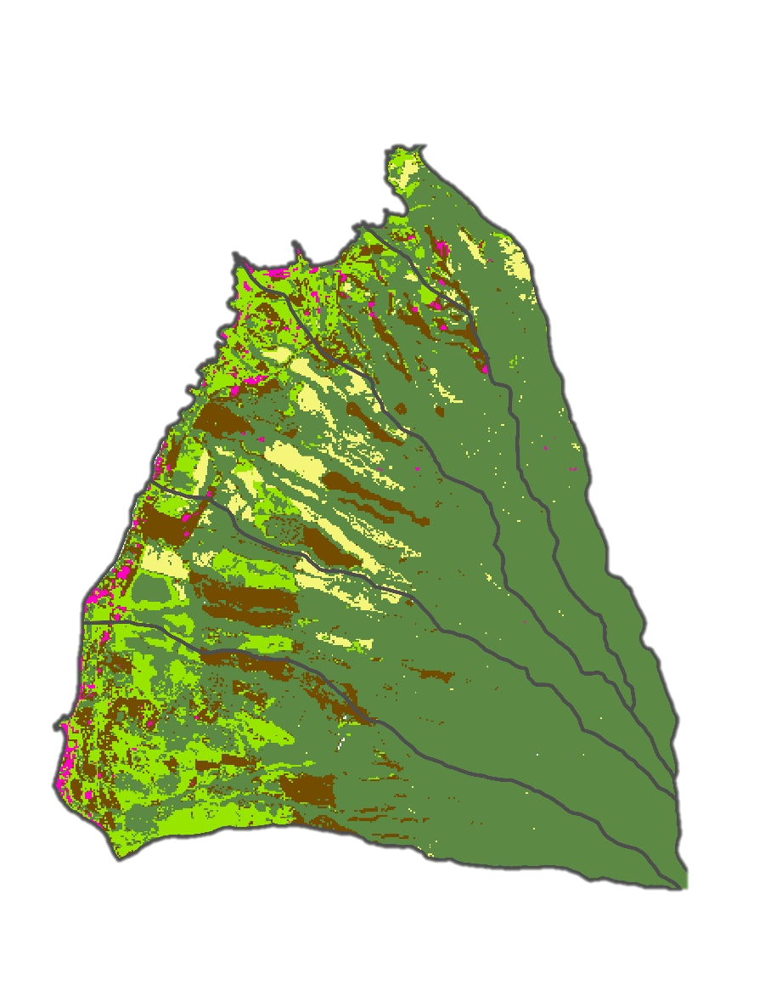
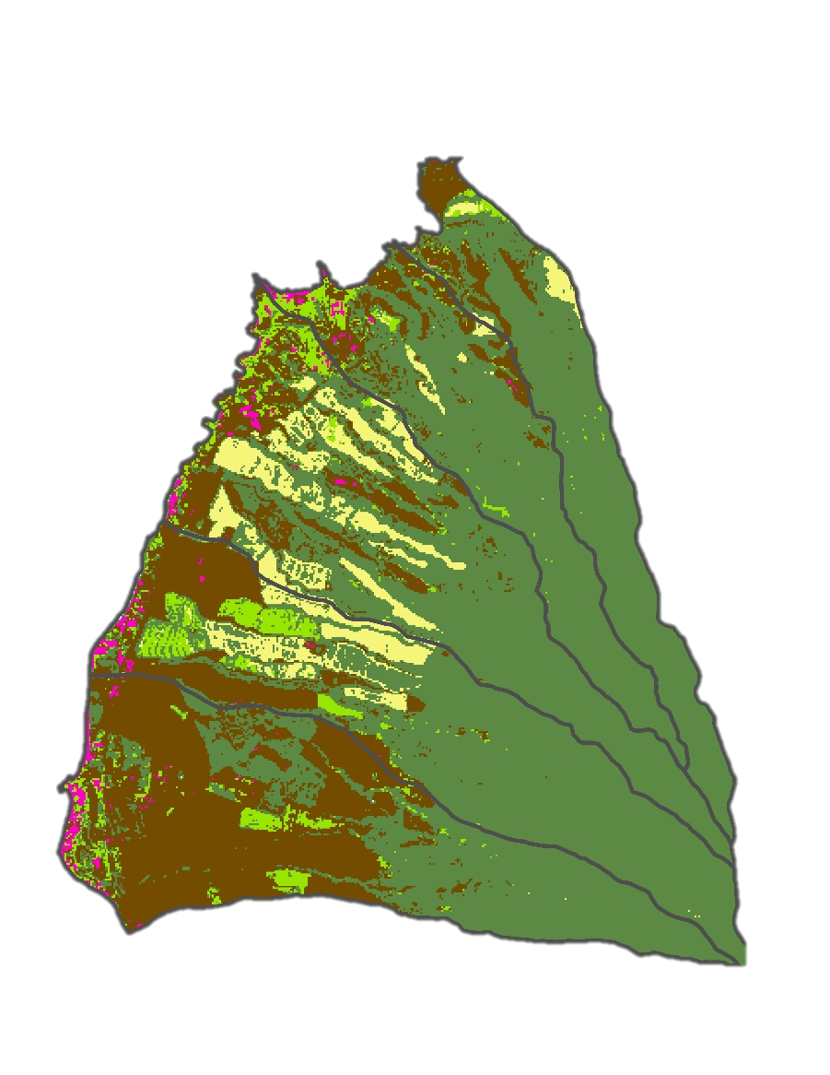
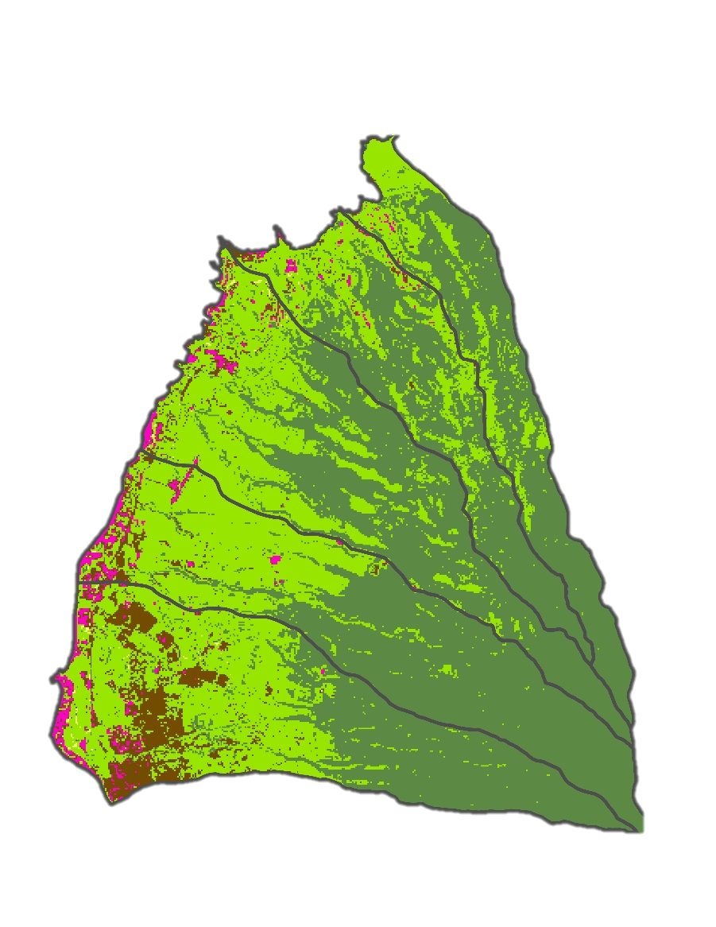
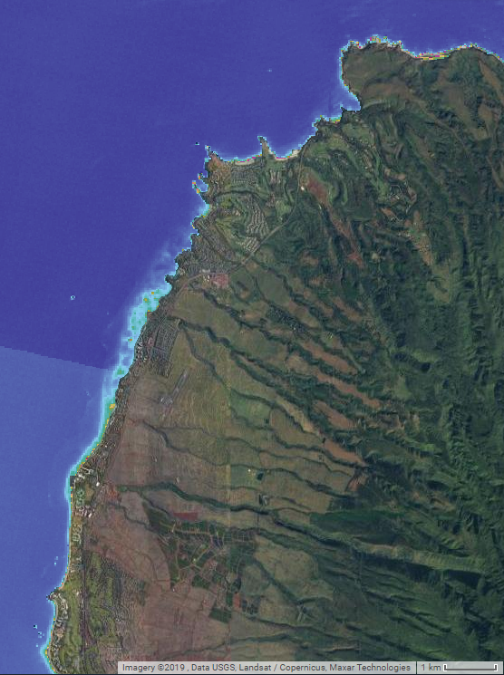
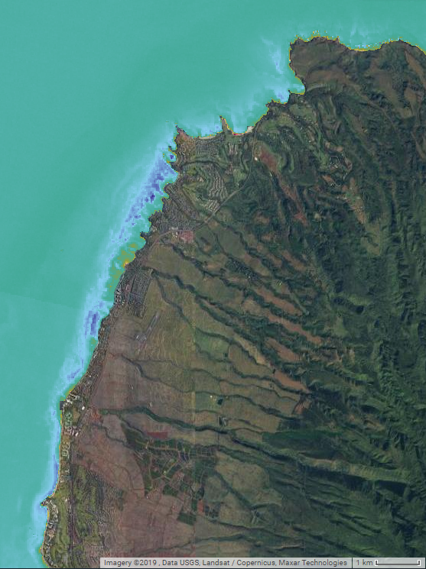
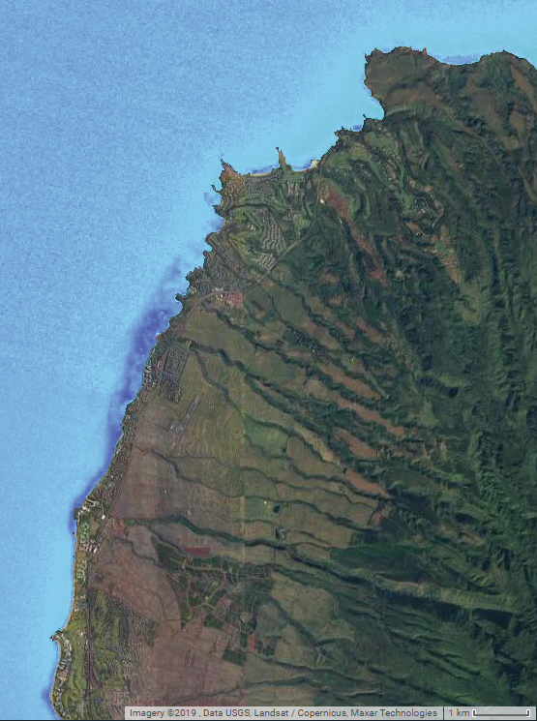
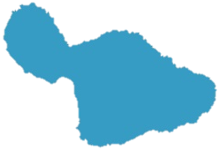
Monitoring the Impact of Land-Based Sources of Pollution on Water Quality Along the Coast of West Maui, Hawai'i, to Assess Coral Reef Condition
Abstract
Study Area and Timeline
Hawai'i Water Resources
West Maui is at risk of losing ecosystem services provided by coral reefs due to land-based sources of pollution (LBSP). In 2011, the US Coral Reef Task Force (USCRTF) identified the West Maui watershed as a priority watershed (along with its sub-watersheds of Wahikuli, Honokōwai, Kahana, Honokahua, and Honolua) after decades of coral decline, giving rise to the multi-agency West Maui Ridge to Reef (R2R) Initiative. The DEVELOP Hawai’i Water Resources team partnered with the R2R Initiative and the Hawai’i Department of Land and Natural Resources Division of Aquatic Resources (DLNR-DAR) to address the need for better watershed management practices. The team provided the partners with a Google Earth Engine tool that displays land use and land cover changes (LULCC) in the five watersheds and detects near-shore turbidity, chlorophyll-a (chl-a), and sea surface temperature using Landsat 4 Thematic Mapper (TM), Landsat 5 TM, Landsat 7 Enhanced Thematic Mapper Plus (ETM+), Landsat 8 Operational Land Imager (OLI), Terra Moderate Resolution Imaging Spectroradiometer (MODIS), and Aqua MODIS. Team members used ancillary data provided by the R2R Initiative and the USGS Pacific Coastal and Marine Science Center (PCMSC) to validate satellite parameter values. The land cover analysis captured a general trend of increasing impervious cover and decreasing vegetated cover from 1989 to 2019; however, the extent of this change varied between each watershed. This analysis, coupled with the tool, can help project partners continually monitor terrestrial and marine patterns associated with coral decline.
Land Study Area: Ridge to Reef Priority Watersheds:
- Honolua
- Honokahua
- Kahana
- Honokowai
- Wahikuli
Marine Study Area: 5 kilometer buffer from shoreline
Timeline: 1989 to 2019
Land Study Area
Marine Study Area
Hawaiian
Islands
Pacific
Ocean
Results
West Maui
Land Use Land Cover Change
Objectives
Classify land cover and land use in West Maui over a 30-year time period to assist partners in detecting patterns of development
Analyze trends in turbidity and chlorophyll-a around West Maui
Explore the relationship between LULCC and water quality parameters
Produce a Google Earth Engine tool that allows partners to view annual land cover classification, map land use changes between chosen years, and explore water quality over time
1989
1999
Barren soil
Urban
2019
Pineapple
Agricultural vegetation
Non-agricultural vegetation
Map Extent
Methodology
Data Inputs
Earth Observations
Landsat 1-4, Landsat 5, Landsat 7, Landsat 8
Validation Data
In situ water quality data & land class control points
Ancillary Data
MODIS (SST)
Water Quality Modeling
Processing
Atmospheric correction & cloud masking
Calculate marine NDVI, turbidity¹, & K_{d}(PAR)²
Validate outputs
& analyze patterns
TIME Tool
Turbidity (NTU)
K_{d}(PAR)
Marine NDVI
Yearly average image compositing
Classify land cover³, & vegetation change⁴
0
30
0
30
-1
1
1. Nechad et al. 2009, 2. Song et al. 2017, 3. CART classifier, 4. NDVI difference
Water quality algorithms run on the Landsat 8 OLI image taken February 10th, 2014.
Marine NDVI can be used as a relative measure of chlorophyll-a, while turbidity and K_{d}(PAR) are informative of light attenuation and amounts of suspended sediment in the water.
N
Map Extent
Outputs
Conclusions
Land cover, vegetation change, and water quality maps
 Google Earth Engine TIME Tool to facilitate interactive data display and analysis
 Analysis of land cover and water quality trends over time
Land cover classifications of composited Landsat imagery accurately reflect known changes in agricultural land use over the study period.
Precipitation was found to be a strong predictor of turbidity events.
Landsat imagery can be used to reliably model water quality shifts in the region.
Algorithms calibrated with site-specific data would improve the accuracy of water quality modeling.
By incorporating more ecosystem dynamics into future studies, the relationship between land cover changes and subsequent water quality changes can be better understood.
Earth Observations
Landsat 4/5
Landsat 7
Landsat 8
Terra MODIS
Aqua MODIS
Project Partners
Acknowledgements
US Coral Reef Task Force, West Maui Ridge to Reef Initiative (R2R)
Hawaii Department of Land and Natural Resources, Division of Aquatic Resources (DLNR-DAR)
USGS Pacific Coastal and Marine Science Center (PCMSC)
Tova Callender, West Maui Ridge to Reef Initiative
Russell Sparks, Hawaii Department of Land and Natural Resources, Division of Aquatic Resources
Curt Storlazzi, US Geological Survey
Dr. Juan Torres-Perez, Bay Area Environmental Research Institute (Science Advisor)
Gina Cova, NASA Ames Research Center Fellow
Zach Bengtsson, NASA Ames Research Center Project Coordination Fellow
John Dilger, Spatial Informatics Group
Dr. William Hernández, University of Puerto Rico
Lorenzo Terenzi, NASA Ames Research Center
Team Members
Arev Markarian
Project Lead
Emily Deardorff
Sophia Skoglund
Arthur Platel
California – Ames | Fall 2019

