Slide 1
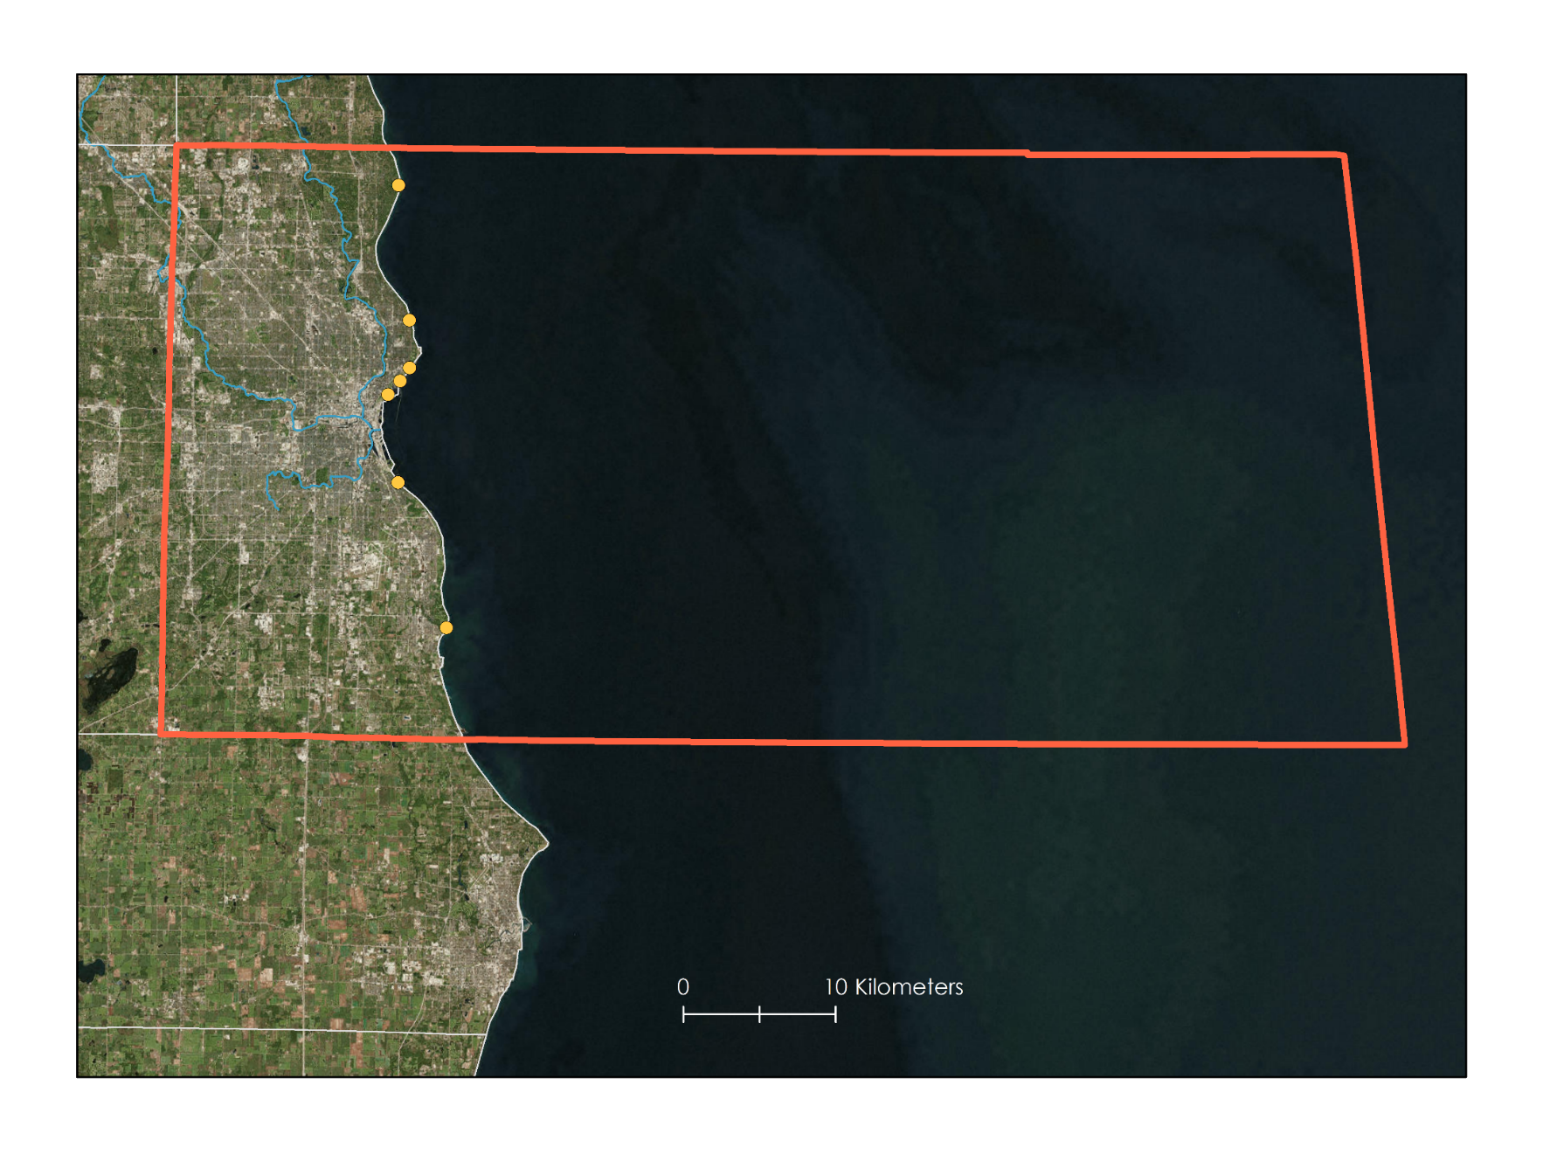
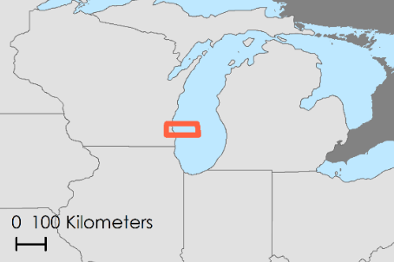
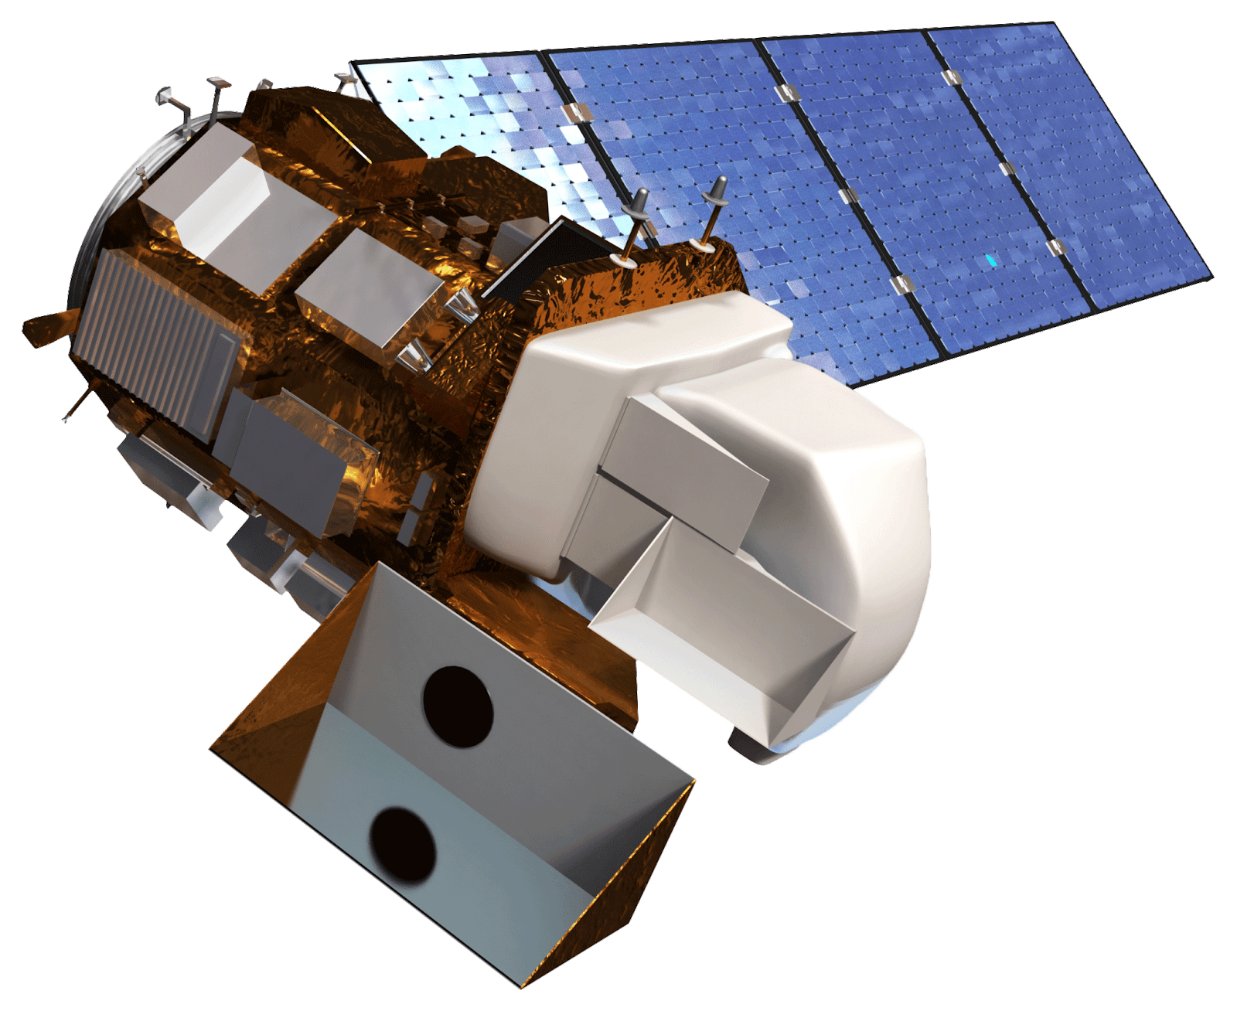
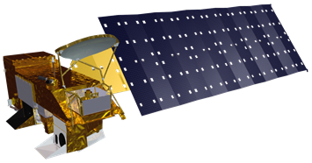
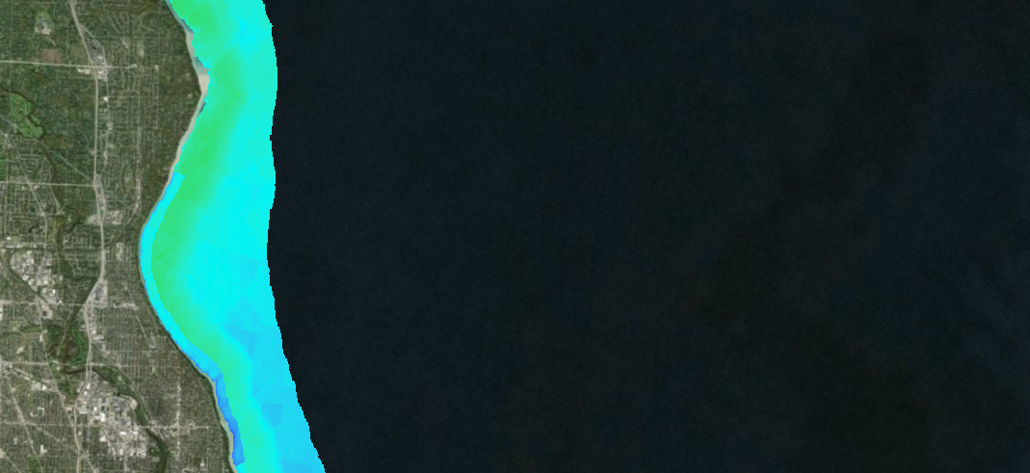
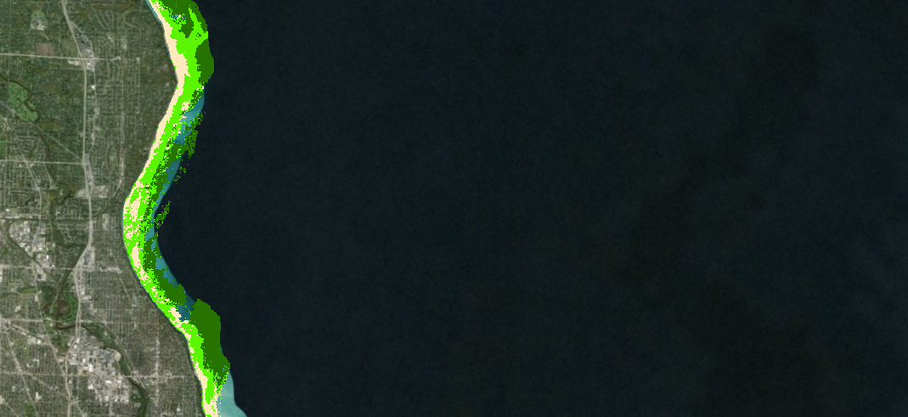
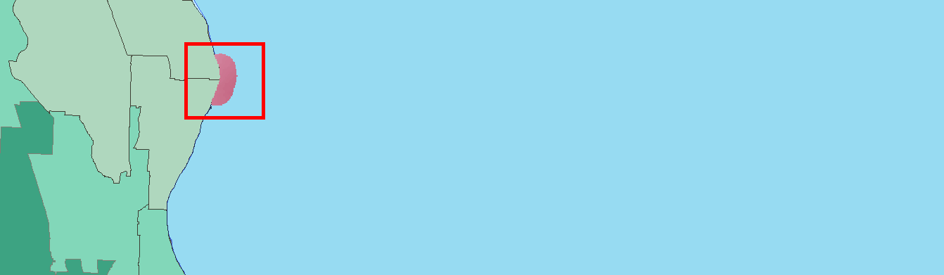
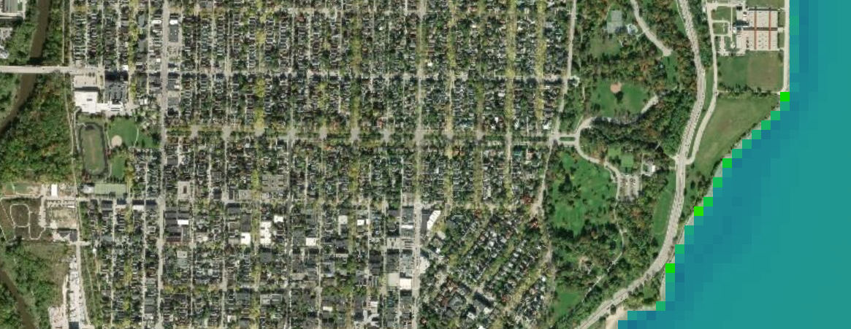
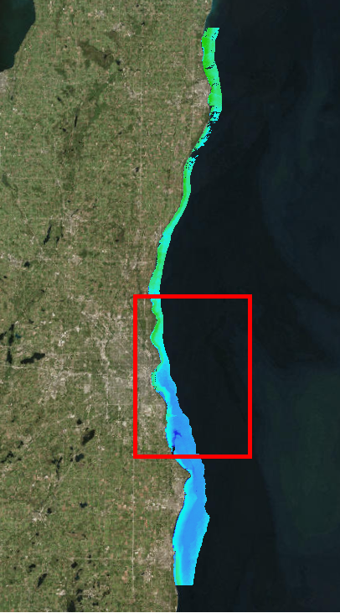
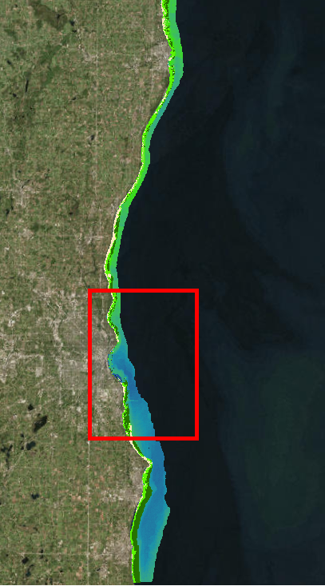
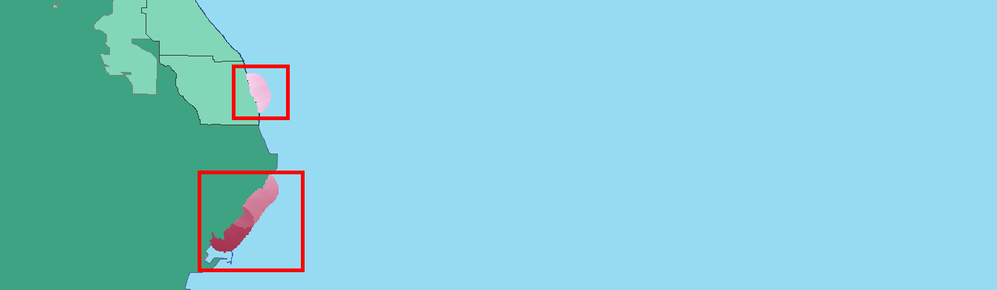
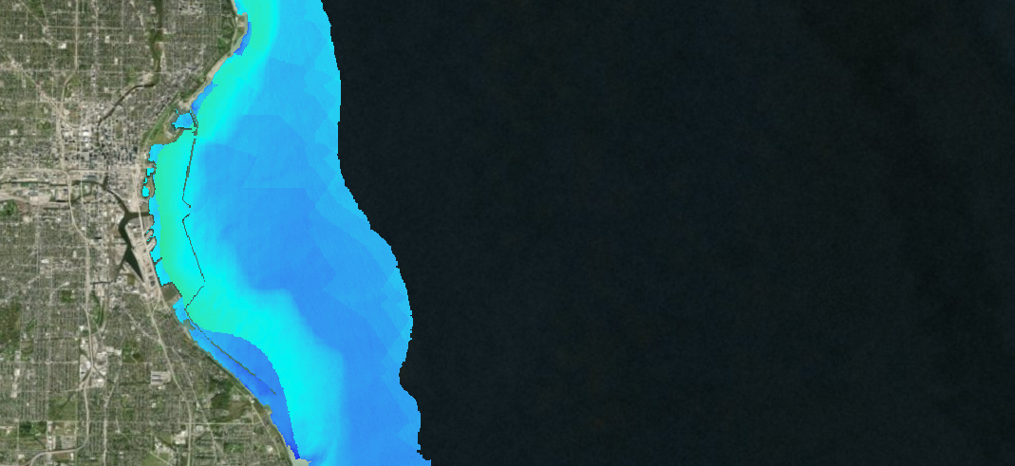
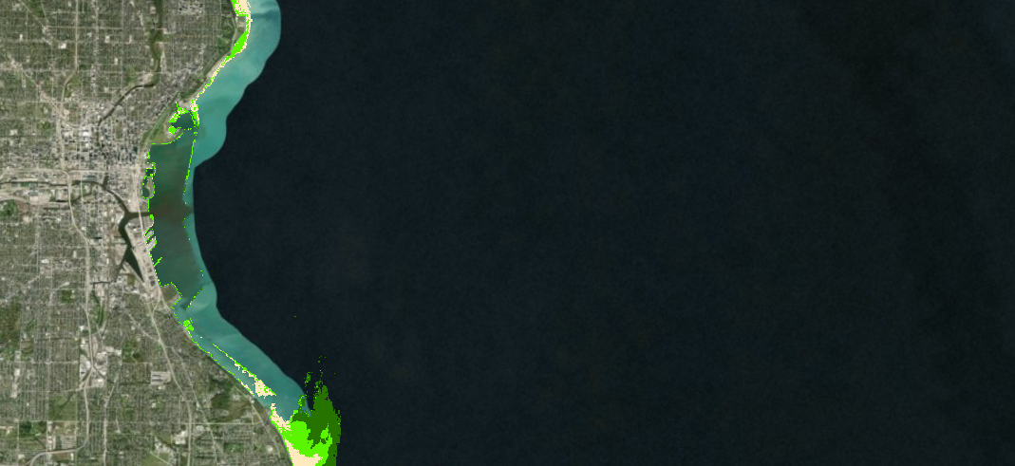
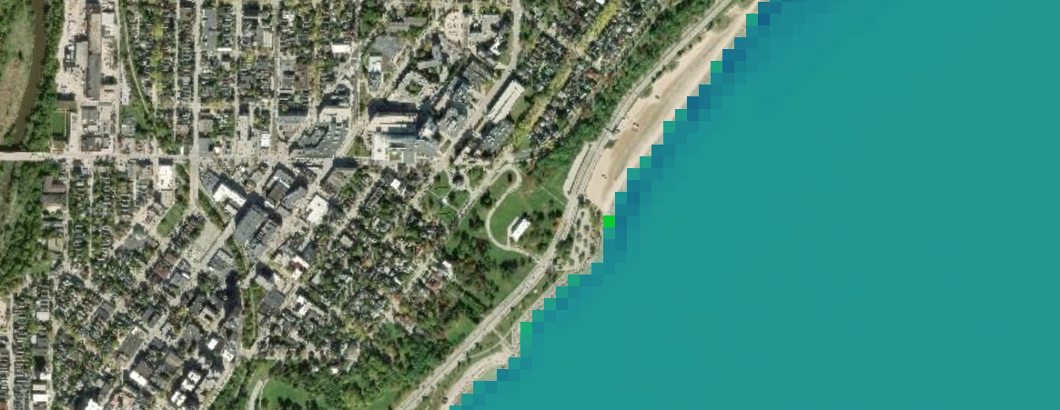
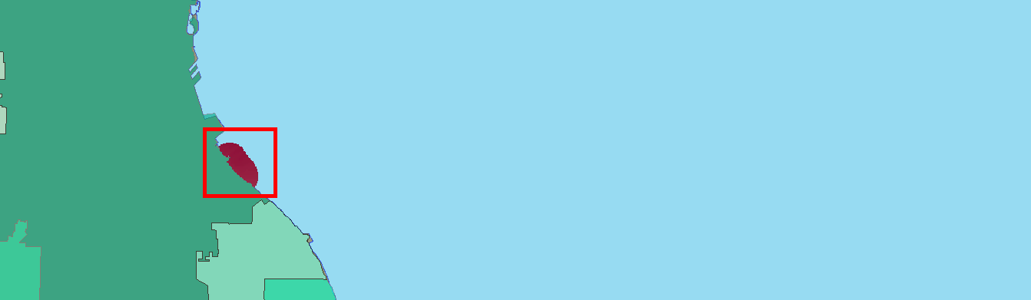
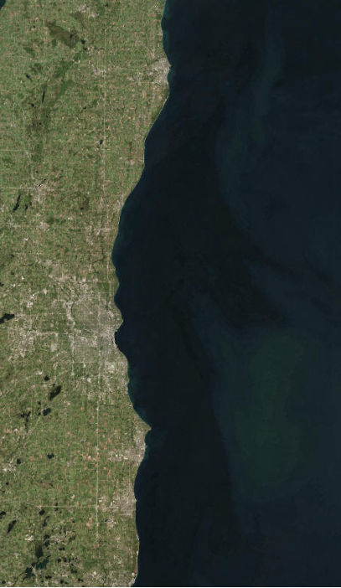
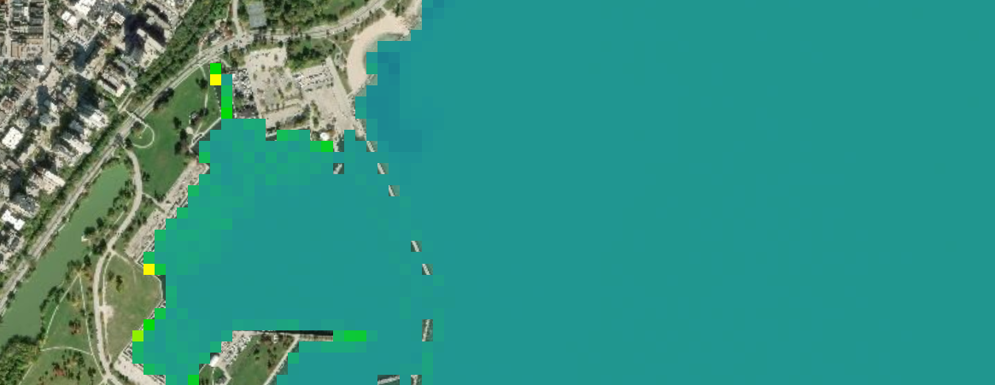
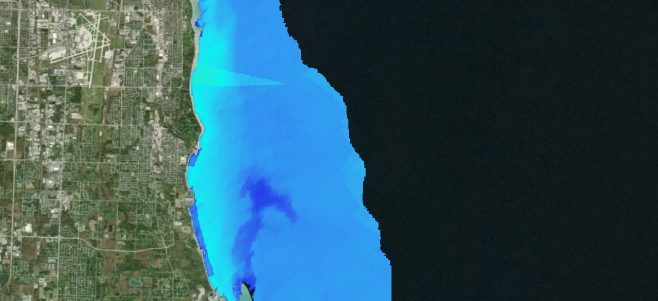
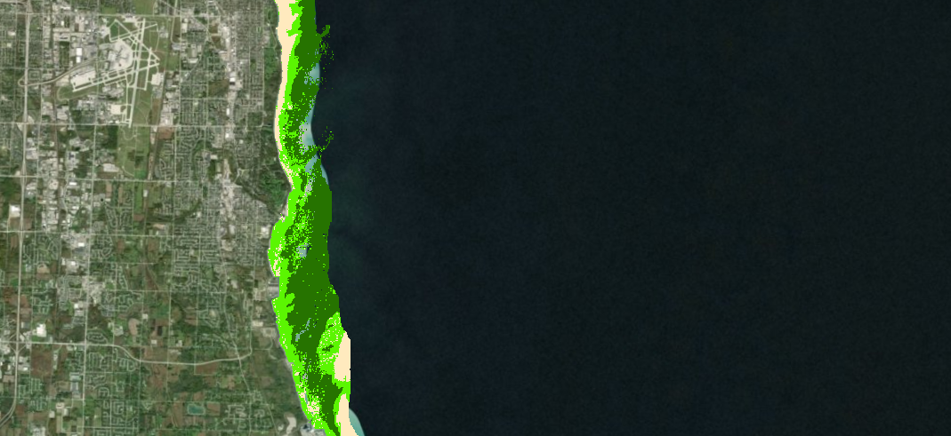

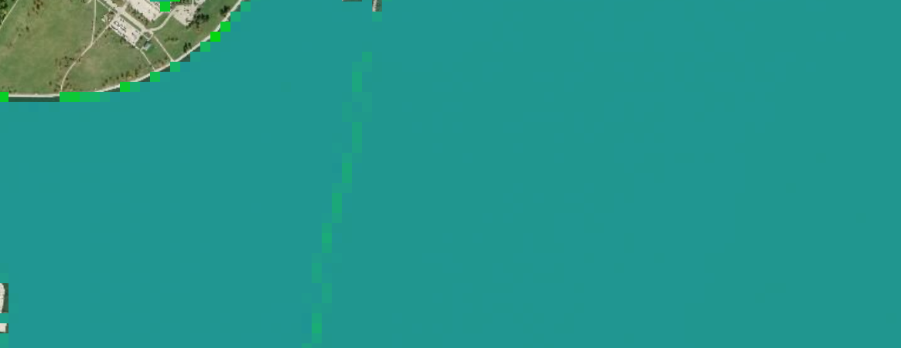




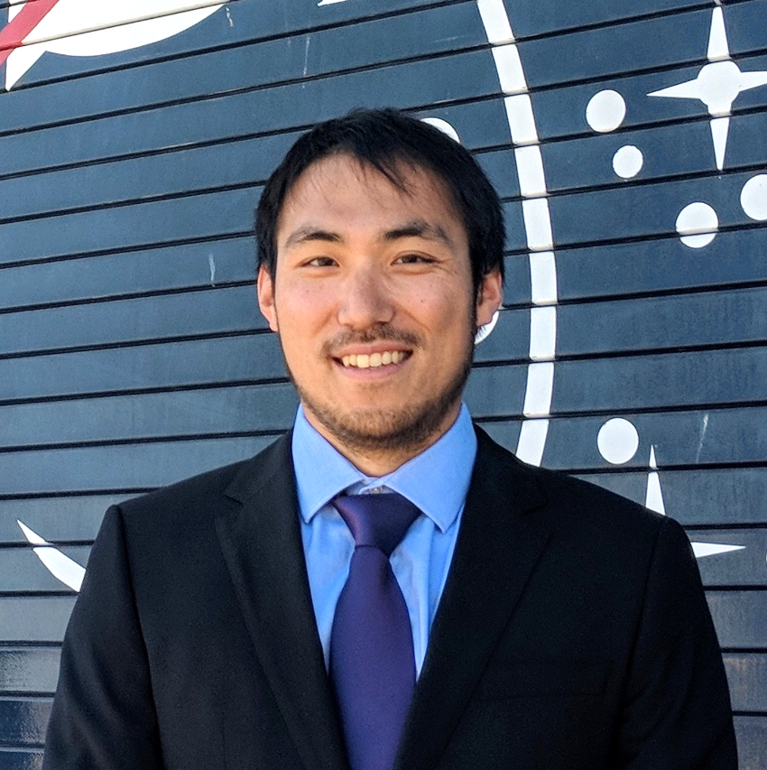

Utilizing NASA Earth Observations and Community Science to Detect and Map the Displacement of Cladophora along the Milwaukee County Shoreline
Abstract
Objectives
Study Area
Although Cladophora is naturally occurring and nontoxic, the accumulation and decay of this green macroalgae creates salient socioeconomic issues for communities situated along the shoreline of Lake Michigan. When Cladophora washes ashore and decays, it creates unaesthetic and unpleasant smelling beaches, potentially endangering public health and threatening the local tourism economy. Furthermore, decaying Cladophora promotes the growth of toxic bacteria, which can impact organisms that come into contact with it. In collaboration with Groundwork Milwaukee, the 2018 NASA DEVELOP Lake Michigan Water Resources team created Cladophora Habitat Suitability and Washup Predictive Maps to identify areas where the algae grows and predict where it will most likely come ashore. These maps were created using Landsat 8 Operational Land Imager (OLI) and Aqua Moderate Resolution Imaging Spectroradiometer (MODIS) imagery of Lake Michigan near Milwaukee, WI, from June to September for the years 2016 and 2017. The results of this project will be validated during the fall 2018 DEVELOP term using in situ data of Cladophora sightings collected by Groundwork Milwaukee using an ArcGIS Collector App. To encourage community involvement, the team developed a project story map and provided Groundwork Milwaukee with content for their community science social media campaign that highlights the significance of this project while informing members of the general public about how they can contribute to cleanup efforts. These products will allow local organizations such as Groundwork Milwaukee to identify, monitor, and predict the movement of Cladophora and allocate cleanup resources more efficiently along the shores of Lake Michigan.
Create Cladophora Habitat Suitability and Washup Predictive Maps to identify factors influencing growth, displacement, and deposition
Utilize the ArcGIS Collector tool via a mobile phone application to gather in situ data of Cladophora washup locations
Produce a project story map and social media campaign content to inform the public about how they can help address issues regarding Cladophora nuisances in their own communities
Doctors Park
Milwaukee
Atwater Beach
Bradford Beach
McKinley Beach
Veterans Lagoon
Lake Michigan
South
Milwaukee
South Shore Park
Grant Park Beach
Beach
River
Milwaukee County
County Boundary
IA
WI
MI
IL
IN
OH
Earth Observations
Methodology & Results
Landsat 8 OLI
Aqua MODIS
EARTH OBSERVATIONS
ACQUIRED SUITABILITY DATA
END PRODUCT
AQUA MODIS
Landsat 8 OLI
Bathymetry
Mussel Distribution
Substrate
Multi-Criteria Evaluation
END PRODUCT
ACQUIRED PREDICTIVE FACTORS
ArcGIS Collector
in situ Data
Cladophora Habitat Suitability Map
Population Density
Water Current Direction
Multi-Criteria Evaluation
END PRODUCT
Ground Truth
Data Processing
DERIVED SUITABILITY DATA
DERIVED PREDICTIVE FACTORS
Cladophora Washup Predictive Map
Compare
Turbidity
Water Temperature
Compare
Shoreline Curvature
Nearshore Structures
Submerged Aquatic Vegetation Mapping Algorithm (SAVMA)
DERIVED ANCILLARY DATA
EARTH OBSERVATIONS
DERIVED ANCILLARY DATA
Submerged Aquatic Vegetation Map
Landsat 8 OLI
Data Processing
Floating Algae Index Map
Cladophora Habitat
Suitability Map
Submerged Aquatic Vegetation Map
A
Cladophora
Washup Predictive Map
Floating Algae Index (FAI) Map
A
Doctors Park
B
Atwater
Beach
Milwaukee
Milwaukee
Milwaukee
B
C
Milwaukee
Bradford
Beach
C
Bradford
Beach
E
McKinley
Beach
D
South Shore
Park
D
Grant
Park Beach
McKinley
Beach
Habitat Suitability
SAVMA Classification
South
Milwaukee
Predictive Value
N
High
N
Sand
Low
High
FAI Value
Low
Less Dense SAV
E
N
High
Low
0
10
Dense SAV
Population Density
Beach
Kilometers
0
10
Low
High
N
0
1
Kilometers
0
Kilometers
10
Kilometer
Conclusions
Team Members
Cladophora Habitat Suitability Maps show more favorable habitat to the north outside of the Milwaukee County boundary, suggesting that Cladophora is carried down south by water surface currents before being deposited on beaches.
SAV maps show a substantial amount of Cladophora within the 10-meter bathymetry contour.
Cladophora Predictive Washup Maps suggest that the southern beaches will generally experience more algae deposition.
All FAI images had an approximate average value of zero, indicating there is no floating algae in the study area or that floating mats of Cladophora are too small to be detected in Landsat-sized pixels.
In situ data, gathered by Groundwork Milwaukee via Collector for ArcGIS, will be used during the fall 2018 DEVELOP term to assess the accuracy of the Cladophora Predictive Washup Map.
Studying the growth and deposition of Cladophora in Milwaukee County is difficult due to the lack of relevant data and field research being performed in our study area.
Jerrold Acdan
Project Lead
Steven Chao
Lawrence Fujiwara
Ella Golovey
Acknowledgements
Lawrence Hoffman (GIS Program Manager, Groundwork Milwaukee)
Deneine Powell (Executive Director, Groundwork Milwaukee)
Alex Halloway (GIS Intern, Groundwork Milwaukee)
Alex Litscher (GIS Intern, Groundwork Milwaukee)
Dr. Juan Torres-Pérez (Bay Area Environmental Research Institute, NASA Ames Research Center)
Dr. Sherry Palacios (Bay Area Environmental Research Institute, NASA Ames Research Center)
Jenna Williams (DEVELOP Center Lead, NASA Ames Research Center)
John Dilger (DEVELOP Geoinformatics Fellow, NASA Ames Research Center)
Project Partner
Groundwork USA, Groundwork Milwaukee
Lake Michigan Water Resources
California – Ames | Summer 2018

