Slide 1
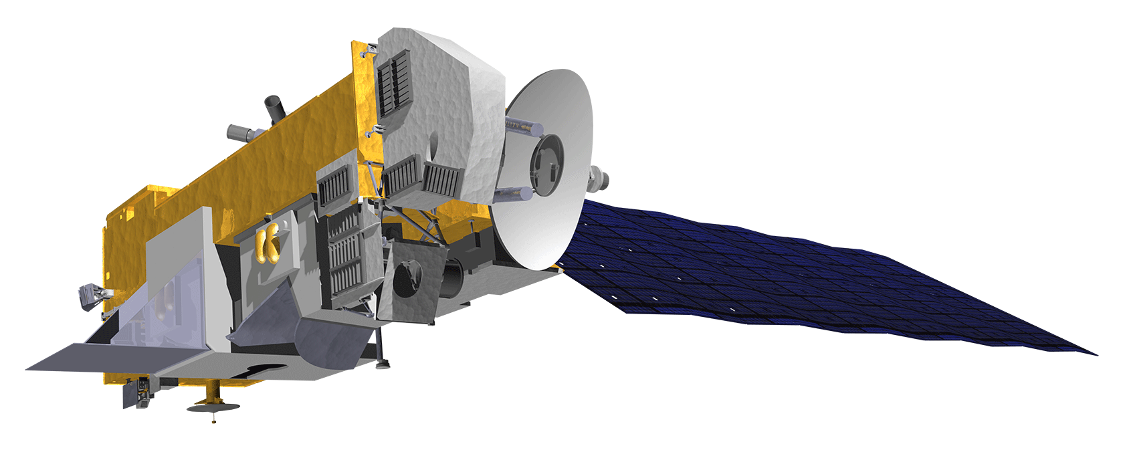
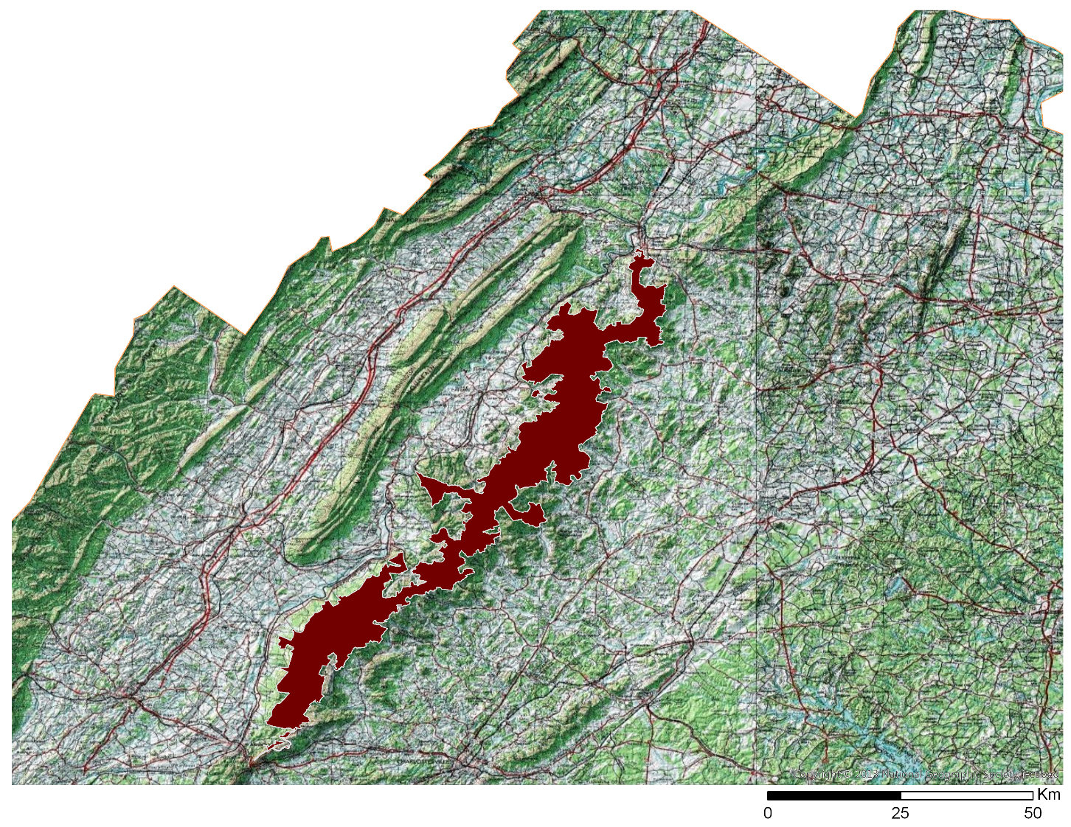
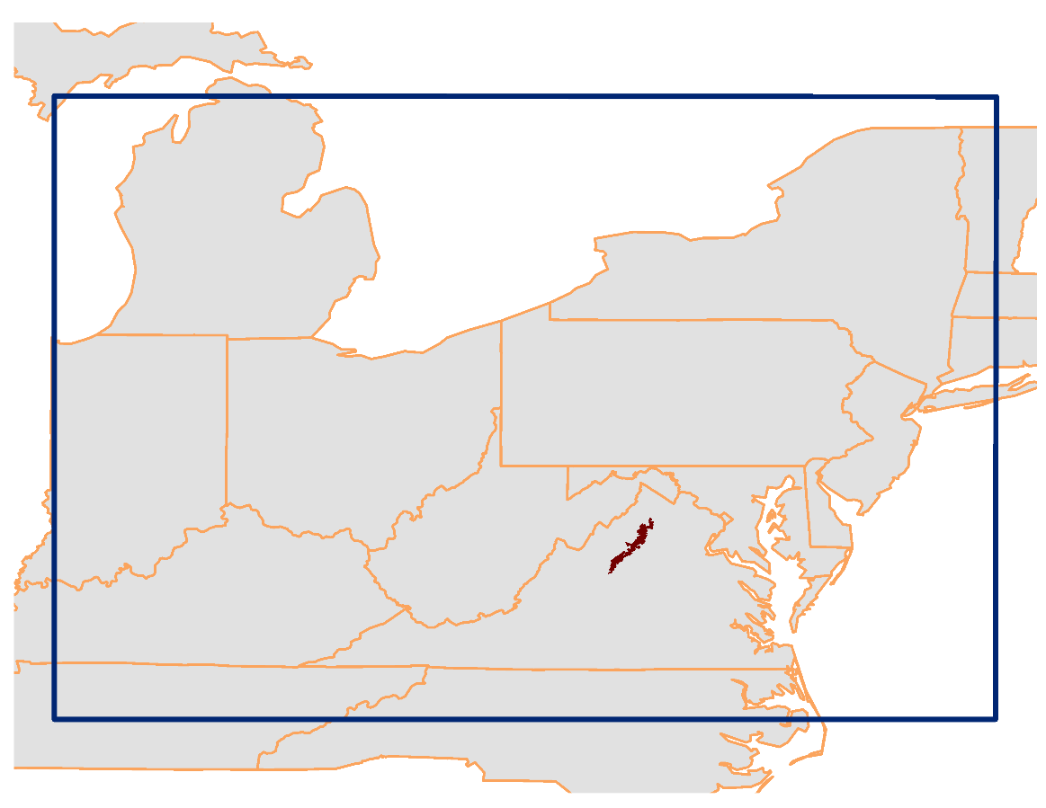
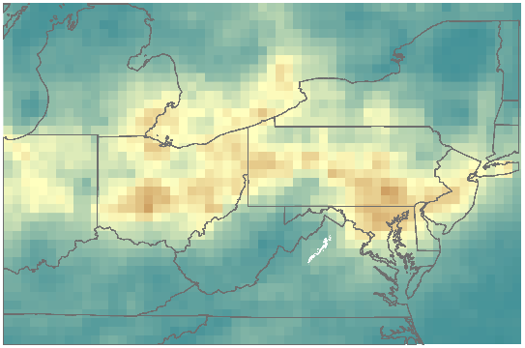
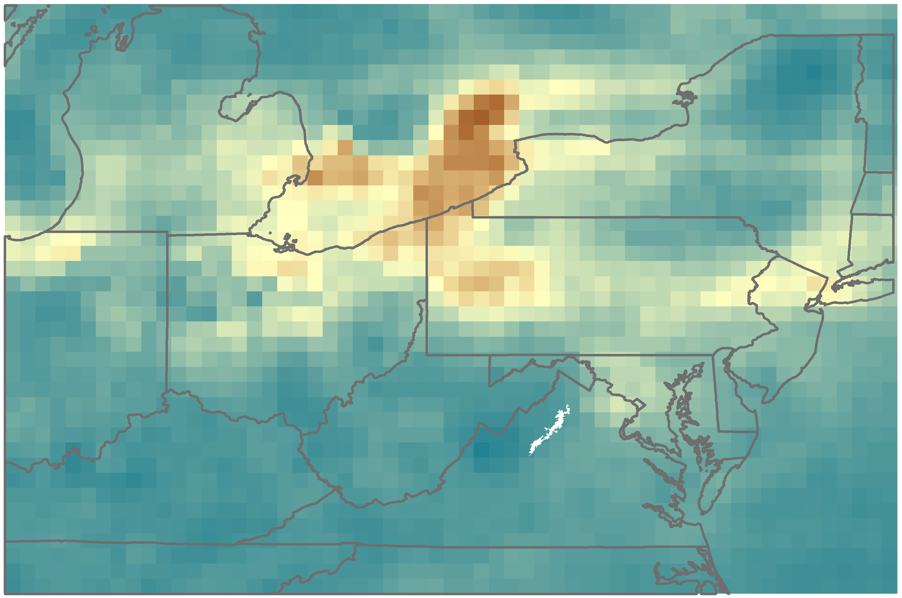
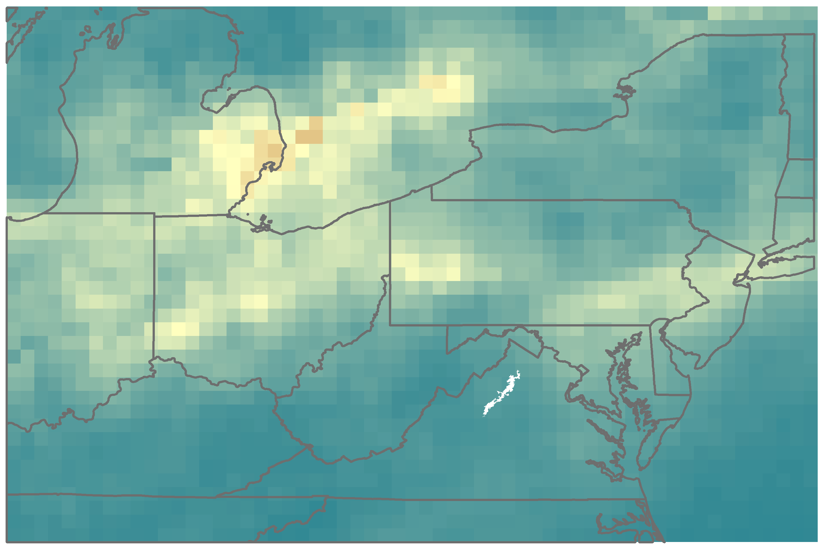
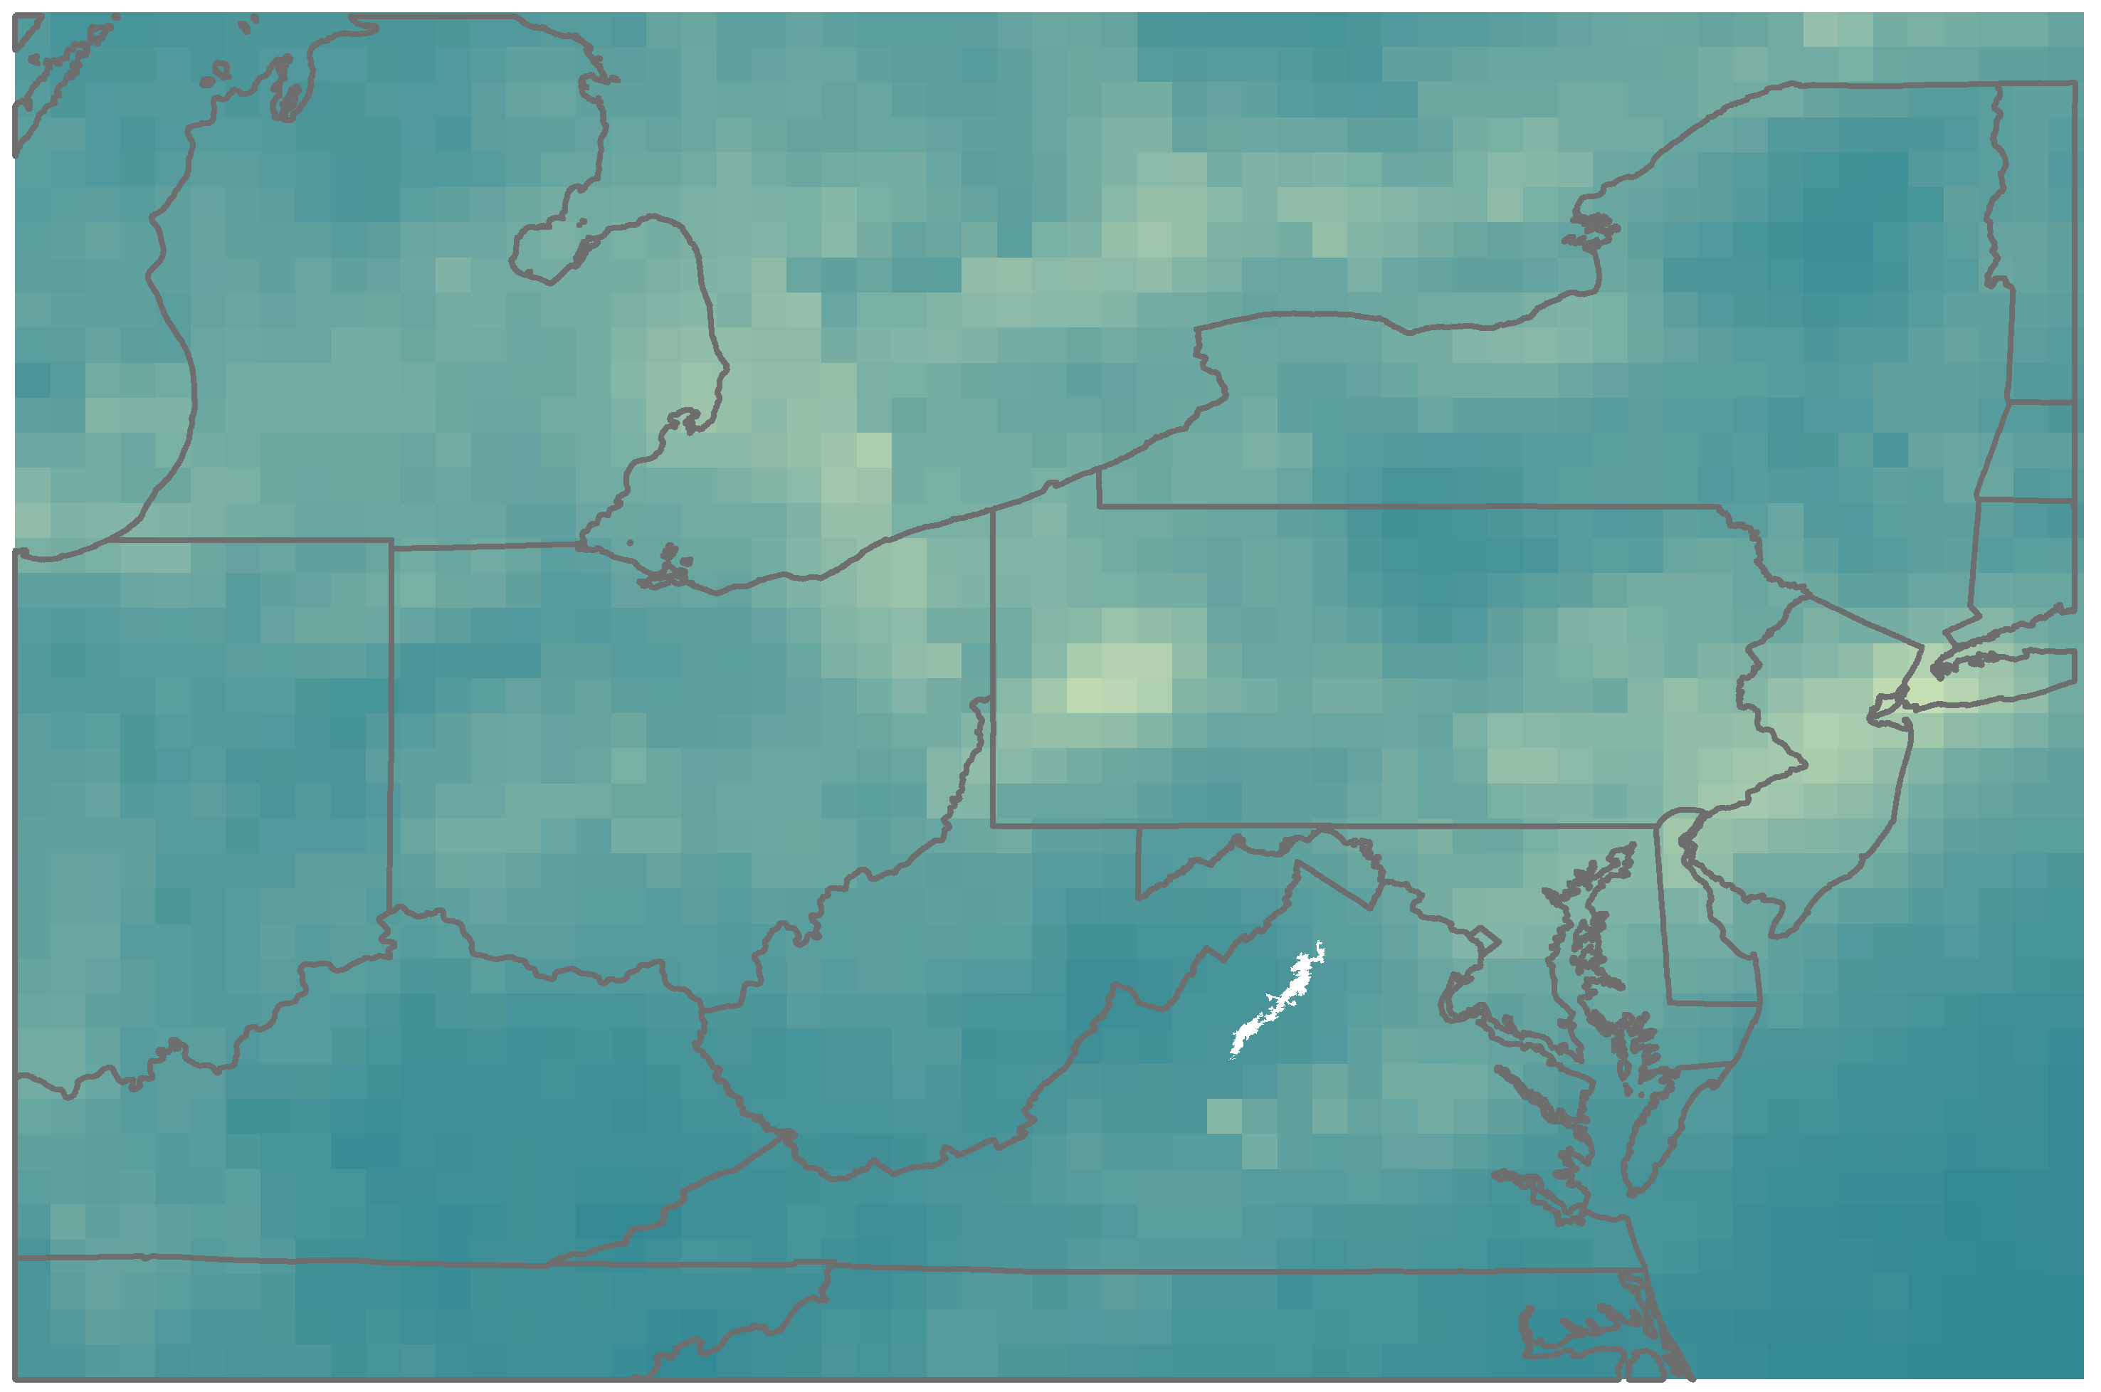
Monitoring Air Quality in Shenandoah National Park to Address National Park Service Initiatives
Abstract
Objectives
Gases such as ozone (O₃), nitrogen dioxide (NO₂), and sulfur dioxide (SO₂) have impeded visibility and impacted air health in Shenandoah National Park, one of the primary attractions of Virginia. Air quality is considered one of the park’s fundamental resources and is essential to maintaining its significance as a premier park with world-class views. This project utilized NASA Earth observations, including Aura's Ozone Monitoring Instrument (OMI), to monitor ozone and nitrogen dioxide that threaten visibility and plant, animal, water, and human health in the park. Trend maps were created to assess spatial and temporal trends in pollutant species over Shenandoah National Park and the surrounding airshed. A methodology was created to help the National Park Service incorporate remote sensing data into their management decisions related to park health and air quality concerns. In situ station data from Big Meadows monitoring station were used to validate the NASA Earth observations. This information will aid in future decisions related to visitor education and ecological management in accordance with mandates from the Clean Air Act, the National Park Service Organic Act of 1916, and the Wilderness Act.
Assess spatial and temporal trends in atmospheric pollutant species over Shenandoah National Park
Analyze trends based on monthly, seasonal, and annual time steps
Create a methodology to visualize air quality parameters over time
Earth Observations
Project Partners
Aura OMI
Methodology
Study Area
Data Acquisition
Aura OMI – Ozone, NO₂, SO₂
Big Meadows (in situ) – CASTNET
Data Processing
Monthly & Annual Averages
Time Series
Data Analysis
Correlation Analysis
Trend Maps
Results
Shenandoah National Park, Virginia
Shenandoah Health & Air Quality
Ozone
Nitrogen and Sulfur Dioxides
January NO₂ Concentrations
2005 2006 2007 2008 2009 2010 2011 2012 2013 2014 2015 2016
2005
2009
2005 2006 2007 2008 2009 2010 2011 2012 2013 2014 2015 2016
OMI Observations
Ground-level Observations
2014
2016
Molecules/cm²
High: 3.95e+016
Low: 0
Conclusions
Remotely sensed NO₂ exhibited a decrease over time, but ozone and SO₂ remained relatively constant.
Ozone and SO₂ data were not statistically correlated with in situ observations.
Tropospheric NO₂ and total column NO₂ were highly correlated.
Remote sensing can provide the park with big-picture, long-term data to foresee trends in air pollutants that affect the park.
Team Members
Acknowledgements
Jalyn Cummings, National Park Service, Shenandoah National Park
Dr. Barkley Sive, National Park Service, Air Resources Division
Dr. Bruce Doddridge, NASA Langley Research Center
Dr. Kenton Ross, NASA Langley Research Center
Ellen Bubak
(Project Lead)
Amanda Clayton
Doug Gardiner
Nicholas Lenfant
Julie Terhune
NASA Langley Research Center – Summer 2017

