Slide 1
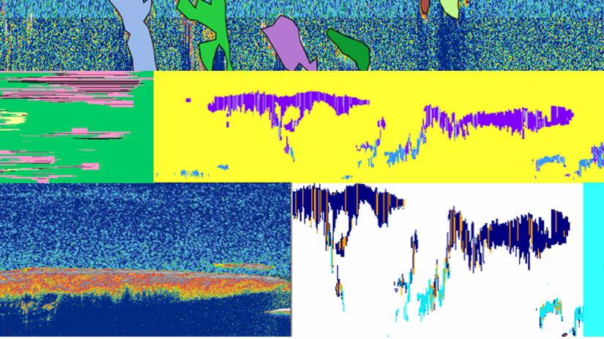
CALIPSO Cross-Cutting
Kathleen Moore (Co-Project Lead)
Enhancing the Usability of Visualization of CALIPSO (VOCAL) Through a Test Case-Driven Approach
Ahmad Aburizaiza (Co-Project Lead)
Adama Ba
Andrea Martinez
Joseph Driscoll

Slide 2
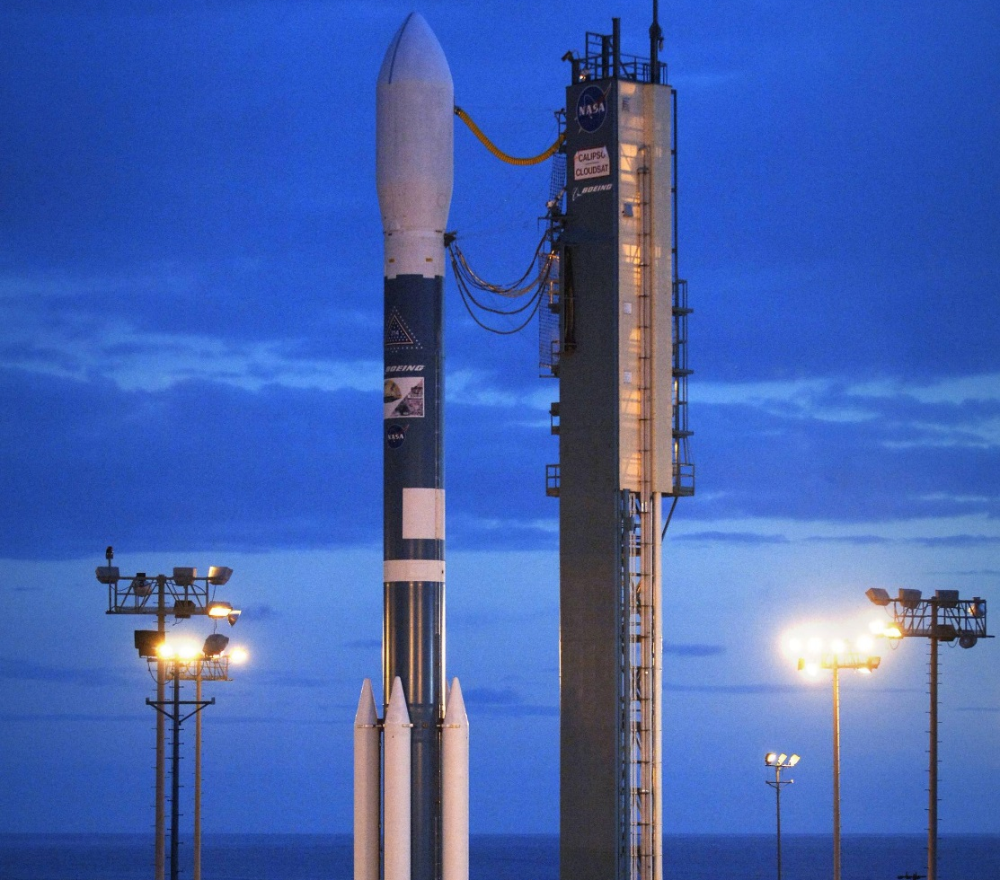
Components
Community Concerns
CALIPSO
Objectives
Use-Cases
Software Development
Conclusion
Future Work
Image Credit: NASA/Bill Ingalls
Notes:
AHMAD: In the following talk, we will discuss these points, beginning with an introduction to the CALIPSO satellite and its motivating applications, to our software development throughout the term on Visualizer of CALIPSO, or “VOCAL.” (Then briefly summarize the trajectory of the talk…)
Image source: https://commons.wikimedia.org/wiki/File:Delta_II_7420_on_Launch_Pad_SLC-2W.jpg

Slide 3
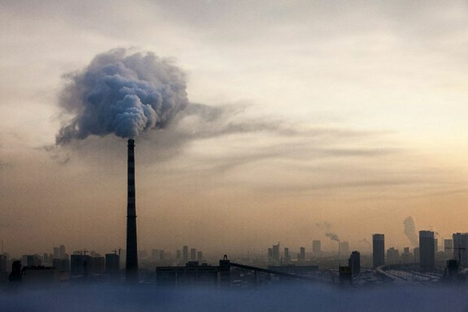
Community Concerns
Health & Air Quality
7 million premature deaths worldwide
Climate
Influences the radiative budget of Earth
Weather
Earth’s surface temperature
Precipitation events
Image Credit: RFA
Notes:
ANDREA: Our project has three focus areas related to community concerns. Health and air quality is a global concern and contributes to 7 million premature deaths worldwide. Aerosol pollutants will have broader impacts on the climate since aerosol act as cloud nuclei, influencing the properties of clouds. This could have range of changes to the radiative budget of Earth and will ultimately result in weather changes, especially in terms of surface temperature and precipitation events. By understanding how aerosol interact within the atmosphere and contribute to these community concerns improved policy decisions can be made. Scientist are improving their knowledge by focusing on point source and dispersion patterns.
Image source: http://www.rfa.org/english/news/china/china-smog-03032016135155.html

Slide 4
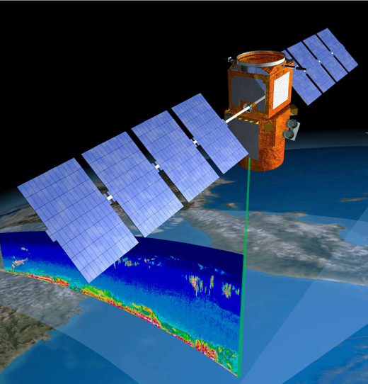
NASA Satellite: CALIPSO
CALIPSO
Cloud-Aerosol LiDAR and Infrared Pathfinder Satellite Observation
LiDAR sensor
CALIOP (Cloud-Aerosols LiDAR with Orthogonal Polarization)
Measurements
Backscattering
Depolarization
Image Credit: NASA
Notes:
ADAMA: CALIPSO is a Lidar-based satellite that scans the atmosphere vertically. Backscattering and depolarization responses from particles in the atmosphere indicate different compositions. There are two supplementary sensors, the Wide Field Camera (WFC) and the Imaging Infrared Radiometer (IIR), in addition to the Lidar sensor. These mostly help with calibration.
Image Source: http://www.rfa.org/english/news/china/china-smog-03032016135155.html

Slide 5
Pre-term VOCAL
Displays HDF
Polygon-drawing and attribute annotation
JSON and database storage
Notes:
KATIE: Prior to the start of this term, VOCAL had the following functionality: It could display HDF files, permit the user to draw polygons around regions of interest, let the user annotate these polygons with attributes about the region in question, and facilitate storage of these polygons into JSON files and a local database.

Slide 6
Pre-term VOCAL
Displays HDF
Polygon-drawing and attribute annotation
JSON and database storage
Notes:
KATIE: Prior to the start of this term, VOCAL had the following functionality: It could display HDF files, permit the user to draw polygons around regions of interest, let the user annotate these polygons with attributes about the region in question, and facilitate storage of these polygons into JSON files and a local database.

Slide 7
Image Credit: Nature, Bjorn Stevens
Objectives
Develop use-case scenarios
Enhance data visualization
Improve annotation flexibility
Ensure compatibility with multiple CALIPSO data products
Notes:
ANDREA: This term, the CALIPSO Cross-Cutting team had a variety of objectives with respect to VOCAL. First, to inform enhancements to the software, the team underwent use-case testing of the software, acting as the intended users, the CALIPSO Science Team. Second, the team wanted to make data visualization comprehensive, to aid aerosol tracking and tagging. Finally, the team set out to add more ways to annotate polygons and ensure compatibility with multiple CALIPSO data products, like Level 2 and Version 4 data.
Image source: http://www.nature.com/nature/journal/v490/n7418/fig_tab/490040a_F1.html Image source
KATIE: After conducting preliminary use-case testing of the software, we added functionality to the software in two categories of enhancement: compatibility and visualization. We identified some inhibitors to usability, which we addressed, and we also extended data import compatibility to Level 2 and Version 4 data.
Image Source:

Slide 8
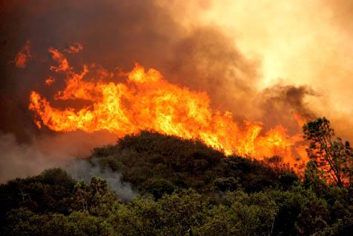
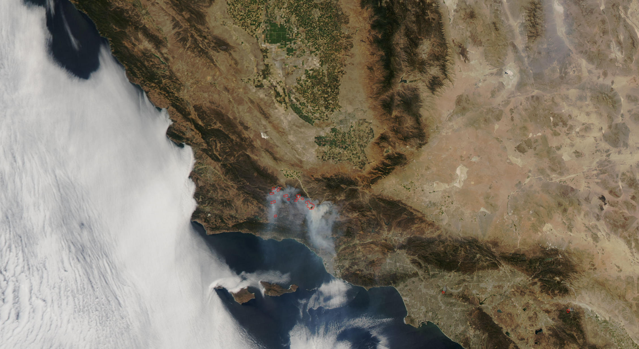
Use-Case: Zaca Fire, Santa Barbara, CA - 2007
Cuyama River
Santa Barbara
Image Credit: Forest Service
Image Credit: NASA
204,207 acres burnt
$118.3 million in loss
43 injuries
Notes:
ADAMA: Zaca fire caused more than $118.3 millions in loss (Data: http://cdfdata.fire.ca.gov/incidents/incidents_details_info?incident_id=190)
Image from NASA earth observatory shows smoke from the Zaca fire in California.
Image sources:
http://www.independent.com/news/2007/aug/09/evacuations-begin-zaca-fire-burns-ever-closer/
http://earthobservatory.nasa.gov/NaturalHazards/view.php?id=18852

Slide 9
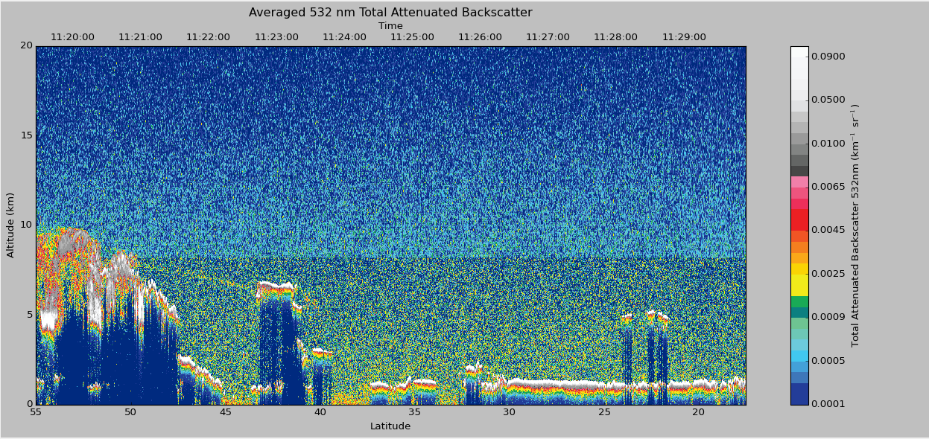
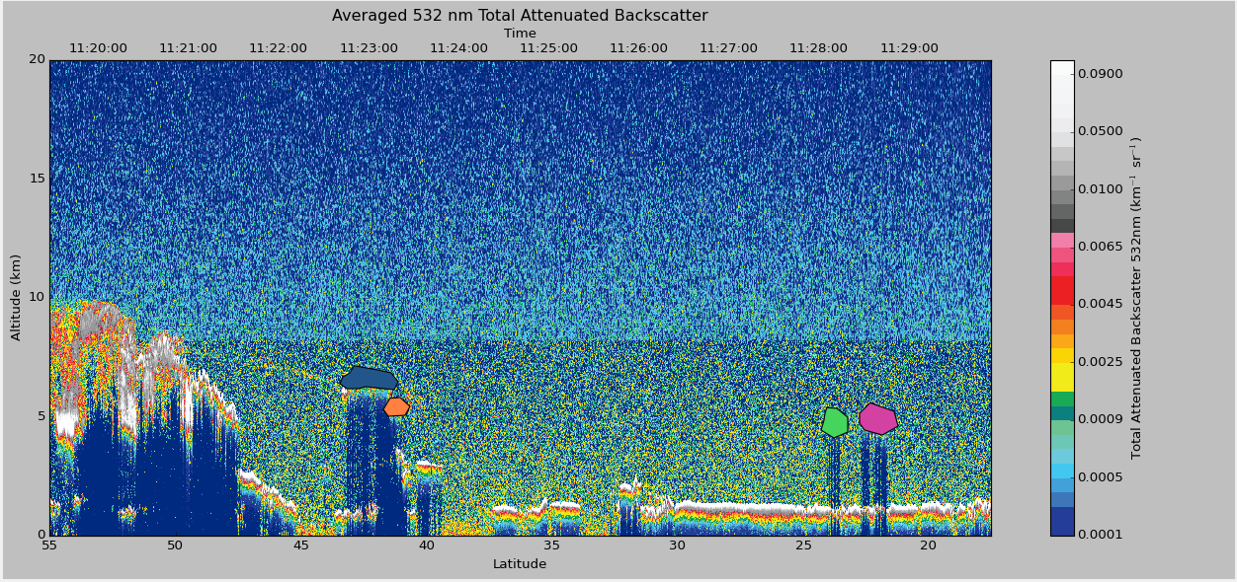
Use-Case: Zaca Fire, Santa Barbara, CA - 2007
Smoke
Smoke
Notes:
ADAMA: Smoke released in the atmosphere can be visualized using VOCAL.

Slide 10
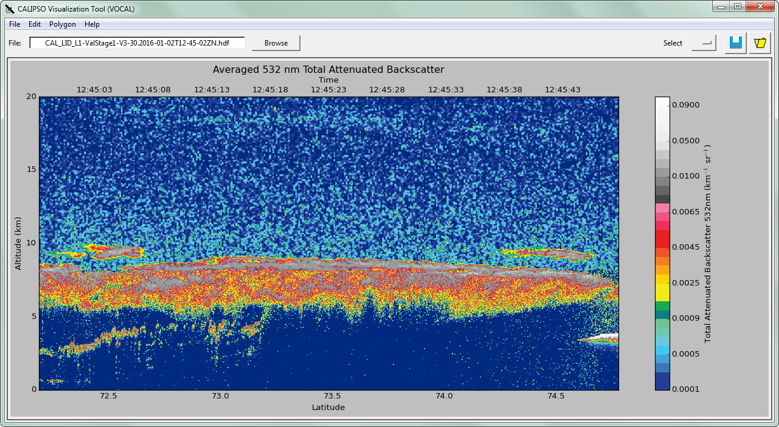
Software Development: Tabs
Notes:
AHMAD: One feature that we added was the ability to tab through data products for a given HDF file. The circled region shows the top of our interface and the tabs that appear, showing multiple possible views of the data in both L1 and L2 formats.
We have configured the graphical user interface or the GUI in other words … for the VOCAL software. The previous version was capable of loading one CALIPSO dataset at a time, only from two dataset options. Now the end user can load up to nine datasets of CALIPSO data. As you can see, only one dataset is selected on the figure to the left, while there are many datasets loaded on the figure to the right. Let me zoom in to the tabs… As you can see, we also implemented a new menu called Tabs. This menu gives the end user the option to hide some tabs or to show them back again. On the next slide, you will see an animated demo of the tabs and the their show/hide menu.

Slide 11
Software Development: Tabs
Notes:
Play video!
AHMAD: One feature that we added was the ability to tab through data products for a given HDF file. The circled region shows the top of our interface and the tabs that appear, showing multiple possible views of the data in both L1 and L2 formats.
As you can see, these are the tabs. The first tab called backscatter 532 tab is selected. Now another tab named depolarized is selected. This is a different dataset style from the same hdf file. Now this is the tabs menu for hiding and showing tabs by the end user for more focused analysis.
Alright, now I will turn it to Andrea where she will talk about two datasets she worked on from level 2 CALIPSO data.

Slide 12
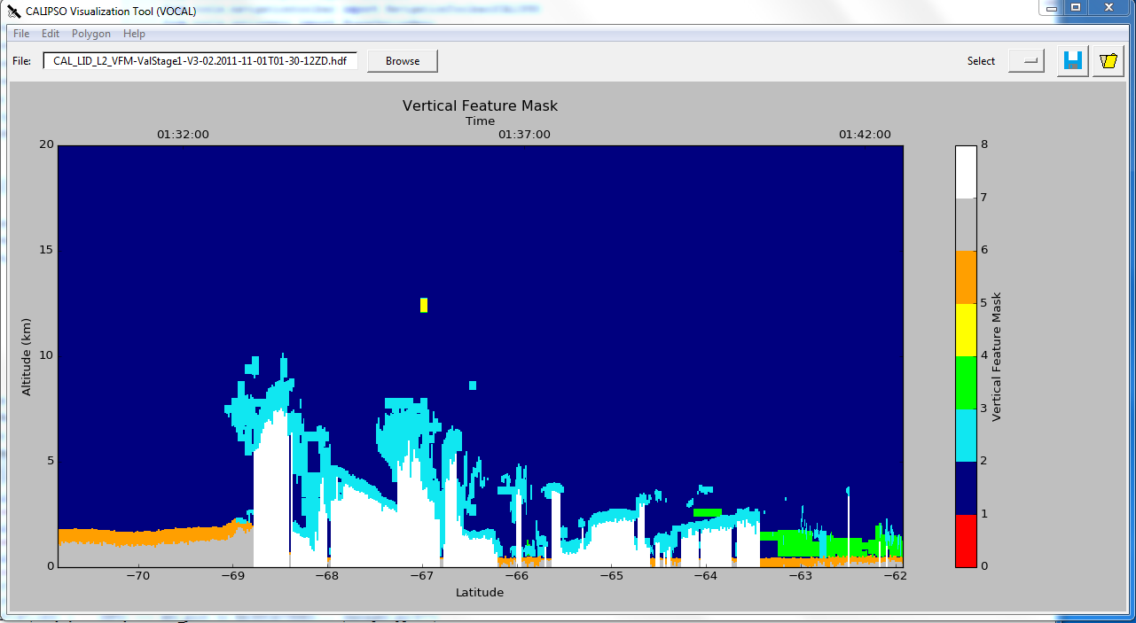
Software Development: Vertical Feature Mask
Notes:
ANDREA: An additional visualization feature that has been added is the vertical feature mask. This feature subtypes atmospheric feature into 7 categories allowing the end user to visually see the difference between a cloud and an aerosol within their dataset.

Slide 13
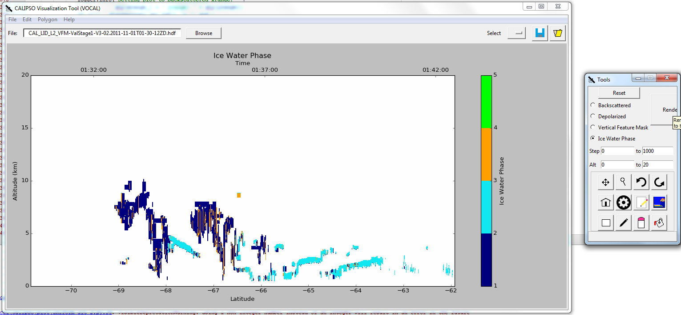
Software Development: Ice/Water Phase
Notes:
ANDREA: The ice/water phase visualization feature also displays atmospheric features. For this case, the water phase is classified allowing scientist to understand how aerosols are impacting cloud properties.

Slide 14
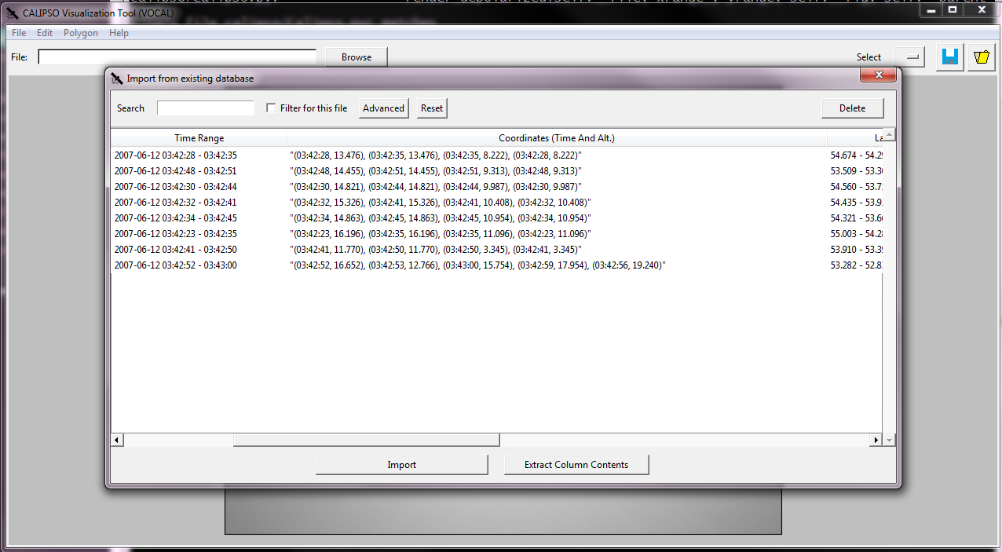
Software Development: Coordinates
Notes:
KATIE: After discussing usability with our partner, we determined that indexing coordinates by time and altitude would be most helpful for scientists working on this vertical profile data, as opposed to latitude and longitude. We incorporated the list of coordinates per polygon into the database, which can then be output in *.txt and *.csv formats.

Slide 15
Software Development: Longitude Display
Notes:
ADAMA: In addition to making coordinates more explicit, we added a second x-axis for longitude.
The more visual error-checking and sanity-checking, the better it is for scientists.

Slide 16
Software Development: Longitude Display
Notes:
KATIE: We also added the longitude range of each polygon into the polygon attribute pane.

Slide 17
Software Development: Drawing Polygons
Prior tool: “invisible” line
Added floating lines
Polygon closed with right-mouse-click
Improved efficiency
Image Credit: RFA
Notes:
Play video!
AHMAD: We also built a new method of sketching the polygons. The previous method was not smooth. In the new method, the user can see the line while sketching the polygon. Also, the user can close a polygon simply by a right-mouse-click.

Slide 18
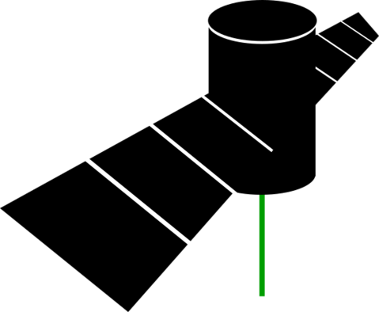
Conclusions
Broadened visualization:
Tabbing
Level 2 & Version 4
More verbose identification:
Longitude added
Polygon coordinates (time, alt.)
Ongoing use-case testing
Notes:
AHMAD: (Summarize bullets)

Slide 19
Future Work
Improve cross-platform compatibility
GeoJSON, KML, and WMS
More nuanced use-cases and FEEDBACK:
CALIPSO Science Team
Mentors: Dr. Kenton Ross, Grant Mercer
Notes:
KATIE: (Summarize bullets)

Slide 20
Dr. Kenton Ross, NASA DEVELOP National Program Science Advisor
Grant Mercer, NASA DEVELOP LaRC, Summer 2015, Team Lead
Michael Bender, NASA DEVELOP National Program Technical Lead
Jordan Vaa, CALIPSO Cross-Cutting III, NASA DEVELOP LaRC, Spring 2016
Nathan Qian, CALIPSO Cross-Cutting II, NASA DEVELOP LaRC, Summer 2015
Ashna Aggarwal, CALIPSO Health & Air Quality, NASA DEVELOP LaRC, Spring 2015
Courtney Duquette, CALIPSO Health & Air Quality, NASA DEVELOP LaRC, Spring 2015
Notes:
KATIE

Slide 21
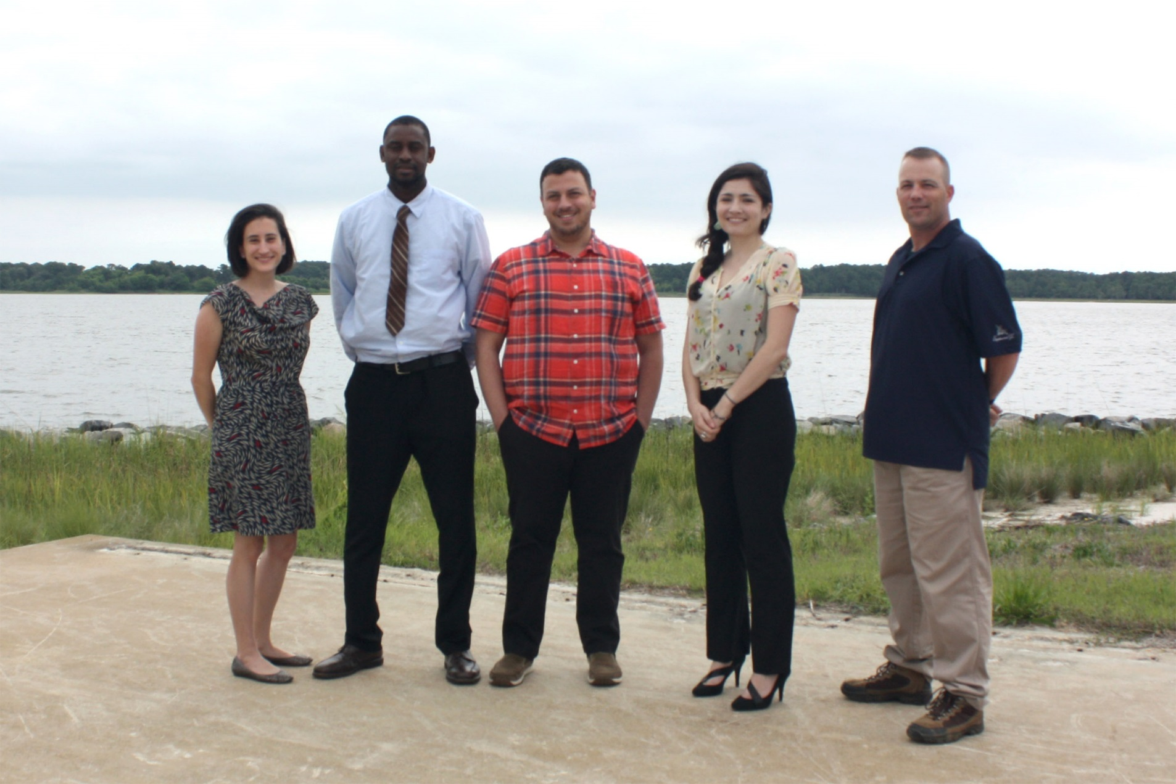
Questions?
Notes:
ANDREA: Thank you for your attention. Any Questions?

Slide 22
Questions?
Notes:
ANDREA: Any Questions?

