Slide 1
Puerto Rico Health & Air Quality II
A Geospatial Assessment of Environmental Variability in Puerto Rico and its Relation to Confirmed Dengue Fever Cases
Andrew Nguyen (Project Lead)
Martha Sayre

Slide 2
Overview
Community Concerns
Objectives
NASA Earth Observation Systems
Study Area
Habitat Assessment Map
Data
Methods (1, 2, 3)
Results (1, 2, 3)
Conclusions
Future Work
Acknowledgements
CC
Object.
Methods
Study Area
NASA Satellites
Data
Results
Con.
Future Work
Acknowledge.

Slide 3
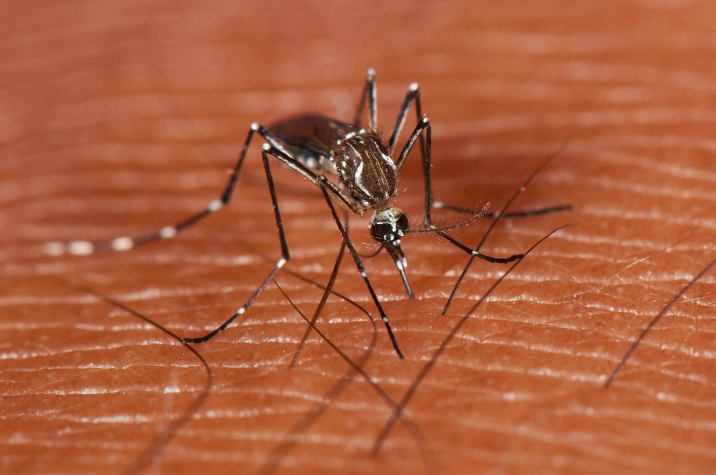
Community Concerns
Dengue fever is the fastest-growing vector-borne disease in the world
Chikungunya and Zika confirmed cases in PR since 2013
Aedes Aegypti (Ae. aegypti) proliferation in populated areas
Multiple environmental factors have been tied to the spread of Aedes aegypti
Image Credit: Mark Yokoyama
CC
Object.
Methods
Study Area
NASA Satellites
Data
Results
Con.
Future Work
Acknowledge.

Slide 4
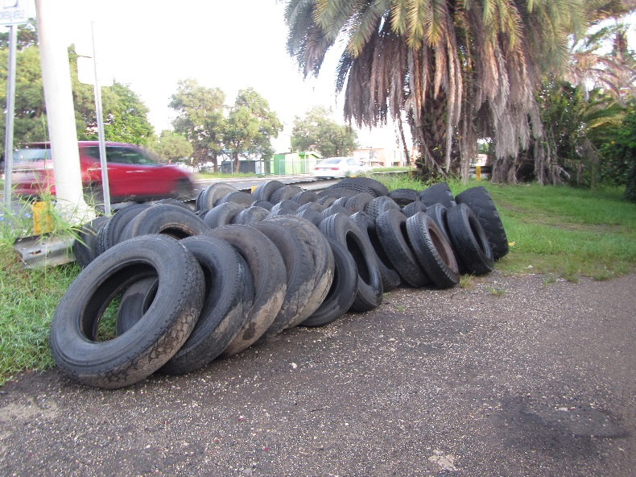
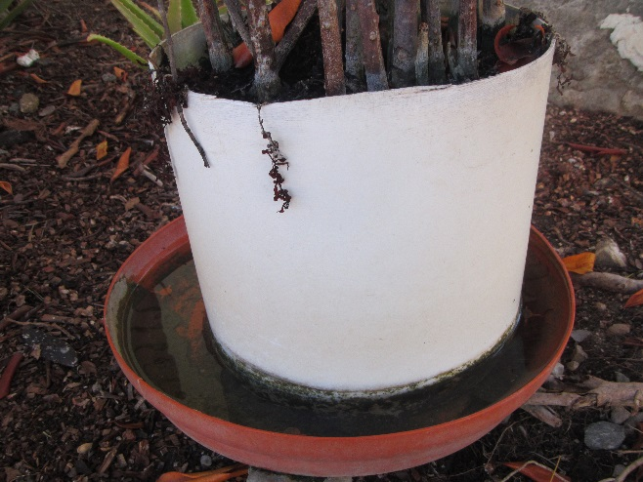
Objectives
Examine the relationship between environmental conditions and Ae. aegypti proliferation throughout the island
Determine the contribution of environmental conditions to CDFC epidemics and produce Ae. aegypti habitat suitability maps
Analyze seasonal and inter-annual changes of related environmental conditions
CC
Object.
Methods
Study Area
NASA Satellites
Data
Results
Con.
Future Work
Acknowledge.

Slide 5

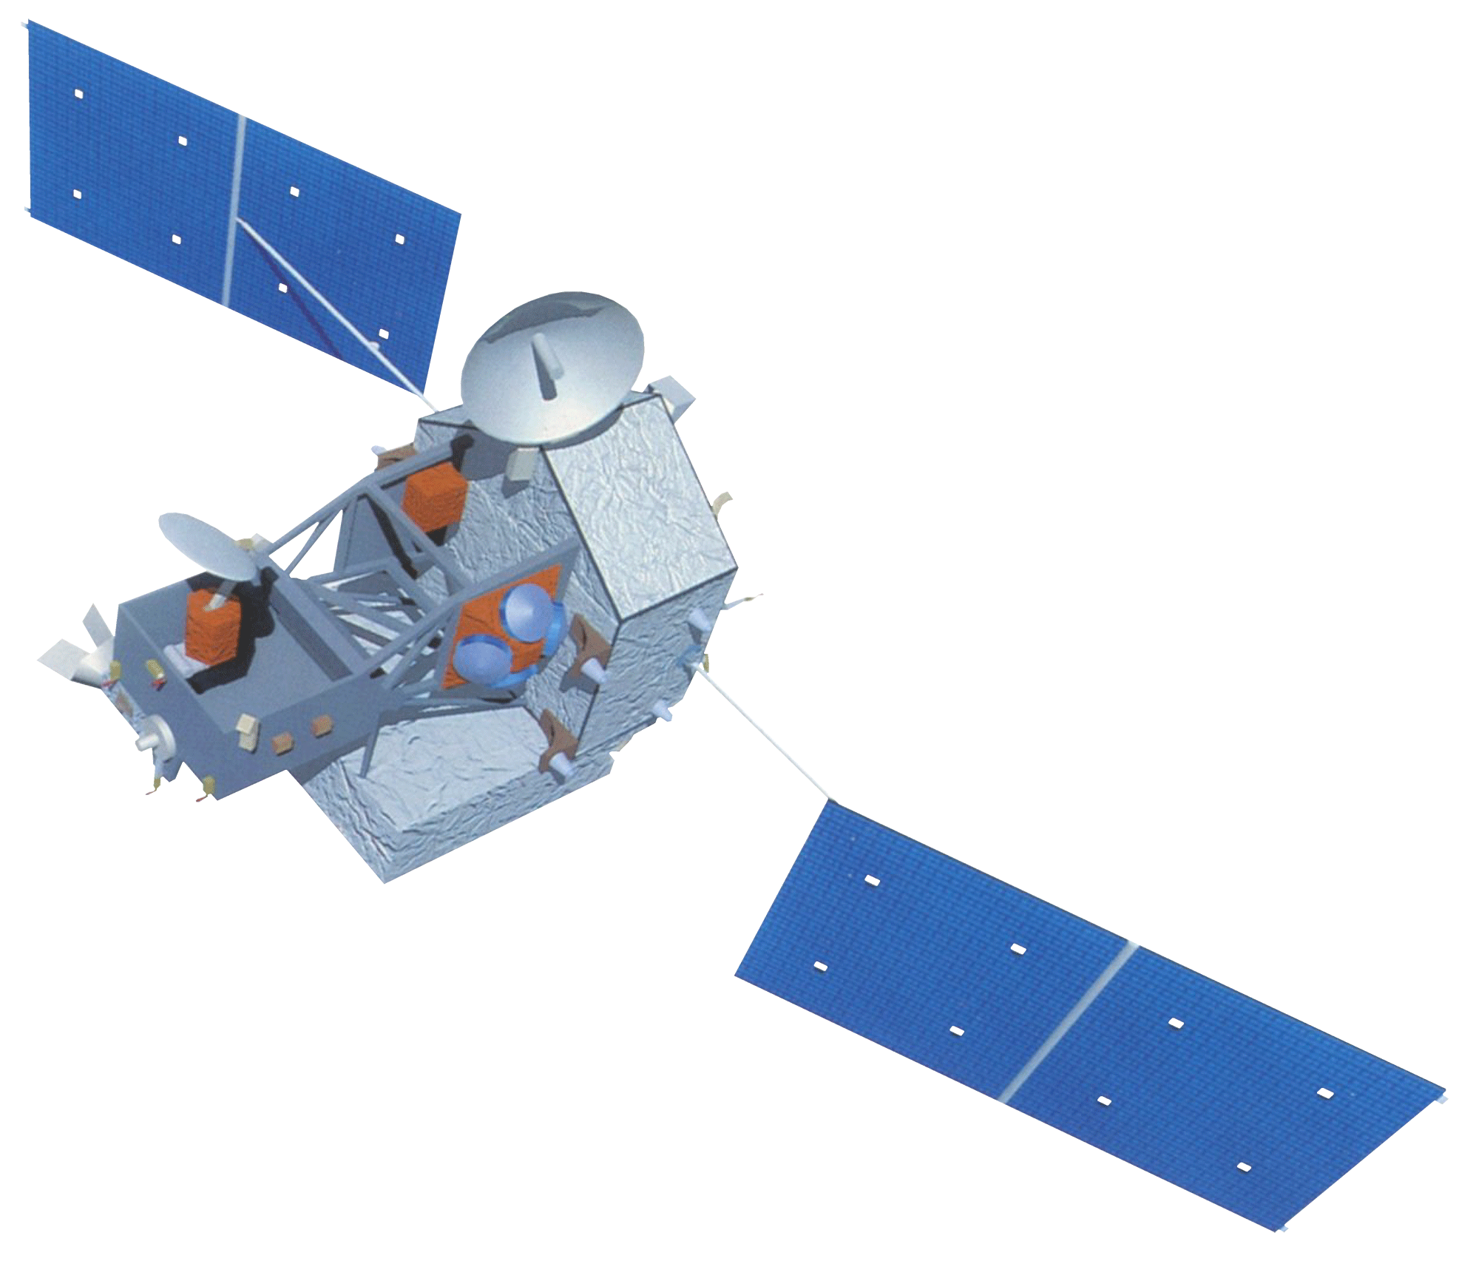
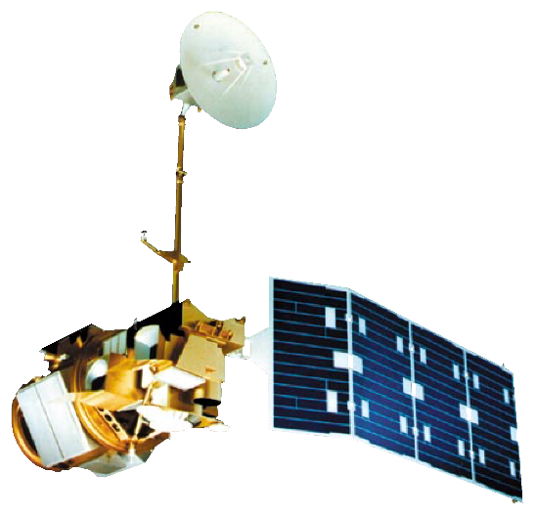

NASA Satellites/Sensors
Terra-MODIS
TRMM-PR
Aqua-MODIS
Landsat 5-TM
CC
Object.
Methods
Study Area
NASA Satellites
Data
Results
Con.
Future Work
Acknowledge.
Notes:
Version 2: This project utilized Remotely-sensed and modeled products – including inputs from these four satellites.
MODIS on Terra and Aqua.
TRMM-PR
Finally, Landsat 5 and 7
Images Source: http://www.devpedia.developexchange.com/dp/index.php?title=List_of_Satellite_Pictures

Slide 6
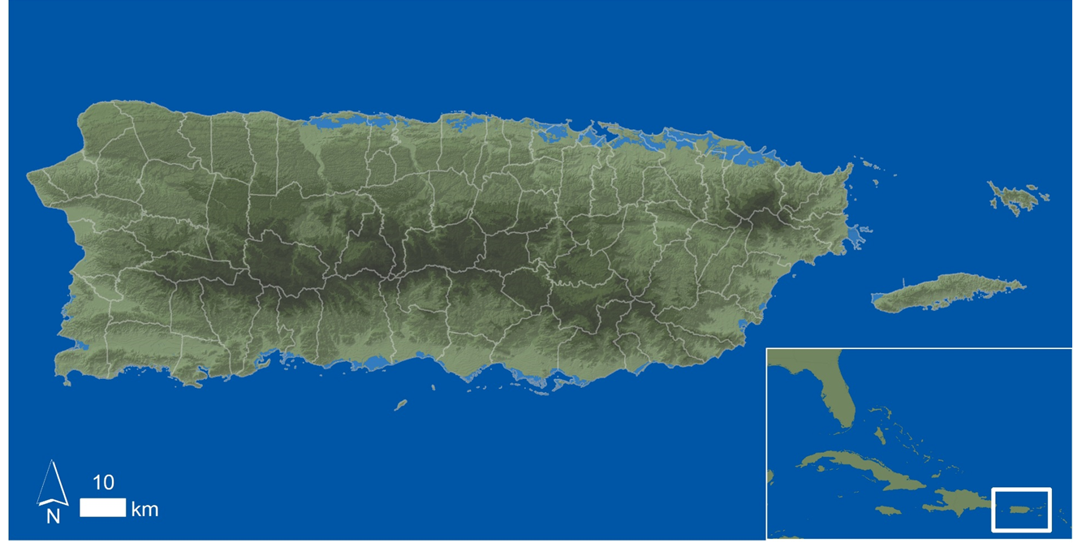
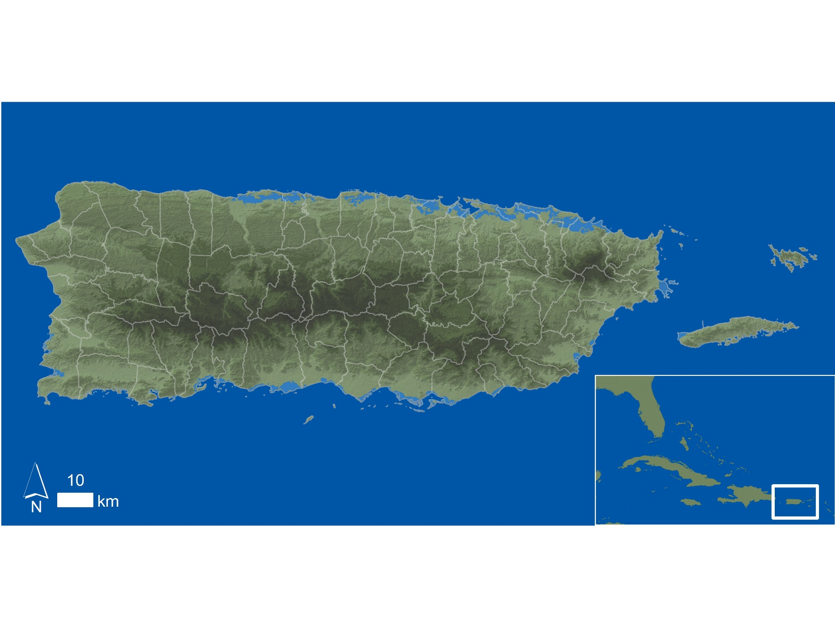
Study Area: Puerto Rico (January 2009- December 2013)
CC
Object.
Methods
Study Area
NASA Satellites
Data
Results
Con.
Future Work
Acknowledge.

Slide 7

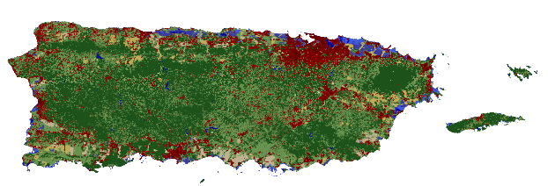
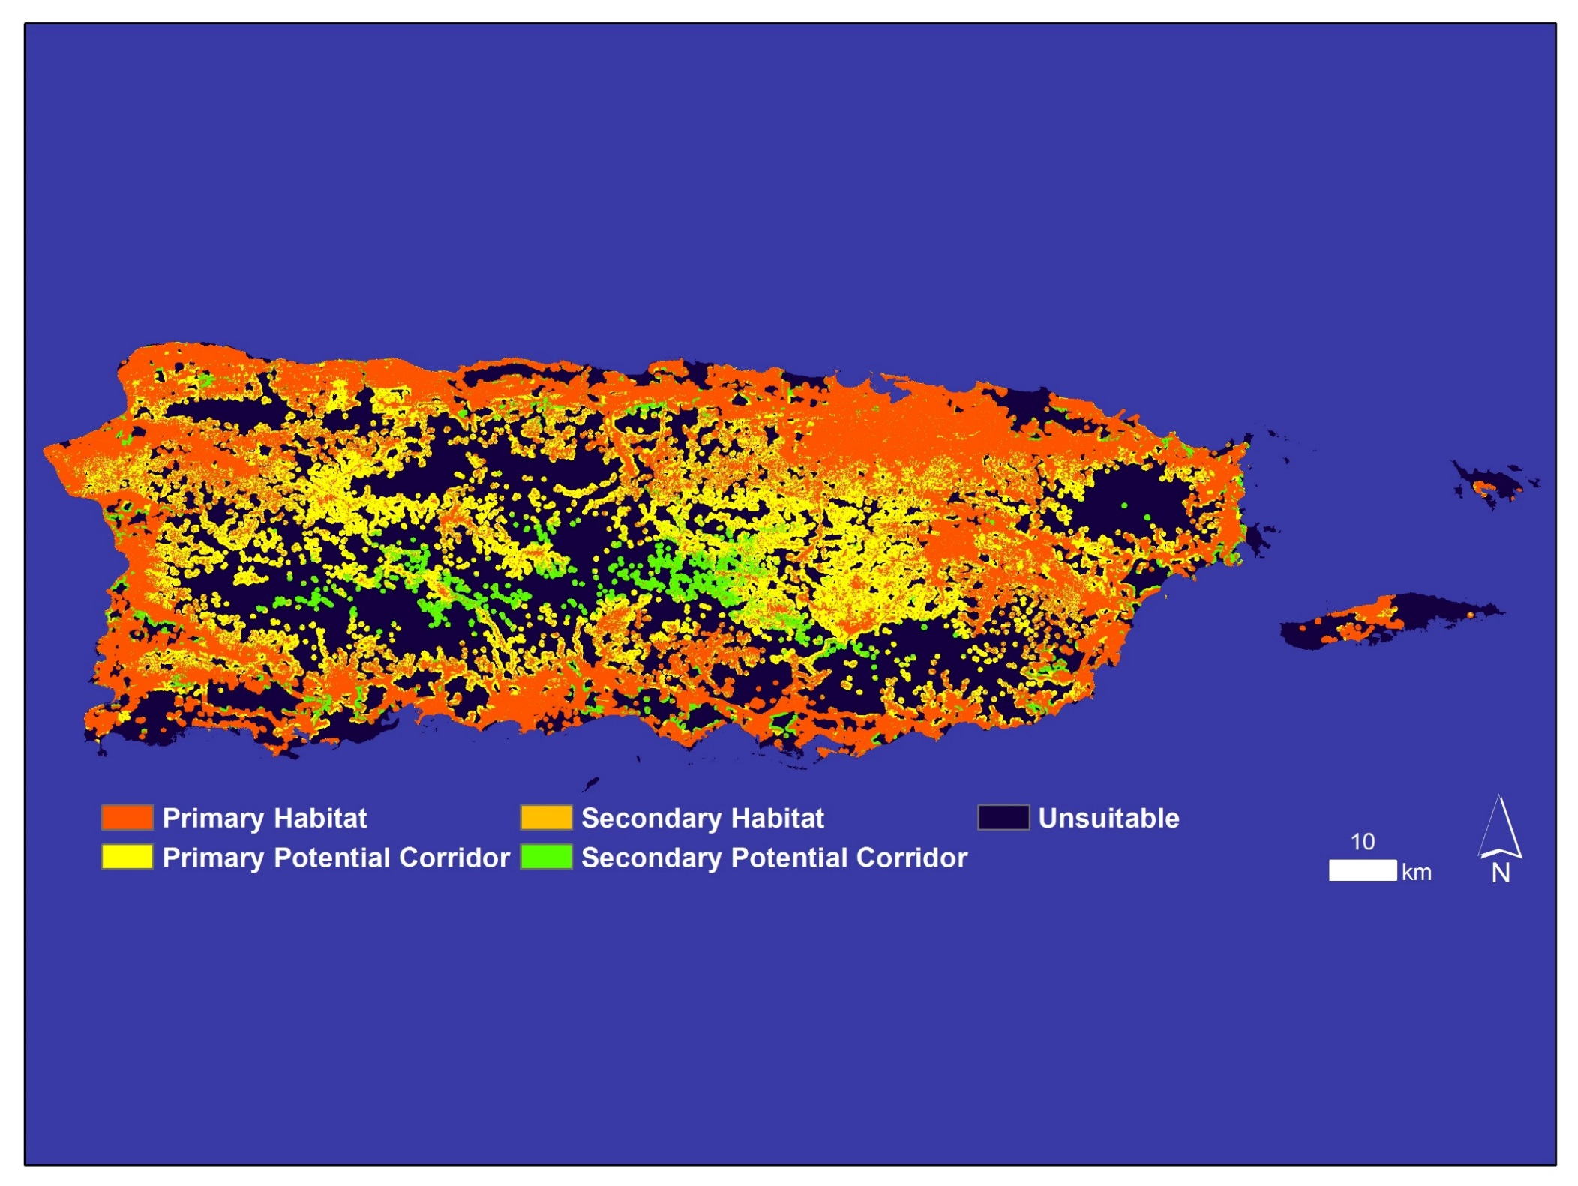
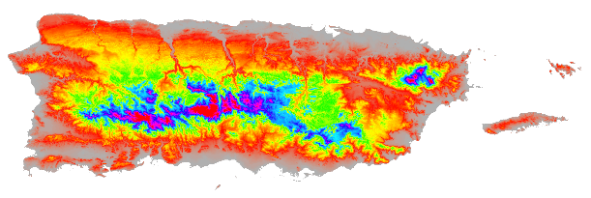
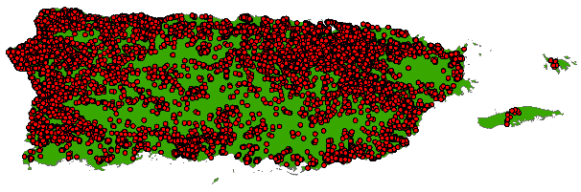
Habitat Assessment Map
Land Cover (30m) NLCD
Elevation (30m) USGS
Confirmed Dengue Fever Cases (In Situ) CDC
CC
Object.
Methods
Study Area
NASA Satellites
Data
Results
Con.
Future Work
Acknowledge.

Slide 8
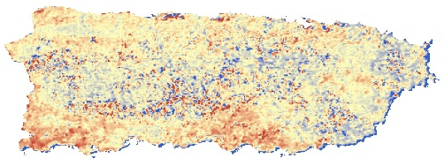
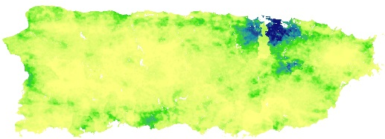


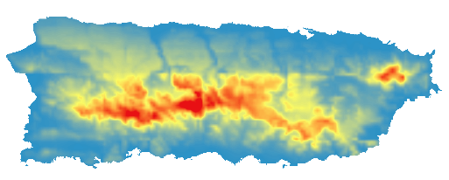
Data
Monthly Jan 2009- Dec 2013
Confirmed Dengue Fever Cases (CDFC) (in-situ)
CDC- Dengue Branch
Normalized Difference Water Index (NDWI) –
(500m) MODIS
Population Density - (100m) WorldPop
Land Surface Temperature (LST) - Day & Night (1km) MODIS
Total Precipitation (TP) - (0.05 Degree)
CHIRPS
CC
Object.
Methods
Study Area
NASA Satellites
Data
Results
Con.
Future Work
Acknowledge.
Relative Humidity (RH) - (1km)
GOES-PRWEB

Slide 9
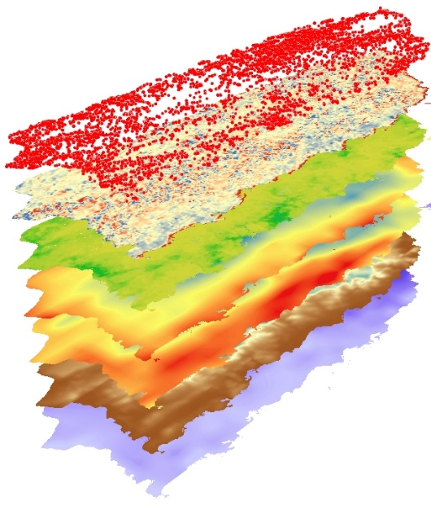
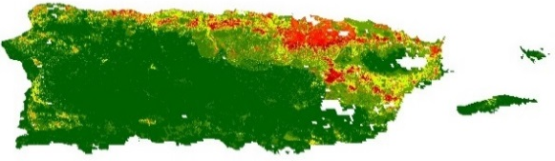
Method 1:Maximum Entropy
Monthly Jan 2009- Dec 2013
1) Dengue Fever
Risk Assessment Maps
TerrSet-Habitat and Biodiversity Modeler Maximum Entropy
1) LST- Day (MODIS)
2) LST- Night (MODIS)
3) TP (CHIRPS)
4) RH (GOES-PRWEB)
5) NDWI (MODIS)
6) CDFC (in-situ)
7) Pop. (WorldPop)
3 Month Lag
3 Month Lag
2 Month Lag
2 Month Lag
2 Month Lag
2) Relative Importance of variables
to CDFC
CC
Object.
Methods
Study Area
NASA Satellites
Data
Results
Con.
Future Work
Acknowledge.

Slide 10
Method 2: Mahalanobis Typicality
Monthly Jan 2009- Dec 2013
CC
Object.
Methods
Study Area
NASA Satellites
Data
Results
Con.
Future Work
Acknowledge.

Slide 11
Method 3: Seasonal Trend Analysis
Monthly Jan 2009- Dec 2013
CC
Object.
Methods
Study Area
NASA Satellites
Data
Results
Con.
Future Work
Acknowledge.

Slide 12
Method 3: Interannual Trends
Monthly Jan 2009- Dec 2013
CC
Object.
Methods
Study Area
NASA Satellites
Data
Results
Con.
Future Work
Acknowledge.

Slide 13
Results 1:Geospatial Dengue Risk
Low Risk
= Confirmed Dengue Fever Cases (CDFC) for August 2010
Medium Risk
High Risk
THESE ARE PLACEHOLDERS
CC
Object.
Methods
Study Area
NASA Satellites
Data
Results
Con.
Future Work
Acknowledge.

Slide 14
Results 2: Time Series
CC
Object.
Methods
Study Area
NASA Satellites
Data
Results
Con.
Future Work
Acknowledge.

Slide 15
Results 2: Permutation Importance
CC
Object.
Methods
Study Area
NASA Satellites
Data
Results
Con.
Future Work
Acknowledge.

Slide 16
Epidemic Vs. Non-Epidemic Years
= 67 %
= 10 %
= 5 %
= 3 %
= 6 %
= 10 %
CC
Object.
Methods
Study Area
NASA Satellites
Data
Results
Con.
Future Work
Acknowledge.

Slide 17
Results 3: Seasonal Trends
CC
Object.
Methods
Study Area
NASA Satellites
Data
Results
Con.
Future Work
Acknowledge.

Slide 18
Results 3: Interannual Trends
CC
Object.
Methods
Study Area
NASA Satellites
Data
Results
Con.
Future Work
Acknowledge.

Slide 19
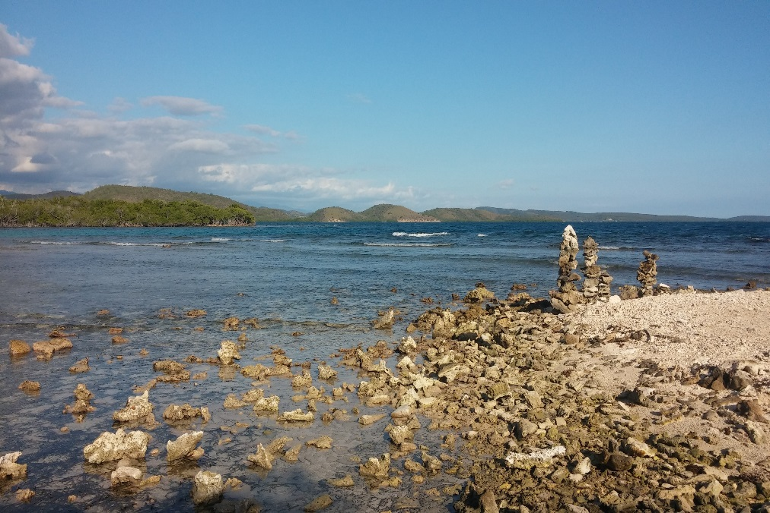
Conclusions
PLACEHOLDER
CC
Object.
Methods
Study Area
NASA Satellites
Data
Results
Con.
Future Work
Acknowledge.

Slide 20

Future work
PLACEHOLDER
CC
Object.
Methods
Study Area
NASA Satellites
Data
Results
Con.
Future Work
Acknowledge.

Slide 21

Advisors
Dr. Juan Torres-Pérez, NASA Ames DEVELOP National Program, Bay Area Environmental Research Institute
Chippie Kislik, Center Manager, NASA Ames DEVELOP National Program
Victoria Ly, Assistant Center Manager, NASA Ames DEVELOP National Program
Alannah Johansen, NASA Ames DEVELOP National Program
Partners
Dr. Pablo Méndez-Lázaro, Medical Sciences Campus of the University of Puerto Rico
Dr. Roberto Barrera, U.S. Centers for Disease Control and Prevention (CDC) Dengue Branch
Jessica Cabrera, Puerto Rico Department of Health
Nirav Nikunj Patel, WorldPop
Notes:
We would like to acknowledge the following
Thank you!

