Slide 1
United States Disasters II
Using Assimilated GRACE-Derived Water and Moisture Products as a Predictive Tool for Wildfire Potential in the Contiguous United States
NASA DEVELOP National Program (JPL)
Summer 2015
Brittany Zajic (Project Lead)
Daniel Jensen
Nick Rousseau
Notes:
Credit: Nick Rousseau
Introduction to the project and myself

Slide 2
Why Wildfires?
What if we could use NASA EOS to predict wildfires?
Soil Moisture
Wildfire
Notes:
Largest cause of wildfire, droughts and dry conditions lead to more wildfires.
Introduce soil moisture as a indicator
The US Disasters team looked to see if we could use NASA EOS to predict wildfire potential from soil moisture.
As many as 90 percent of wildland fires in the United States are caused by humans
Wildfires in the United States have become more frequent in the last several decades
Drought Conditions increase wildfire activity, leading to an increase in economic loss, environmental degradation, and property damage
http://www.nps.gov/fire/wildland-fire/learning-center/fire-in-depth/wildfire-causes.cfm#sthash.qibgZFDi.dpuf

Slide 3
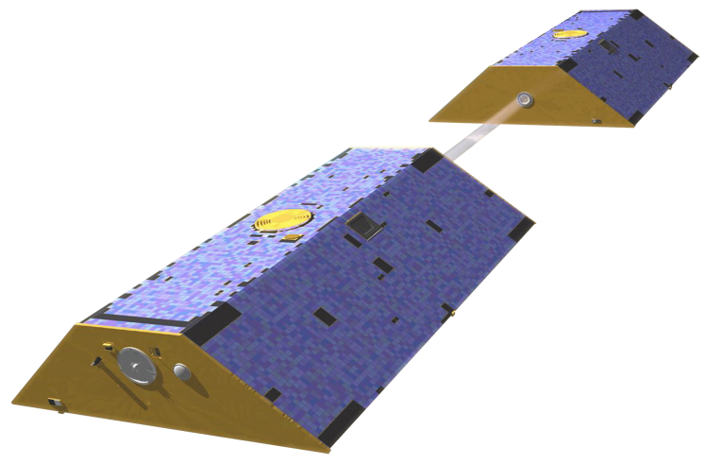
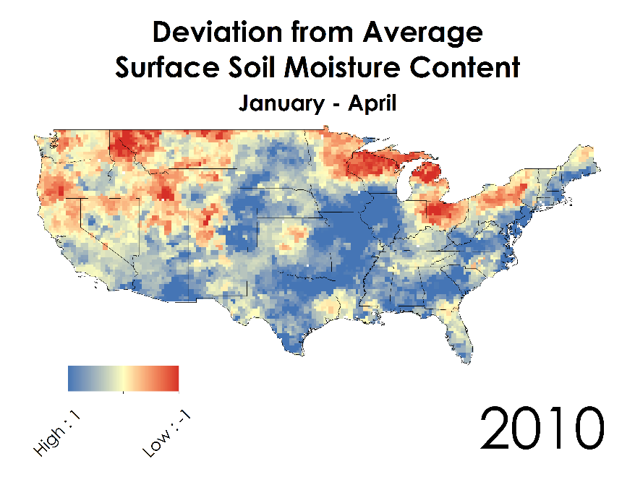
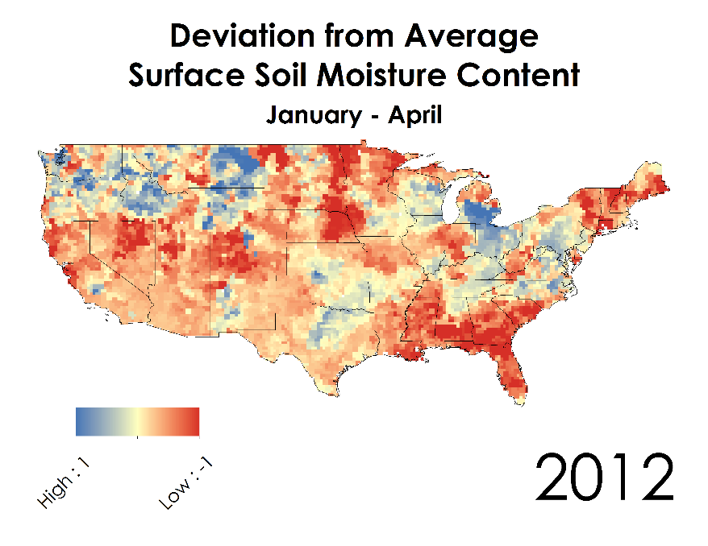
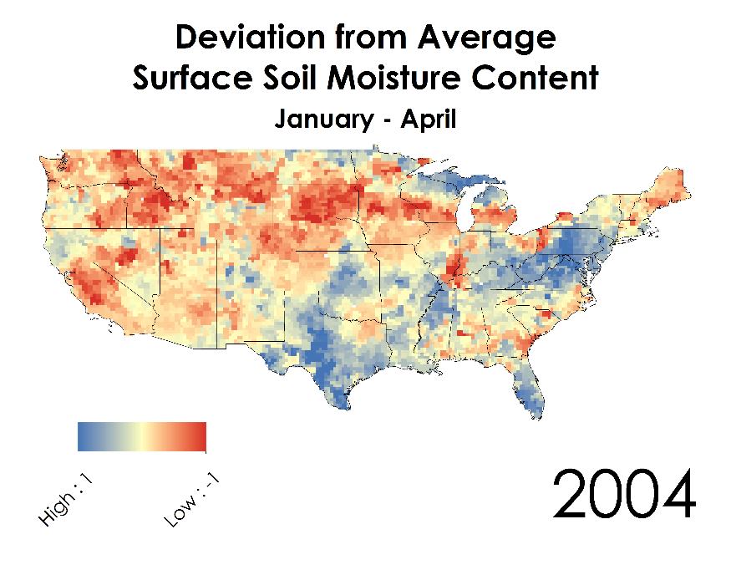
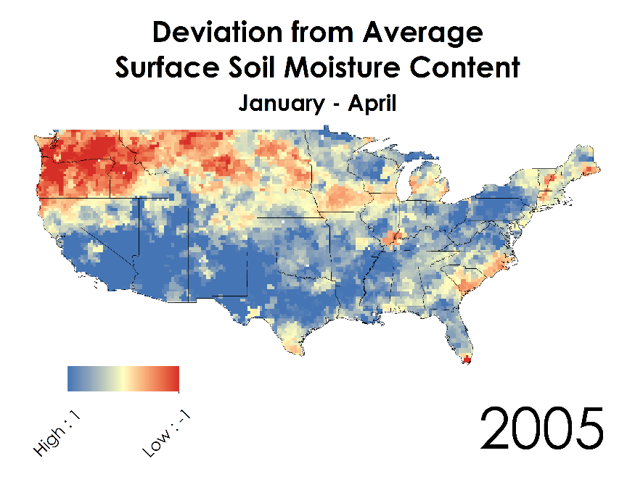
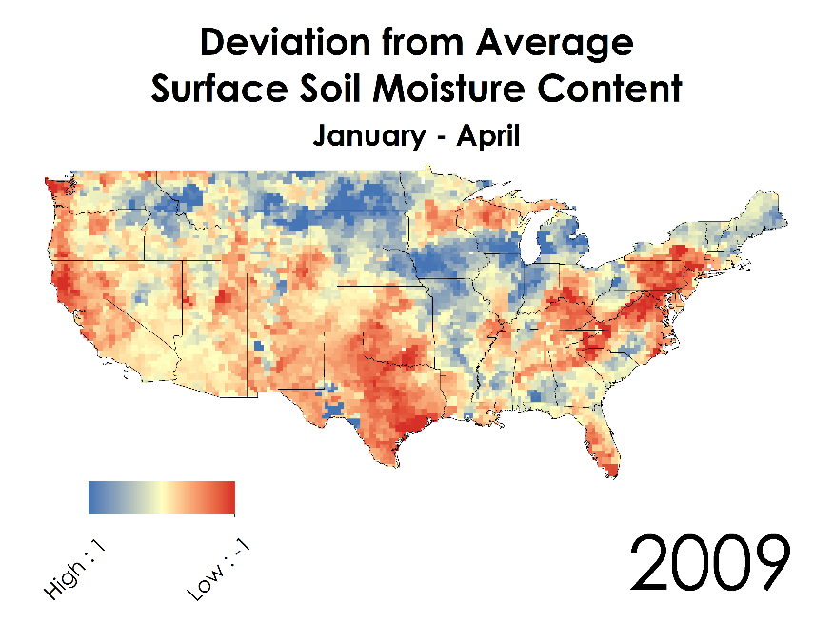
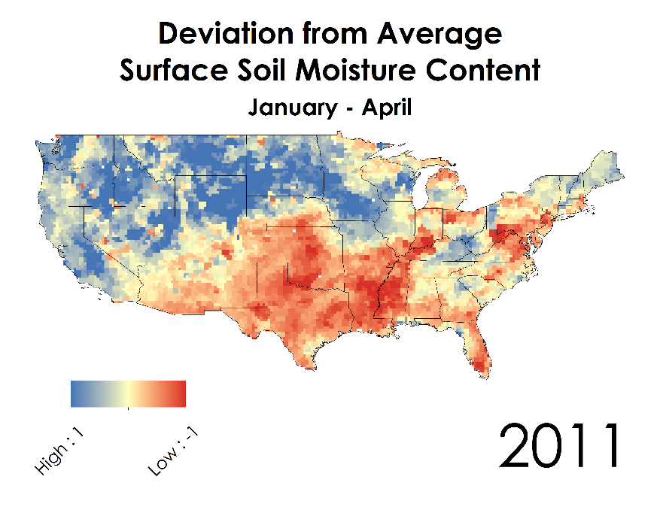
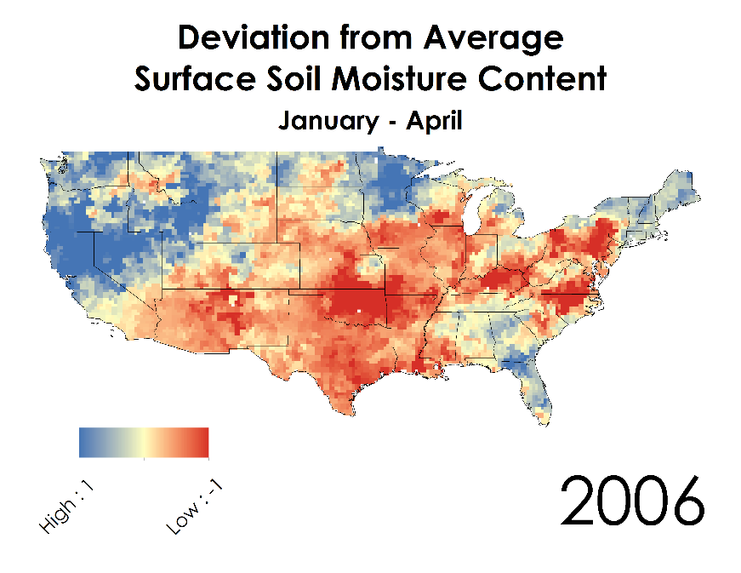
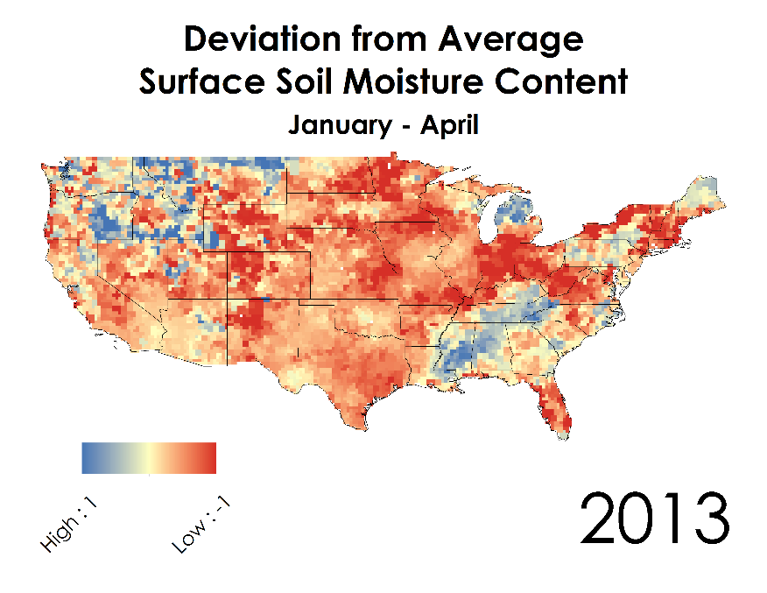
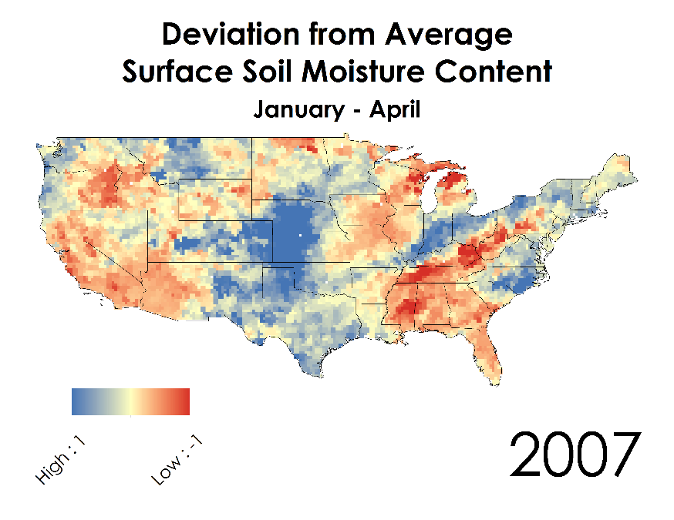
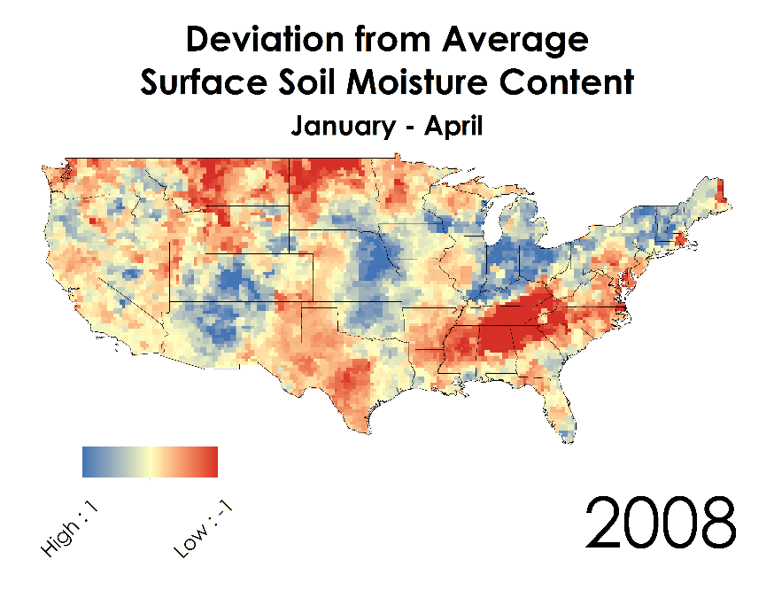
GRACE (Gravity Recovery and Climate Experiment)
Assimilated Soil Moisture Data

Slide 4
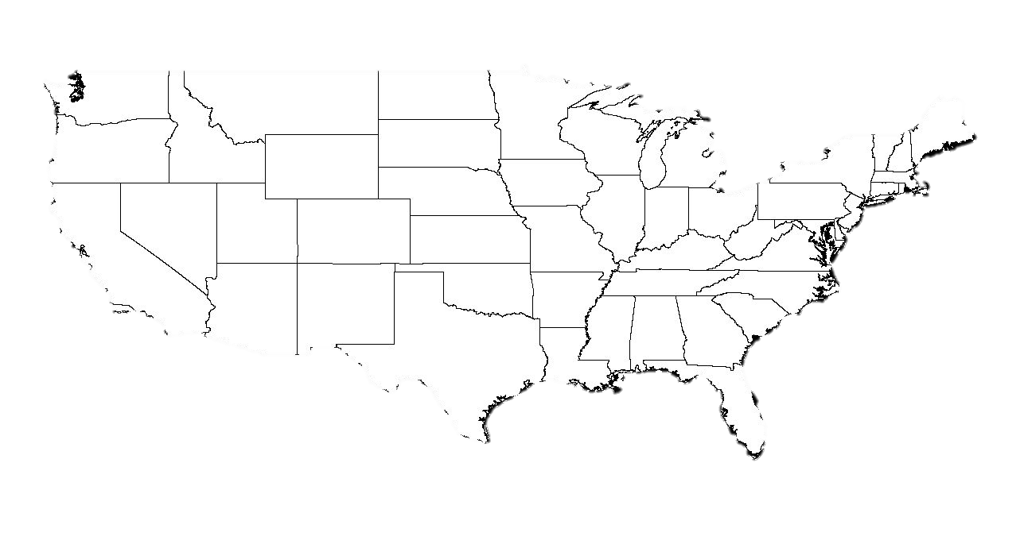
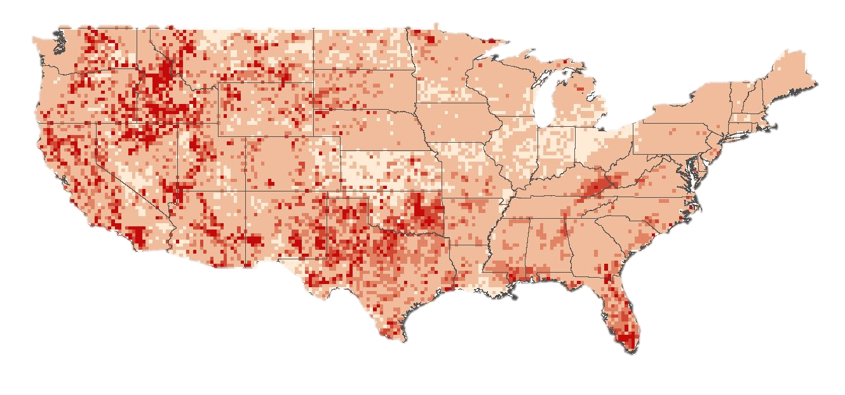
Wildfire Data Spatial Wildfire Occurrence Data
Human Causes of Wildfires
Notes:
Credit: Creative Commons

Slide 5
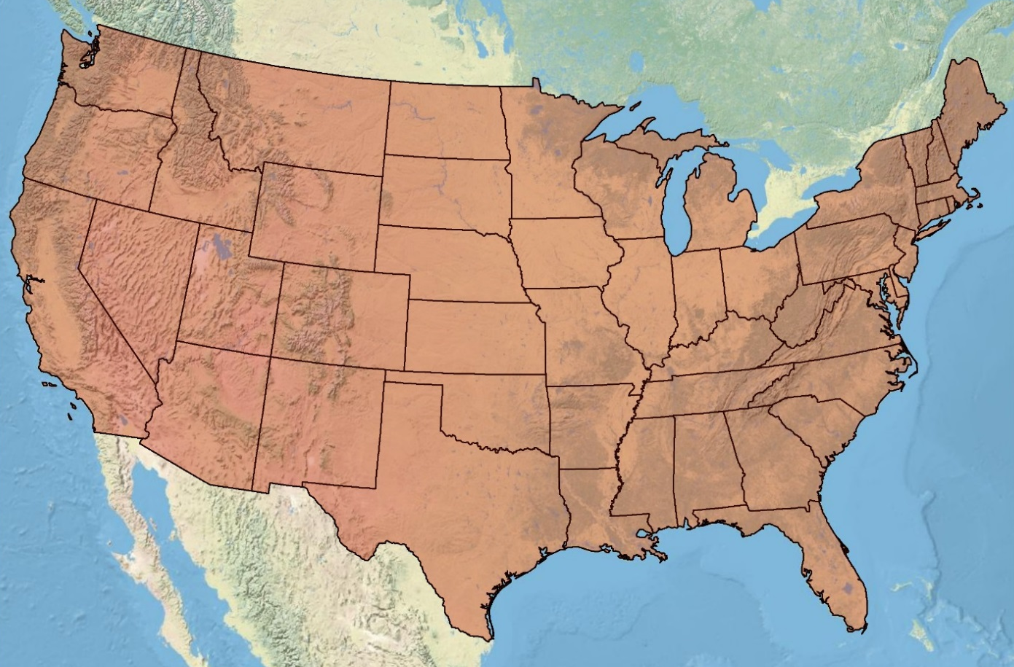
Objectives
Study Period: January 2003 to December 2013
Location: Contiguous United States
To quantify a relationship between assimilated GRACE data and wildfire data by land cover type
Create a predictive algorithm that forecasts wildfire potential on a national scale
Notes:
“And with these resulting relationships”

Slide 6
Methodology
Assimilated GRACE (Surface Soil Moisture Content)
Matching Spatial and Temporal Resolution
(Python – NumPy Array)
Annual Average January-April
Annual Total Burned Area
USDA Forest Service Wildfire Spatial Database
Matching Spatial and Temporal Resolution
(Python – NumPy Array)
Data Processing
(Python)
Joint Probability Model
(Graphs)
Annual Total Number of Wildfires
NLCD 2011 Land Cover Data Product
Resample and Reclassified
(Land Cover Analysis)
Matching Spatial and Temporal Resolution (Python – NumPy Array)

Slide 7
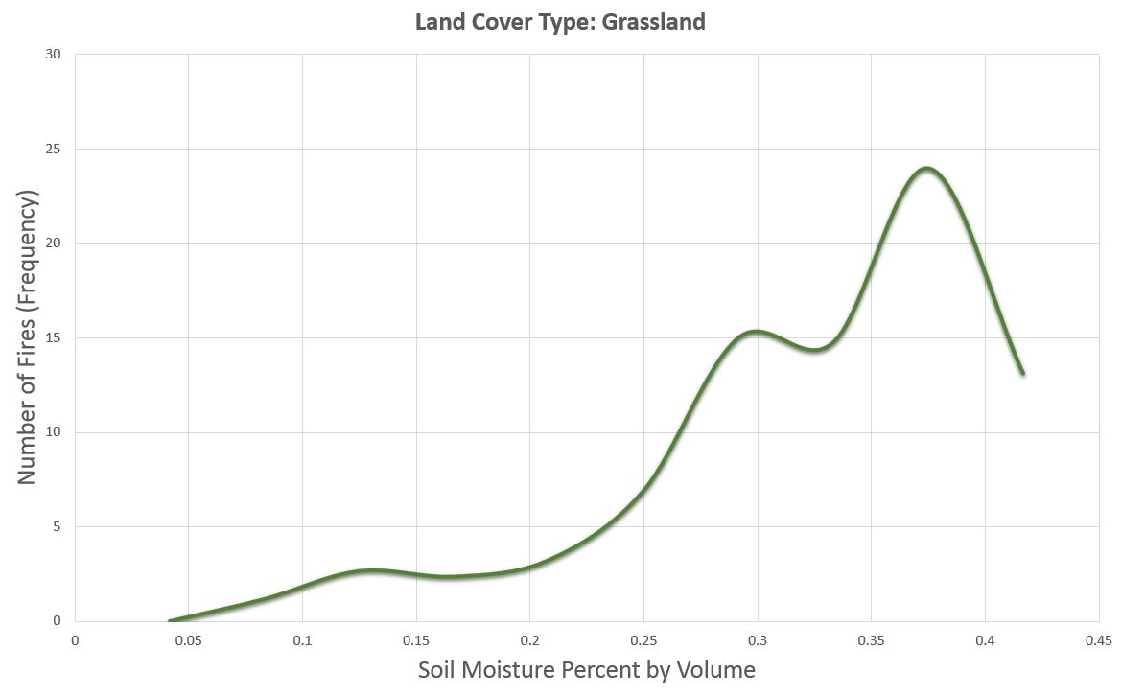
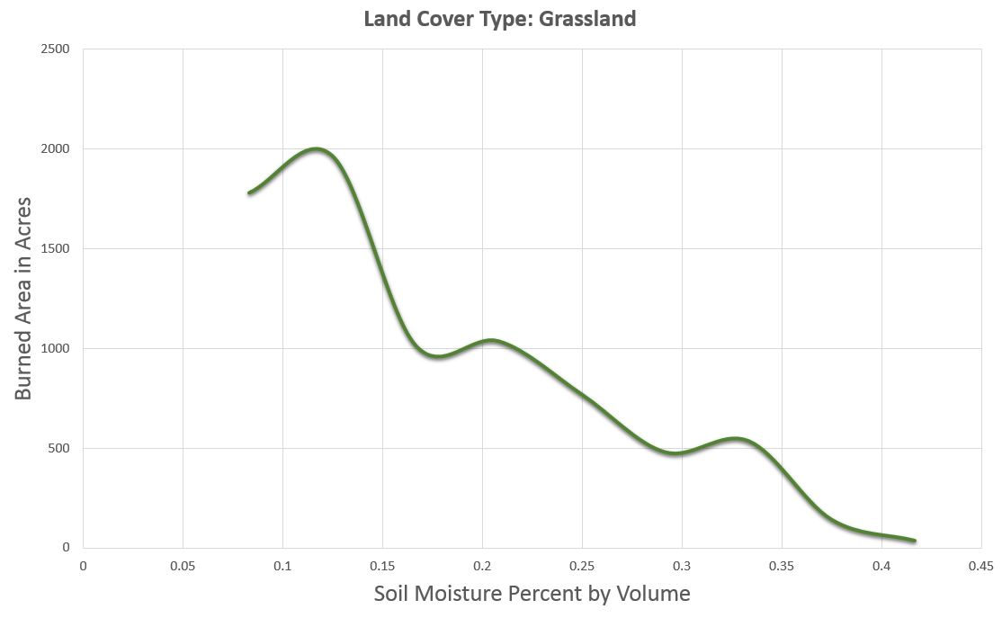
Methodology (continued)
Predicted Maps

Slide 8
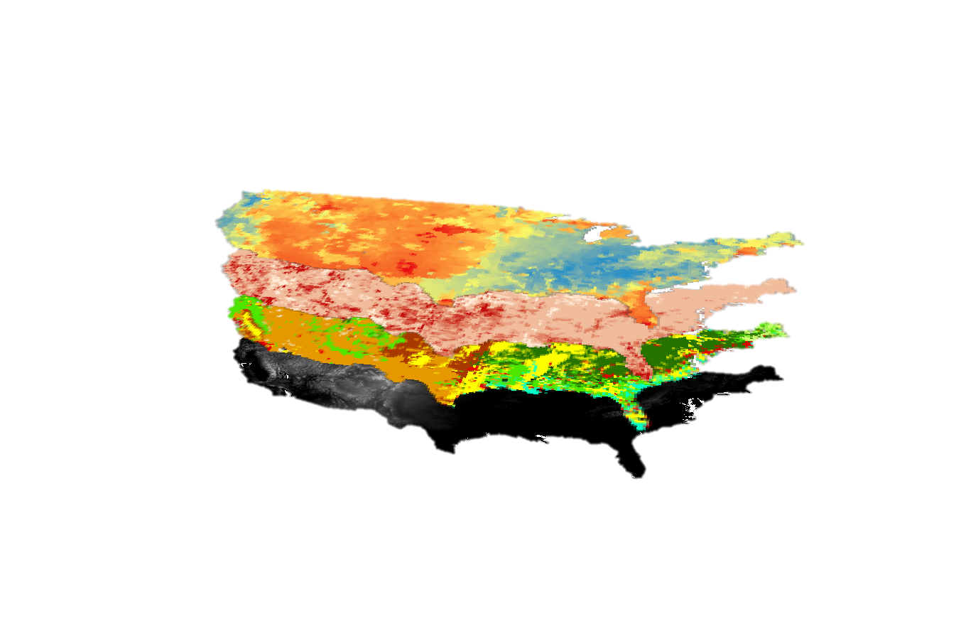
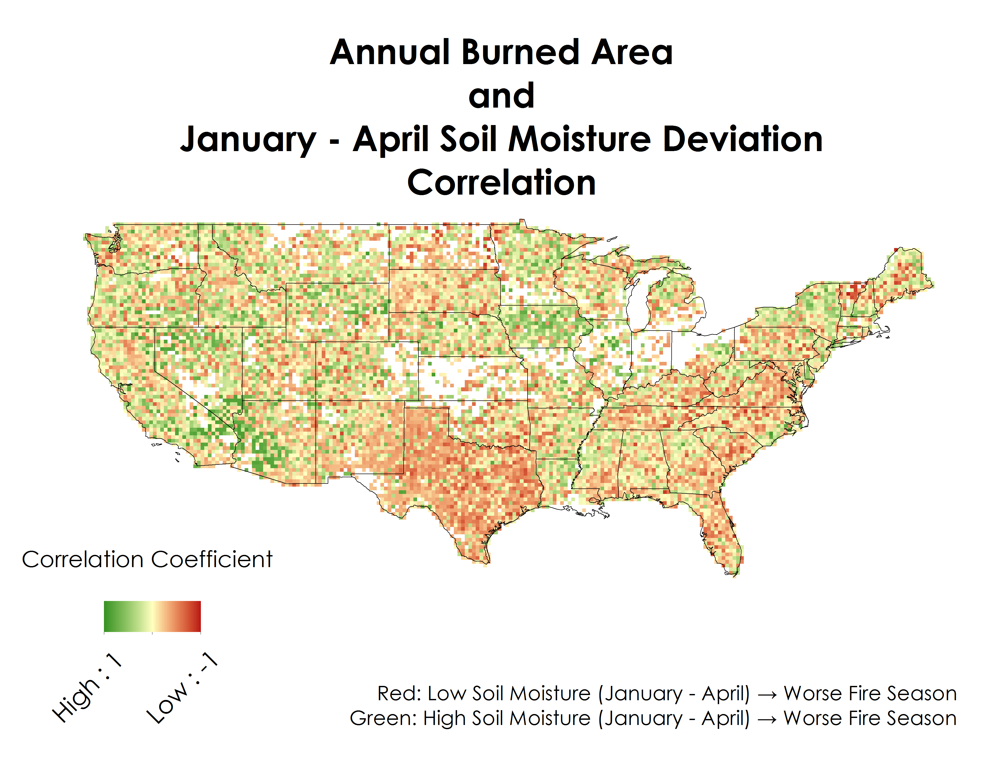
Results
(PLACEHOLDER)
Notes:
THIS SLIDE WILL BE COMPLETED BY MONDAY JULY 27TH

Slide 9
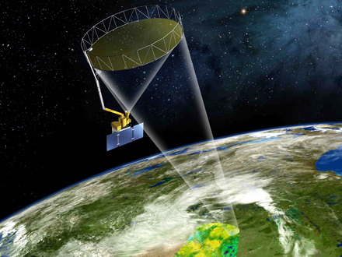
Conclusion and Discussion
High coefficient of determination values (r² ) suggest a strong relationship between assimilated soil moisture data and wildfire data
SMAP
Soil Moisture Active Passive
Predictive wildfire potential maps using NASA EOS will help better serve the USDA Forest Service Fire Management
Notes:
Credit: NASA JPL
R^2 value:
There is a relationship between low soil moisture and burned area
Integrate this end product algorithum with SMAP data for better resolution soil moisture data

Slide 10
Acknowledgements
Partners:
Dr. Matt Rodell, NASA Terrestrial Hydrology Program at Goddard Space Flight Center
Mark Finney, Chuck McHugh, and Everett Hinkley, USDA Forest Service
Advisor:
Dr. John T Reager, NASA Jet Propulsion Laboratory
Past Contributors:
Max Baldridge, NASA DEVELOP National Program

