Slide 1
African Great Lakes Weather
Utilizing NASA Earth Observations to Identify Indicators
to Help Predict Deadly Storms Over the African Great Lakes
William Wilson (Project Lead)
Annabel White
Grant Bloomer
Juan Antonio Chacón Castro

Slide 2
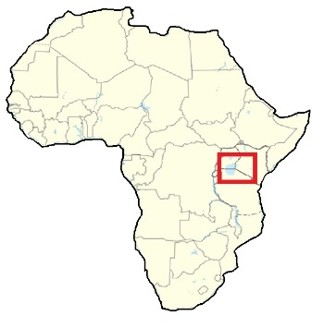
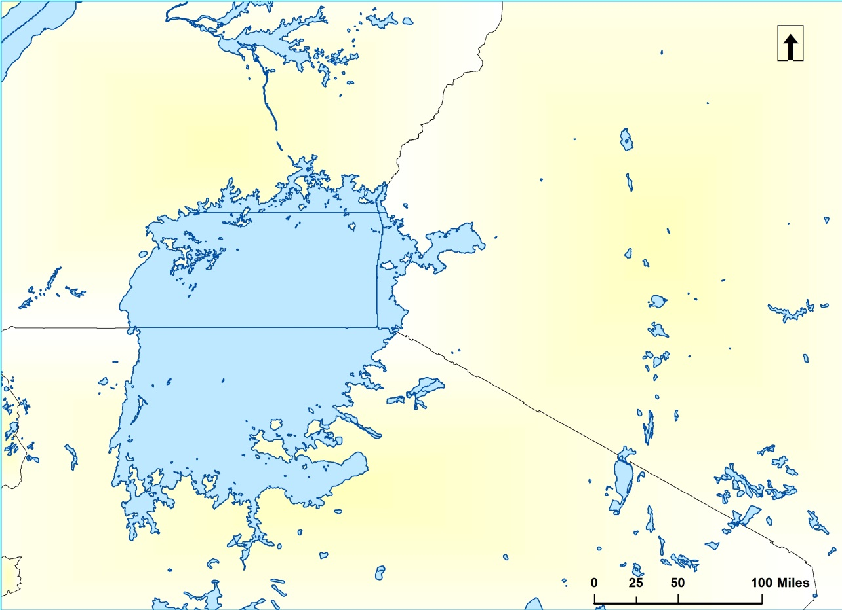
Lake Victoria & the African Great Lakes
27% of the world’s freshwater
3 of the largest lakes in Africa
Geologic context of the area defined by East African Rift Valley.
Uganda
Lake
Victoria
Kenya
Tanzania
Notes:
Our study area for this project consisted of the African Great Lakes, and in particular, Lake Victoria.
The African Great Lakes are home to 27 percent of the world’s freshwater resources and include 3 of the largest lakes in Africa.
In fact, Lake Victoria is the second largest freshwater lake in world in terms of surface area.
The African Great Lakes area is defined by the East African Rift Valley and Lake Victoria rests in a depression inside this area.
As you can see from the map, Lake Victoria’s jurisdiction is split between the countries of Uganda, Tanzania, and Kenya.

Slide 3
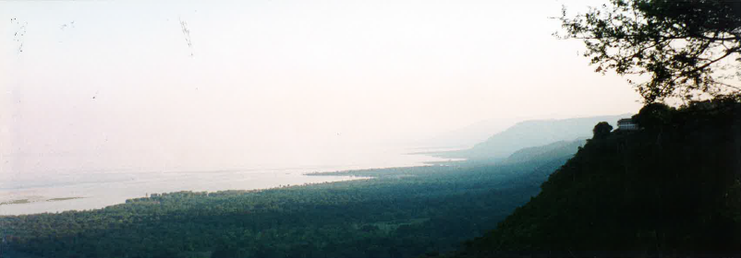
Community Livelihood & Concern
Over 30 million people live in Lake Victoria watershed alone
Close economic ties to the lake as a source of food and livelihood
2 million fishermen catch around a million ton of fish each year
Estimated 5,000 weather related deaths occur on the lake per year
Image Credit: Gil and Melinda Blackburn
Notes:
Image Source: The Blackburn Family – Wise, VA
The reason this project is so important is because of the millions of people the lake weather affects.
There are over 30 million people who live in the Lake Victoria watershed alone, many of whom depend on the lake as a source of food and employment.
Storms in this area are intense and can be hard to predict, as they are often not a part of a larger storm system which can be easily forecasted.
This fact, combined with inadequate storm warning systems, leads to an estimated 5000 weather related deaths on Lake Victoria each year.
Link to article: http://www.cnn.com/2013/01/17/world/africa/lake-victoria-weather-deaths/

Slide 4
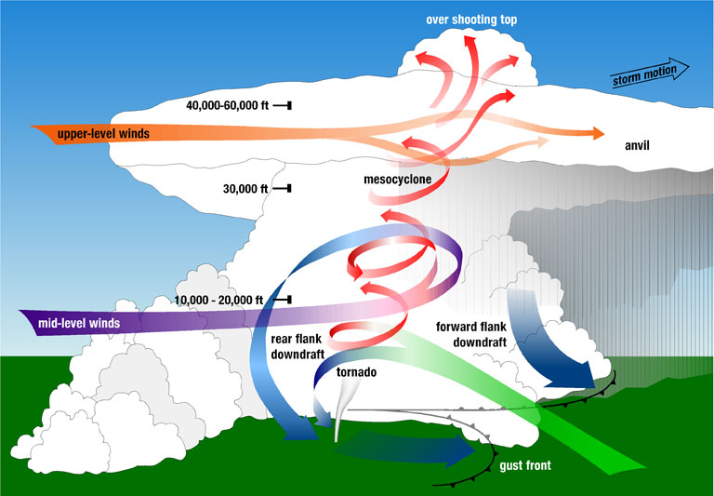
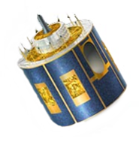
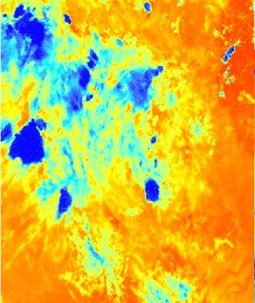

Background Info: Overshooting Tops & the HSED
EUMETSAT SEVIRI
Infrared Images
OT’s
Hazardous Storm Event Database
Image Source: Wikimedia Commons
Notes:
In order to pick an appropriate temporal study date for our project, we used the Hazardous Storm Event Database, which was compiled by Kristopher Bedka of NASA Langley’s Science Directorate, Climate Science Branch.
His algorithm uses infrared imagery created from the SEVIRI sensors of EUMETSAT’s METEOSAT geostationary satellites in order to detect cloud phenomena known as overshooting tops.
These overshooting tops, as illustrated in this picture, are dome-like protrusions that shoot out of the top of some clouds. The presence of these overshooting tops can be linked to storm events, which is why they were used to create this database.
Image Source: Wikimedia Commons, http://www.nssl.noaa.gov/primer/tornado/images/tor_formation_lg.jpg

Slide 5
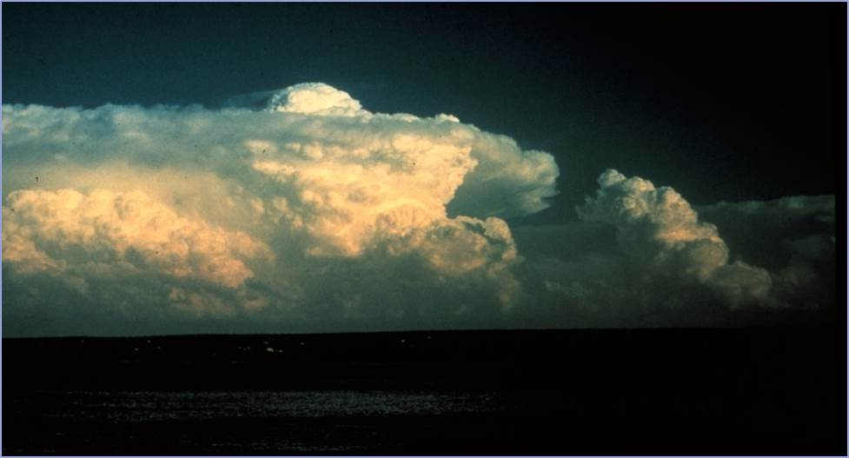
Image Source: Wikimedia Commons
Determining the study dates
Study Dates
50th
Hazardous Storm Event Database
Summarize
OT detections / day
Intensity
Percentiles
Study
Dates
99th
Notes:
Study dates have been figured by summarizing database to count OT detections over a diurnal cycle. Using these raw count values, lists of dates were generated at the 99th and 50th percentiles. Subsequently, a systematic sampling method was used across these chronological lists of equal size to narrow down sample dates to 10 days at each percentile or ‘intensity level’ respectively.
Image Source: Wikimedia Commmons, http://www.photolib.noaa.gov/htmls/wea00106.htm

Slide 6
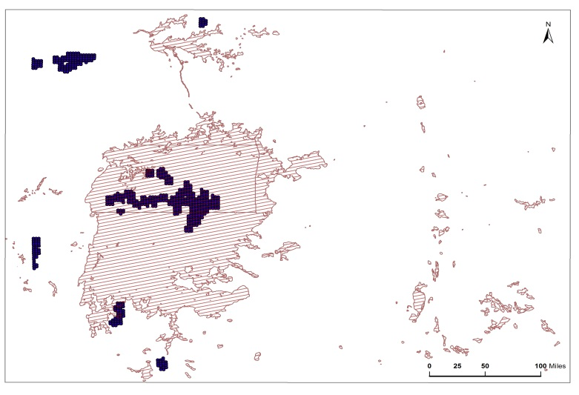
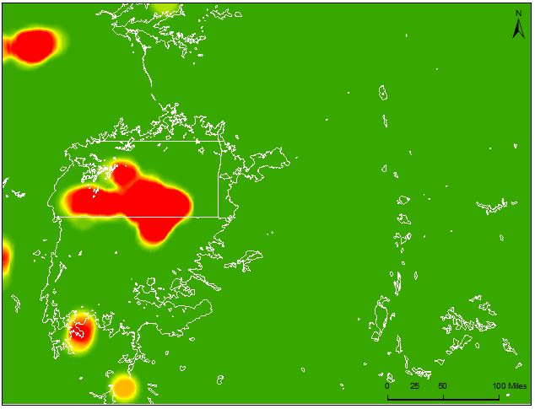
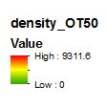
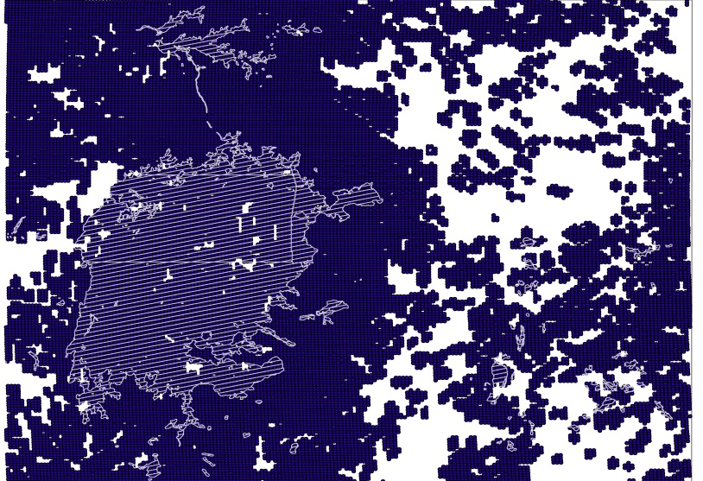
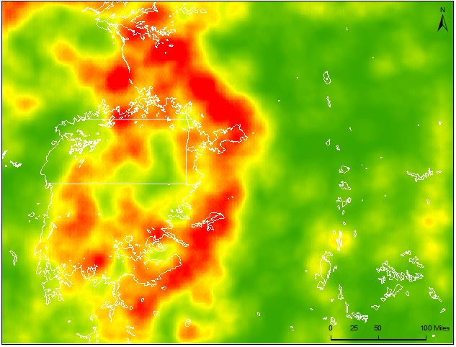
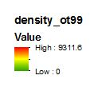
Overshooting Tops (OT) Points
OT Detections at 50th percentile (IL50)
OT Detections at 99th percentile (IL99 )
Notes:
This slide shows the raw OT data points on the left and the point density continuous fields on the right.
The point density maps used a stretch based on standard deviation of values. The Stretch was used to show more variation in the data at the 99th percentile.
Notice where the detections are concentrated at each percentile.

Slide 7
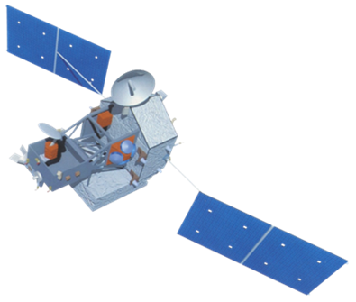

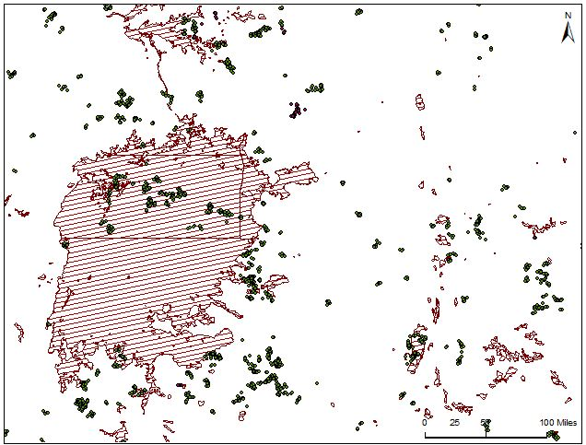
TRMM - LIS
Tropical Radar Measuring Mission – Lightning
Infrared Sensor
Collections of adjacent observed pulse events in the same 2ms timeframe (lightning strikes)
TRMM
‘Areas’
‘Flashes’
‘Groups’
‘Events’
Image Source: DEVELOPedia
Notes:
The TRMM LIS sensor compiles lighting optical pulses into 4 levels. This project utilized the ‘groups’ level which often acts a the building block of LIS data due to its interpretability as singular lightning flashes.
We looked at LIS data to see how it ‘lay’ with the OT points.
Image source: DEVELOPedia

Slide 8
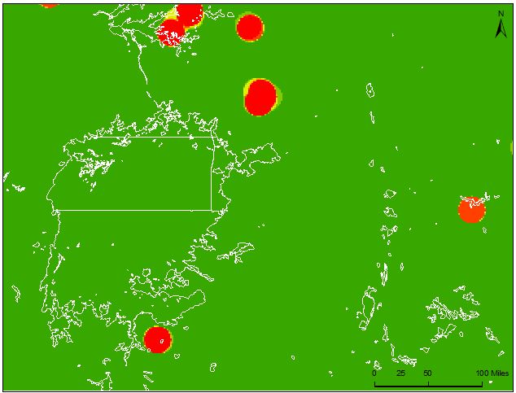
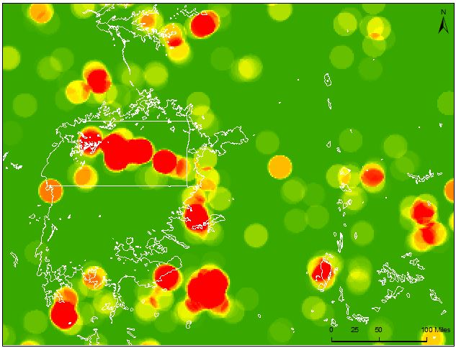
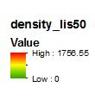
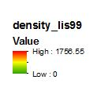
Detection Point Density
LIS Group Detections IL50
LIS Group Detections IL99
OT Detections IL50
OT Detections IL99
TRMM
Notes:
The detection point density maps. LIS ‘groups’ at the top while the previously seen OT point densities are at the bottom. The LIS point density maps were stretched the same way as the OT density maps mentioned previously.
We thought that the LIS 99th and the OT 99th patterned pretty well here. Although more statistics would be ideal , the OT detection algorithm that was employed has shown to be accurate in other literature so we stuck to figuring our study dates based off this algorithm.

Slide 9
MERRA
Modern Era Retrospective-Analysis for Research and Applications
MERRA
MAT1NXSLV
Geopotential
Height
Eastward Wind
Northward Wind
Temperature
Humidity
Vertical Pressure Velocity
Surface Skin Temperature
Notes:
Product MAT1NXSLV or the MERRA IAU 2D atmospheric single-level diagnostics
This global coverage product-set contains variables that are time-averaged (hourly), single-level, at native-resolution (1/2° by 2/3°)
MERRA products were downloaded sub-set to our study area bounds for the 20 days from the determined study dates.
All products downloaded at 500mb pressure level (except surface skin temperature). This is because 500 mb occurs at around a 6 km altitude and circulations, winds, and/or localized regions of cold temperatures at that altitude have strong impacts on what happens with regards to thunderstorms at the surface.
Processing in MATLAB:
- extracted the above variables from the larger list of variables in product.
- averaged these variables over 6 hour quarters, diurnally, and for the global mean for the intensity level.
- created diurnal contour maps in MATLAB showing these variables over the study days side-by-side.
MERRA Data Variable Names
PS - Time average surface pressure
U500 – Eastward wind at 500 mb
V500 – Northward wind at 500 mb
T500 – Tempurature at 500 mb
Q500 – Specific humidity at 500 mb
OMEGA500 - Vertical pressure velocity at 500 mb
TS – Surface skin tempurature

Slide 10
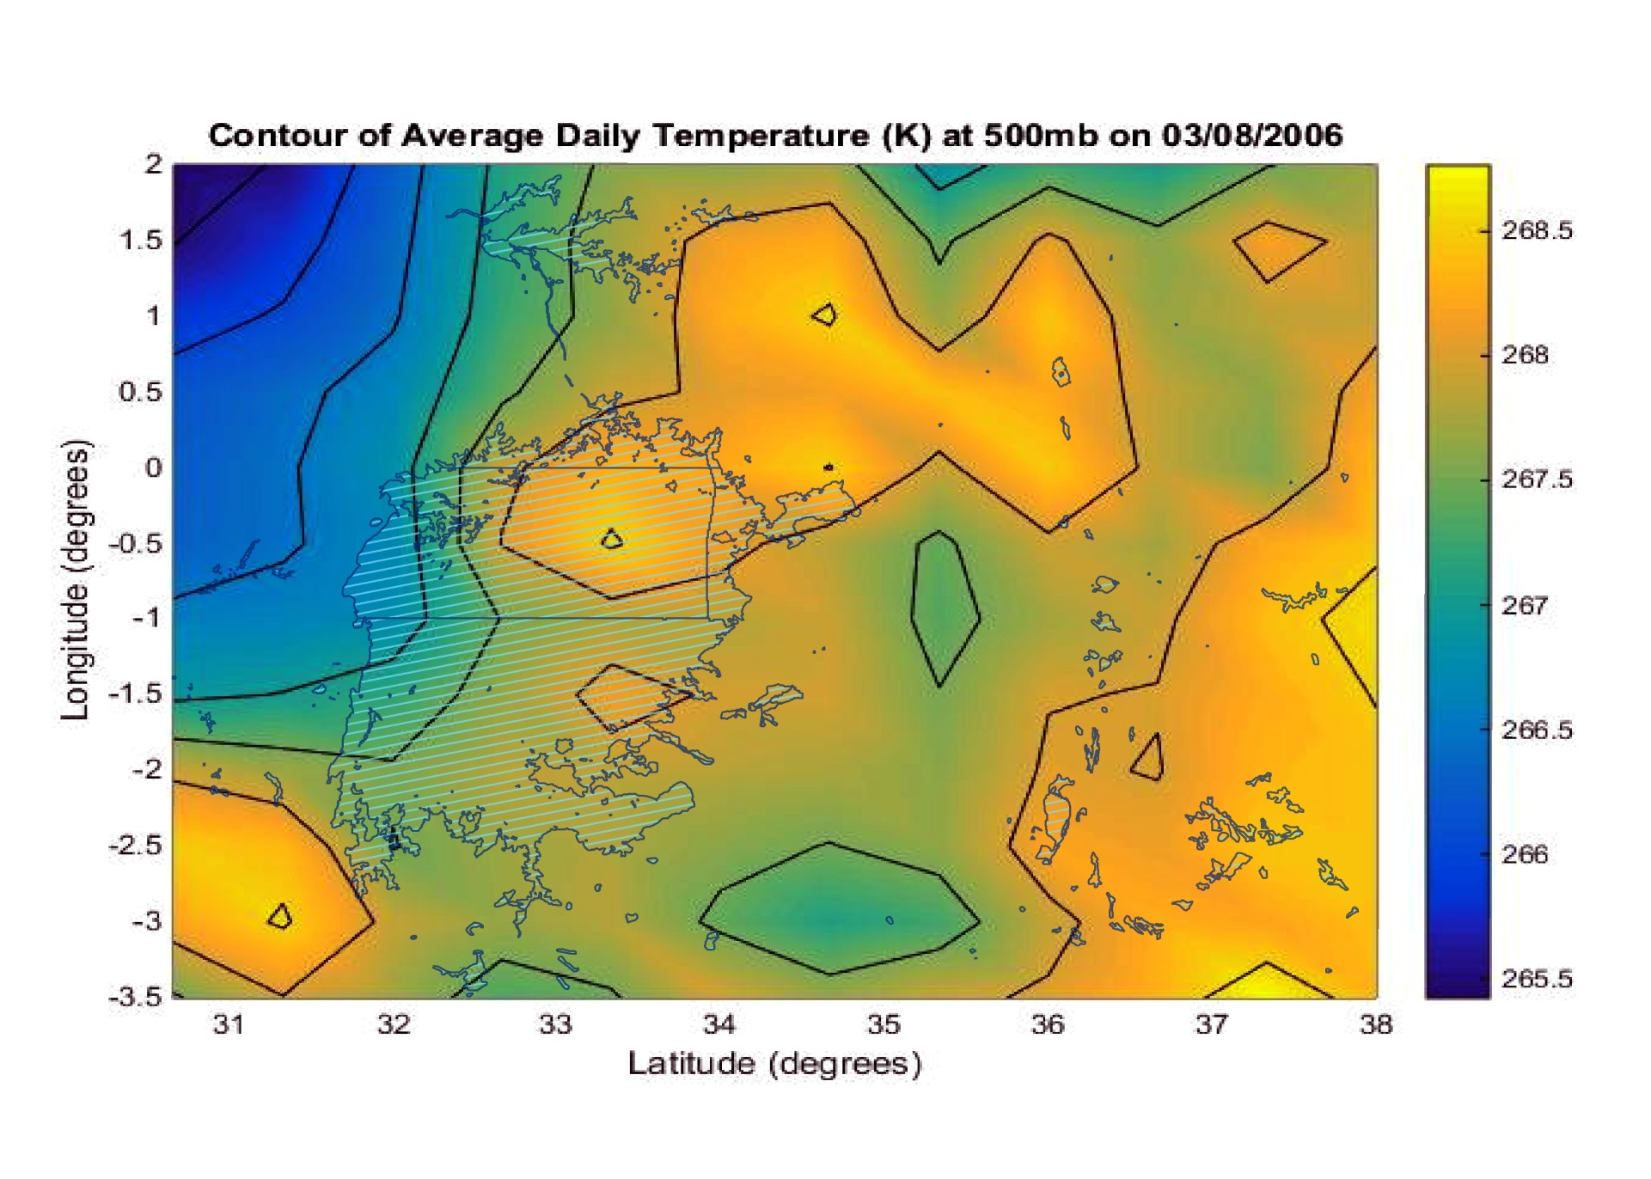
Contoured MERRA variables
Notes:
Example output of our MATLAB script. This product (Temperature at 500mb pressure level) was time averaged over a single day. Lake Victoria has been included for reference.

Slide 11
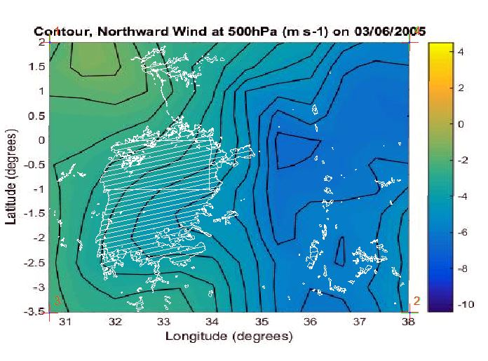
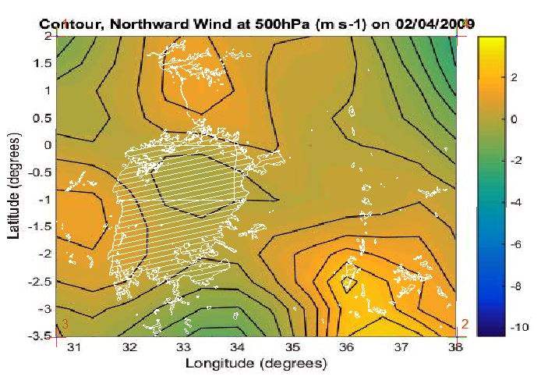
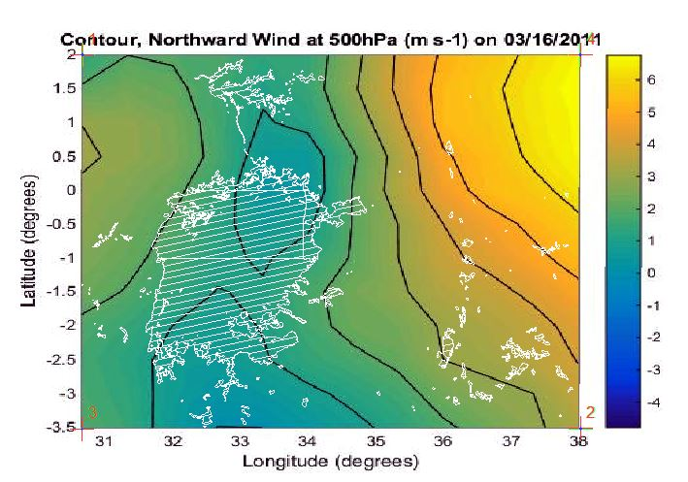
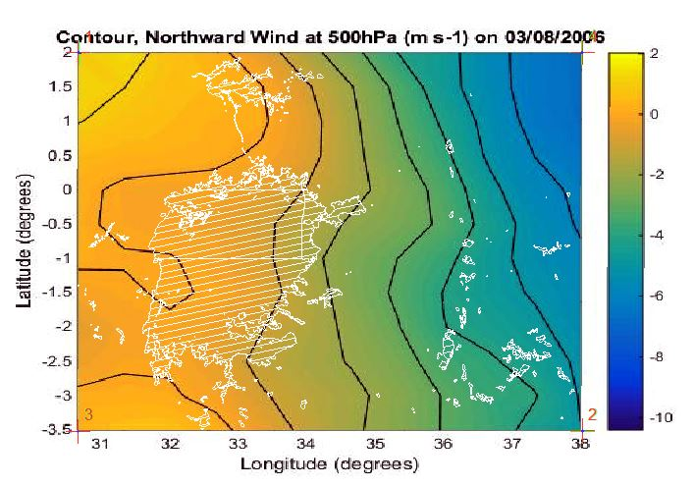
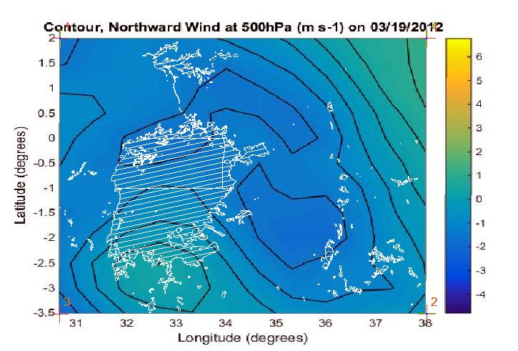
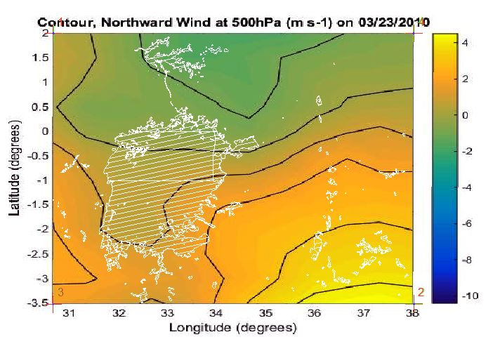
Contoured MERRA variables
IL50
IL99
Notes:
Example series of daily averaged contours at both the 50th and 99th intensity sets.
Recommendations for further analysis / utilization of contour map series might include averaging across days to look at ‘grand mean’ of intensity set, but maybe more importantly looking at time of day averages instead of total diurnal average.
Also need to look at additional MERRA variables and at different pressure levels.

Slide 12
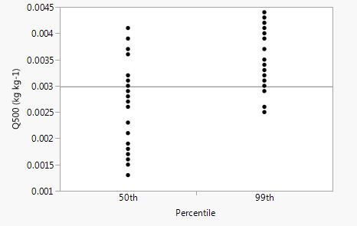
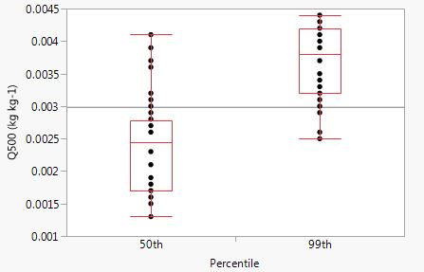
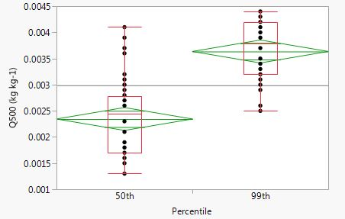
Distribution Analysis
Response Plot
Quantile Plot
Variance Plot
Notes:
Contours hard to draw conclusions, so data behind the contours was looked at using JMP 12 statistical package.
Here we see three graphs.
Graph 1 shows our raw response values in the categorical 50th and 99th groupings.
Graph 2 shows us the quantile plots of these response values. It was at this point summary statistics and other data were extracted from sets.
Graph 3 shows us the mean diamonds in reference to an analysis of variance that shows whether sets are signifigantly different in their repsonses from eachother.

Slide 13
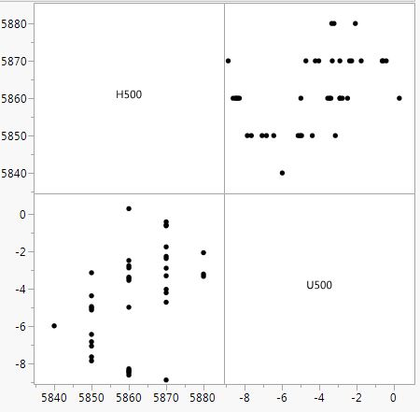
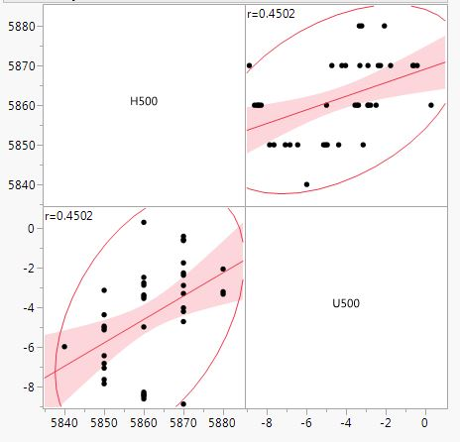
Correlation Analysis
Raw Scatterplot
Scatterplot w/ Pearson values
Notes:
Correlation Multivariate Analysis.
How well do the variables correlate linearly with each other? ( How do they change in response to each other? )
And , how does this correlation strength change between intensity sets?
Graph A shows raw scatterplot.
Graph B includes density ellipse and a fit line, although fit line not a tool usually associated directly with correlation analysis. Also included are the Pearson correlation strength values.

Slide 14
Conclusions & Future Work
One-way analyses showed significant differences between sets for variables of atmosphere moisture content (Q500) and vertical pressure levels (OMEGA500).
Correlation takeaways
Strong positive correlation between northward and eastward wind components (at 500mb) at IL50 conditions diminishes almost entirely at IL99 level.
Strong positive relationship between height and temperature (at 500mb) at IL99 is diminished from IL50.
Strong negative correlation between temperature and east-ward wind at IL50 has evaporated at IL99.
Reasonably strong negative correlation between atmospheric moisture content and eastward winds (at 500mb) at IL50 has become a very strong positive correlation at IL99.
Same for height (at 500mb ) with eastward winds.
Notes:
Correlations are not causation…explain how much variables ‘move’ together..no linear assertion of cause
“Strong” included correlations with Pearson coefficients exceeding .25 in either direction
Correlation Takeaways… related Pearson coefficients (by bulletpoint)
.5399 → 0.1179
.6695 → .3620
-.6243 → -.0716
-.3467 → .7756
-.3700 → .4502

Slide 15
Conclusions & Future Work
Future work on this project will revolve around the following:
Analysis at different pressure levels, esp. in the lower atmosphere (850mb, 700mb etc)
Statistical analysis and aggregation at different time steps (6 hours, day-night)
Contours used to capture more of the environment by looking at grand means and across a wider study area.
Synchronization of OT points with TRMM (LIS) swaths.

Slide 16
Advisors
Dr. Kenton Ross – NASA DEVELOP
Kristopher Bedka – NASA Climate Science Branch
Dr. DeWayne Cecil – Global Science and Technology, Inc.
Robert VanGundy – University of Virginia’s College at Wise
Partners
Kenya Meteorological Department
Others
Melanie Salyer - Mentor

Slide 17
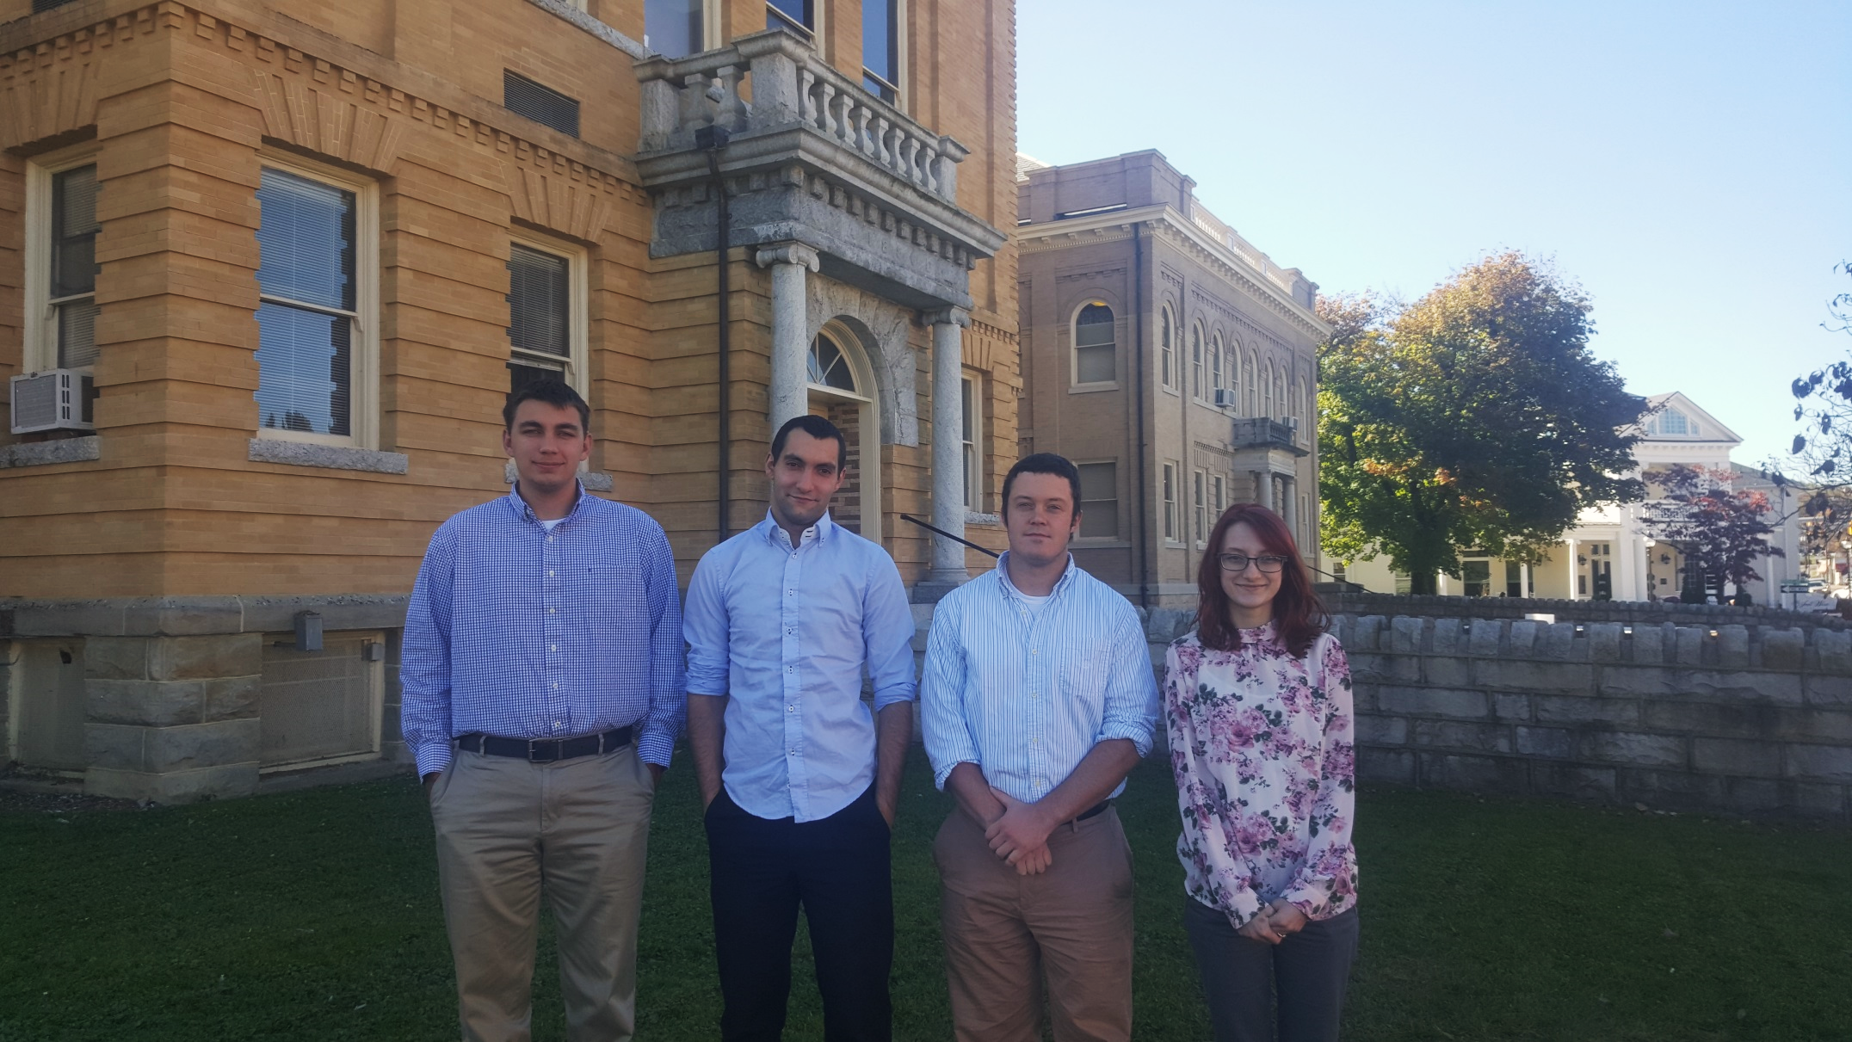
Project Team
From left to right: Grant Bloomer (Big Stone Gap, VA), Juan Antonio Chacón
Castro (Marbella, Spain), Will Wilson (Norton, VA), Annabel White (Clintwood, VA)
Notes:
Team : )

