Slide 1
Himalaya Disasters III
Utilizing a Landslide Identification Product and a Real-time Rainfall Detection Tool for Enhanced Landslide Detection
Amanda Rumsey (Project Lead)
Jessica Fayne
Jordan Scheffler

Slide 2
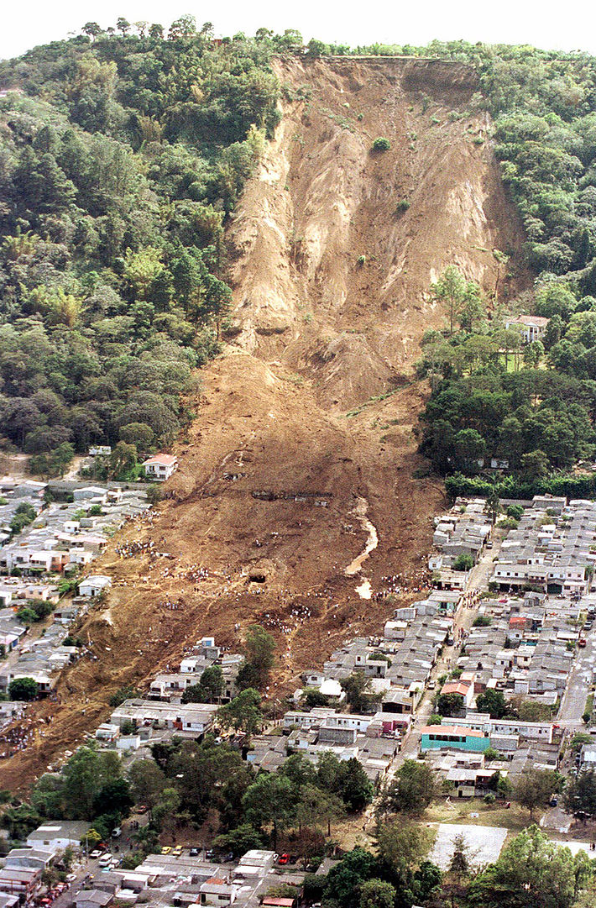
Introduction
What is a Landslide?
Type of mass wasting event
Occurs when down-slope forces exceed the strength of the slope materials
Impact of Landslides
Economic Damage
Loss of Life
Resource Availability
Nepal
Mountainous Terrain
Infrastructure
Monsoonal Rains
Wikimedia: Orlovic, 2007
Notes:
What is a landslide?
A landslide is a type of mass wasting event that occurs when down-slope forces exceed the strength of the slope materials.
Impacts of landslides
As a global natural hazard, landslides have the ability to cause immense economic damage, significant loss of life, and can have adverse effects on a variety of available resources.
Nepal
Nepal is particularly susceptible to landslides due to its mountainous terrain, active geodynamics, infrastructure, and heavy monsoonal rains.
https://upload.wikimedia.org/wikipedia/commons/7/73/ElSalvadorslide.jpg

Slide 3
Study Area: Nepal
Location:
Southern Asia, between China and India
Elevation Range:
70 – 8850 meters
Population:
31.5 million
Precipitation:
160 mm – 5000 mm
Notes:
Speaker Notes:
Location: Nepal is a landlocked, mountainous East Asian country that is slightly larger than the state of Arkansas.
Area: The country is 147,181 square kilometers in size.
Climate: 8 Climatic zones across the country due to large gradients in altitude and precipitation.

Slide 4
Pixabay: Simon Steinberger, 2007
Community Concerns
Hundreds of fatalities and millions of dollars lost annually due to landslide damages
Of the 3402 landslides reported between 2000 and 2010, 88.9% of the landslides affected at least one person
Landslide are responsible for greater damage than currently recognized due to:
Under-reporting
Misclassification
Notes:
-On average, Nepal experiences 135 casualties and loses millions of dollars annually due to landslide damages.
-According to the ICIMOD landslide dataset, 88.9% of the landslides reported between 2000 and 2010 affect one or more people
-With current under estimation of landslide impacts and increasing trend in frequency and intensity of landslide events due to anthropogenic factors, it is critical to develop a landslide identification product and a landslide hazard assessment model that have the ability to accurately quantify hazard and serve as a decisions support tool for end-users.
Picture Source
Author: Simon Steinberger
Source: Pixabay
URL:http://pixabay.com/en/mount-everest-himalayas-nuptse-276995/
Date: 1/28/2007
*its creative commons

Slide 5
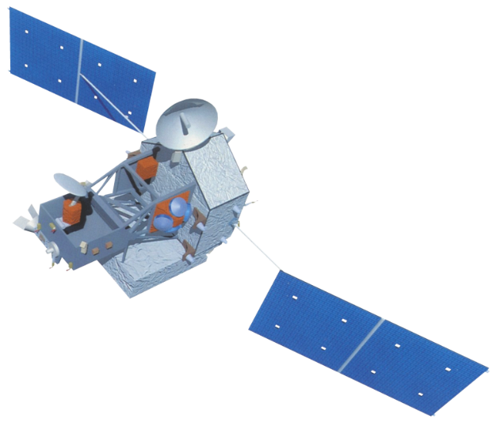
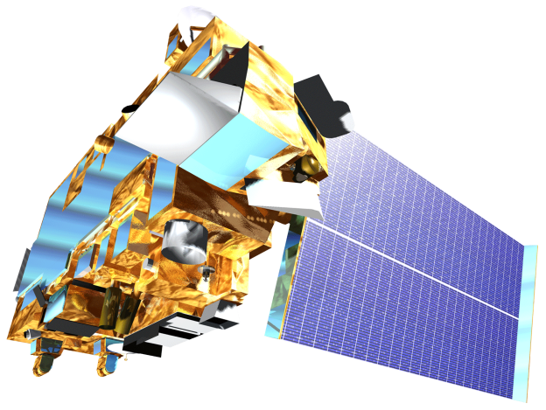
Objectives
Validate the results of SLIP using digitized landslide event information
Develop a web-based platform to display the results of SLIP and DRIP products
Perform rainfall threshold analysis
Comparative rain gauge and TRMM analysis for Nepal
Notes:
http://www.devpedia.developexchange.com/dv/images/c/c2/03_Landsat8.png
http://www.devpedia.developexchange.com/dv/images/1/1a/04_TRMM.png
http://www.devpedia.developexchange.com/dv/images/9/91/05_Terra.png

Slide 6
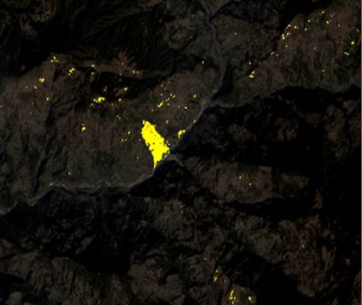
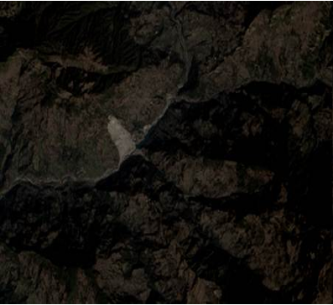
Methodology: SLIP
Hey, we cant decide between this slide format and the next. What do you think NPO?
Data Collection
Collect Landsat scenes and extract R, IR,SWIR and QA bands
Cloud Mask
Use the QA Band to Remove Clouds from the R, IR, and SWIR images
Red Increase
Calculate percent change between two Red images
Post SLIP Image
Moisture Index
Calculate moist areas using the IR and SWIR bands, comparing two images
Remove Flat Terrain
Remove pixels with slopes lower than 15%
Pre SLIP Image
Notes:
Image Source:
Jessica Fayne
Speaker notes: Originally written in R, transcribed in to python this term. Original calibration based on one large landslide event. Calibration and validation have since been expanded to multiple areas (i.e. CA, Rio, Nepal), and algorithm improved.

Slide 7
Methodology: SLIP
Data Collection
Collect Landsat scenes and extract R, IR,SWIR and QA bands
Cloud Mask
Use the QA Band to Remove Clouds from the R, IR, and SWIR images
Post SLIP Image
Red Increase
Calculate percent change between two Red images
Moisture Index
Calculate moist areas using the IR and SWIR bands, comparing two images
Remove Flat Terrain
Remove pixels with slopes lower than 15%
Pre SLIP Image

Slide 8
Methodology: DRIP
GPM
GPM data is downloaded in near real-time
TRMM
IMERG 30-Minute
TMPA-RT 3B42
Data Collection
Thresholds
Comparison
Alert
Monthly mean thresholds calculated from historical TRMM data
Monitors 30 min GPM IMERG data; looks for anomalies compared with thresholds
If current rainfall levels are significantly higher than thresholds, alert is issued for the affected area
Notes:
Image Source:
Aakash Ahamed, Justin Roberts-Pierel
Speaker Notes: Schematic of workflow for DRIP model. DRIP used to monitor precipitation in Nepal.

Slide 9
Methodology: SLIP Validation
Identify landslide event
Using landslide inventory
catalogs
Data collection
Landsat 8 OLI imagery
Delineate landslide manually (GIS)
Delineate landslide automatically (SLIP)
Perform accuracy assessment
Compare landslide detection results

Slide 10
Methodology: Rainfall analysis
Threshold Analysis
Cluster Analysis
Thornwaite Climatic Thresholds
Koppen Climatic Thresholds
Rain Gauge and TRMM Analysis
GLC landslide comparison

Slide 11
Maps & Logos
Maps
Import the legend separately.
Make sure all text is legible and editable.
Cite base layer source in speaker notes.
Logos
US Federal logos only.
No state, NGO, local and or international government logos, or software logos.

Slide 12
Advisors
Dr. Dalia B. Kirschbaum, NASA Goddard Space Flight Center
Dr. John D. Bolten, NASA Goddard Space Flight Center
Thomas A. Stanley, NASA Goddard Space Flight Center
Partners
International Centre for Integrated Mountain Development (ICIMOD)
Former Teammates
Justin Roberts-Pierel
Aakash Ahamed
Jamie Shiplet

