Slide 1
Mobile County Health and Air Quality
Using NASA Earth Observing Resources to Implement an Environmental Suitability Model to Ascertain Transmission Risk of Chagas
James Pickett, Project Lead (University of South Alabama)
Shikher Mishra, (University of South Alabama)
Brandi Stewart, (University of South Alabama)
Walt Clark (Center Lead) and Amber Jones (Asst Center Lead)
Notes:
Introduction, thanks, formalities

Slide 2
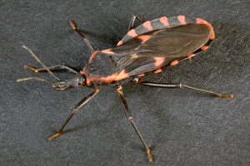
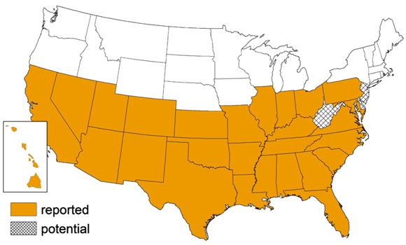
Community Concern
CHAGAS Disease
Caused by the protozoan T. cruzi
Typically vectored through Triatomines in the Reduviidae family of insects
Heavy disease burden in Latin America, estimated 8 million people infected in Mexico, central America, and South America.
TRIATOMINES (the Vector)
11 known species in United States
Triatoma sanguisuga is the most wide spread.
After taking a blood meal, typically one per molt, the insect defecates and releases the protozoan at the bite site
Triatomine blood-feeding and defecation behaviors are important factors for vector-borne transmission and vary across species
Adult Triatomid Sanguisuga
Image Credit: James Gathany (www.cdc.gov)
“Romana’s sign,” the swelling of a child’s eyelid
Infection of eye or around the bitesite
Image Credit: Journal of Young Investigators (JYI)
CDC’s distribution map of T. Sanguisuga
Image Credit: www.cdc.gov
Notes:
To start off, we want to cover the basics of Chagas. I’m sure {both or all} of you are familiar with it as this point but to initiate this model, we needed to start at the ground level. Chagas is the parasitic infection of the T. cruzi parasite…
The main human Chagas disease cycle consists of the parasite, T. cruzi, being transferred from an infected mammalian reservoir to a human host through an insect vector (triatomines).
The acute phase is characterized by flu-like symptoms and last for roughly 12 weeks, during which time trypomastigotes (the infectious form of the T. cruzi parasite) are detectable.
Mild or non specific symptoms – patients may not come to clinical attention.
After the acute phase, parasites become undetectable to microscopy, and the patient enters the chronic phase.
Patients with chronic Chagas Disease are known to have complications with the circulatory and gastrointestinal systems.

Slide 3
Partners & End Users
University of South Alabama
Created a Priority Collection Site Map for partners to use in the field in order to place traps for capturing T. sanguisuga specimens for testing of Chagas
• Dr. Frances Mujica, Department of Earth Sciences
• Dr. John McCreadie, Department of Biology
Mobile County Health Department
Dr. Monica Night, Epidemiology

Slide 4
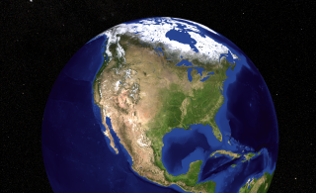
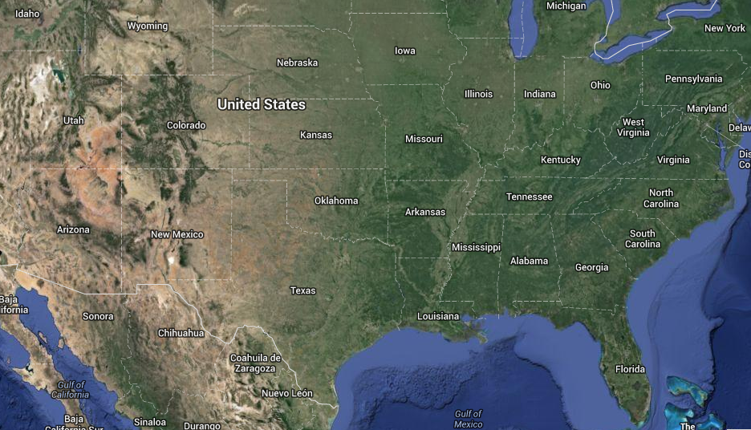
Study Area
Model Domain:
Southeast United States
Post Modeling analysis:
Mobile County, Alabama
Notes:
Remote sensing is a regional application
The model required more species locations. This was helpful in defining the model

Slide 5
Objectives
Demonstrate the ability of NASA Earth Observing data to aid in Ecological Niche modeling
Compile a habitat suitability map for Chagas Disease using the Genetic Algorithm for Rule-set Production (GARP) model.
Determine optimal collection sites for insect species using post-analysis data; wildland urban interface and socioeconomic data.

Slide 6
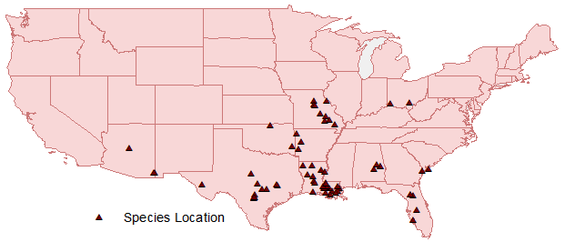
Species Occurrence Data
GARP requires species occurrence locations, climatic, and environmental parameters to find correlations so suitable habitat predictions can be made
Databases used:
Global Biodiversity Information Facility
Louisiana State Arthropod Museum
67 distinct specimen locations were acquired
Triatoma sanguisuga species location coordinates
Notes:
Recall, known species occurrence locations, climatic, and environmental parameters to find correlations are used to predict suitable habitats for the species to maintain a population.
Because this project modeled the southeast, with a particular focus on Mobile county, only locations found in Florida, Southern
Louisiana, Eastern Texas, and Arkansas were used.
Databases used were the Global Biodiversity Information Facility, and the Louisiana State Arthropod Museum

Slide 7
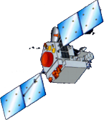
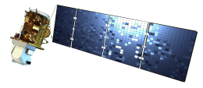
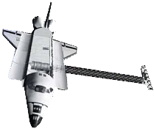
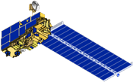
Data Acquisition
Type (No. of layers) | Sensor/Source | Spatial Resolution | Temporal Coverage
Precipitation (8) | www.worldclim.org1 | ~1 KM | 1950 – 2000 (Avg.)
Temperature (11) | www.worldclim.org1 | ~1 KM | 1950 – 2000 (Avg.)
Land Cover (1) | National Land Cover Database (NLCD). Based on Landsat | ~30 M | 2006
NDVI (1) | Global Land Cover Facility (GLCF). Based on MODIS data. | ~ 250 M | 2006
NDWI (1) | www.geoland2.eu. Based on SPOT VGT data. | ~ 1 KM | 2009 - Present
Slope (1) | www.worldclim.org1. Based on SRTM data | ~ 1 KM | Unknown
Altitude (1) | www.worldclim.org1. Based on SRTM data. | ~ 1 KM | Unknown
Land Surface Temperature (2) | http://neo.sci.gsfc.nasa.gov. Based on MODIS data. | 0.1 ̊ | 2007 – 2013 (Avg.)
Soil Moisture (2) | http://www.esrl.noaa.gov. Modal calculated. | 0.5 ̊ | 2005 – 2013 (Avg.)
Socio-Economic | http://sedac.ciesin.columbia.edu/, https://www.census.gov/ | N/A | 2010
Wild-Urban Interface | Census, National Land Cover Database (NLCD) and the protected Areas Database version 1.1 | N/A | 2010 (Census), 2006 (NLCD)
1Worldclim.org created interpolated bioclimatic layers using climate databases by the Global Historical Climatology Network (GHCN), Food and Agriculture Organization (FAO), World Meteorological Organization (WMO), International Centre for Tropical Agriculture (CIAT), Regional, Electronic Hydrometeorological Data Network (R-HydroNET), and a number of additional minor databases.
TRMM
Aqua
Landsat 8
used in final analysis
SRTM
Terra
Notes:
NASA Open data policy
Amount of data disallowed the use of non-derived data

Slide 8
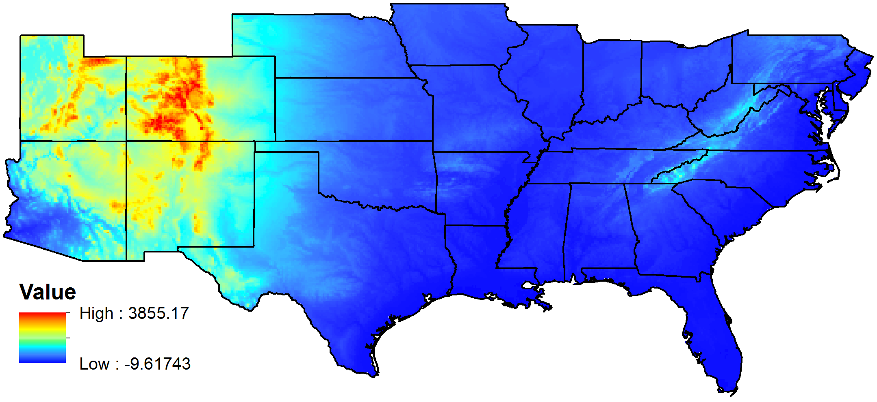
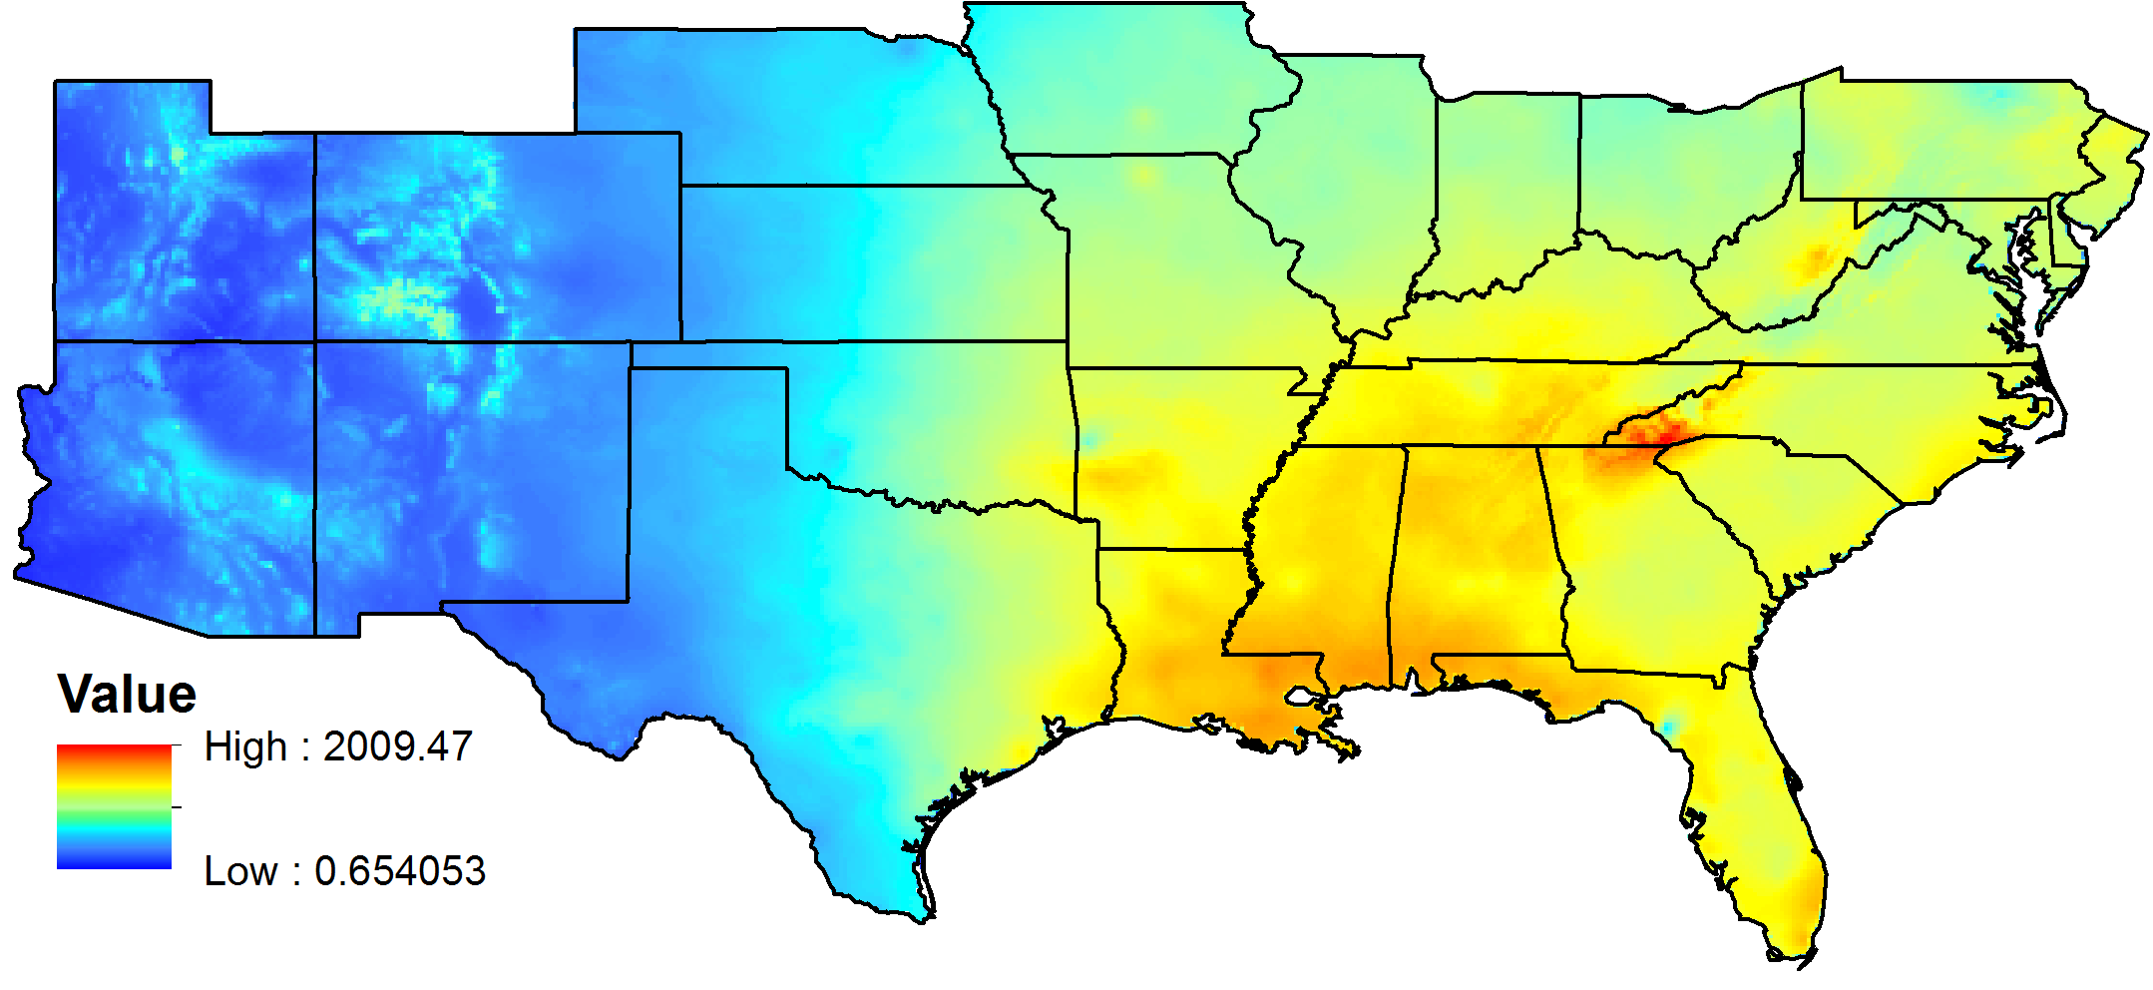
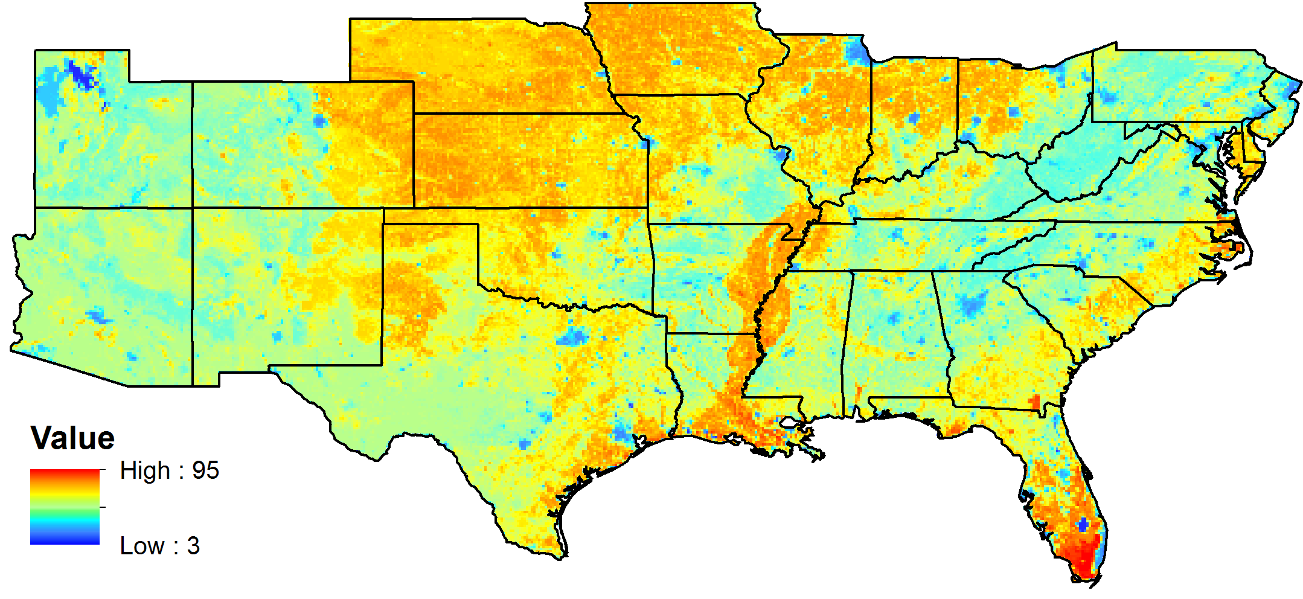
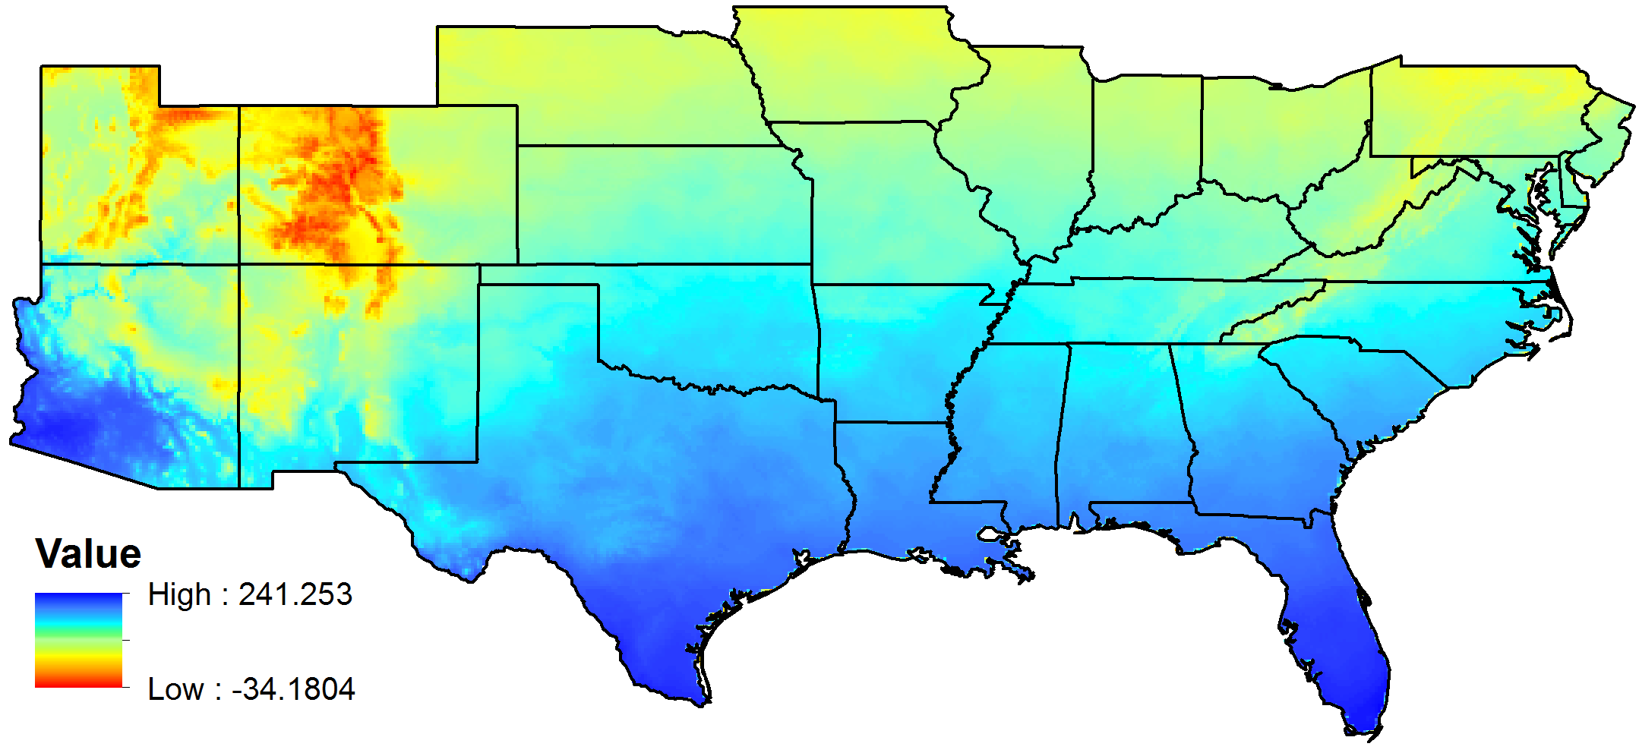
Data Processing
ArcGIS and ERDAS were used to process the data into ASCII files with uniform spatial resolution and extent.
Acquired species location coordinates were compiled in ArcMAP10
Annual Mean Temperature
Altitude
Land Cover
Annual Precipitation

Slide 9
GARP WORKFLOW
Environmental
Geospatial Layers
Initial Rule Creation
Prediction Maps
Probabilistic Approach
Genetic Algorithm
Final Rule Creation
Training Dataset
Prediction Accuracy Calculation
Point Localities
Testing Dataset
GARP (Genetic Algorithm for Rule-Set Production)
Notes:
This block diagram gives the macro view about the internal working of GARP. In later slides I will explain the micro level functioning of each block.
So, as said earlier, GARP uses two types of inputs i.e. Environmental layers and point localities.
GARP divides point localities into two parts i.e. training dataset and testing dataset as defined by user.
In the beginning, GARP uses probabilistic approach to create initial rule to predict species location with the use of training dataset and environmental layers.
This initial rule is then fed to genetic algorithm to create final rule.
Lastly, final rule is used along with environmental layers to create prediction maps. These prediction maps just represent two possibilities i.e. presence and absence.
Prediction accuracy of the final rule is also calculated for the testing as well as training datasets.

Slide 10
OUR APPROACH
Environmental Parameters
(Simulation 1 :- 28 Parameters
Simulation 2 :- 24 Parameters)
Clipped & Resampled
All Parameters
GARP (Desktop Version)
O/Ps with test probability > 0.5 filtered
(Simulation 1 :– 86 O/Ps were filtered.
Simulation 2 :– 57 O/Ps were filtered.)
500 m
PCA (categorical) derived Parameters
(Simulation 1 :– 6 Parameters
Simulation 2 :– 5 Parameters)
Clipped & Resampled
PCA (categorical) derived Parameters
(Simulation 1 :– 6 Parameters
Simulation 2 :– 5 Parameters)
GARP (Desktop Version)
90 m
O/Ps with test probability > 0.5 filtered
(Simulation 1 :– 200 O/Ps were filtered.
Simulation 2 :– 100 O/Ps were filtered.)
All Parameters
All O/Ps were combined to produce composite probability map.
All O/Ps were combined to produce composite probability map.
GARP (CLI Version)
GARP (CLI Version)
Simulation w/ PCA derived layers was not performed
Image Differencing
Simulation w/o PCA derived layers couldn’t be acquired due to disk space limitation of supercomputer and large data size.
Justification?
Masking with Wild-Urban Interface & Socio-Economic Data.
Simulation 2 results were chosen as final after analysis
Analysis showed that both O/Ps were significantly different.
Final Probability Map
Notes:
PCA explained here

Slide 11
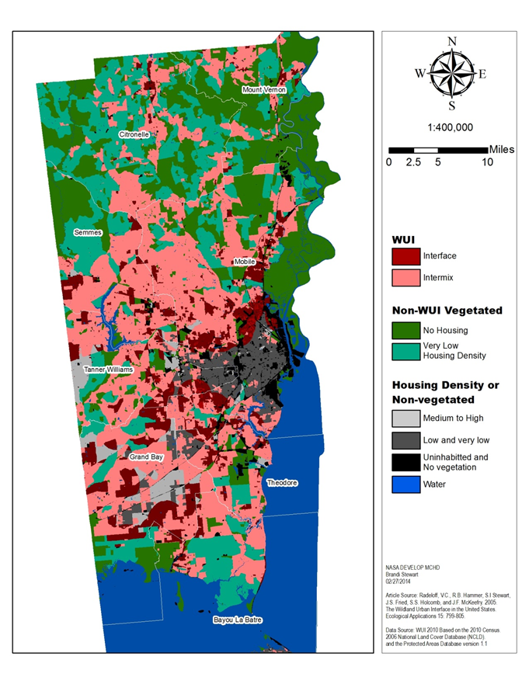
Post-Modeling Analysis
Wildland-Urban Interface (WUI)
Interface: Communities with housing in the vicinity of the continuous vegetation.
Intermix: Communities where housing and vegetation intermingle
Housing Density: number of housing units per square kilometer
Data Source WUI 2010 Based on the 2010 Census 2006 National Land Cover Database (NLCD).
Notes:
The threat of the peridomestic habitat.
WUI is important because this is where people are at the most risk of encountering the vector.

Slide 12
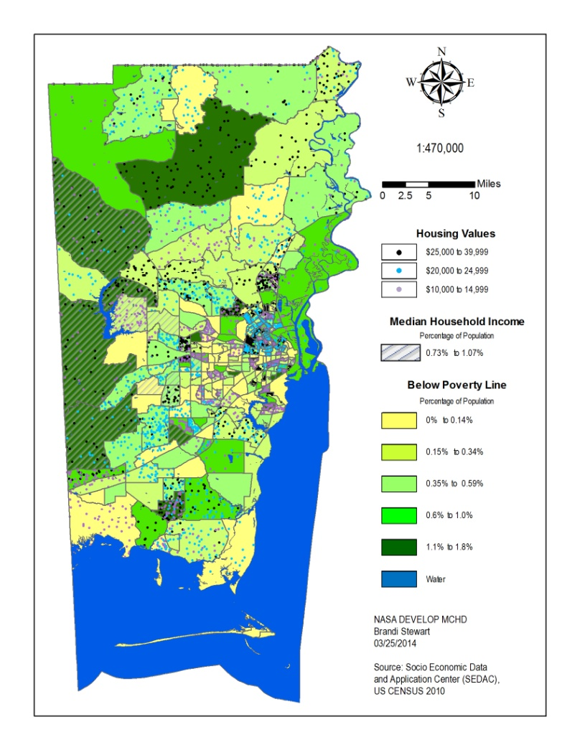
Post-Modeling Analysis (2)
Socio-Economic Data
Indicators
Median Household Income
Per Capita Income
Employment
Housing by Value
Public Assistant Income
Households Below Poverty Line
Notes:
Employment, Public Assistant Income and Per capita Income were used as preliminary insights into the US Census data. The indicators used to create the map was housing by value, public assistant income, and households below poverty line.
Housing by value is represented(see slide)
Below poverty Line (see Slide)
Median household Income (see slide)

Slide 13
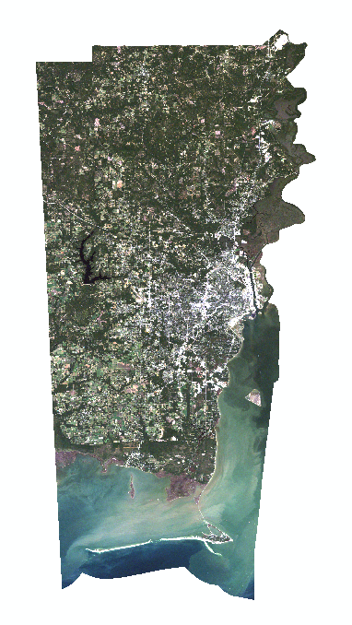
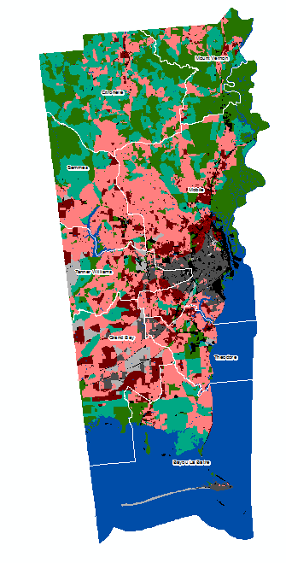
Post-Modeling Analysis (3)
Comparison of Landsat 5TM True Color with the Socioeconomic data and Wildland Urban Interface
Socioeconomic Data
2010 US Census
Socioeconomic Data and
Application Center (SEDAC)
Landsat 5TM
RGB 321
Datum: UTM WGS 1984
October 2011
Wildland Urban Interface
2010 US Census
2006 National Land Cover
Database (NLCD)
Notes:
This gives perspective of the area. Since the SED is expressed in census tracts and the WUI is expressed in a county format. This can also be used to further prove the extent of the WUI.

Slide 14
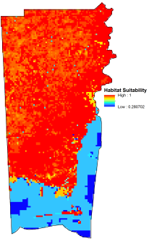
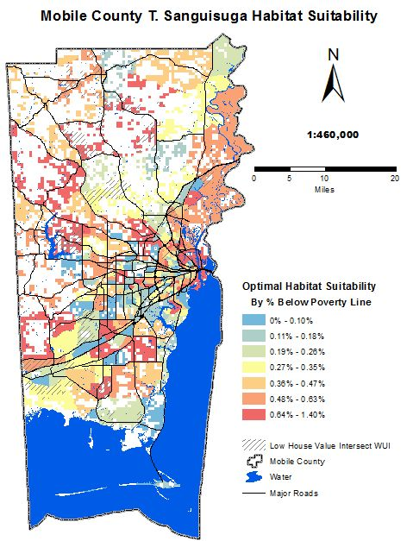
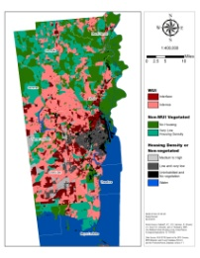
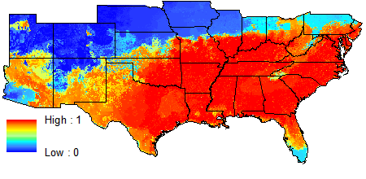
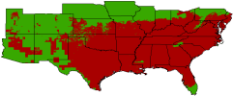
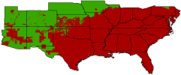
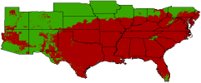
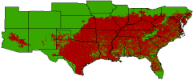
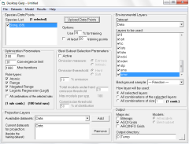
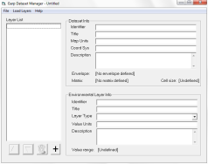
Methods Overview
Socio-Economic Data
Wild-Urban Interface (WUI) Data
Landsat 8
Environmental Layers
MODIS
T. Sanguisuga Collection Sites

Slide 15
Final Results
Top left: GARP outputs stacked to create a habitat suitability map of the United States.
Bottom left: High suitability and Housing Value map for Mobile County.
Center: Habitat Suitability of T. sanguisuga in Mobile, county.
Notes:
Specific Regions of data Interpretation

Slide 16
Conclusion
The majority of the Southeastern United States shows high habitat suitability for T. sanguisuga
Stacking all outputs reveal areas of Mobile, county with higher probabilities of encountering T. sanguisuga. Specifically the southern portion of the County, which contain large areas of wetlands
Screening performed with Wild-Urban interface/intermix and socio-economic data further refined target trap setting locations

Slide 17
Limitations
Model outputs may become distorted when resampling input data to a resolution that is much finer than the source data
Upcoming NASA Satellite Soil Moisture Active Passive(SMAP) would have allowed the model to make better correlations with the vector’s preferred habitat
Finer resolution greatly increases computational demand and makes it difficult to run on desktop computers.
Top components from the PCA of the originally intended parameters proved to be insufficient as surrogates for the parameters in running GARP.

Slide 18
Future Work
Locate additional coordinates for collected T. sanguisuga
Running GARP with finer resolution, but keeping the parameters close to the source data
Utilizing VIIRS nightlights to include emissive light sources in the model
Using the GARP output to forecast the disease distribution of a possible outbreak.

