Slide 1
Scene 1: Opening
Scene Elements
Script: | Official DEVELOP introductory clip
Estimated Scene Duration: | 8 seconds
Narrator/ Team Member: | none
Scene Text/ Captions: | none
Royalty Free Music: | none

Slide 2
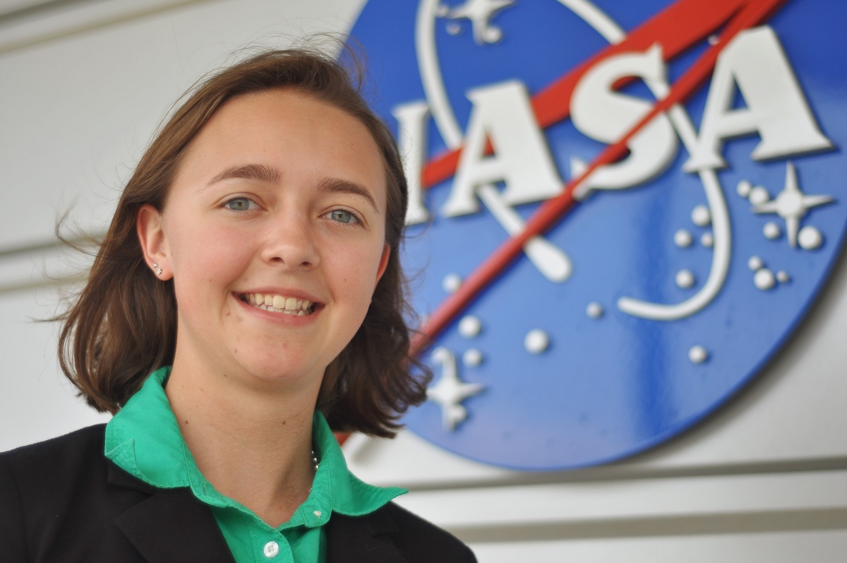
Scene 2: Intro Team
Scene Elements
Script: | >>My name is Sam Weber. >>My name is Hayley Solak. >>My name is Tiffani Orne. We are the New England Water Resources team. The purpose of our project was to use NASA Earth observations to monitor chlorophyll, cyanobacteria and algal blooms in Lake Champlain during the summer months from May 2002 through June 2013.
Estimated Scene Duration: | 25 seconds
Narrator/ Team Member: | all
Scene Text/ Captions: | "Monitoring Chlorophyll, Cyanobacteria, and Algal Blooms in Lake Champlain" when mentioned
Royalty Free Music: | none

Slide 3
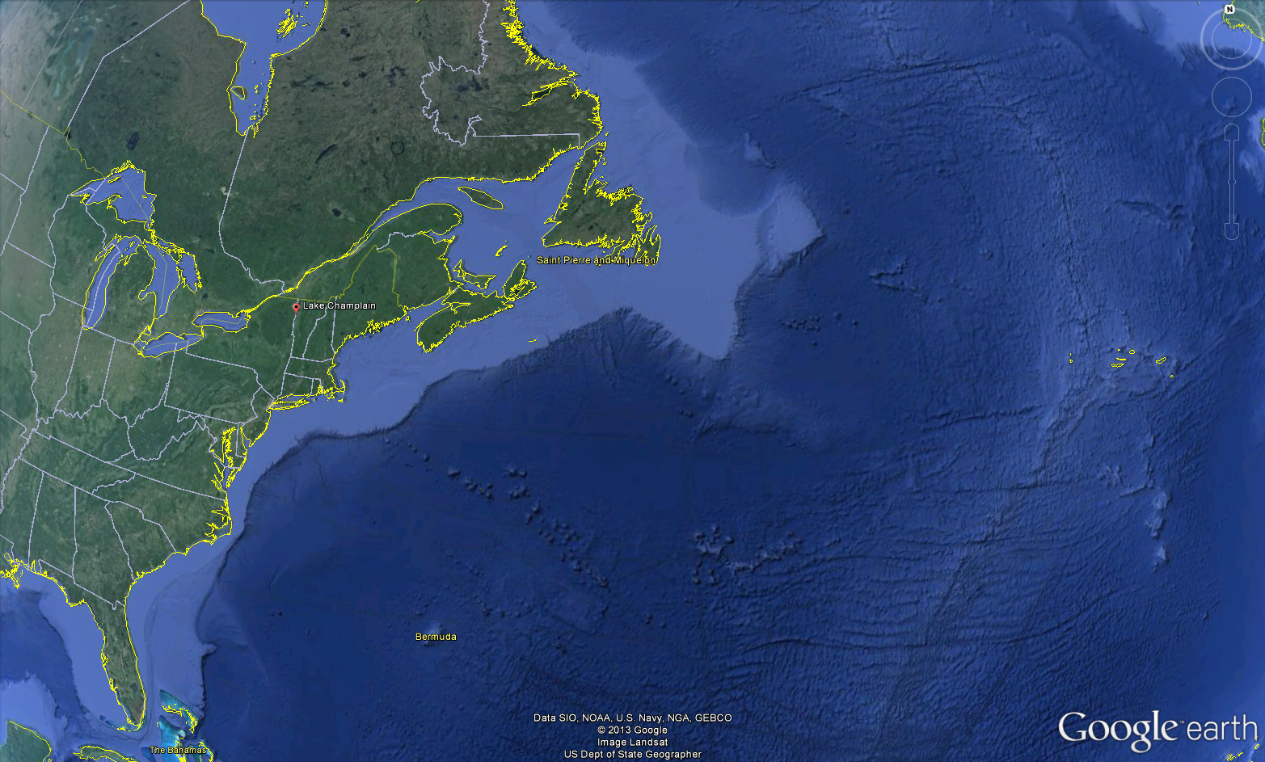
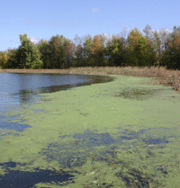
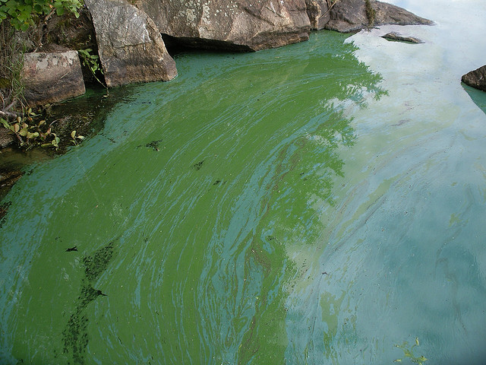
Scene 3: Community Concerns
10 seconds
Photo: Citation
Photo: Stefe / CC BY-NC-ND 2.0
Scene Elements
Script: | Approximately 145,000 people rely on Lake Champlain for their drinking water and it is also a major breeding ground for migratory birds. Of the 300 bird species present at the lake throughout the year, 24 are listed as endangered species. Development in the Lake Champlain watershed has led to increased nutrient levels in the lake, allowing algae to reproduce exponentially and create hazards to both human and ecological health. Pollution sensitive organisms are unable to survive, decreasing lake diversity and disrupting complex food webs. Some organisms may not show signs of toxic exposure, however they can still cause a wide range of illnesses if consumed by humans. There are no known remedies for these illnesses, nor are there any methods of removing the toxins from the water.
Estimated Scene Duration: | 35 seconds
Narrator/ Team Member: | Sam
Scene Text/ Captions: | none
Royalty Free Music: | none

Slide 4
Scene 4: Partners
Vermont Department of Environmental Conservation
Lake Champlain Basin Program
Lake Champlain Committee
Scene Elements
Script: | The partners for this project were the Lake Champlain Basin Program, the Lake Champlain Committee, and the Vermont Department of Environmental Conservation. All three organizations currently monitor water quality in the lake using a combination of in situ measurement stations and water samples collected by volunteers. However, these samples may not be representative of quality in the lake as a whole, and therefore remote sensing offers more consistent, objective monitoring while using less volunteers.
Estimated Scene Duration: | 20 seconds
Narrator/ Team Member: | Hayley
Scene Text/ Captions: | none
Royalty Free Music: | none

Slide 5
Scene 5: Data Usage
Scene Elements
Script: | Aqua MODIS, Landsat 7 ETM+, and Landsat 8 OLI data were downloaded from the USGS Global Visualization Viewer (GloVIS) website for use in this project. In situ measurement data collected by the Vermont Department of Environmental Conservation were used to compare with calculated values.
Estimated Scene Duration: | 17 seconds
Narrator/ Team Member: | Tiffani
Scene Text/ Captions: | images of the satellites, or video of satellites http://svs.gsfc.nasa.gov/cgi-bin/details.cgi?aid=3939 (Source: NASA/GSFC Scientific Visualization Studio)
Royalty Free Music: | none

Slide 6
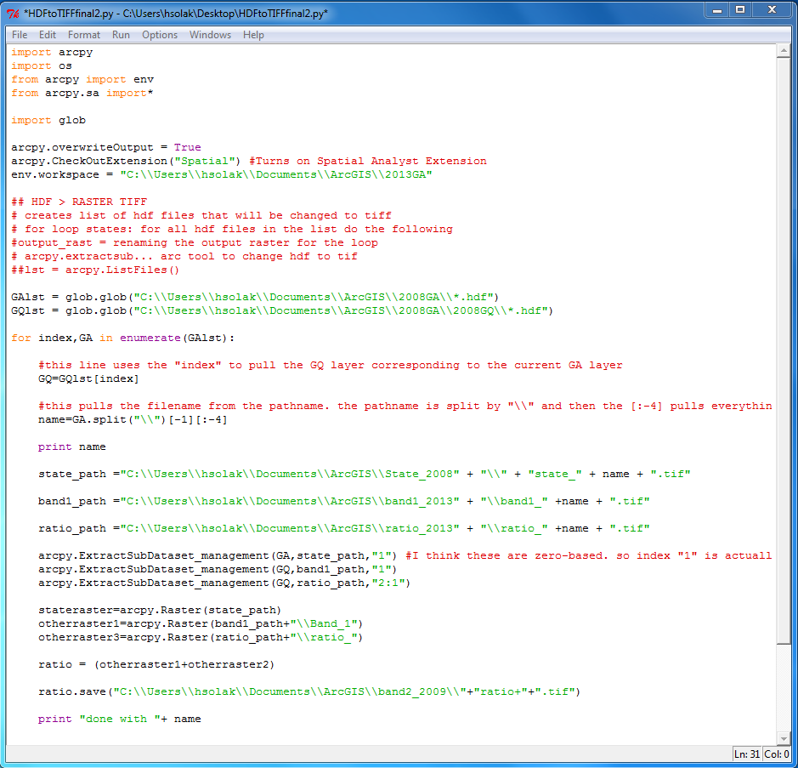
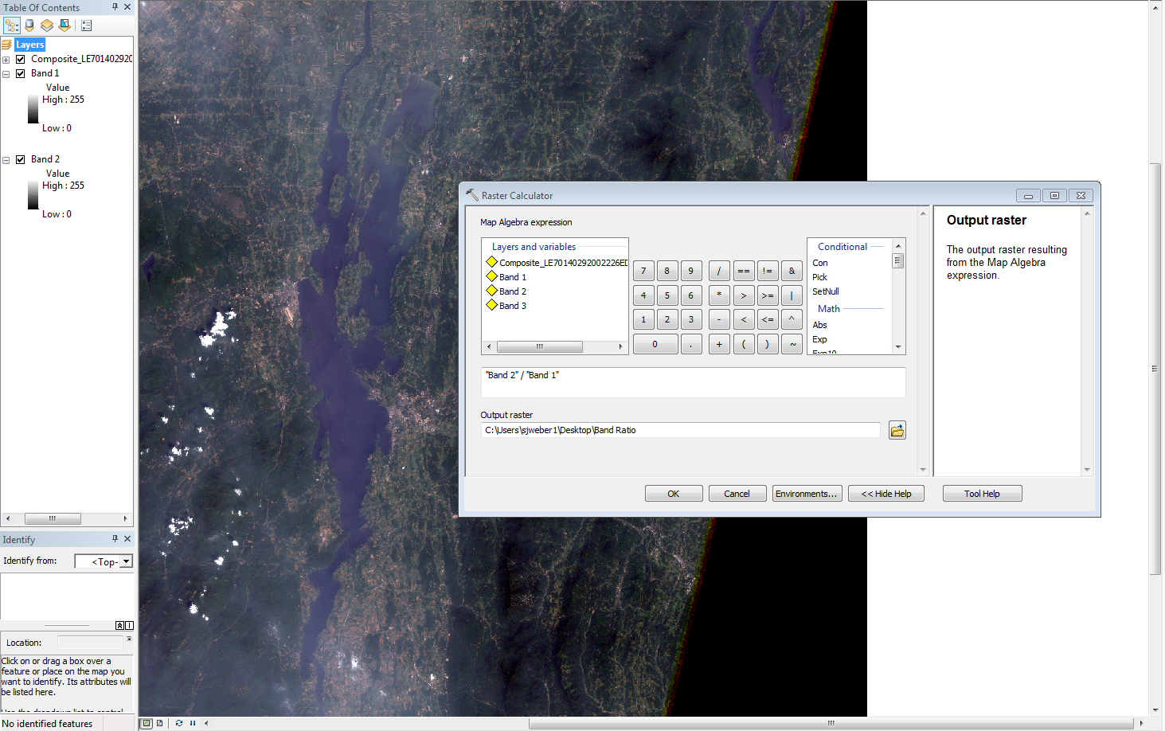
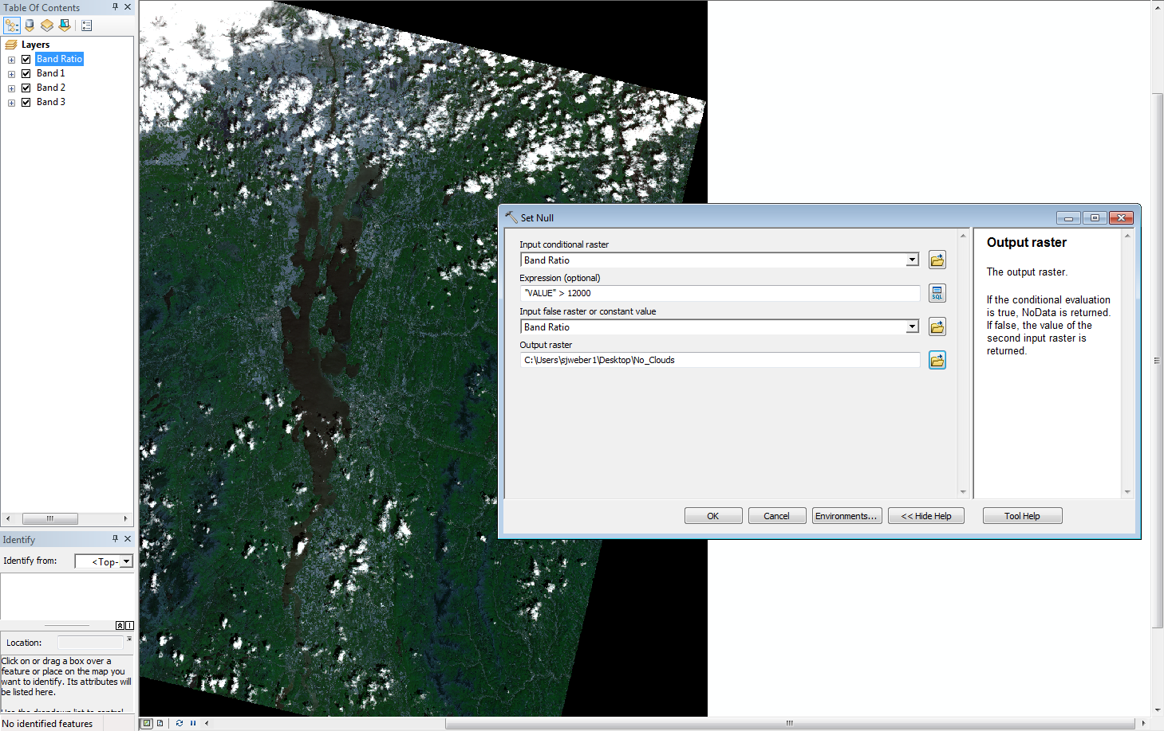
Scene 6: Analysis
Scene Elements
Script: | Landsat data were used to calculate chlorophyll-a, cyanobacteria, and phycocyanin concentration using the Raster Calculator tool in ArcGIS. Bands one, two, and three were used to create ratios for the chlorophyll-a and cyanobacteria equations, while the phycocyanin equation used bands one, three, five, and seven individually. Once the calculations were completed, the Set Null tool was used to remove erroneous cloud pixels. Aqua data were used to calculate total suspended sediment using a model created in a previous term. A python script was used to extract the state file and near infrared bands one and two from the MODIS data to use as inputs for the model. The model used band one to calculate TSS, while the state file and NIR bands were used to create cloud and land masks.
Estimated Scene Duration: | 42
Narrator/ Team Member: | Hayley
Scene Text/ Captions: | none
Royalty Free Music: | none

Slide 7
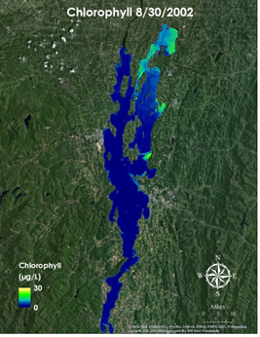
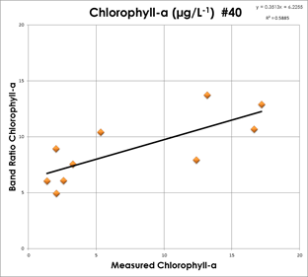
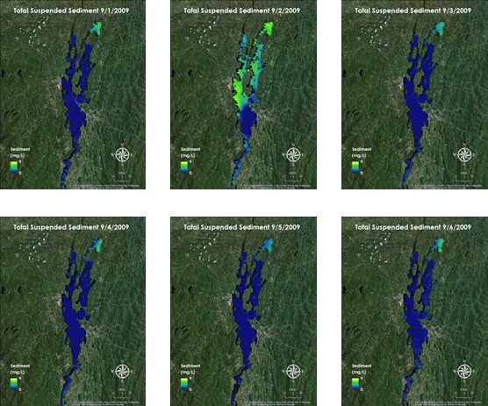
Scene 7: Results
Scene Elements
Script: | Maps were created showing the concentration of chlorophyll-a, cyanobacteria, phycocyanin, and total suspended sediment throughout the lake. These values were then compared with in situ measurement data at specific locations to verify the accuracy of the algorithms. Scatterplots were created to show the correlation between these values. Scatterplots also showed the correlation between TSS and biophysical parameters, including a .89 correlation between TSS and phycocyanin. A time series was created for each parameter to show the change throughout the decade. A six day segment of the TSS time series, from September 1 through September 6, 2009 shows how quickly change can occur. On September 1, sediment is concentrated in Mississiquoi Bay in the north. On the 2nd, sediment is present throughout the main segment of the lake, and on the 3rd, the main concentration is again in Mississiquoi Bay. Levels decrease in Mississiquoi Bay from September 4 to 5, but have increased again on September 6.
Estimated Scene Duration: | 47 seconds
Narrator/ Team Member: | Tiffani
Scene Text/ Captions: | none
Royalty Free Music: | none

Slide 8
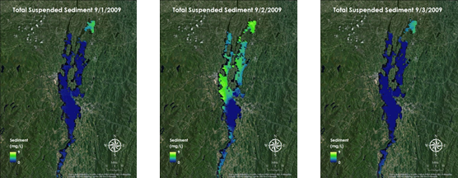
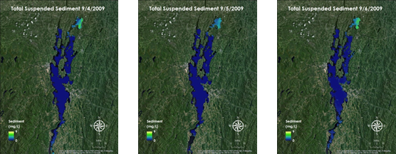
Scene 9: Conclusions
Scene Elements
Script: | This project showed that NASA Earth observations can be used to accurately track concentrations of chlorophyll-a, cyanobacteria, phycocyanin, and total suspended sediment. /***/ Remote sensing allows end users to monitor water quality throughout the entire lake rather than only specific in situ measurement stations. /***/ Biophysical parameters showed correlation with in situ measurements, but the availability of Landsat data without significant cloud cover is limited, therefore water quality tracking would be less frequent. /***/ This causes monitoring issues because algae levels can drastically change in a single day. /***/ Total suspended sediment concentrations correlated well with the biophysical parameters, so using Aqua data provides a reliable alternative. /***/ Aqua samples more frequently than Landsat; however, the resolution is coarser. /***/ The best method of water quality monitoring with remote sensing would combine the two data types.
Estimated Scene Duration: | 42
Narrator/ Team Member: | Sam
Scene Text/ Captions: | none
Royalty Free Music: | none

Slide 9
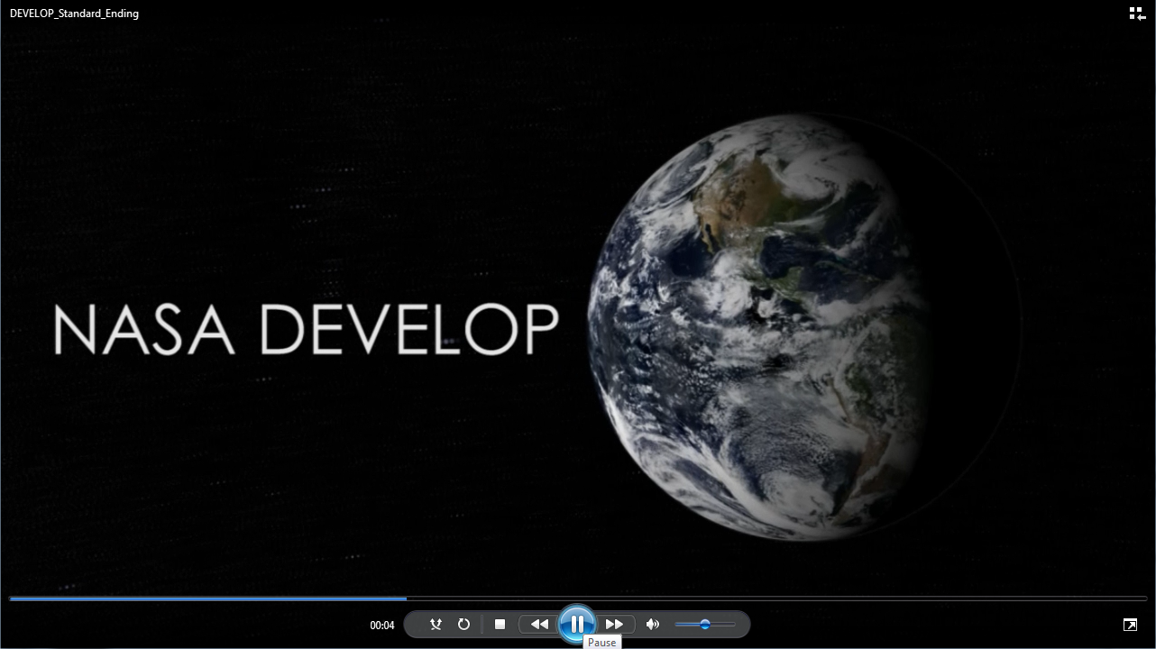
Scene 10: Ending
Scene Elements
Script: | Official DEVELOP ending
Estimated Scene Duration: | 11 seconds
Narrator/ Team Member: | none
Scene Text/ Captions: | none
Royalty Free Music: | none

