Slide 1
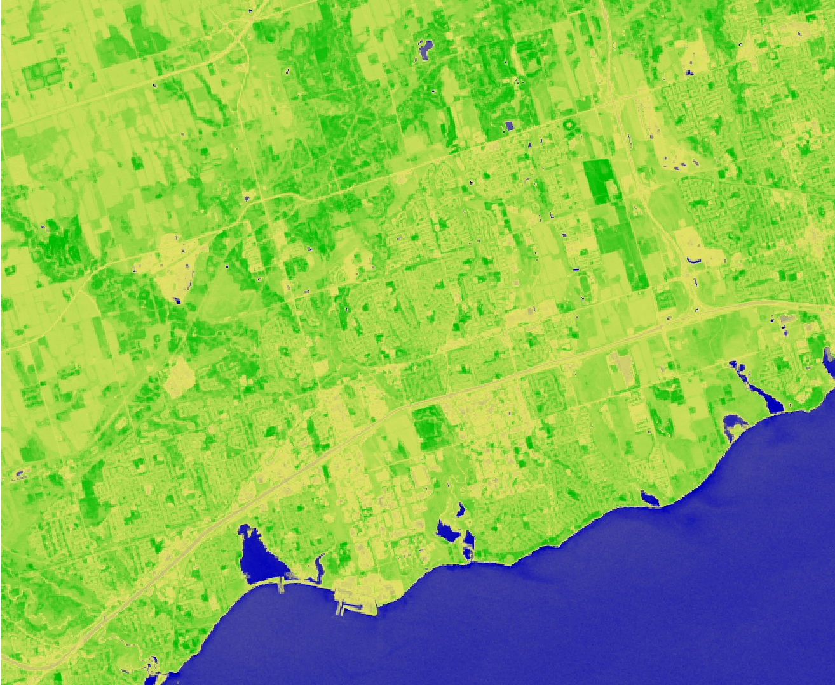
Ajax Urban Development
Utilizing NASA Earth Observations to Assess Urban Forest as an Adaptation Strategy for Extreme Heat in Ajax, ON, Canada
Huntington Keith
Eleanor Dhuyvetter
Dean Blumenfeld
Elizabeth Dyer
Notes:
Ajax Urban Development, Arizona node located in Tempe. Center Lead: Lance Watkins, Assistant Center Lead and Fellow: Elizabeth Dyer, Project Lead: Huntington Keith, Team Members: Eleanor Dhuyvetter and Dean Blumenfeld

Slide 2
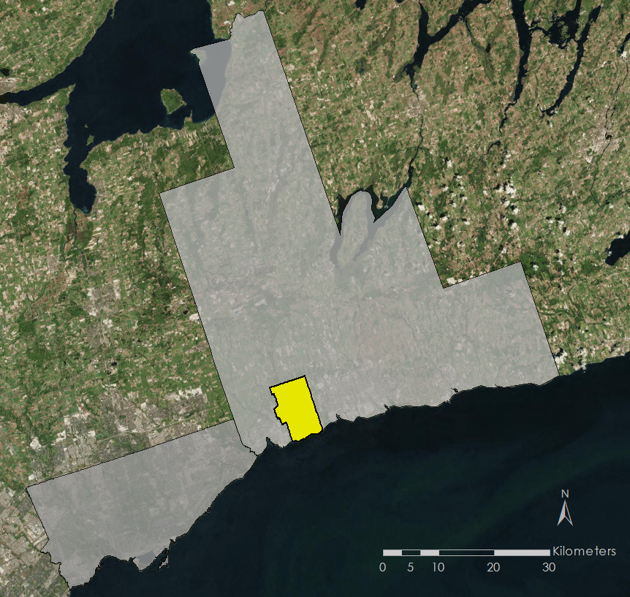
Study Area and Period
Ajax, Ontario, Canada
Population: 120,000
Area: 67 km²
Typical summer temperature: 22 °C
Typical winter temperature: 0 °C
Yearly precipitation: ~800mm
Modeling Period: January 2000 – December 2016
Forecasting Period: January 2040 – December 2049
Durham Region
Ajax
Lake Ontario
Toronto
Notes:
Images created using ArcMap
Mention that is a suburb outside of Toronto, and in the Great Lakes Region, and is quickly growing

Slide 3
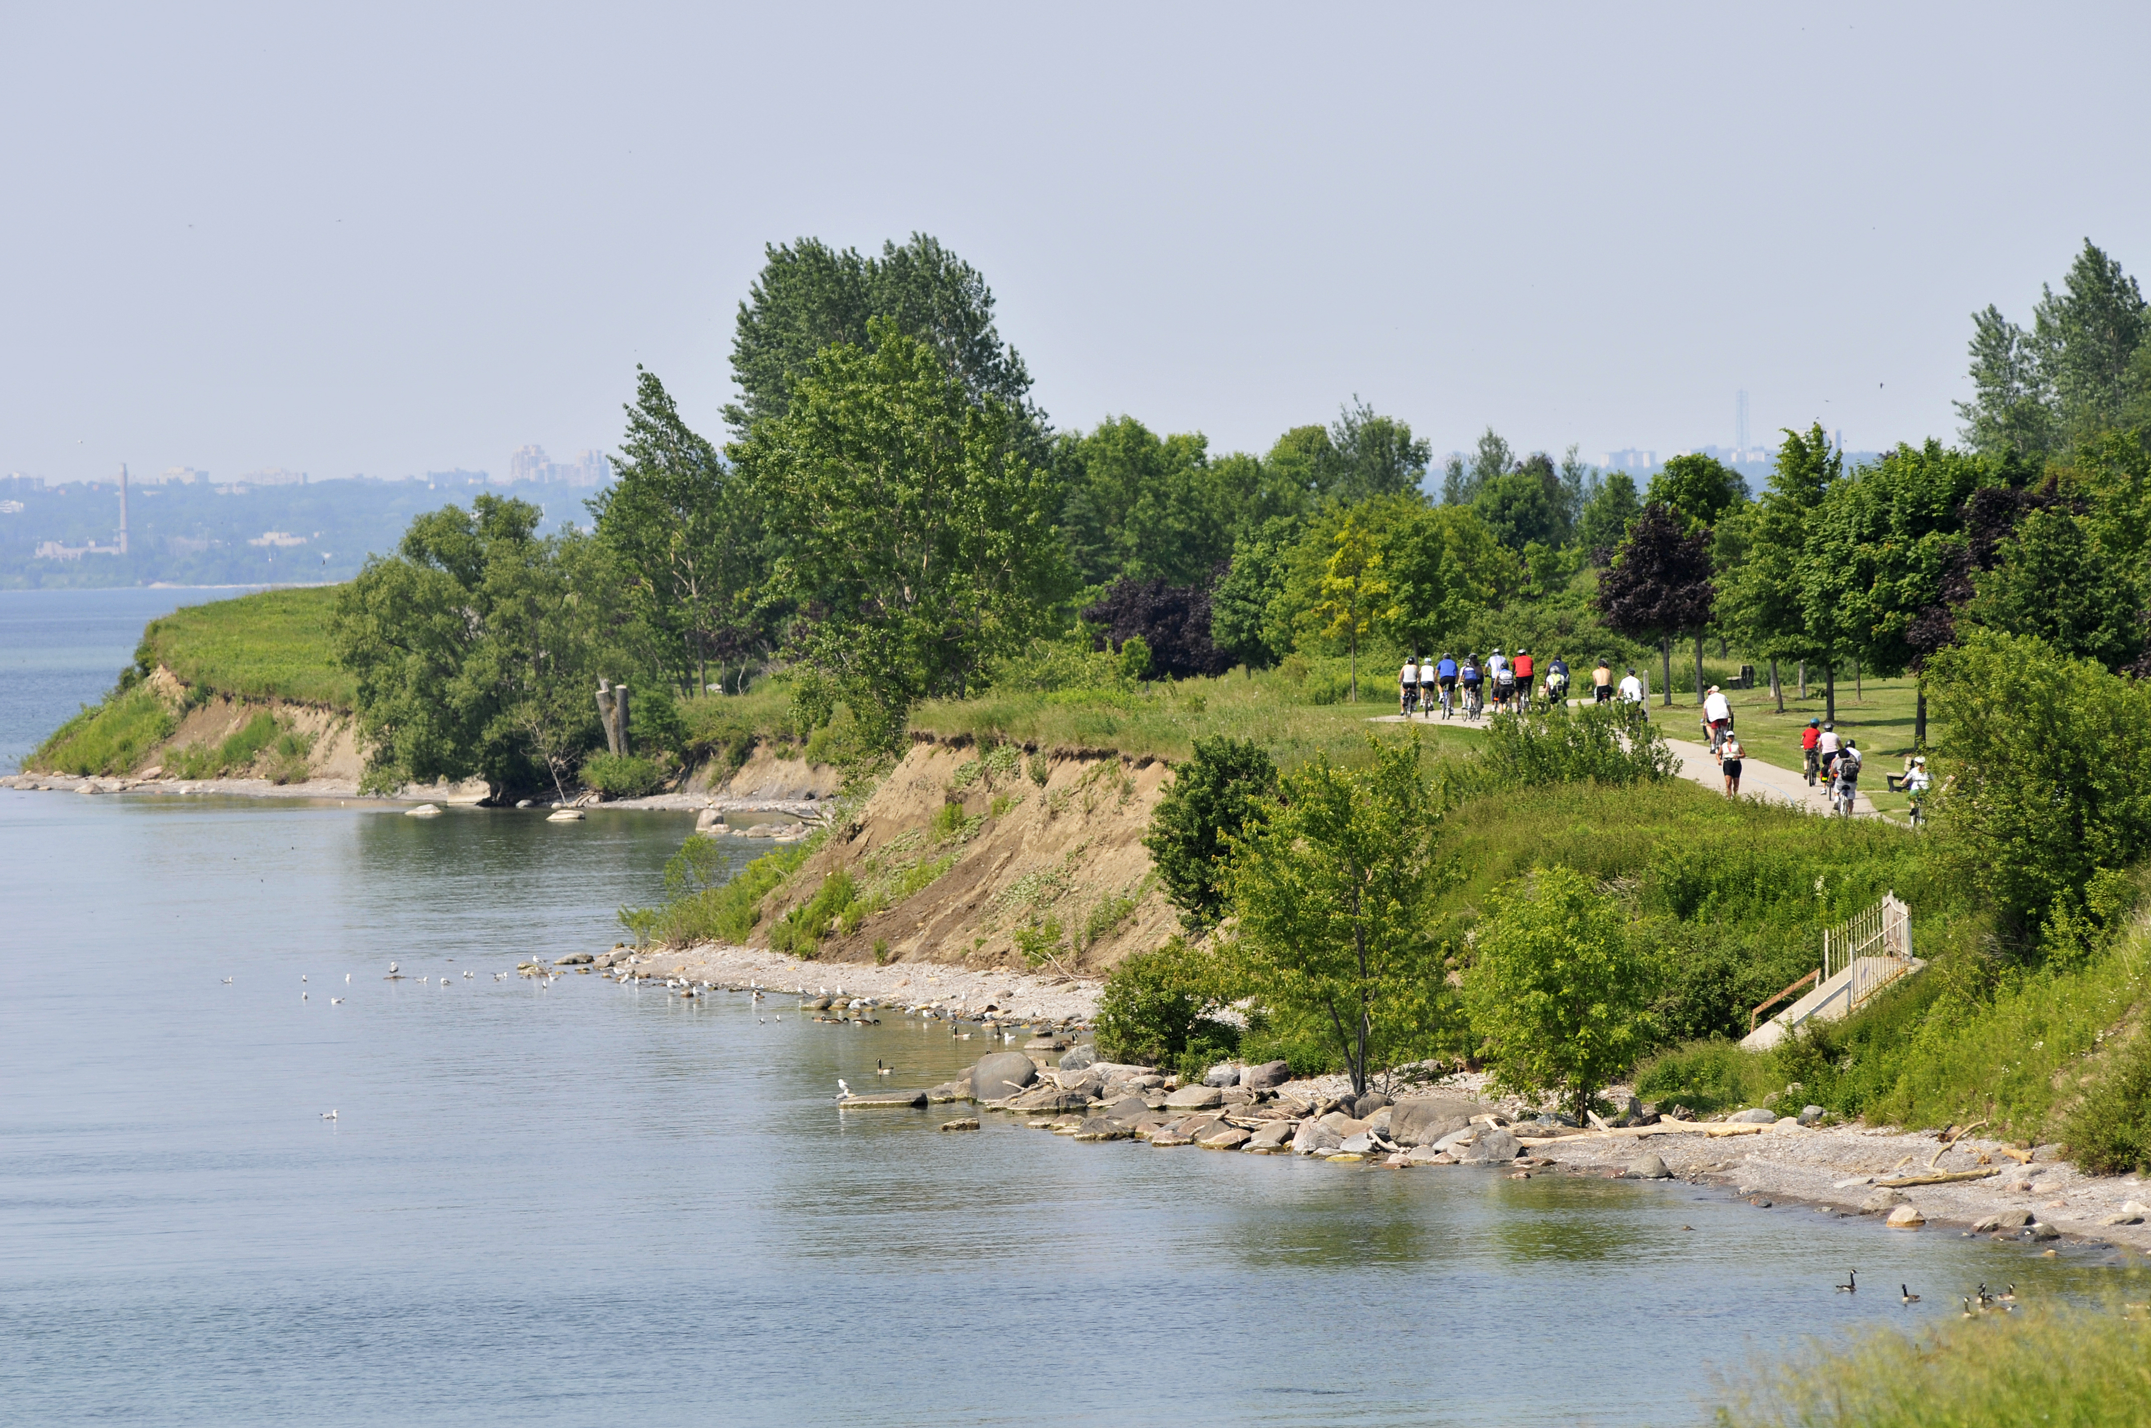
Objectives
Analyze tree arrangement at the block scale
Forecast tree stress based on projected changes in weather patterns
Identify locations where Ajax residents are most vulnerable to extreme heat
Create a 2017 land use and land cover classification for the town of Ajax, Ontario
Image Credit: Town of Ajax, Operations & Environmental Service
Notes:
Images provided by the Town of Ajax: Operations & Environmental Service
Analyze how different placements of trees will effect how the thermal environment of a city block
Using the SENES Consulting report, forecast what will happen to the tree stress as the weather in Ajax changes
Identify populations and the locations of those populations within Ajax that will be the most venerable to extreme heat
Create a 2017 land use and land cover classification for the town of Ajax, Ontario.

Slide 4
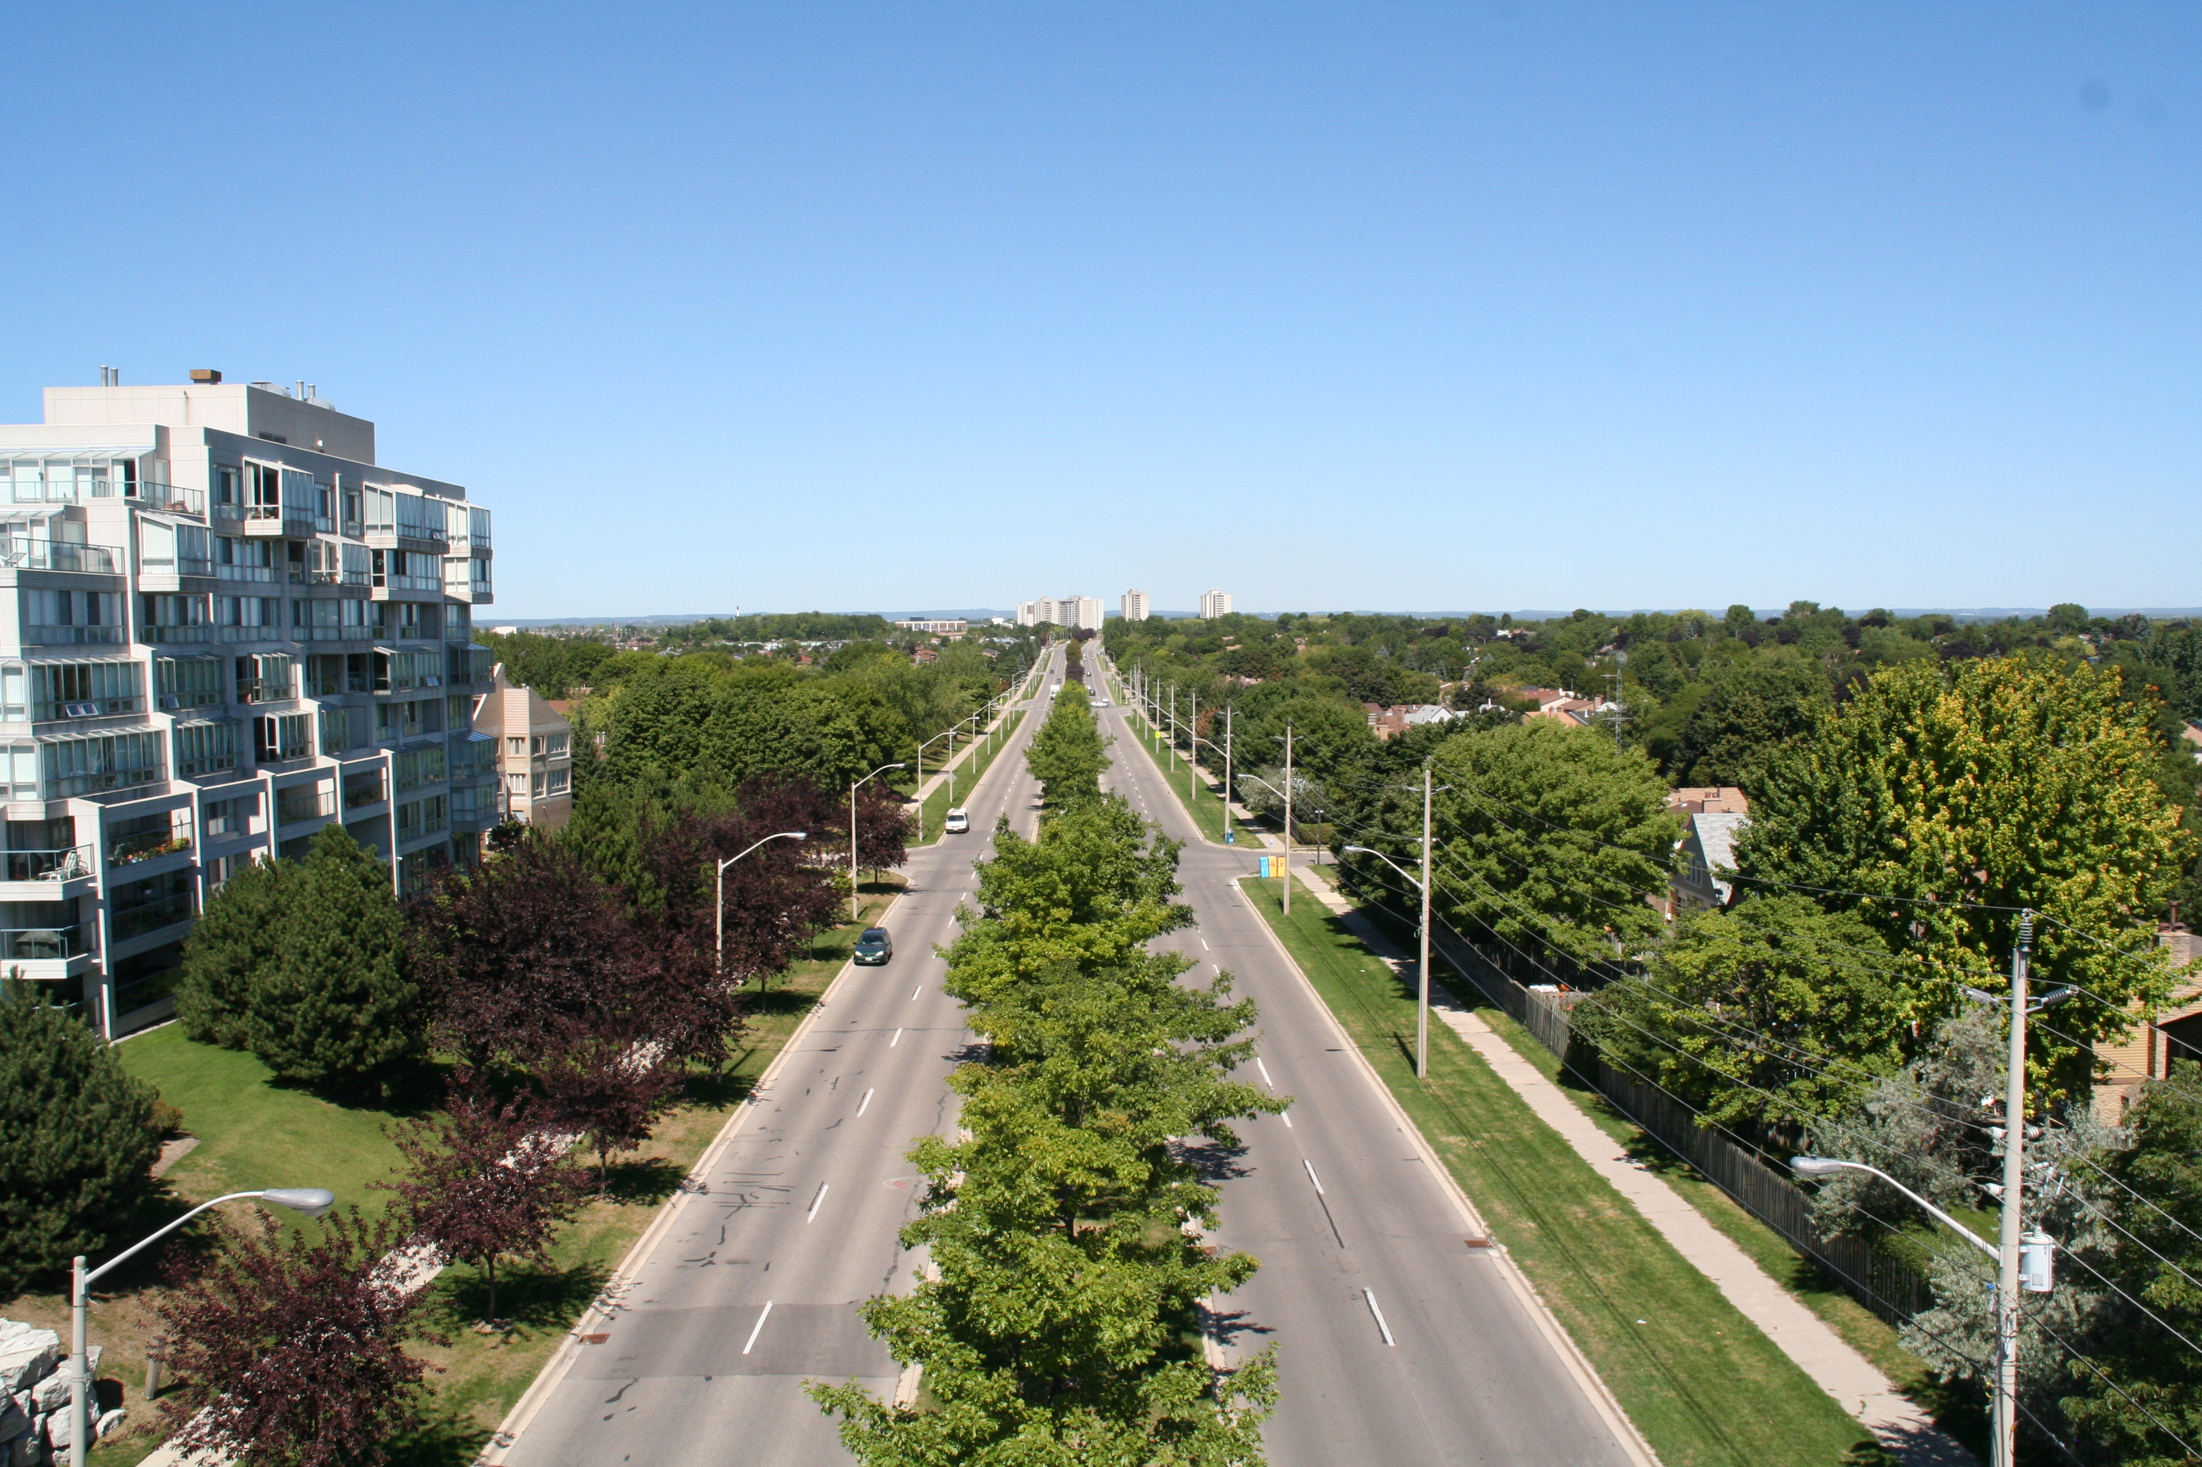
Partners
Town of Ajax, Operations & Environmental Services
Great Lakes and St. Lawrence Cities Initiative
Arizona State University, Urban Climate Research Center
Image Credit: Town of Ajax, Operations & Environmental Service
Notes:
Images provided by the Town of Ajax: Operations & Environmental Service
There are three partners for this project. The primary partner was the Town of Ajax, Operations & Environmental Services, with Jade Schofeld as the contact. Other partners were the Great Lakes and St. Lawrence Cities Initiative, and the ASU Urban Climate Research Center

Slide 5
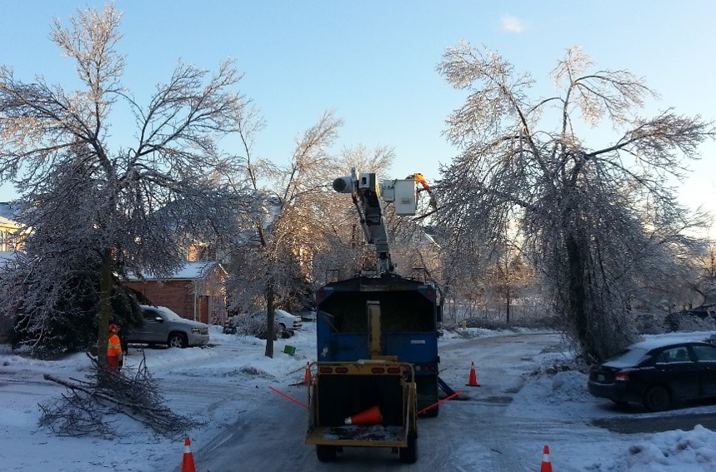
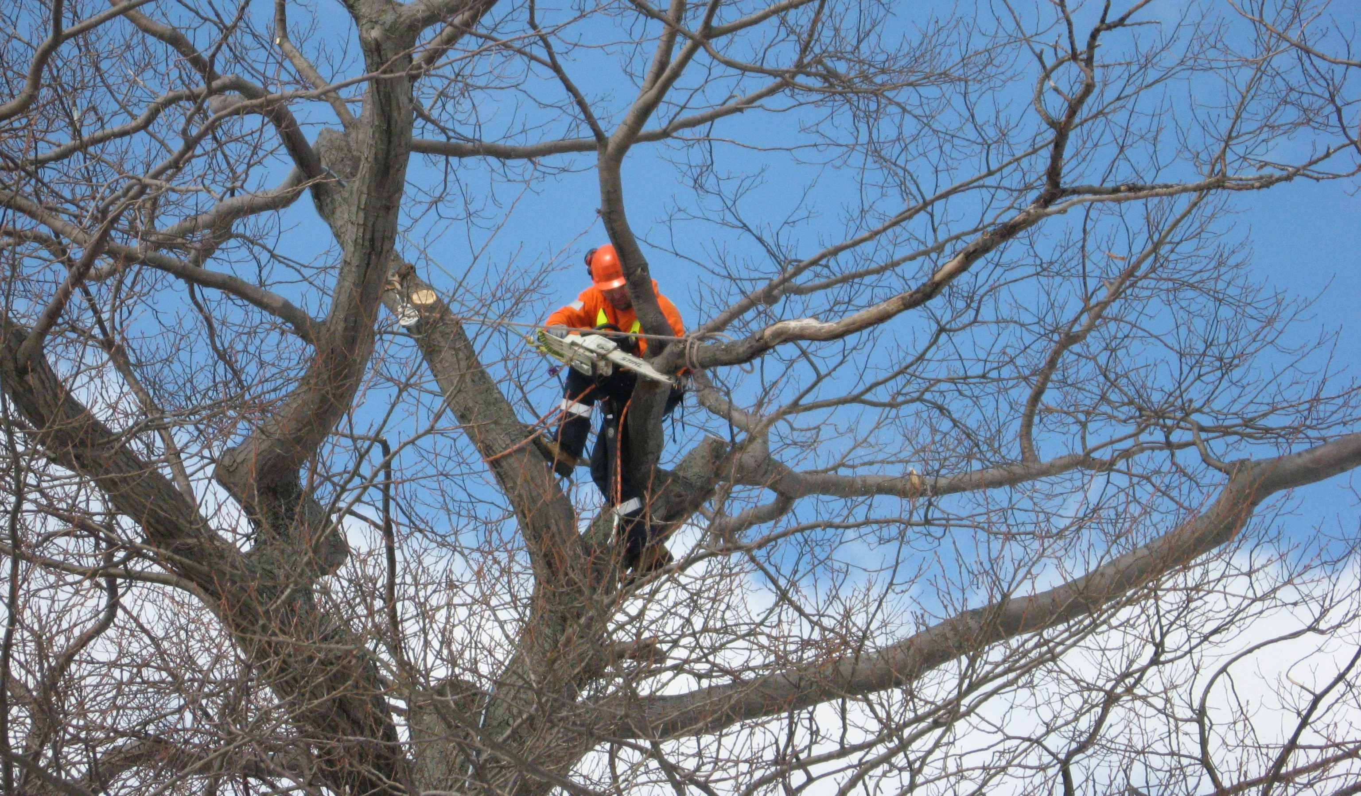
Community Concerns
Recent extreme weather events have impacted the health of Ajax’s urban forest and have led to a reduction in overall tree coverage
Maintaining the health of Ajax’s urban forest is essential
SENES Consulting modeled how weather and climate will change in the near future
Changing conditions could challenge the ability of Ajax and surrounding municipalities to grow or maintain tree coverage needed to build community resilience to extreme weather
Image Credit: Town of Ajax, Operations & Environmental Service
Notes:
Images provided by the Town of Ajax: Operations & Environmental Service
Ajax’s urban forest is essential, since forests are effective infrastructural adaptations that can provide reprieve from extreme heat, as they provide shade during the day, and can cool off the area through evapotranspiration
SENES report → modeled past and future climate, indicating that the Ajax area can expect an increase in daily average, maximum, and minimum
temperatures, and increase of monthly rainfall, and an increase in the intensity and frequency of weather.

Slide 6
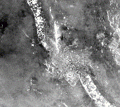
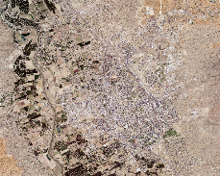
Methodology - Overview
Data
Processing
Analysis
Landsat 5, 8
Planet Scenes
Orthoimagery
SENES
Daymet
Census of
Canada
Vegetation
Index
Tree cover %
Land Surface Temperature
Landcover Classification
Climate Time
Series
Social
Vulnerability
Index
Climatic
variables &
NDVI correlation
Heat Vulnerability Analysis
Tree health
forecast
Notes:
There were three major steps in our methodology: gathering the data, processing the data, and analyzing the output of those processes. Each step gave results that were used in the following steps

Slide 7
Methodology - Overview
Data
Processing
Analysis
Landsat 5, 8
Planet Scenes
Orthoimagery
SENES
Daymet
Census of
Canada
Vegetation
Index
Tree cover %
Land Surface Temperature
Landcover Classification
Climate Time
Series
Social
Vulnerability
Index
Climatic
variables &
NDVI correlation
Heat Vulnerability Analysis
Tree health
forecast
Notes:
There were 7 main sources of data. Landsat 5 and Landsat 8 for multiband imagery, Planet scenes for high resolution imagery, Orthoimagery for ground truthing, SENES consulting report for future climatic conditions, Daymet for past climatic conditions, and census of Canada for demographic data

Slide 8
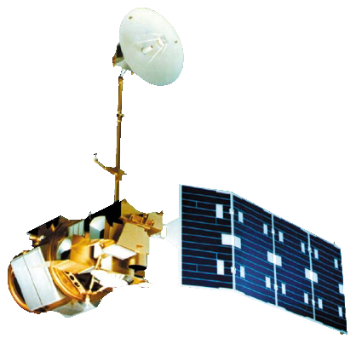
Data
NASA Satellites:
Other Datasets:
PlanetScope high resolution imagery
Orthoimagery provided by Town of Ajax, Operations & Environmental Services
SENES Consultants Durham Region Future Climate prediction results
Daymet V3
Census of Canada
Landsat 5 TM
Landsat 8 OLI/TIRS
Image Credi: NASA
Notes:
Image Credi: NASA
PlanetScope provided 3 band 3 meter resolution data. Orthoimagery provided 20 cm resolution imagery of the Ajax surface. SENES Climate predictions provided the predicted changes in weather for the Ajax area. Daymet V3 provided a record of gridded data set of estimated weather station data for the Ajax area from. Census of Canada provided the social vulnerability data.

Slide 9
Methodology - Overview
Data
Processing
Analysis
Landsat 5, 8
Planet Scenes
Orthoimagery
SENES
Daymet
Census of
Canada
Vegetation
Index
Land Surface Temperature
Landcover Classification
Climate Time
Series
Social
Vulnerability
Index
Climatic
variables &
NDVI correlation
Heat Vulnerability Analysis
Tree health
forecast
Notes:
There were three main tools used in processing the data, and five layers were created to be used in the analysis. These tools and processes are laid out in more detail over the next several slides.

Slide 10
Processing
_
LST
NDVI
Landsat 5
Landsat 8
Google
Earth Engine
+
:
Daymet
SENES
Google
Earth Engine
+ =
Climate
time series
Orthoimagery
Planet Scenes
Landcover classification
ArcGIS Pro
Canadian Census
Social Vulnerability Locations
ArcMap
Notes:
The three tools were Google Earth Engine, ArcGIS Pro, and ArcMap. Google Earth Engine used large spatial datasets, such as Landsat 5, Landsat 8, and Daymet to create Land Surface Temperatures, Normalized Difference Vegetation Indices, and Climate time series. ArcGIS Pro was used to create a landcover classification using Planet Scenes and orthoimagery, and ArcMap was used to identify social vulnerability locations.

Slide 11
Processing
_
LST
NDVI
Landsat 5
Landsat 8
Google
Earth Engine
+
:
Daymet
SENES
Google Earth Engine was used to perform band math on Landsat 5 and Landsat 8 data to estimate land surface temperature(LST) and Normalized Difference Vegetation Index (NDVI)
Climate
time series
Orthoimagery
Planet Scenes
Landcover classification
Canadian Census
Social Vulnerability Locations
Notes:
Google Earth Engine was used to perform band math on Landsat 5 and Landsat 8 data to estimate land surface temperature(LST) and Normalized Difference Vegetation Index (NDVI). This was done using the API and built in functions of GEE. Land surface temperature was only calculated with Landsat 8, while NDVI was calculated using both Landsat 8 and 5

Slide 12
Processing
_
LST
NDVI
Landsat 5
Landsat 8
Google
Earth Engine
+
:
Daymet
SENES
Google
Earth Engine
+ =
Climate
time series
Orthoimagery
Planet Scenes
Google Earth Engine was used to aggregate daily weather data to create a monthly temperature and precipitation time series
Landcover classification
Canadian Census
Social Vulnerability Locations
Notes:
The Daymet data set, which is an interpolated metrological data set of 1km resolution, is interpolated based off of ground based weather stations. This data was used to come up with a monthly time series from the daily data for precipitation and temperature, as well as to verify SENES consulting’s model.

Slide 13
Daymet & SENES
Notes:
These show the differences between DayMet’s observed values and SENES Consulting’s predicted values, as well as the values at the weather station at the nearest airport to Ajax.

Slide 14
Processing
_
LST
NDVI
Landsat 5
Landsat 8
Google
Earth Engine
+
:
Daymet
SENES
Google
Earth Engine
+ =
Climate
time series
Orthoimagery
Planet Scenes
Landcover classification
ArcGIS Pro
ArcGIS Pro was used to perform a supervised classification to create a detailed landcover classification
Canadian Census
Social Vulnerability Locations
Notes:
ArcGIS Pro was used to perform supervised classification on the Planet scenes. The Orthoimagery was used to verify and ground truth the produced landcover classes.

Slide 15
Processing
_
_
LST
NDVI
Landsat 5
Landsat 8
Google
Earth Engine
:
+
:
Daymet
SENES
Google
Earth Engine
+ =
Climate
time series
Orthoimagery
Planet Scenes
ArcMap was used to aggregate data layers from the Canadian Census to determine social vulnerability
Landcover classification
Canadian Census
Social Vulnerability Index
ArcMap
Notes:
There were five layers that went into the social vulnerability index: median household income, unemployment, age, recent immigrant, and marital status. Each of these were ranked from low to high. For each dissemination area, the rank for each category was added together. The higher the total, the more at risk the area was.

Slide 16
Landcover and Social Vulnerability
2016 Land Cover Classification
Social Vulnerability Index
Notes:
The social Vulnerability index ranks how vulnerable population could be when faced with extreme stresses. It was calculated by ranking each disseminations area by socio-economic, age, education, income, recently immigrated, and employment from high to low. The rank in each category was combined to determine the social vulnerability index, with larger numbers being more vulnerable.
There are 8 land cover classes, based off of a previous landcover classification from 2010.

Slide 17
Methodology - Overview
Data
Processing
Analysis
Landsat 5, 8
Planet Scenes
Orthoimagery
SENES
Daymet
Census of
Canada
Vegetation
Index
Tree cover %
Land Surface Temperature
Landcover Classification
Climate Time
Series
Social
Vulnerability
Index
Climatic
variables &
NDVI correlation
Heat Vulnerability Analysis
Tree Health
Forecast
Notes:
The final step in our methodology was our analysis, where the results from the processing were put together to determine our three final layers.

Slide 18
Analysis
Climate variables &
NDVI correlation
Tree Health Forecast
NDVI
Climate Time Series
Landcover Classes
R
Regression
LST
Social Vulnerability
Index
Land Cover
Aggregation
Heat
Vulnerability Analysis
ArcMap
Notes:
Using the landcover classification (which included a derived tree cover percent layer), the climate time series, and the NDVI layers, a stepwise regression was performed to find the most impactful factors on tree stress, and then calculated to come up with a tree health forecast
The land surface temperature layer was overlain with the social vulnerability locations to determine which areas with the largest percentage of vulnerable people were at risk from the extreme heat
One location of with high vulnerability was chosen to perform an envimet simulation, which is a fluid dynamic simulation that models how different plant arrangements will change the thermal environment of an area.

Slide 19
Results - Climate Variables & NDVI
During preliminary analysis, we found a potential correlation in the forested area of Ajax
Areas with natural cover like forests should be more influenced by natural processes
Notes:
Correlation coefficients are graphed above for 3 different land cover areas within Ajax; a sample Forested Area, a sampled Residential Area, and averaged across the whole Ajax Area. The relationship analyzed here was each climate variable as a function on NDVI.

Slide 20
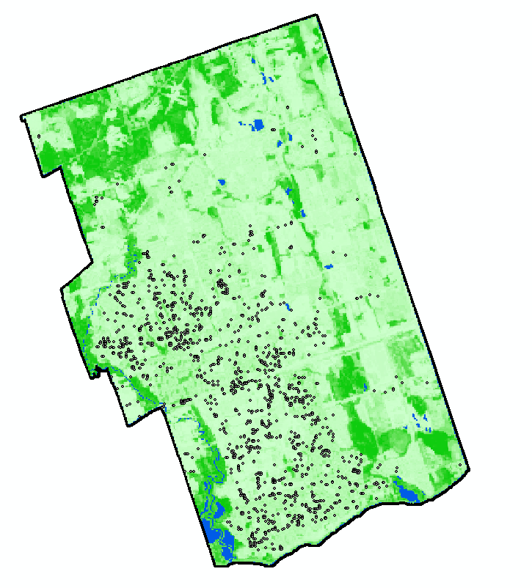
Results – Tree Cover Percentage
Tree cover percentage analysis had an R² value ~ 0.6 when compared to current orthophotos
Points indicate locations where tree cover percent and land cover classification did not change over the years
Initial results from the random forest model show very low R² values
Tree Cover
100 %
0 %
Water
Constant Value
Notes:
Tree cover percentage was calculated to determine how the tree cover changed over time, and will be used in future work as a factor in tree health forecast

Slide 21
Analysis
Climate variables &
NDVI correlation
Tree Health Forecast
NDVI
Climate Time Series
Landcover Classes
R
Regression
LST
Social Vulnerability
Index
Land Cover
Aggregation
Heat
Vulnerability Analysis
ArcMap
Notes:
Using the landcover classification, the climate time series, and the NDVI layers, a stepwise regression was performed to find the most impactful factors on tree stress, and then calculated to come up with a
The land surface temperature layer was overlain with the social vulnerability locations to determine which areas with the largest percentage of vulnerable people were at risk from the extreme heat
One location of with high vulnerability was chosen to perform an envimet simulation, which is a fluid dynamic simulation that models how different plant arrangements will change the thermal environment of an area.

Slide 22
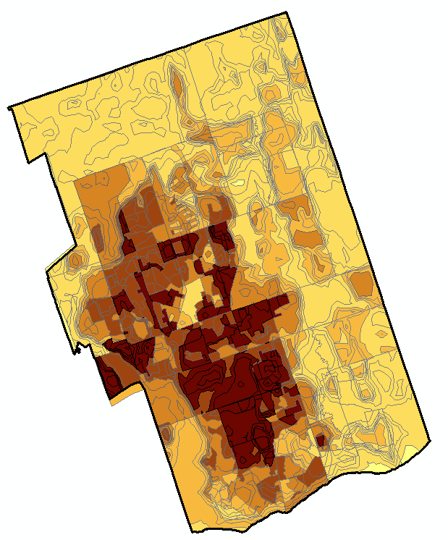
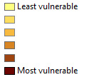
Results - Areas of Concern
The map shows the dissemination areas that are at the greatest risk from extreme heat
The base map represents socially vulnerable populations
The contours represent temperature gradients
Index from Heat Vulnerability & Summer LST
Notes:
Taking the LST derived from Landsat 8 and the social vulnerability locations derived earlier, the two layers were overlain. The areas with high heat and high social vulnerability were determined to be at the greatest risk from extreme heat. The contours represent temperature gradations, while the basemap represent the socially vulnerable populations.

Slide 23
Case Study: ENVI-ME
Simulation of area around Ajax Town Hall
Due to technical difficulties, ENVI-MET results for a full day have yet to be completed
The results from the first 4 hours of simulation (Midnight – 5 AM are displayed to the right)
No conclusions can be drawn from one 4 hour simulation
Notes:
The goal with simulating Ajax's town hall environment was to see how various modifications to tree placement and size would affect the surface air temperature. We recreated the Ajax town all area including a row of houses to the east of the area and the streets surrounding the property. The inclusion of the surrounding features gave important information to the model since the surrounding structures can heavily affect wind flow and other weather variables. Hourly weather station data including temperature, wind speed and direction, precipitation, and relative humidity gathered at Oshawa Airport were used as an input into the software ENVI-MET. The software used this information, along with the recreated town hall space to simulation July 11th's weather. To test various modifications to tree placement, our team created 3 other town hall environments that each had one thing changed; 13 trees were added to the parking lot and placed in between stalls in one alteration, the second had more trees added to the grass boundary of the parking lot, and the third had existing younger trees replaced by taller and more dense trees. There were some complications with starting the simulations that led to very minimal results. The results that the team currently has are of a 4 hour period starting at midnight for the original town hall environment. No conclusions can be drawn since we do not have any grounds for comparison. Once the other simulations are created for a 24 hour period the team's plan is to compare temperature at various times of day, including the hottest point of the day and a couple hours after sun set when the surfaces are cooling off, in each modified environment to see which environment sustains the coolest air temperatures.

Slide 24
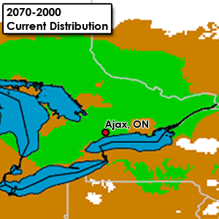
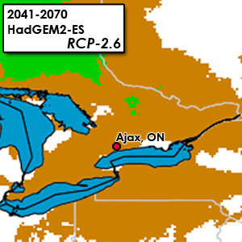
Conclusions
Some results indicate that average Tmax and Tmin of the previous winter may be a rough indicator of tree health in areas with natural cover
Areas with consistent tree cover % tend to be in residential areas
Low correlation between climatic variables & NDVI in residential areas may be due to residential areas being better managed
Random forest model was more accurate for classification; Linear stepwise was better for forecasting
Areas in central Ajax tended to be most vulnerable to heat
Acer platanoides
(Norway Maple &
Crimson King Maple)
Image Credit:
Natural Resources Canada
Plant Hardiness
Notes:
Ajax Town Hall was an area of intersection with vulnerable residence, hot surface temperatures, and the potential risk of stressed trees as a result of future weather extremes.
At the building scale, simulated results show that adding 3 new trees to the Town Hall’s southcenter courtyard in a spatial arrangement of 2 in the center circle and one in the adjacent grass area between the sidewalk will cool 2 meter air temperatures by approximately 3 ℃

Slide 25
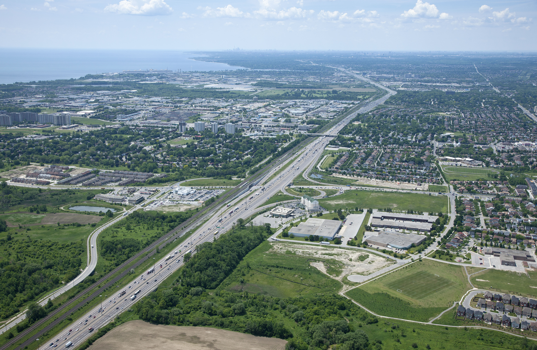
Errors and Uncertainties
Landsat’s 30 m resolution averages pixel values for areas larger than trees
NDVI is not tree-specific
Tree health depends on more variables than what were measured
The Daymet climate data is estimated over 1 km grid cells
SENES data has its own uncertainty associated with predicting changes in climate
Image Credit: Town of Ajax, Operations & Environmental Service
Notes:
These are not the only errors in in the project, but were the ones that were the most impactful. Getting the data to be in the same scale proved to be problematic, as we were working on several different scales: 1km for Daymet, 30m for Landsat, 3m for Planet, and 20cm for the ortho imagery. This led to a lot of potential error during the resampling pocess

Slide 26
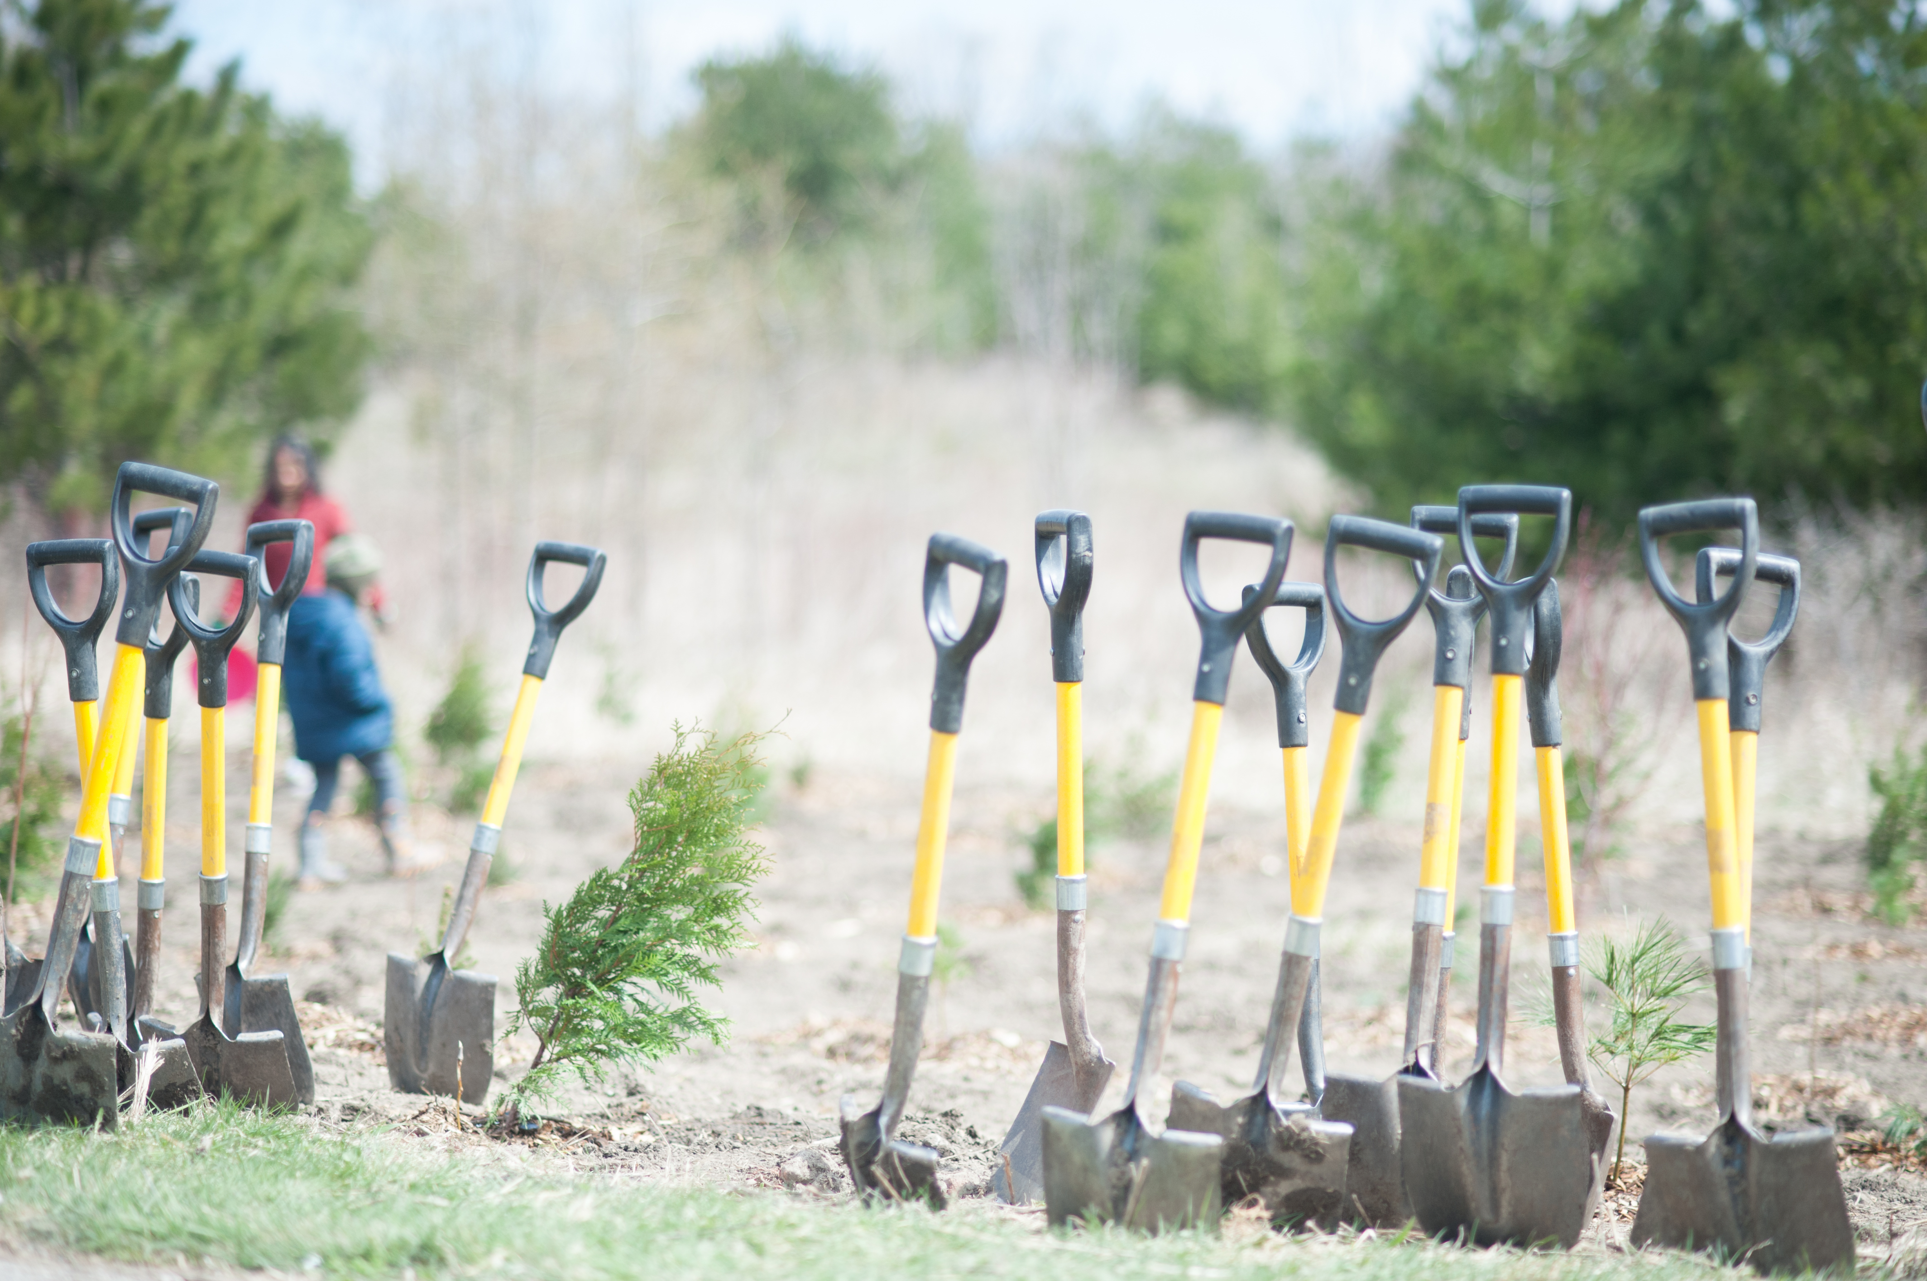
Future Work
Incorporate additional climatic variables
Complete 24 hour ENVI-MET run for other 3 modified environments with the goal of comparing various modifications to the existing tree arrangement
Use imagery with higher spatial resolution (ex: Sentinel-2)
Image Credit Town of Ajax: Operations & Environmental Service
Notes:
The focus would be to analyze more cities and climatic variables to see the spatial variation of tree health and climatic variables in cities across the North American continent. We would also focus on creating a better prediction for the future NDVI based on said climate factors.

Slide 27
Acknowledgements
The authors would like to thank:
Dr. David Hondula, Arizona State University, DEVELOP Arizona Advisor
Dr. Qunshan Zhao, Arizona State University, DEVELOP Arizona Advisor
Dr. Peter Crank, Arizona State University, Climate Research Center Lead
Dr. Kenton Ross, National Science Advisor, DEVELOP National Program Office
Notes:
Thanks to all involved, without whom this project would not have been possible.

