Slide 1
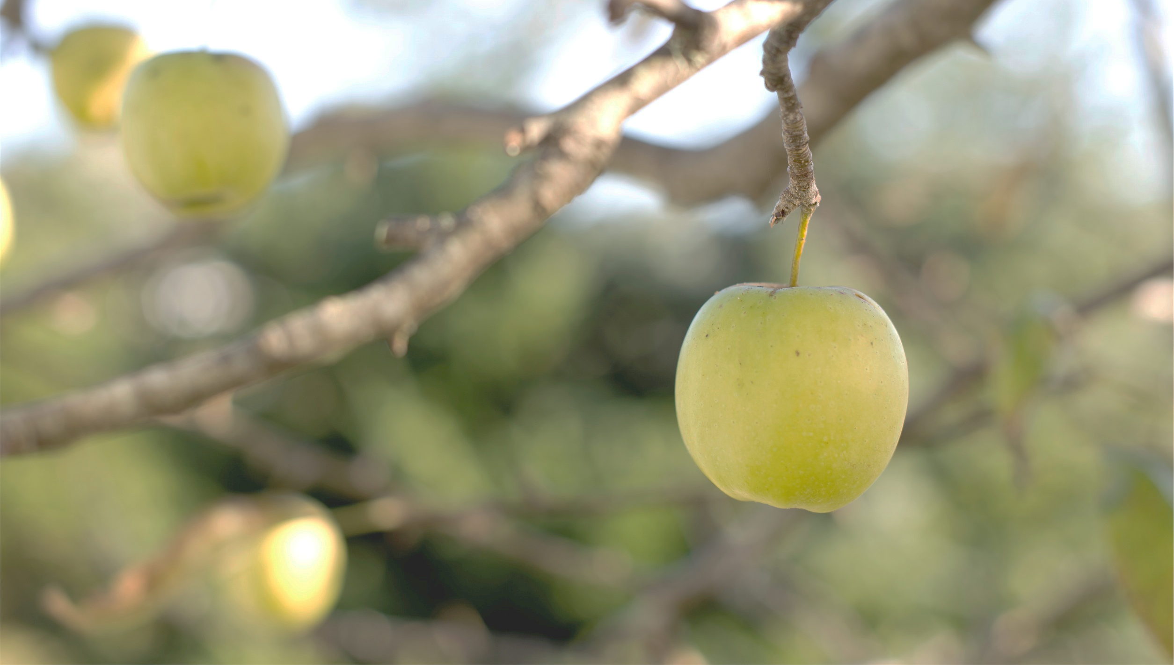

Northwest United States Agriculture III
Northwest United States Agriculture III
Assessing Current and Future Plant Hardiness Zones for Apple Production in Washington State using Climate Models and NASA Earth Observations
Assessing Current and Future Plant Hardiness Zones for Apple Production in Washington State using Climate Models and NASA Earth Observations
Madeline Ruid (Team Lead)
Teresa Fenn
Madeline Ruid (Team Lead)
Teresa Fenn
Matthew Mullen
Sarah Philbrick
Matthew Mullen
Sarah Philbrick
James Hendrickson
James Hendrickson
Tim Mossholder, stocksnap

Slide 2
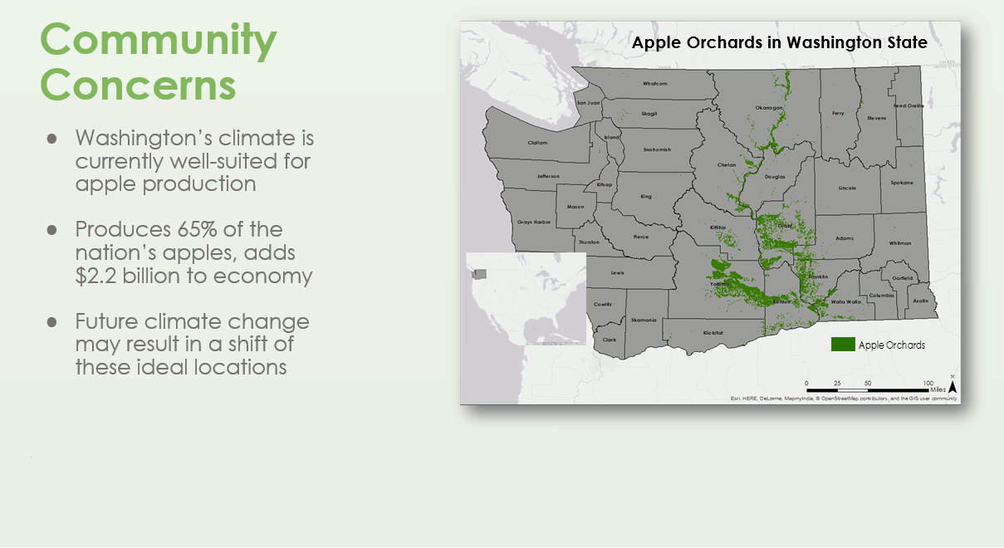
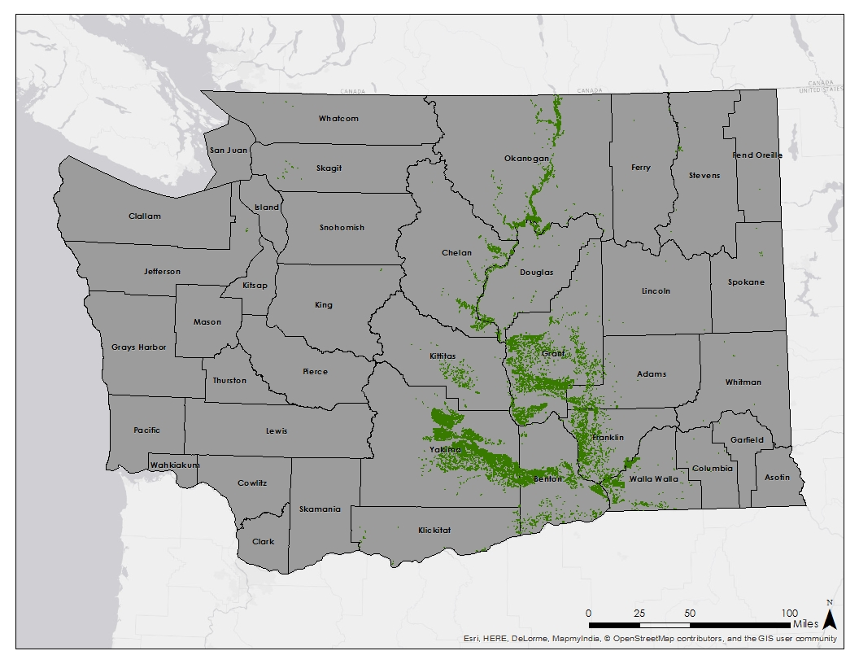
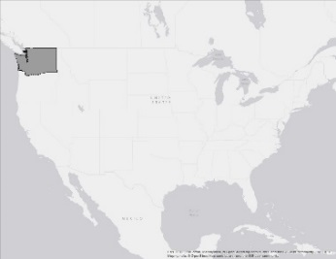
Community Concerns
Apple Orchards in Washington State
Washington’s climate is currently well-suited for apple production
Produces 65% of the nation’s apples, adds $2.2 billion to economy
Future climate change may result in a shift of these ideal locations
Study Area/ Time Periods:
Washington State
Present: (2002-2015) & Future: 2045 (2040-2049), 2065 (2060-2069), 2095 (2090-2099)
Notes:
Washington State’s climate is currently well-suited for apple production with its warm, dry summers and cool, wet winters. As a result, the state produces 65% of the nations apples and adds 2.2 billion dollars to the nations economy. The map on the right shows where the apples are primarily grown, which is to the right of the Cascade mountains. However, there is concern that future climate change, especially rising temperatures, will result in a shift of these ideal growing conditions. Given this concern our we are studying the state of Washington for both the present-day period the future decades of the 2040s, 2060s, and 2090s to assess the current growing conditions and how these growing conditions may shift.
NOTE: currently an animation that adds the study area/periods at the bottom after ~20 seconds. Could make it all one static slide, but may look too busy?
in high apple-producing counties like Yakima and Grant counties.

Slide 3
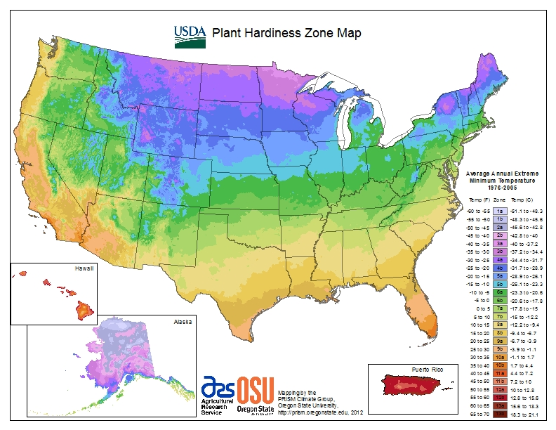
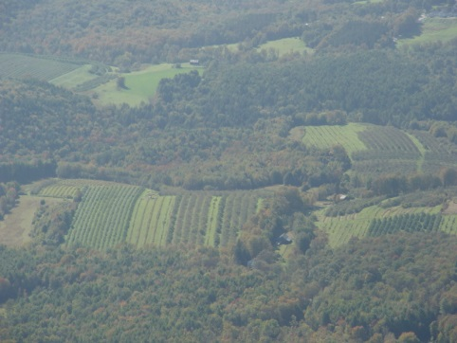
Plant Hardiness Zones
Based on average annual extreme minimum temperature
Divided into 10 degree Fahrenheit zones
Guide as to which plants will thrive at a given location
Apples grow best in zones 5 through 7
Notes:
So how do we track changes in growing season suitability? One way to determine plant suitability is with Plant Hardiness Zones. The USDA calculates theses zones by dividing the average annual extreme minimum temperatures into 10F zones. This map can then act as a guide for determining which plants will thrive at a given location. Apples grow best in zone 5 through 7, but different varieties are grown in zones 4 through 9,. Apples are limited to these intermediate zones because frost can destroy the apple crop in zones with temperatures that are too cold, while zones with hotter temperatures do not provide enough chill hours that are vital to an apple crop’s success.
29 seconds

Slide 4
Apple Suitability
Plant Hardiness Zones
Based on average annual extreme minimum temperature
Growing Degree Days
Heat accumulation formula:
([Tmax + Tmin]/2) - 10 °C
Growing Season Temperature
Ideal average temperature of 19 °C
Notes:
In addition to plant hardiness zones, growing degree days and average growing season temperature can both be estimated using temperature data and directly relate to whether an area is suitable for growing apples. Growing degree days look specifically at how many days are above and below the minimum and maximum thresholds of a species. For our project, high growing degree days is inversely reltated to apple suitability because we are calculating the amount of days for the codling moth, which can greatly destroy apple crops. In addition, it is important to look at the average growing season temperature. The growing season lasts from May through September, and the ideal temperature for apples is 19 degrees Celsius.
27 seconds
In addition to plant hardiness zones, apple suitability can also be measured with growing degree days and average growing season temperature. Growing degree days look specifically at how many days are within the minimum and maximum temperature thresholds for a species. For our project, high growing degree days is inversely related to apple suitability because we calculated the amount of growing degree days for the codling moth, which is one of the most common pests that can severely damage apple crops. In addition, it is important to look at the average growing season temperature. For apples, the growing season lasts from May through September, and the ideal temperature is around 19C.
~28 seconds

Slide 5

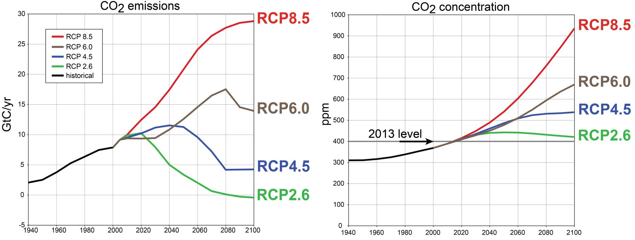
Project Partner
Dr. Michael Glenn, Ph.D. United States Department of Agriculture, Agricultural Research Service
Objectives
Extreme
Map Plant Hardiness Zones
  Current
  Forecasted (2045, 2065, and 2095)
    RCP4.5 & RCP8.5 Emissions Scenarios
Suitability Maps
  Current
  Forecasted (2045, 2065, and 2095)
    RCP4.5 & RCP8.5 Emissions Scenarios
Moderate
Source: Alaska Science Center, USGS
Notes:
We have partnered with Dr. Michael Glenn from the UDSA’s Agricultural Research Service for this project. This is his third term with DEVELOP and he has been with the Northwest U.S. Agriculture project since it’s inception. In partnership with Dr. Michael Glenn, we created current and forecasted PHZ maps; as well as suitability maps that combine PHZs, GDDs, and AGSTs. The current time period matches up with the availbe MODIS time period of 2002-2015, while the future time periods are averages of each of the decades of interest.
In addition, each future time period includes two different emissions scenarios. In the RCP8.5, or the most extreme emissions scenario, where CO2 reaches almost 1000ppm by 2100, and RCP4.5, a more moderate scenario where emissions begin to level off by the end of the century.

Slide 6
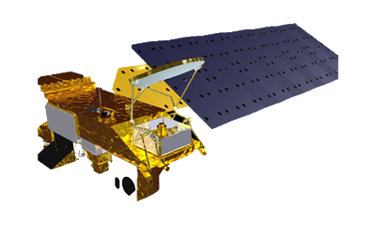
NASA Earth Observations & Projections
MODIS Land Surface Temperatures in Washington State from 2002-2015
NASA Earth Exchange Downscaled Climate Projections (NEX-DCP30) for 2045, 2065, and 2095
Aqua
March 2009
March 2045
Notes:
Our research used 2 NASA datasets to complete our objectives. First, the present-day maps were calculated based on daily land surface temperature measurements from the MODIS instrument on NASA’s Aqua satellite from January 2002 to June 2015. For future temperature projections, we used NASA’s Earth Exchange Downscaled Climate Projections, or the NEX-DCP30 dataset. The output is an ensemble average of 33 models and has 800m resolution, which is much higher than most other climate projections.
Currently-Modis data clipped, projected but not converted to air temperature.
~33 seconds

Slide 7
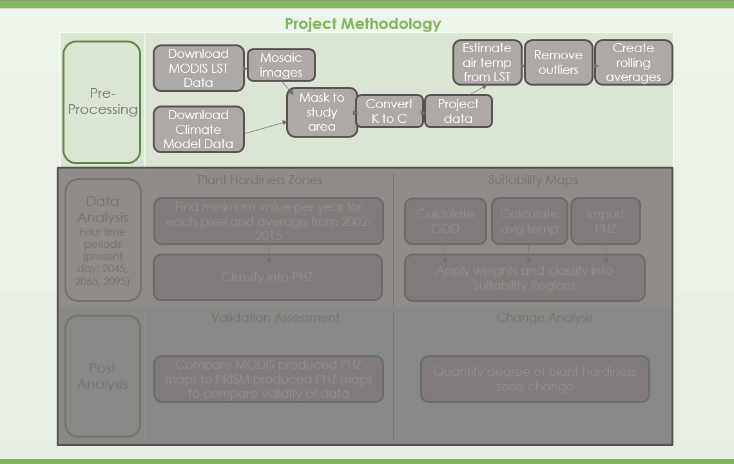
Notes:
Once the data was processed, it was converted to air temperature using a linear regression obtained from historic weather station data, then combined into five day rolling averages to calculate GDD. The annual minimum values were averaged together to create the PHZ maps. Once all three parameters were calculated, they were ranked on a standard scale and combined to create suitability maps. The accuracy of the maps was assessed by comparing our maps to the map currently used by the USDA, and an updated map which spans from 2002-2015 using PRISM data which was used by the USDA to create their official maps spanning from 1976-2005.
Note, methodology an animation which cycles between the three stages

Slide 8
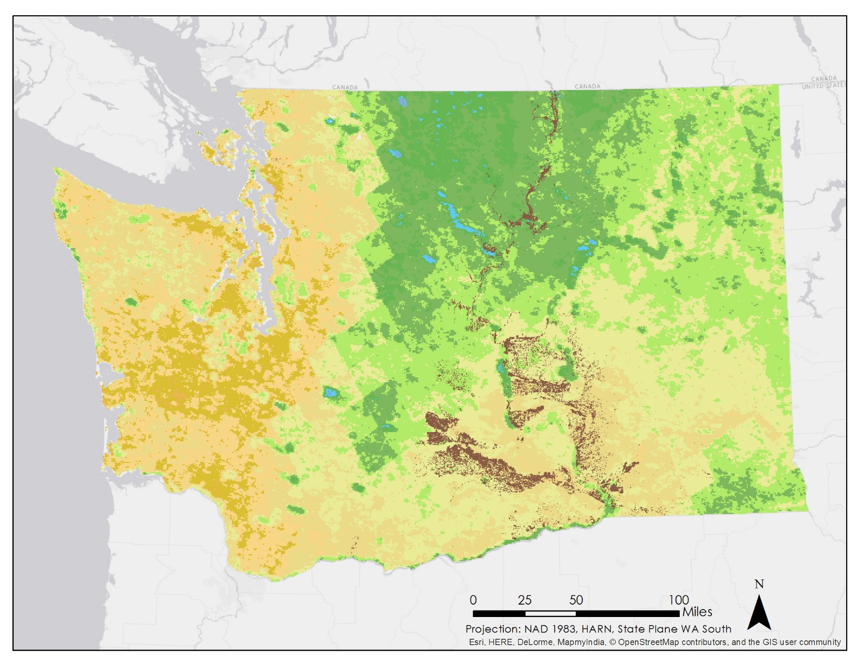
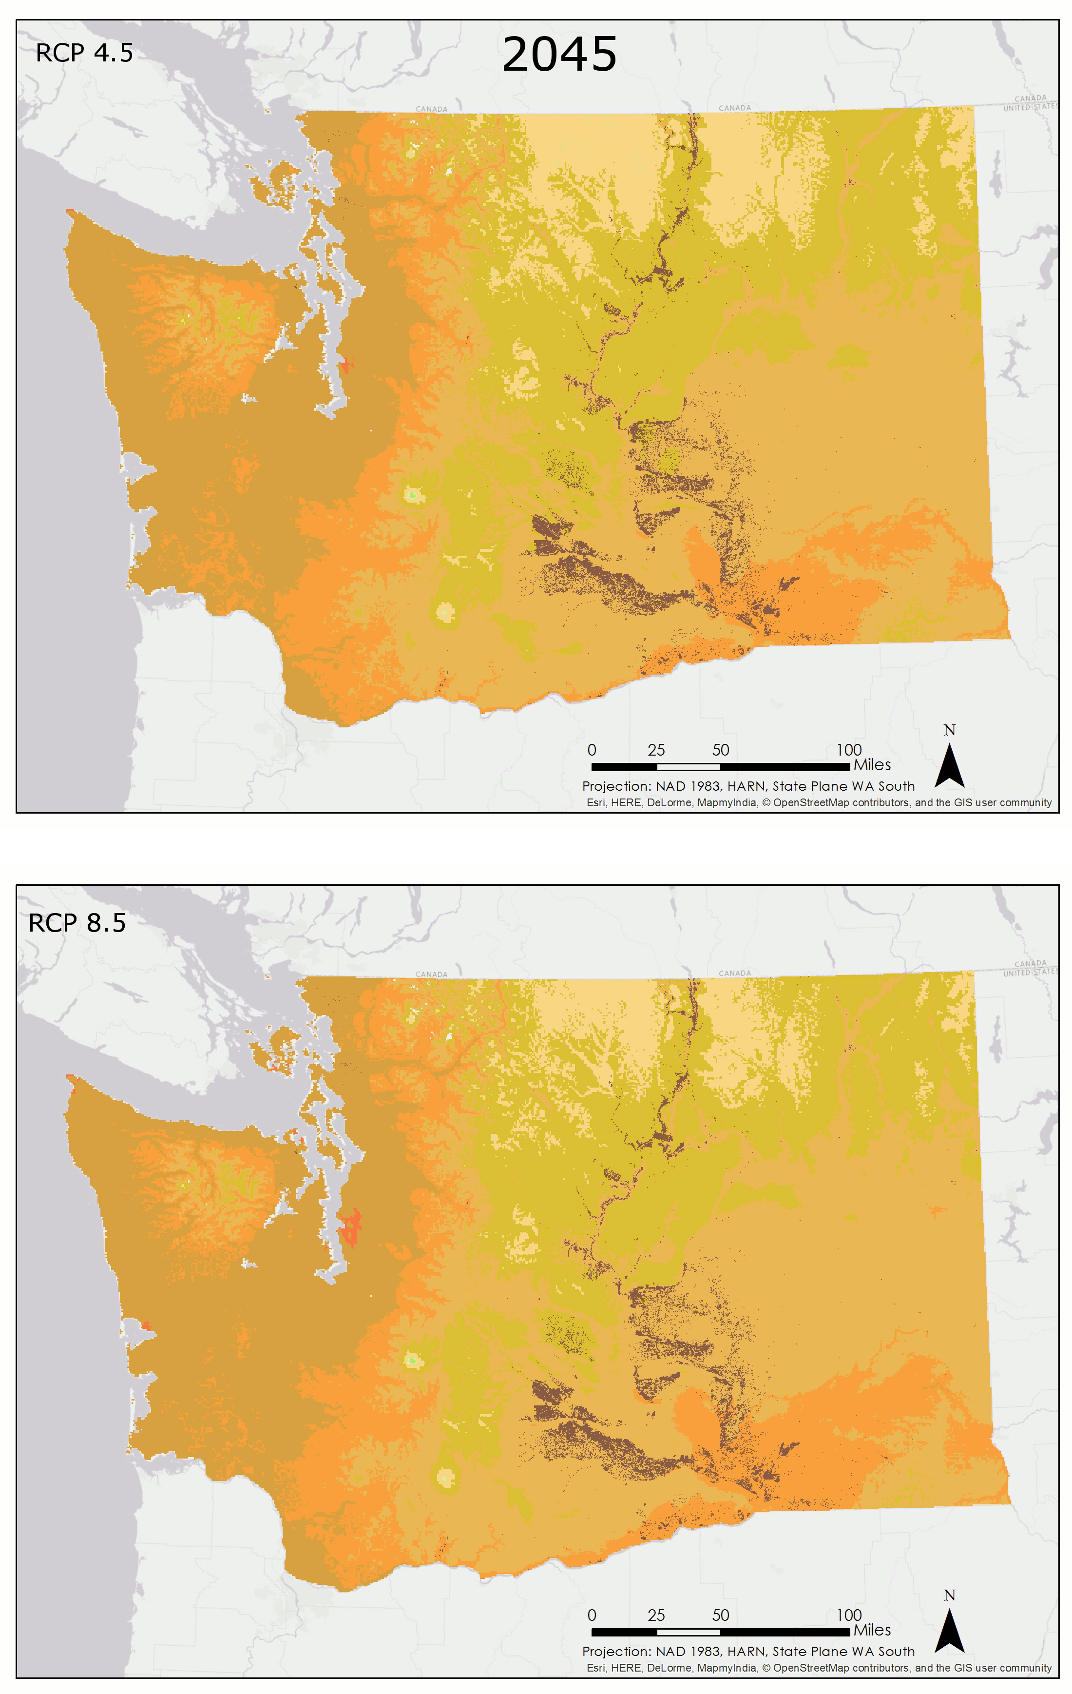
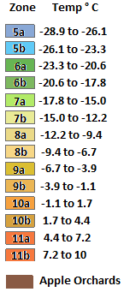
Conclusions: PHZs
Present-day with MODIS
Moderate
Extreme
Notes:
The large map on your left shows the current plant hardiness zones that were produced with the MODIS data. Based on this map, apples are currently produced in zones 6b through 8a, with zones 5-7 being ideal. However, as seen on the right, by 2045, the plant hardiness zones shift towards a much warmer climate. Zones 6 and 7completely disappear from the map and orchards will be found in zones 9a-10a. There is little difference between the moderate and extreme scenarios until 2095. By 2065, zone 8 has almost disappeared, and zone 10a expands. In 2095, while there is little difference in the moderate scenario, the extreme scenario shows zone 10 expanding to cover the entire orchard area.
NOTE: Animation with the two right panels rotating between scenarios, with timing staying on 2045 longer than the next two scenarios. It totals 30 seconds.

Slide 9
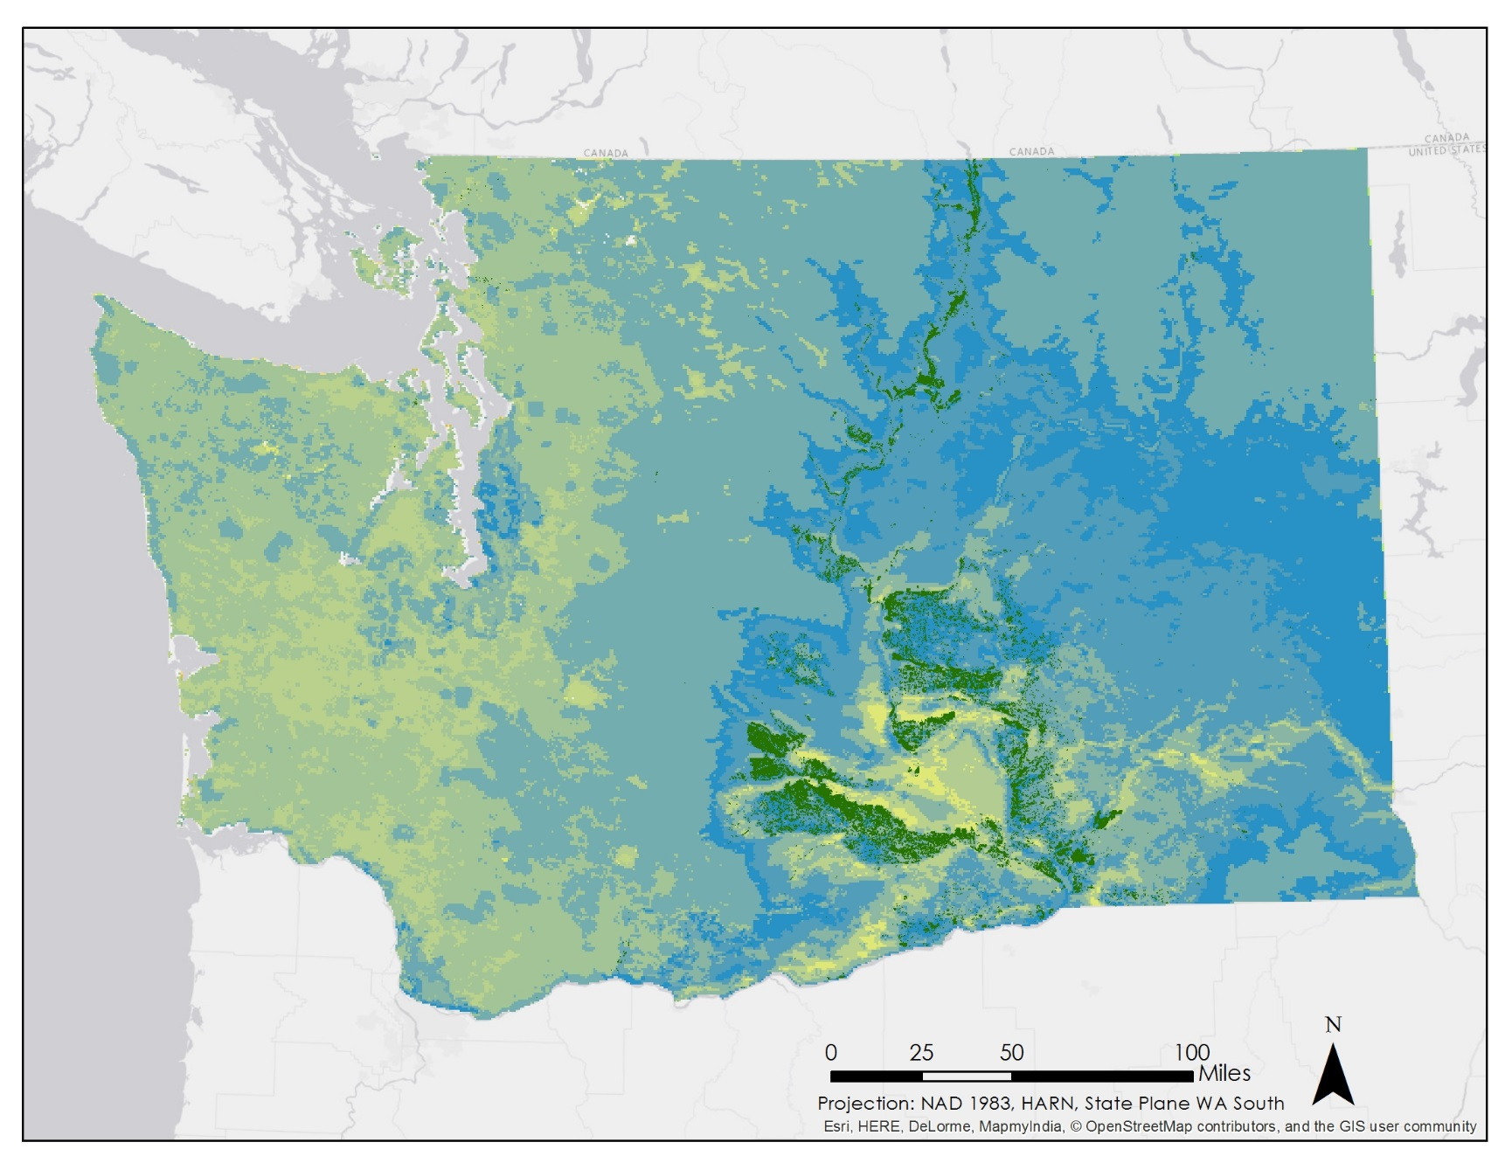
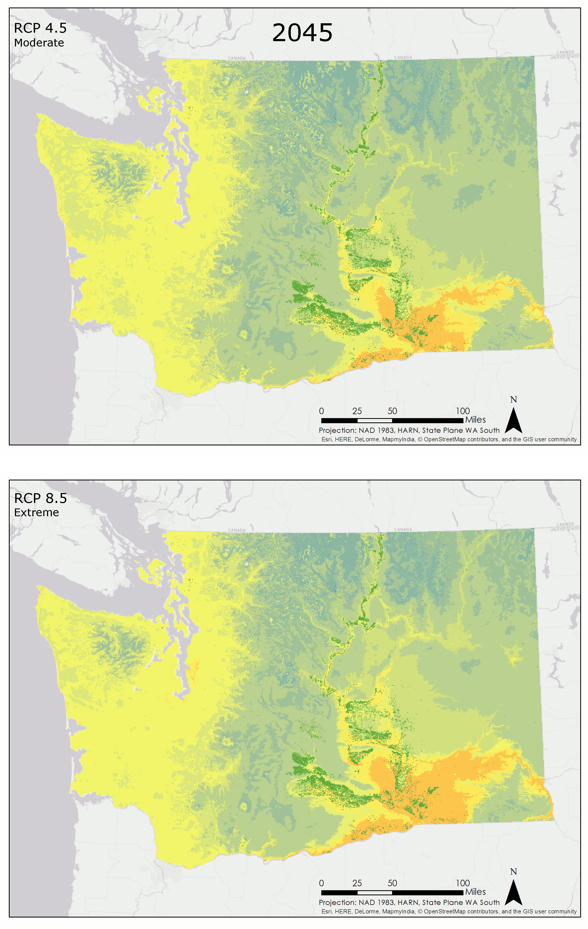

Conclusions: Apple Suitability
Present-day with MODIS
Notes:
By combining PHZ, GDD, and AGST, we created suitability maps for Washington state. Suitability is ranked on a scale of 0 to 100, 100 being the most suitable. Currently, orchards are within zones of high to moderately high suitability and no orchards exist in areas with a suitability score below 65. However, suitability significantly decreases in 2045. In the north, conditions are moderately suitable; while in the south, conditions are moderately unsuitable. In 2065, the unsuitable areas have expanded. The extreme scenario shows strips of very low suitability appearing in the south. The moderate scenario shows very little change between 2065 and 2095; however, the extreme scenario shows a drastic change in conditions. Suitability is extremely low for all apple orchards.
NOTE: right panel an animation with similar timing to that on previous slide

Slide 10
Conclusions
Current Conditions:
PHZ and suitability map shows good conditions for apples.
Moderate Scenario:
Conditions steadily worsen. Marginally suitable in the north by 2095.
Extreme Scenario:
Significant worsening of conditions. By 2095, Washington very unsuitable.
Acknowledgements:
Dr. Kenton Ross, NASA DEVELOP National Program Science Advisor
Dr. Noel Baker, NASA Postdoctoral Program Fellow
Dr. Michael Glenn, USDA-ARS Appalachian Fruit Research Station
Jeffry Ely, NASA DEVELOP Geoinformation Scientist
Northwest United States Agriculture I, Fall 2014
Northwest United State Agriculture II, Spring 2014
Notes:
In conclusion, apple orchards are currently located in areas with ideal growing conditions. However, the moderate emissions scenario show that conditions will steadily worsen, with unsuitable conditions already occurring by 2045. The north will be the only marginally suitable area by 2095. For the extreme scenarios, the phzs and the suitability maps both show a significant worsening of conditions, and by 2095, the entire state of Washington is very unsuitable for apple growth.

