Slide 1
Indonesia Disasters
Creating an Enhanced Methodology for Mapping Burn Scars in Indonesia by Transforming Red Green Blue False Color Composites to Hue Saturation Value Images Using Landsat
Jerrod Lessel (Project Lead)
Alex Sweeney

Slide 2
Study Area
Central Kalimantan, Indonesia
Notes:
Study area is in Indonesia in the Central Kalimantan province, located on the island of Borneo. Central Kalimantan is denoted in green.
Base layer source.
Natural Earth. (2015). Admin 0 - Countries, Available from: http://www.naturalearthdata.com/downloads/10m-cultural-vectors/10m-admin-0-countries/ (Accessed 01 June 2015)

Slide 3
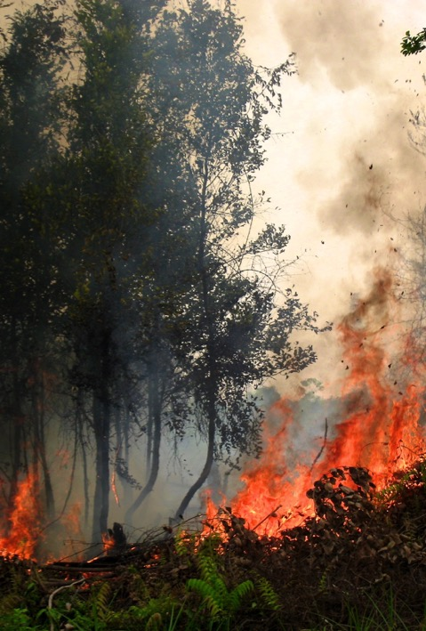
Community Concerns
Fires = dominant cause of deforestation between 1989-2008
  93% of forest loss
  69% of net C emissions
Adversely affects air quality, human health, biodiversity, and productivity
September 2014 - government ratified regional agreement to reduce pollution from fires
Flickr: CIFOR
Notes:
Indonesia experiences extensive deforestation due to different land conversion activities such as agricultural expansion, establishment of palm and pulp plantations, and peatland alteration, mostly as a result of fires (Tansey et al., 2008; Carlson et al., 2012; McDonald Pittman et al., 2013; Spessa, et al., 2015). Between 1989-2008, fire was the dominant cause of deforestation, accounting for 93% of forest loss, as well as 69% of total carbon emissions in Indonesia [Carlson et al., 2012].\
Fires adversely affect air quality, human health, biodiversity, and productivity [McDonald Pittman et al., 2013; Hayasaka et al., 2014; Spessa et al., 2015], and the impact has become so severe that in September of 2014, Indonesia finally ratified a regional agreement signed in 2002, which decided to concentrate efforts to reduce pollution from forest fires [Minnemeyer, S., 2014].

Slide 4
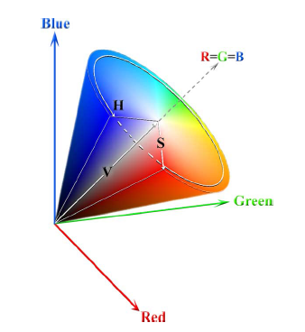
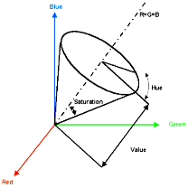
R=G=B
Hue
Value
Credit: Pekel et al. (2011)
Objectives
Tested a new methodology for mapping burn scars using Landsat Thematic Mapper (TM) and Enhanced Thematic Mapper Plus (ETM+)
Color transformed Red Green Blue (RGB) color space to Hue Saturation Value (HSV)
Isolated a hue range that differentiates burn scars
Notes:
Present a new methodology for effectively mapping and identifying burn scars using scenes from Landsat TM and ETM+.
Landsat TM and ETM+ scenes were used to test a technique of transforming Red Green Blue (RGB) false color composites utilizing the SWIR, NIR, and red bands to Hue Saturation Value (HSV) in order to determine whether it was an effective procedure for identifying burn scars.
The advantage of using this color transformation technique is that by converting the normal RGB color space into an HSV space, we are able to isolate the hue from the saturation and the value. This in turn, when applied to a false color composite consisting of shortwave infrared, near infrared, and red wavelengths allows for a superior discrimination between vegetation, soil, and water [Pekel et al., 2011]. This enhanced classification between the various land covers aids in the identification of burn scars at high spatial resolution.

Slide 5




Landsat 5 (TM)
Landsat 7 (ETM+)
Aqua
Terra
Satellites
& Sensors
Landsat Thematic Mapper (TM) and Enhanced Thematic Mapper Plus (ETM+)
Aqua and Terra
  MODIS Active Fire Product
Notes:
~200 Landsat TM and ETM+ scenes were downloaded from United States Geological Survey’s (USGS) Earth Explorer website over Central Kalimantan for 12 different path/row combinations.
The bands we used had a spatial resolution of 30 m, with an approximate scene size of 170 kilometers (km) from north to south by 183 km from east to west [USGS, 2015].
Additionally, MODIS Active Fire Product was used in order to cross reference burn scars with fire data.
MODIS employs sensors aboard the Aqua and Terra satellites, and can make four fire observations daily at 10:30 and 22:30 (Terra) and 13:30 and 01:30 (Aqua).
Specifically, the fire product uses the 1 km fire channels at 3.9 µm and 11 µm, and uses a contextual algorithm to detect fires utilizing the middle infrared radiation from fires, where it exhibits strong emission [Justice et al., 2006].
Base layer source.
Natural Earth. (2015). Admin 0 - Countries, Available from: http://www.naturalearthdata.com/downloads/10m-cultural-vectors/10m-admin-0-countries/ (Accessed 01 June 2015)
Landsat Tiles Source.
United States Geological Society (USGS). (2013). Path/Row Shapefiles, Available from: http://landsat.usgs.gov/tools_wrs-2_shapefile.php (Accessed 23 June 2015)

Slide 6
Methodology
False color RGB were created using bands 5 (Middle Infrared), 4 (Near Infrared), and 3 (Red)
RGB transformed to HSV in ENVI
Visual analysis to isolate hue range
RGB Construction
HSV Transformation
5
4
3
SWIR (5), NIR (4), Red (3)
RGB
Hue
Notes:
False color images using the 5 (Middle Infrared - SWIR), 4 (Near Infrared - NIR), and 3 (Red) bands were created using ENVI and subsequently the null values were removed from each scene
The false color images were then transformed from RGB color values to HSV using the RGB to HSV transformation technique within ENVI.
After the color transformation was completed the Hue values for each scene were isolated and exported in geotiff format for use within ArcMap.

Slide 7
Methodology Continued
ArcMap model builder to isolate a hue range
IRI Data Library to construct vegetation indices
More content will be included in Final Draft with imagery.
Notes:
To identify the burn scars, the hue images were first processed to isolate the pixel values between XX-XX using the extract by attributes tool in ArcMap model builder. These values were found to be the primary values that corresponded to the MODIS fire data after visual inspections of the images.

Slide 8
Results
Forthcoming in Final Draft.

Slide 9
Errors & Uncertainties
Forthcoming in Final Draft.

Slide 10
Conclusions
Forthcoming in Final Draft.

Slide 11
Advisors
Dr. Pietro Ceccato, Research Scientist, IRI, Columbia University
Partners
Rizaldi Boer, Bogor Agricultural University
Louis Verchot, Center for International Forestry Research

Slide 12
References
Bastarrika, A., Chuvieco, E., & Martín, M. P. (2011), Mapping burned areas from Landsat TM/ETM+ data with a two-phase algorithm: Balancing omission and commission errors. Remote Sensing of Environment, 115(4), 1003-1012.
Carlson, K.M., Curran, L.M., Ratnassari, D., Pittman, A.M., Soares-Filho, B.S., Asner, G.P., Trigg, S.N., Gaveau, D.A., Lawrence, D., and Rodrigues, H.O. (2012), Committed carbon emissions, deforestation, and community land conversion from oil palm plantation expansion in West Kalimantan, Indonesia. Proceedings of the National Academy of Sciences, 109(19), 7559-7564, doi: 10.1073/pnas.1200452109.
Garcia-Haro, F. J., Gilabert, M. A., & Melia, J. (2001), Monitoring fire-affected areas using Thematic Mapper data. International Journal of Remote Sensing, 22(4), 533-549.
Hayasaka, H., Noguchi, I., Indra Putra, E., Yulianti, N., and Vadrevu, K. (2014). Peat-fire-related air pollution in Central Kalimantan, Indonesia, Environmental Pollution, 195, 257-266, doi: 10.1016/j.envpol.2014.06.031.
Hyer, E.J., Reid, J.S., Prins, E.M., Hoffman, J.P., Schmidt, C.C., Miettinen, J.I., and Giglio, L. (2012). Patterns of fire activity over Indonesia and Malaysia from polar and geostationary satellite observations, Atmospheric Research, 122, 504-519, doi: 10.1016/j.atmosres.2012.06.011.
Justice, C., Giglio, L., Boschetti, L., Roy, D., Csiszar, I., Morisette, J., and Kaufman, Y. (2006), Algorithm Technical Background Document: MODIS Fire Products. Available from: http://modis-fire.umd.edu/files/atbd_mod14.pdf (Accessed 22, June, 2015)
Koutsias, N., Pleniou, M., Mallinis, G., Nioti, F., & Sifakis, N. I. (2013), A rule-based semi-automatic method to map burned areas: exploring the USGS historical Landsat archives to reconstruct recent fire history. International journal of remote sensing, 34(20), 7049-7068, doi: 10.1080/01431161.2013.816452.
McDonald Pittman, A., Carlson, K.M., Curran, L.M., and Ponette-González. (2013), NASA Satellite Data Used to Study the Impact of Oil Palm Expansion Across Indonesian Borneo, The Earth Observer, 25(5), 12-16, Available from: http://lcluc.umd.edu/Documents/Publications/2014/Pittman_et_al_Earth_Observer_Sept_Oct_2013_12-16.pdf (Accessed 22 June 2015)
Minnemeyer, S., Putraditama, A., Anderson, J., Sizer, N., and Song, C. (2014), Fires Spread Across Indonesia as Parliament Approves Haze Treaty, Available from: http://www.wri.org/blog/2014/09/fires-spread-across-indonesia-parliament-approves-haze-treaty (Accessed 23 June 2015)
Spessa, A.C., Field, R.D., Pappenberger, F., Langner, A., Englhart, S., Weber, U., Stockdale, T., Siegert, F., Kaiser, J.W., and Moore, J. (2015). Seasonal forecasting of fire over Kalimantan, Indonesia, Natural Hazards and Earth System Science, 15(3), 429-442, doi: 10.5194/nhess-15-429-2015.
Tansey, K., Beston, J., Hoscillo, A., Page, S.E., and Paredes Hernández, C.U. (2008), Relationship between MODIS fire hot spot count and burned area in a degraded tropical peat swamp forest in Central Kalimantan, Indonesia. Journal of Geophysical Research: Atmospheres, 113(D23), 112. doi: 10.1029/2008JD010717.
United States Geological Survey (USGS). (2015), Frequently Asked Questions about the Landsat Missions, Available from: http://landsat.usgs.gov/band_designations_landsat_satellites.php (Accessed 22 June 2015)

