Slide 1
Navajo Nation Climate II
Monitoring Drought Conditions in the Navajo Nation Using NASA Earth Observations
Cheryl Cary (Project Lead)
Anton Surunis
Michael Gao
Sophie Turnbull-Appell
Vickie Ly
Notes:
HELLO
Thank you all for joining us today,
I’m Cheryl Cary, I graduated from UC Santa Cruz with a degree in Earth Sciences,
I’m Michael Gao,
I’m Vickie Ly,
I’m Anton Surunis,
And I’m Sophie Turnbull-Appell, and we’re the Navajo Nation Climate II Team

Slide 2
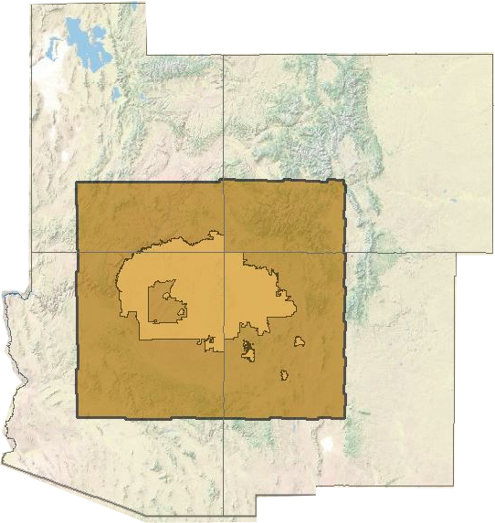
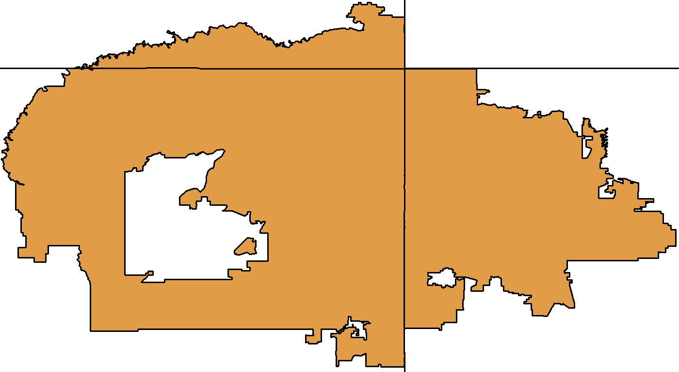
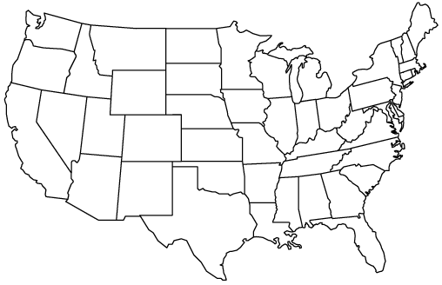
The Navajo Nation
Drought in the Navajo Nation
Utah
New Mexico
Arizona
12 EPA lvl. IV Ecoregions
Semi-arid highlands
Forested Mountains
Notes:
The Navajo Nation is the largest Native American territory in the United States in both area and population,
*click*
It is located at the 4 corners of Utah, Arizona, New Mexico, and Colorado. (Point with laser)
*click*
The Nation contains 12 level four EPA ecoregions,
*click*
Including Semi-arid highlands
*Click*
and Forested Mountains
https://www.flickr.com/photos/nhanchanahal/3906018450/in/photolist-6XancG-pHznnV-awfFdx-9QYkgL-ra2R8m-e4ZAsX-rrBfCn-9YDHQd-e4Zwig-6P3Zyn-e56cMW-6P833w-e3QndZ-dNP5uB-6P43Gg-hnUkJr-ftwuy-51SdNj-6P84xs-6PKDR3-6P3Udk-6P3TPc-6P3ZKD-6PFwpx-6P4458-6P3YLM-6PKDkE-6P8bAG-6P83zo-6P89DJ-6P8atC-6P84Gf-6P3Z7Z-6P842b-6P428n-6P3VMc-6PFvzv-6P8cnU-6P41iD-6P89UW-6P3W9k-6PFvUk-6P3ZoM-6P42QT-6P43gP-6P3YkV-6P3TDV-6P874N-6P8aZU-6PKDYQ/
Photo Credit: Nagaraju Hanchanahal, “Monument Valley, Utah Arizona”

Slide 3
Drought in the Navajo Nation
Utah
New Mexico
Arizona
Decreasing Precipitation
70,000+ residents without water
Increasing Temperatures
Notes:
BACKGROUND
The climate in the Navajo Nation is inherently arid and dry.
*click*
Between 1901 and 2010, annual average temperatures in the southwest have increased by 1.1 – 2.1 °F.
*click*
Climate change is predicted to continue trends of high temperatures, high aridity, and low snowpack.
*click*
This has left the NN with over 70,000 residents without direct access to water in homes. In order to monitor drought, the Navajo Nation uses what is called the…

Slide 4
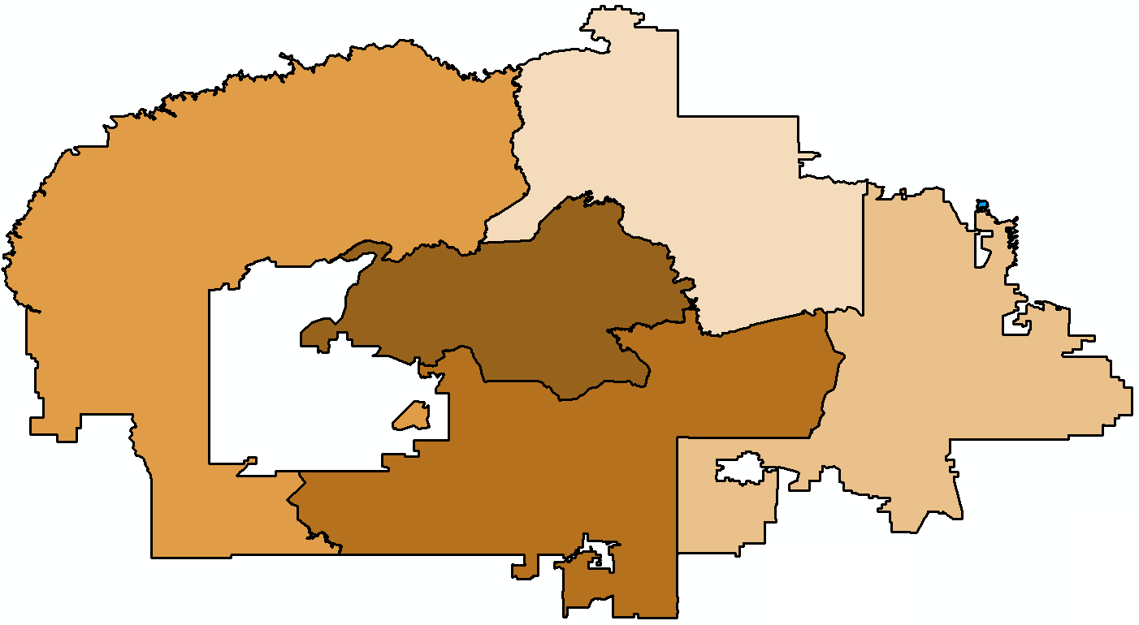
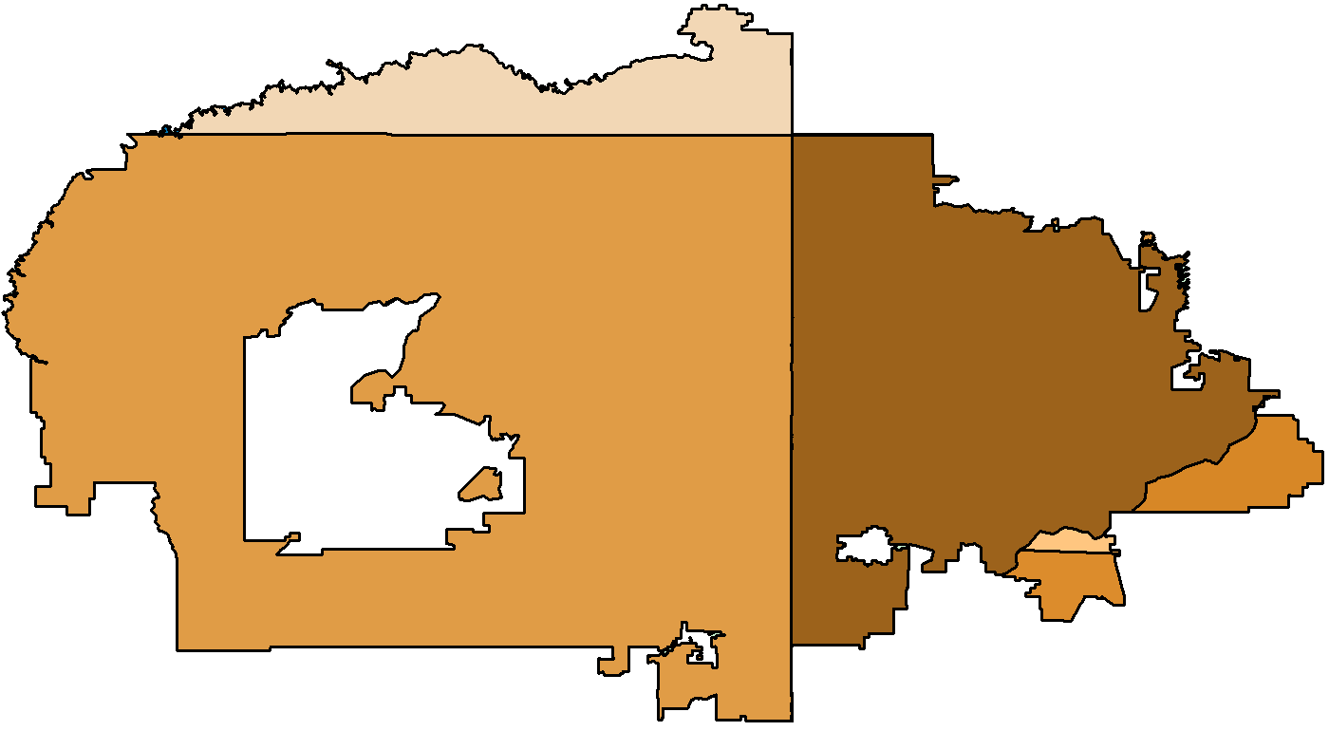
Objectives
Issues in Drought Monitoring
NASA DEVELOP & Navajo Nation
Five Agencies
Utah
Term 1
Spatially-inaccurate climate data
New Mexico
= (Xi-X)
σ
Standardized Precipitation Index
SPI
Three Climate Divisions
Arizona
Inadequate rain gage coverage
Xi = accumulated precipitation over months of interest
X = historical avg. accumulated precipitation over months of interest
σ = standard deviation
Decreasing Precipitation
70,000+ residents without water
Increasing Temperatures
Notes:
DROUGHT MONITORING
…the Standardized Precipitation Index…
*click*
…or SPI. The SPI is a probability based indicator of abnormally wet or dry time periods based on historical precipitation trends specific to the area.
*click*
It is calculated by comparing precipitation at a given time of interest to historical avg. precipitation
the Navajo Nation uses the SPI to make monthly drought reports – indicating which areas are experiencing the most severe drought.
*click*
The Navajo Nation manages its water on an agency basis, shown here. These five agencies are the Navajo Nation’s equivalent of US states.
*click*
Currently, the NN gathers its own precipitation data using rain gauges. Unfortunately, the network consists of only 88 gauges, which are very often clustered near roads and towns.
*click*
The NN’s other source of climate data is through the WRCC. This data is given over state-based climate divisions, shown here in this map.
*click*
As you can see, these climate divisions do not adequately represent water managers’ needs, and because of these reasons, when the Navajo Nation has funding for drought mitigation it is usually distributed evenly across the entire nation.

Slide 5
Tool Data: Accumulated Monthly Precipitation
NASA DEVELOP & Navajo Nation
Term 1
Historical
Geodatabase
SPI
Methods
Tool
Term 2
1901
Produces an average SPI over an user specified area
2014
Compare drought intensity over time
Notes:
To address this issue, our team partnered with the Navajo Nation Department of Water Resources over the past two terms in order to find a way to utilize NASA Earth Observations data in their drought mitigation decisions
*click*
During the First term we focused on creating a geodatabase of historical climate data specific to the area
*Click*
And planning the best way to create SPI values customized to the NN
*Click*
During the second term our team got down to business creating a tool
*Click*
Our tool produces SPI rasters, and average SPI values for user specified areas
*Click*
And allows water managers to compare drought intensity over time
*click*
To create this tool, our team utilized…
*click*

Slide 6
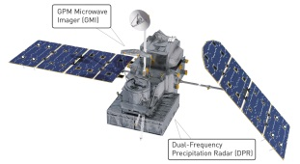
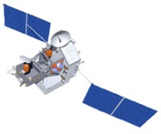
Tool Data: Accumulated Monthly Precipitation
GPM
TRMM
PRISM
Tropical Rainfall Measuring Mission
Global Precipitation Measurement
Parameter-elevation Relationships on Independent Slopes Model
1901
2014
Notes:
…three sources of precipitation data, both modeled and remotely-sensed. Our first data set is the
Parameter-elevation Relationships on Independent Slopes Model, also known as PRISM. PRISM
is a nationwide climate model developed by Oregon State University, going back as early as
1901.
*click*
Our next data set is sourced from the Tropical Rain Measuring Mission, or TRMM, a NASA
satellite launched in 1997. TRMM provided us with continuous precipitation data from then,
until its mission end in April of this year.
*click*
Our final data set came from the Global Precipitation Measurement mission, a NASA satellite
launched in February of 2014. GPM provides our tool with high resolution precipitation data
from now, on.
*click*
Combined, all three of these data sets provide our tool with continuous data from 1901 and into
the future.
*click*
We created a geodatabase of drought-related NASA Earth Observation data from 3 sources:
The first source was the Parameter-elevation Relationships on Independent Slope Model, or PRISM.
*click*
We used PRISM for historical modeled precipitation data that spans from 1901 to 2000. This was to give us a historical baseline of average rainfall amounts to be able to compare against recent rainfall amounts.
The second source was the precipitation radar from the Tropical Rainfall Monitoring Mission, or TRMM.
*click*
We used this for relatively recent to current observed precipitation data, from 2000-2015.
The third source was the Global Precipitation Measurement, or GPM.
*click*
Beginning in 2014, GPM replaced TRMM as the main source of accumulated monthly precipitation data for the Navajo Nation.

Slide 7
Tool Data: Processing
Tool Data: Accumulated Monthly Precipitation
SPI Rasters
GPM
TRMM
PRISM
SPI Algorithm
Precipitation Rasters
1901
Precipitation
Pixels
SPI
Pixels
2014
Notes:
With the accumulated monthly precipitation from PRISM, TRMM, and GPM, we calculated SPI values for the pixel in the rasters using this process that you can follow in this flow chart.
We began by creating a time series of accumulated monthly precipitation data over the past 30 years (a requirement for the SPI). We stacked these rasters, and for each precipitation pixel, we ran it through a SPI algorithm. The output is an SPI value for each pixel. Reassembling this gives us a series of SPI rasters.
The power of this is that an SPI value can be calculated spatially and temporally, different from using just in-situ rain gauge data. And this process will give water managers in the Navajo Nation the ability to calculate an average SPI value over a specific selected area – whether that be a political boundary, watershed, ecoregion, or self-drawn polygon.

Slide 8
SPI Rasters
Precipitation Rasters
SPI Algorithm
Precipitation
Pixels
SPI
Pixels
Notes:
So in applying this conceptually, let’s take a look at what it actually looks like.
Using the accumulated precipitation data, we created the Drought Severity Assessment – Decision Support Tool, or DSA for short. The user begins at this interface, which was headed and created by resident wizard Michael Gao.
Within this user interface, water managers can do 3 things:
1. Calculate SPI value
The user selects the ‘type’ of SPI, a 1-month, 6-month, or 12-month, depending on the TYPE of drought they want to examine; then they identify the time range – by selecting the starting month and year; and then the ending year. Within the folder, you can see that we have a folder containing the TRMM precipitation data. This will take that data and go through that conceptual process, and output SPI rasters.
2. Summary Statistics.
With these SPI rasters, the user chooses a boundary – like an chapter, agency, watershed, or ecoregion-- within which to calculate statistics.
Right here, we select ECOREGION, so you can see the zonal statistics for the boundary selected.
3. Visualizations.
The user can look at these gridded SPI values through time in order to visualize how drought severity is changing.

Slide 9
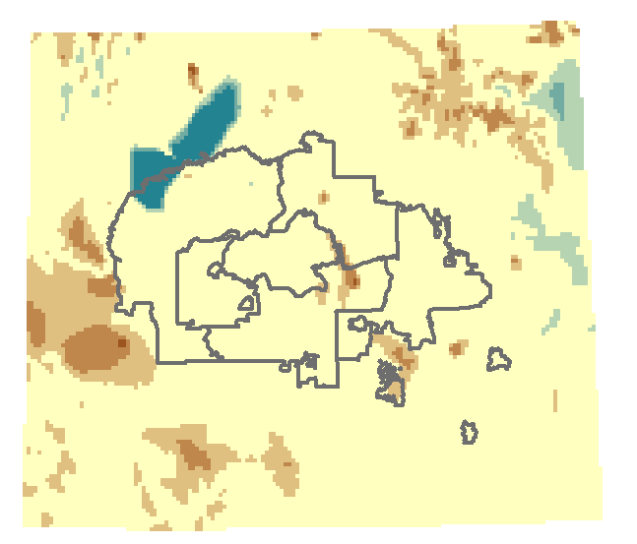
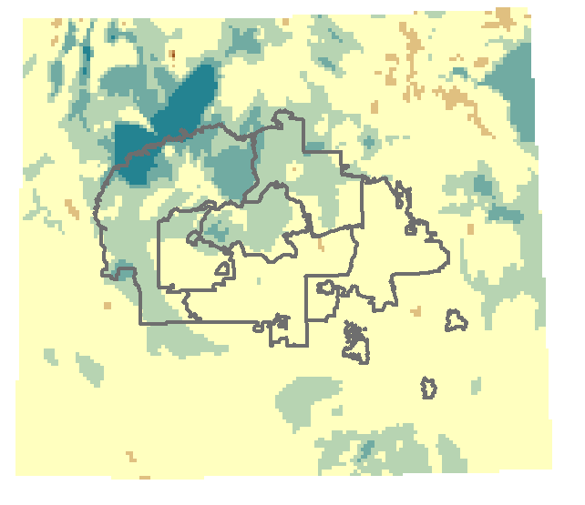
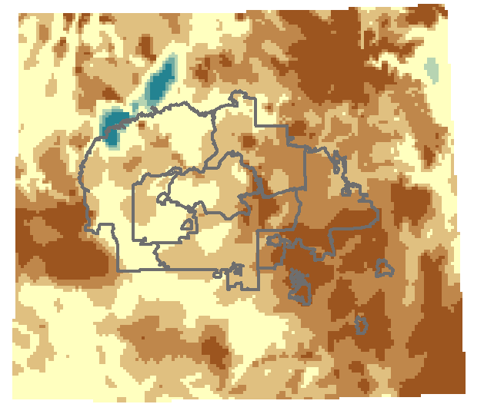
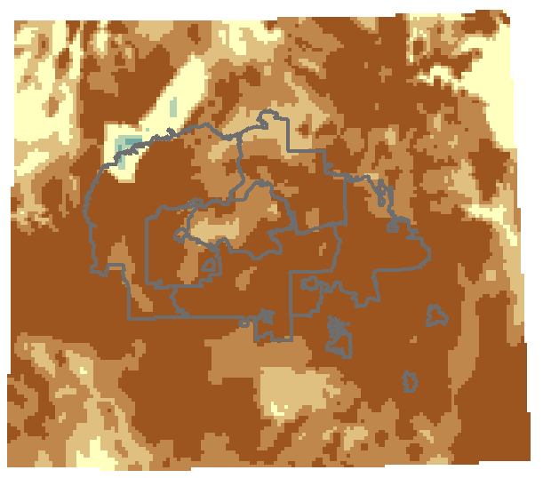
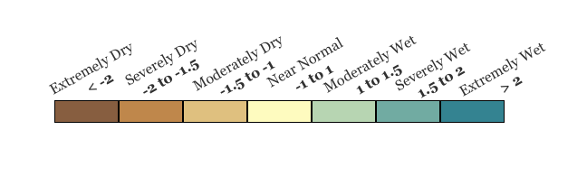
Results of Tool
by Classification
Jan 2014
Feb
2014
April
2014
May
2014
Notes:
*click*
The results of this tool will support decision-making in the Navajo Nation.
Water managers will be able to use SPI maps to make monthly drought reports, and also look at more long term climatic trends.
Here we have classified SPI maps. Hydrologists and resource managers can use these to look at trends over the area regardless of political boundaries.
These maps range from January to April 2014, when the Navajo Nation is coming out of one of its rainy seasons.
Looking at the big picture: we can see the transition from abnormally wet areas (as shown in blue) to abnormally dry (as shown in orange)
Looking at the finer detail: water managers will be able to examine what areas are receiving more rain than others, or which areas are experiencing a more intense drought.

Slide 10
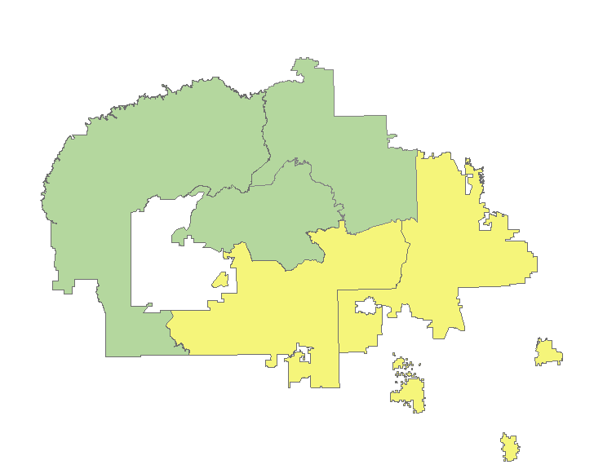
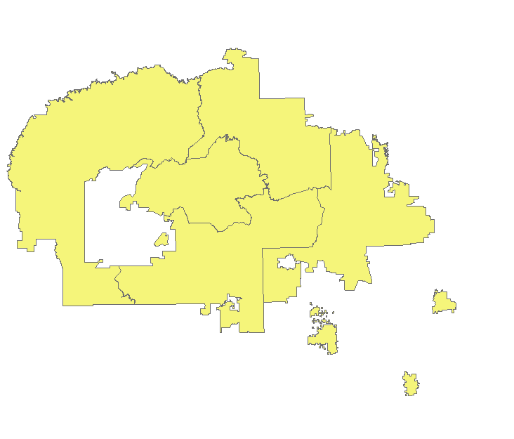
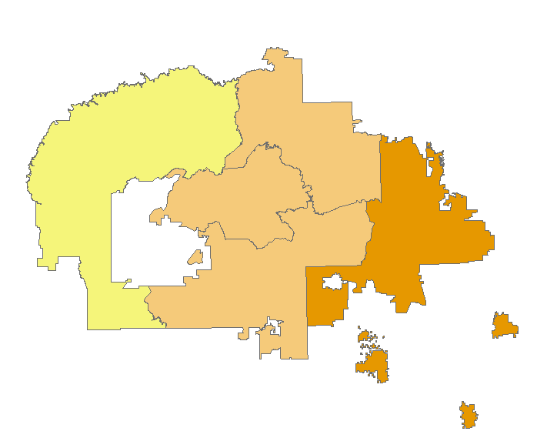
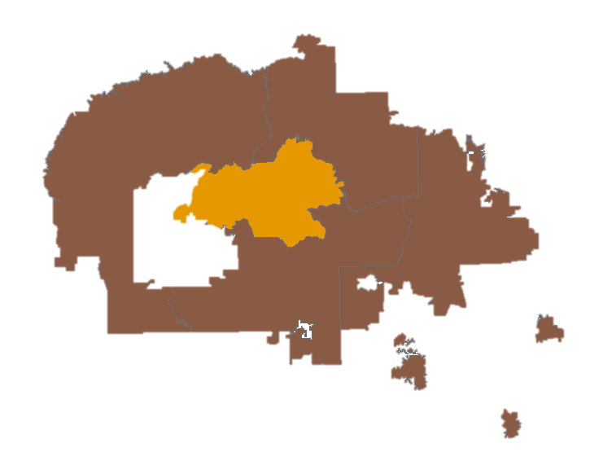
Results of Tool
by Agency
Jan
2014
Feb
2014
May
2014
Apr
2014
Notes:
In a decision support capacity, this tool can be used to create drought maps with average SPI values for Navajo Nation agencies, which are similar to states, in order to allocate resources.
*click*
Again, in comparing January 2014 to April 2014 we can see how average SPI values for agencies change in the northwest from moderately wet (in green) to near normal (in yellow); and how in the southeast, near normal (yellow) to severely dry (orange).

Slide 11
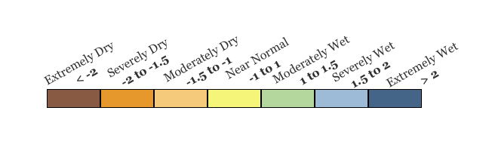
Results of Tool
by Agency: Western Navajo
Feb
2014
Jan
2014
May
2014
April
2014
Notes:
In a decision support capacity, this tool can be used to create drought maps with average SPI values for Navajo Nation agencies, which are similar to states, in order to allocate resources.
*click*
Again, in comparing January 2014 to April 2014 we can see how average SPI values for agencies change in the northwest from moderately wet (in green) to near normal (in yellow); and how in the southeast, near normal (yellow) to severely dry (orange).

Slide 12
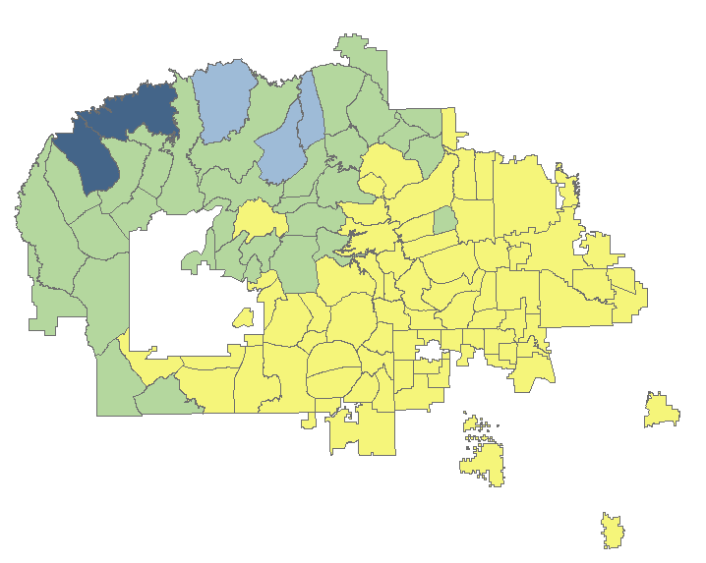
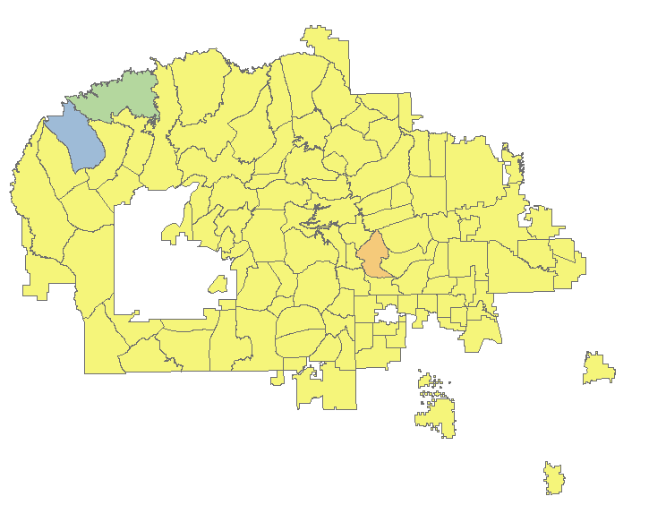
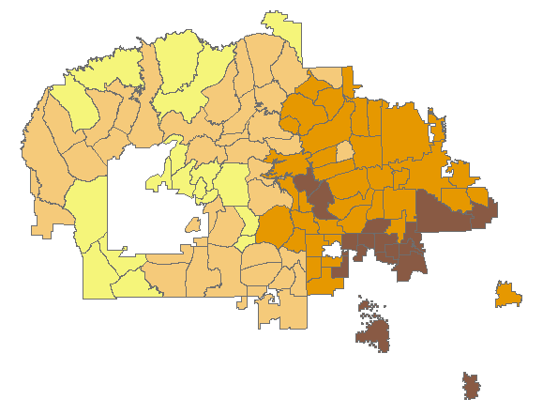
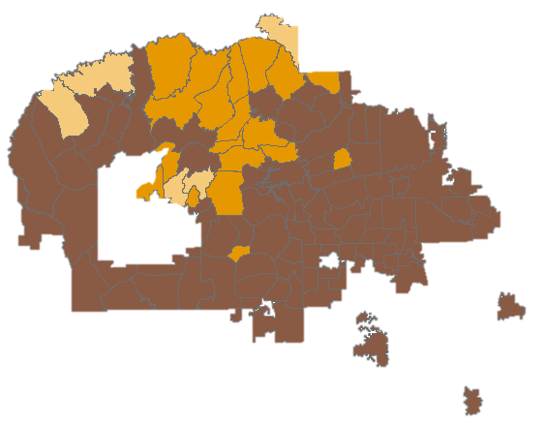
Results of Tool
by Chapter
Jan
2014
Feb
2014
Apr
2014
May
2014
Notes:
And, at an even finer scale we can look at average SPI values for Chapters in the nation, similar to our definition of counties.
*click*
Here we can see that SPI values are not the same across all chapters.
For example, looking at January 2014, some chapters in the northwest corner are extremely wet vs chapters in the southeast are near normal.
You can see that in March 2014, chapters in north are near normal, whereas the southeast are also severely to extremely dry.

Slide 13
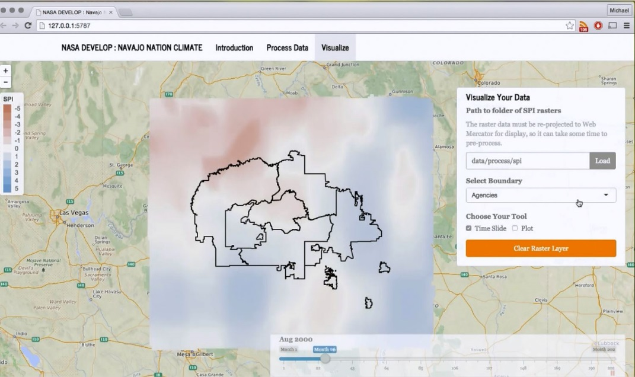
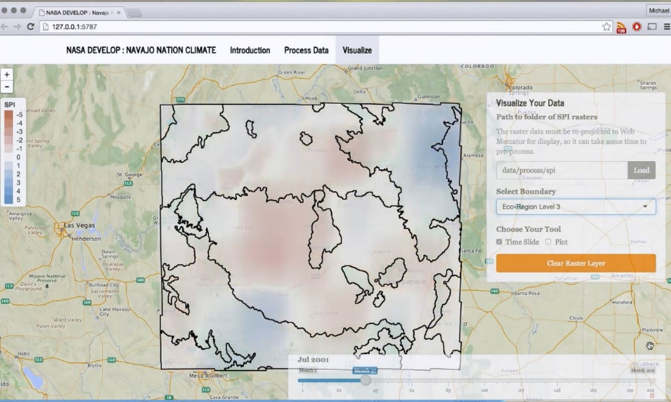
Benefits of Research
April
2014
Calculate SPI-specific to the Navajo Nation
Produce monthly drought reports with current and historical data
Allocate drought dollars in most impacted areas
Apr
2014
Notes:
*click*
With the DSA,
The Navajo Nation will be able to calculate SPI values specific to the region, with spatial and temporal detail and continuity.
*click*
And with these SPI maps, water resource managers will be able to produce monthly drought reports with current and historical data to inform political decisions
*click*
Like where the most impacted areas are and how to allocate financial resources

Slide 14
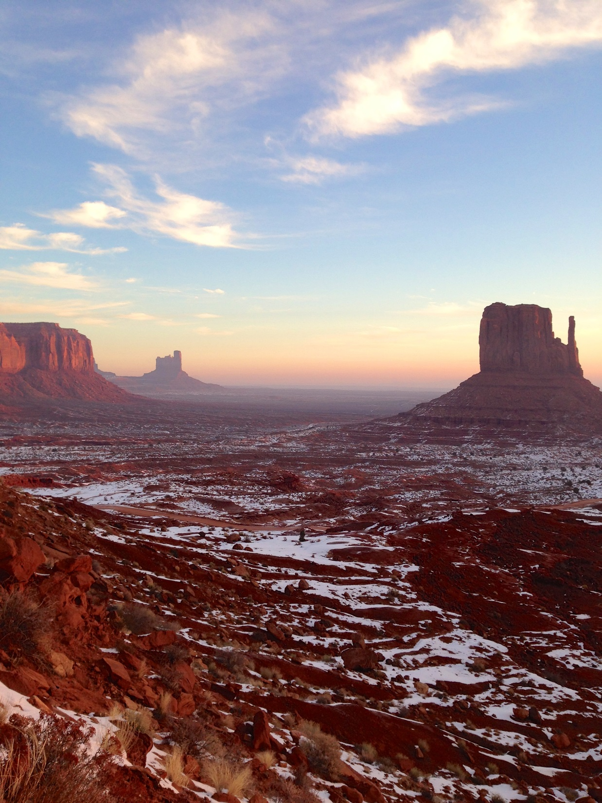
Working with the Nation
Integration of NASA data into resource management
New data resources to support decisions
Tool Infrastructure for changing needs
Notes:
Working closely with the NN Water Resources managers has been a key component to creating a decision support tool that really integrates NASA Earth Observations data into their drought monitoring practice
This tool gives them access to data that they were unaware of in the past, and provides more resources to support decisions regarding research allocations.
Our collaboration with the resource managers also allowed us to create the tool in a way that it is customizable and can grow with the needs of the resource managers.
Photo credit: https://www.flickr.com/photos/on_earth/16319427382/

Slide 15
Future Work
Hosting on NASA GitHub
Applications to other tribal and rural communities
Webinar/training with ARSET
Understanding drought regime changes
Notes:
Looking into the future we are currently in the Software Release process within NASA in order to have our tool hosted on the NASA Git hub. This will allow it to be accessible to the public, and customized for other areas without adequate in situ data networks.
We are looking forward to a possible upcoming collaboration with the program ARSET for both a webinar and hopefully an in-person training with the Navajo Nation and our tool.
We also envision our tool being able to be used to compare SPI drought severity with other drought indicator variables to better understand drought regime changes
Photo credit: https://www.flickr.com/photos/mandj98/3059115395/in/photolist-5EjLqT-4zDq3a-8jmWk9-pPYPi4-cqjp6Q-eJRJTx-btnY6A-5hRGzp-fxGCxN-dG7YCr-dxoxA7-jkEXcW-gMAZY3-hDCAtF-pFv63V-c8fEWm-nPXhUs-c5tHHf-4gCZjC-rqZYQz-nEzZTo-dSjFQe-jj4C5k-tkc2Ad-rt71CV-6P67J9-4S62Ra-6dsVoc-cCExP7-WhcUg-MeVaa-snFTcZ-pewfXn-nyr1NQ-ex1np9-5DkwG2-5j4dHC-fij94R-nQcQTA-noHy2a-7mwx7M-9TepWi-JxquZ-oAnsBC-djbrjH-jkuDUY-8B7kfj-6Dzwfb-7eA8eP-2p3qb

Slide 16
Advisors
Dr. Jay W. Skiles, NASA Ames
Dr. Venkat Lakshmi, University of South Carolina
Dr. Juan Torres-Peres, NASA Ames
Partners
Navajo Nation Department of Water Resources: Water Management Branch
Teresa Showa :: Robert Kirk :: Maurice Upshaw
Crystal Lynn Tulley-Cordova :: Carl McLennan
Navajo Technical University
Ramsey Seweingyawna
DEVELOP Staff
NASA DEVELOP National Program
Clayton Sodergren :: Amber Brooks :: Chippie Kislik :: Andrew Nguyen

Slide 17
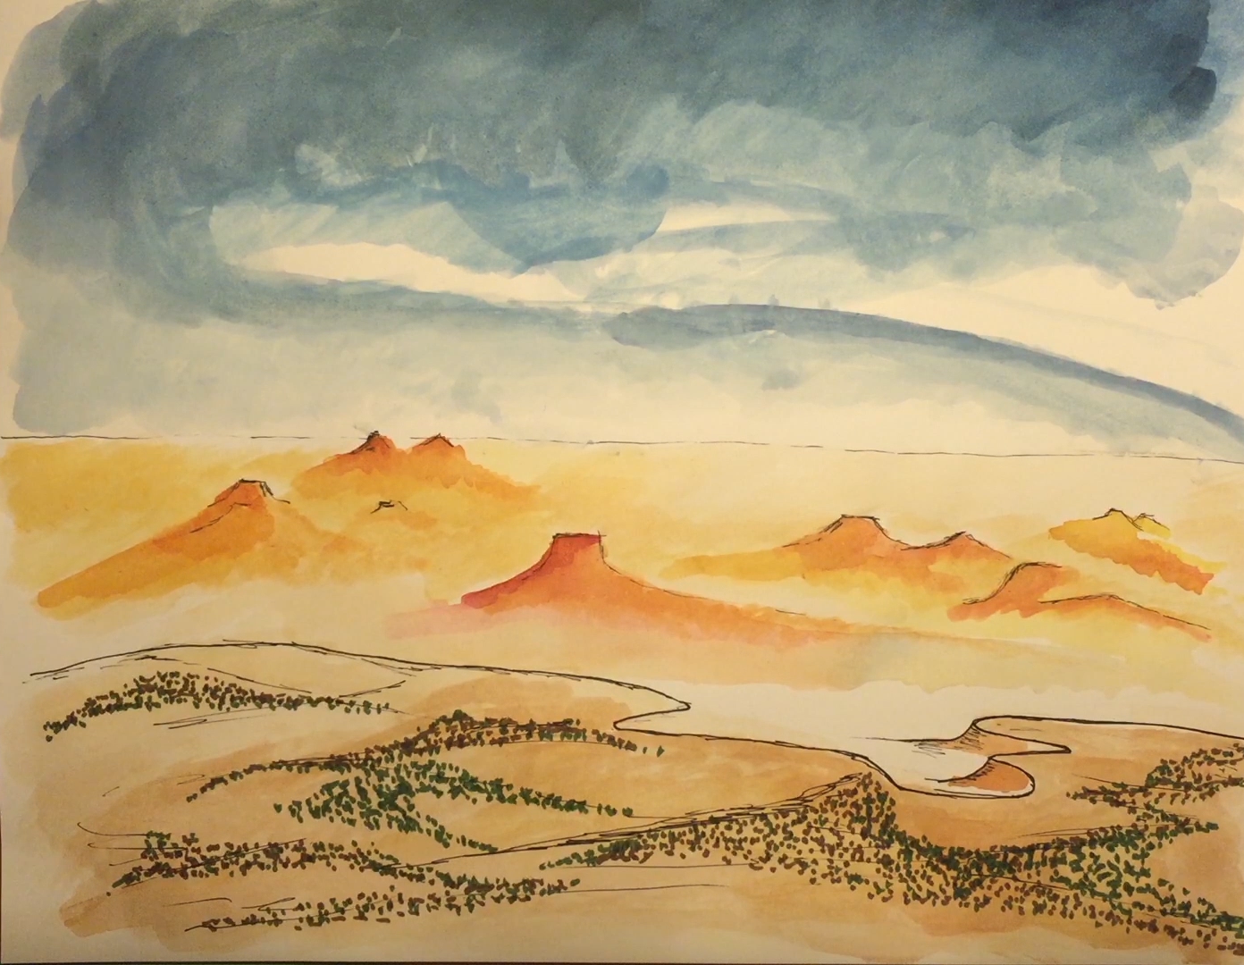
Thank you!

