Slide 1
New Jersey Health & Air Quality
Modeling near surface air temperature profiles of complex urban systems based on land surface properties by correlating on-site and satellite data to better understand temperature profiles in urban microclimates
Maryam Karimi (Project Lead)
Jerrod Lessel

Slide 2
Introduction
Urbanization and the impact of urban heat island (UHI) effect
UHI can create numerous health risks including respiratory difficulties, heat cramps, heat stroke, and heat-related mortality
Image Credit: amnh.org
Can a better understanding of microclimates help us understand and resolve urban heat island effects?
Notes:
Image Source: http://commons.wikimedia.org/wiki/File:Claude_Monet_-_The_Magpie_-_Google_Art_Project.jpg

Slide 3
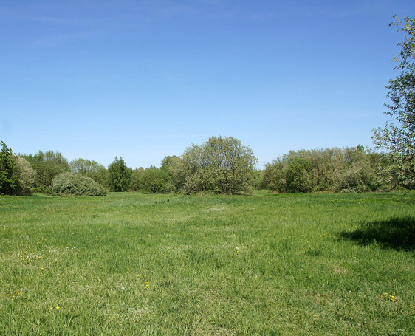
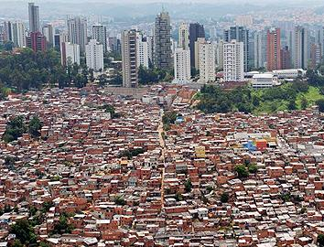
Image Credit: inhabitat.com
Introduction
Due to landscapes changing from permeable/moist surfaces to more impermeable/dry surfaces increases UHI
Notes:
These notes should be thorough enough for someone not familiar with the project to clearly present the material.
Image Source: http://commons.wikimedia.org/wiki/File:Claude_Monet_-_The_Magpie_-_Google_Art_Project.jpg

Slide 4
Introduction
Heat Waves and Mortality
Exposure-response function for temperature related mortality in Manhattan, NY based on daily data from 1982 to 1999
Image Credit: Li, et al., 2013
Notes:
Image Source: Li, T., Horton, R. M., & Kinney, P. (2013). Future projections of seasonal patterns in temperature-related deaths for Manhattan. Nature climate change, 3, 717

Slide 5
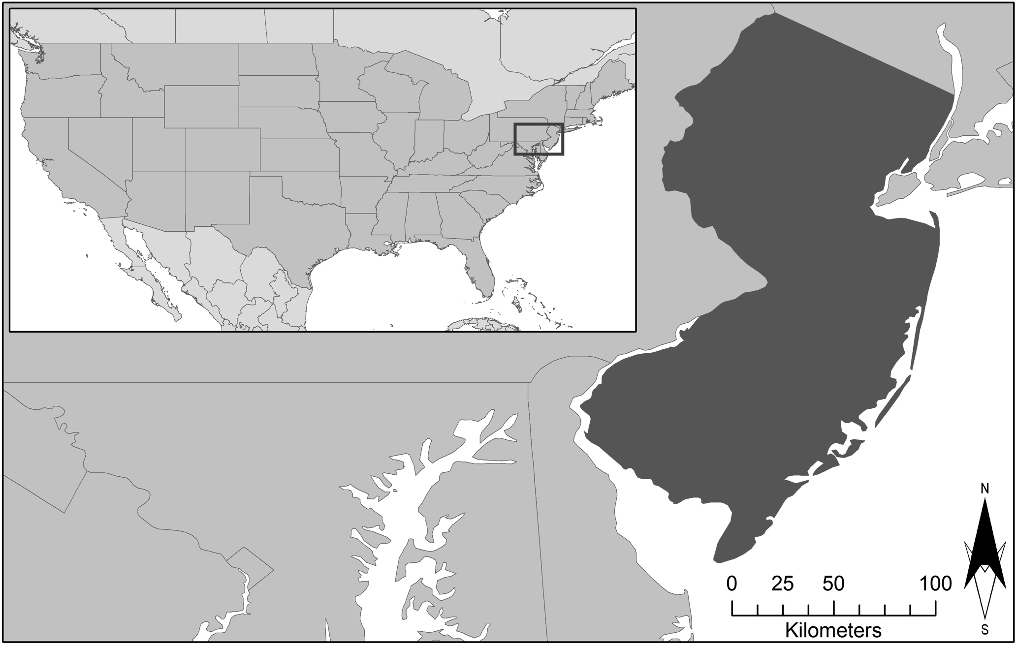
Introduction
Study Area:
Glassboro, NJ
(Rowan University Campus)
Study Period:
September – November 2015
New Jersey
Glassboro

Slide 6
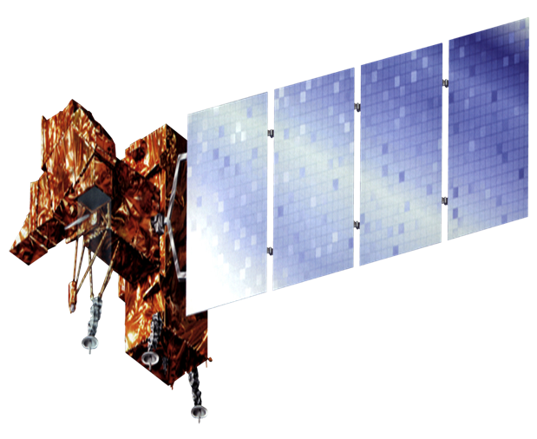
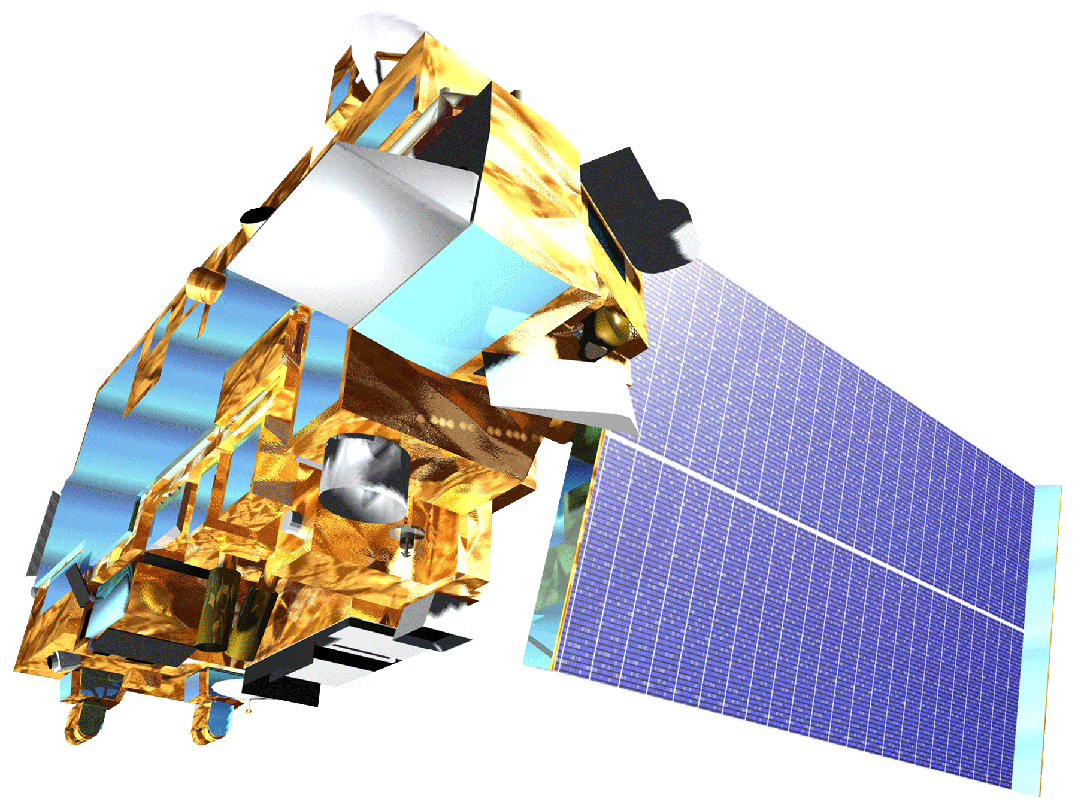
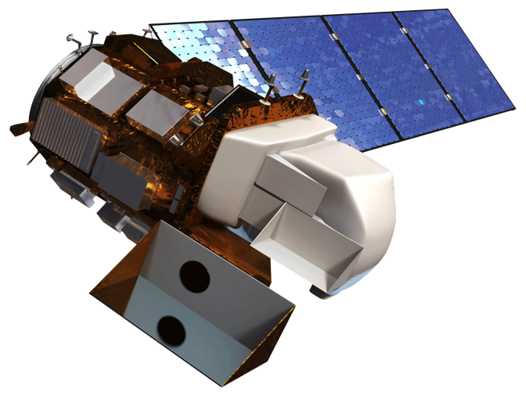
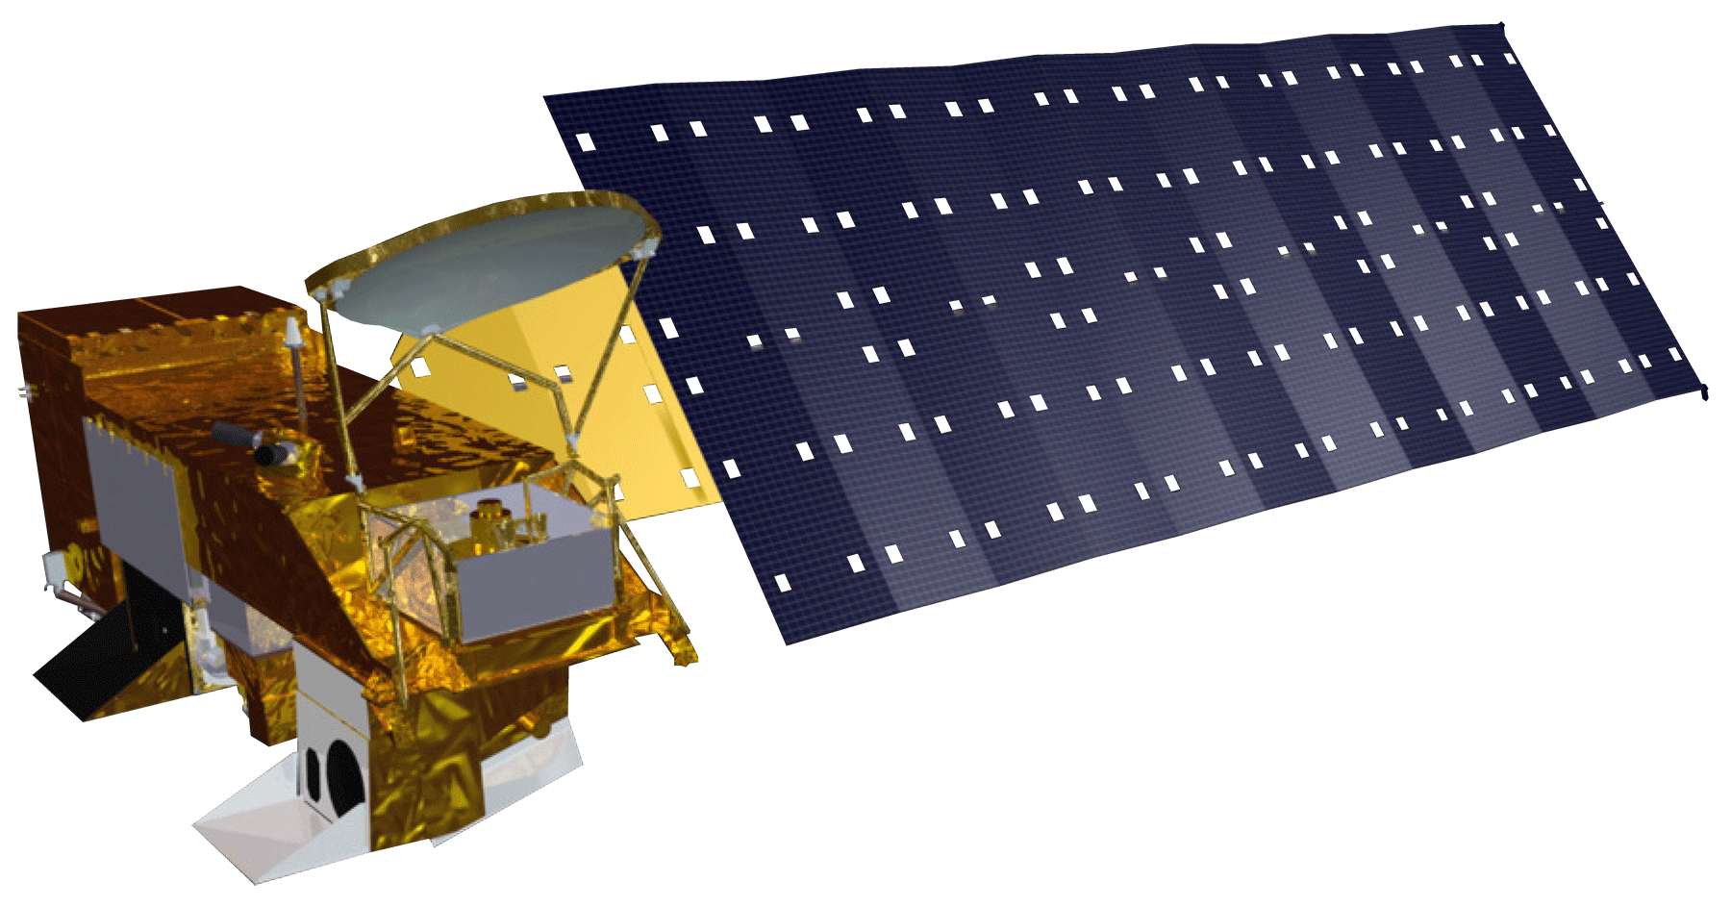
To improve understanding of the effect of the Urban Heat Island (UHI) on the near surface air temperature where humans interact
Mitigating the UHI effects in urban microclimate’s
Develop a correlation identifying the role of surface features on near surface air temperature for new perspectives in urban design for developers and city management
Methodology
NASA Earth Observations:
Landsat 7 – ETM+
Landsat 8 – OLI/TIRS
Aqua – MODIS
Terra – MODIS
Landsat 7
Terra
Landsat 8
Aqua

Slide 7
To improve understanding of the effect of the Urban Heat Island (UHI) on the near surface air temperature where humans interact
Mitigating the UHI effects in urban microclimate’s
Develop a correlation identifying the role of surface features on near surface air temperature for new perspectives in urban design for developers and city management
Methodology
Collect raw probe data
Collect remotely sensed data
Compare remotely sensed data to probe data
Analyze probe data
Compare probe data for differing environmental factors

Slide 8
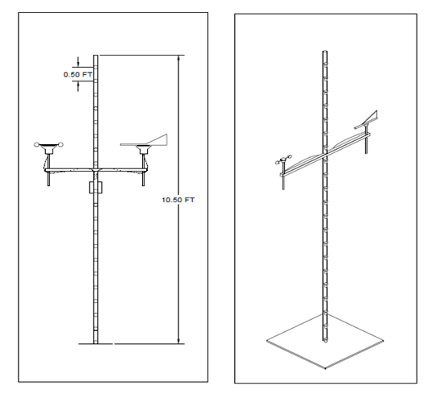
To improve understanding of the effect of the Urban Heat Island (UHI) on the near surface air temperature where humans interact
Mitigating the UHI effects in urban microclimate’s
Develop a correlation identifying the role of surface features on near surface air temperature for new perspectives in urban design for developers and city management
Methodology
Temperature Probe Setup
The sensors were spaced at half foot increments on a 10 foot pvc pole.
The temperature probe setup was then employed within varying microclimates located on the Rowan University campus.
The chosen microclimates exhibited three different surface types: mainly grass surface, area with a water surface, and a predominantly concrete surface.

Slide 9
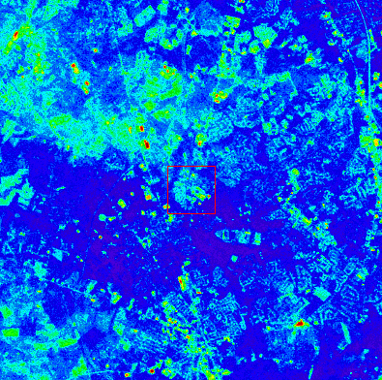
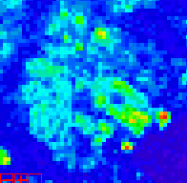
To improve understanding of the effect of the Urban Heat Island (UHI) on the near surface air temperature where humans interact
Mitigating the UHI effects in urban microclimate’s
Develop a correlation identifying the role of surface features on near surface air temperature for new perspectives in urban design for developers and city management
Methodology
Convert Landsat ETM+ thermal band to temperature
Compare Landsat temperature to field measurement data
Rowan University
Campus

Slide 10
Results and Discussion
Forthcoming in Final Draft

Slide 11
Conclusions
Forthcoming in Final Draft

Slide 12
Acknowledgements
List advisors, partners, and others who have contributed in any way to the project.
If your project is a multi-term one, acknowledge past contributors.
Choose one of the two following slides as an acknowledgements page. Feel free to modify them as needed to fit your content.
Image Credit: Monet
Notes:
Image Source: http://commons.wikimedia.org/wiki/File:Claude_Monet_-_The_Magpie_-_Google_Art_Project.jpg

Slide 13
Advisor
Pietro Ceccato (Research Scientist, Lead Environmental Monitoring Program, The International Research institute for Climate and Society, The Earth Institute, Columbia University)
Partners
Thomas Matte (Bureau of Environmental Surveillance and Policy, New York City Department of Health and Mental Hygiene)
Aurash Khawarzad (We Act for Environmental Justice)
Patrick Kinney (Columbia University, Mailman School of Public Health)
Brian Vant-Hull (Consortium for Climate Risk in the Urban Northeast)

